Slide 1

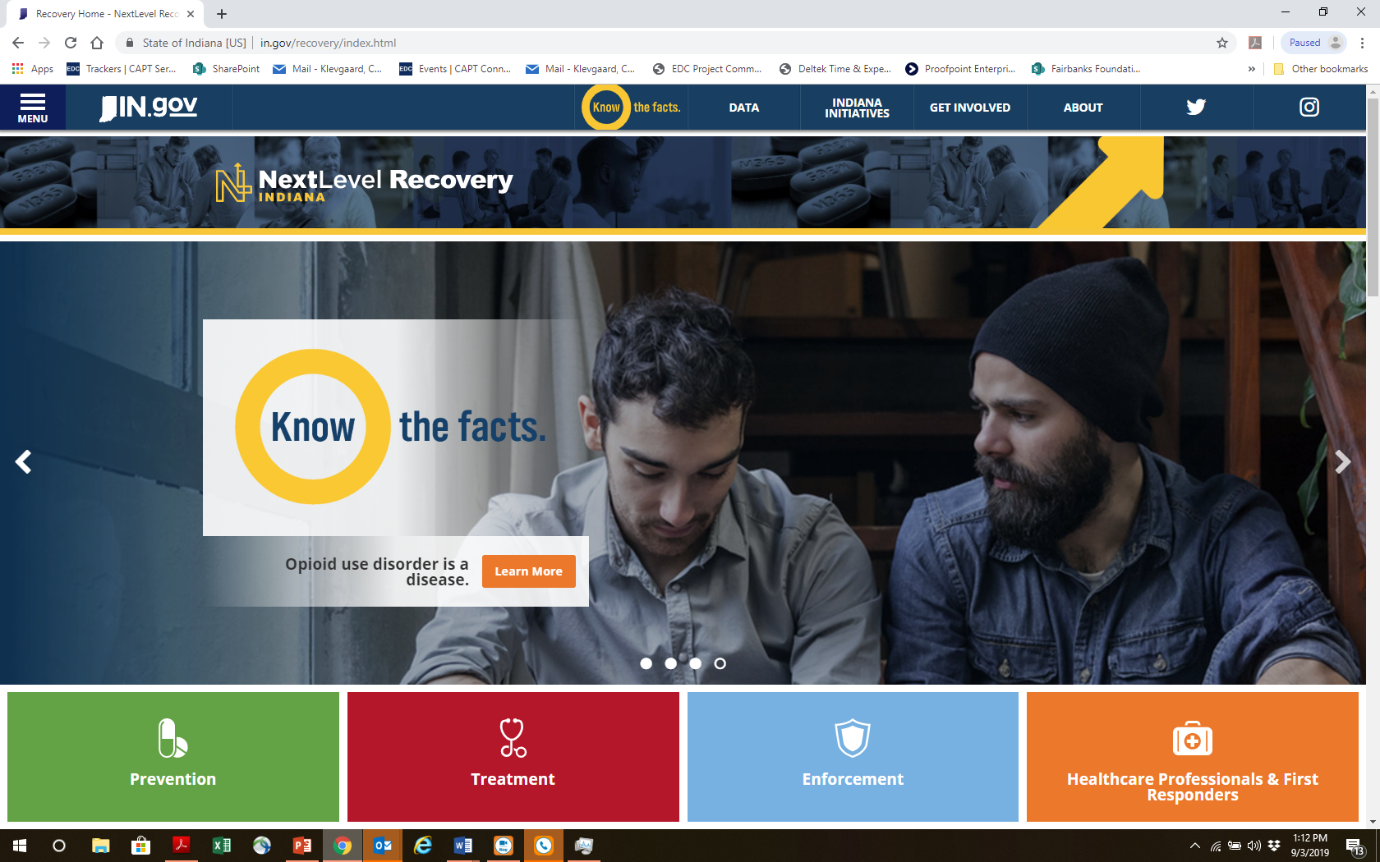
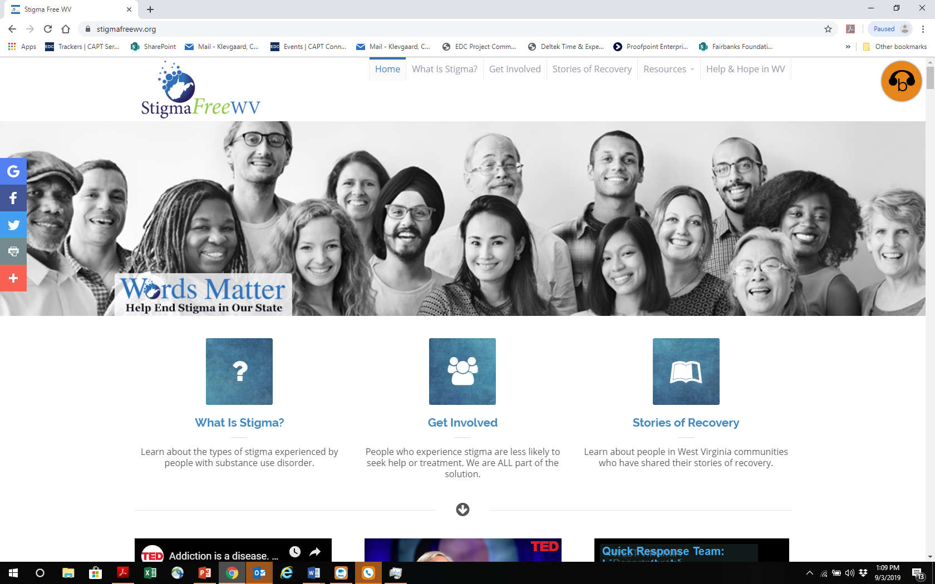
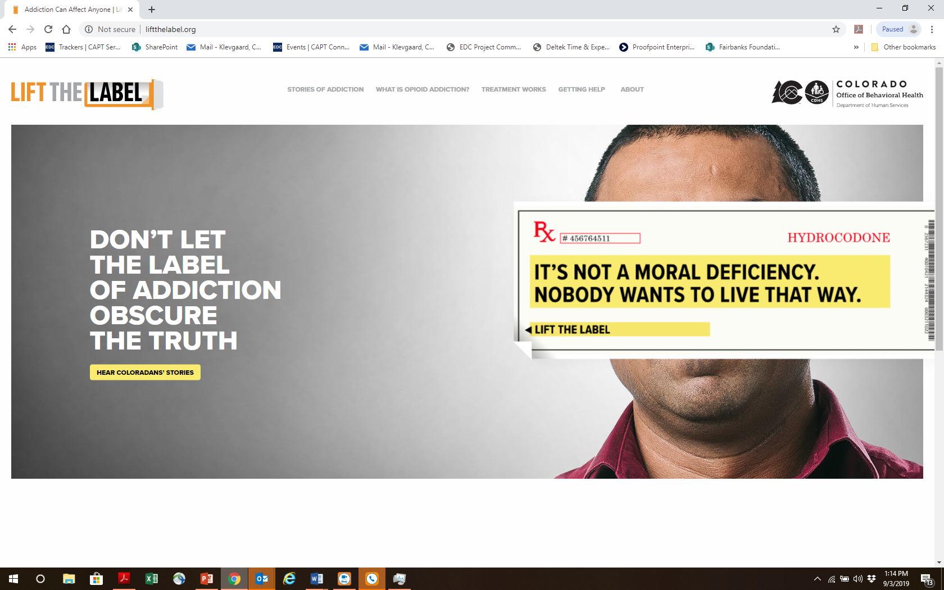

Preventing the Spread of Stigma: Examples of Large-Scale Stigma Campaigns Engaging Prevention
September 17, 2019 10:00 AM CST
Chuck Klevgaard, CSPS, Prevention Manager (PTTC)
Mark Loggins: Indiana Next Level Recovery Know the Facts
Jenny Lancaster: StigmaFree West Virginia
Elizabeth Owen: Colorado Lift the Label Public Awareness Campaign
Notes:
This 90 minute webinar will define stigma for prevention practitioners and the various levels as which it can occur. The webinar will address common myths associated with substance use disorder that can perpetuate stigma for this population and address changes in terminology and attitude that can emphasize "person-first" rather than the de-humanization of this population.

Slide 2
At the conclusion of this workshop, you will be able to :
List common elements of statewide campaigns designed to reduce stigma.
Describe strategies for using evidence based approaches for large-scale initiatives.
Describe the roles for prevention practitioners in highlighted campaigns.
List strategies for assessing the impact of stigma campaigns

Slide 3
Review: Approaches to Reducing Stigma
Education, such as mental health literacy campaigns;
Protest and advocacy (e.g., letter writing and Twitter campaigns);
Programs that facilitate social contact between people with and without behavioral disorders (contact-based programs);
Notes:
Educational anti-stigma interventions present factual information about the stigmatized condition with the goal of correcting misinformation or contradicting negative attitudes and beliefs. They counter inaccurate stereotypes or myths by replacing them with factual information.
Mental health literacy programs are a common educational strategy. Educators, health professionals, and policy makers have recognized the important role of schools in addressing the mental health needs of young people and have endorsed the implementation of school mental health programs (Wei et al., 2013).
Across a wide range of stigmatizing conditions, people without the stigmatized conditions have little meaningful contact with those who have these conditions. Lack of contact fosters discomfort, distrust, and fear (Cook et al., 2014). Contact interventions aim to overcome this interpersonal divide and facilitate positive interaction and connection between these groups (Shera, 1996). In contact-based behavioral health anti-stigma interventions, people with lived experience of mental illness or substance use disorders interact with the public describing their challenges and stories of success. These strategies are aimed at reducing public stigma on a person-to-person basis but have also been shown to benefit self-stigma by creating a sense of empowerment and boosting self-esteem (Corrigan et al., 2013) A systematic review of anti-stigma programs aimed at college students by Yamaguchi and colleagues (2013) found that in-person contact and video contact were the most effective intervention types for changing attitudes and reducing social distance. Corrigan and colleagues (2012) found that in-person contact is superior to video contact, with in-person contact having twice the effect size as video contact. A systematic review of 13 studies found that education and contact-based interventions are commonly used for stigma related to substance use disorders (Livingston et al., 2012), but because of the overall dearth of studies with this focus, it is not possible to draw firm conclusions about the value of contactbased interventions over educational interventions. The preponderance of available evidence suggests that interventions that combine contact with education will be most effective.
Because contact-based strategies can be used to reduce both public and self-stigma, there is a wide range of potential intervention targets. One approach to integrating contact-based interventions into day-to-day activities is through the use of peer services (see Chapter 3). Peer service Copyright © National Academy of Sciences. All rights reserved. Ending Discrimination Against People with Mental and Substance Use Disorders: The Evidence for Stigma Change APPROACHES TO REDUCING STIGMA 75 providers are people with lived experience who work as health care team members and foster the provision of nonjudgmental, nondiscriminatory services while openly identifying their own experiences. When integrated into service-provision teams, peers can help others to identify problems and suggest effective coping strategies (Armstrong et al., 1995; Corrigan and Phelan, 2004; Davidson et al., 1999; Gates et al., 1998; Mowbray, 1997).
Protest messaging and advocacy can help to engage and activate “fence sitters”—people who have some investment in behavioral health stigma change but limited knowledge about how to translate their beliefs into action. A call to action can also energize unengaged stakeholders by raising awareness about the harmful effects of stigma. Group protests also provide opportunities for stakeholders to meet and develop a sense of solidarity and common purpose
Multidisciplinary, multilevel ecological approaches are needed to understand and address structural stigma and to engage groups and organizations, including lawyers, journalists, educators, and business and property owners, to address the root causes of structural stigma.

Slide 4
Review: Approaches to Reducing Stigma
Contact-based education programs, which combine contact with educational content designed to raise public awareness
Media campaigns delivered over a range of platforms, including traditional and newer social media;
Peer programs in which people who have disclosed their conditions offer their experience and expertise to individuals and families
Notes:
Educational anti-stigma interventions present factual information about the stigmatized condition with the goal of correcting misinformation or contradicting negative attitudes and beliefs. They counter inaccurate stereotypes or myths by replacing them with factual information.
Mental health literacy programs are a common educational strategy. Educators, health professionals, and policy makers have recognized the important role of schools in addressing the mental health needs of young people and have endorsed the implementation of school mental health programs (Wei et al., 2013).
Across a wide range of stigmatizing conditions, people without the stigmatized conditions have little meaningful contact with those who have these conditions. Lack of contact fosters discomfort, distrust, and fear (Cook et al., 2014). Contact interventions aim to overcome this interpersonal divide and facilitate positive interaction and connection between these groups (Shera, 1996). In contact-based behavioral health anti-stigma interventions, people with lived experience of mental illness or substance use disorders interact with the public describing their challenges and stories of success. These strategies are aimed at reducing public stigma on a person-to-person basis but have also been shown to benefit self-stigma by creating a sense of empowerment and boosting self-esteem (Corrigan et al., 2013) A systematic review of anti-stigma programs aimed at college students by Yamaguchi and colleagues (2013) found that in-person contact and video contact were the most effective intervention types for changing attitudes and reducing social distance. Corrigan and colleagues (2012) found that in-person contact is superior to video contact, with in-person contact having twice the effect size as video contact. A systematic review of 13 studies found that education and contact-based interventions are commonly used for stigma related to substance use disorders (Livingston et al., 2012), but because of the overall dearth of studies with this focus, it is not possible to draw firm conclusions about the value of contactbased interventions over educational interventions. The preponderance of available evidence suggests that interventions that combine contact with education will be most effective.
Because contact-based strategies can be used to reduce both public and self-stigma, there is a wide range of potential intervention targets. One approach to integrating contact-based interventions into day-to-day activities is through the use of peer services (see Chapter 3). Peer service Copyright © National Academy of Sciences. All rights reserved. Ending Discrimination Against People with Mental and Substance Use Disorders: The Evidence for Stigma Change APPROACHES TO REDUCING STIGMA 75 providers are people with lived experience who work as health care team members and foster the provision of nonjudgmental, nondiscriminatory services while openly identifying their own experiences. When integrated into service-provision teams, peers can help others to identify problems and suggest effective coping strategies (Armstrong et al., 1995; Corrigan and Phelan, 2004; Davidson et al., 1999; Gates et al., 1998; Mowbray, 1997).
Protest messaging and advocacy can help to engage and activate “fence sitters”—people who have some investment in behavioral health stigma change but limited knowledge about how to translate their beliefs into action. A call to action can also energize unengaged stakeholders by raising awareness about the harmful effects of stigma. Group protests also provide opportunities for stakeholders to meet and develop a sense of solidarity and common purpose
Multidisciplinary, multilevel ecological approaches are needed to understand and address structural stigma and to engage groups and organizations, including lawyers, journalists, educators, and business and property owners, to address the root causes of structural stigma.

Slide 5



Today’s Presenters
Mark Loggins: Indiana Next Level Recovery Know the Facts
Jenny Lancaster: StigmaFree West Virginia
Elizabeth Owens: Colorado Lift the Label Public Awareness Campaign
Notes:
Mark Loggins
State Opioid Response Grant Director
Division of Mental Health and Addiction
Indiana Family and Social Services Administration

Slide 6
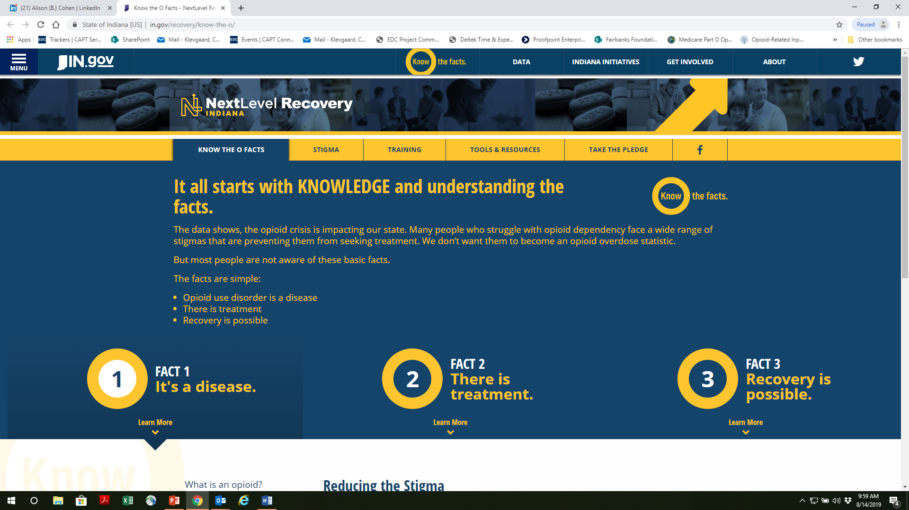
Indiana: Know the O Facts
  Mark Loggins
  State Opioid Response Grant Director
  Indiana, DMHA
Notes:
The opioid crisis has had a devastating impact on the State of Indiana, much like the rest of the country.
In assessing the needs of the state for addressing this epidemic, a number of the usual suspects surfaced. Indiana needed more treatment providers in both urban and rural areas; it needed better access to care in terms of payer source and Medicaid expansion; needed to bolster its availability of naloxone to lay-persons and first responders; it needed to expand and strengthen its PDMP to cover more providers.
But experts and key stakeholders in the community also noted the role of stigma in preventing people from seeking treatment for opioid use disorder. The state of Indiana sought to not only address the stigma of opioid use disorder through a statewide campaign, but also educate the public about what opioid use disorder is… and what it is not.
The State of Indiana planned and launched this campaign in the Fall of 2017. This campaign is a cross agency collaboration with the Family and Social Services Administration, Indiana State Department of Health, and the Governor Eric Holcomb’s Office as part of the Next Level Recovery Initiative.

Slide 7
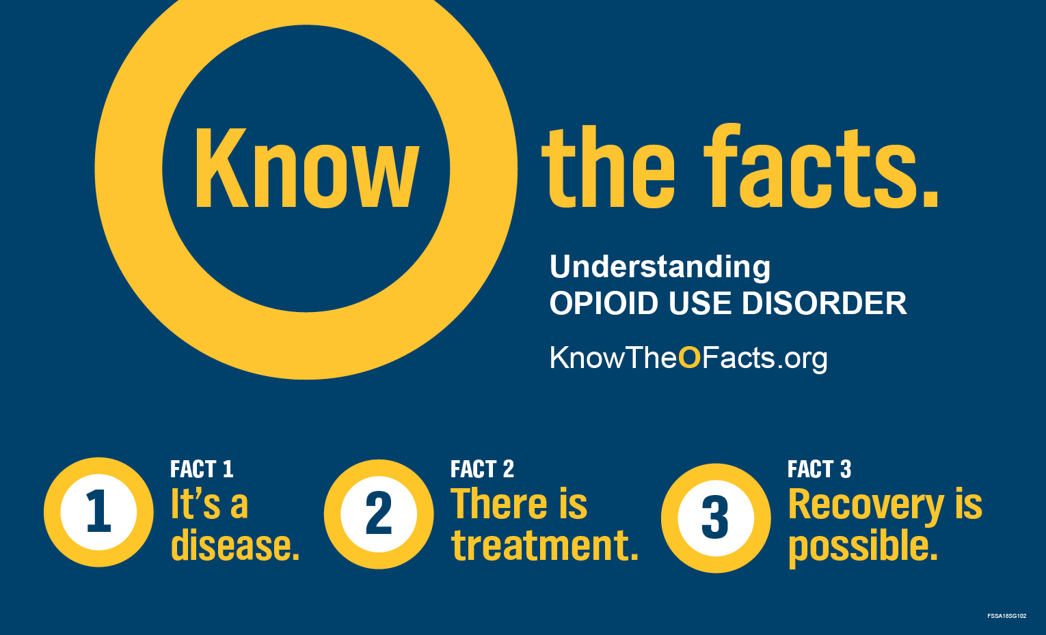

Notes:
Know the O Facts has sought to educate the public about the facts of Opioid Use Disorder.
Fact 1) Opioid Use Disorder is a disease
- As the use of opioids increases, dramatic changes in brain function increases and the increased desire and planning on how to get opioids becomes an obsession. These changes to the brain are caused by opioid use disorder. Neuroscientists have concluded that it is a chronic brain disease, precipitated by long-term changes to the biological structures of the brain.
Fact 2) There is Treatment
- The most effective method of treatment for an opioid use disorder is called medication-assisted treatment (MAT). MAT is the combination of three FDA-approved medications and counseling and cognitive behavioral therapy. The State of Indiana currently has 18 active Opioid Treatment Programs, with 5 more planned to open in the next year.
Fact 3) Recovery is possible
- Recovery is a process of change through which people improve their health and wellness, live self-directed lives, and strive to reach their full potential. There are four major dimensions that support recovery: Health, Home, Purpose, and Community. Through restoring the quality of these four dimensions, a person receiving treatment for opioid use disorder can indeed recover to live a full and healthy life.
While we understand opioid use disorder is a more complex issue, these 3 facts should be the foundation that the general public should build upon. With this knowledge, comes the opportunity for understanding and empathy for people dealing with this disease.

Slide 8
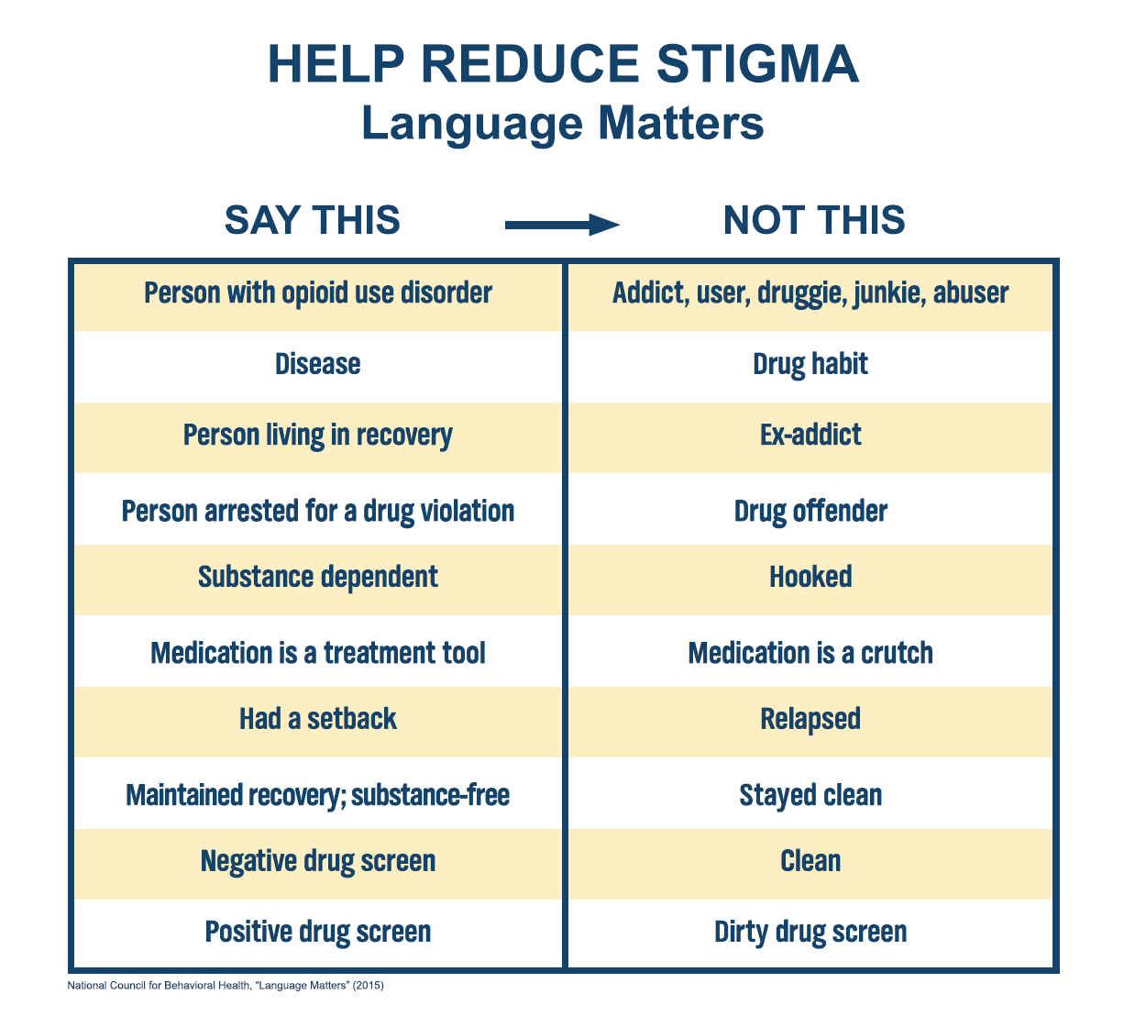
Notes:
The next key message in the Know The O Facts campaign is that reducing stigmatizing language can go a long way to getting more people to treatment. Language matters, whether we think about it or not. Terms like: junkie, druggie, abuser are words that deprive the humanity from a person suffering from this disease.
Person first, humanizing language encourages more empathy for people suffering from this disease. Nobody should be solely defined by their disease.
Other terms and sentiments about treatment, recovery, and setbacks can be harmful for someone who may need help themselves, or perhaps a loved one. Nobody would feel comfortable seeking help for their disease, if that meant they were immediately cast aside and degraded. We should encourage and empathize with those who need help.

Slide 9
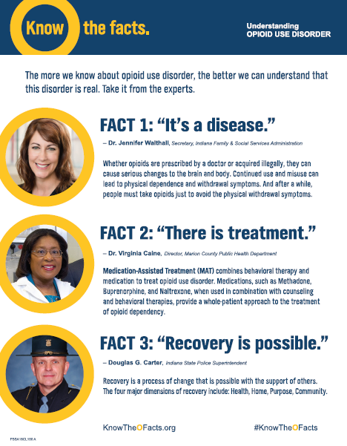
IN: Know The O Facts
Key Elements of the Campaign
Education/Awareness
Language Matters/ Stigma
Take the pledge
Outreach Materials
Social Media
Notes:
Education: We all need a basic understanding of the disease. From opinionated personalities and media outlets, there is a plethora of information and language out there. Most folks have heard of opioids, heroin, or fentanyl… but who knows what context they heard it in. We educate the public about the 3 basic facts and allow for further information to be filtered through that context.
Language Matters: I like to tell people that we can change the way we talk about opioid use disorder “one word at a time”. We want to offer person first language as not only a de-stigmatizing strategy, but also because the terms are more accurate and recovery oriented.
Take the Pledge: Our one call to action is that we encourage the public to Take the Pledge to reduce stigma. This is an mostly anonymous, symbolic act to pledge your support for reducing stigma.
Outreach Materials: We have created outreach material that can be accessed on website, but also have outreach contacts than send material out or be onsite to distribute the material
Social Media: We have worked with our Communications Department to make sure Know the O Facts is active on Twitter and Facebook. We have daily posts with uplifting messages, personal recovery stories, and reminders to use person first language

Slide 10
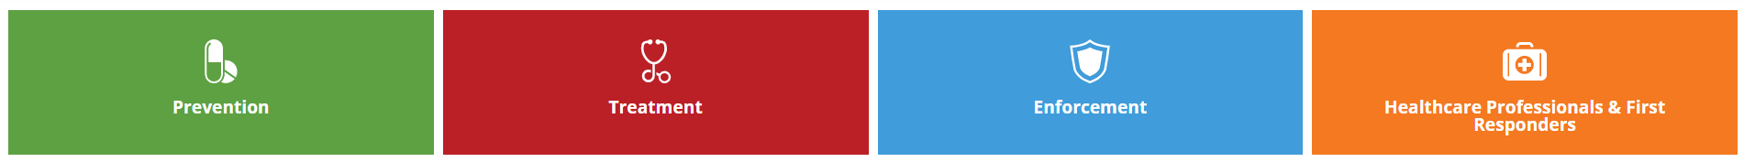
IN: Know The Facts
Strategies For Engaging Prevention
Partnerships with Stakeholders, agencies, and organizations
Plant a seed for further discussion
Notes:
Early on in the campaign, we knew that although this would be a unifying message, it needed to be communicated in a diverse manner. EMTs, Fire, and Police have been on the front lines and may not want to hear from another Human Services person about appropriate language. But when the Chief of Police, State EMS Director, or the Fire Marshall speaks, that gives the message more legitimacy and clout. We have good standing relationships with county health departments, local coordinating councils, first responders, and our local universities to help get the message out.
The topic of opioid use disorder and addiction is a very heavy subject. Its not something that most folks seek out on their average day, mostly because it can feel depressing, out of control, or perhaps “someone else’s problem”. We understand that not everyone wants to have a conversation in an expo hall or county fair about the stigma of addiction. But what we want them to walk away with a kernel of knowledge that we are out there. The next time the topic of addiction or opioids come up, they may think “Didn’t that guy at the fair last week give me a brochure about this?”.

Slide 11
IN: Know The O Facts
Key Lessons Learned
This is not a message everyone wants to hear
Not all stigmatizing language is malicious in nature; but rather habit or cultural
Don’t lose the forest for the trees
Notes:
People have very personal attachments to their feelings regarding the stigma of addiction. Years of stereotypical portrayals on TV, anecdotal horror stories, or even traumatic personal experiences can have a profound effect on a person’s feelings toward addiction. We are not in the business of telling people that their feelings are wrong or misguided. Instead, we want to inform them on the facts and listen to their stories. Sometimes as people talk about their own stigmas, opportunities to explain how the disease factors into their story, or perhaps how hard it is for someone to break free of the stigma surrounding opioid use disorder. We don’t need to convert everyone, but just simply be there to listen and share.
Many people use stigmatizing language and have NO IDEA that what they said was potential harmful. They may be more familiar with terms like drug abuser, junkie, or addict and simply repeated those terms. That is why we are not so concerned with correcting everybody’s speech. If a person uses stigmatizing language in conversation, we simply use the correct term when we reply. We are also not in the business of making people defensive or ashamed of themselves. We are changing the way we talk one word at a time.
Opioid use disorder is the hot topic right now and rightly so. 130 people die of an overdose in this country everyday. But soon the tides will turn, and stimulants will become the next wave of drugs. Tobacco, alcohol, and other substance use disorders are compiling comparable body counts. We need to get the conversation started with opioids, but it cannot stop there. Substance use disorder is the big picture, and perhaps mental health past that. This needs to be backed up by using destigmatizing language for all addiction disorders.

Slide 12
IN: Know The O Facts
Evaluation or Measure of Impact?
It is difficult to measure stigma
Media language monitoring
Surveys
Notes:
Stigma is not a number everyone wears on their sleeves. It is hard to judge where public opinion stands without an expensive polling operation. Indiana is aware that 18 months of digital, tv, and radio marketing isn’t going to undo decades worth of stigmatizing beliefs and behaviors. We have to remind ourselves that progress will not be measured today or tomorrow, but potentially years down the road.
The FSSA Communication Department in Indiana monitors press clippings to evaluate language use in the media among journalists, policymakers, and medical community. We have consistently seen great results in changing the narrative from the media; away from drug abusers or addicts, but more persons with opioid use disorder. There are still instances of stigmatizing language in the local media, but the positive usually outweighs the negative.
The campaign did distribute surveys to stakeholder groups and persons in treatment for opioid use disorder in October 2017, March 2018, and October 2018. There isn’t conclusive data to show progress. We are not discouraged and are currently working to recreate an improved tool for measuring stigma and evaluating distribution methods.
Let me end by saying this: We know the message is good and effective in educating the public about opioid use disorder. We’ve seen moderate expansion of our reach in social media and digital marketing. We have data that shows people are seeing and hearing the message, even data on people seeking out the message, but we know we must remain vigilant in finding out if Indiana has moved the needle in reducing stigma. The personal and anecdotal evidence I can share, from face to face conversations with the general public in Indiana is: 1) This campaign is so very needed in our state. People in recovery or working in the addiction field see this type of messaging as effective and a great tool in talking with their peers and patients. 2) We have educated 10s of thousands of people about not only stigmatizing language, but MAT, naloxone, and what is considered an opioid. And 3) We still have a lot of work to do, but we are making a difference. There is always at least one person in a crowd that thinks this is all hogwash or perhaps we are coddling people too much. But that voice is miniscule compared to the hope and gratitude espoused by and for this campaign on a daily basis.
Visit knowtheofacts.org and take the pledge today!

Slide 13
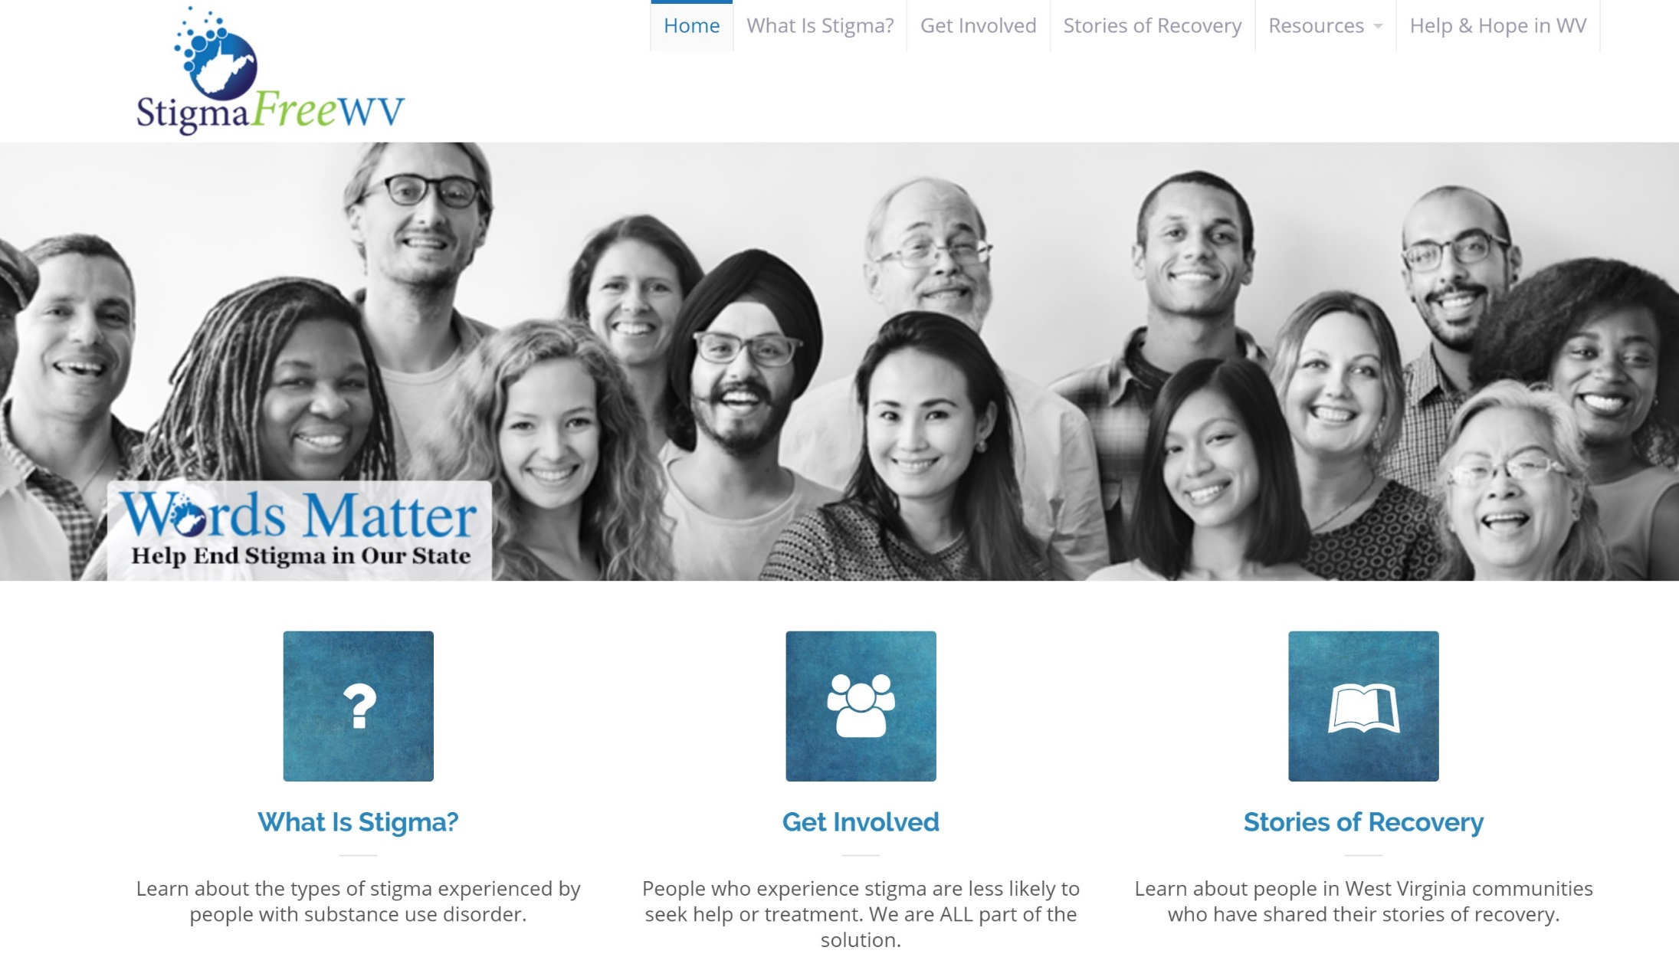
West Virginia : StigmaFreeWV
  Jenny Lancaster, Terzetto Creative, LLC

Slide 14
WV: StigmaFreeWV
Strategies For Engaging Prevention
Funding provided by the WVDHHR Bureau for Behavioral Health through SAMHSA grants
Collaborated with WV Prevention Lead Organizations in development and launch of campaign
Launched both Help & Hope WV and Stigma Free WV together through the Prevention First Network
Provided resources – presentations with talking points, handouts, etc. – and trained Prevention Leads to deliver trainings
Utilized the Prevention First Network and social media to amplify messages/trainings.

Slide 15


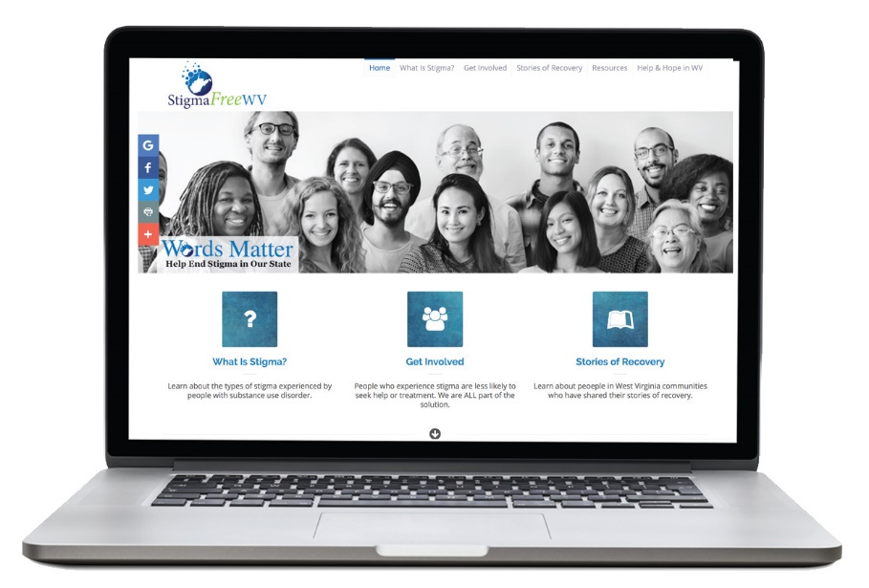


Slide 16
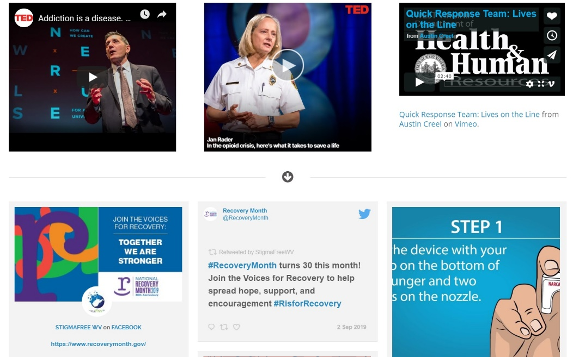
WV: StigmaFreeWV
Key Elements of the Campaign
Research and targeted audiences
Website and social media
Presentations, webinars, outreach materials
Personal stories - recovery and MAT (partners)

Slide 17
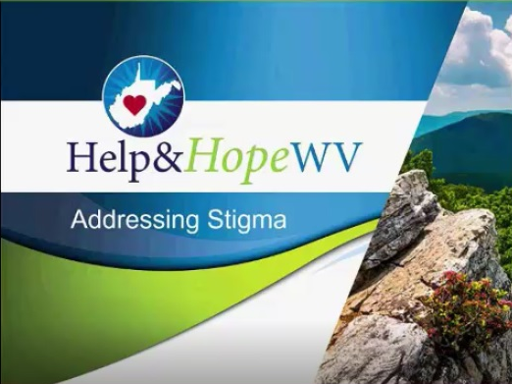
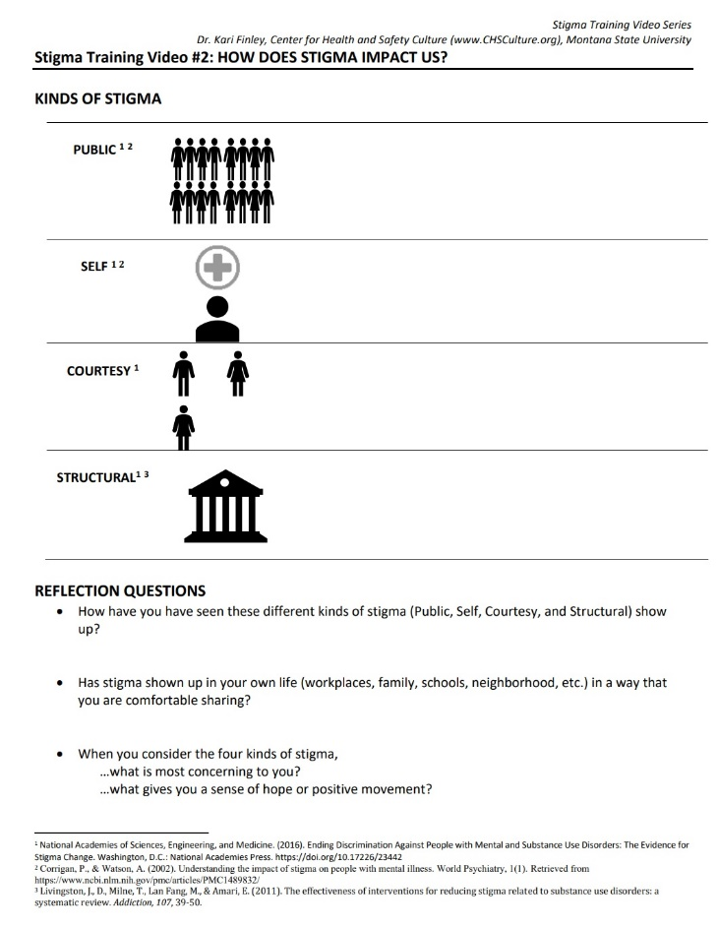
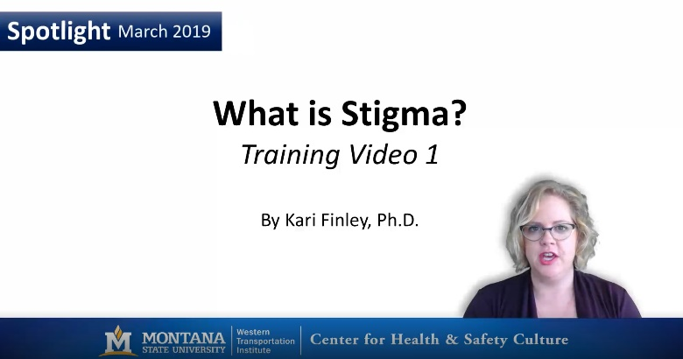
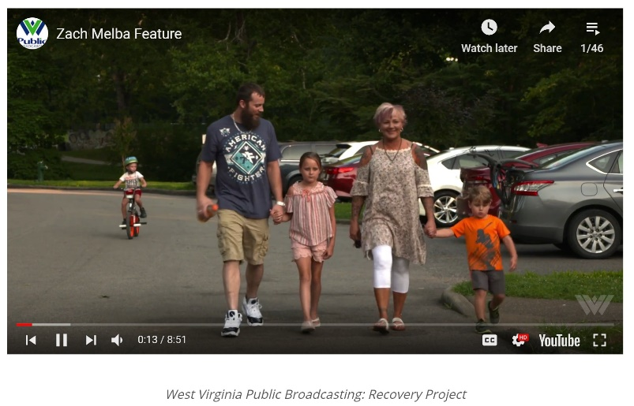
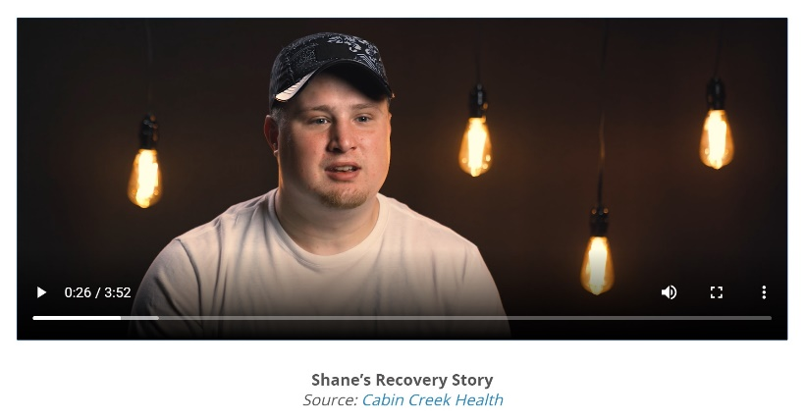

Slide 18

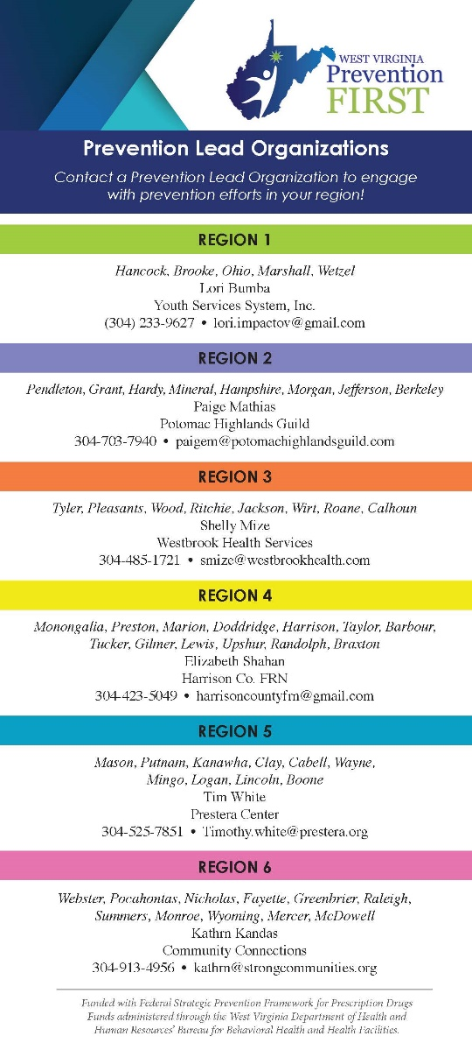





Slide 19
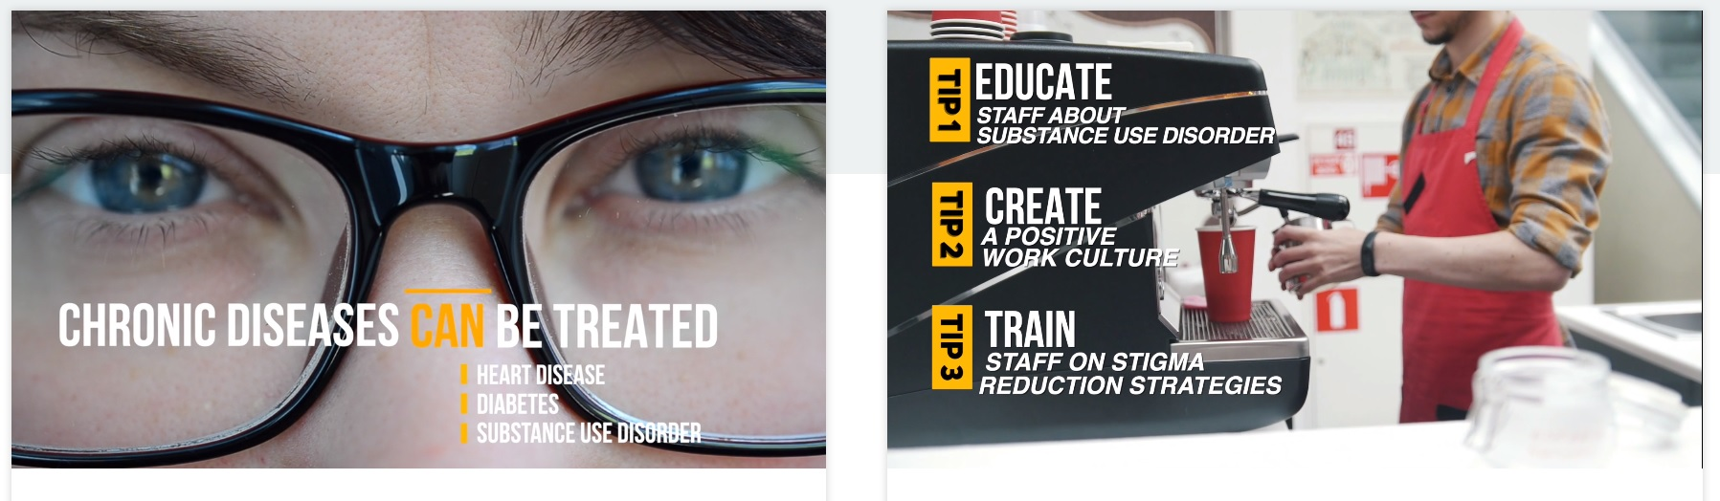
WV: StigmaFreeWV
Key Lessons Learned
Input from various audiences is critical
Expand trainings beyond the usual audiences
Leverage collaboration with other organizations
Expand reach through other messengers
Source: US Attorney’s Office Southern District of WV

Slide 20

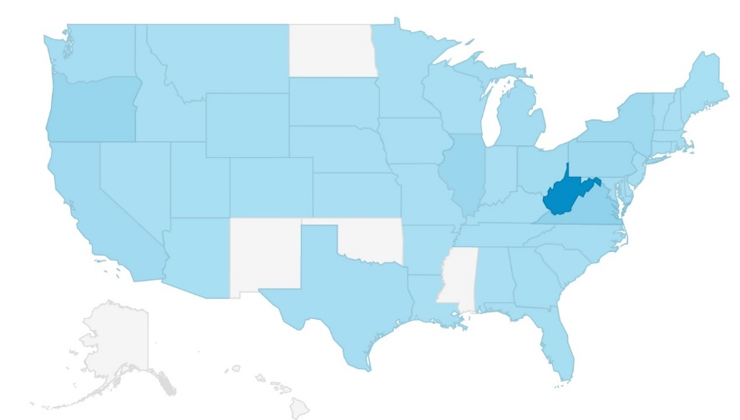

WV: StigmaFreeWV
Evaluation or Measure of Impact
Website and social media analytics
Number of trainings delivered
Pre- and post-training surveys
Future measure: online course completion, pre- and post-tests

Slide 21
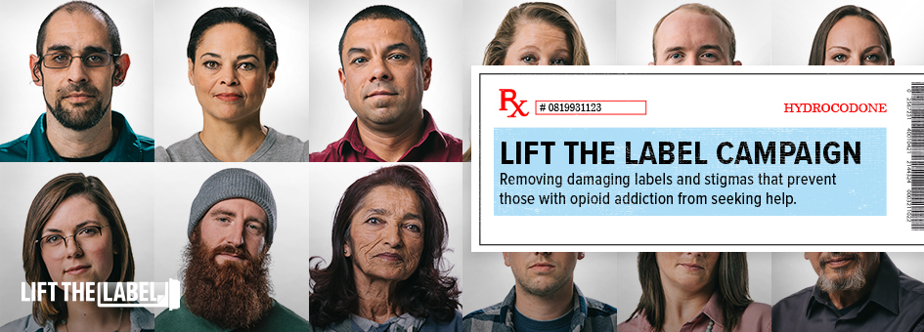
Colorado: Lift The Label
  Elizabeth Owens
  Director of Policy and Communications
  Colorado Department of Human Services, Office of Behavioral Health

Slide 22
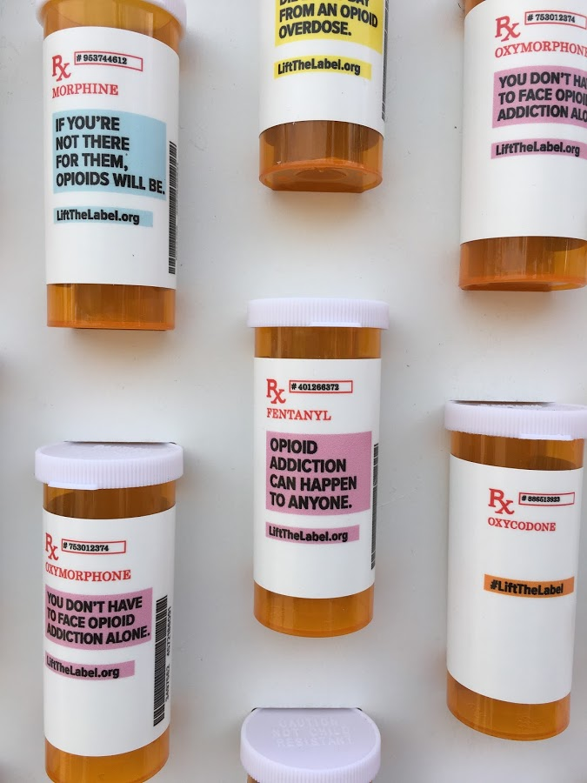
CO: Lift The Label
Key Elements of the Campaign
Storytelling
Videos
Opioid Memorial Wall
Advertisements (TV, digital, banner)
Outreach materials
Social media
Professionals training

Slide 23

CO: Lift The Label
Strategies For Engaging Prevention
Education about opioids
Emphasizing connectedness
Educating professionals

Slide 24
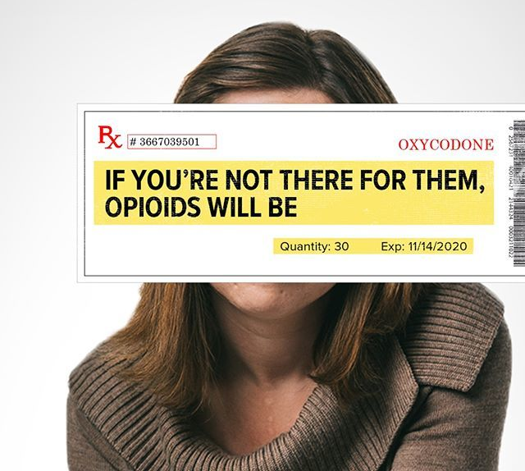
CO: Lift The Label
Key Lessons Learned
Power of authentic voices
Changing social media tactics because of stigma
More work to do on diversity
In-demand resource at the community level

Slide 25

CO: Lift The Label
Evaluation or Measure of Impact?
Analytics
Feedback from campaign talent
Colorado Health Access Survey
RTI evaluation
www.liftthelabel.org

Slide 26


Questions
Mark Loggins: Indiana Next Level Recovery Know the Facts
Jenny Lancaster: StigmaFree West Virginia
Elizabeth Owens: Colorado Lift the Label Public Awareness Campaign

Slide 27

Local Messaging: Kalamazoo: Look Beyond
Mental health, substance use and developmental disability challenges have been increasing in the U.S. These challenges affect thousands of people in Kalamazoo County. They are all potentially subject to stigma, as well as their families and caregivers. Stigma has RIPPLE EFFECTS. For our community to thrive, we need to address it.
By reducing stigma, the entire community can benefit in areas like health, education and overall wellbeing. With #LookBeyond, we hope to also address SYSTEMIC CHANGE that will improve the lives of the populations we serve – and the larger community as well

Slide 28

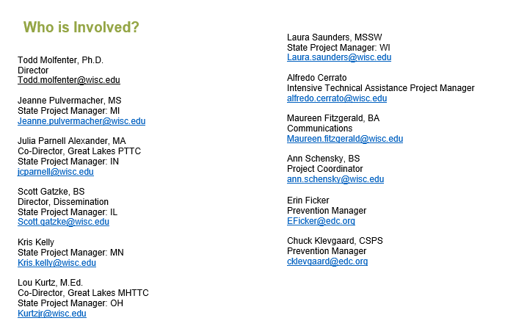

Slide 29
Lobby Poll
I am interested in statewide campaigns because:
(Check all that apply)
Our state/agency or organization is interested in launching a campaign.
We hope to extend the reach of our campaign.
I want to learn how other states evaluate the impact of their efforst to reduce stigma
I want to learn more about how to engage prevention professionals

