Slide 1
Sustainability is…
Lobby Question
Finding ways to make all our prevention outcomes last
Making sure staff keep their jobs
Securing a grant before our funding ends
Not just about money
Something we can and should work on now
Other
Notes:
Multiple choice, multiple answer poll

Slide 2
Strategies for Prevention Sustainability: Advancing Sustainability through Strategic Partnerships
Clare Neary, MPAP, Project Coordinator, Rutgers University School of Social Work
Jessica Goldberg, MSW, MPH, CPS, Training and Technical Assistance (TTA) Specialist, EDC
Ivy Jones-Turner, MPA, TTA Specialist, EDC

Slide 3
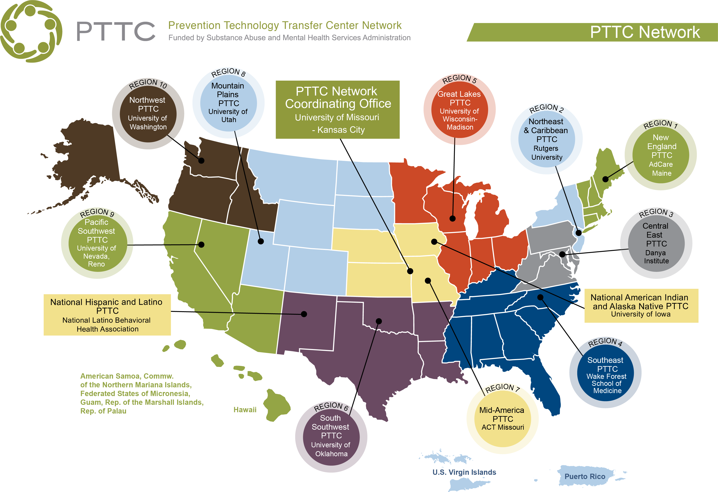
Notes:
Presenter references TTC map and says: “Prevention Technology Transfer Center - Northeast Caribbean is directed by the Center for Prevention Science, Rutgers University and partnering with EDC”

Slide 4
Technical Information
This webinar is being recorded. Following the event, we will share the recording with participants.
Please contact the call facilitator if you have any concerns or questions.

Slide 5
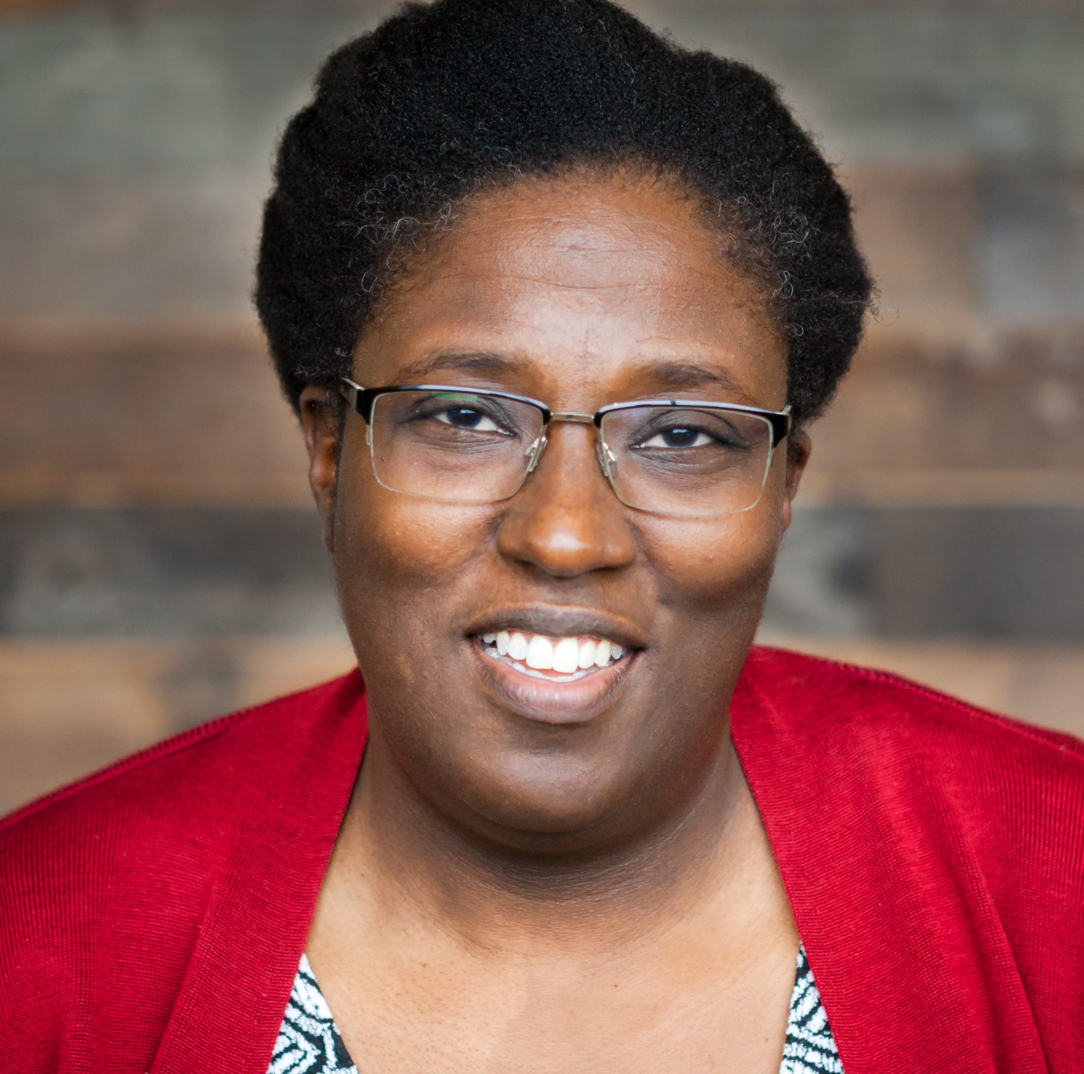
Presenters
Clare Neary
Project Coordinator,
Rutgers University MPAP
Northeast & Caribbean PTTC
Jessica Goldberg
T/TA Specialist
Region 2 PTTC
Ivy Jones-Turner
T/TA Specialist
Region 2 PTTC

Slide 6
Learning Objectives
Describe a sustainability model that includes focus on sustaining effective processes and positive outcomes
Explore the role of partnerships to sustain prevention efforts
Identify opportunities and challenges to advancing sustainability efforts during the Covid-19 pandemic
Notes:
This webinar will
review sustainability strategies and outline how prevention professionals might strategically engage partners in sustaining prevention efforts during the current social and economic environment.
Learning Objectives: During the webinar, we will review a comprehensive sustainability model, explore the role of partnerships to sustain prevention efforts, and approaches to building these relationships.

Slide 7
What is Sustainability?

Slide 8
How do you define sustainability?
Poll
Sustainability
Notes:
Open ended poll or use items from PS/CSPS sustainability toolkit (which is better to use – PS to generate business interest?)

Slide 9
Prevention Sustainability is…
Process of building an adaptive and effective system that achieves and maintains desired long-term results.
A community’s ongoing capacity and resolve to work together to establish, advance, and maintain effective strategies that continuously improve health and quality of life for all.
(In the context of preventing substance misuse) sustainability the capacity of a community to produce and maintain positive prevention outcomes after initial funding ends and over time.
Notes:
Definition & goal of sustainability
the process of building an adaptive and effective system that achieves and maintains desired long-term results . SAMHSA (2019) Substance Abuse and Mental Health Services Administration: A Guide to SAMHSA's Strategic Prevention Framework. Rockville, MD: Center for Substance Abuse Prevention. Substance Abuse and Mental Health Services Administration, 2019 https://www.samhsa.gov/sites/default/files/20190620-samhsa-strategic-prevention-framework-guide.pdf
A community’s ongoing capacity and resolve to work together to establish, advance, and maintain effective strategies that continuously improve health and quality of life for all. – CDC Healthy Communities Program. (2011). A sustainability planning guide for healthy communities. ​ https://www.cdc.gov/nccdphp/dch/programs/healthycommunitiesprogram/pdf/sustainability_guide.pdf

Slide 10
Components of Sustainability
Outcomes
STRATEGIC PARTNERSHIPS
Strategies
Process
EQUITY
Notes:
Starts planning for sustainability at beginning of initiative
Includes documenting outcomes
Includes partners
Builds capacity
Expands resources

Slide 11
Sustaining a Strategic Planning Processes

Slide 12
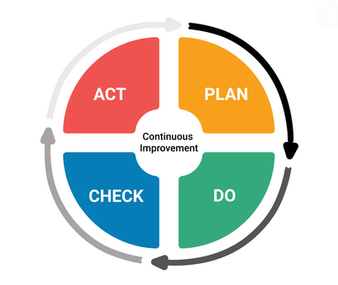
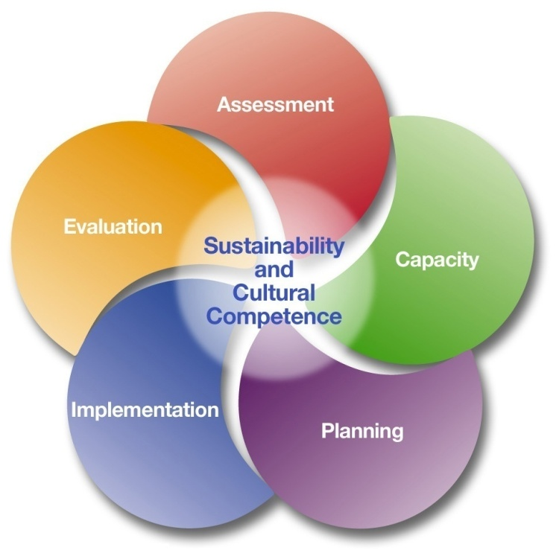
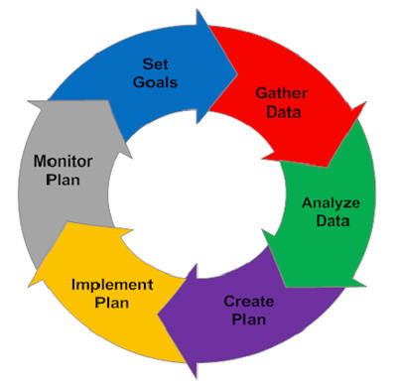
What Do We Mean by Process?
Notes:
Sustainability & Reviewing Processes
Goal is maintain processes, procedures, etc. to continue prevention strategies.
Review and identify w/staff/partners procedures that support efforts – what necessary, what can be eliminated?
Have signed MOUs to continue getting access to needs assessment data? do have plan for ongoing ways to collect assessment data, especially from key informants? Are key stakeholders and members of population of focus part of planning process? Have considered train the trainer model – and have coalition staff also trained as trainers?
As review procedures – take opportunity to assess partner satisfaction, confirm partner commitment to roles,

Slide 13
What Do We Mean by Process?
Assessment: Obtain data, prioritize needs/problems, share findings
Capacity: Build a team, raise awareness, promote participation
Planning: Prioritize risk/protective factors, select interventions, share plan with stakeholders
Implementation: Ensure fidelity, adapt interventions as needed, course-correct
Evaluation: Collect process and outcome data, draw conclusions, share lessons learned

Slide 14
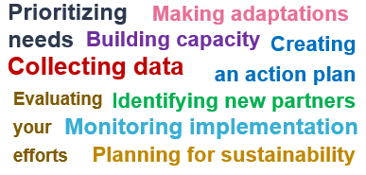
Discussion
Question
Are there certain processes that you use to conduct your prevention activities that are working well for you?
Prioritizing needs
Making adaptations
Building capacity
Creating
an action plan
Collecting data
Evaluating your efforts
Identifying new partners
Monitoring implementation
Planning for sustainability
Notes:
Goal – recognize we often do this. shift to developing plan that consistently covers all of these practices

Slide 15
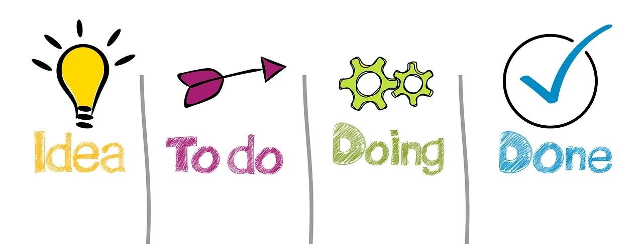
Why Sustain Process?
To maintain a data-driven decision-making approach that works
To position your community to receive additional funding
To preserve the proven process that got you this far
Notes:
I hope you all feel proud of your accomplishments. We know it was a lot of hard work to get where you are. You didn’t just wake up one morning and begin doing effective prevention work. We know following the SPF process leads to strong prevention efforts and positive outcomes. We need to keep effective process going so that we can continue to do good work.
We know that the SPF is not a linear process.
Your hard work implementing the SPF (e.g. your identification of key stakeholders; the capacity you’ve built in the community; the shared risk factors you’ve identified, etc.) will not be lost as other substance abuse issues arise.
Best process can be just as important as best practice.
¹SPF SIG Cross-site Workgroup. (October 11-12, 2006). Common measures of implementation fidelity: SPF SIG Cross-site Workgroup. Progress report presented at SPF SIG Evaluation Conference, Gaithersburg, Maryland.
² Green, L., & Kreuter, M. (2005). Health program planning: an educational and ecological approach. (4th Edition). Boston: McGraw-Hill.

Slide 16
How Do You Know Which Processes to Sustain?
Take an inventory of:
Past processes that helped us complete key tasks
Past processes that did not help us complete key tasks
New processes that will help us complete key tasks moving forward
Then prioritize helpful past processes and necessary new ones
Notes:
Establishing Process Guidelines
Clear guidelines can help your team identify local processes that support effective strategic planning as well as who should take the lead in keeping them going. Use the guidelines below as a starting point for reviewing your community’s processes, but feel free to adapt them as needed. For each step of the SPF, do the following:
Identify past processes that helped your community complete key tasks. By documenting what worked well, you can help your community continue to use these successful strategic planning processes over time.
Identify past processes that did not help your community complete key tasks. By documenting what did not work well, you can help your community improve or discard any unsuccessful processes.
Identify new processes that will help your community complete key tasks moving forward. To be truly successful over time, you can’t just look at processes from the past. Your community is always changing, and your processes will need to change along with it.
Determine your task force’s level of responsibility. Your larger prevention task force may or may not be the right group to sustain the processes needed to support effective strategic planning. In some cases, others in the community may be better positioned to keep successful processes going over time.

Slide 17
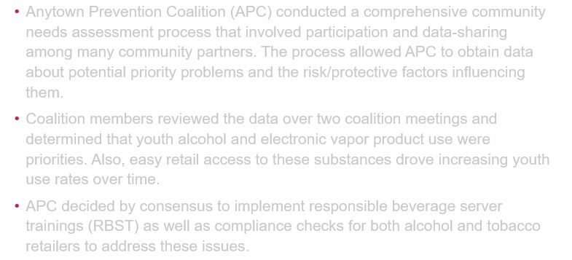
Case Example: Anytown Prevention Coalition
Anytown Prevention Coalition (APC) conducted a comprehensive community needs assessment process that involved participation and data-sharing among many community partners. The process allowed APC to obtain data about potential priority problems and the risk/protective factors influencing them.
Coalition members reviewed the data over two coalition meetings and determined that youth alcohol and electronic vapor product use were priorities. Also, easy retail access to these substances drove increasing youth use rates over time.
Data Collection
Strategy Selection
Problem/Factor Prioritization
APC decided by consensus to implement responsible beverage server trainings (RBST) as well as compliance checks for both alcohol and tobacco retailers to address these issues.
APC
Notes:
Do you think that these processes are working for the coalition?
Yes
No

Slide 18
Sustaining Effective Strategies

Slide 19
Which of the strategies that you’re currently implementing is the most effective?
How do you know?
Discussion
Question

Slide 20
Keys to Sustaining Effective Interventions
Build Community Support
Develop Organizational Capacity
Ensure Effectiveness
Notes:
[In slideshow, click repeatedly for each step to appear that’s associated with each key.]
So our goal is to sustain or maintain our long term outcomes. There are three important keys to doing this and they all relate to the SPF so they should look familiar to you. In implementing the SPF process, these three keys are especially effective when thinking about sustainability. You can’t wait to think about sustainability until nearing your grant’s completion. You must think about sustainability all through the process from the start, from when you are doing your assessment and building your capacity. Let’s look at them…
Community support – This refers to cultivating community buy-in for prevention and promotion and the positive outcomes they achieve. ( click 1 time for the step 2 to appear) It is what we do in Step 2 when we build capacity.
Organizational capacity – This refers to the assurance that the community agencies, organizations, and institutions have what it takes internally to do prevention and achieve positive outcomes. ( click 1 time and step 2 will come up)
In Step 2, we focus on determining if there are gaps in resources and where we need to strengthen organizational capacity.
Effectiveness – This refers to the assurance of the effectiveness and alignment of the preventions system to produce positive outcomes. This is an integral part of Step 3. Effectiveness can be accomplished with a strategic planning process—the SPF—which involves assessing a community’s needs, determining a comprehensive approach based on those needs, and implementing and evaluating the approach.
[Click a 3rd time for Step 3 to appear next to “Effectiveness.”]
Ask for concrete examples of each key to sustainability.

Slide 21
Key: Ensuring Effectiveness
Strategies are a good fit and evidence-based
Strategies are aligned with risk/protective factors
Evaluation plan supports ongoing monitoring
Implementation is high quality
Notes:
Key #3: Point out that effectiveness is more than just using evidence-based interventions. Effectiveness depends on making sure the logic model lines up. For example:
Interventions are aligned with the problem and risk factors, and have sufficient reach.
Evidence-based interventions are selected that are a good fit conceptually and practically.
Implementation is high quality, which involves buy-in from the community, administrative support, and adequate training for staff to do the intervention. (This will be discussed more in a little while.)
There is a plan for evaluation that will provide ongoing data to make improvements as needed. (This will be discussed more later on.)

Slide 22
Key: Build Community Support
Encourage
Develop
Connect
Celebrate
Notes:
[In slideshow, the image will appear automatically when you come to the slide.]
Key #1: Discuss ways to build community support, such as:
Encourage community ownership (This relates to community readiness)
Develop community leaders and champions ( This relates to capacity)
Connect to other prevention efforts locally, regionally, and statewide (This relates to assessment, capacity and planning.)
Celebrate accomplishments at meetings and publicly in the media, in local newsletters, and through e-mail blasts
Ask participants for examples of ways that they have built community support for substance abuse prevention (or examples of ways that they have seen it built).

Slide 23
Key: Enhance Organizational Capacity
Strong Support
Access to Resources
Formal Linkages
Notes:
Key #2: Discuss ways to enhance organizational capacity, such as:
Formal linkages (MOUs) with key partners
Access to resources and expertise (i.e., Who is good at what? Who has the skills, talents, or materials to assist you?)
Strong administrative structure that will allow you to be competitive for grants and other opportunities
Ask for other suggestions.
Have participants think about a group (e.g., a book group, a religious group) they have been a part of for awhile—have them pair up with someone and share why they have stayed in the group.

Slide 24
Case Example: Anytown Prevention Coalition
While the coalition took a break from meeting over the summer, the coordinator, working a reduced schedule, tried to find an appropriate RBST for the community. When her efforts proved unsuccessful, she decided to develop a training herself.
The training she designed didn’t include any hands-on application activities (e.g., role-plays on checking I.D.s, practice spotting fake I.D.s). This gap didn’t go un-recognized: when the coordinator remembered to bring evaluation surveys to the trainings, participants reported dissatisfaction with the training experience, mentioning specifically that they didn’t know how to apply the information to their daily work.
Seeing that the RBST effort had missed its mark, the coalition steering committee reconvened in the fall and identified an evidence-based RBST to replace the homegrown one.
Strategy Adaptation
Mid-course Corrections
Process Data Collected
APC
Notes:
Do you think that these processes are working for the coalition?
Yes
No
To what extent do you think the coalition implemented effective strategies?
Not at all
Somewhat
Completely

Slide 25
Sustaining Positive Outcomes

Slide 26
Why Is it Important to Sustain Outcomes?
Sustained outcomes…
Provide a clear, evidence-based link between the work you do and actual reductions in substance misuse behaviors
Ensure that limited prevention resources are put to good use
Notes:
³Birckmayer, J., Holder, H., Yacoubian, G., & Friend, K. (2004). A general causal model to guide alcohol, tobacco, and illicit drug prevention: Assessing the research evidence. J. Drug Education, 34(2), 121-153.
4 Johnson, K., Hays, C., Center, H., & Daley, C. (2004). Building capacity and sustainable prevention innovations: A sustainability planning model. Evaluation and Program Planning, 27, 135-149.

Slide 27
Examine Your Strategies
To determine which strategies are producing positive outcomes, work with members of your population(s) of focus to develop a shared definition of success and consider each strategy’s evidence of effectiveness.
Notes:
So now we move to examining our prevention strategies with this outcomes lens. To what extent are they contributing to our positive outcomes?
This is not about sustaining all strategies. This is where you have to examine and potentially winnow.
CAPT proposes that you consider four main criteria.
Evidence of effectiveness: You want to look at both your process and outcome data. Depending on where you are at in implementation, you may not be able to show long-term outcomes, but you can look at process data as well as short-term outcomes. Is this strategy on the track you anticipated when you selected it? This is a step where you need to look at your logic model to see how strategies connect to outcomes. In the next slide we are going to come back to this concept, but let’s take a look at all four first.
Document internal capacity: Strategies that have adequate resources now are more likely to attract the support they’ll need to continue.
Assess the level of community support: This is an important criteria but also one we need to be careful with. We aren’t here to sustain strategies just because they feel good or are popular. What is the level of tangible community support? Are external partners supporting this strategy? Are you getting what you need from the broader community? You need to consider whether the strategy is a good fit for the community. Again, this is a good place to take time to think about the cultural appropriateness of the strategy.
Coalition involvement: For some strategies, your coalition may have been involved or even in the lead for getting a strategy underway. As you do your sustainability planning, consider whether the strategy is still best led by the coalition.
Picture Link: https://pixabay.com/en/fork-road-dirt-direction-path-two-2115485/

Slide 28
Consider Evidence of Effectiveness
Strategies | Process Data | Outcome Data
Compliance Checks | # checks completed Written procedures created | Increased pass rate Reduced rates of underage alcohol
Prescriber Education | # providers at events # follow-up contacts Nature of contacts | Changes in prescribing habits Change in use of PMP data
Notes:
We are coming back to the first criteria for examining strategies. We want to unpack this a bit.
Often when we talk about evidence of effectiveness, we are looking at selecting strategies. We want to know about the evaluation results that show this strategy has been effective. But you are past the point of selecting this strategy. You selected it and you’ve been implementing it. Now you want to look at the evidence of effectiveness in your own community.
As we said earlier, depending on how long you have been implementing the strategy, you may not see changes in your long-term outcomes. This is where you look at process data and your short-term or intermediate outcomes.
In our example here, you may not have results to know if rate of underage drinking is going down. Even if you do, you still need to look at process and early outcome data to see if you can attribute some of that decline to compliance checks.

Slide 29
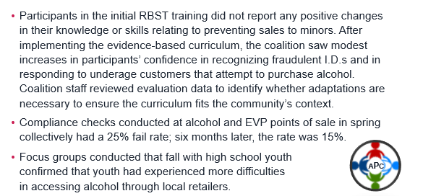
Case Example: Anytown Prevention Coalition
Participants in the initial RBST training did not report any positive changes in their knowledge or skills relating to preventing sales to minors. After implementing the evidence-based curriculum, the coalition saw modest increases in participants’ confidence in recognizing fraudulent I.D.s and in responding to underage customers that attempt to purchase alcohol. Coalition staff reviewed evaluation data to identify whether adaptations are necessary to ensure the curriculum fits the community’s context.
Compliance checks conducted at alcohol and EVP points of sale in spring collectively had a 25% fail rate; six months later, the rate was 15%.
Analyze evaluation data
Draw conclusions
Focus groups conducted that fall with high school youth confirmed that youth had experienced more difficulties in accessing alcohol through local retailers.
APC
Notes:
Share example of sustainability that includes multiple components (prefer real example)
Coalition staff trained in curriculum, 1 trained as trainer along with school counselor
Coalition transitions overdose data tracking to health dept/ambulance company

Slide 30
Sustainability and COVID-19

Slide 31
How has COVID affected your sustainability planning efforts?
Discussion Question
x

Slide 32
Impact of COVID-19 on Prevention
Prevention organizations/coalitions have moved from in-person to virtual service delivery
Unique emerging issues in the substance misuse prevention landscape
Greater emphasis on training and developing new partnerships to build organizational and staff capacity
Organizations are exploring a variety of strategies for implementation
Notes:
Impacts of covid on SMP
Remote workers - SMP staff, partners
How prevention efforts operate – limited Access to students/clients (physically closed to CBO, adapt or change programs to offer virtually, increased use of strategies to engage youth (smaller groups, more frequent outreach to youth, increased use of meditation/mindfulness strategies, etc.)
Substance Use landscape – alcohol policy relaxed, reported higher rates of use among specific populations (women,
Partnership changes – identified partners w/stronger population ties, school partners less engaged, partner staff reassignments (contact tracing), agencies reaching out to partner on SMP,

Slide 33
Are there any unintended (and/or unexpected) positive impacts of COVID-19 on your prevention efforts?
Discussion Question

Slide 34
Impact of COVID-19 on Prevention Possible silver linings
Different boats, same storm
More awareness of COVID-related substance misuse and other behavioral health issues
Greater awareness of need to maximize resources
Greater comfort using virtual platforms to communicate about and conduct our work, and adapting our efforts to meet the moment
Notes:
How this context can serve as opportunity to help advance sustainability? What strategies will be helpful?
Changing Context results in: reframing prevention efforts, Changing landscape for how implement interventions, How maximize resources – time, effort, meetings, etc.
These become opportunity to assess processes to sustain, engage partners, focus on building partner/coalition capacity, and review available and required resources
We’re all in the same storm in different boats, figuring out how to implement and sustain efforts
Our stakeholders and the public may be more aware of Covid-related substance misuse and other behavioral health issues
Partners may have a greater appreciation for the need to maximize resources
Practitioners have had to gain greater comfort using virtual platforms to communicate about and conduct our work, and in adapting our efforts to meet the moment

Slide 35
Sustainability Can Be…
Preparatory
Reactive
Notes:
Preparatory – capacity building, educating decision makers, long term, and future oriented, laying the groundwork
Reactive – short term, responding to changes, focus on scaling back existing services, and survival oriented

Slide 36
In Challenging Times Like These…
...Sustainability IS the ability to adapt

Slide 37
Increasing Sustainability in Challenging Times
Double down on what is effective and doable
Problems and Related Behaviors
Risk and Protective Factors
Short-term Outcomes
Long-term Outcomes
Interventions
Feasibility
Effectiveness
Notes:
There are many, many possible formats for logic models. This is the format we’ve been using….
And also just to make sure we’re all on the same page before moving forward… Here’s an example of the logic model we used during this series.
You’ll see it has the standard 3 different parts.
And now that you know more about evaluation, you may want to link up with other state, county, or community prevention providers to develop a more comprehensive logic model. Here’s why and how…

Slide 38
Increasing Sustainability in Challenging Times
Adapt with care
Try to build capacity before making changes
If you choose to adapt, adhere to evidence-based principles
Make sure adaptations enhance feasibility and don’t compromise positive outcomes
Monitor the impact of course corrections

Slide 39
Increasing Sustainability in Challenging Times
Prioritize Strategic Partnerships
Develop a team approach
Enhance your focus on capacity building
Identify benefits of and resolve barriers to partner engagement
Leverage the assets, resources and perspectives of key stakeholders
Notes:
Sustainability & Partnership
Role of partnerships in sustaining prevention - identify potential roles:
are there parts of intervention/program activities that partners are leading/or can lead? (data collection, data analysis, evaluation, communications messaging via social media, training, etc.),
Sustainability & Resources (stone soup story – everyone brings what have & contributes to prevention efforts)
Review resources each partner brings (not all resources are financial. Access to leaders or volunteers, info etc also valuable.)
Funding – assess program costs – what required? What’s one-time or ongoing? (booklets, training, recreational activities/incentives for participants, etc.)
Explore variety of ways to fund these costs – fundraise, solicit donations, share costs across partners
NEED FLUSH OUT MORE EXAMPLES HERE
Include equity principles
What is the level of tangible community support? Are external partners supporting this strategy? Are you getting what you need from the broader community?
It’s important for us to assess community support for particular strategies, but as we mentioned earlier, we need to be discerning about this criteria as well. Should something be sustained just because it’s popular? I think we’d all agree that shouldn’t be the only criteria.
Although it’s not the only criteria to consider, you do need to assess whether the strategy is a good fit for the community. If there is not strong evidence of tangible community support, you may want to think about the cultural appropriateness of the strategy.

Slide 40
Increasing Sustainability in Challenging Times
Think expansively about your options
(Hint: It’s not just about funding)
Pass off
Policy
Earn
Ask
Reconfigure
Share
Notes:
An important point to drive home, is that sustainability is more than just about money, securing new funding, writing for grants, etc.
This is called the PEARS model, (and not just an excuse to put a bunch of delicious pears on the screen ;) ! ) It’s an acronym where each letter stands for a particular sustainability approach.
P = Pass Off the initiative to another organization or create a policy that institutionalizes the initiative as something that happens regularly and is reinforced by organizational mandates
E = Earn money from the initiative, for example, charging a small fee to attend an event hosted by the organization
A = Ask, this represents traditional fundraising, grant writing, donation appeals, etc.
R = Reconfigure, the initiative is changed in such a way that facilitates sustaining it. Maybe the organization hosts an annual award ceremony for community partners and typically provides dinner at the event. This could reconfigured to a potluck style event, so everyone contributes.
S = Share the initiative with another organization, maybe your agency funds a youth survey within the community, maybe then you could work with the local PTA so that they fund the survey costs every other year, and your organization funds it in intervening years
https://commons.wikimedia.org/wiki/File:Eight_varieties_of_pears.jpg

Slide 41
Increasing Sustainability in Challenging Times
Strengthen your commitment to advancing health equity
“
Organizations that give diverse voices equal airtime are nearly twice as likely as others to unleash value-driving insights and their employees are 3.5 times more likely to contribute their full innovative potential.
“
(Center for Talent Innovation, 2013)
Notes:
When we bulid an equity focus in, we have better outcomes
Positive outcomes are easier to sustain and what we should be sustaining
Examples:
Organizations that give diverse voices equal airtime are nearly twice as likely as others to unleash value-driving insights and their employees are 3.5 times more likely to contribute their full innovative potential.
Firms with inclusive cultures are 45% more likely to report a growth in market share over the previous year and 70% more likely to capture a new market.
Here are more stats, CLICK: Companies that are in the top quartile for racial/ethnic diversity are 35% more likely to have financial returns above their national industry medians.
CLICK: Companies in the top quartile for gender diversity are 15% more likely to have financial returns above the national medians for their industry.
CLICK: Credit Suisse LGBT 270 index has outperformed the MSCI All Country World Index, which is a stock index designed to track broad global equity-market performance, by an excess of 3% per annum over the past 6 years with an average return of 6.4% each year.

Slide 42
Developing Partnerships to Advance Health Equity: Sample Action Steps
Examine current representation and gaps
Ensure a climate of culture humility within the group
Learn about the specific population community you are interested in engaging
Determine organizational readiness for new members and/or partners
Discussion with current and new community stakeholders about their communities’ interests and concerns
Notes:
Learn about the population community you are interested in engaging
History, culture and values
Organizations and community infrastructure
Interests and passions
Past experience with the topic
Not operate in transactional – tit for tat manner. People can detect this. how make others feel comfortable? Lead? Help network between partners?

Slide 43
What is one thing you can do in the next month to enhance your sustainability efforts?
Discussion
Question
To d0
Notes:
Goal – recognize we often do this. shift to developing plan that consistently covers all of these practices

Slide 44
Questions?

Slide 45
Thank You!
If you have questions or comments, don’t hesitate to contact:
Ivy Jones-Turner
MPA, CPS
T/TA Specialist
Region 2 PTTC, EDC
ijonesturner@edc.org
Jessica Goldberg MSW, MPH, CPS
T/TA Specialist
Region 2 PTTC, EDC
jgoldberg@edc.org

Slide 46
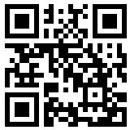
Evaluation
Please take the time to complete a brief evaluation:
Your feedback is appreciated!
https://ttc-gpra.org/P?s=175631

