Slide 1



Latino Culture and Communication: More than Just Translation
Diana Padilla
September 2021

Slide 2

Certificate of Completion
At the end of the session, you will complete an online evaluation prior to closing and going offline (instructions to follow).
Certificates will be sent out within a week or so along with a copy of the slides.
This webinar is approved for 2 hours of CASAC, CPP, CPS credentialing.
You must attend the entire session.

Slide 3
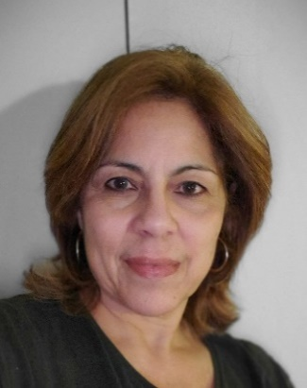
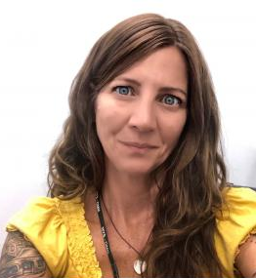
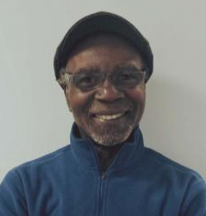
Northeast & Caribbean ATTC Team
Diana Padilla
Research Project Manager
SBIRT Technical Assistance
Patricia (Tri) Chaple Project Administrator
Clyde Frederick Technologist
This webinar training is provided under New York State Office of Addiction Services and Supports (OASAS) Education and Training Provider Certification Number 0115. Training under a New York State OASAS Provider Certification is acceptable for meeting all or part of the CASAC/CPP/CPS education and training requirements.

Slide 4
Disclaimer
The development of these training materials was supported by grant TI082504 (PI: M. Chaple) from the Center for Substance Abuse Treatment, Substance Abuse and Mental Health Services Administration (SAMHSA), United States Department of Health and Human Services. The contents are solely the responsibility of the Northeast and Caribbean Addiction Technology Transfer Center, and do not necessarily represent the official views of SAMHSA.

Slide 5
Purpose of SAMHSA’s Technology Transfer Centers
5
The purpose of the Technology Transfer Centers (TTC) program is to develop and strengthen the specialized behavioral healthcare and primary healthcare workforce that provides substance use disorder (SUD) and mental health prevention, treatment, and recovery support services.
Help people and organizations incorporate effective practices into substance use and mental health disorder prevention, treatment and recovery services

Slide 6



Slide 7
Each TTC Network Includes 13 Centers
7
Network Coordinating Office
National American Indian and Alaska Native Center
National Hispanic and Latino Center
10 Regional Centers (aligned with HHS regions)

Slide 8

HHS Regions
10 Regional Centers
REGION 10
REGION 1
REGION 8
REGION 5
REGION 2
REGION 3
REGION 9
REGION 4
REGION 6
REGION 7

Slide 9
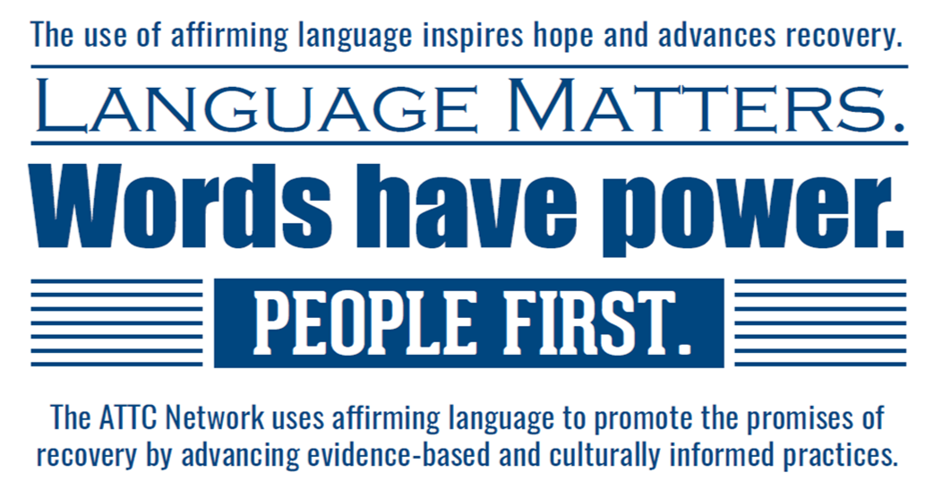

Slide 10
Virtual Platform Logistics
Chat box
Raise your hand feature
Muting and unmuting
Connectivity issues
Camera visual and participation

Slide 11
Goals
Instruct on cultural dynamics that frame the client/patient dialogue and interactions.
Review strength-based strategies for effective communication with Hispanic/Latinx communities.

Slide 12
Objectives
Review current data on Hispanic and Latino disparity rates.
Identify how culture and cognition shape perspectives and influence communication.
Review the DSM-5 cultural formulation interview
List strengths of adhered to cultural characteristics that can be used to support behavior change and the Latino recovery process
Identify culturally adapted evidence-based practices for Hispanic and Latino populations

Slide 13
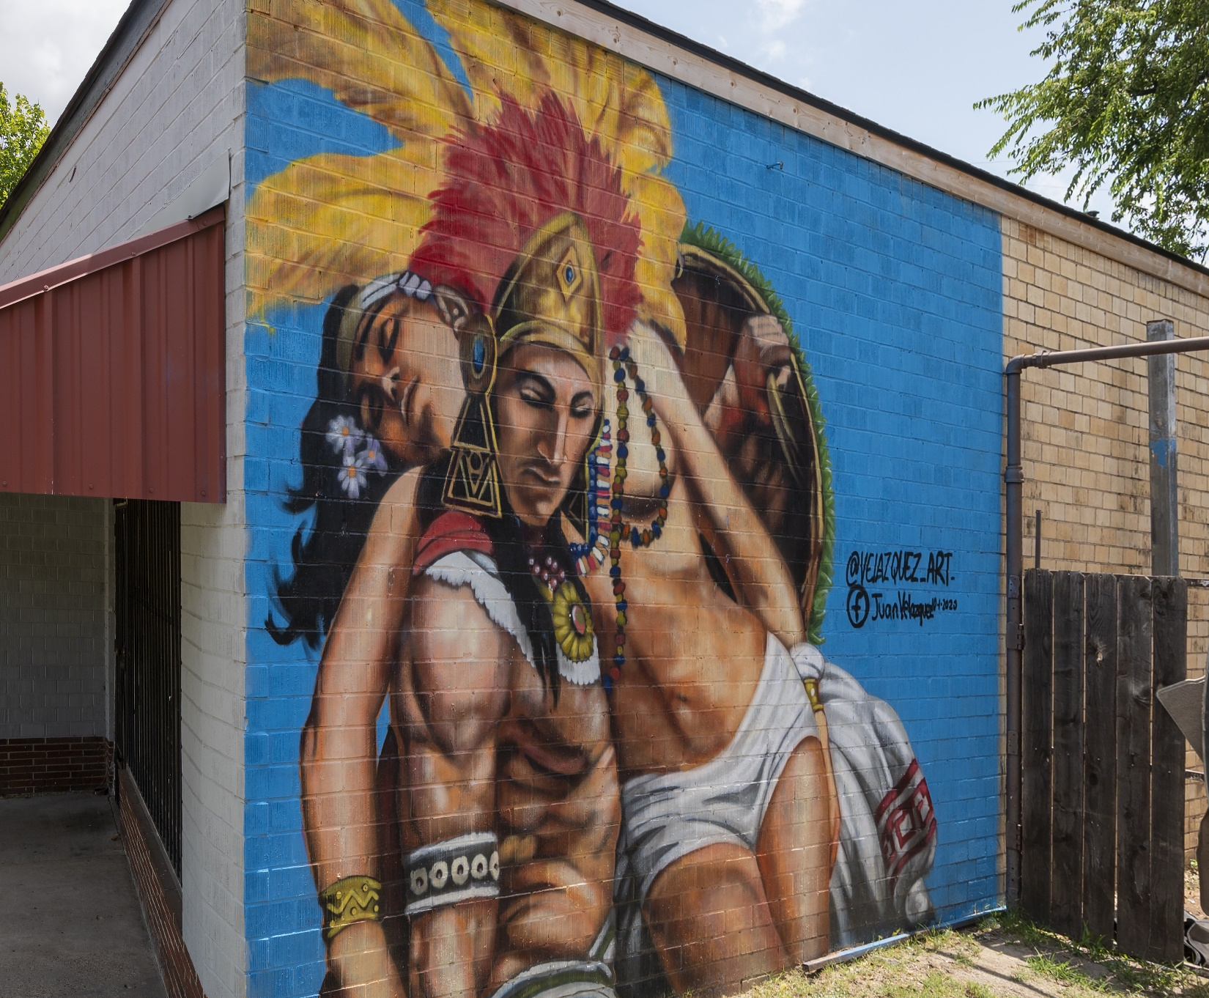

Aztec warrior mural by Fort Worth based artist Juan Velazquez in Elmwood, Dallas. It was created October 1st, 2020.
It was painted in honor of Hispanic Heritage Month.
Notes:
National Hispanic Heritage Month (Spanish: Mes Nacional de la Herencia Hispana) is a period from September 15 to October 15 in the United States for recognizing the contributions and influence of Hispanic Americans to the history, culture, and achievements of the United States].

Slide 14
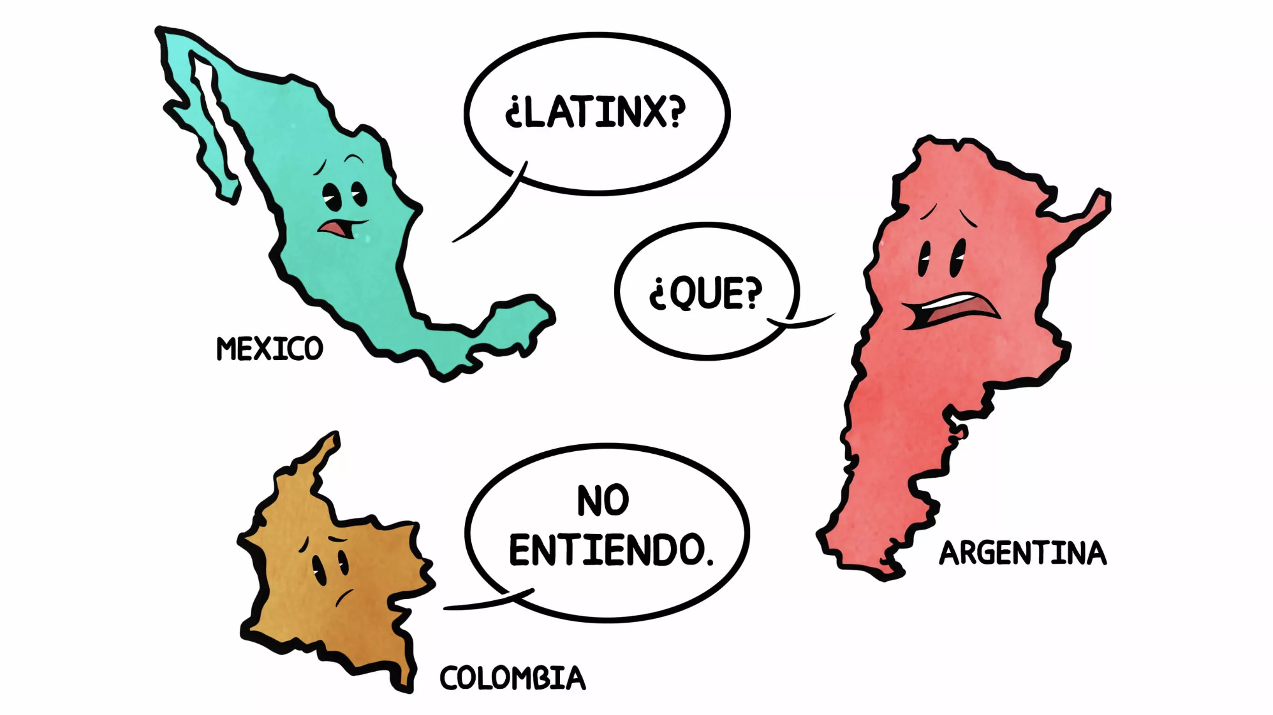

Slide 15
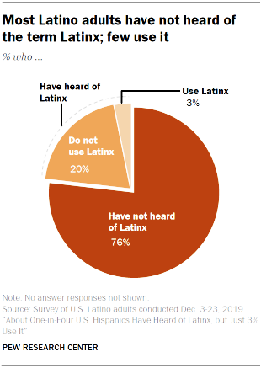
Population ‘Terms’
About One-in-Four U.S. Hispanics Have Heard of Latinx, but Just 3% Use It.
Young Hispanic women among the most likely to use the term.

Slide 16
The Cultural Communities
Hispanic: usually refers to language and those whose ancestry comes from Spain or Spanish speaking countries.
Latino: usually refers to geography and specifically, to Latin America which includes individuals from the Caribbean, South America, and Central America.
Latinx: a gender-neutral term that persons use instead of or alongside “Latino” and “Latina,” and refers to a person of Latin American origin or descent.

Slide 17
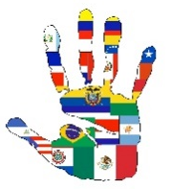
Large Group Question
17
Think of a time when you were speaking to someone and felt you weren't heard, (could be at work, with family, or doctors, while shopping, etc.).
Why do you think it happened?
Did it affect or change your interactions going forward, whether with same person or other people?

Slide 18
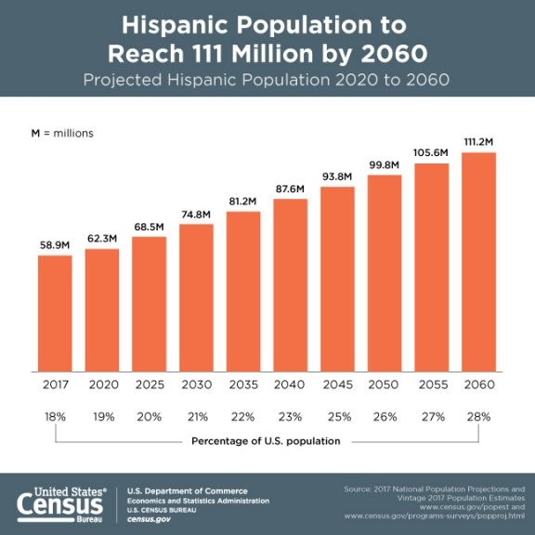
Projected Hispanic Population 2020 to 2060
Statista, United States' population growth projections for 2015-2060, Published by Statista Research Department, Dec 31, 2014,
https://www.statista.com/statistics/183481/united-states-population-projection/

Slide 19
Substance Use and Misuse
1.1 million Latinx youth used illicit drugs in the past year, including 208,000 who misused opioids in the past year.
92% of Latinx youth with a substance use disorder did not receive treatment in a specialty facility.
17% of Hispanics adults suffer from mental illness, and 15% of Latino youth experienced a major depressive episode.
SAMHSA’s 2018 National Survey on Drug Use and Health (NSDUH)

Slide 20
Community Perspectives
The “battle” of managing language barriers
Preference for bilingual providers
Negative bias toward interpreted encounters
“Getting by” with limited language skills
Fear of being a burden
Stigma and discrimination due to language barriers
Steinberg EM, Valenzuela-Araujo D, Zickafoose JS, Kieffer E, DeCamp LR. The "Battle" of Managing Language Barriers in Health Care. Clin Pediatr (Phila). 2016;55(14):1318‐1327. doi:10.1177/0009922816629760

Slide 21
In Their Own Words
“Sometimes they don’t want to understand you because you are Hispanic.” Another mother stated, “They humiliate you… I feel they discriminate because they speak English.”

Slide 22
Reported Language Barriers
Hispanics are more likely to report poor communication with their health provider.
57% of Hispanic adults surveyed experienced a language or cultural barrier in the healthcare system.
44% experienced a cultural barrier
49% experienced a language barrier
57% experienced either a language or cultural barrier
Steinberg EM, Valenzuela-Araujo D, Zickafoose JS, Kieffer E, DeCamp LR. The "Battle" of Managing Language Barriers in Health Care. Clin Pediatr (Phila). 2016;55(14):1318‐1327. doi:10.1177/0009922816629760

Slide 23
Other Barriers Include…
The use of jargon.
Emotional barriers and taboos.
Lack of attention, interest, distractions, or irrelevance to the receiver
Differences in perception and viewpoint.
Physical barriers to non-verbal communication.
Language differences and the difficulty in understanding unfamiliar accents.
Expectations and prejudices which may lead to false assumptions or stereotyping.
Cultural differences.

Slide 24
Un-interactive Dialogue
Nearly 6 in 10 Hispanic adults have had a difficult time communicating with a health care provider because of a language or cultural barrier.
“When I tell them I don’t understand them, they’ll bring someone over to speak to me in Spanish and I don’t understand them either,” said Torres, who is Puerto Rican and was raised in New York. “We didn’t grow up speaking that formal Spanish, so I have no idea what they are saying.”
AARP, Associated Press-NORC Center for Public Affairs Research, Latinos Have Health Care Communication Woes, July 2018, https://www.aarp.org/health/conditions-treatments/info-2018/latinos-hispanics-doctors-nursing-homes.html

Slide 25
Frustration of Miscommunication
Along with communication challenges, many Hispanics are concerned about language or cultural accommodations for people in their community who seek long-term care services.
Torres said he’s not confident he’ll find a culturally sensitive nursing home when he gets older. “I’d rather just live alone and poison myself by accident rather than stay in one of those homes right now,” he said.
AARP, Associated Press-NORC Center for Public Affairs Research, Latinos Have Health Care Communication Woes, July 2018, https://www.aarp.org/health/conditions-treatments/info-2018/latinos-hispanics-doctors-nursing-homes.html

Slide 26
Interpreter Services
26% of Hispanic adults surveyed reported communicating through an interpreter, 52% family member acted as the interpreter.
“It was a battle to say anything‥‥ I couldn’t ask why they had to get so many vaccines or why not. I battled for so long.” Other mothers described the need to switch primary care providers to maintain access to bilingual providers.”
What are challenges of using a ‘family’ interpreter?
What are challenges of using a phone line interpreter?

Slide 27
Culture & Recovery
Recovery is culturally-based and influenced. Culture and cultural background in all of its diverse representations - including values, traditions, and beliefs - are keys in determining a person’s journey and unique pathway to recovery. Services should be culturally grounded, attuned, sensitive, congruent, and competent, as well as personalized to meet each individual’s unique needs.
SAMHSA, 8-Engaging-Hispanic-and-Latino-Communities-Supporting-Recovery-BRSS-TACS-Info-Brief-508C-authors-feb-5

Slide 28
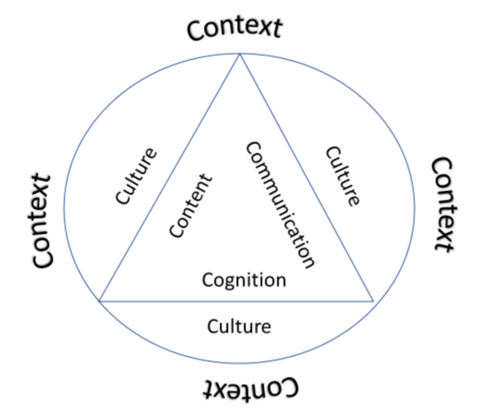
Language Mechanics
What you hear
How you interpret
What is actually said
What was meant

Slide 29
What is Actually Conveyed?
Miscommunication often stems from a misalignment of explicit and implicit meaning between the sender and receiver.
Explicit characteristics of culture are the observable behaviors, rituals, symbols and heroes of a culture. These include the way people dress, the kind of food they eat, music, dance, the things that are considered beautiful and/or ugly.
The implicit characteristics of a culture are the underlying values, the unwritten norms of behavior that guide people regarding which are considered appropriate or inappropriate.

Slide 30
Cultural Context
“Culture hides more than it reveals, and strangely enough what it hides, it hides most effectively from its own participants.” - Edward T. Hall
Culture provides the overall framework wherein humans learn to organize their thoughts, emotions, and behaviors in relation to their environment.
Sage Publications, The Cultural Context, https://www.sagepub.com › upm-binaries ›42958_2_The_Cultural_Context

Slide 31
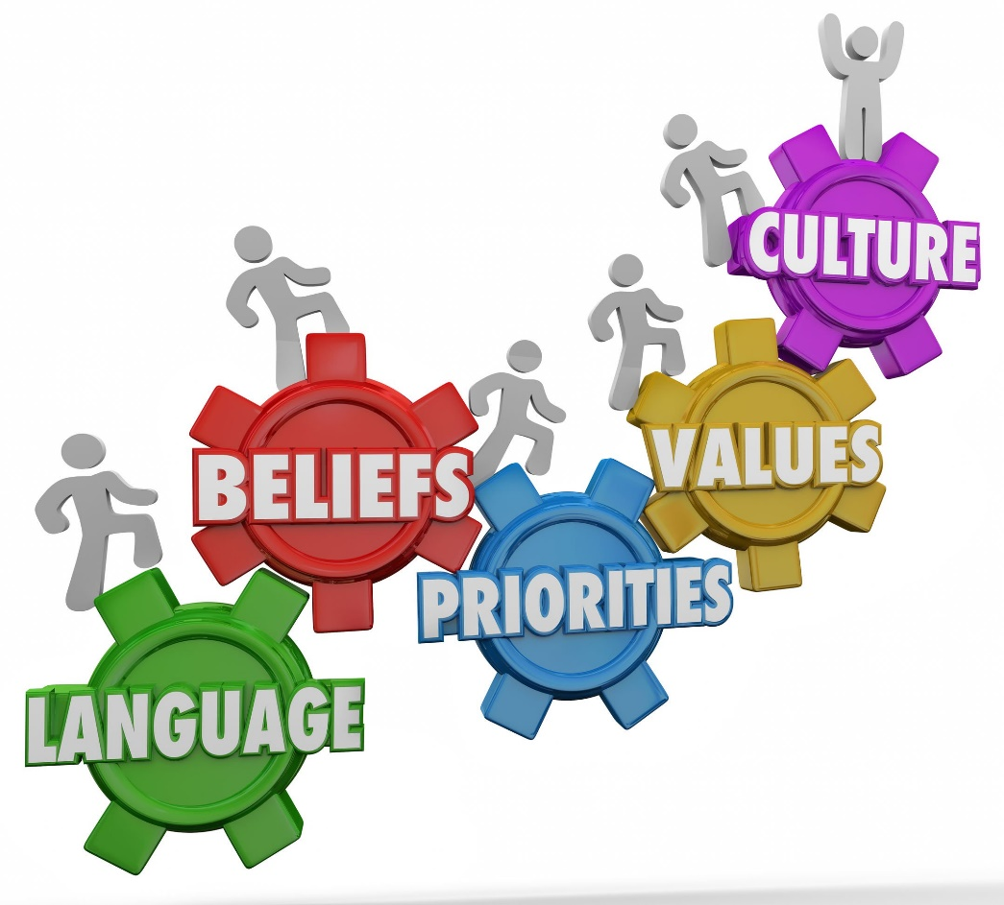
Language and Culture
Language and culture are intertwined. When you interact with another language, it means that you are also interacting with the culture that speaks the language.

Slide 32
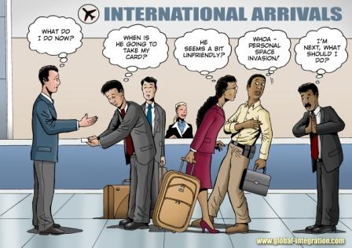

Slide 33
Cultural Influences on Communication
What would you do next if it were you?
Time and Space
Face and Face-Saving
Nonverbal Communication

Slide 34
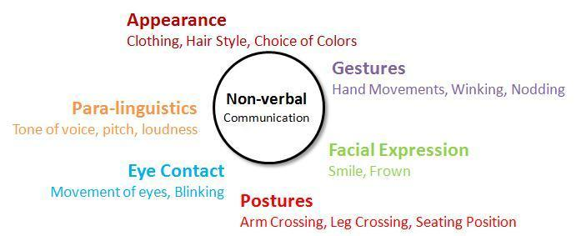
Aspects of Communication

Slide 35
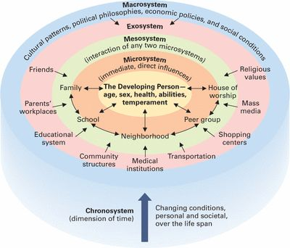
Lifetime Development

Slide 36
Cultural and Social Differences
Latinos, Latinx vary greatly with respect to national background and experience with immigration, socioeconomic and education status
Status in their families and communities matter, (personalism)
In complex and sometimes indirect ways, these factors protect or adversely impact language.

Slide 37
Cross Cultural Dynamics
Variable language skills
Recognition of cultural differences without reinforcing stereotypes
Different cultural norms of politeness and communication styles, (i.e., argumentative & interruption)
Awareness of perceived status norms between cultures

Slide 38
We Know That…
The way we mentally process information inﬂuences our interaction with others
Context influences perspectives and consequent information sharing
Linguistic differences exist between Hispanic cultural groups
Cultural values and beliefs may be similar but expressed differently between groups, (or vice versa)
Understanding characteristics and trends within Hispanic, Latino, Latinx can help your communication efforts.

Slide 39
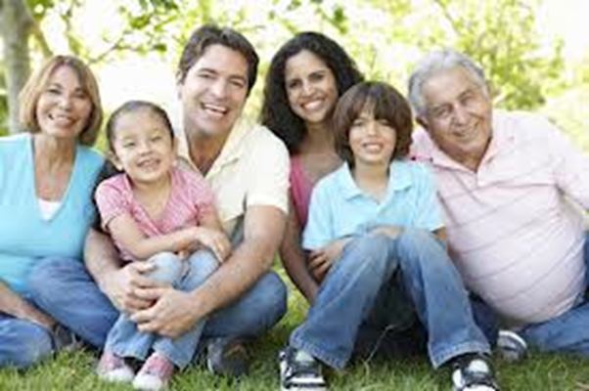
Family - Familism
May include grandparents, aunts, uncles, cousins, long time close friends, and godparents of the family's children.
Central to identity
Source of support

Slide 40
Male Role Expectations
Machismo
Power role as head of the family
Refers to a man’s expected responsibility to provide for and protect his family
Influences behavior and attitudes of adolescent males during time of identity formation

Slide 41
Female Role Expectations
Marianism - self-sacrificing and submissive to the male
Hembrism - head of household, Latinas tend to maintain multiple roles in their families
Quinceañera, rite of passage
Familism - hierarchical priority

Slide 42
Cultural Nuances
Fatalism: ‘Que será,” or “Es la voluntad de Dios.” “God is punishing me for my sins.”
Medical Beliefs (Curandero). They may go to him or priest before they go to a specilist.
Work: A reliance on manual labor and the acceptance of ‘pain’ related to it.
Untrusting: Lack of trust of government agencies or other helping entities.
Transient: Moving to where the work is.

Slide 43
Social Interaction and Interpersonal Traits
Simpatía - Congeniality
Personalism - What is valued is personal rather than institutional relationships, formal vs informal communication style, face and face saving
Respect - Appropriate deferential behavior toward others based on gender, age, economic status, etc. (E.g. ‘Don Fabio’)

Slide 44
Spirituality
Religions: Roman Catholic, Pentecostal, Evangelical
3 MAIN HEALING/SPIRITUAL SYSTEMS
Curanderismo – Mexican American
Espiritismo – Puerto Rican
Santeria – Cuban
Hispanic and Latino patients may combine respect for the benefits of mainstream medicine, tradition, and traditional healing, with a strong religious component.

Slide 45
Immigration & Migration
Immigrants
  Permanent residents (family dislocation, fragmentation, and reconstruction)
  Work, Student, Visitor visas
  Undocumented
  Family dislocation, fragmentation, and reconstruction.
  Culture change for individuals and across generations

Slide 46
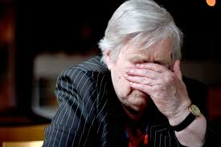

Generational Perspectives
50
Elder Hispanics are more likely to have unfavorable attitudes toward mental health services.
  Younger Latinos tend to be better informed of mental health issues & have exposure to mental health services than older counterparts.
  Acculturation.

Slide 47
Mother and Daughter
Explore and recognize the importance of how situations are perceived (other person view) and addressed from a cultural context
Case: Hispanic mother allows daughter to use in house. Daughter has a low paying full time job and sniffs several bags of dope a day…
Potential strategy..?

Slide 48
When Language Impacts
For someone struggling with addiction or substance use disorder, language is often impactful.
Stigma and shame are typically uniformed biases, that can further depress potential motivation needed for recovery.

Slide 49
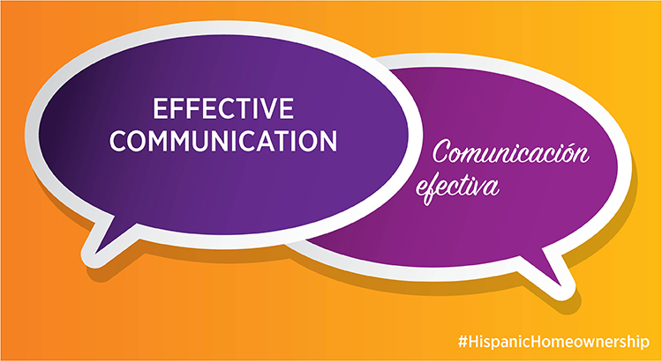

Slide 50
Communication Dynamics
Engage in a respectful, warm, and mutual introduction with the client because less acculturated Hispanics expect a more formal interaction, and the counselor will be seen as an authority figure and should be appropriately dressed.
Explain confidentiality and elicit their understanding.
Have the client state in his or her own words the problem or problems as he or she sees it - determine the possible influence of religious or spiritual beliefs.

Slide 51
Communication Tips
Empathy and perspective taking, by eliciting information from that person.
Provides us information to develop strategies about how to best inﬂuence them.
Not everyone needs the same amount of contact, and the quality of communication is almost certainly as important as the quantity.

Slide 52
Cultural Humility
Cultural Humility is one construct for understanding and developing a process-oriented approach to competency.
Preferred language and meaning within context
Ask open ended questions of themselves, their view of their situation, support systems, etc.
Active listening, reflecting, summarizing
American Psychology Reflections on Cultural Humility, http://www.apa.org/pi/families/resources/newsletter/2013/08/cultural-humility.aspx

Slide 53

CORE Communication Skills
OARS
Open-ended Questions
Affirmations
Reflective Listening
Summaries

Slide 54
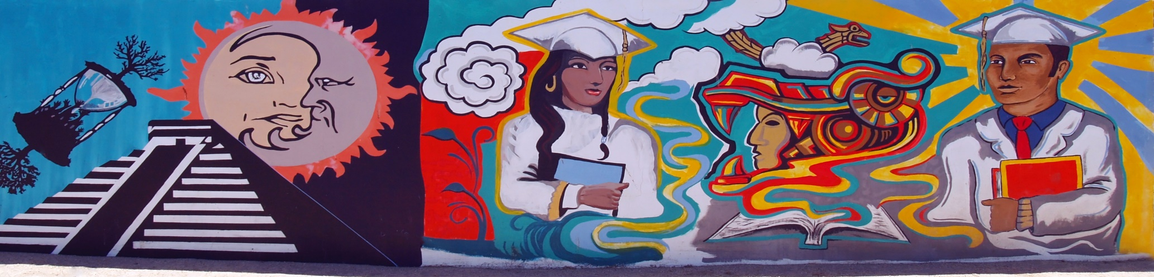
Language Mechanics
What you hear
How you interpret
What is actually said
What was meant

Slide 55
Probing for Information
Background information is essential to getting to know a new client.
Reviewing the notes and details with the client is relevant to initiating a rapport and communication style
What is important to the client
Explore details by eliciting the client’s perspective on situation, (use OARS)

Slide 56
Cultural Formulation Interview – DSM-5
Cultural Humility and the CFI
Cultural definition of problem
Cultural perceptions of cause, context, and support
Stressor and supports
Role of cultural identity
Cultural factors affecting self-coping and past help seeking
Cultural Formulation Interview (CFI)
https://multiculturalmentalhealth.ca/wp-content/uploads/2019/07/2013_DSM5_CFI.pdf

Slide 58
Provider Recommendations
Take time to understand backgrounds and preferences
Many Latinx, Latinos, Hispanics, have strong preferences about how they identify
Build on the respect Hispanic communities have for family.
Direct person-to-person contact is best when communicating with Latino families.

Slide 59
Provider Recommendations (cont)
Consider the best language skills/resource to reach and engage the Latinx person.
Incorporate appropriate cultural elements.
Ensure your materials are reading-level appropriate for the specific community you serve.
Track your results, adjust your strategies, and improve your communication and engagement.

Slide 60
Substance Use Treatment and Recovery
“Let’s not fit the Latinx client into the treatment program, facilitate a recovery program that is tailored and suited to the Latinx client.”

Slide 61
Culturally and Linguistically Appropriate Services (CLAS) in Health and Health Care
59
“The CLAS standards are intended to advance health equity, improve quality and help eliminate health care disparities by providing a blueprint for individuals and health and health care organizations to implement culturally and linguistically appropriate services.”
OMH Home, Blog: National Partnership for Action, What Do the New CLAS Standards Mean for Behavioral Health? https://minorityhealth.hhs.gov/npa/blog/BlogPost.aspx?BlogID=2808

Slide 62
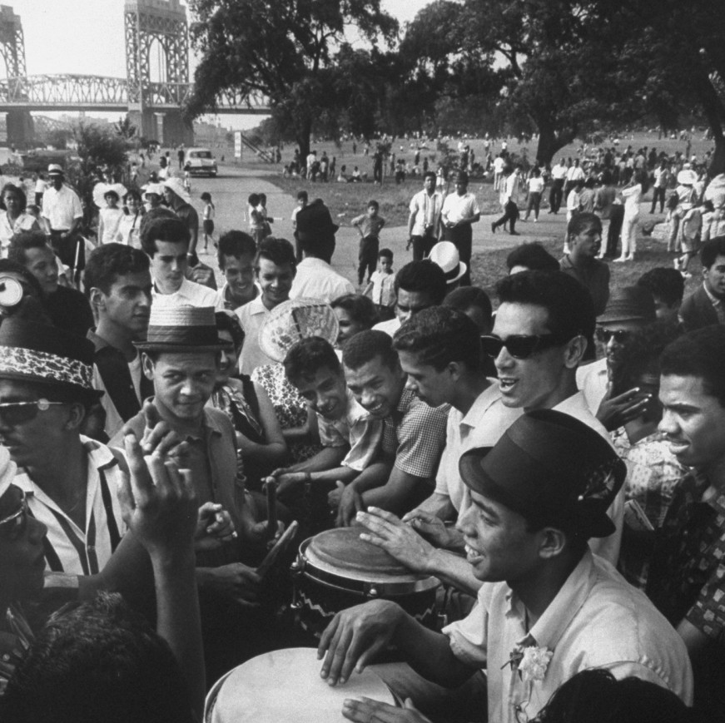
Celebrating traditional festival of San Juan, in New York City, 1962
Notes:
Every June 23d, Puerto Ricans celebrate la Noche de San Juan  an eve of a feast for Saint John, the Baptist's birth. Unlike other festivities around the world, in Puerto Rico, this celebration -which occurs two days before the summer solstice- marks a holiday spent at the beach.
The tradition goes that at the stroke of midnight, people take at least three backward plunges hough some do seven or 12 dives, to rid life of all negativity.

Slide 63
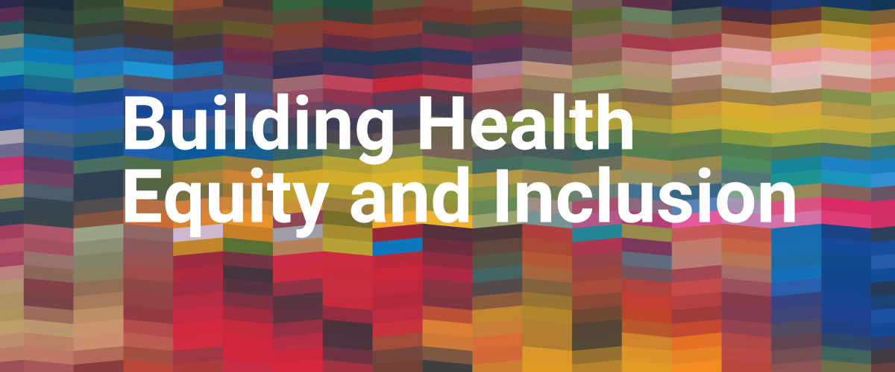
ATTCnetwork, Building Health Equity and Inclusion, Free Resources https://attcnetwork.org/centers/global-attc/clas-resources

Slide 64
Certificate of Completion
Before signing off, please complete the online evaluation prior to logging off.
Certificates will be sent out within a week or so along with a copy of the slides.
This webinar is approved for 2 hours of CASAC, CPP, CPS credentialing.

Slide 65
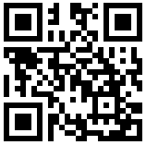

Contact and Survey
Diana Padilla
Research Project Manager
Equity & Inclusion Technical Assistance
Diana.Padilla@nyspi.columbia.edu
Clyde Frederick
Technologist
NeC-ATTC Program Support
Clyde.Frederick@nyspi.columbia.edu
Division on Substance Use Disorders / New York State Psychiatric Institute
Department of Psychiatry / Columbia University Medical Center
ATTCnetwork.org/northeastcaribbean
If you are sharing a computer with others, please type your names in the chat box.
Please fill out your evaluation forms – it will only take a couple of minutes! Just scan the code with the camera on your smart phone, click on the link in the chat box, or type the link into your browser: https://ttc-gpra.org/P?s=798320
Don’t worry if you can’t – an email with the link will be sent to you tomorrow, along with a copy of the slides.

