Slide 1



Screening, Brief Intervention,
& Referral to Treatment
(SBIRT)
Part I
Diana Padilla
SBIRT Technical Assistance
October 2021

Slide 2

Notes:
World MH day Oct 10

Slide 3
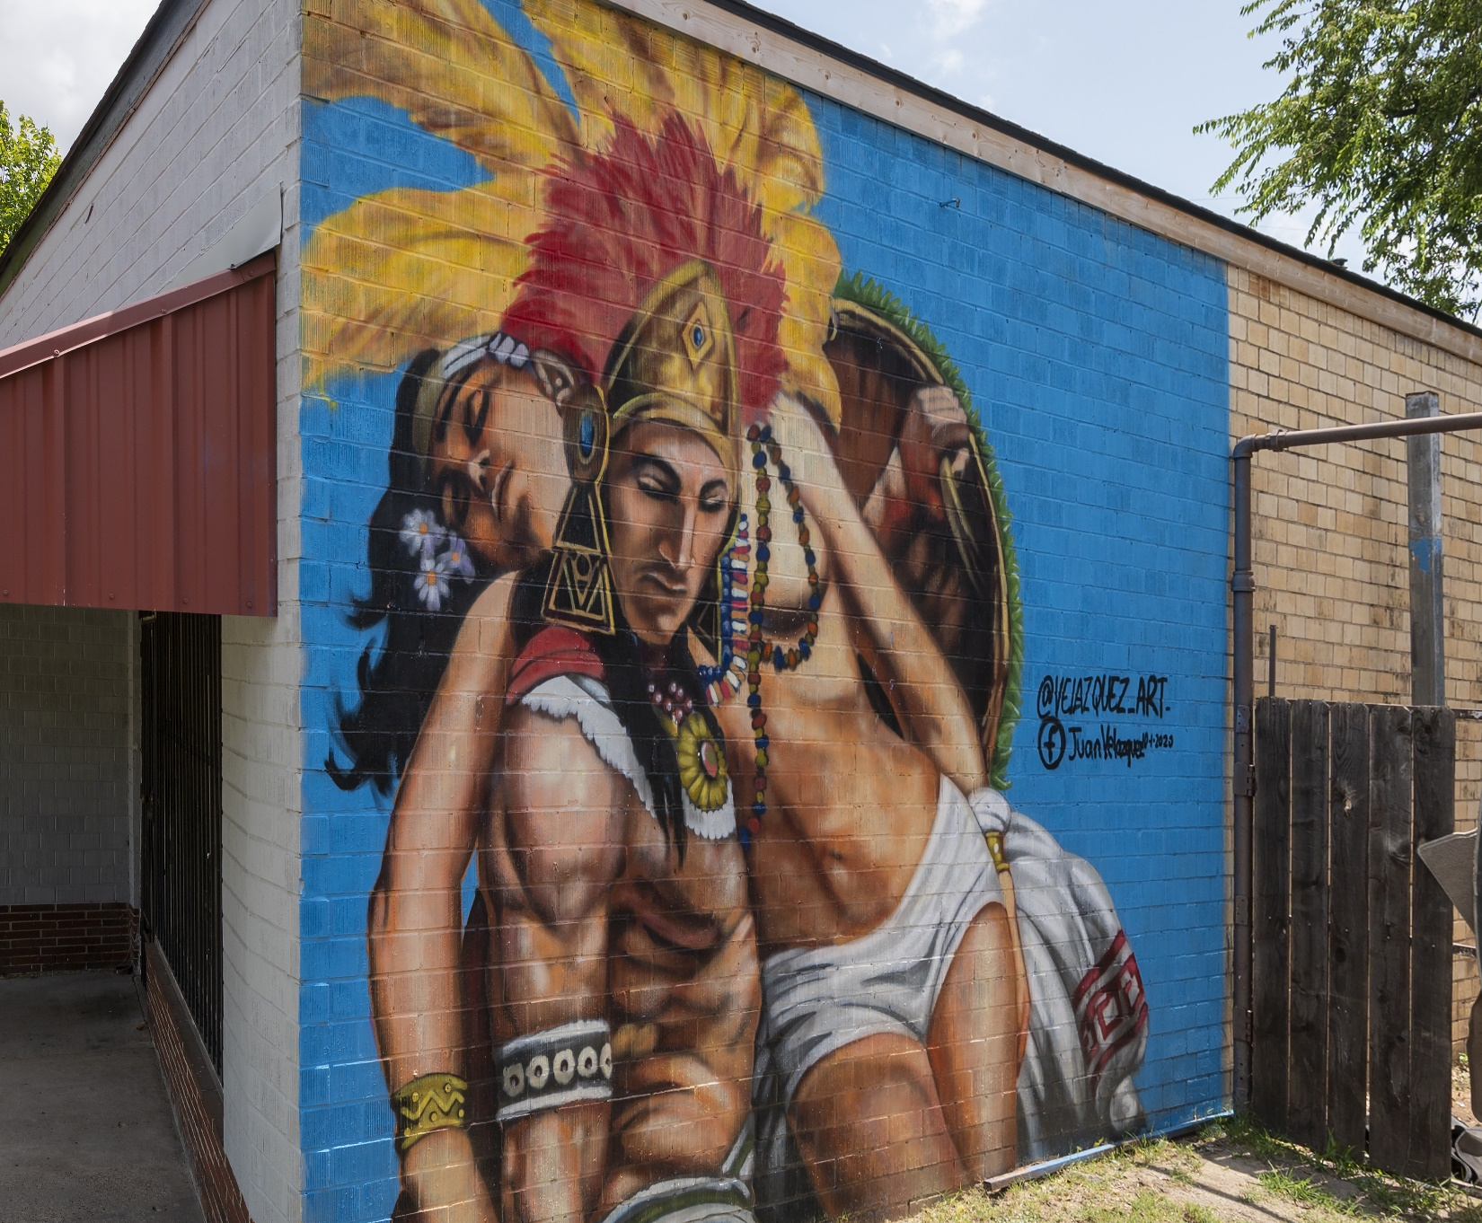
Aztec warrior mural by Fort Worth based artist Juan Velazquez in Elmwood, Dallas. It was created October 1st, 2020.
It was painted in honor of Hispanic Heritage Month.
Notes:
National Hispanic Heritage Month (Spanish: Mes Nacional de la Herencia Hispana) is a period from September 15 to October 15 in the United States for recognizing the contributions and influence of Hispanic Americans to the history, culture, and achievements of the United States.

Slide 4

Certificate of Completion
At the end of the session, you will complete an online evaluation prior to closing and going offline (instructions to follow).
Certificates will be sent out within a week or so along with a copy of the slides.
This webinar is approved for 6 hours of CASAC, CPP, CPS credentialing.
You must attend the entire session.

Slide 5



Northeast & Caribbean PTTC Team
Diana Padilla
Research Project Manager
SBIRT Technical Assistance
Patricia (Tri) Chaple Project Administrator
Clyde Frederick Technologist
This webinar training is provided under New York State Office of Addiction Services and Supports (OASAS) Education and Training Provider Certification Number 0115. Training under a New York State OASAS Provider Certification is acceptable for meeting all or part of the CASAC/CPP/CPS education and training requirements.

Slide 6
Disclaimer
The development of these training materials was supported by grant TI082504 (PI: M. Chaple) from the Center for Substance Abuse Treatment, Substance Abuse and Mental Health Services Administration (SAMHSA), United States Department of Health and Human Services. The contents are solely the responsibility of the Northeast and Caribbean Addiction Technology Transfer Center, and do not necessarily represent the official views of SAMHSA.

Slide 7
Purpose of SAMHSA’s Technology Transfer Centers
7
The purpose of the Technology Transfer Centers (TTC) program is to develop and strengthen the specialized behavioral healthcare and primary healthcare workforce that provides substance use disorder (SUD) and mental health prevention, treatment, and recovery support services.
Help people and organizations incorporate effective practices into substance use and mental health disorder prevention, treatment and recovery services

Slide 8



Slide 9
Each TTC Network Includes 13 Centers
9
Network Coordinating Office
National American Indian and Alaska Native Center
National Hispanic and Latino Center
10 Regional Centers (aligned with HHS regions)

Slide 10

HHS Regions
10 Regional Centers
REGION 10
REGION 1
REGION 8
REGION 5
REGION 2
REGION 3
REGION 9
REGION 4
REGION 6
REGION 7

Slide 11


Slide 12
Virtual Platform Logistics
Chat box
Raise your hand feature
Muting and unmuting
Break-out rooms
Connectivity issues
Camera visual and participation
Break

Slide 13
Core Modules
What Is SBIRT and Why Use It?
How does SBIRT fit into Public Health?
EBP Screening Tools for Substance Use
Brief Intervention and Essential Motivational Interviewing Skills
Referral to Treatment

Slide 14
What Is SBIRT?
Why Use It?

Slide 15

Prevalence of Substance Use
165.4 million people were past month substance users (i.e., tobacco, alcohol, or illicit substances)
In 2019, the majority of the 9.3 million misusers of prescription pain relievers had misused only prescription pain relievers in the past year, but they had not used heroin.
139.7 million people were past month alcohol users
65.8 million were binge drinkers in the past month
16. million were heavy drinkers in the past month
SAMHSA, 2019 National Survey on Drug Use and Health, https://www.samhsa.gov/data/release/2019-national-survey-drug-use-and-health-nsduh-releases,,

Slide 16
Prevalence of Substance Use - continued
There were 10,511 fatalities caused by drunk drivers in 2018, which translates to 29% of all traffic deaths.
17% of all traffic deaths among those aged between 0-14 involve some kind of alcohol.
In 2016, over 10,000 deaths that resulted from drunk-driver collisions. That same year, over 1 million drivers have been arrested for driving under the influence of alcohol (and substances).
Policy Advice, 18 Drunk Driving Statistics that Will Make You Sober, https://policyadvice.net/insurance/insights/drunk-driving-statistics/

Slide 17
College Alcohol Related
Prevalence of Drinking: According to the 2019 NSDUH, 52.5 percent of full-time college students ages 18–22 drank alcohol in the past month compared with 44.0 percent of other persons of the same age.
Prevalence of Binge Drinking: According to the 2019 NSDUH, 33.0 percent of college students ages 18–22 reported binge drinking in the past month compared with 27.7 percent of other persons of the same age.
Prevalence of Heavy Alcohol Use: According to the 2019 NSDUH, 8.2 percent of college students ages 18–22 reported heavy alcohol use in the past month compared with 6.4 percent of other persons of the same ag.
Substance Abuse and Mental Health Service Administration. 2019 National Survey on Drug Use and Health. Table 6.21B – Types of Illicit Drug, Tobacco Product, and Alcohol Use in Past Month among Persons Aged 18 to 22, by College Enrollment Status and Gender: Percentages, 2018 and 2019. Available at https://www.samhsa.gov/data/sites/default/files/reports/rpt29394/NSDUHDetailedTabs2019/NSDUHDetTabsSect6pe2019.htm#tab6-21b. Accessed 9/15/20.

Slide 18
Mental and Physical Harms of
High-Risk Drinking

Slide 19
Hazards of Alcohol and Other Substance Use
Increased risk for…
Injury/trauma
Criminal justice involvement
Chronic health conditions
Social problems
Mental health consequences (e.g., anxiety, depression)
Increased absenteeism and accidents in the workplace

Slide 20
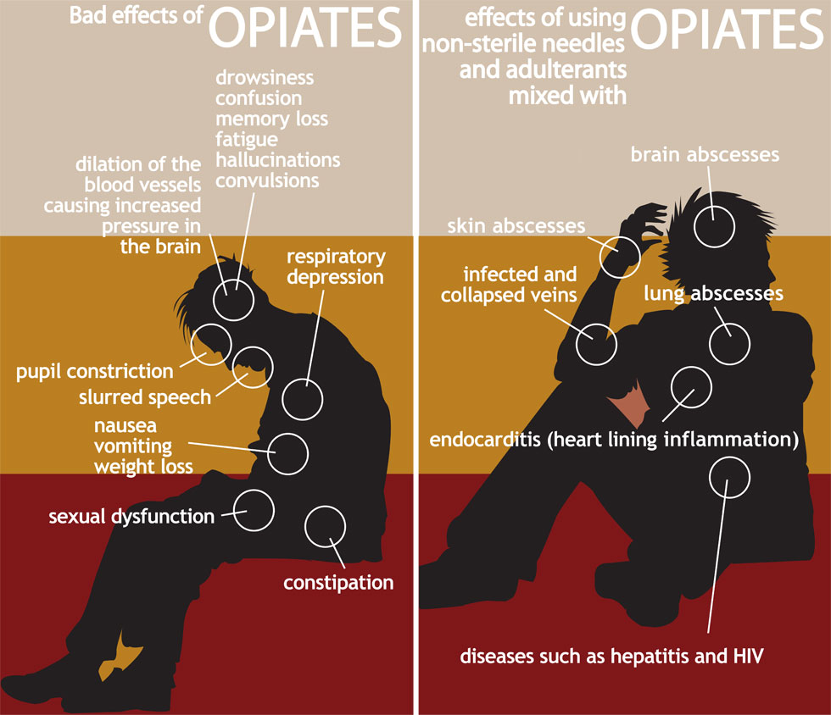
Physical and Cognitive Harms of Opiates
Drug Enforcement Adminsitration Museum & Visitors Center, https://www.deamuseum.org/ccp/opium/effects.html, Pentagon City, VA

Slide 21
A New Initiative
Substance use screening, brief intervention, and referral to treatment (SBIRT) is a systems change initiative. As such, we are required to shift our view toward a new paradigm, and:
  Re-conceptualize how we understand substance use problems.
  Redefine how we identify substance use problems.
  Redesign how we treat substance use problems.

Slide 22
Historical Response to Substance Use
Substance Use Services have focused on two areas:
  Prevention - Precluding or delaying the onset of substance use.
  Treatment - Providing time, cost, and labor intensive care to patients who are acutely or chronically ill with a substance use disorder.

Slide 23
23
Traditional Perspective on Substance Use
Abstinence
Responsible Use
Addiction

Slide 24
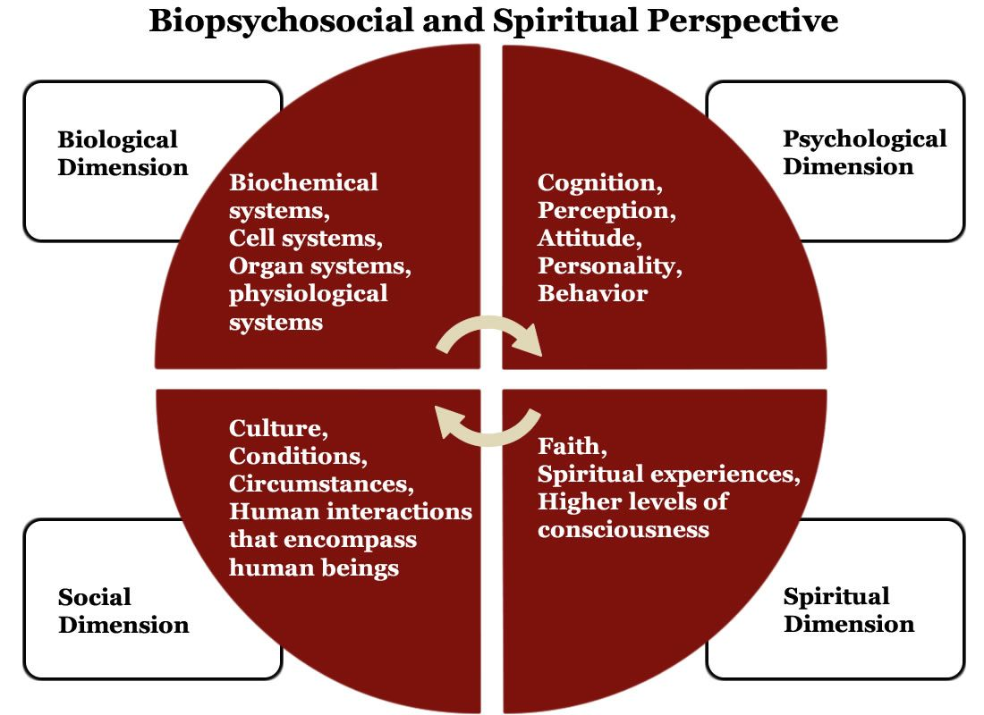
Biopsychosocial and Spiritual Model of Addiction

Slide 25
How Does SBIRT Fit Into Public Health?

Slide 26
26
Substance Use is
a Public Health Problem

Slide 27
Substance Use Terms
Substance Use, (SU) refers to the consumption of psychoactive substances
At-risk Substance Use, refers to consuming at levels resulting in harmful or hazardous consequences.
Substance Use Disorder, (SUD) meets a diagnostic criteria

Slide 28
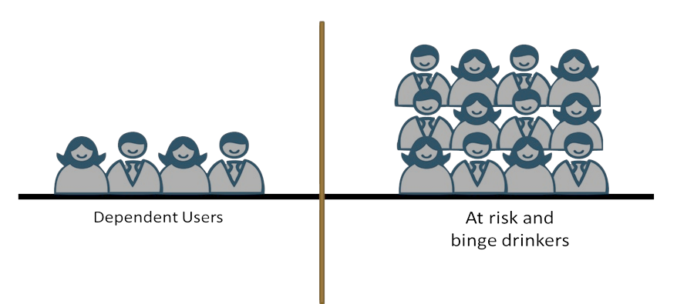
Rethinking Substance Use Problems From a Public Health Perspective
28
Substance Use Disorders
At-risk and Binge Drinkers

Slide 29
29
Learning from Public Health
The public health system of care routinely screens for potential medical problems, provides preventative services prior to the onset of acute symptoms, and delays or precludes the development of chronic conditions.

Slide 30
The SBIRT Model -
A Continuum of Substance Use
Abstinence
Experimental Use
Social Use
Binge Use
Misuse
Substance Use Disorder

Slide 31

Goal of SBIRT
The primary goal of SBIRT is to identify and effectively intervene with those who are at moderate or high risk for psychosocial or health care problems related to their substance use.

Slide 32
Moving Parts
Pre-screening (universal).
Full screening (for those with a positive pre-screen).
Brief Intervention (for those scoring over the cutoff point).
Extended Brief Interventions or Brief Treatment (for those who are at moderate or high risk)
Specialty Treatment for those who have a probable substance use disorder.

Slide 33
Screening for Substance Use in Your Practice Setting

Slide 34
Why Screen Universally?
Early identification and intervention lead to better outcomes.
Detect alcohol and substance use patterns that can increase future injury or illness risks.
Intervene and educate about at-risk alcohol and other substance use.
Research has shown that approximately 90 percent of substance use disorders go untreated.
Notes:
34

Slide 35
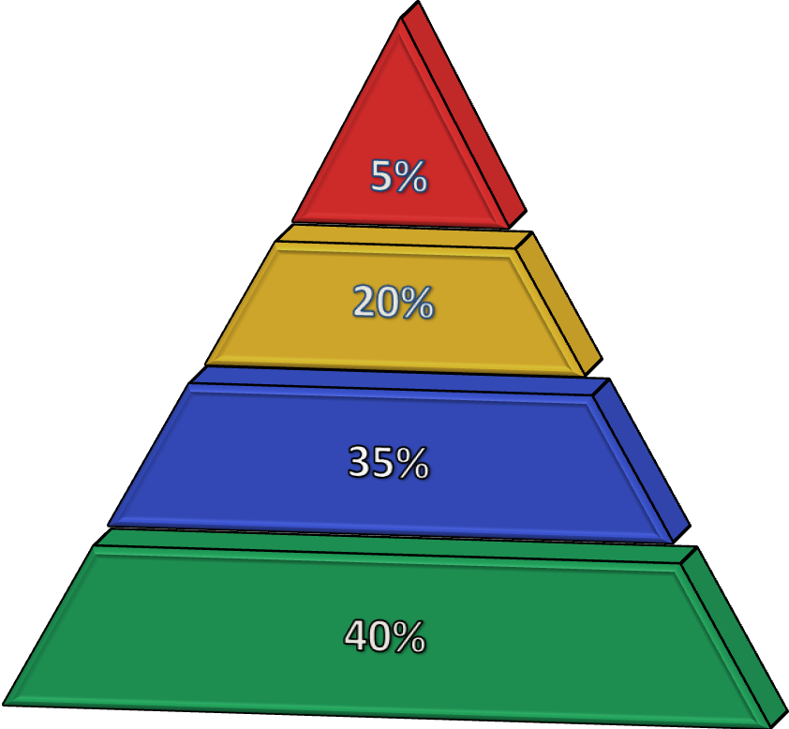
Based on Findings of Screening
Severe/Very High Risk,
Probable Substance Use Disorder (20+)
High Risk/Harmful Use (8-19)
Low-Risk Use (1-7)
Abstainers (0)

Slide 36
Moderate Drinking Levels
The 2015-2020 Dietary Guidelines for Americans defines moderate drinking as up to:
1 drink per day for women of legal drinking age
Up to 2 drinks per day for men of legal drinking age
NIAAA, Rethinking Drinking, What are the different drinking levels?, https://www.rethinkingdrinking.niaaa.nih.gov/How-much-is-too-much/Is-your-drinking-pattern-risky/Drinking-Levels.aspx

Slide 37
Binge and Heavy Drinking
Binge drinking is a pattern of drinking that brings blood alcohol concentration (BAC) to 0.08 percent or higher. This typically occurs after 4 drinks for women and 5 drinks for men - in about 2 hours.
Heavy alcohol use is defined as more than 4 drinks on any one day for men or more than 3 drinks for women.
NIAAA, Rethinking Drinking, What are the different drinking levels?, https://www.rethinkingdrinking.niaaa.nih.gov/How-much-is-too-much/Is-your-drinking-pattern-risky/Drinking-Levels.aspx

Slide 38
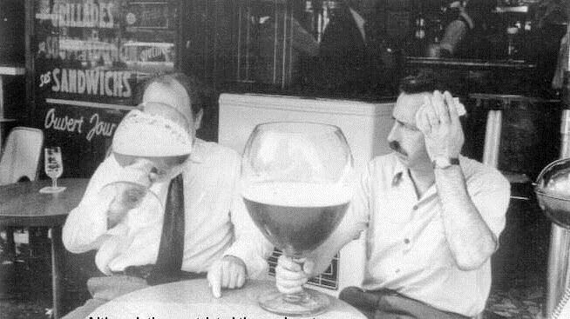
When Screening, it’s Useful to Clarify What One Drink Is!

Slide 39
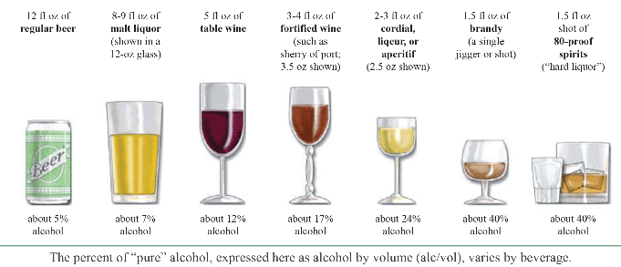
Standard Drink
National Institute of Alcohol Abuse and Alcoholism. (2015). Rethinking drinking: Alcohol and your health. Retrieved from http://pubs.niaaa.nih.gov/publications/RethinkingDrinking/Rethinking_Drinking.pdf.

Slide 40
Screening Does Not Provide
a Diagnosis!

Slide 41
41
Screening Does Provide
Education and positive feedback for low/no risk users.
Immediate identification of level of risk.
A context for a discussion on substance use.
Information on the level of involvement in substance use.
Insight into areas where substance use may be problematic.
Identification of patients who are most likely to benefit from brief intervention.
Identification of patients who are most likely in need of referral for further assessment.

Slide 42
Validated Screening Tools - Adults
AUDIT: Alcohol Use Disorder Identification Test
DAST: Drug Abuse Screening Test
ASSIST: Alcohol, Smoking, and Substance Abuse Involvement Screening Test
TICS: Two-Item Conjoint Screen (TICS) for Alcohol and Other Drug Problems
NIAAA and NIDA: single question pre-screens

Slide 43
Validated Screening Tools - Youth
CRAFFT: Adolescent Screen (Car, Relax, Alone, Forget, Family or Friends, Trouble)
CRAFFT II: Adolescent short screening (How many days of alcohol, marijuana, other drugs), along with (Car, Relax, Alone, Forget, Family or Friends, Trouble)
NIAAA: Alcohol Screening for Youth Ages 9-18 years
S2BI: Screening to Brief Intervention Tool
BSTAD: Brief Screener for Tobacco, Alcohol, and other Drugs

Slide 44
Validated Screening Tools - Pregnant Women
T-ACE: Tolerance, Annoyed, Cut-down, Eye-opener
TWEAK: Tolerance, Worried, Eye-opener, Amnesia (blackouts), (K) Cut-down
4P’s PLUS: Screen for substance use in pregnancy

Slide 45
CAGE-AID
45
CAGE-AID (CAGE Questions Adapted to Include Drugs)
Have you ever felt you ought to cut down on your drinking or drug use?
Have people annoyed you by criticizing your drinking or drug use?
Have you felt bad or guilty about your drinking or drug use?
Have you ever had a drink or used drugs first thing in the morning to steady your nerves or to get rid of a hangover?
Scoring: Item responses on the CAGE-AID are scored 0 for "no" and 1 for "yes" answers. A higher score is an indication of alcohol problems. A total score of 2 or greater is considered clinically significant
Interpretation: One or more "yes" responses is regarded as a positive screening test. It’s an indication of possible substance use and need for further evaluation.
Online Version: https://www.hiv.uw.edu/page/substance-use/cage-aid

Slide 46
CRAFT II
Screening and Brief Intervention protocols
https://www.masbirt.org/schools

Slide 47
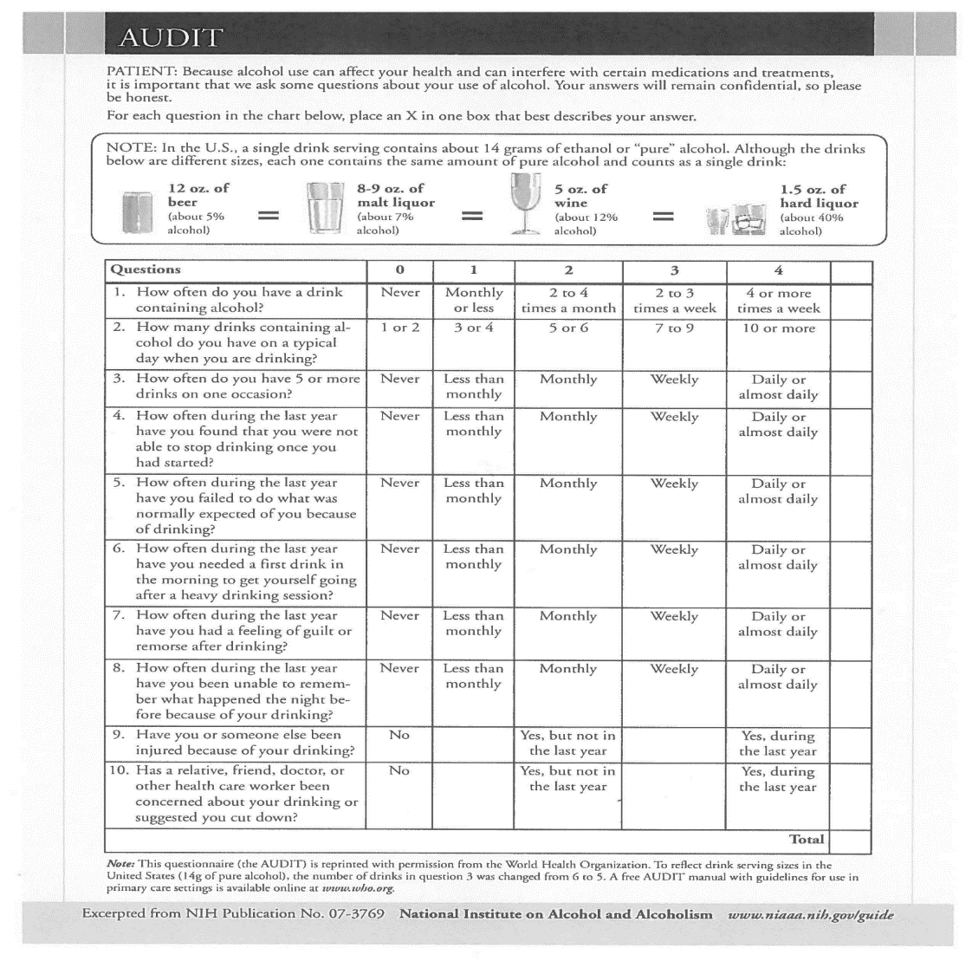
AUDIT Questionnaire
47

Slide 48
AUDIT Domains
Domains | Question Number | Item Content
Hazardous Alcohol Use | 1 2 3 | Frequency of drinking Typical quantity Frequency of heavy drinking
Substance Use Disorder Symptoms | 4 5 6 | Impaired control over drinking Increased salience of drinking Morning drinking
Harmful Alcohol Use | 7 8 9 10 | Guilt after drinking Blackouts Alcohol-related injuries Others concerned about drinking

Slide 49
Scoring the AUDIT
Severe/Very High Risk,
Probable Substance Use Disorder (20+)
High Risk/Harmful Use (8-19)
Low-Risk Use (1-7)
Abstainers (0)

Slide 50
AUDIT Scores and Zones
Score | Risk Level | Intervention
0-7 | Zone 1: Low Risk Use | Alcohol education to support low-risk use – provide brief advice
8-15 | Zone 2: At Risk Use | Brief Intervention (BI), provide advice focused on reducing hazardous drinking
16-19 | Zone 3: High Risk Use | BI/EBI – Brief Intervention and/or Extended Brief Intervention with possible referral to treatment
20-40 | Zone 4: Very High Risk, Probable Substance Use Disorder | Refer to specialist for diagnostic evaluation and treatment

Slide 51
Confidentiality
Adolescents who are aware of confidentiality are more willing to seek health care compared to their peers who may not be aware of confidentiality.
State laws govern minor patient rights to confidentiality of information shared with health care providers about alcohol and drug use, but states vary as to whether or not a minor can confidentially receive drug treatment services.
You should explain the full confidentiality policy regarding the disclosure of sensitive issues directly to the adolescent at the very beginning of the screening.
If the adolescent is willing it can be helpful to explain the confidentiality policy to both the adolescent and the parent or guardian at the same time.

Slide 52
Before Starting
What might you need to consider to create an atmosphere of trust, (culturally appropriate, trauma informed, affirming) and comfortability prior to beginning the screen?
I would like to ask you some questions that I ask all my patients. These questions will help me to provide you with the best care possible. As with all medical information your responses are confidential. Also, we can stop at any time.

Slide 53
Let’s Review
Screening does not provide a diagnosis.
Screening does provide immediate identification of level of risk.
There are 2 levels of screening.
There are 4 types of intervention.

Slide 54

Motivation

Slide 55
55
1. Precontemplation
Definition:
Not yet considering change or
unwilling or unable to change.
Primary Task:
Raising Awareness
6. Recurrence
Definition:
Experienced a recurrence
of the behaviors.
Primary Task:
Cope with consequences and
determine what to do next
2. Contemplation
Definition:
Sees the possibility of change but
is ambivalent and uncertain.
Primary Task:
Resolving ambivalence/
Helping to choose change
Stages of Change:
Primary Tasks
5. Maintenance
Definition:
Has achieved the goals and is
working to maintain change.
Primary Task:
Develop new skills for
maintaining recovery
3. Preparation
Definition:
Committed to changing.
Still considering what to do.
Primary Task:
Help identify appropriate
change strategies
4. Action
Definition:
Taking steps toward change but
hasn’t stabilized in the process.
Primary Task:
Help implement change strategies
and learn to eliminate
potential relapses
Notes:
Talking Points
Use the pointer so participants can follow along on screen.
The Stages of Change is a theoretical perspective that we can use to understand where people are coming from in terms of their substance use. At the top in blue is the first stage called precontemplation. At this stage people do not see a problem with their use and are not considering change.
The stages that follow are contemplation, preparation, action, maintenance, and recurrence.
Contemplation is a stage that we strive to move patients to if they are at risk for substance use related problems. Patients in the contemplation stage can see the possibility of change, but they are ambivalent about changing.
The preparation stage is where we begin to identify strategies for change.
Action is where changes are taking place.
Maintenance is where patients have achieved their goal and are working to maintain their new behaviors.
Recurrence is when patients may relapse or go back to their old behaviors. Recurrence is part of the process of changing.
References
Pacific Southwest ATTC (2011). SBIRT Curriculum, retrieved September 24, 2013 from http://www.attcnetwork.org/regcenters/productdetails.asp?prodID=784&rcID=11

Slide 56
Motivational Interviewing
Motivational Interviewing is a person-centered, evidence-based, goal-oriented method for enhancing intrinsic motivation to change by exploring and resolving ambivalence with the individual.
Notes:
Talking Points
Review the definition of motivational interviewing.
Patient-centered refers to a fundamental collaborative approach to the practitioner/patient relationship. Patient-centered specifically refers to Carl Rogers’ (1946) reflective listening which is a central skill for a Motivational Interviewing practitioner. The practitioner follows the patient’s thoughts, feelings, and perceptions, and responds with reflective statements. Reflective statements include degrees of complexity such as possible meaning behind the patient’s statement and reflection of possible patient feelings.
Person-centered: Person-centered is a transition of the term patient-centered. It is advocated for use by those who believe it is less clinical, less role defining, more equalizing and more personable than the term patient-centered. The term person-centered also serves to broaden MI’s relevance beyond the clinical setting.
Evidence-based includes practices that are shown to be successful through research. Models that have shown the greatest levels of effectiveness have the ability to replicate successful outcomes with different populations over time.
Directional: MI is both person-centered and directional. Directional refers to the use of specific strategies and interventions that may facilitate the patient’s movement toward exploration, change talk, problem recognition (resolving ambivalence) or the decision to change. The practitioner guides the discussion towards the possibility of change.
Intrinsic Motivation: The motivation that comes from the patient. It is the practitioner’s job to find out what it is and amplify it, reflect it back.
Ambivalence: This refers to the patient’s experience of conflicting thoughts and feelings about a particular behavior or change – advantages and disadvantages. The MI practitioner listens for and evokes the patient’s reasons for concern and arguments for change (change talk), while also accepting and reflecting perceived disadvantages of change (sustain talk). The practitioner reflects both sides, sometimes in the form of a double sided reflection. The recognition of ambivalence may add clarity to where the patient has not been ready to move forward or reach a decision. The MI practitioner listens for and evokes the patient’s own arguments for change and assists the patient to keep moving in the direction of change.

Slide 57
End of Part I
Part II, October 14th, 10a-1:00p
Diana Padilla
Research Project Manager
SBIRT Technical Assistance
Diana.Padilla@nyspi.columbia.edu
Clyde Frederick
Technologist/Program Support
Clyde.Frederick@nyspi.columbia.edu

Slide 58
Screening, Brief Intervention,
& Referral to Treatment
(SBIRT)
Part II
Diana Padilla
SBIRT Technical Assistance
October 2021

Slide 59
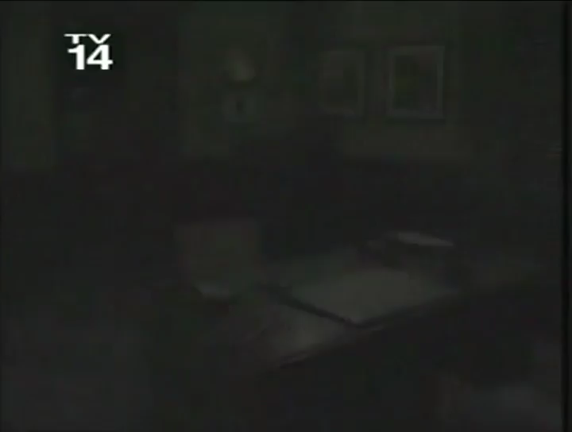
Providing Care

Slide 60
The Spirit of Motivational Interviewing
60
Partnership - Collaboration
Acceptance - Note that acceptance in the context of MI does not mean that you are agreeing with the patient.
Compassion - A deliberate commitment to pursue the welfare and best interest of the other
Evocation - A strengths-based perspective

Slide 61
Underlying Assumptions
61
Acceptance - demonstrate autonomy and client choice
Elicit versus Impart - work with the patient’s perception or ideas about change rather than directing that process
Ambivalence is a normal part of change

Slide 62
Underlying Assumptions
62
Avoid the righting reflex!
Remember that someone who is ambivalent to change, if pressed with advice, will gravitate toward the negative side of their ambivalence.

Slide 63
Brief Intervention and
Essential Motivational
Interviewing Skills

Slide 64
The MI shift
From feeling responsible for changing the patient’s behavior to supporting them in thinking and talking about their own reasons and means for behavior change.

Slide 65

OARS
Open-ended Questions
Affirmations
Reflective Listening
Summaries

Slide 66
Open-ended Questions
What do these convey, and can we turn closed-ended questions into an open-ended ones?
Do you feel depressed or anxious?
Do you like to smoke marijuana?
So, you are here because you are concerned about alcohol, correct?
Do you agree it would be a good idea for you to go to treatment?
When do you plan to quit drinking?

Slide 67
Affirmations
“You’ve persevered through many tough times.”
“You have gained a lot of knowledge and experience in your past attempts to stop drinking.”

Slide 68
Reflections
Reflections are statements; not questions.
Good reflections seek understanding.
Simple reflections simply repeat in the same words or paraphrase what the speaker has actually said.

Slide 69
Simple Reflection
Patient: I had a really hard time sticking to my abstinence goal this week.
Practitioner: It was difficult for you to stick to your abstinence goal

Slide 70
Change Talk vs Sustain Talk
Change Talk - reasons, desires, and commitment to change
Sustain Talk - reasons, desires, and commitment to stay the same
Let’s take a closer look!

Slide 71
Some Ways to Elicit Change Talk
Ask Evocative Questions
Use the Change Rulers
Look Back
Look Forward
Explore Goals and Values

Slide 72
‘Readiness’ Ruler
Importance, Confidence, Readiness
On a scale of 1-10 how important is it for you to make a change in your drinking or substance use?
If client says a 6, you would ask, “Why not a 4?”
0 1 2 3 4 5 6 7 8 9 10
READINESS
Miller, W. R., & Rollnick, S. (2013, p.175). Motivational Interviewing: Helping People Change, 3rd Edition (3rd ed.). The Guilford Press.
Notes:
.

Slide 73
Change Talk
Is client speech that favors movement in the direction of change.
Is by definition linked to a particular behavior change goal.
Is expressed in present or future tense, not past tense.

Slide 74
Sustain Talk
Desire, ability, reason, or need to continue the targeted behavior:
  Look, I don’t have a drinking problem.
  My dad was an alcoholic; I’m not like him.
  I can quit anytime I want to.
  I just like the taste.
  That’s all there is to do in my town!

Slide 75

Giving Feedback to Clients
Provide information in an MI-consistent manner
Elicit-Provide-Elicit (EPE)
  First ask for the client’s own perception (elicit)
  Provide your feedback (provide)
  Ask for the client’s response to feedback (elicit)

Slide 76
Video A
http://youtu.be/_VlvanBFkvI

Slide 77
Rate the BI
How would you rate this provider’s interviewing skills?
Imagine you are the patient...how might you feel?
Is this approach:
  Helpful?
  Harmful?
  Neutral?

Slide 78
Video B
http://youtu.be/67I6g1I7Zao

Slide 79
Brief Negotiated Interview (BNI)

Slide 80

What are the Goals of a BI?
The general goals of a BI are to:
  Educate
  Increase awareness
  Motivate
  Assist

Slide 81
What are the Goals of a BI? (continued)
The goals of a BI are fluid and are dependent on a variety of factors including:
  The patient’s screening score.
  The patient’s readiness to change.
  The patient’s specific needs.

Slide 82
What is Your Role?
Provide feedback
Offer information
Understand the patient’s viewpoints
Explore options
Assist in making new decisions
Support the patient
Give advice

Slide 83
Where Do I Start?
What you do depends on where the patient is in the process of changing.
The first step is to be able to identify where the patient is coming from.

Slide 84
Correlating SU with Client Goals
What is the patient seeking to access through your agency?
What substances are commonly used among your client population?
How would the identified substance use affect the patient’s ability to benefit from the service they are seeking?

Slide 85

Brief Negotiated Interview
Build Rapport
Pros and Cons
Information and Feedback
Readiness Ruler
Action Plan

Slide 86
1. Build Rapport
Set up a safe environment
Introduce yourself and address patient by name
Show an interest in understanding the patient’s point of view
Use reflective listening
Your attitude and demeanor may increase the likelihood that the patient will be honest

Slide 87
2. Ask About Pros & Cons
  Ask the patient to put his/her hands out as if you were going to drop something in each hand.
  Then ask the patient to mentally drop into the right hand the “good” things about drinking; and into the left the things that aren’t so good about drinking.
  Summarize for the patient and ask which hand feels heavier.
  Use the discussion to underscore the patient’s ambivalence.

Slide 88
3. Information and Feedback
Ask permission
Range of scores and context
Screening results
Interpretation of results (e.g., risk level)
Substance use norms in population
Link to physical or mental health problems reported
Patient feedback about results: Elicit a response
Emphasize that you are providing this information to enhance patient choice

Slide 89
4. Readiness to Change
Importance / Confidence / Readiness
On a scale of 1-10 how important might it be that you make a change in your drinking, substance use? ….If client says a 8 you would ask, “Why not a 6 or a 5?”
Reflective listening
On a scale of 1-10 how confident are you that you can make a change in your drinking, substance use? .…If client says a 5...what might you would say?
1 2 3 4 5 6 7 8 9 10

Slide 90
5. Action Plan
Create an action plan and identifying steps.
Help the patient identify strengths and supports.
Write down the action plan and give it to the patient.
Make referrals as appropriate.
Close the session by thanking the patient.

Slide 91

Putting it all Together
Build Rapport
Ask about Pros and Cons
Give Feedback and Information
Assess Readiness to Change
Develop an Action Plan

Slide 92
Chris
You are a 40 year old divorced parent of 2 boys, age 9 and 7. You have your own catering business, which is struggling. You have high blood pressure, feel stressed and have bouts of depression from time to time. You are mostly a beer drinker, but occasionally add hard liquor to the mix. You find that drinking is both a social activity and a stress reducer.
However, it has had some negative effects on your work and your relationship with your sons and your ex. You have driven after drinking on more than one occasion but have never been arrested for DUI. Your doctor is concerned about your stress and how it is affecting your blood pressure, so he recommended some counseling to address your stress and depression.

Slide 93
SBIRT Brief Intervention
Build Rapport – Can you tell me about an average day when you do drink or use _________? (summarize)
Pros and Cons – If you don’t mind, what do you like about __________? (summarize). What are the not-so-good things about _________? (summarize)
Give Info/Feedback – Well, I have some information about _________, would you mind if I share it with you? (Connect how the substance use can affect their health and their goals). Then ask the client what they think of what you just shared with them.
Readiness Ruler – On a scale of 1 to 10, how important is it, for you to do something to reduce the amount of alcohol or _________ that you use?
Action Plan – Would you mind if I write this down and check in with you about it the next time I see you?

Slide 94
Referral to Treatment
(Referral for Further Assessment)

Slide 95

Patients Screened in Primary Care
Evidence indicates that approximately 5% of patients screened will require a referral to either brief treatment or specialty treatment.

Slide 96

What Is Treatment?
Treatment may include:
Counseling and other psychosocial rehabilitation services
Medications
Complementary wellness (diet, exercise, meditation)
Combinations of the above
An addition to treatment can be linkage to peer support groups (AA, NA) or other services.

Slide 97

Treatment Can Include…
Provided within levels of care often available in multiple treatment settings.
Level of care is determined by severity of illness.
Inpatient treatment is reserved for those with more serious illness (imminent threat to self or others, comorbidity).

Slide 98
Levels of Care in NYS
Outpatient/Intensive Outpatient
Inpatient (“rehab”)
Medication for Opioid Use Disorder (OUD) or Alcohol Use Disorder (AUD)

Slide 99
Levels of Care in NYS - continued
Crisis/Detoxification: Three Levels
Recovery support (peer services, housing supports, case management)
Residential (stabilization, reintegration, rehabilitation)

Slide 100
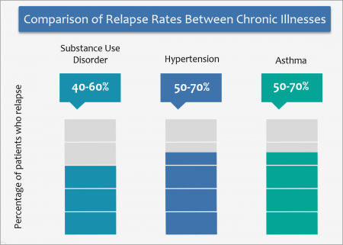
Recurrence Rates Similar to Other Chronic Illnesses
Evidence-based treatment is essential for the treatment of a chronic, recurring condition such as addiction.
Overdose Lifeline, About Addiction/Substance Use Disorder, https://www.overdoselifeline.org/news/about-addiction/

Slide 101

Wait Times
Up to 50% of patients with a serious alcohol or substance use problem will not show up for a first appointment if put on a waiting list
Longer wait time = Greater attrition

Slide 102
Making Successful Referrals
Many patients can be successfully treated in outpatient unless there are other risk factors.
How you broach and discuss referral contributes to his/her likelihood of successful uptake of treatment.
Make the patient aware of the range of options/levels of care.

Slide 103
What Is a Warm-Handoff Referral?
The “warm-handoff referral” is the action by which the clinician directly introduces the patient to the treatment provider at the time of the patient’s medical visit

Slide 104
Providing a Referral to Treatment
List of treatment facilities
Familiarity with levels of care
Know treatment referral criteria
Schedule appointment immediately
Warm hand-off
Follow up

Slide 105
Common Mistakes To Avoid
Rushing into “action”
Referring to a program that is full or does not take the patient’s insurance
Not knowing your referral base
Not considering pharmacotherapy in support of treatment and recovery
Seeing the patient as “resistant” or “self-sabotaging”

Slide 106

Summary
Treatment works.
With a minimal amount of preparation, you can know what is available in your community.
Clarify your procedures for referral.
Warm handoffs work best.
Follow up.

Slide 107
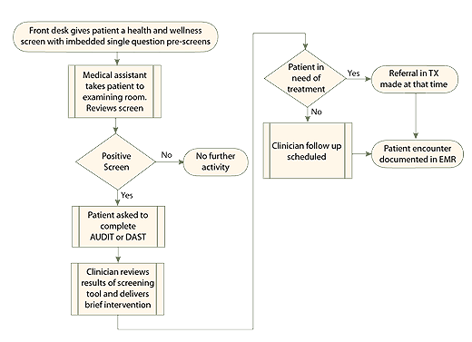
SBIRT in a Practice Setting

Slide 108
Referral Resources
NYS OASAS Treatment Availability Dashboard: https://findaddictiontreatment.ny.gov/
NYS OASAS Complete Treatment Provider Directory:
https://apps.oasas.ny.gov/reports_doc/TreatmentDirectory.pdf
SAMHSA’s Behavioral Health Treatment Services Locator: https://findtreatment.samhsa.gov/

Slide 109
Certificate of Completion
At the end of the session, you will complete an online evaluation prior to closing and going offline (instructions to follow).
Certificates will be sent out within a week or so along with a copy of the slides.
This webinar is approved for 6 hours of CASAC, CPP, CPS credentialing.
You must attend the entire session.

Slide 110
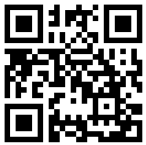

Contact and Survey
Diana Padilla
Research Project Manager
SBIRT Technical Assistance
Diana.Padilla@nyspi.columbia.edu
Clyde Frederick
Technologist
NeC-ATTC Program Support
Clyde.Frederick@nyspi.columbia.edu
Division on Substance Use Disorders / New York State Psychiatric Institute
Department of Psychiatry / Columbia University Medical Center
ATTCnetwork.org/northeastcaribbean
If you are sharing a computer with others, please type your names in the chat box.
Please fill out your evaluation forms – it will only take a couple of minutes! Just scan the code with the camera on your smart phone, click on the link in the chat box, or type the link into your browser: https://ttc-gpra.org/P?s=231363
Don’t worry if you can’t – an email with the link will be sent to you tomorrow, along with a copy of the slides.
Certificates will be sent within a week.

