Slide 1
Workforce Development Series The Application of the 4 E's using the Strategic Prevention Framework
Monday, March 27, 2023
Presented by Carlton Hall & Dorothy Cheney

Slide 2
Disclaimer
This training is 100% supported SAMHSA of the U.S. Department of Health and Human Services (HHS).
The contents are those of the author(s) and do not necessarily represent the official views of, nor an endorsement, by SAMHSA/HHS, or the U.S. Government.

Slide 3
Notes:
We welcome & celebrate our diverse community of professionals.
We strive to create an inclusive atmosphere that respects the broad spectrum of identities and backgrounds of all Retrievers.
Inclusivity begins with our language and the words we choose to use.
To that end, the PTTC Network uses affirming language to bring everyone into the conversation.

Slide 4
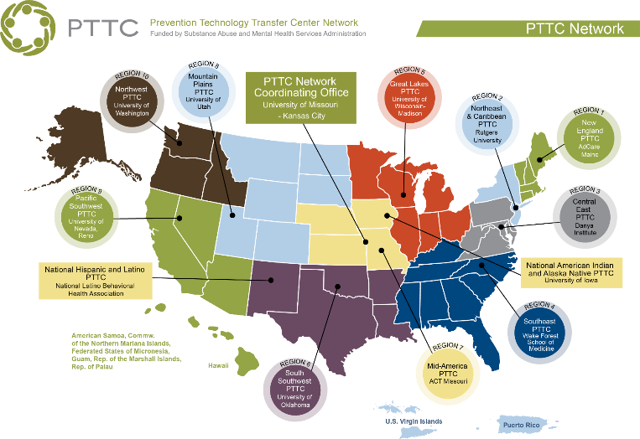
Co-Directors
Kimberly Wagoner, DrPH, MPH
and Mark Wolfson, PhD
Notes:
SE PTTC 8 states Established in 2018 SAMHSA,
10 Domestic Reg Centers.
2 National Centers (National Hispanic/Latino CTr & Native Amer/Alaska Native)
-improve implementation and delivery of effective SA prevention interventions
provide training and TA to the substance abuse prevention field

Slide 5
Develop training and technical assistance tools, products, and services for the substance misuse prevention field
Disseminate these across the southeast region
Improve implementation & delivery of effective substance misuse prevention interventions
Reduce substance misuse
Notes:
.

Slide 6
Housekeeping
Webinar Recording
available in 2-3 days on our page
After the webinar:
Complete the
Evaluation Form
A download of the Certificate of Attendance
to gain access to

Slide 7
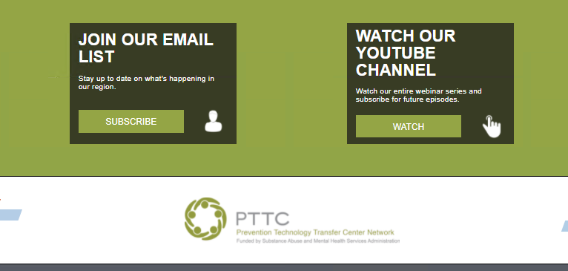
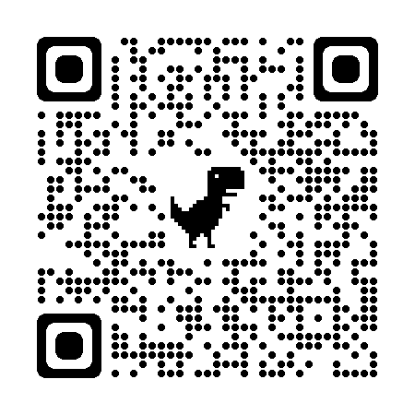
Bottom of our main webpage
pttcnetwork.org/southeast
Sign up for our newsletter here!
TONS of great trainings to share/watch with your coalition members

Slide 8
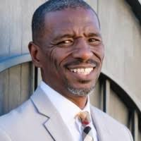
Today’s Presenters
Carlton Hall
Dorothy Chaney
Notes:
Dorothy Chaney is the Founder of Wisconsin Community Health Alliance, an organization committed to supporting coalitions, agencies, and individuals to improve the health of their communities and the environments in which they live. Dorothy is committed to equity in community health and works with communities both nationally and internationally to address health disparities and support the development of local solutions to complex problems. For more than 20 years, Dorothy has worked with community-based coalitions to address the impact of substance use on youth and families. Dorothy has also served on many state level work groups and advisory committees in Wisconsin. Chaney also works with communities to implement collective impact approaches to improve community health.
Carlton Hall is the President and CEO of Carlton Hall Consulting LLC (CHC), a multi-faceted, full-service consulting firm designed to provide customized solutions and enable measurable change for communities, organizations, families, and individuals. Carlton Hall has been providing intensive substance abuse prevention focused and community problem solving services to the nation for the last 25 years. Currently, Carlton and the CHC team provide executive training and technical assistance support to the Southeast PTTC (Region 4)

Slide 9
SE PTTC SAMHSA 4E’s Learning Lab
Learning Laboratory – Session #2 – March 27, 2023

Slide 10
Our partners

Slide 11
Introductions
What is your name?
What is your nickname?
What organization do you work for?
What is your favorite E?
Enter all 4 items … then press enter

Slide 12
SAMHSA 4E’s - Learning Laboratory
Session #1
March 3, 2023
Session 1: Understanding the 4E’s
SAMHSA Overview of the 4E’s
Introduction to the 4E’s
Discussion – Breakout
Application – Breakout
Next Steps

Slide 13
SAMHSA 4E’s - Learning Laboratory
Session #2
March 27, 2023
Session 2: Application of the 4E’s Using the SPF
Intersection of the 4E’s and the SPF
Discussion - Breakout
Applying the 4E’s in the SPF
Next Steps and Evaluation

Slide 14
Session 2 Objectives
Participants will be able to:
Describe how the 4 E’s intersects with the SPF
Provide insights into how the 4 E’s can be operationalized within the SPF
Network with others about applying the 4E’s

Slide 15
Modern and Comprehensive Prevention System (4Es)
Modern and Comprehensive Prevention System (4Es)
Early Action
Easy Access
Create and sustain barrier-free access to prevention resources and services.
Act early in the risk trajectory across the lifespan and along the continuum of care.
SUD
Prevention
System
Develop and support opportunities for everyone to achieve optimal health.
Deliver resources and services responsive to local needs and based on comprehensive data.
Equitable Opportunities
Effective Delivery
15
Notes:
Here’s the SAMHSA context for prevention.
A comprehensive system relies on early action, easy access, effective delivery, and equitable opportunities.
These are the critical elements needed to deliver prevention programming at the local, state, and national levels.
Sound policy implementation in all four areas is critical to our success.
This is a refresh of how we talk about prevention, what it means, why it matters, and why everyone, old and new partners, are needed to ensure prevention is reaching and benefiting everyone.
Our primary goal is to support states, tribes, and jurisdictions in their efforts to institutionalize comprehensive SUD prevention systems, which are responsive to and reflective of the communities being served.
A comprehensive prevention system relies on early action, easy access, effective delivery, and equitable opportunities. SAMHSA/CSAP refers to these four elements as the four Es as necessary for effective prevention service delivery.
The 4E’s encompass our North Star of what an ideal prevention system could be.
Regardless of the level you work at – national, state, tribal, jurisdictional, or community – addressing all 4Es helps us deliver effective prevention services to our communities.

Slide 16
Let’s Review Highlights of Session One

Slide 17
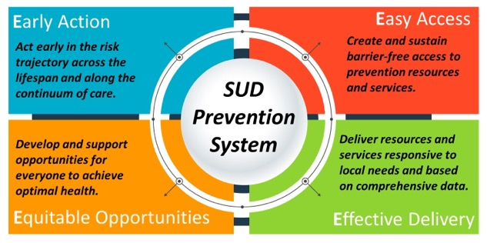
The 4E’s
Early Action
Easy Access
Equitable Opportunities
Effective Delivery
17

Slide 18
Early Action
Act early in the risk trajectory across the lifespan and along the continuum of care.
18

Slide 19
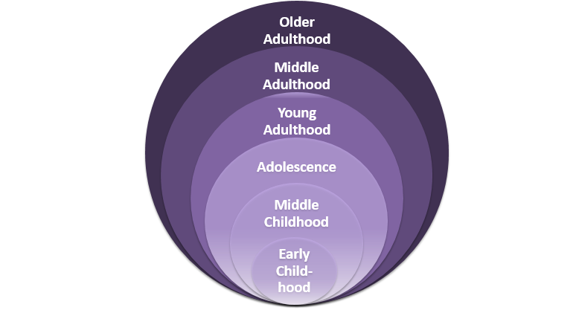
Developmental Perspective - Lifespan
Source: SAMHSA SAPST Training

Slide 20
https://nida.nih.gov/sites/default/files/early_childhood_prevention_march_2016_508.pdf

Slide 21
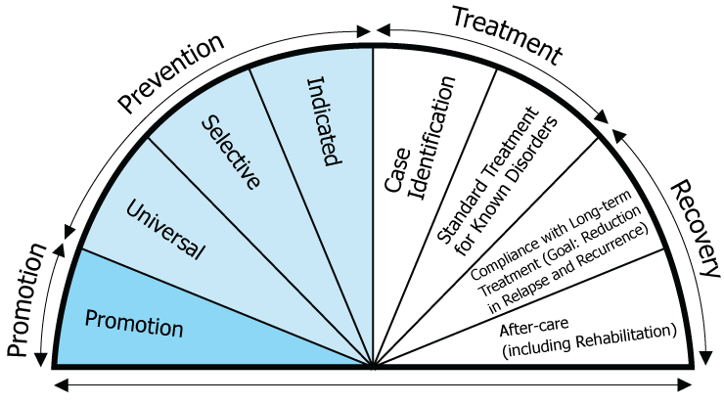
Continuum of Care
Source: National Research Council and Institute of Medicine. (2009). Preventing Mental, Emotional, and Behavioral Disorders Among Young People: Progress and Possibilities

Slide 22
Early Action
Older Adults think it is safe to mix alcohol and Rx
Residents in assisted living facilities attend happy hours and then return to their apartment and take their Rx

Slide 23
Easy Access
Create and sustain barrier-free access to prevention resources and services
23

Slide 24
Easy Access
Barriers to access can include:
Cost
Transportation
Language
Culture
Time and Location
Childcare
Opportunity cost
24

Slide 25
Working with the community to ensure prevention materials for a community event
are translated into languages spoken in the community and are culturally appropriate

Slide 26
Equitable Opportunities
Develop and support opportunities for everyone to achieve optimal health.
26

Slide 27
Equitable Opportunities
Ensuring equitable opportunities can include:
Partnering with organizations representing “hard-to-reach” populations and/or populations experiencing health disparities
Involving participants in planning and delivery of the program
Addressing the social determinants of health
27

Slide 28
Nothing About Us Without Us…

Slide 29
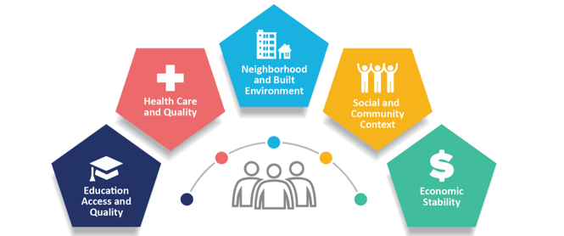
How do we ensure that we
Involve participants in planning and delivery of the program
Address the social determinants of health
Do we have policies in place?

Slide 30
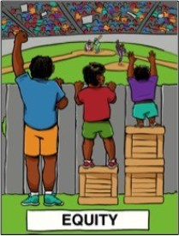
Considerations For Equitable Engagement
“Most policies are facially neutral (race silent) but not racially neutral—they can have negative or positive racial impacts.
Negative racial impacts may or may not have been intentional. Positive racial impacts often require intentionality.
When racial impacts are not consciously considered during the lawmaking/decision-making process, there is more likelihood that negative racial impacts will result-- implicit bias is the default.” - Race Forward
http://grenetwork.org/wp/wp-content/uploads/2014/04/An-Introduction-to-Racial-EquityAssessment-Tools.pdf

Slide 31
QUESTIONS FOR ADVANCING EQUITY AND INCLUSION
“1. Where are the decision-making points that affect outcomes?
2. What decisions/actions may be reinforcing the status quo, implicit bias and current inequities?
3. What alternative action options could produce different outcomes?
4. Which action will best advance equity and inclusion?
5. What reminders, supports and accountability systems can be structured into routine practices to keep equity as a high priority?” - Race Forward
http://grenetwork.org/wp/wp-content/uploads/2014/04/An-Introduction-to-Racial-EquityAssessment-Tools.pdf

Slide 32
Effective Delivery
Deliver resources and services responsive to local needs and based on comprehensive data.
32

Slide 33
Effective Delivery
Ensuring effective delivery requires that programs, services and strategies must:
Respond to local needs
Be data driven
Be delivered in a culturally competent manner
Be strength-based and trauma-informed
33

Slide 34
Respond to local needs
Be data driven
Be delivered in a culturally competent manner
Be strength-based and trauma-informed

Slide 35
Session #1
What was significant to you?
What questions do you have?
What comments to you have?
35

Slide 36
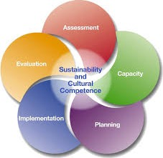
The Strategic Prevention Framework (SPF)

Slide 37
The Strategic Prevention Framework
The SPF includes these five steps:
1 . Assessment
2 . Capacity
3 . Planning
4 . Implementation
5 . Evaluation
The SPF is guided by two principles that should be integrated into each of the steps:
Cultural competence
Sustainability
Source: https://www.samhsa.gov/sites/default/files/20190620-samhsa-strategic-prevention-framework-guide.pdf

Slide 38
The Intersection
The 4E’s can be applied to each element of the SPF.

Slide 39
Assessment

Slide 40
The Intersection - Poll
Which of the 4E’s is most easily applied to assessment?
Early Action?
Easy Access?
Equitable Opportunities?
Effective Delivery?
.

Slide 41
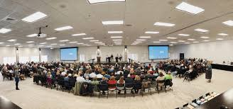
Capacity

Slide 42
The Intersection - Poll
Which of the 4E’s is most easily applied to capacity?
Early Action?
Easy Access?
Equitable Opportunities?
Effective Delivery?
.

Slide 43
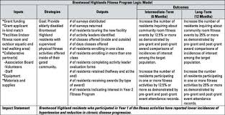
Planning

Slide 44
The Intersection - Poll
Which of the 4E’s is most easily applied to planning?
Early Action?
Easy Access?
Equitable Opportunities?
Effective Delivery?
.

Slide 45
Implementation

Slide 46
The Intersection - Poll
Which of the 4E’s is most easily applied to implementation?
Early Action?
Easy Access?
Equitable Opportunities?
Effective Delivery?
.

Slide 47
Evaluation

Slide 48
The Intersection - Poll
Which of the 4E’s is most easily applied to evaluation?
Early Action?
Easy Access?
Equitable Opportunities?
Effective Delivery?
.

Slide 49
Cultural Competence
Cultural competence principles:
Include the target population in prevention planning
Use a population-based definition of community
Stress using relevant, culturally appropriate prevention approaches
Employ culturally competent evaluators
Promote competence among program staff, who reflect the community

Slide 50
The Intersection - Discussion
How can we apply the 4E’s to cultural competence?
Early Action?
Easy Access?
Equitable Opportunities?
Effective Delivery?
.

Slide 51
Sustainability
Sustainability includes:
On-going community collaboration
Community “ownership” of the prevention efforts
Demonstrating change and positive outcomes in the community
Long-term community commitment of resources

Slide 52
The Intersection - Discussion
How can the 4E’s support sustainability?
Early Action?
Easy Access?
Equitable Opportunities?
Effective Delivery?
.

Slide 53
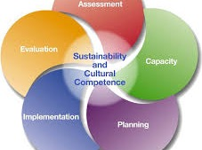
Applying the 4E’s to your organization’s work with the SPF

Slide 54
The Intersection - Poll
Which of the 4E’s will be most easily applied in your work?
Early Action?
Easy Access?
Equitable Opportunities?
Effective Delivery?
.

Slide 55
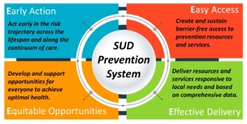
Discussion - Application
How can you could apply the 4E’s to your organization’s work with the SPF?
Identify opportunities and challenges.

Slide 56
Next Steps Breakout #2
56

Slide 57
Next Steps
What key concepts will you share within your organization and among your community partners?
What additional information / training / support would be helpful in using the 4E’s to guide your work?

Slide 58
Evaluation
Enter link or QR code here.

Slide 59
THANK YOU!
Presentation by CHC LLC ©2023 All Rights Reserved
59

Slide 60
PTTCnetwork.org/southeast
southeast@PTTCnetwork.org
https://lp.constantcontactpages.com/su/OaIT5aj/SignUp

