Slide 1

Preventing the Spread of Stigma: Changing Attitudes and the Terminology We use Regarding Substance Use Disorders. - Part 1
September 10, 2019 10:00 AM CST
Phillip Barbour, Master Trainer, Center for Health and Justice at TASC
Chuck Klevgaard, CSPS, Prevention Manager (PTTC)
Notes:
This 90 minute webinar will define stigma for prevention practitioners and the various levels as which it can occur. The webinar will address common myths associated with substance use disorder that can perpetuate stigma for this population and address changes in terminology and attitude that can emphasize "person-first" rather than the de-humanization of this population.

Slide 2
Lobby Poll
I am interested in stigma because I believe:
(Check all that apply)
Words matter
Prevention professionals can make a difference
The opioid crisis has created even more reasons to work on stigma
All the above

Slide 3

Presenter
Phillip Barbour has worked in the field of substance abuse counseling since 1990, beginning his career in the field as a counselor in a methadone clinic on the west side of Chicago. He joined Treatment Alternatives for Safe Communities (TASC) in 1991, and has worked in a number of the agency’s criminal justice programs.
Mr. Barbour has provided training throughout the United States on numerous topics, including clinical supervision, stigma reduction, motivational interviewing, and many other related subjects.
Phillip Barbour
Master Trainer, Center for Health and Justice at TASC
Notes:
Phillip Barbour has worked in the field of substance abuse counseling since 1990, beginning his career in the field as a counselor in a methadone clinic on the west side of Chicago. He joined Treatment Alternatives for Safe Communities (TASC) in 1991, and has worked in a number of the agency’s criminal justice programs, including several years as an administrator with TASC’s Corrections Transition Programs. Mr. Barbour has provided training throughout the United States on numerous topics, including clinical supervision, reentry management, criminal thinking, motivational interviewing, and many other related subjects. Mr. Barbour’s expertise is shaped not only by his professional experiences, but also by the fact that he once came through the treatment and criminal justice systems which he now helps to improve.
This 90 minute webinar will define stigma for prevention practitioners and the various levels as which it can occur. The webinar will address common myths associated with substance use disorder that can perpetuate stigma for this population and address changes in terminology and attitude that can emphasize "person-first" rather than the de-humanization of this population.

Slide 4

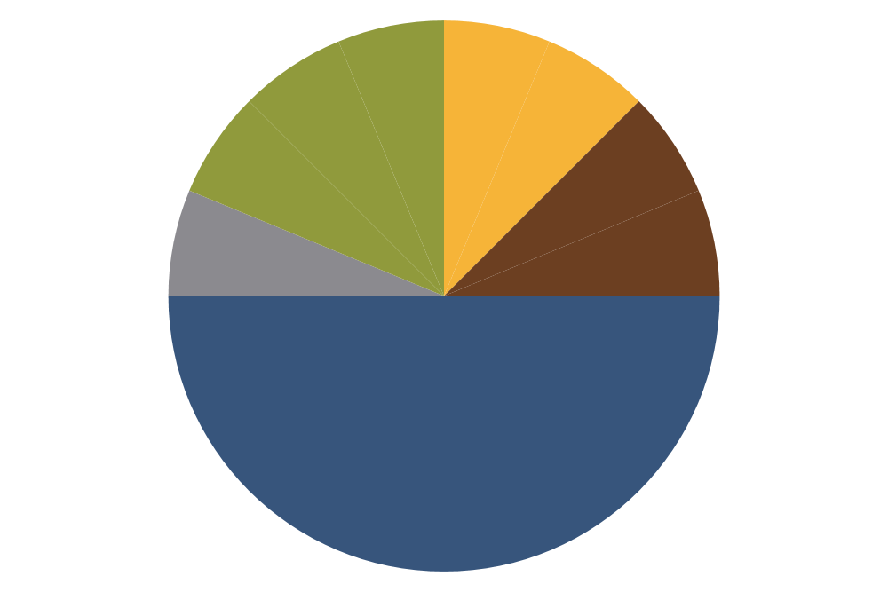


IOM Continuum
Treatment
Prevention
Recovery
Indicated
Case Identification
Maintenance
Selective
Standard Treatment
Promotion
Universal
Long-Term Treatment
Promotion
After-care and Rehabilitation
Promotion

Slide 5
Presentation Summary
This 90 minute webinar will define stigma for prevention practitioners and the various levels as which it can occur. The webinar will address common myths associated with substance use disorder that can perpetuate stigma for this population and address changes in terminology and attitude that can emphasize the "person-first" rather than de-humanization of this population.

Slide 6
Learning Objectives
Define stigma in general and what it looks like in the world of SUD and MH.
Explore some facts and myths about SUD and treatment
How to combat stigma
Language strategies that can reduce stigma

Slide 7
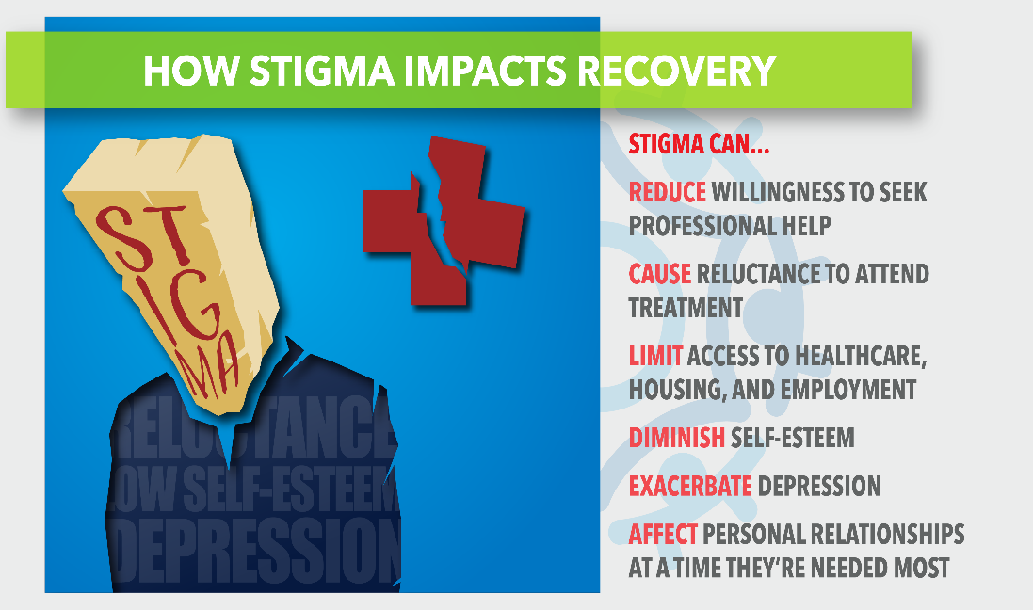



Definition of Stigma

Slide 8
Stigma Defined: Merriam-Webster
“a set of negative and often unfair beliefs that a society or group of people have about something.”
“is a mark of disgrace that sets a person apart from others. When a person is labelled by their illness they are no longer seen as an individual but as part of a stereotyped group.”
“The definition of a stigma is something that takes away from one's character or reputation.”

Slide 9
Stigma
Definition
Stereotype-ideas
Prejudice-beliefs
Discrimination-actions
Types
Self
Public
Structural
Other Examples?

Slide 10

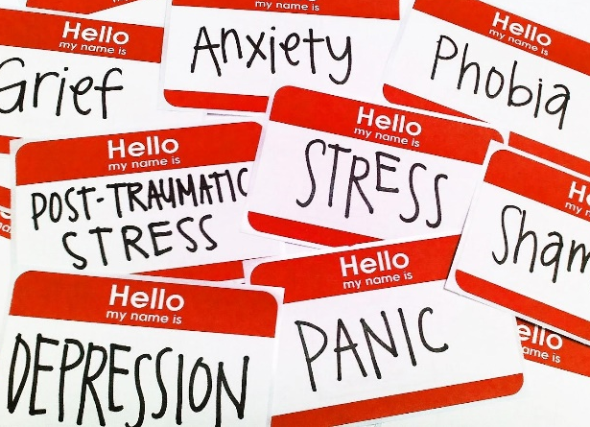
The Impact of Stigma on SUD & Mental Health

Slide 11
Expressed Concern
Did you get no sleep last night?
You’re so distant.
Why are you leaving so early ?
Why are you so depressed ?
I’M JUST REALLY TIRED
You can talk to me…
You look so out of it
You look awful
You sound down.
Cheer up dude !
What’s wrong with you today?
Tell me, what’s the matter ?
Notes:
It may start out as someone being concerned. But for the person suffering it may seem as though they are being singled out or attacked for some reason.

Slide 12
Thoughts
Leadership might treat me differently.
Getting help could harm my career.
I will be seen as weak.

Slide 13

Labels

Slide 14
HOW STIGMA IMPACTS RECOVERY
STIGMA CAN…
REDUCE willingness to seek professional help
CAUSE reluctance to attend treatment
LIMIT access to healthcare. Housing, and employment
DIMINISH self-esteem
AFFECT personal relationships at a time they are needed most

Slide 15
What We Know About Addiction
Addiction is a chronic disease characterized by drug seeking and use that is compulsive, or difficult to control, despite harmful consequences.
SUD is a disease not a choice (some still don’t believe that)
SUD is treatable.
It's common for a person to relapse, but relapse doesn't mean that treatment doesn’t work.
Source: National Institute on Drug Abuse, Understanding Drug Use and Addiction https://www.drugabuse.gov/publications/drugfacts/understanding-drug-use-addiction
Notes:
NIDA.org
https://www.drugabuse.gov/publications/drugfacts/understanding-drug-use-addiction

Slide 16


Facts and Myths About
Drug Addiction
MYTHS
FACTS
Ten Popular Myths About Drugs, Addiction, and Recovery, Wednesday, November 10th, 2010 https://www.phoenixhouse.org/news-and-views/our-perspectives/ten-popular-myths-drugs-addiction-recovery/
Notes:
Ten Popular Myths About Drugs, Addiction, and Recovery
Deni Carise, Ph.D.
Chief Clinical Officer, Phoenix House
https://www.phoenixhouse.org/news-and-views/our-perspectives/ten-popular-myths-drugs-addiction-recovery/

Slide 17

Myth #1: If it’s a prescription, it must be safe; you can’t get addicted to something your doctor prescribes.
MYTH
FACT
FACT: Although many medications are perfectly safe if taken in the prescribed dosage for a short period of time, prolonged use can be dangerous—and, yes, addictive.
Notes:
Some prescription drugs are especially hazardous if the user exceeds the prescribed dosage or takes a combination of drugs.
Ten Popular Myths About Drugs, Addiction, and Recovery
Deni Carise, Ph.D.
Chief Clinical Officer, Phoenix House
https://www.phoenixhouse.org/news-and-views/our-perspectives/ten-popular-myths-drugs-addiction-recovery/

Slide 18
Myth #2: “Natural” drugs are safer than synthetic ones.
MYTH
FACT: Marijuana, mushrooms and other “natural” highs still alter brain chemistry and produce dangerous side effects. They aren’t harmless just because they grow in the ground.
FACT
Notes:
Ten Popular Myths About Drugs, Addiction, and Recovery
Deni Carise, Ph.D.
Chief Clinical Officer, Phoenix House
https://www.phoenixhouse.org/news-and-views/our-perspectives/ten-popular-myths-drugs-addiction-recovery/

Slide 19
Myth #3: The heroin era (or the crack crisis, the age of ecstasy, etc.) is over.
MYTH
FACT: Drugs don’t just go away. Although certain drug trends become more popular and available and then seem to diminish in popularity over time, a drug doesn’t pose a lesser threat to you – or your kids – simply because it is associated with the culture of a previous decade.
FACT
Notes:
It’s also a regional thing, some drug are more readily available is some places.
Ten Popular Myths About Drugs, Addiction, and Recovery
Deni Carise, Ph.D.
Chief Clinical Officer, Phoenix House
https://www.phoenixhouse.org/news-and-views/our-perspectives/ten-popular-myths-drugs-addiction-recovery/

Slide 20
Myth #4: If you have a high alcohol tolerance, you don’t have a drinking problem.
MYTH
FACT: If you feel nothing after several drinks, you DO have a problem. A casual drinker wouldn’t be able to finish a couple of six-packs—and if they did, they’d feel very sick. If you’re drinking this much and feeling fine, you need help.
FACT
Notes:
Ten Popular Myths About Drugs, Addiction, and Recovery
Deni Carise, Ph.D.
Chief Clinical Officer, Phoenix House
https://www.phoenixhouse.org/news-and-views/our-perspectives/ten-popular-myths-drugs-addiction-recovery/

Slide 21
Myth #5: If you have a stable job and family life, you’re not addicted.
MYTH
FACT: You may still have a job or career, a loving spouse and kids, and still have a drug or alcohol problem. Just ask any physician in recovery—many of them practiced for years without anyone recognizing their drug addiction.
FACT
Notes:
Holding down a job doesn’t mean you’re not addicted—it could mean that you have a tolerant spouse or boss, or you are in a career that puts up with excessive drug or alcohol use. Although you may still be treading water, you are risking everything, and rock bottom may not be far away.
Ten Popular Myths About Drugs, Addiction, and Recovery
Deni Carise, Ph.D.
Chief Clinical Officer, Phoenix House
https://www.phoenixhouse.org/news-and-views/our-perspectives/ten-popular-myths-drugs-addiction-recovery/

Slide 22
Myth #6: Drug addiction is a choice.
MYTH
FACT: Drug use is a choice, and prolonged use changes your body and brain chemistry. When that happens, the user no longer appears to have a choice—this is when use and misuse become addiction.
FACT
Notes:
Ten Popular Myths About Drugs, Addiction, and Recovery
Deni Carise, Ph.D.
Chief Clinical Officer, Phoenix House
https://www.phoenixhouse.org/news-and-views/our-perspectives/ten-popular-myths-drugs-addiction-recovery/

Slide 23
Myth #7: Detox is all you need. You aren’t addicted after you finish detox.
MYTH
FACT: Detox is difficult and it’s just the beginning. The new “ultra rapid detox” (where sedation is used) programs can be dangerous and even deadly.
FACT
Notes:
Detox is difficult and it’s just the beginning. The new “ultra rapid detox” programs can be dangerous and even deadly. Finally, detox is the first step towards recovery, but addiction is a chronic illness—like diabetes, asthma or hypertension, it needs to be managed throughout the lifespan. There is no cure.
Ten Popular Myths About Drugs, Addiction, and Recovery
Deni Carise, Ph.D.
Chief Clinical Officer, Phoenix House
https://www.phoenixhouse.org/news-and-views/our-perspectives/ten-popular-myths-drugs-addiction-recovery/

Slide 24
Myth #8: If someone in recovery uses drugs or alcohol again, they’ll be right back where they were when they first quit.
MYTH
FACT: This can be a self-fulfilling prophecy. If you believe that one drink will throw you back to “square one,” then it will. However, it is entirely possible to relapse, realize your mistake, and get right back in recovery.
FACT
Notes:
Ten Popular Myths About Drugs, Addiction, and Recovery
Deni Carise, Ph.D.
Chief Clinical Officer, Phoenix House
https://www.phoenixhouse.org/news-and-views/our-perspectives/ten-popular-myths-drugs-addiction-recovery/

Slide 25
Myth #9: You need to be religious in order to get sober.
MYTH
FACT: Sobriety doesn’t require you to believe in God or subscribe to any organized religion. It helps, however, if you believe in humanity, family, community, and the good aspects of yourself—beliefs that are greater and stronger than your own daily life with drugs.
FACT
Notes:
Ten Popular Myths About Drugs, Addiction, and Recovery
Deni Carise, Ph.D.
Chief Clinical Officer, Phoenix House
https://www.phoenixhouse.org/news-and-views/our-perspectives/ten-popular-myths-drugs-addiction-recovery/

Slide 26
Myth #10: Addicts are bad people.
MYTH
FACT: Addicts aren’t “bad” people trying to get “good,” they’re sick people trying to get well. They don’t belong to a particular race or exist only in certain parts of the country. They are proof that addiction doesn’t discriminate—but, thankfully, neither does recovery.
FACT
Notes:
They are lawyers, farmers, soldiers, mothers and grandfathers who struggle with drug dependence on a daily basis.
Ten Popular Myths About Drugs, Addiction, and Recovery
Deni Carise, Ph.D.
Chief Clinical Officer, Phoenix House
https://www.phoenixhouse.org/news-and-views/our-perspectives/ten-popular-myths-drugs-addiction-recovery/

Slide 27

Chat Question
Type in the chat
As prevention practitioners, we are in a unique position to reduce the stigma surrounding substance misuse.
Type in the chat box examples of how prevention practitioners address stigma where you work.

Slide 28

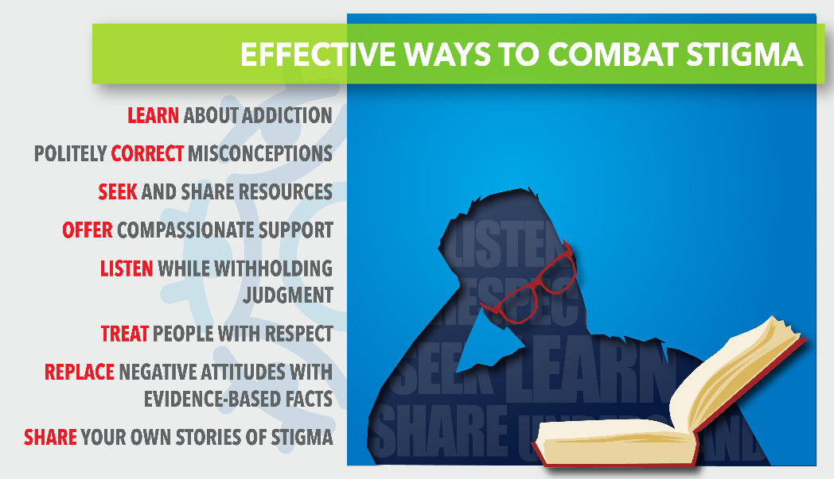


LANGUAGE MATTERS

Slide 29
TWO MAIN FACTORS
Two main factors affect the burden of stigma placed on a particular disease or disorder: perceived control that a person has over the condition and perceived fault in acquiring the condition.
Cancer = No fault
MH and or SUD = You’re at fault in some way
Notes:
Two main factors affect the burden of stigma placed on a particular disease or disorder: perceived control that a person has over the condition and perceived fault in acquiring the condition. When we believe a person has acquired their illness through no fault of their own, and/or that they have little control over it, we typically attach no stigma to either the person or the illness. Consider hard-to-treat cancers, for example. By contrast, many people mistakenly believe mental health conditions, including substance misuse disorders, are both within a person’s control and partially their fault. For these reasons, they frequently attach more stigmas to them.iii The potential for stigma is greater still when someone is using an illegal substance, which carries the additional perception of criminality.

Slide 30
SOCIETY TREATS PEOPLE WITH SUD DIFFERENT
Substance use disorder is among the most stigmatized conditions in the US and around the world
Health care providers treat patients who have substance use disorders differently
People with a substance use disorder who expect or experience stigma have poorer outcomes
Source: Words Matter, How Language Choice Can Reduce Stigma. https://preventionsolutions.edc.org/sites/default/files/attachments/Words-Matter-How-Language-Choice-Can-Reduce-Stigma_0.pdf
Notes:
Substance use disorder is among the most stigmatized conditions in the US and around the world. People do not want to work with, be related to, or even see people with a substance use disorder in public. Further, many believe that people with a substance use disorder can or should be denied housing, employment, social services, and health care.
▪ Health care providers treat patients who have substance use disorders differently. Clinicians have lower expectations for health outcomes for patients with substance use disorders; this in turn can affect whether the provider believes the patient is deserving of treatment. Some health care providers, falsely believing that substance use disorders are within a person’s control, cite feelings of frustration and resentment when treating patients with substance use disorders.
▪ People with a substance use disorder who expect or experience stigma have poorer outcomes. People who experience stigma are less likely to seek out treatment services and access those services. When they do, people who experience stigma are more likely to drop out of care earlier. Both of these factors compound and lead to worse outcomes overall.
As prevention practitioners, it is incumbent upon us to do what we can to reduce the burden of SUD stigma. An important first step is to examine—and, if needed, change—the language we use.

Slide 31
CHECKING YOURSELF: ARE YOU PERPETUATING SUD STIGMA?
Does the language you use shape how the public views SUD?
Does it perpetuate negative stereotypes?
When you talk about SUD are you making it about the person or the condition?
Notes:
The language practitioners use to talk about substance misuse shapes how the public views substance use disorders. Unintentionally stigmatizing language can perpetuate negative stereotypes about the types of people who are affected by substance misuse and can decrease public support for prevention and treatment programs. By contrast, language that supports pro-health activities, even if a person is actively using substances, can help decrease stigmas. For example, prevention messages that highlight the self-efficacy of people with SUDs to use naloxone to reverse opioid overdose frames them as PAGE 2 Developed under the Substance Abuse and Mental Health Services Administration’s Center for the Application of Prevention Technologies task

Slide 32
Language Does Matter
SAY THIS…
NOT THAT…
Substance Use Disorder
Person with a substance use disorder
Positive drug screen
Recurrence of use
In recovery, abstinent, in remission
Substance Abuse
Addict, substance abuser, junkie
Dirty drug test
Relapse, off the wagon
Clean, ex-addict
Notes:
1. DRAFT: Changing the Language of Addiction.” Office of National Drug Control Policy, 3 Nov 216.
2. Ferner, Matt. “Here’s One Simple Way We Can Change The Conversation About Drug Abuse.” The Huffington Post, 3 Mar 2015.

Slide 33
EFFECTIVE WAYS PREVENTION STAFF CAN WORK TO COMBAT STIGMA
LEARN about addiction
Politely CORRECT misperceptions
SEEK and share resources
OFFER compassionate support
TREAT people with respect
REPLACE negative attitudes with evidence-based facts
SHARE your own stories of stigma
Notes:
Ending Discrimination Against People with Mental and Substance Use Disorders: The Evidence for Stigma Change.
https://www.ncbi.nlm.nih.gov/books/NBK384914/

Slide 34


Questions

Slide 35
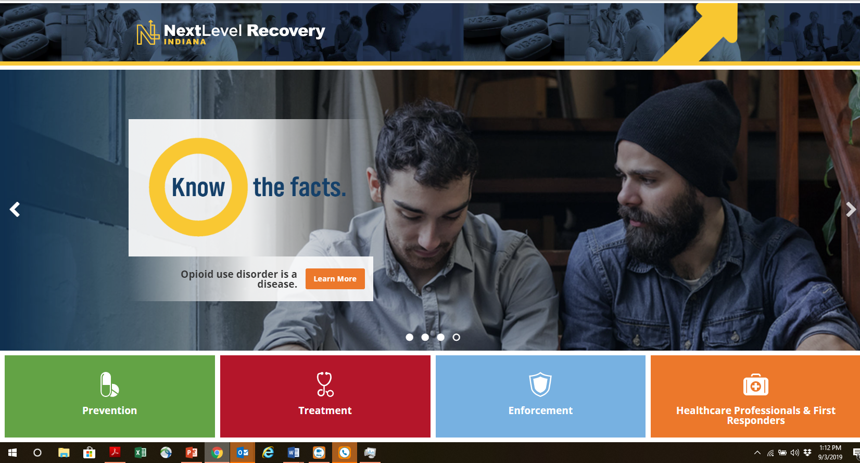
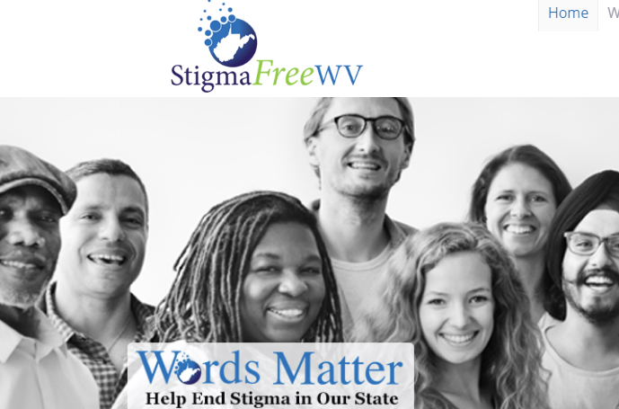
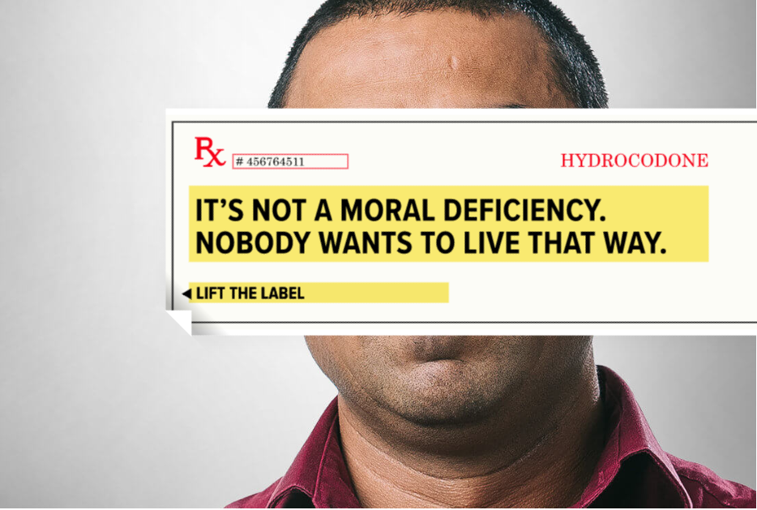

Preventing the Spread of Stigma: Examples of state-wide Stigma Campaigns Engaging Prevention
September 17, 2019 10:00 AM CST
Chuck Klevgaard, CSPS, Prevention Manager (PTTC)
Mark Loggins: Indiana Next Level Recovery Know the Facts
Jenny Lancaster: StigmaFree West Virginia
Elizabeth Owen: Colorado Lift the Label Public Awareness Campaign
Notes:
This 90 minute webinar will define stigma for prevention practitioners and the various levels as which it can occur. The webinar will address common myths associated with substance use disorder that can perpetuate stigma for this population and address changes in terminology and attitude that can emphasize "person-first" rather than the de-humanization of this population.

Slide 36
Resources
Words Matter, How Language Choice Can Reduce Stigma. https://preventionsolutions.edc.org/sites/default/files/attachments/Words-Matter-How-Language-Choice-Can-Reduce-Stigma_0.pdf
SAMHSA "Overcoming Stigma, Ending Discrimination" Resource Guide: https://www.samhsa.gov/sites/default/files/programs_campaigns/02._webcast_1_res ources-508.pdf
“Addictionary” glossary of non-stigmatizing terms: https://www.recoveryanswers.org/addiction-ary/

Slide 37

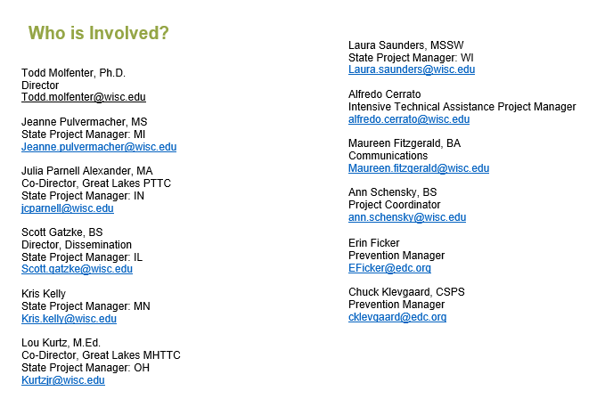
Great Lakes PTTC Staff

