Slide 1
This product was funded under a cooperative agreement from the Substance Abuse and Mental Health Services Administration (SAMHSA) (Grant Number: H79SP081015). All material, except that taken directly from copyrighted sources, is in the public domain and may be used and reprinted for training purposes without special permission. However, any content used should be attributed to the Pacific Southwest Prevention Technology Transfer Center.
Notes:
These slides can be used as a stand-alone overview or incorporated into other presentations or materials. Citing the Pacific Southwest PTTC as the author of these slides is greatly appreciated, noting that all content is derived from the various sources on this topic.
One note: The Institute of Medicine changed names and is now referred to as the National Academies of Sciences, Engineering, and Medicine in 2015. The National Academies of Sciences, Engineering, and Medicine are private, nonprofit institutions that provide expert advice on some of the most pressing challenges facing the nation and the world. https://www.nap.edu/content/about-the-national-academies-press

Slide 2
A Substance Misuse Prevention Practitioner’s Role in Reducing Stigma
Developed by the Pacific Southwest PTTC 2020
Notes:
Good afternoon/morning,
This presentation entitled A Substance Misuse Prevention Practitioner’s Role In Reducing Stigma was developed by the Pacific Southwest Prevention Technology Transfer Center. These slides can be used as a stand-alone overview of the varying levels of stigma or incorporated into other presentations or materials as relevant

Slide 3
Disclaimer
The views expressed in this presentation do not necessarily represent the views, policies, and positions of the Substance Abuse and Mental Health Services Administration or the U.S. Department of Health and Human Services.

Slide 4
Today’s Road Map
What is Stigma?
How Stigma Impacts Prevention?
Stigma: What Can We Do About It?
Notes:
Today we are discussing an important topic (Stigma) that influences the way we work, serve, and communicate with our clients, populations, colleagues, etc.
We will focus on the following topic areas today:
What is Stigma?
How stigma impacts our prevention work?
What can we do about it and how do we approach stigma as prevention practitioners?

Slide 5
Definition of Stigma¹
Stigma is a negative view based on an attribute and stereotype about a person or group.
Stigma describes a negative view, for example, of substance use disorder, depression, bipolar disorder, or people who have these illnesses. These negative views create prejudice which leads to negative actions and discrimination.
Notes:
For the purposes of this presentation to ensure we are all operating within the same framework, let’s take a look at the definition of stigma as defined by the National Academies of Sciences, Engineering, and Medicine.
As we take a closer look at this definition it is important to differentiate between the following words:
The word prejudice relates to the attitude that is amplified against a person or group whereas, discrimination is related to the behaviors motivated by such attitudes.

Slide 6
How Stigma Impacts Prevention
Notes:
Now that we have an understanding of what stigma is, we are now going to transition to exploring the various levels of stigma including Structural Stigma, Public Stigma, and Self Stigma and how they may inform and impact prevention.

Slide 7
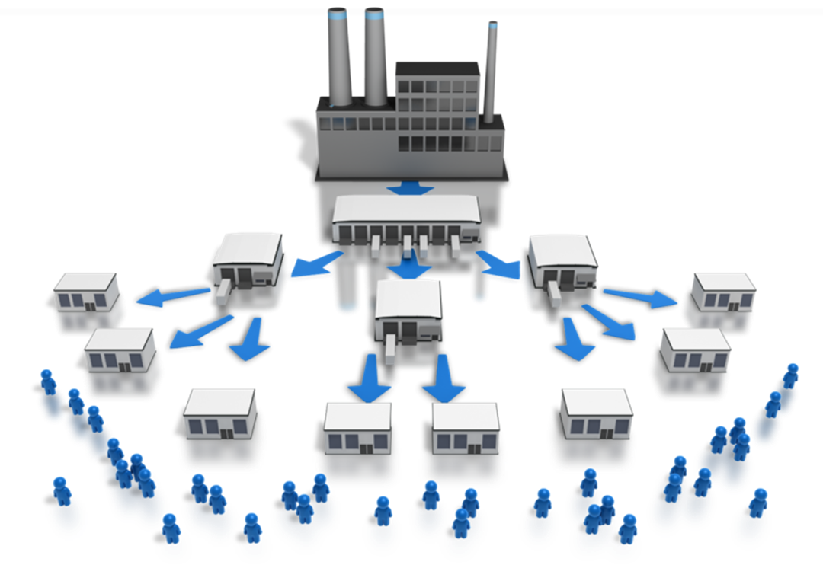
How Structural Stigma Impacts Prevention²
Saving People In the River:
Focus on Intervention and Treatment
Sense of urgency
Requires a lot of resources, capacity and energy
Thinking Upstream:
Which people seem to be the most at risk of falling in the river?
What is protecting those people that don’t fall in the river?
Notes:
Let’s first look at Structural Stigma.
How many of you have heard the public health fable about people in the river? This story is also often referred to as the Upstream Story. (tell the story briefly as illustrated below)
A man and a woman were fishing on the river bank when they saw a woman struggling in the current. They rescued her. Soon, they saw a man struggling. They rescued him, too. This continued all afternoon.
Finally, the exhausted pair decided to go upstream to find out where and why so many people were falling in. They discovered a beautiful overlook along the river’s edge without any warning signs or protective barriers. The couple went to community leaders to report the number of victims they had rescued and explain the connection to the unprotected overlook
Many of us have used this story to address the balance in public health and health care approaches that attend to fixing problems vs. identifying the root causes and seeking to prevent the problem at it’s source. This story can also help to illustrate some ways that structural stigma impacts our prevention work-those upstream efforts to address to build protection.
Community leaders agreed to install a protective guard and post warning signs. Preventing the problem saves resources, energy, and lives.
This parable shifts focus from downstream (individual treatment) to upstream (prevention strategies for the whole community.
Downstream-Chronic disease treatment—emergency services, pharmacology, surgery, and dialysis.
Mid-stream-Modifying individual behavior—physical activity, nutrition, tobacco use, maternal health, high school graduation, and violence control.
Upstream-Addressing social determinants of health—conditions in which people are born, grow, live, work, and play.
Stigma has significant impact on how people both access and then receive prevention, intervention and treatment services related to Substance Use Disorder.
It might be illustrated in this story by what people have the easiest access to being saved- are people north of the village more likely to be saved then those further down stream? Are some of the people perceived by the rescuers as “more savable” than others- perhaps due to their health or perceived strength or other factors. Often these decisions are made with good intention, “we can only save so many people, let’s save the ones that have the best chance.” Unfortunately, the decisions on who gets the intervention is not always based in evidence, but instead on perception. Over time these decisions become institutionalized and create structural stigma (and institutional racism) and related health disparities.
What are some of examples of structural stigma that impact your work?
(underserved communities, lack or unequal use of enforcement of policies/laws, discrimination in access to programs or resources)
Prevention is in a unique place to look at those risk and protective factors related to structural stigma and help to identify structural and systemic, evidence based prevention strategies to address them.

Slide 8
Addressing Structural Stigma⁷
Who do you seek to impact:
Interventions:
Legislators
Policy Makers
Employers
Health Care Providers
Criminal Justice
Professionals
Others?
Legal Strategies
Policy Strategies
Advocacy Strategies
Professional Education
Notes:
So what are some potential ways to address structural stigma?
Legislative and Policy Change/Strategies:
Requires an examination of the root cause of structural stigma and the related discrimination. For example, people with psychiatric disabilities may experience more problems with employment, housing, law enforcement, and education. Addressing the source of this can help: ex: mental health care visits in LGBTQ decreased after same-sex marriage was legalized in Massachusetts. Depression and anxiety decreased in low-income families when they received rental vouchers. In other words, mental health can improve when structural issues are addressed through legislation and policy.
This requires multi-disciplinary and multi-level ecological approach. Focusing only on education and attitude change might not bring as much of a reduction in stigma as addressing structural changes through legislation and policies to address underlying problems and/or discrimination. These are more likely to promote social equity and overall quality of life.
Advocacy/Protest:
Protest: a formal objection to negative representations of people with SUD
Can engage “fence sitters” and energize unengaged stakeholders by raising awareness around substance misuse prevention
Group protests provide opportunity for stakeholders to meet and develop a sense of solidarity, purpose
Focus on influencing opinion leaders, politicians, journalists, community officials
Can also focus on legislative reform to enact protections of rights, increase access to resources, and reduce inequalities
Professional Education
This is the LEAST studied method, so effectiveness of this strategy is unknown. A few anecdotal successes can be found in the literature. However, the idea behind this intervention is moving beyond cultural competency to address how structures produce health inequities and the push to change the U.S. medical education structure

Slide 9
Public Stigma vs. Self-Stigma⁶
Component | Public Stigma | Self-Stigma
Stereotype | Negative belief about a group. For example, dangerous incompetent and weak of character. | Negative belief about self. For example, weak of character and incompetent.
Prejudice | Agreement with belief and/or negative emotional reaction. For example, anger or fear. | Agreement with belief Negative emotional reaction. For example, low self esteem and low self-efficacy.
Discrimination | Behavioral response to prejudice For example, avoidance of work and housing opportunities, and withholding help. | Behavioral Response to prejudice. For example, a failure to pursue work and housing opportunities.
Notes:
Let’s take a look at public stigma and how it differs from self stigma which we will look at a little more closely in a moment.
At this point refer to the slide and walk the audience through the information presented on the slide to ensure they recognize the differences.

Slide 10
Addressing Public Stigma⁶
Interventions:
Who do you seek to impact:
The general public
Populations of higher need or greater disparity
Mass Media Messaging
Education
Community Programs
Contact strategies
Notes:
So what are some potential ways to address public stigma?
In addressing public stigma you must ask who do you ultimately want to reach and impact while addressing public stigma?
Who you seek to impact:
The general public
Populations of higher need or greater disparity such as:
Gender Identity
Sexual Orientation
Age
Race/Ethnicity
Socioeconomic status
Other
Mass Media Campaigns
Media campaigns can take place at any level—local, state, or national. The goal is generally to counter inaccurate stereotypes or myths by presenting facts and data about the specific stigmatized condition. Tend to be the best evaluated. Most commonly used to address public stigma.
One type of educational intervention
Community programs
Focus on the ability of a community to respond to problems and promote healthy communities. These include much of the capacity building work that we support through prevention work: clearly specifying the problem and population’s needs and r/p factors, identifying and increasing resources and readiness, coalition building, intervention planning, and networking.
At another level, community programs also include community-based programs that support and provide wrap-around services to those suffering from the stig condition.
Contact Strategies
Because stigma can cause such a social and interpersonal divide, the goal of contact strategies is to shrink that divide and create connections between those who do and do not have a stigmatizing condition. People with the lived experience of a stig condition share their experiences with the public, describing their challenges and successes. The aim is to reduce public stigma through person to person contact.
Often combined with various types of educational strategies, and tend to be more effective when combined. These can be done in-person, by video, and online. These are common for addressing stigma and substance use disorder, but not as well studied as with mental health.

Slide 11
How Self Stigma Impacts Prevention⁶
Lack of trust to engage with others for fear of being shamed
Shame and isolation reduce access to programs and resources
Tokenism-becoming the “expert” in recovery
Celebrity- providing a negative example- “don’t’ be like me”
Notes:
Even though we often say “nothing about us without us”, it’s hard to engage people with lived experience into our prevention coalitions in meaningful and respectful ways. (might be amplified by public stigma in the community).
Often times communities struggle to get “high risk parents” to their evidence based interventions…this can be a huge barrier to access- Many “high risk” populations have legitimate concerns about facing community judgement or scorn if they identify themselves in their communities.
An example of tokenism-Mr. X is an alcoholic, we’re so happy to have Mr. X on our prevention coalition to talk to youth so they don’t make the same mistakes…”

Slide 12
Addressing Self Stigma^{5,6}
Interventions:
Who do you seek to impact:
Persons with behavioral disorders
Education
Empowerment Strategies
Peer Support
Notes:
So what are potential ways to address self stigma?
While educational campaigns are most often used at the public stigma level, evaluations suggest they are most effective at reducing self-stigma, which is a notable barrier to seeking and continuing with treatment. Educational campaigns are typically focused on correcting inaccurate beliefs that people have about substance use disorders and those who struggle with them. Educational campaigns must be developed and implemented with care and caution as they may have a reverse affect and increase stigma.
Literacy campaigns can help individuals and families seek services. One example is Mental Health First-aid. Part of the success with these campaigns is they start with problem recognition in a non-judgmental way, in that it attributes the symptoms to an illness rather than family factors or personality.
Empowerment
Contact strategies that are generally designed to address public stigma have the potential benefit of increasing a sense of empowerment and self-esteem, which could reduce self-stigma.
Peer Support
This is very similar to contact strategies between those with and without the stig condition. Peer support uses people with the stig condition who are further along in the recovery process as team-members in service provision who are open about their own experiences. They help others identify problems and coping strategies. Importantly, it acts as a counterbalance to the discrimination, rejection, isolation that one might face when seeking treatment and support. The value of peer support is very clear. It advances the rights of those with the condition, services to them, employment opportunities, and overall quality of life improves.

Slide 13
Prevention Sets the Table^{3,4}
Prevention providers can create safe and equitable opportunities for engagement:
Use non stigma supporting language
Engage persons with substance use disorders consistently and intentionally
Be a platform for the real voice of those impacted by SUD to address stereotypes and prejudices
Notes:
It is important to use data to inform and support decisions to determine which populations you will work with, but use data cautiously to not increase stigma towards specific populations or towards the health condition.
Using non stigma supporting language becomes very important for prevention practitioners/providers. Stay away from terms that promote stigma such as addict, junkie, user, alcoholic, addiction, substance abuse, bad mother/father, clean, dirty, etc.
Use terms to decrease stigma such as person with substance use disorder, Substance Use Disorder (SUD), harmful use, substance misuse, etc.
There are always other ideas and strategies to engage diverse groups. Explore other ideas and approaches based on the population base you are trying to reach.
Would anyone like to share best practices, or approaches that have proven successful in engaging diverse populations?

Slide 14
References
¹National Academies of Sciences, Engineering, and Medicine. 2016. Ending Discrimination Against People with Mental and Substance Use Disorders: The Evidence for Stigma Change. Washington, DC: The National Academies Press. https://doi.org/10.17226/23442.
²National Collaborating Centre for Determinants of Health. (2014). Let’s talk: Moving upstream. Antigonish, NS: National Collaborating Centre for Determinants of Health, St. Francis Xavier University.
³Office of National Drug Control Policy, Memorandum (January 2017), Changing the Language of Addiction.
⁴Brennan Ramirez LK, Baker EA, Metzler M. Promoting Health Equity: A Resource to Help Communities Address Social Determinants of Health. Atlanta: U.S. Department of Health and Human Services, Centers for Disease Control and Prevention; 2008.
⁵Peterson D. Barnes A., and Duncan C (2008), Fighting Shadows, Self-stigma and Mental Illness Whawhai ATU te Whakama Hihira.
⁶Corrigan, P. W., & Watson, A. C. (2002). Understanding the impact of stigma on people with mental illness. World psychiatry : official journal of the World Psychiatric Association (WPA), 1(1), 16–20.
⁷Hatzenbuehler M. L. (2016). Structural stigma: Research evidence and implications for psychological science. The American psychologist, 71(8), 742–751. doi:10.1037/amp0000068

