Slide 1
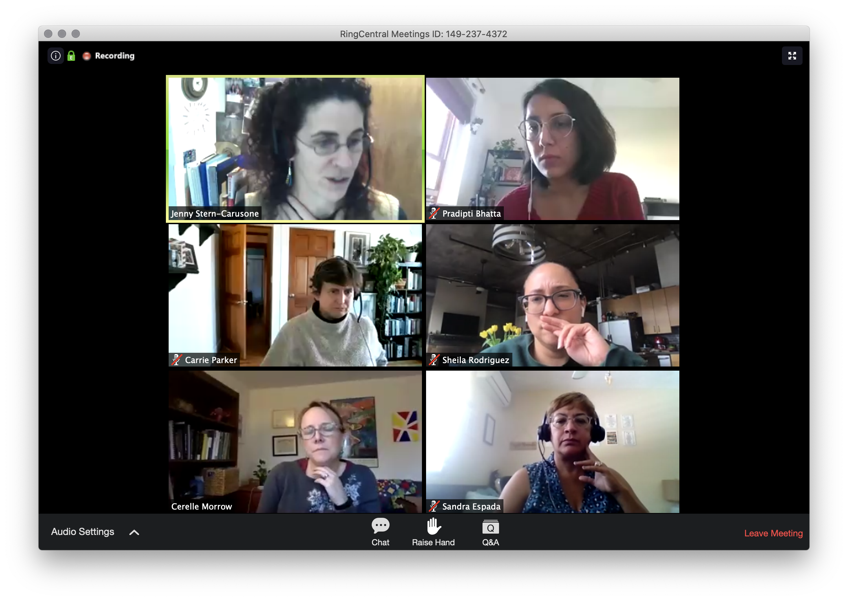
Información general de Ring Central
El audio se transmitirá a través de los altavoces de su computadora o vía teléfono si elige marcar. Los micrófonos se silenciarán para los participantes del seminario web. Utilice el panel de chat para preguntas, comentarios o sugerencias.
Abra el panel de chat y seleccione "Todos los panelistas y participantes" para conversar con todos, o seleccione "Todos los panelistas" para conversar solo con los panelistas.
Notes:
Technical info: This webinar is being recorded. Following the event, we will share the recording with participants.
Please contact the call facilitator if you have any concerns or questions.

Slide 2
La colaboración en mi trabajo parece ______
En su experiencia…
Notes:
In chat

Slide 3
Mejorando la colaboración en la continuidad de servicios: para profesionales del uso indebido de sustancias en Puerto Rico Sesión 1/2
Presentadores:
Haner Hernández, Ph.D., CPS, CADCII, LADCI
Shai Fuxman, Ed.D

Slide 4
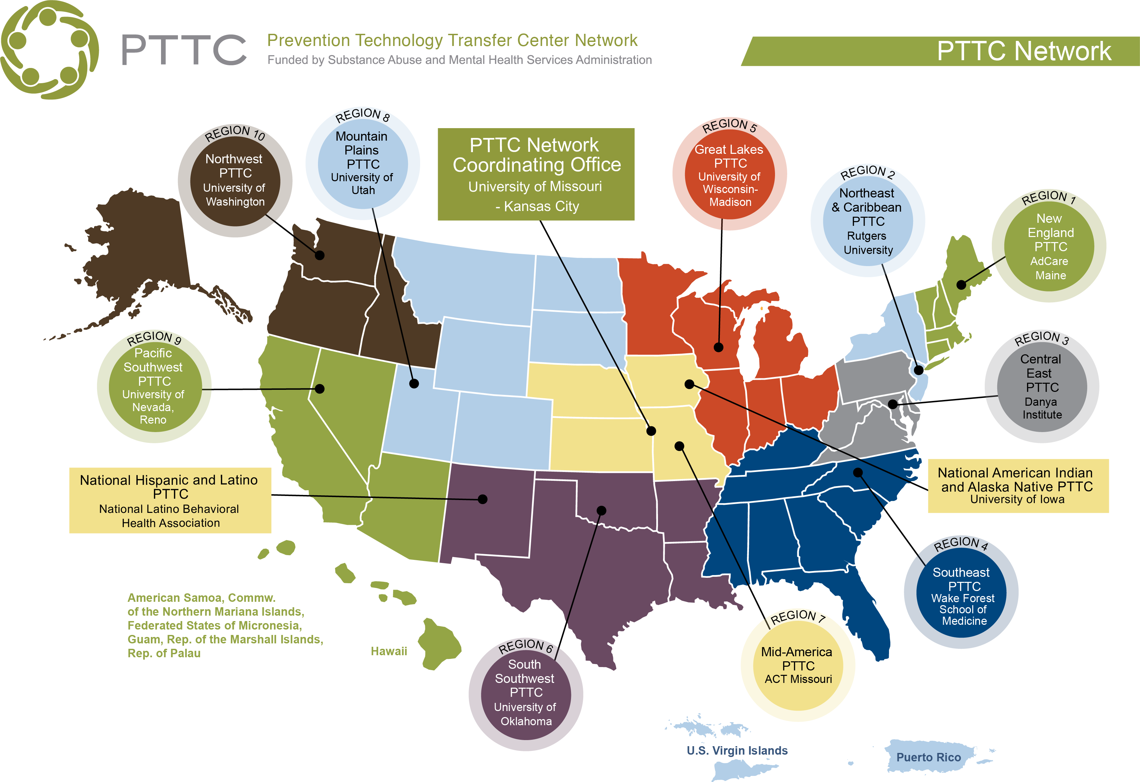

Slide 5
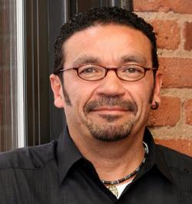
Presentadores De Hoy
Haner Hernández, Ph.D., CPS, CADCII, LADCI
Shai Fuxman, Ed.D

Slide 6
Objetivos de Aprendizaje
Revisar el Continuum of Care (continuidad de servicios)
Enumere las similitudes y diferencias entre la intervención, prevención, el tratamiento y la recuperación del uso indebido de sustancias
Identificar posibles soluciones a las barreras comunes para colaborar en todo el continuo
Identificar estrategias para colaboración a lo largo del continuo
Notes:
De Haner para considerer: recommend that use Harm Reduction in multiple places to highlight the power of collaborations and prevention efforts across the continuum of care. For example, a harm reduction focus has enabled us to embrace syringe access programs, safe injection kits, Narcan distribution and training, condom distribution, Fentanyl testing strips, and safe consumption sites. While these have been controversial to some, there is data to prove that they work, and funders (including SAMHSA), health departments and health care settings, criminal justice settings, and providers all over the world are embracing harm reduction philosophies, techniques, and strategies.
Revisar el Continuum of Care (continuidad de servicios) del Instituto de Medicina (IOM)
Enumere las similitudes y diferencias entre la prevención, el tratamiento y la recuperación del uso indebido de sustancias.
Identificar estrategias para asociarse a lo largo del continuo.
Identificar posibles soluciones a las barreras comunes para colaborar en todo el continuo.

Slide 7
Preparando el escenario: el panorama actual del uso indebido de sustancias en Puerto Rico
Notes:
Preparando el escenario: el panorama actual del uso indebido de sustancias en Puerto Rico

Slide 8
Tendencias Actuales
Número de infecciones por COVID y número de muertes en Puerto Rico
169,183 casos
2,394 muertes
27% vacunados por completo y 41% recibió al menos 1 dosis de vacuna
Estádisticas de los participantes con algún diagnostico relacionado a sustancias (2019 - 2020):
Utilización de Opioides 70.1%
Uso principal de Heroína: 33.7%
Notes:
General talking points about COVID and substance use trends:
Hispanics represented 6.7% of study population (832 people), so this is really background data.
During covid, overall rates of substance misuse increased, especially among those who are higher users.
34% of study participants reported binge drinking
Participants who reported experiencing COVID-19-related stress reported consuming more drinks, and a greater number of days drinking,
60% of study participants reported increased their levels of drinking. Reasons for increased drinking included
increased stress (45.7%),
increased alcohol availability (34.4%), and
boredom (30.1%).
13% of study participants reported decreased drinking
58.1% reported that their drinking had decreased because of diminished alcohol availability,
29.7% reported that their drinking had decreased because of less free time, and
12.2% reported that their drinking had decreased because of having less money.
21.6% listed some combination of these three reasons and
25.7% gave some other reason.
participants with children under the age of 18 currently living with them reported that their drinking had increased (53.6%) than had decreased (32.4%) or stayed the same (35.9%, χ² p < 0.001).
a larger percentage of males reported that their drinking had decreased (29.17%) compared to those whose drinking had increased (13.1%) or stayed the same (12.6%).
51.4% of those whose drinking had decreased also reported being stressed by having to spend more time working versus 43.6% of those whose drinking had increased and 30.9% of those whose drinking had stayed the same.
Note from Ivy: One way we can address data is to report on what we have, hopefully data at least to 2018 (if not 2020). It may be more ‘national’ data like in these stories that we share:
As more states legalize marijuana, more children accidentally ingest THC-laced edibles - The Washington Post
US alcohol consumption is up 14% during COVID-19, JAMA study finds (usatoday.com)
Alcohol Consumption Has Spiked During the Pandemic. Could the Consequences Outlast the Coronavirus? | Bostonia | Boston University (bu.edu)
Places to look for more;
Yes, try the BRFSS, fingers crossed you’ll find additional data there. What about including the following data points, beginning with both the 2013-14 data, and any updates available from BRFSS?
Age of first Alcohol use (can be historical)
45% youth btwn 7-12th grades have used alcohol (ASSMCA 2015-17 – from Alianza’s website))
Percent of youth have used marijuana
12% youth 7th-12th grade report using marijuana at least once (ASSMCA –from Alianza’s website)
% youth or adults report binge drinking more
Among Adults 18+ -- 48.6% male 51.1% female in 2010 (from https://www.niaaa.nih.gov/sites/default/files/hispanicFact.pdf pg 3)
COVID Data from https://www.nytimes.com/interactive/2021/us/puerto-rico-covid-cases.html
Other data:
https://assmca.pr.gov/estadistica/Ao%20Fiscal%2020192020/Peticion%20Sustancias%2024%20julio%202020.pdf
https://nccd.cdc.gov/BRFSSPrevalence/rdPage.aspx?rdReport=DPH_BRFSS.ExploreByLocation&rdProcessAction=&SaveFileGenerated=1&irbLocationType=States&islLocation=72&islState=&islCounty=&islClass=CLASS01&islTopic=TOPIC07&islYear=2019&hidLocationType=St

Slide 9
¿Qué tendencias de uso indebido de sustancias está observando en su comunidad?
En su comunidad…
8
Notes:
https://www.pexels.com/photo/black-tower-viewer-with-landscape-background-1502914/h

Slide 10
Factores de Riesgo
…y aún más durante COVID-19
-Pobreza
-Racismo
Sociedad
-Incertidumbre económica
-Violencia en la comunidad
-Falta de conexión con la comunidad
-Barreras a servicios de salud
Escuela y Comunidad
-Falta de estructura y rutinas diarias en la escuela
-Desconexión de la comunidad
Familia y Amigos
-Desempleo de los padres
-Desconexión de amigos y familiares (soledad)
-Falta de apoyo de la familia
-Trauma en la familia
Individuo
-Riesgos de salud individuales
-Condiciones de salud mental preexistentes
- Discapacidades sociales
- Problemas de salud mental
- Trauma
Notes:
Shai Fuxman, Ed.D

Slide 11
Factores de Protección
Sociedad
-Pólizas económicas y sociales
-Cultura y tradiciones
-Apoyo de organizaciones comunitarias
Escuela y Comunidad
Familia y Amigos
-Seguimiento y apoyo de los padres
-Conexiones virtuales con amigos
Individuo
-Resiliencia individual
-Habilidades sociales y emocionales
Notes:
Shai Fuxman, Ed.D

Slide 12
El modelo de la continuidad de servicios
Notes:
"El Modelo de la Continuidad de Servicios

Slide 13
La continuidad de servicios
Tratamiento
Prevención
Tratamiento
Uso indebido de sustancias y / o trastorno por uso de sustancias no diagnosticado
Multiples caminos a la recuperación
Prevención
Indicativo
Identificación
Indicativo
Identificación de Caso
Tratamientos para adición
Selectivo
Selectivo
Universal
Tratamientos de adicción
Individual y familiar
Mantenimiento
Prevención de recaída
Recuperación
Promoción
Universal
Tratamiento a largo plazo prevención de recaída
Promoción
Comunidad
Promoción
Cuidado después de tratamiento
Cuidado después de tratamiento y rehabilitación
Sociedad
Promoción
Uso de sustancias
Notes:
From Haner to mention in this slide or next: Also, we should reference how SUD providers describe the “continuum of care:” Prevention Intervention treatment and Recovery Supports. This model highlights “Intervention.” This is where prevention and treatment intersect. Also, there is a strong focus on Recvery Supports and Recovery Capital.
In the notes: •Note that Recovery phase begins in treatment (for those that go to treatment; most people in need of services don't go to treatment and can initiate their recovery via another pathway (12 step, faith-based, etc.).
I believe it’s important to mention the Multiple Pathways of Recovery. Not everyone needs or wants treatment and many people get better via other pathways: 12 step, faith-based, exercise, SMART, Rational, Celebrate Recovery, Harm Reduction, etc.
Use this slide as an overview slide:
This model was first presented by the Institute of Medicine in 1994 as the mental health intervention spectrum, and it was expanded in 2009 to include promotion.
The continuum of care describes the scope of behavioral health services for individuals before, during, and after they experience a behavioral health problem or disorder. It includes promotion, prevention, treatment, and maintenance.
The continuum segments the need for care and the type of care required from various parts of the health care system. This means there are multiple opportunities for addressing behavioral health problems.
The continuum underscores the interrelationship among promotion, prevention, treatment, and maintenance. While some services may be more specific, individualized, or costly than others, it shows that each phase along the continuum does not exist in isolation.
In 2015, the National Academy of Sciences voted to change the name of the Institute of Medicine to the National Academy of Medicine.
Note that Recovery phase begins in treatment
De Haner highlight the Multiple Pathways of Recovery (non-clinical, including harm reduction) on this slide. Specifically where is says “Treatment.” Similar to what you have with the box and arrow pointing to “Substance Misuse.”
Some terminology:
SAMHSA has supported the addition of Recovery as an overlay to the Continuum of Care. Recovery actually begins when a person makes the decision to seek a substance free, healthy lifestyle. That actually begins when they initiate treatment or actively pursue another pathway to recovery.

Slide 14
La continuidad de servicios
Tratamiento
Prevención
Tratamiento
Uso indebido de sustancias y / o trastorno por uso de sustancias no diagnosticado
Prevención
Indicativo
Identificación
Indicativo
Identificación de Caso
Tratamientos para adición
Selectivo
Selectivo
Universal
Tratamientos de adicción
Individual y familiar
Mantenimiento
Prevención de recaída
Recuperación
Promoción
Universal
Tratamiento a largo plazo prevención de recaída
Promoción
Comunidad
Promoción
Cuidado después de tratamiento
Cuidado después de tratamiento y rehabilitación
Sociedad
Promoción
Uso de sustancias

Slide 15
Definición de colaboración
Colaboración en nivel:
“Trabajar en conjunto con otros o juntos, especialmente en un esfuerzo intelectual.”
– Merriam Webster Dictionary
Indivudual
Profesional
Comunitario
Estatal, gubernamental
Entre otros partes interesados

Slide 16
¿Cuales han sido obstáculos para trabajar en colaboración? ¿Cuales ejemplos existen de colaboraciones efectivas?
Notes:
@Haner - Facilitated dialogue about what has led to these conditions;
Que ha funcionado bien
Que ha sido desafiante
Ejemplos de adaptaciones / cambios exitosos durante COVID
Challenges to working collaboratively
Existed before COVID
Complicated by COVID
Make the case to strengthening prevention infrastructure both to “do” prevention work but also to work collaboratively with other sectors to provide services and support no matter where someone is in terms of behavioral health conditions
COVID and other natural disasters has impaired the ability to work across sectors; not only strengthening prevention infrastructure to do prevention but also about strengthening it to work collaboratively with other sectors to provide support no matter where someone is in terms of behavioral health conditions - importance of working together across the continuum (always difficult to work across continuum or especially now because of current series of events? Maybe Haner has more insight on this
Photo: https://www.pexels.com/search/group%20of%20people%20wearing%20a%20mask/

Slide 17
Cuando piense en su trabajo, comparta las palabras que le vienen a la mente relacionadas con:
En su opinion…
Promoción
Prevención
Notes:
Respond in chat
Briefly Explore answers to these questions
What do you see as the greatest strength of promotion and prevention efforts in your community?
What do you see as the greatest areas of need in health promotion and substance prevention in your community?

Slide 18
Navegando a través de la continuidad de servicios
Promoción
Prevención
Notes:
From Haner: We should mention that this reality is as a result of the creation and maintance of Silos. We should also point to the fact that many systems are now beginning to work together (criminal justice, faith-based, health care, treatment, recovery, etc.) with the goal of dismantling the Silos. I think this is an opportunity to e strength based.
Share the following analogy of three blindfolded men:
The three blindfolded men are all holding on to a different part of an elephant. One feels like he is holding on to a paint brush, the other a hose, and the third a wall. They don’t see that they are all feeling a different part of an elephant.
When we look at the problem of substance misuse, practitioners across the continuum may approach only a select part of the problem (e.g., health promotion, substance misuse prevention, treatment). But together, we comprise a comprehensive approach to addressing the problem.
Ask participants to give an example where only one part of the continuum is being addressed (not a comprehensive approach). In the content of the three blindfolded men, what’s an example where only the trunk is being felt?
For example, when a law enforcement officer arrests an individual for driving under the influence, that officer is preventing potential adverse outcomes from substance misuse (including fatal car crashes). However, that arrest is not addressing any underlying substance use disorder that the individual may have, and it’s possible that individual will drive under the influence again. Also, this situation doesn’t include any prevention efforts to prevent people from diving while intoxicated in the first place, which could stop other individuals from arrest or car crashes.
Ask participants to give an example where a comprehensive approach IS being taken to the continuum. In the content of the three blindfolded men, where every part of the elephant is felt and the men share what the feel with eachother so they know what the entire elephant looks like?
For example, a community may implement a naloxone distribution process so that individuals who experience an overdose can be administered this life-saving antidote. In addition, the community implements a number of referral to treatment mechanism and increases treatment and recovery support services offerings. In addition, the community implements a number of prevention interventions to decrease public demand for opioids including prescriber education and youth programs like LifeSkills.

Slide 19
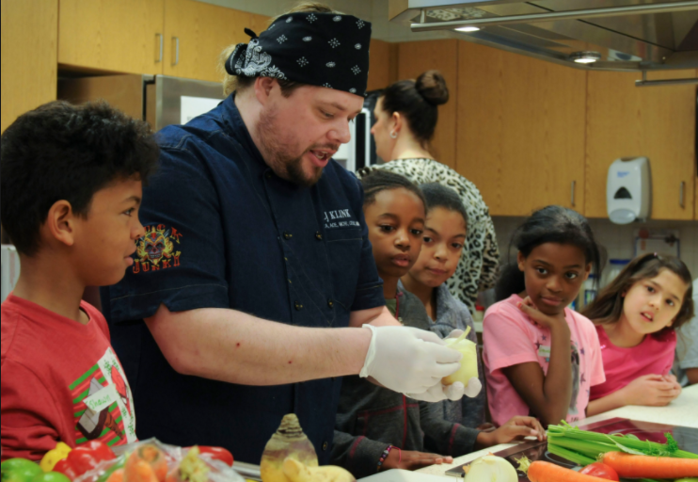
Definición de promoción
Intervenciones (por ejemplo, programas, prácticas y estrategias ambientales) que ayudan a las personas a hacerse cargo de su vida y mejorar su bienestar.
"No impulsado por un énfasis en la enfermedad, sino por un enfoque en la mejora del bienestar". (IOM 1994)
Notes:
Ask to write in chat for some examples of ways to promote well-being (e.g., programs based in schools, community centers, or other community-based settings that promote emotional and social competence through activities emphasizing self-control and problem solving). Ask participants:
Why is promotion along the bottom of the continuum as well as part of the half-circle? Make sure the point is made that throughout the continuum of care it’s important to work on promoting well-being. Promotion now includes family and individual
In practice, there is considerable overlap between prevention and promotion. Promotion focuses on helping people embrace health and wellness and supporting those factors that protect well-being.
Promotion focuses on the general population or a particular defined population group.
The aim of promotion is to enhance people’s ability to:
“Achieve developmentally appropriate tasks”
Acquire a “positive sense of self-esteem, mastery, well-being, and social inclusion”
“Strengthen their ability to cope with adversity”
[Photo source: https://commons.wikimedia.org/wiki/File:Parents_and_their_kids_cook_healthy_and_tasty_meals_150321-A-ZT122-040.jpg]

Slide 20
Definición de prevención
Intervención Universal
Dirigido a toda la población o grupo que no se ha identificado en riesgo individual
Intervención Selectiva
Dirigido a un subgrupo de la población con un riesgo superior al promedio
Intervención Indicada
Dirigido a personas de alto riesgo con síntomas o marcadores muy tempranos de predisposición a un trastorno
Notes:
Prevention is defined as “interventions that occur prior to the onset of a disorder and are intended to prevent or reduce risk for the disorder.
5 National Research Council and Institute of Medicine. (2009). Preventing mental, emotional, and behavioral disorders among young people: Progress and possibilities (O’Connell, M. E., Boat, T., & Warner, K. E., Eds.) (p. 66). Washington, DC: National Academies Press.

Slide 21
Ejemplos de estrategias de prevención universales, selectivas e indicadas
Universal
Selectiva
Indicada
Alcohol | Leyes que aumentan las penas por proporcionar alcohol a menores | Grupos de apoyo para personas con antecedentes familiares de dependencia del alcohol | Programas escolares de prevención del alcohol para jóvenes involucrados en el sistema de tribunales de menores
Marihuana | Políticas del campus universitario sobre el uso de marihuana | Programas de tutoría para jóvenes con actitudes positivas hacia el consumo de marihuana | Programas para personas detenidas por conducir bajo los efectos del alcohol
Medicamentos con receta | Proveando información al público sobre prácticas seguras de almacenamiento de medicamentos. | Reforzar los mensajes de uso seguro con personas que actualmente usan medicamentos con receta y que tienen antecedentes familiares de abuso de sustancias. | Educar a las personas que han sufrido una sobredosis previa sobre el uso de naloxona
Notes:
Walk participants through examples of universal, selected and indicated prevention interventions for alcohol, marijuana, and prescription drugs. Ask participants:
What types of interventions have you been most involved in in your prevention work?

Slide 22
Navegando a través de la continuidad de servicios (cont.)
Caminos Multiples
Mantenimiento
Recuperación
Notes:
The goal of this next section is to provide you with a basic understanding of treatment, maintenance and recovery in order to:
Increase your general understanding of these disciplines so that you can be a resource within your organization/agency and in the communities you serve
Begin to explore the potential points of collaboration and key elements to keep in mind when fostering an environment where collaboration is possible

Slide 23
La terminología importa
hay muchos caminos para la recuperación,
el tratamiento funciona, la recuperación es contagiosa
Alcohólico, drogadicto, adicto, dejar el hábito
Notes:
Before talking about definitions, take a moment to talk about some of the public’s views on people with substance use disorders and our role as prevention practitioners in promoting positive messages.
As prevention practitioners, we are often interacting with individuals across our community. In that role, it’s likely we will come across individuals who are struggling with addiction or substance use disorders, or their loved ones, who will have questions for you because they are aware of your role as a preventionist.
As we discussed on the previous slide, you can be a resource in your community on the different elements of the continuum and how to navigate across it. But at you all know, it’s not just what you say, but how you say it. We are ambassadors when it comes to messaging about the work across the continuum.
Consider these two images. Which of these photos more accurately describes the public’s view of a person with a substance use disorder?
Now let’s think about messaging, [click animation once]. Here are some phrases to describe a negative view of persons with addition or substance use disorders.
Now let’s think about supportive messaging to describe treatment and recovery [click animation once].
What are some other messages that you’ve heard that support the work of treatment and recovery? Possible messages include: “One size (treatment) does not fit all” and “Relapse may be part of the recovery process”
[Photo source: https://pixabay.com/en/depression-man-anger-sadness-2912404/]
[Photo source: https://www.flickr.com/photos/obrashalomcampogrande/10734494115]

Slide 24
¿Cuáles son las fortalezas del sistema de tratamiento en su comunidad?
¿Cuáles son las áreas de mayor necesidad en el sistema de tratamiento de su comunidad?
¿Que piensa usted?

Slide 25
Definición de tratamiento
"Intervenciones que son de naturaleza terapéutica (como psicoterapia, grupos de apoyo, medicación y hospitalización), [que] se brindan a las personas que cumplen o están cerca de cumplir [los criterios para un diagnóstico de trastorno por uso de sustancias]".
— Institute of Medicine Report (1994)
Notes:
Expand upon the definition on the slide:
The 1994 Institute of Medicine report defines treatment as “interventions, which are therapeutic in nature (such as psychotherapy, support groups, medication, and hospitalization), are provided to individuals who meet or are close to meeting [the criteria for a substance use disorder diagnosis].
There are two components in treatment intervention: 1) case identification, and 2) standard treatment for the known disorder, which includes interventions to reduce the likelihood of future co-occurring disorders. The optimal treatment protocol aims to reduce the length of time the disorder exists, halt a progression of severity, and half the recurrence of the original disorder, or if not possible to increase the length between episodes.”
Some examples include:
Principles of Substance Abuse Treatment:
Addiction is a complex but treatable disease
No single treatment is appropriate for everyone.
Treatment needs to be readily available
Effective treatment attends to multiple needs of the individual
Remaining in treatment for an adequate period of time is critical
Behavioral therapies are the most commonly used forms of drug abuse treatment
Medications are an important element of treatment especially when combined with counseling and other behavioral therapies.
An individual's treatment and services plan must be assessed continually and modified as necessary
Many drug-addicted individuals also have other mental disorders
Medical assisted detoxification is only the first stage of addiction treatment
Treatment does not need to be voluntary to be effective
Drug use during treatment must be monitored continuously, as lapses during treatment do occur.
Treatment programs should test patients for the presence of infectious diseases
6 Institute of Medicine (1994). Reducing Risks for Mental Disorders: Frontiers for Preventive Intervention Research. Washington, DC: The National Academies Press. https://doi.org/10.17226/2139.
Photo source: https://torange.biz/33977.html

Slide 26
Definición de manteniemiento
"Las intervenciones que son de apoyo, educativas y / o farmacológicas por naturaleza se brindan a largo plazo a las personas que tienen [un trastorno por uso de sustancias] y cuya enfermedad continúa".
— Institute of Medicine Report (1994)
Notes:
Expand on the definition on the slide:
The 1994 Institute of Medicine report defines treatment as “interventions, which are supportive, educational and/or pharmacological in nature, are provided on a long-term basis to individuals who have met the [the criteria for a substance use disorder diagnosis] and whose illness continues. The two components of maintenance interventions are 1) the patient’s compliance with long-term treatment to reduce relapse and recurrence and 2) the provision of after-care services to the patient, including rehabilitation. The aim of both components is to decrease the disability associated with the disorder.”
Recovery support services are part of maintenance since its aim it to increase the likelihood of maintaining long-term recovery.
6 Institute of Medicine (1994). Reducing Risks for Mental Disorders: Frontiers for Preventive Intervention Research. Washington, DC: The National Academies Press. https://doi.org/10.17226/2139.
Photo source: https://www.flickr.com/photos/greeblie/3338710223

Slide 27
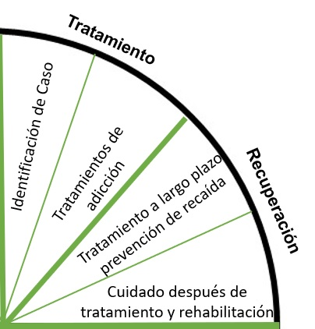
Tratamiento y manteniemiento: algunos ejemplos
Desintoxicación ("Detox")
Residencial (paciente hospitalizado)
Paciente ambulatorio intensivo / hospitalización parcial
Paciente externo
Tratamiento asistido por medicamentos
Mantenimiento de recuperación
Notes:
Ask participants to write in chat before animating the list: What are some types of treatment and maintenance programs that you are aware of?
Emphasize recovery goes from treatment
Remind participants that although the principles of effective treatment are the name, the language we use to describe them may be difference. For example, detoxification or detox programs are also referred to as medically managed withdrawal programs). Click once to bring in the list of examples of treatment and maintenance programs. Describe this list in greater detail using the notes below:
Detoxification (“Detox”): Often the first program in a treatment process, detoxification programs help an individual clear his/her body of a substance. These programs help individuals manage the “acute and potentially dangerous physiological effects of stopping drug use.” Detox programs do not help individuals address the “psychological, social, and behavioral problems associated with addiction” so in most cases, post-detox treatment programming is recommended (NIDA, 2017). Detox can be stand-alone, or part of a longer-term residential program.
Residential: All of these services consist of living on-site, where 24 hour support is provided by trained personnel. These services can range in duration (from short-term to long term, 6-12 months) (NIDA, 2017), location (hospital or non-hospital) (Facing Addiction in America, 2016) and in level of intensity (from clinically managed low-intensity to medically monitored high-intensity) (American Society of Addiction Medicine, 2015).
Intensive outpatient/partial hospitalization: These services are typically a “step-down” from residential services, where an individual attends 9-20 hours (or more) of service a week (American Society of Addiction Medicine, 2015) and are an option for individuals who are limited by the restrictions of residential programs and are “living in an environment that supports recovery but who need structure to avoid relapse” (Facing Addiction in America, 2016).
Outpatient services: “Typically consists of less than 9 hours of service/week for recovery or motivational enhancement therapies and strategies…delivered in a wide variety of settings” (American Society of Addiction Medicine, 2015). These services an provide both group and individual behavioral services. They can be appropriate for an individual with a mild substance use disorder, or for an individual who has completed a more intensive treatment program (Facing Addiction in America, 2016).
Medication-assisted treatment: Some medications are approved by the FDA in the treatment of alcohol and opioid use disorders. Medication-assisted treatment consists of a combination of medicine and behavioral therapies (Facing Addiction in America, 2016).
Remind participants that we talk about maintenance, we often also talk about recovery maintenance and some of these types of recovery programs may come up during the brainstorm. Expand with the notes below:
Since the original IOM report was published there has been an increased acknowledgement of the role that peer and recovery support services play in an individual’s recovery. However, it is important to point out that these services are not treatment services (but they can be provided in concert with treatment services).
Recovery support services: According to SAMHSA, recovery support services are “are non-clinical services that are used with treatment to support individuals in their recovery goals.” We’ll talk about these more extensively in the next section. (SAMHSA, 2016)
Peer support services: According to SAMHSA, peer support services are delivered by individuals who have common life experiences with the people they are serving. [This] includes informational, emotional, and intentional support.” Examples: Alcoholics Anonymous, Narcotics Anonymous, and other 12-step programs (SAMHSA, 2016).
7 U.S. Department of Health and Human Services (HHS), Office of the Surgeon General, Facing Addiction in America: The Surgeon General’s Report on Alcohol, Drugs, and Health. Washington, DC: HHS, November 2016. https://addiction.surgeongeneral.gov/chapter-4-treatment.pdf
8 National Institute on Drug Abuse NIDA. (2018, January 17). Principles of Drug Addiction Treatment: A Research-Based Guide (Third Edition). Retrieved from https://www.drugabuse.gov/publications/principles-drug-addiction-treatment-research-based-guide-third-edition
9 American Society of Addiction Medicine (2015). What are the ASAM Levels of Care? Available at http://asamcontinuum.org/knowledgebase/what-are-the-asam-levels-of-care/
10 Substance Abuse and Mental Health Services Administration (2016). Treatments for substance use disorders. Available at https://www.samhsa.gov/treatment/substance-use-disorders

Slide 28
Definición de recuperación
"La experiencia de una vida productiva significativa dentro de los límites impuestos por los riesgos de adicción. La recuperación es tanto la aceptación como la trascendencia de la limitación. Es el logro de una salud óptima, el proceso de elevarse y convertirse en algo más que una enfermedad. La recuperación, a diferencia del tratamiento, la realiza y define la persona en recuperación".
— William White
Salud
Manejar enfermedades y tomar decisiones que apoyen el bienestar
Comunidad
Tener relaciones de apoyo y redes sociales
Recuperación
Hogar
Tener un lugar estable y seguro para vivir
Propósito
Participar en actividades diarias significativas
Notes:
White’s definition includes strength-based language against pathologizing individuals and it empowers individuals to define their own recovery.
Expand upon the definition on the slides with the notes below:
SAMHSA has delineated four major dimensions that support a life in recovery:
Health: overcoming or managing one’s disease(s) as well as living in a physically and emotionally healthy way;
Home: a stable and safe place to live;
Purpose: meaningful daily activities, such as a job, school, volunteerism, family caretaking, or creative endeavors, and the independence, income and resources to participate in society; and
Community: relationships and social networks that provide support, friendship, love, and hope.
There are multiple pathways to recovery, meaning that individuals can reach their recovery status through a number of different channels—only some of which include traditional treatment.
Recovery is a “self-defined” status. The main takeaway here is that recovery is a state of being, and each individual who is in recovery may definite it differently. However, it is important for people in recovery to self-identify this way so that the public sees that it is possible for people with substance use disorders to go on to live happy, productive lives.
Additional notes on self-defined status:
For example, a study of persons in long-term treatment and recovery support programs defined themselves differently:²
“In recovery” (75%)
“Recovered” (13%)
“Used to have a problem” (9%)
“Medication assisted recovery” (3%)
In addition, this same study found that individuals defined recovery differently. Some individuals in recovery continued to use alcohol, but abstained from other drug use, other individuals abstained from all alcohol and drugs.
Individuals may be in recovery may still define themselves as having as substance use disorder (for example, a person in recovery for 20+ years may still self-define as “an addict” or “an alcoholic.”).
11 Substance Abuse and Mental Health Services Administration. (2012). SAMHSA's Working Definition of Recovery. Rockville, MD: Substance Abuse and Mental Health Services Administration. Retrieved from http://store.samhsa.gov/product/SAMHSA-s-Working-Definition-of-Recovery/PEP12-RECDEF
12 Witbrodt, J., Kaskutas, L. A., & Grella, C. E. (2015). How do recovery definitions distinguish recovering individuals? Five typologies. Drug And Alcohol Dependence, 148109-117. Available at https://www.ncbi.nlm.nih.gov/pmc/articles/PMC4330112/

Slide 29
Recuperación: algunos ejemplos
Coaching de recuperación / especialistas de pares
Ayuda mutua y apoyo entre pares
Residencias de recuperación
Escuelas de recuperación
Centros comunitarios de recuperacion
Recuperación
Recovery
Notes:
Coaching de recuperación / especialistas de pares
Ayuda mutua y apoyo entre pares
Residencias de recuperación
Escuelas de recuperación
centro comunitarios de recuperacion
Before animating-in the list of examples, ask participants:
What are some types of recovery services or programs that you are aware of?
Remind participants that a number of services fall under the categories of “recovery support.” The examples on this slide are supported by SAMHSA. Elaborate on these examples using the notes below:
Recovery coaches (which according to White, 2006 are also referred to as “recovery manager, recovery mentor, recovery support specialist, recovery guide, personal recovery assistant, and helping healer”) are certified professionals who work to “link clients from treatment institutions to indigenous communities of recovery, and to address complex co-occurring problems that inhibit successful recovery.” (White, 2006). This role is distinct from both a sponsor (often part of 12-step programs) and a therapist. Certified recovery coaches are called Certified Peer Specialists (CPS).
Mutual aid services exist for both persons in recovery and his/her family members and are lead by nonprofessionals with lived-experience with substance use disorders. According to SAMHSA “the most widely available mutual support groups are 12-Step groups, such as Alcoholics Anonymous (AA), but other mutual support groups such as Women for Sobriety (WFS), SMART Recovery® (Self-Management and Recovery Training), and Secular Organizations for Sobriety/Save Our Selves (SOS) are also available” (SAMHSA, 2008). Peer support services are similar to mutual aid, but they don’t typically have a philosophy
Recovery residences, also called recovery houses, are “sober, safe, and healthy living environments that promote recovery from alcohol and other drug use and associated problems” (National Association of Recovery Residences, 2012). Recovery residences, previously called halfway hours, have been increasingly regulated by the National Association of Recovery Residences and state standards and offer varied levels of services (e.g., peer support, medication, and counseling).
Recovery schools, according to SAMHSA, “help students remain abstinent through various programs of recovery, such as Twelve Step programs, and offer state-certified diplomas.” (SAMHSA, 2016).
13 White, W. (2006). Sponsor, Recovery Coach, Addiction Counselor: The Importance of Role Clarity and Role Integrity. Philadelphia, PA: Philadelphia Department of Behavioral Health and Mental Retardation Services.
14 SAMHSA (2008). An introduction to mutual support groups for alcohol and drug abuse. Substance Abuse in Brief Fact Sheet. Volume 5, Issue I. Available at https://store.samhsa.gov/shin/content/SMA08-4336/SMA08-4336.pdf
15 National Association of Recovery Residences (2012). A primer on recovery residences: FAQs from the National Association of Recovery Residents. Available at http://narronline.org/wp-content/uploads/2014/06/Primer-on-Recovery-Residences-09-20-2012a.pdf
16 SAMHSA (2016). SAMHSA’s Recovery Support Efforts. Available at https://www.samhsa.gov/recovery/samhsas-efforts

Slide 30
¿Cuáles son las fortalezas del sistema de recuperación en su comunidad?
¿Cuáles son las áreas de mayor necesidad en el sistema de recuperación de su comunidad?
¿Que opina usted?
Notes:
Ask to write in chat

Slide 31
Similitudes y diferencias
a través del continuo

Slide 32
Promoción de la comprensión en los sectores de intervención, prevención, tratamiento y recuperación
Si quisiera contarles a los profesionales de otra disciplina o de otro sector del continuo de atención sobre su trabajo, ¿qué les diría?
¿Que diría usted?

Slide 33
Similtudes
INTERVENCIÓN
Importancia de la preparación para el cambio
Guiado por estándares éticos
Involucra a las poblaciones indicadas
Atiende a personas en riesgo y a sus familiares
Se centra en el bienestar de la comunidad
Utiliza acercamientos basados ​​en evidencia
PREVENCIÓN
TRATAMIENTO
RECUPERACIÓN

Slide 34
Comprensión de las diferencias clave
PREVENCIÓN
TRATAMIENTO
Centrada en personas diagnosticadas clínicamente con trastornos por uso de sustancias
Centrada en las poblaciones y el medio ambiente (enfoque de salud pública)
Centrada en las personas que se identifican a sí mismas (una persona se está recuperando cuando dice que lo está)
INTERVENCIÓN
RECUPERACIÓN
Centrada en la necesidades inmediatas de las personas
Centrada en las personas que se identifican a sí mismas (una persona se está recuperando cuando dice que lo está)
Notes:
Elaborate on the notes on the slide using the notes below: What Prevention Practitioners Need to Know About Treatment
Insurance-driven payment structure: Treatment providers are paid through insurance reimbursement and fee-for-service models (insurance drives the treatment modality)
Individual-focused: Treatment is focused on individual behavior change (less contact with the community and families)
Clinical settings: Treatment often occurs in clinical settings, compared to prevention, which often occurs in community settings. Some treatment modalities partner with the community (outpatient), but in most cases the setting is treatment-specific.
Professional licensure: The only people who do treatment work are treatment professionals (compared to recovery and prevention which engage a number of non-professionals).
What Prevention Practitioners Need to Know about Recovery Support:
Elaborate on the notes on the slide using the notes below:
Variable funding structure: Funding comes from grants, state government, private entities
Various settings: Recovery support practitioners work in a variety of settings (churches, recovery residences, recovery high schools)
Volunteer supported: Many recovery initiatives are volunteer supported or volunteer-lead—and many of these volunteers are in recovery themselves
Individual- and community-focused: Recovery activities seek to promote change in individuals. However, part of that work is about building a community that is focused on building a community that supports recovery efforts.

Slide 35
¿Ha colaborado con otros sectores en el pasado? Si es así, ¿qué estrategia ha utilizado?
¿Que ha hecho en el pasado?
Notes:
Ask participants to write in chat
Keep an eye for possible person as participant to contribute (Juan Velez from ASSMCA)

Slide 36
Desafíos comunes a la colaboración y posibles soluciones
Asignación de recursos
Lenguaje
Logística
Claridad de funciones
Historia
Notes:
Elaborate on the notes on the slide using the notes below:
Resource allocation: Tensions over limited resources, determining who pays for what, and the specifics about how to keep funding streams separate
Logistics: Since people who work in prevention, treatment and recovery get paid in different ways, there can be logistical challenges about where and when to meet (especially because a majority of treatment providers only get paid for providing a service—so they are not compensated for attending a coalition meeting).
Language: For example, the term “prevention” means a number of different things. Prevention can mean MAT, but not policy or enforcement. Intervention in prevention means strategy, intervention in treatment brings family members together to intervene in an individual’s life.
Role clarity: The three different sectors have different roles who work within them. Lack of understanding can lead to confusion about where one individual’s role ends and the other’s begins.
History: Historically, these disciplines have not worked together. Project officers oversee separate treatment and prevention grants. Agencies are set up separately. Prevention/Public health model has a different approach than the clinical treatment approach.
Photo source:
https://www.flickr.com/photos/pictures-of-money/17123240849
https://pxhere.com/en/photo/868210
https://pixabay.com/en/clock-time-pointer-time-of-watches-705672/
https://pixabay.com/en/speech-icon-voice-talking-audio-2797263/
https://en.oxforddictionaries.com/usage/historic-or-historical
https://pxhere.com/en/photo/733154

Slide 37
Acercamientos de colaboración a lo largo del continuo
Alineación entre las disciplinas de prevención, tratamiento y / o recuperación (a nivel estatal, del condado o de la comunidad)
Programación co-ubicada (por ejemplo, operaciones de prevención en entornos de tratamiento y recuperación)
Intervenciones posteriores a una sobredosis
Intercambio de recursos / conocimientos
Identificar métodos de asociación
Notes:
Elaborate on the points on the slide with the notes below:
Many states (as well as tribes and jurisdictions) have engaged in strategic alignment across prevention, treatment, and recovery sectors. This includes community-level collaborations (e.g., prevention coalitions engaging participation from the local recovery community and treatment sector) and strategic planning at the agency level to ensure that efforts to address substance misuse problems align.
Prevention programming located in treatment and recovery systems includes programs for children of parents who are in residential treatment programs with their children or are incarcerated and have a substance use disorder, for example.
Post-overdose interventions—often called “warm handoffs”—engage individuals who have recently survived a non-fatal overdose (and their families). Since these individuals may or may not be ready for treatment—many effective models have included both prevention (naloxone distribution, overdose prevention, referral to community support services like housing, employment, etc.) and treatment (screening, referral, etc.).
Cross-continuum resource- and knowledge-sharing to improve navigation across the continuum. In our work, prevention practitioners are often asked about the other elements of the continuum (including substance abuse treatment and recovery)—perhaps because the individual is looking for information for themselves or their loved ones. Being knowledgeable about how these other fields work, and what resources are available in your state or community helps improve navigation across the continuum.

Slide 38
¡Sea el mejor colaborador que pueda ser!
Servir de recurso para otras personas que intentan navegar por el sistema de atención
Fomentar la colaboración en todo el continuo
Abogar por el papel de su sector en los esfuerzos colaborativos
Notes:
Link this slide to the previous slide.
There is a lot we can learn about and understand about treatment, maintenance and recovery—there are whole fields of study on these topics. We are going to focus on your understanding of treatment, maintenance, and recovery with these particular goals in mind:
Become a resource. Within the realm of prevention you are often interacting with the whole community. Within that community are people who may be experiencing misuse or a disorder who as you questions or more often a family member or friends of a loved one. You should understanding enough to guide them into the system so they can access the resources they need.
Foster collaboration. Understanding each other’s work often leads to opportunities for collaboration.
Advocate for the role of prevention. By understanding the other parts of the continuum, prevention practitioners can more clearly articulate to partners within other discipline how prevention is aligned with treatment and recovery, and how the system works better when interventions are aligned.
Share as ideas on ways to navigate the system:
SAMHSA’s Behavioral Health Treatment Services Locator website
SAMHSA’s Bringing Recovery Supports to Scale Technical Assistance Center Strategy (BRSS TACS)
State substance abuse helplines and websites
State 211 lines (https://unitedwaypr.org/en/community-initiatives/2-1-1-puerto-rico/)
Recovery support websites
[Photo source: https://pixabay.com/en/lens-camera-lens-focus-focusing-1209823/]

Slide 39
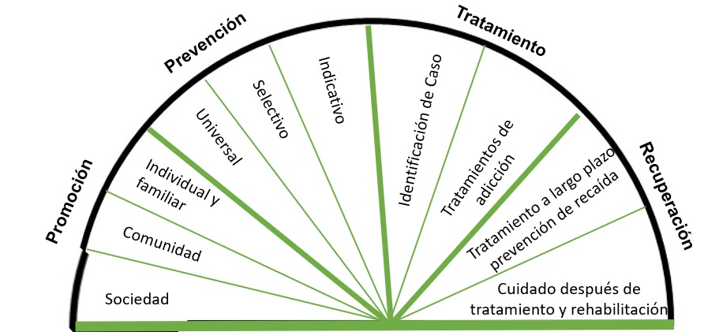
Recapitulando nuestras fortalezas
Notes:
Ask participants to write in the chat things that come to mind as strengths of prevention, treatment and recovery after a brief explanation below.
Presenter Notes:
We’ve talked a lot today about these three disciplines—prevention, treatment, and recovery. We’ve talked about how these fields are different and how they are similar—and where there is opportunity for overlap. Now, let’s take a moment to digest this information and think about the strengths of these three fields.
As we reflect on these strengths, remember to keep these in mind as you move forward with your work. Remember, your increased awareness will help address some of the common challenges we discussed. Try to be flexible and check for understanding (are we trying to do the same thing, but just using different words?).
Prevention, treatment, and recovery share common goals.
Prevention, treatment, and recovery have distinct sets of services funded through separate sources.
https://commons.wikimedia.org/wiki/File:An_ordinary_flower_bud.jpg
https://commons.wikimedia.org/wiki/File:Flower_Bud.JPG
https://pixabay.com/en/sun-flower-flower-blossom-bloom-1621990

Slide 40
¿Preguntas?
Notes:
Depending on how many people asked questions during the registration process, we may have a list of questions we’ll address if the material didn’t cover it. We can also invite questions if time allows.

Slide 41
Segunda parte a este seminario web
Mejorando la colaboración en la continuidad de servicios: para profesionales del uso indebido de sustancias en Puerto Rico Sesión 2/2
El 26 de mayo, 2 a 3:30

Slide 42
¡Gracias!
Si tengas preguntas, contactese:
Ivy Jones-Turner
MPA, CPS
T/TA Specialist
Region 2 PTTC, EDC
ijonesturner@edc.org
Jessica Goldberg MSW, MPH, CPS
T/TA Specialist
Region 2 PTTC, EDC
jgoldberg@edc.org

Slide 43
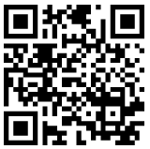
Evaluación de Satisfacción
Inmediatamente después de que finalice este seminario web, tómese el tiempo para completar una breve encuesta de evaluación. Nos ayude esta información para continuar mejorando nuestros servicios.
evaluación:
https://ttc-gpra.org/P?s=663161&lng=Spanish
Gracias por atender a nuestra presentación.

Slide 44
Referencias
New York Times (2021) Tracking Coronavirus in Puerto Rico: Latest Map and Case Count. May 2021. https://www.nytimes.com/interactive/2021/us/puerto-rico-covid-cases.html
ASSMCA (2021) Estudios, Investigaciones y Estadísticas. May 2021. https://assmca.pr.gov/estadistica/Pages/default.aspx
Weeks, L. (2015). Addiction in American history: 14 vivid graphs. National Public Radio. Available at https://www.npr.org/sections/npr-history-dept/2015/04/17/400061497/addiction-in-american-history-14-vivid-graphs
U.S. Department of Health and Human Services (HHS), Office of the Surgeon General, (2016). Facing Addiction in America: The Surgeon General’s Report on Alcohol, Drugs, and Health. Washington, DC. Available at https://addiction.surgeongeneral.gov/surgeon-generals-report.pdf
American Psychiatric Association. (2000). Diagnostic and statistical manual of mental disorders (DSM-IV) (4th ed.). Washington, DC: American Psychiatric Association.
Willenbring, M. L. (2008). New research is redefining alcohol disorders; Does the treatment field have the courage to change? Addiction Professional 6(5), 12-19.
National Research Council and Institute of Medicine. (2009). Preventing mental, emotional, and behavioral disorders among young people: Progress and possibilities (O’Connell, M. E., Boat, T., & Warner, K. E., Eds.) (p. 66). Washington, DC: National Academies Press.
Institute of Medicine (1994). Reducing Risks for Mental Disorders: Frontiers for Preventive Intervention Research. Washington, DC: The National Academies Press. https://doi.org/10.17226/2139.
U.S. Department of Health and Human Services (HHS), Office of the Surgeon General. Facing addiction in America: The surgeon general’s report on alcohol, drugs, and health. Washington, DC: HHS, November 2016. https://addiction.surgeongeneral.gov/chapter-4-treatment.pdf
National Institute on Drug Abuse NIDA. (2018, January 17). Principles of drug addiction treatment: A research-based guide (3rd Ed.). Retrieved from https://www.drugabuse.gov/publications/principles-drug-addiction-treatment-research-based-guide-third-edition
Notes:
Estudios, Investigaciones y Estadísticas

Slide 45
Referencias
American Society of Addiction Medicine (2015). What are the ASAM levels of care? Available at http://asamcontinuum.org/knowledgebase/what-are-the-asam-levels-of-care/
Substance Abuse and Mental Health Services Administration (2016). Treatments for substance use disorders. Available at https://www.samhsa.gov/treatment/substance-use-disorders
Substance Abuse and Mental Health Services Administration. (2012). SAMHSA's Working Definition of Recovery. Rockville, MD: Substance Abuse and Mental Health Services Administration. Retrieved from http://store.samhsa.gov/product/SAMHSA-s-Working-Definition-of-Recovery/PEP12-RECDEF
Witbrodt, J., Kaskutas, L. A., & Grella, C. E. (2015). How do recovery definitions distinguish recovering individuals? Five typologies. Drug And Alcohol Dependence, 148109-117. Available at https://www.ncbi.nlm.nih.gov/pmc/articles/PMC4330112/
White, W. (2006). Sponsor, Recovery Coach, Addiction Counselor: The Importance of Role Clarity and Role Integrity. Philadelphia, PA: Philadelphia Department of Behavioral Health and Mental Retardation Services.
SAMHSA (2008). An introduction to mutual support groups for alcohol and drug abuse. Substance Abuse in Brief Fact Sheet. Volume 5, Issue I. Available at https://store.samhsa.gov/shin/content/SMA08-4336/SMA08-4336.pdf
National Association of Recovery Residences (2012). A primer on recovery residences: FAQs from the National Association of Recovery Residents. Available at http://narronline.org/wp-content/uploads/2014/06/Primer-on-Recovery-Residences-09-20-2012a.pdf
SAMHSA (2016). SAMHSA’s Recovery Support Efforts. Available at https://www.samhsa.gov/recovery/samhsas-efforts

