Slide 1



Intimate Partner Violence Among Hispanic and Latina Populations
Diana Padilla
July 2021
Notes:
Buenos dias y beinvenidos as este seminario llamado, Violencia de pareja íntima entre las poblaciones hispanas y latinas.
Este seminario se la trae atraves del centro de transferencia de tecnología de prevención del noreste y caribe, segunda región
Yo soy Diana Padilla y sere su presentadora esta mañana.

Slide 2

Certificate of Completion
Complete an online evaluation by scanning the code with the camera on your phone, click on the link that Clyde will put in the chat, write down the link and type in your browser, or email for the link.
Certificates will be sent out within a week with a copy of the slides.
This webinar is approved for 2 hours of CASAC, CPP, CPS credentialing. You must attend the session in its entirety.
Notes:
Complete an online evaluation by scanning the code with the camera on your phone, or clicking on the link that Clyde will put in the chat. If neither of those work, either write down the link and type in their browser, or email patricia.chaple for the link.
Certificates will be sent out within a week.
A copy of the slides will be sent out on Monday.
Photo purchased: ID 180103732 © Wave Break Media Ltd | Dreamstime.com

Slide 3


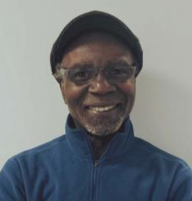
Northeast & Caribbean PTTC Team
Diana Padilla
Research Project Manager
Technical Assistance and Implementation:
Screening, Brief Intervention, Referral to Treatment, (SBIRT)
Equity & Inclusion
Patricia (Tri) Chaple Project Administrator
Clyde Frederick Technologist
This webinar training is provided under New York State Office of Addiction Services and Supports (OASAS) Education and Training Provider Certification Number 0115. Training under a New York State OASAS Provider Certification is acceptable for meeting all or part of the CASAC/CPP/CPS education and training requirements.
Notes:
Research project manager
I provide technical assistance around SBIRT, helping organizations to implement SBIRT in their settings. I will be presenting on the SBIRT model later in the month.

Slide 4
Disclaimer
The development of these training materials was supported by grant TI082504 (PI: M. Chaple) from the Center for Substance Abuse Treatment, Substance Abuse and Mental Health Services Administration (SAMHSA), United States Department of Health and Human Services. The contents are solely the responsibility of the Northeast and Caribbean Addiction Technology Transfer Center, and do not necessarily represent the official views of SAMHSA.

Slide 5
Purpose of SAMHSA’S Technology Transfer Centers
5
The purpose of the Technology Transfer Centers (TTC) is to develop and strengthen the specialized behavioral healthcare and primary healthcare workforce through development, dissemination, and implementation of Evidence-based Practices (EBPs).
Notes:
Read slide or refer participants to content

Slide 6


Notes:
SAMHSA’s provides workforce development and support in the addiction, mental health, and prevention disciplines.

Slide 7
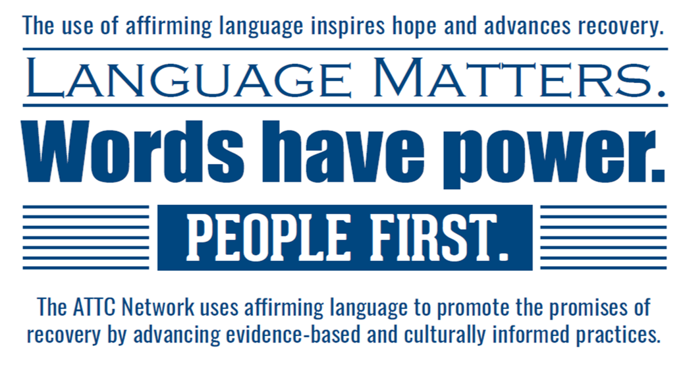
Notes:
Trauma informed, culturally appropriate, and inclusive in our language

Slide 8

What if…?
It is possible that the content can trigger feelings, visions of past experiences, etc.
What can you do?
Notes:
It is possible that the content can trigger feelings, visions of past experiences, personal or witnessed….hat can you do if it does? (immediate self care options)

Slide 9
Hotline Call
“Barry is controlling and jealous. He works but I don’t get to see a dime of it, and I have to go to the food pantry a lot.
He spends all of our money on liquor and going to bars with his friends. He won’t let me work or leave the house; I don’t have my own keys. He’s the worst when he’s drunk and beats me. I’m tired of it but don’t dare leave because he’ll find me, like he did before.
What do I do?
Notes:
There are times when the most you can do is be available for that person, or do a safety plan for inside of the home

Slide 10
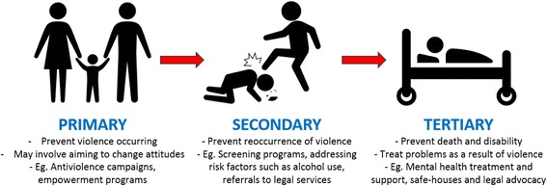
Intimate Partner Violence (IPV) Prevention
Kirk L, Terry S, Lokuge K, Watterson JL. Effectiveness of secondary and tertiary prevention for violence against women in low and low-middle income countries: a systematic review. BMC Public Health. 2017;17(1):622. Published 2017 Jul 4. doi:10.1186/s12889-017-4502-6
Notes:
Primary prevention is any action, strategy or policy that prevents intimate partner violence from initially occurring. Primary prevention seeks to reduce the overall likelihood that anyone will become a victim or a perpetrator by creating conditions that make violence less likely to occur. Prevention of IPV focuses on preventing first-time perpetration and first time victimization.
Secondary and Tertiary prevention (often called intervention, or prevention) are efforts to identify and address early signs of abuse or abusiveness (secondary) or even to change individuals who are already abused or abusive (tertiary) in order to reduce the consequences of abuse and prevent recurrence.
Intimate partner violence includes physical violence, sexual violence, threats of physical or sexual violence, psychological/emotional abuse, financial abuse, and stalking between those who are or have been involved in a marital, sexual, or dating relationship.

Slide 11
Primary Prevention
Notes:
We defined IPV as

Slide 12
Evolution of Terms and Inclusivity
Domestic Violence
vs
Intimate Partner Violence
IN Public Safety, Domestic Violence and Intimate Partner Violence: What’s The Difference? October, 2015, https://inpublicsafety.com/2015/10/domestic-violence-and-intimate-partner-violence-whats-the-difference/
Notes:
The traditional view of violence in a relationship focused on a crime of abuse involving two individuals in a heterosexual) marriage. Typically, the abuser was the husband and the wife was the victim. This is the origin of the term “domestic violence,” where the abusive behavior was viewed as a form of violence that existed within a domestic relationship.
In the ‘70s, women’s right groups advocated for victims resulting in shelters and other services for DV victims. Shelters provided research opportunities, awareness increased, Congress passed the Violence Against Women Act (VAWA). this legislation strengthened those laws by specifically identifying violence against women as a crime that needed more focused attention.
Societal views expanded to better understand the types of violence that exist within relationships as well as the reality that the roles of abuser and victim are not gender-specific. As a result, the term “intimate partner violence” was introduced to encompass a broader understanding of violence in relationships. While it is challenging to specifically identify when it came into existence, but it appears to have gained momentum sometime around 2000. (Gay marriage legal 2015)
Use of the term “intimate partner violence” moved us away from the old view that abusive violence only occurs in marital relationships where the husband was the abuser and the wife was the victim. The concept of intimate partner violence acknowledges that abuse can exist in any type of personal intimate relationship, regardless of sexual orientation, marital status, or gender. Like “domestic violence,” this new term does not assign the roles of the abuser and victim to one gender or the other.
For our purposes this afternoon and because much of the most current literature still uses these terms interchangeably, but I will try to keep to IPV in the spirit of inclusivity.

Slide 13
Intimate Partner Violence
The term “intimate partner violence,” (IPV), describes physical violence, sexual violence, stalking and psychological aggression (including coercive acts) by a current or former intimate partner.
IPV occurs across age, ethnic, gender and economic lines, among persons with disabilities, and among both heterosexual (cisgender) and same-sex couples.
American Psychological Association, Intimate Partner Violence, Facts & Resources, https://www.apa.org/topics/violence/partner
Notes:
Cisgender relating to a person whose sense of personal identity and gender corresponds with their birth sex. Compare with transgender

Slide 14
Reported or Documented
About 1 in 4 women and nearly 1 in 10 men have experienced contact sexual violence, physical violence, and/or stalking by an intimate partner during their lifetime and reported some form of IPV-related impact.
Over 43 million women and 38 million men experienced psychological aggression by an intimate partner in their lifetime.
2018 NCVRW Resource Guide: Sexual Violence Fact Sheet, https://ovc.ncjrs.gov/ncvrw2018/info_flyers/fact_sheets/2018NCVRW_SexualViolence_508_QC.pdf
Notes:
Approximately 1 in 4 women and 1 in 9 men in the United States have experienced rape, physical violence and/or stalking by an intimate partner in their lifetime.

Slide 15
In the News
A 12-year-old girl was allegedly raped last year in Peru and is the youngest victim of a pandemic in the shadow of gender violence, (February 2021).
Andrea Ruiz, 35, was denied a restraining order and despite the fact that her abuse was described in a very descriptive way, 30 days later she was murdered by her abuser (May 2021).
Keishla Marlen Rodríguez, 27, was killed by boxer lover Félix Verdejo Sánchez, (May 2021).
Latin American women battle shadow pandemic of gender-based violence,
https://www.thenewhumanitarian.org/news-feature/2021/2/24/latin-american-women-battle-pandemic-gender-based-violence, As Puerto Rico mourns Keishla Rodriguez's death, boxer Félix Verdejo is indicted in her killing, May 6, 2021, https://www.nbcnews.com/news/latino/puerto-rico-mourns-keishla-rodriguez-s-death-boxer-f-lix-n1266598. Puerto Rico's new tipping point: Horrific femicides reignite fight against gender violence, May 18, 2021, https://www.nbcnews.com/news/latino/puerto-rico-s-new-tipping-point-horrific-femicides-reignite-fight-n1267354
Notes:
12-year-old girl was allegedly raped last year in Peru, she became one of the youngest victims in a shadow pandemic of gender-based violence that has skyrocketed around the world as the coronavirus crisis has unfolded. (February 2021)
35 year old, Andrea Ruiz, was denied a restraining order and despite very descriptive telling of her abuse. 30 days later her abuser killed her. (May 2021)
27 year old, Keishla Marlen Rodriguez was killed by lover boxer Felix Verdejo Sanchez. (May 2021)
On the crowded streets of Panama City, a woman approaches a hospital, clutching her purse and phone. Before she reaches the entrance, two police officers block her path.
“You! What are you doing? Today only women can be outside,” the woman, who is transgender and asked not to be identified by name for her security, recalls one officer saying.
She took a deep breath, trying to cover her fear, and explained she had a doctor’s appointment. But the officers interrogated her and denied her entrance, she reported to a human-rights group later that week. The second officer, who is also a neighbor, punched her in the face when she tried to step outside on a separate, subsequent date, she said.

Slide 16
IPV in Hispanic and Latinx Communities
4 out of 10 Latinos say they have been called by offensive names, told to return to their home country, criticized for speaking Spanish in public, or have suffered discrimination or unfair treatment for being Hispanic.
24% of Hispanics say someone has discriminated against or treated them unfairly because of their background.
Pew Research Center, Latinos and Discrimination, https://www.pewresearch.org/hispanic/2018/10/25/latinos-and-discrimination/October 25, 2018

Slide 17
Domestic Violence in Puerto Rico, 2020
Notes:
https://www.baynews9.com/fl/tampa/news/2021/07/20/puerto-rican-activist-speak-out-on-spike-in-domestic-violence-cases

Slide 18
National Lifetime Prevalence Rates of Violence by Race/Ethnicity
 | White | Black | Asian/ Pacific Islander | Hispanic | American Indian
Women | N=645 | N=780 | N=133 | N=628 | N=88
Rape | 7.7% | 7.4% | 3.8% | 7.9% | 15.9%
Physical | 21.3% | 26.3% | 12.8% | 21.2% | 30.7%
Stalking | 4.7% | 4.2% | -- | 4.8% | 10.2%
Overall | 24.8% | 29.1% | 15.0% | 23.4% | 37.5%
American Psychiatric Association, Intimate Partner Violence, A Guide for Psychiatrists Treating IPV Survivors, https://www.psychiatry.org/psychiatrists/cultural-competency/education/intimate-partner-violence, retrieved, April 29, 2020
Notes:
Although IPV affects individuals across race/ethnicity, gender, and socioeconomic background, minority women experience IPV at disproportionately high rates.
Other risk factors for IPV include socioeconomic deprivation (low income and lower educational status), exposure to adverse childhood experiences (ACEs), young age, unemployment, and being a member of a sexual minority.
"Intimate Partner Violence" includes any harm by a current or former partner or spouse. Approximately 1 in 4 women and 1 in 9 men in the United States have experienced rape, physical violence and/or stalking by an intimate partner in their lifetime.

Slide 19
Hotline Call
“The woman’s partner had never threatened her with a gun before, but when she told him she had to go to work during the COVID-19 outbreak, he refused to let her. The woman told her partner that she had to go if she wanted to keep her job.
Then he took out his gun and began to clean it.”
Notes:
But when she told him she had to go to work during the COVID-19 outbreak, he refused to let her, according to Katie Ray-Jones, CEO of the National Domestic Violence Hotline, to which the woman placed a call in mid-March. The woman told her partner that she had to go if she wanted to keep her job. Then he took out his gun and began to clean it.
“Abusive partners don’t cope well when they feel like they’re losing control,” Ray-Jones said. “And it often causes them to reassert their control over their partners.”
One concern, Ray-Jones said, is that survivors trapped at home with an abuser might be less able to reach out for help. Typically, domestic violence survivors seek help when they’re outside the home, at work or visiting with friends. Cooped up, they may no longer be able to call the hotline without fear of being discovered. Ray-Jones said the hotline saw a slight dip in the number of calls during the week of March 16, but that calls have since gone back to a more normal rate. She’s not sure whether the dip occurred because victims could not get away from their abusers to reach out, or because they were busy dealing with other crises and tasks, like a lost job or the need to stock up on food.

Slide 20
Confinement Risks
Financial anxieties
Close quarters
Health concerns
Skyrocketing gun sales
Notes:
Financial anxieties, close quarters, and health concerns all bring extra stress into the home, and are associated with a higher risk of abuse. Add skyrocketing gun sales to the mix, and Ray-Jones says she has serious reason to worry about abuse victims’ safety.
Loss of jobs
Statewide ‘Shelter in place’ restrictions
Health resources for medications (pharmacy, adherence), urgent care
Gun sales increased 41%, 1.9 million guns were sold in the month of March 2020 alone, 3.7 million back ground checks
Recipe for Disaster…..Widespread economic strain, a surge in firearm sales, and social distancing could have grave consequences for victims of intimate partner abuse.

Slide 21

Types of Abuse
Physical
Sexual
Emotional
Verbal
Economic
Digital
Psychological
Notes:
Physical abuse can range from bruising to homicidal. Often times, the physical abuse escalates into frequent and serious attacks.
Sexual abuse includes forcing the partner to perform sexual acts against their will, injuring the partner during the sexual act,
Emotional abuse, which can include name calling, derogatory comments, humiliation, and other actions aimed at lowering the victim's self-esteem
Economic or financial abuse includes any conduct that maintains power and control over finances, such as preventing a partner from obtaining or maintaining a job position, making a partner ask for money for each expense, limiting access to a couple to funds and knowledge of family finances, controlling the couple's funds, damaging the couple's credit,
Verbal includes
Technological, digital abuse includes the use of technology such as cell phones, computers, or the internet to control and stalk a partner.
Psychological abuse can include the use of threats, mind games or psychological manipulations, tactics to convince victims that they are crazy, and other acts that frighten victims.
Stalking (or stalking, in English) can include repeated and unnecessary contacts through text messages, phone calls, email or social networks, the presence in sites that the victim frequents, the surveillance of the victim's activities by means of technological resources and other actions aimed at controlling the movements of the victim or instilling fear.
ABUSE THROUGH THE IMMIGRATION STATE There are specific abuse tactics that some abusers use against their immigrant partners.
Having any leverage is extremely opportunistic

Slide 22
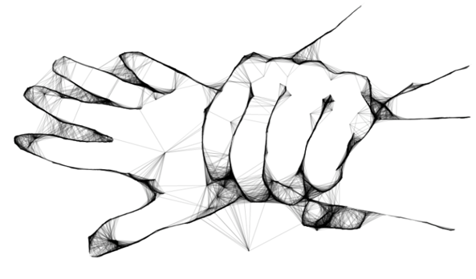
Physical
Physical abuse is any intentional and unwanted contact with you or something close to your body.
Sometimes abusive behavior does not cause pain or even leave a bruise, but it’s still unhealthy
Notes:
Battered women average 6.9 physical assaults by the same partner in a year
On average, nearly 20 people per minute are physically abused by an intimate partner in the US. During one year, this equates to more than 10 million women and men

Slide 23

Sexual
Sexual abuse refers to any action that pressures or coerces someone to do something sexually they don’t want to do
Unwanted kissing or touching, unwanted rough or violent sexual activity, rape or attempted rape
Refusing to use condoms or restricting someone’s access to birth control, keeping someone from protecting themselves from sexually transmitted infections (STIs),
Sexual contact with someone who is very drunk, drugged, unconscious, or otherwise unable to give a clear and informed “yes” or “no.”
2018 NCVRW Resource Guide: Sexual Violence Fact Sheet/2, https://ovc.ncjrs.gov/ncvrw2018/info_flyers/fact_sheets/2018NCVRW_SexualViolence_508_QC.pdf
Notes:
Over their lifetime, an estimated 19% of women and 2% of men will have been raped, while 44% of women and 23% of men will experience some other form of sexual violence
Most victims of rape or sexual assault are females under 24 years of age
Most rapes committed against women are committed by an intimate partner (spouse, boyfriend/girlfriend) or someone else they know (friend, family member, acquaintance)

Slide 24

Emotional
Emotional abuse is threatening a partner, or his or her possessions or loved ones, or harming a partner’s sense of self worth to gain and maintain control of the relationship.
Examples include, but are not limited to:
Name-calling
Intimidation
Isolating a partner from their friends and family
Breiding, M.J., Chen, J., & Black, M.C. (2014), Henning, K., & Klesges, L.M. (2003). Prevalence and Characteristics of Psychological Abuse Reported by Court -Involved Battered Women. Journal of Interpersonal Violence, 18(8)
Notes:
Emotional abuse is threatening a partner or his or her possessions or loved ones, or harming a partner’s sense of self worth to gain and maintain control of the relationship.
Examples include, but are not limited to:
Name-calling
Intimidation
Isolating a partner from their friends or family
48.4% of women and 48.8% of all men have experienced at least one psychologically aggressive behavior by an intimate partner
95% of men who physically abuse their intimate partners also psychologically abuse them
18.7% of women have experienced threats of physical harm by an intimate partner

Slide 25

Verbal
Verbal abuse refers to the use of language and tone as a means to instill fear and control or subordinate another person for either self-gratification or to impose one’s view or will on another to gain an unfair advantage.
Examples include: (Yelling) “How could you be so stupid?!”
(Screaming) “Don’t you ever speak while I’m talking!”

Slide 26

Economic
To limit a partner's access to assets or conceal information and accessibility to the family finances, which diminishes the capacity for the partner to support him/herself
Giving an allowance & monitoring what’s bought, denying access to his/her own paycheck, using the partner’s SS# to obtain credit without the partner’s permission.
NCADV, Quick Guide: Economic and Financial Abuse, April 12, 2017,
https://ncadv.org/blog/posts/quick-guide-economic-and-financial-abuse
Notes:
To limit a partner's access to assets or conceal information and accessibility to the family finances, which diminishes the capacity for the partner to support him/herself rendering them dependent on the abuser
Giving an allowance & monitoring what’s bought, denying access to his/her own paycheck, using the partner’s SS# to obtain credit without the partner’s permission, refusing to give money, food, clothing, rent, or medication, forbidding a partner to go to work or limiting their hours
Victims and survivors are often forced to choose between staying in abusive relationships and poverty or even homelessness. Economic abuse is a very common reason victims stay in abusive relationships. Economic abuse can take many forms, including employment-related abuse, preventing the victim from accessing existing funds, coerced debt, and more.
Employment-related abuse prevents the victim from earning money by:
Preventing victim from going to work
Sabotaging a victim's employment
Interfering with a victim's work performance through harassing activities such as frequent phone calls or unannounced visits
Demanding that the victim quits her/his job
Preventing the victim from looking for jobs or attending job interviews
Between 21-60% of victims of intimate partner violence lose their jobs due to reasons stemming from the abuse
Victims of intimate partner violence lose a total of 8 million days of paid work each year, 32000/yr

Slide 27

Digital
Digital abuse is the use of technologies such as texting and social networking to bully, harass, stalk, or intimidate a partner
Dictating who can and cannot be social media friends, using social media sites to keep tabs on partner, constant texts to the point of fear of being away from the phone, and/or looks through phone frequently.
Notes:
Nearly half of all young people age14-24 report being electronically harassed in some form; 40% report incidences of digital dating abuse, and 11% have shared naked pictures of themselves
49% percent of young people surveyed say they have been electronically harassed in at least one of the ways included in the 2013 survey
Photo purchased; dreamstime_xxl_49854431 (2)

Slide 28

Psychological
Any act, including confinement, isolation, verbal assault, humiliation, intimidation, infantilization, or any other treatment which may diminish the sense of identity, dignity, and self-worth
Such as…
Making them think there’s something wrong with them
Giving them the impression that they’re crazy
Imitating or mocking the person
Notes:
Other forms of abuse include revenge porn. Revenge porn is the posting, sharing, or publishing of nude and/or sexually explicit pictures/videos of a person on the internet without their consent, often accompanied by personal or identifying information ………………..Revenge porn is digital sexual assault
This term may be a bit uncomfortable for some of your audience members. You may address that discomfort by saying, “As uncomfortable as it may be to use this phrase in a professional setting, its effect on the victims is far worse than we can imagine.”
You may also direct them to www.EndRevengePorn.org for them to follow up at a later date.
This is not NEW. In the 1980’s, women sued Hustler Magazine for publishing their photos in the Beaver Hunt section without their permission. Several courts determined that publishing intimate photos without verifying whether the pictured women actually gave the go-ahead gave the false impression that all of the featured women felt comfortable with their pictures appearing in a “coarse and sex-centered magazine.”

Slide 29
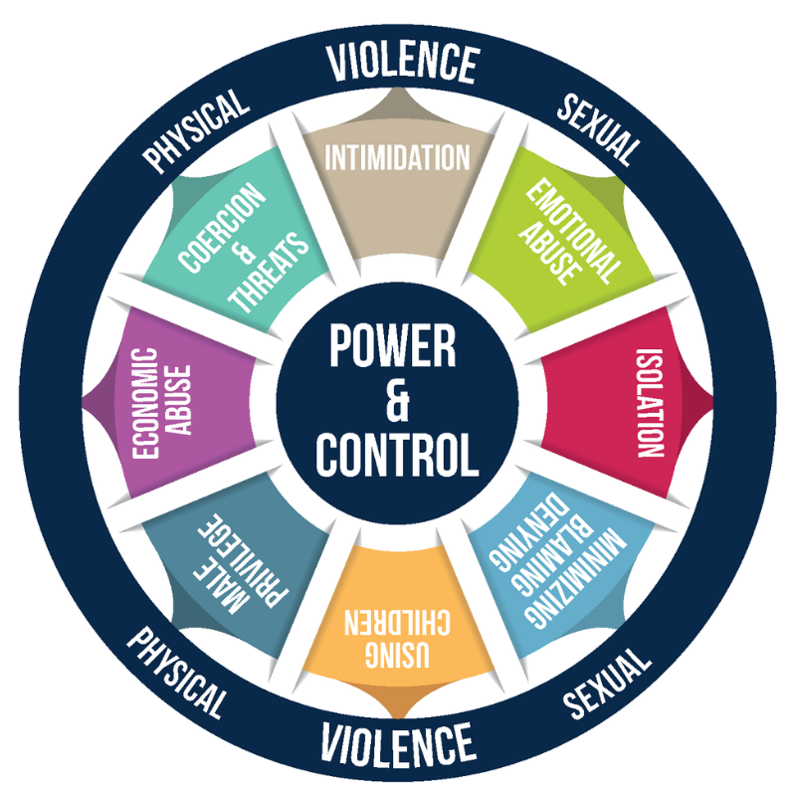
Power and Control

Slide 30
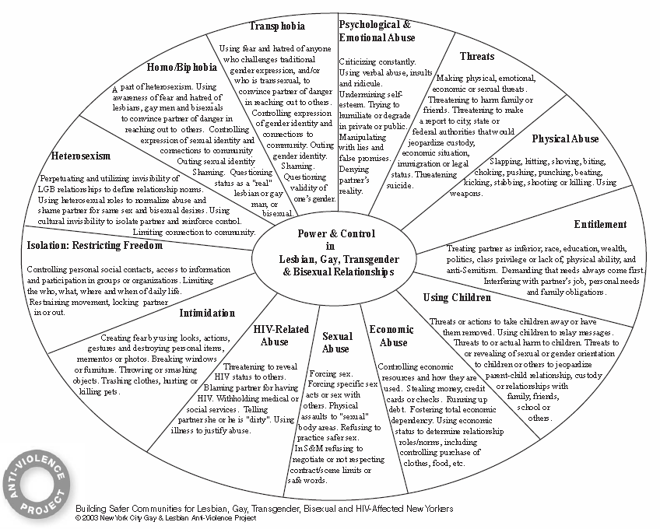
Power and Control in LGBTQ+

Slide 31

Why Stay?
Fear (of leaving, of losing custody, etc.)
Low self esteem
Source of income
Unaware of options or resources
Traumatic impact
Others?
Notes:
A victim's reasons for staying with their abusers are extremely complex and, in most cases, are based on the reality that their abuser will follow through with the threats they have used to keep them trapped: the abuser will hurt or kill them, they will hurt or kill the kids, they will win custody of the children, they will harm or kill pets or others, they will ruin their victim financially -- the list goes on.
A recent study of intimate partner homicides found 20% of homicide victims were not the domestic violence victims themselves, but family members, friends, neighbors, persons who intervened, law enforcement responders, or bystanders.
National Coalition Against Domestic Violence (NCADV)'s

Slide 32
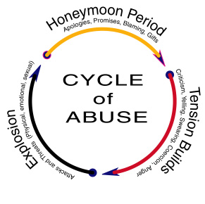
Cycle of Abuse

Slide 33
Narcisism
33
Abusive people believe that they have the right to control and restrain their partners, and they can enjoy the feeling of exercising power.
They often believe that their own feelings and needs should be the priority in their relationships, using abusive tactics to dismantle equality and make their partners feel less valuable and worthy of respect in the relationship.
Notes:
Male abusers are mentally ill and need psychological remedies such as therapy or medication
Initial studies characterized battered women as mentally ill
Men's violence is the result of their inability to control their anger and frustration.
Abusive people believe that they have the right to control and restrain their partners, and they can enjoy the feeling of exercising power.
They often believe that their own feelings and needs should be the priority in their relationships, so they use abusive tactics to dismantle equality and make their partners feel less valuable and worthy of respect in the relationship.

Slide 34
IPV Physical Symptoms
The most common injuries are headaches, insomnia, chronic pain, choking sensations, hyperventilation, and gastrointestinal symptoms, chest, back, and pelvic pain.
Traumatic brain injury (TBI) and nonfatal strangulation (choking) are often unrecognized forms of IPV and can lead to significant short and long-term neurologic sequelae.
Notes:
The most common injuries are headaches, insomnia, chronic pain, choking sensations, hyperventilation, and gastrointestinal symptoms, chest, back, and pelvic pain.
Traumatic brain injury (TBI) and nonfatal strangulation (choking) are often unrecognized forms of IPV and can lead to significant short and long-term neurologic sequelae.
(Neurological sequelae are those complications involving the central nervous system (CNS) that include cognitive, sensory, and motor deficits that may encompass emotional instability and seizure activity in the most severe cases.)
Broken bones and blacks eyes, (vision)

Slide 35
Coping with IPV
A decade ago, Christina Love was dropped off at a domestic violence shelter in Anchorage, Alaska, fearing her partner might attempt to kill her.
There was alcohol on her breath, so the shelter turned her away. Feeling like she had nowhere else to go, she went right back to her partner, who she says sexually assaulted her that very night.
Love was using substances, both alcohol and heroin, to cope with the trauma of IPV.
Notes:
Another time, her partner hit her in the face with a 2-by-4, and her jaw had to be wired shut. “Police brought me to the shelter, and they wouldn’t take me,” Love told Rewire.News in an interview. The same shelter turned her away because Love had been kicked out before for allegedly using and selling heroin.
Again, she went back to her partner.
Love says she was kicked out of six shelters over the years for substance-related offenses.
“The only place I had to go back to was my partner or else I would be homeless,” Love said. “There were times where [shelters] didn’t take me, and I had no where to go back to, and so I tried to commit suicide.”
Love still spends a lot of time going in and out of shelters that treat IPV, but now she’s teaching the people who run them how to improve their services as a training project specialist with the Alaska Network on Domestic Violence and Sexual Assault.
“These systems were designed to help me, and they did more harm by rejecting me, by telling me messages that I wasn’t worthy,” she said. “It was so dehumanizing to not be able to access services.”

Slide 36
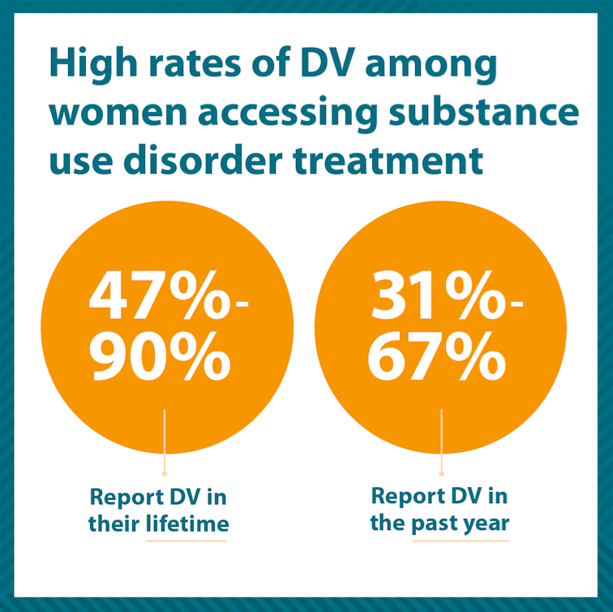
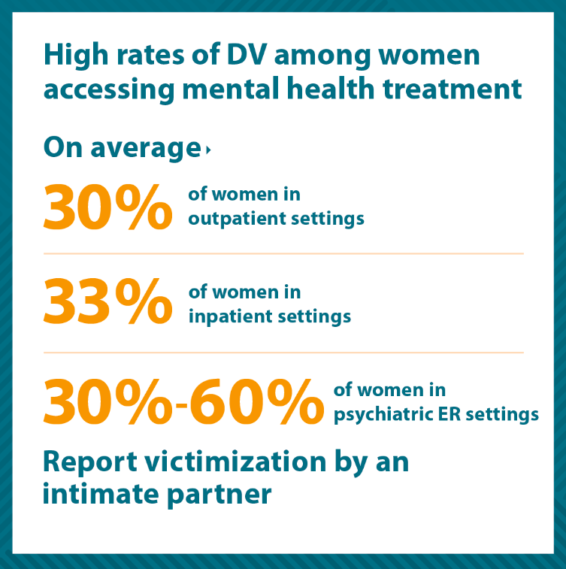
IPV, Mental Health, Substance Use
Domestic violence can have traumatic mental health and substance use effects, and is prevalent among people accessing mental health and substance use treatment.
National Center on Domestic Violence, Trauma, and Mental Health,
https://www.bwjp.org/resource-center/resource-results/national-center-on-domestic-violence-trauma-mental-health.html
Notes:
The other thing to consider is how the current environment increased everyone’s stress levels, and other challenges increased, resulting in higher rates of mental health problems and substance use

Slide 37
IPV and Mental Health
Major depressive disorder (MDD)
Generalized anxiety disorder (GAD
Posttraumatic stress disorder (PTSD)
Other substance use and related disorders
Notes:
Approximately 20% of IPV survivors reported experiencing a new onset of psychiatric disorders such as major depressive disorder (MDD), generalized anxiety disorder (GAD), and posttraumatic stress disorder (PTSD) and a wide range of substance use disorder
Women ever experiencing IPV are more likely to report complex health issues like unwanted pregnancy, sexually transmitted infections, musculoskeletal pain, physical disability, substance abuse, as well as psychological morbidities such as depression, anxiety and posttraumatic stress disorder (PTSD).
Each person experiences trauma differently. Some may have few or no lingering symptoms.
Trauma results from an event, series of events, or set of circumstances that is experienced by an individual as physically or emotionally harmful or life threatening and can have lasting adverse effects on the individual’s functioning and mental, physical, social, emotional, or spiritual well-being, their ability to live a relatively healthy life.
Substance abuse and dependence
Depression symptoms and disorders
Anxiety symptoms and disorders
Impairment in relational/social and other major life areas (including treatment)
Increased risk for mental illness and increases in symptom severity
Sleep disorders
Gastric conditions

Slide 38
Symptoms of PTSD
Fear and anxiety
Shame
Internalized guilt
Nightmares and memories
Hypervigilence
Notes:
Symptoms usually start early, within 3 months after the traumatic incident, sometimes years later
Symptoms must last more than a month and be severe enough to interfere with relationships or work to be considered PTSD.
To be diagnosed with PTSD, an adult must have all of the following for at least 1 month
At least one re-experiencing symptom
At least one avoidance symptom
At least two symptoms of arousal and reactivity.

Slide 39
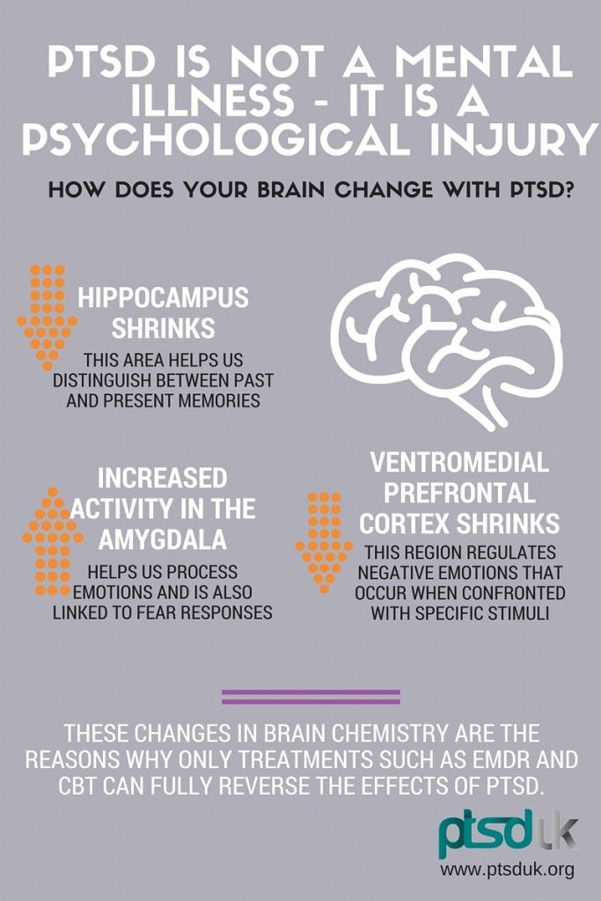
Notes:
One potential impact of IPV over time the severity of trauma or PTSD:
When affected by trauma, the hippocampus may be physically affected; studies have shown that in people suffering from PTSD, the volume of their hippocampus may be smaller than others. Mainly, the hippocampus will affect the ability to recall some memories for trauma survivors.
The brain structures that make up the limbic system play a major role in how one
experiences certain emotions (fear and anger), motivations, and memory.
If the prefrontal cortex shrinks, it would indicate difficulty with making informed decisions in terms of safety, in terms of helplessness can play a part in why coping with substances might be a viable option to deal with violence and oppression for some.
Emotional Dysregulation and Intimate Partner Violence can decapitate an individual

Slide 40
Other Vulnerabilities
Experiencing a mental health or substance use disorder places individuals at greater risk for being controlled by an abusive partner
Stigma associated with substance use and mental illness contributes to the effectiveness of abusive tactics and can create barriers for survivors when they seek help
Notes:
Stigma with mental health is very real within communities, but IPV is not believed when the abuser presents as a responsible and jovial person, at times potential supports ignorantly may suggest what it is that the person victimized is doing to cause conflict with their partner.
It is easier to manipulate a mind who’s functions are already compromised

Slide 41
Secondary Prevention
Notes:
We defined IPV as

Slide 42

Hispanic and Latinx
Notes:
Latinos have been in this country for 500+ years BEFORE the U.S. was founded, but that gets grossly overlooked by the media. But again, we’re specifically talking about historical trauma so we’ll start with immigration. For the Latino community the story is about the journey of immigration.

Slide 43
Hispanic and Latinx Communities Today
Approximately 1 in 3 of Latinas have experienced physical violence by an intimate partner in their lifetime, 50% don’t report
Depression and psychological distress are strongly associated with IPV
Unique cultural and contextual configuration for IPV among Hispanic women
Due to barriers like anti-immigrant laws, Latinas are 1/2 as likely to report abuse vs survivors from other ethnic/racial groups
Cummings, A. M., Gonzalez-Guarda, R. M., & Sandoval, M. F. (2013). Intimate Partner Violence Among Hispanics: A Review of the Literature. Journal of Family Violence, 28(2), 153–171. http://doi.org/10.1007/s10896-012-9478-5, Encuentro Latino, Latinos and Domestic Violence Fact Sheet, www.latinodv.org
Notes:
1 in 12 of Hispanic/Latina women experienced this violence in the previous 12 months (2011)
Non-immigrant Latina survivors contact formal services for IPV resources more often than immigrant Latinas⁹
Research is beginning to document work related IPV among Latin@s. One study reported abusive strategies such as, on the job surveillance, on the job harrassment, and work disruption tactics. However, they also found strategies that were unique in a Latino sample, such as denying access to driver’s license, lying about childcare arrangements, and sending the partner to their country of origin temporarily¹
Ethnic minority individuals who live in poor neighborhoods may experience multiple risk factors for depression, including unemployment, poverty, frequent changes of residence, and multiple stressful life events.
Abused Mexican-American women who report higher levels of spirituality also report higher levels of resilience in coping with intimate partner violence.

Slide 44
Cultural Perspectives
Every person has their own philosophies that speak to how they are and how they live, often founded on values inherent to the community of they identify with.
Cultural norms with them that influence how they experience and react to domestic violence.
Notes:
Consider culture and how influences how you engage

Slide 45
Hispanic, Latina, Latinx
Familismo refers to the importance of the family to its members and who is identified as family. The family unit is the fundamental and central support system for identity.
Personalism is about how one is perceived by the other, the face and face, as well as the formal or informal communication style.
Respect affects many areas of behavior, appropriate deferential behavior towards others based on gender, age, economic situation, etc. (that is, "Doña Serena").

Slide 46
Gender Role Expectations
Machismo underscores male responsibilities, including the provision and protection of the family.
Marianism is characteristic of many Latinas who believe that they must be submissive, self-sacrificing and complacent with their partner even in times of conflict.
Feminism where women are heads of household and tend to maintain multiple responsibilities.

Slide 47
Other Aspects of Culture
Religion can prevent victims from using services because they believe that the "sanctity of marriage" precludes any steps that may result in divorce or separation.
Acculturation in some studies indicates that gender-based violence is less prevalent among those with strong ties to traditional Latino cultural values ​​and orientation, and is associated with poor mental health among Latino survivors.
Immigration talks about possible limitations. Decisions about IVP are deeply affected by their immigration status and the climate of their communities.
Notes:
Los latinos han estado en este país durante más de 500 años ANTES de que se fundaran los EE. UU., Pero los medios lo pasan por alto. Pero, de nuevo, estamos hablando específicamente del trauma histórico, así que comenzaremos con la inmigración. Para la comunidad latina, la historia trata sobre el viaje de la inmigración.

Slide 48
Secondary Prevention
Notes:
Secondary prevention (often called intervention, or prevention) are efforts to identify and address early signs of abuse or abusiveness (secondary), screening addressing risk factors, SU, MH, referral to legal services.
Tertiary prevention or even to change individuals who are already abused or abusive (tertiary) in order to reduce the consequences of abuse such as death treat MH issues, provide safe housing, legal advocacy.

Slide 49
IPV Screening Tools
All of the screening tools evaluated by the USPSTF are directed at patients and can be self-administered or used in a clinician interview format. The 5 tools that showed the most sensitivity and specificity were:
HITS (Hurt, Insult, Threaten, Scream)
OVAT (Ingoing Violence Assessment Tool)
STaT (Slapped, Things and Threaten)
HARK (Humiliation, Afraid, Rape, Kick)
CTQ-SF (Modified Childhood Trauma Questionnaire–Short Form)

Slide 50
Hurt, Insulted, Threatened with Harm and Screamed (HITS) Domestic Violence Screening Tool

Slide 51
SAFE Screening for IPV
Stress and safety
  Do you feel safe in your relationship?
Afraid or Abused
  Has your partner ever threatened you or your children
  Has your partner ever abused you or your children
Friends and Family
  If you were hurt, would your friends or family know?
  Would they be able to help you?
Emergency Plan
  Do you have a safe place to go in an emergency?
  Do you need help in locating a shelter?
  Would you like to talk to a counselor about this?

Slide 52
Elements of Safety Planning
Become familiar with safe places
Create a code word
Keep computer safety in mind
Lean on a support network
Prepare an excuse
Stay safe at home
Notes:
Crisis Intervention
Become familiar with safe places. Learn more about safe places near you such as a local domestic violence shelter or a family member’s house. Learn the routes and commit them to memory. Find out more about sexual assault service providers in your area that can offer support.
Create a code word. It might be a code between you and your children that means “get out,” or with your support network that means “I need help.”
Keep computer safety in mind. If you think someone might be monitoring your computer use, consider regularly clearing your cache, history, and cookies. You could also use a different computer at a friend’s house or a public library.
Lean on a support network. Having someone you can reach out to for support can be an important part of staying safe and recovering. Find someone you trust who could respond to a crisis if you needed their help.
Prepare an excuse. Create several plausible reasons for leaving the house at different times or for existing situations that might become dangerous. Have these on hand in case you need to get away quickly.
Stay safe at home. If the person hurting you is in your home, you can take steps to feel safer. Try hanging bells or a noise maker on your door to scare the person hurting you away, or sleep in public spaces like the living room. If possible, keep the doors inside your house locked or put something heavy in front of them. If you’re protecting yourself from someone who does not live with you, keep all the doors locked when you’re not using them, and install an outside lighting system with motion detectors. Change the locks if possible.

Slide 53
Safety Planning When Leaving the Abuser
Make an escape bag
Plan a destination
Plan a route
Prepare your support network
Important Safety Note
Domestic Violence Personalized Safety Plan
http://www.ncdsv.org/images/dv_safety_plan.pdf
Notes:
Make an escape bag. Pack a bag that includes all important papers and documents, such as your birth certificate, license, passport, social security card, bills, prescription drugs, and medical records. Include cash, keys, and credit cards. Hide the bag well. If it’s discovered, call it a “hurricane bag” or “fire bag.” If you are escaping with children, include their identifying information as well.
Plan a destination. If you’re not going to stay with someone you know, locate the nearest domestic violence shelter or homeless shelter.
Plan a route. Then plan a backup route. If you are driving, have a tank of gas filled at all times. If you rely on public transportation, know the routes departure times. Many public transportation systems have mobile apps that update their schedules and arrival times.
Prepare your support network. Keep your support network in the loop. Let them know how to respond if the perpetrator contacts them.
Important Safety Note: If the dangerous situation involves a partner, go to the police or a shelter first.

Slide 54
Before Starting
What might you need to consider to create an atmosphere of trust and comfortability (trauma informed, culturally responsive, affirming) prior to beginning the screening with a patient?

Slide 55
Responses
When receiving many “no’s” to questions about safety, you may want to add...
…“I see that you have checked “no” about questions relating to feeling safe with your partner.
Do you have any other questions about this issue? (No)
I just want you to know that if anything like this ever does come up, this is a safe place to talk about it and get help.”
Notes:
Safety at Home:
Keep in mind that mild or infrequent IPV can escalate in frequency and severity. Always be aware of your surroundings. Be aware of triggers and red flags that indicate a violent incident may occur. Keep a journal of things that happen at home and keep it in a safe place
This is something you can easily stress over the phone, and consider your tone and don’t sound hurried.

Slide 56
Identifying Their Needs
Asking about IPV will enable you to:
Better understand your clients’ choices, feelings, and safety issues
Understand what experiences are contributing to their health problems, mental health problems, or substance abuse
Help them access services for themselves and their children
Inform them of their right to be healthy and safe

Slide 57
Trauma Informed Care (TIC)
Trauma Informed Care is an organizational structure and treatment framework that involves understanding, recognizing, and responding to the effects of all types of trauma.
TIC also emphasizes physical, psychological, and emotional safety for both consumers and providers, and helps survivors rebuild a sense of control and empowerment.
Notes:
Read highlighted portion. This slide is a setup for the next video, which is a very powerful statement as to what can happen to people who do NOT receive proper trauma informed care after being traumatized. [Segway/Transition Statement] You may insert your own, or use mine, “Let’s take a look at a powerful story of how life can look without trauma informed care.”

Slide 58
Trauma Informed in Practice
Trauma can affect survivors’ experience of services
Avoidance of trauma triggers
Reluctance to reach out when trust has been betrayed
Re-traumatization in clinical settings; misperception of trauma responses and coping strategies

Slide 59
When Screening and Assessing
Screening & Assessment with an IPV/Trauma Lens: Understanding intersections; understanding responses; understanding culture, strengths, resources, options, & supports
TI Approach to Screening & Assessment Relationships and environments we create: How we connect, how we ask, how we respond, how we partner, what we expect
What does it take to do that? Understanding trauma, IPV & context; Awareness of own responses; and support to address them including a TI organizational culture & ongoing training & supervision
National Center on Domestic Violence, Trauma & Mental Health, http://www.nationalcenterdvtraumamh.org/, retrieved May 2020

Slide 60
Tertiary Prevention
Notes:
Tertiary prevention or even to change individuals who are already abused or abusive (tertiary) in order to reduce the consequences of abuse such as death treat MH issues, provide safe housing, legal advocacy.

Slide 61
Referrals
Medical services
Law enforcement agencies
Legal assistance
Victim assistance programs
Support groups
Others?

Slide 62
IPV Resources
National Domestic Violence Hotline, 800.799.SAFE(7233), https://www.thehotline.org/help/
Domestic Violence Personalized Safety Plan, http://www.ncdsv.org/images/DV_Safety_Plan.pdf
National Center on Domestic Violence, Trauma & Mental Health, http://www.nationalcenterdvtraumamh.org/,
The National Coalition Against Domestic Violence—An advocacy organization working to prevent domestic violence and empower those affected.
The Academy on Violence & Abuse—An interdisciplinary organization of healthcare professionals dedicated to making violence and abuse a core component of medical and related professional education and clinical care.

Slide 63
Certificate of Completion
Before you leave!
Complete an online evaluation by scanning the code with the camera on your phone, click on the link that Clyde will put in the chat, write down the link and type in your browser, or email for the link.
Certificates will be sent out within a week with a copy of the slides.
This webinar is approved for 2 hours of CASAC, CPP, CPS credentialing. You must attend the session in its entirety.
Notes:
Complete an online evaluation by scanning the code with the camera on your phone, or clicking on the link that Clyde will put in the chat. If neither of those work, either write down the link and type in their browser, or email patricia.chaple for the link.
Certificates will be sent out within a week.
A copy of the slides will be sent out on Monday.
Photo purchased: ID 180103732 © Wave Break Media Ltd | Dreamstime.com

Slide 64

Contact and Survey
Diana Padilla
Research Project Manager
SBIRT Technical Assistance
Diana.Padilla@nyspi.columbia.edu
Clyde Frederick
Technologist
NeC-ATTC Program Support
Clyde.Frederick@nyspi.columbia.edu
Division on Substance Use Disorders / New York State Psychiatric Institute
Department of Psychiatry / Columbia University Medical Center
ATTCnetwork.org/northeastcaribbean
If you are sharing a computer with others, please type your names in the chat box.
Please fill out your evaluation forms – it will only take a couple of minutes! Just scan the code with the camera on your smart phone, click on the link in the chat box, or type the link into your browser: (LINK REMOVED)
Don’t worry if you can’t – an email with the link will be sent to you on Monday, along with a copy of the slides.
Certificates will be sent within a week.
QR CODE REMOVED

