Slide 1
Preventing Underage Alcohol Use Part 2: Strategies and Recommendations for Prevention
Thank you for joining us today.
We will begin promptly at 1PM Eastern.
While waiting for us to get started, please share in the chat if there are any T/TA topics you are interested in hearing more about from us in the future.

Slide 6

Housekeeping
Webinar Recording
available online in 4-6 weeks at
bit.ly/ce-pttc
After the webinar:
Complete the
brief, 10-question Evaluation Form
Resource Page
List of resources shared today
PowerPoint slides
Link to request Certificate of Attendance
to gain access to

Slide 7
Welcome
Central East PTTC Webinar
Preventing Underage Alcohol Use Part 2: Strategies and Recommendations for Prevention
The Central East PTTC is housed at the Danya Institute in Silver Spring, MD
Oscar Morgan Executive Director | Deborah Nixon Hughes Project Director
Notes:
PTTC SLIDE

Slide 8
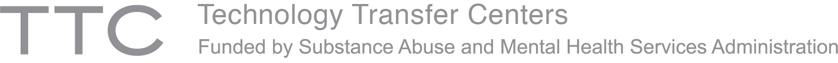



Each TTC Network includes 13 centers.
Network Coordinating Office
National American Indian and Alaska Native Center
National Hispanic and Latino Center
10 Regional Centers (aligned with HHS regions)
Notes:
The purpose of the Technology Transfer Centers (TTC) is to develop and strengthen the specialized behavioral healthcare and primary healthcare workforce that provides prevention, treatment and recovery support services for substance use disorder (SUD) and mental illness.
National Coordinating Office provides network wide coordination and serves as Liaison for national and international focused activities
National Population Specific Centers Serve as center of excellence/subject matter exp. for specific pops nationally

Slide 9
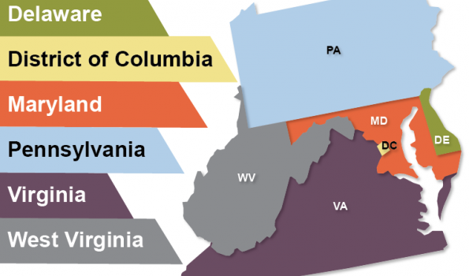
Central East Region
HHS REGION 3
Notes:
Central East serves HHS Region 3 with SAMHSA’S to develop & implement reg. approach for workforce dev. Activities and collaborate with SAMHSA Reg. Admins to support the region.

Slide 10
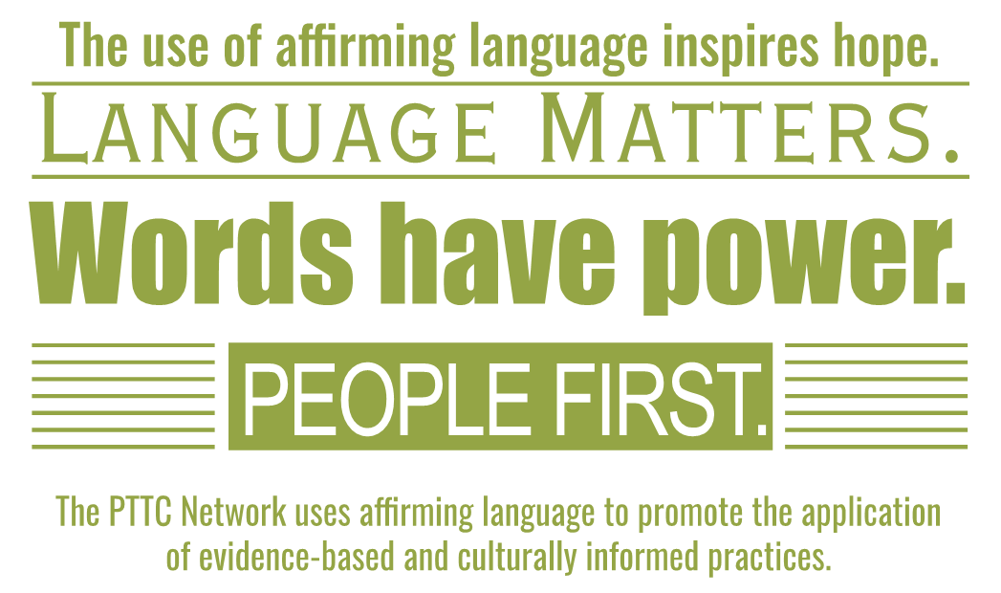

Slide 11
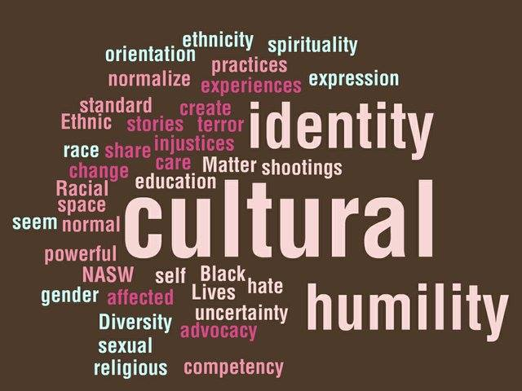

Slide 12
PTTC Mission
1
To Strengthen the Capacity of the Workforce
2
To Deliver Evidence-Based Prevention Strategies
Facilitate Opportunities for Preventionists to Pursue New Collaboration Opportunities, which include Developing Prevention Partnerships and Alliances
3
Notes:
Central East serves HHS Region 3 with SAMHSA’S to develop & implement reg. approach for workforce dev. Activities and collaborate with SAMHSA Reg. Admins to support the region.

Slide 13
Central East PTTC Specialty Area
Engaging and Collaborating with Primary Care Providers for Substance Use Prevention
Primary Care
Reducing Stigma
Prevention
Notes:
Central East serves HHS Region 3 with SAMHSA’S to develop & implement reg. approach for workforce dev. Activities and collaborate with SAMHSA Reg. Admins to support the region.

Slide 14


Eligibility
Consistent with Regional, State and Local Needs
No Cost
EBPs provided by Subject Matter Experts
Data Driven
Notes:
Central East serves HHS Region 3 with SAMHSA’S to develop & implement reg. approach for workforce dev. Activities and collaborate with SAMHSA Reg. Admins to support the region.

Slide 15








PTTC Focus Areas
Opioid/ Harm Reduction Strategies
Youth Vaping/Tobacco
Trauma
Youth Alcohol and Suicide
Health equity and the elimination of disparities
Suicide prevention and substance use overdoses
Workforce Development
Notes:
Central East serves HHS Region 3 with SAMHSA’S to develop & implement reg. approach for workforce dev. Activities and collaborate with SAMHSA Reg. Admins to support the region.

Slide 16













Services Available
Online Courses
Technical Assistance
Skill Based Training
Webinar
Facilitate Prevention Partnership & Alliances
Research Learning Collaborative
Toolkits
Newsletter
Technology Driven Models
Literature Searches
Virtual Meeting
Research Publication

Slide 17


Other Resources in Region 3

Slide 18
Preventing Underage Alcohol Use Part 2: Strategies and Recommendations for Prevention
Josh Esrick
PTTC Prevention Specialist
Chief of Training and Technical Assistance
Carnevale Associates, LLC
Emily Patton
Senior Research Associate
Carnevale Associates, LLC
April 27, 2023

Slide 19



Presenters
Josh Esrick
Emily Patton

Slide 20
Learning Objectives
Recognize the importance of providing evidence-based alcohol misuse prevention strategies
Describe evidence-based environmental strategies for preventing underage alcohol use
Describe evidence-based behavioral strategies for preventing underage alcohol use among early adolescents and college-age youth
Identify Federal prevention efforts to address underage alcohol use

Slide 21
The Importance of Evidence
Part I discussed the continued need for underage alcohol use prevention services
Need to ensure that the interventions we implement have the greatest possible likelihood of success
Strength of evidence varies significantly
Many EBPs for underage alcohol use exist
Notes:
Prevention can have many goals, varying in specificity, related to preventing and reducing rates of substance misuse or associated factors
When preventionists implement polices/programs/strategies, it is important to know that what we are doing will help us achieve our goals
The evidence base for prevention tells us what policies/programs/strategies can have what impacts among which populations
Evidence can also mean prevalence data, telling us about the concerns in our communities

Slide 22
Continuum of Evidence (CDC)
Notes:
Q. What is your or your agencies’ process for evaluating the evidence of programs?
Photo Credit: https://www.cdc.gov/violenceprevention/pdf/understanding_evidence-a.pdf (page 8)
Keep in mind throughout the planning process
Puddy, R. W. & Wilkins, N. (2011). Understanding Evidence Part 1: Best Available Research Evidence. A Guide to the Continuum of Evidence of Effectiveness. Atlanta, GA: Centers for Disease Control and Prevention
At one end of the continuum are programs or strategies that have been rigorously evaluated through scientific methods. While caveats exist to all research exist, programs/strategies at this end are the ones we are most confident in saying are effective.
At the other end of the continuum are programs or strategies that have not been as thoroughly evaluated; such as not being studied as often, or having studies with less rigorous methodological designs, or only found effective under certain specific circumstances. These are NOT programs/strategies that have been found ineffective though.
Most programs/strategies fall somewhere along this continuum and often there will not be a supported or well-supported program that fits a communities specific needs. That’s okay, and we’ll talk about “best fit” later in this presentation.

Slide 23
Environmental vs. Behavioral Strategies
Environmental strategies seek to change the environment and context away from supporting use
  E.g., Increased compliance checks on alcohol retailers to ensure they are not selling to youth
Behavioral strategies seek to impact individuals’ knowledge, skills, and behaviors related to their risk of substance use
  E.g., A course that teaches life skills to high school students to reduce underage alcohol use
Notes:
Theory of Planned Behavior--beliefs, attitudes, knowledge, to impact decision making. teaching lifeskills...
Environmental Strategies
Policy
Enforcement
Communication
Multi-Component
Behavioral Strategies

Slide 24
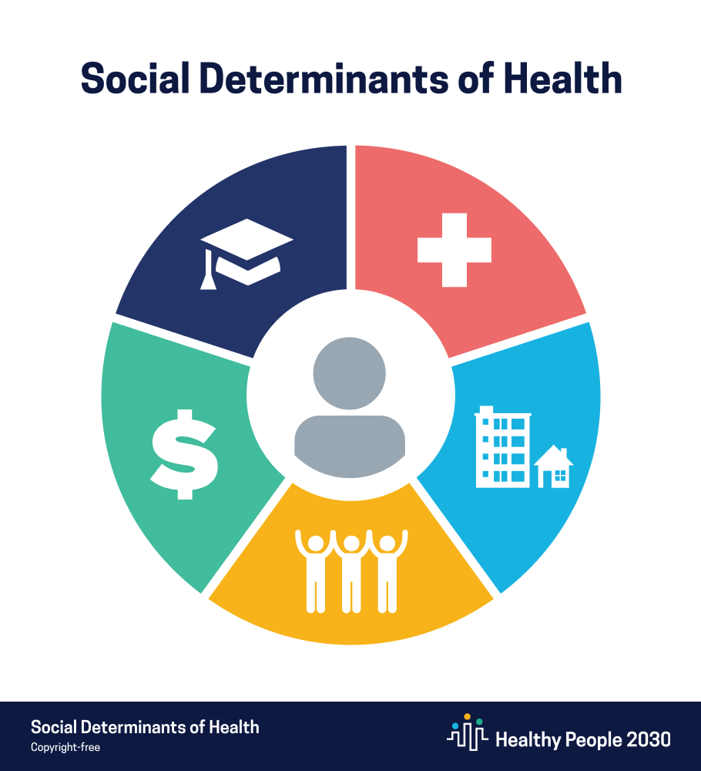
And Don’t Forget the Social Determinants of Health!
Some of the environmental strategies we’ll cover today address some SDOH
Many other potential interventions exist with a high likelihood of success due to their impact on known risk factors
But they often haven’t been studied to verify an impact on underage alcohol use
Notes:
https://health.gov/healthypeople/objectives-and-data/social-determinants-health (also Image Credit)
Funding childcare for working parents
Training health care providers on how to better serve populations of need
Implementing anti-discrimination workplace training
Enforcing anti-pollution regulations
Developing new ”green spaces” in the community
Expanding school safety programs

Slide 25
Modeling An Approach (Frieden, 2010)
Greater Individual Effort Needed
Counseling and Education
Clinical Interventions
Greater Population Impact
Long-Lasting Protective Interventions
Environmental Context
Socio-Economic Factors
Notes:
https://www.ncbi.nlm.nih.gov/pmc/articles/PMC2836340/
Socio-Economic Factors- Social determinants of health: e.g. poverty levels, education levels, etc.
Environmental Context- Changes that make the healthy choice the default option, regardless of socio-economic factors: e.g. Raising the MLDA
Long-Lasting Protective Interventions- 1-time or infrequent preventive measures: e.g. classic example from other fields: immunization. Within prevention: community awareness raising
Clinical Interventions- Interventions to address individual root causes: e.g. reducing stress, providing housing, etc.
Counseling and Education- Interventions to effect behavioral change; e.g. education on the risks of substance use
Socio-Economic Factors
Lower socio-economic status associated with higher alcohol risk behavior among adolescents
Environmental Context
Excise taxes; retailer education
Long-Lasting Protective Interventions
Graphic anti-FASD or anti-DUI campaigns; social norms campaign
Clinical Interventions
Teaching peer pressure and stress coping skills
Counseling and Education
Education about the risks of problem alcohol use

Slide 26

Environmental: Policy Changes
Many different policies exist, with a variety of goals (SAMHSA):
  Prevent youth from obtaining alcohol
  Deter adults from selling or providing alcohol to youth
  Make alcohol less attractive to youth
Notes:
https://preventionsolutions.edc.org/services/resources/policy-strategies
https://www.collegedrinkingprevention.gov/CollegeAIM/EnvironmentalStrategies/default.aspx
Q. What are some policies we can implement to achieve these goals?

Slide 27
Preventing Youth from Obtaining Alcohol
Minimum-age-of-purchase and of-possession laws
Alcohol home delivery restrictions
Restricted alcohol availability at community events
Location or density restrictions on retailers
ID sales check requirements
Notes:
“Minimum age of alcohol purchase, sale, and server laws are a suite of alcohol control policies that stipulate the minimum age for alcohol transactions. Minimum age of purchase laws prohibit minors from buying or attempting to buy alcoholic beverages. Minimum age of seller laws specify a minimum age for employees who sell alcoholic beverages in off-premises establishments (e.g., liquor, grocery, and convenience stores). Minimum age of server laws specify a minimum age for employees who serve or dispense alcoholic beverages in on-premises establishments (e.g., bars and restaurants).”
“Minor in possession of alcohol laws prohibit the possession, consumption, or internal possession of alcohol by underage youth.”
“Alcohol restrictions at community events are policies that control the availability and use of alcohol at public venues (e.g., concerts, street fairs, and sporting events). Restrictions can be implemented voluntarily by event organizers or through local legislation.”
“Local licensing or zoning ordinances can limit the location and density (i.e., number within a geographic area) of outlets within a community where alcohol can be legally sold for the buyer to drink on-premise (e.g., bars, restaurants) or off-premise (e.g., liquor stores).”

Slide 28
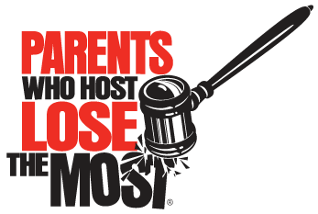
Deter Adults From Providing Access
Responsible beverage retailer/seller training requirements
Dram shop liability laws
Educating retailers/sellers about enforcement efforts
------
Social host liability laws
Beer keg registration
Notes:
Image credit: https://preventionactionalliance.org/about/programs/parents-who-host-lose-the-most/
“State laws and/or local ordinances can mandate responsible beverage server/seller training (RBST) designed to provide alcohol outlet owners, managers, and staff with the knowledge and skills needed to serve alcohol responsibly and fulfill the legal requirements of alcohol service.”
“Dram shop liability laws are statutory (i.e., written) provisions that allow licensed drinking establishments (e.g., restaurants, bars, liquor stores) to be held financially liable for serving alcohol to an underage or intoxicated person who later causes injury to a third party.”
“Social host liability laws impose civil and/or criminal penalties on individuals (social hosts) for underage drinking events held on property they own, lease, or otherwise control.”
“Beer keg registration requires retailers to tag, sticker, or engrave an identification number on kegs that exceed a specified capacity (two- to eight-gallon minimum depending on the state). Tagged kegs help law enforcement officers identify the liable adult who purchased the keg used in underage drinking situations.”

Slide 29
Making Alcohol Less Attractive
Advertising restrictions
Happy hour restrictions
Price increases
Education about enforcement activities
Sanctions for violating policies
Campus policies
Notes:
Image Credit: https://www.csmonitor.com/USA/Society/2015/0121/L.A.-ban-on-some-alcohol-ads-will-protect-young-people-advocates-say
“Alcohol advertising restrictions include any policies that limit advertising of alcoholic beverages, particularly advertisements that expose young people to pro-alcohol messages. They can include regulations on electronic media (e.g., radio, television internet), print media (e.g., magazines and newspapers), outdoor billboards, and signs.”
“Happy hour restrictions are policies that reduce or limit alcohol price promotions and specials. Happy hour promotions often attract younger drinkers and encourage binge-drinking by making alcohol less expensive.”
“Alcohol price increases involve raising the unit price of alcohol by raising excise taxes (often included in the price of alcohol) and/or sales taxes (charged in addition to the price of alcohol). The revenue generated from tax increase(s) can be used to support public health and public safety services.”

Slide 30
Recommendations to Improve Effectiveness
Make sure adults are held accountable for providing underage access
Ensure there are deterrents against use and incentives for not using
Restrict alcohol access generally in settings where youth may have access
Provide education on enforcement efforts and policy changes
Notes:
https://preventionsolutions.edc.org/services/resources/policy-strategies

Slide 31

Environmental Scanning (CADCA)
The “4 Ps of Marketing”
  Price, Promotion, Place, Product
Environmental Scanning is a process of learning about the 4 Ps as part of a needs assessment
  And determining the appropriate environmental strategies to address them
Notes:
https://www.cadca.org/sites/default/files/resource/files/environmentalstrategies.pdf
This Photo by Unknown Author is licensed under CC BY-SA
The “4 Ps of Marketing”
Price, Promotion, Place, Product
Particularly relevant to determining the availability and attractiveness of alcohol to older youth
Environmental Scanning is a process of learning about the 4 Ps as part of a needs assessment
And determining the appropriate environmental strategies to address them

Slide 32

Environmental: Enforcement Strategies
Numerous laws and regulations exist to prevent underage alcohol use; enforcement improves their effectiveness (SAMHSA)
  Retailer compliance surveys
  Compliance sales checks
  Police enforcement
  Sobriety checkpoints
  Juvenile diversion programs
Notes:
https://preventionsolutions.edc.org/services/resources/enforcement-strategies-0
” Alcohol purchase surveys, also known as compliance surveys, use young adults who appear—but are not—underage as decoys to attempt to purchase alcohol from retail stores. This strategy, which can reveal how easily available alcohol is to young people and who is selling it to them, can be used when compliance checks are not possible (e.g., law does not permit underage decoys to buy alcohol, lack of law enforcement capacity).”
“Compliance checks use underage decoys to attempt to purchase alcohol from retail merchants.”
Undercover law enforcement such as the Cops in Shops program. Also neighborhood patrols and responding to complaint calls about parties and other alcohol consumption.
“Law enforcement officials use sobriety checkpoints to evaluate drivers for signs of alcohol or drug impairment and enforce existing driving under the influence (DUI) or driving while intoxicated (DWI) laws accordingly.”
“Juvenile Diversion programs are typically for first-time youth offenders who have been arrested for drug or alcohol-related crimes (e.g., driving while intoxicated, underage possession of alcohol, disorderly behavior resulting from intoxication). As an alternative to processing offenders through the court system, resulting in fines or incarceration, diverted youth receive sanctions and services designed to address risk factors that contribute to alcohol-related offenses. Diversion programs vary in length, services provided, and requirements for parent/guardian involvement.”

Slide 33
Recommendations to Improve Effectiveness
Address community concerns about law enforcement
Address loosening enforcement due to COVID
Enforce minor-in-possession laws
Enforce impaired driving laws
Implement zero tolerance driving laws
Educate the community about enforcement efforts
Expand complementary prevention efforts, such as beverage server training
Notes:
https://preventionsolutions.edc.org/services/resources/enforcement-strategies-0
“Research suggests that communities are more likely to reduce underage drinking and its consequences if they:
Enforce minor-in-possession as well as minimum-age-of-purchase laws using undercover buying operations (e.g., compliance checks). Undercover community buying operations that provide positive and negative feedback to merchants are effective in increasing retailer compliance with underage drinking laws.¹
Limit driving privileges for those who violate minimum-age purchase and minor-in-possession laws. Suspending the driver’s license of a person under age 21 following a conviction for any alcohol or other drug violation is an effective way to increase compliance with minimum-age of purchase and minor-in-possession laws among youth.²
Enforce impaired driving laws. This kind of enforcement is important because it increases public perception of the risk of being caught and punished for driving under the influence of alcohol. Sobriety checkpoints are one example of this kind of public enforcement of underage drinking laws.³
Pair enforcement of laws against sales to minors with server training. Such pairing increases the effectiveness of training programs in producing changes in selling and serving practices.⁴
Educate the public about increased enforcement efforts. For policy changes and enforcement to be successful, the public must know what policies they are expected to follow, and the extent to which penalties for violating such policies are appropriately severe and swiftly and consistently implemented.^{5”}

Slide 34

Environmental: Communication Strategies
Efforts to change negative community norms and reinforce positive norms related to preventing underage alcohol use (SAMHSA)
  Media advocacy
  Social norms campaigns
  Counter-advertising
  Marketing campaigns
Notes:
https://preventionsolutions.edc.org/services/resources/communication-strategies
“Media and other communications efforts can be used to help change or reinforce community norms concerning tolerance of alcohol sales to, and use by, minors. Policies must correspond with community beliefs about the harm of a particular substance or the "rightness" or "wrongness" of a particular action. For a community to accept, promote, and enforce a particular policy or regulation, there must be some understanding of the problem and a readiness to change based on that understanding.
For this reason, prevention practitioners frequently employ the local media and use public education strategies to influence community norms. Media can also increase public awareness of specific issues and problems related to underage drinking; attract community support for program efforts; reinforce individual-, family-, and community-level programs for young people and/or their parents; and keep the public informed about program progress. Research suggests that these communication campaigns are more effective when they:
“

Slide 35
Recommendations to Improve Effectiveness
Combine with more intensive and interactive efforts
Present messages that appeal to youth and directly counter their perceptions of alcohol
Tailor messages to different groups
  “Underage youth” are NOT homogenous
Place messages where youth are likely to encounter them
Notes:
“Are combined with more intensive and interactive prevention approaches. When coupled with other, more intensive and interactive prevention approaches or with policy and enforcement activities, the media can be a useful tool for reaching many people in the surrounding community.¹
Present messages that appeal to young people’s motives for and perceptions of drinking alcohol. Messages that appeal to or correct young people’s perceptions of risk are more likely to be effective than messages that do not.² For example, counter-advertising campaigns that disseminate information about the hazards of a product or the industry that promotes it can help reduce alcohol sales and consumption.
Tailor messages to the audience. "Young people" are not a homogeneous group—they vary by a range of characteristics, including (but not limited to) age, gender, ethnicity, education, social group, and experience. Knowledge of these traits can help prevention practitioners develop and deliver appropriate messages that resonate with the particular audience(s) they are trying to reach.³
Place messages where young people are likely to see and hear them. It is strategic to pay for television and radio "spots" in choice airtimes when youth are more likely to view or listen.⁴ Similarly, new media and social media provide other channels to reach youth with messages about underage drinking.
“

Slide 36

Multi-Component Strategies
Efforts to combine behavioral strategies with environmental strategies
Rely on bringing different sectors of the community together to collaborate
Take a public health approach to preventing underage alcohol use
Notes:
Border Binge Drinking Reduction Program
Midwestern Prevention Project
Massachusetts Saving Lives Program
Communities Mobilizing for Change on Alcohol
Community Trials Intervention to Reduce High-Risk Drinking
The Border-Binge Drinking Reduction program is a multi-component program that combines communication, enforcement, and policy strategies to reduce underage drinking and binge drinking in border towns. It aims to prevent U.S. youth under 21 years old from entering another country that has a lower legal drinking age (i.e., Mexico) to gain commercial access to alcohol.
The Midwestern Prevention Project (MPP), also known as Project STAR, is a comprehensive, school-centered, and community-based program for sixth- to eighth-grade students that includes a classroom curriculum, parent education, community organizing, policy development, and media advocacy. Components are introduced sequentially over the span of five years.
Targeting alcohol-related traffic incidents, the Massachusetts Saving Lives program combines community organization efforts with enforcement of underage drinking laws, community events, communication campaigns, environmental modifications, and focused education/trainings.
Communities Mobilizing for Change on Alcohol (CMCA) is a multi-step community organizing process, designed by community members (including youth) and led by a part-time community organizer, that combines policy, law enforcement, and communications strategies to prevent underage drinking.
“Implemented by coalitions over several years, the Community Trials (CT) Intervention to Reduce High-Risk Drinking combines public awareness campaigns, responsible beverage service, and enforcement of existing alcohol laws.”

Slide 37
Recommendations to Improve Effectiveness
Focus on complimentary strategies
Coordinate with other prevention efforts
Collaborate with experts and other stakeholders
Focus on preventing adult problem alcohol use as well
Notes:
Q: Are there other environmental strategies you have implemented to prevent underage drinking?

Slide 38

Prevention Strategies for Early Adolescents
Notes:
This Photo by Unknown Author is licensed under CC BY-ND

Slide 39

Evidence-Based Behavioral Strategies (Blueprints)
Functional Family Therapy
LifeSkills Training
Multisystemic Therapy (MST)
New Beginnings
Positive Action
Notes:
This Photo by Unknown Author is licensed under CC BY
Behavioral Strategies
At least 5 model/model + programs for ages 5-14 with alcohol-related outcomes; another 17 promising programs (Blueprints)
Environmental Strategies
Most studies of environmental strategies for underage drinking have focused on older youth
Those broadly focused on social determinants of health may likely have an impact though

Slide 40
Functional Family Therapy
Short-term, family-based intervention for adolescents with justice-involvement at risk for institutionalization
Implementation requires master’s level therapists with licensed clinical therapist oversight
Among other outcomes, found to significantly reduce alcohol use among early adolescents
Notes:
https://www.blueprintsprograms.org/programs/28999999/functional-family-therapy-fft/
Short-term, family-based intervention for delinquent youth at risk for institutionalization
Intended to improve within-family attributions, family communication, and supportiveness
And decrease negativity and dysfunctional behavior patterns
Implementation requires master’s level therapists with licensed clinical therapist oversight
Among other outcomes, found to significantly reduce alcohol use among youth ages 12-14

Slide 41
LifeSkills Training
Classroom-based universal prevention program for ages 12-14; intended to reduce alcohol, tobacco, and marijuana use, & reduce violence
Primary implementers are teachers; should attend a 15-hour training and obtain program materials
Among other outcomes, found to significantly reduce alcohol use for up to 6 years post-intervention
Notes:
https://www.blueprintsprograms.org/programs/5999999/lifeskills-training-lst/
Classroom-based universal prevention program for ages 12-14; intended to reduce alcohol, tobacco, and marijuana use, & reduce violence
Focus on teaching self-management skills, social skills, and drug awareness and resistance skills
Primary implementers are teachers; should attend a 15-hour training and obtain program materials
Among other outcomes, found to significantly reduce alcohol use for up to 6 years post-intervention

Slide 42
Multisystemic Therapy
An intensive family- and community-based intervention
A therapist with a caseload of 4 to 6 families, provides most of the mental health services and coordinates access to other important services
MST has demonstrated a variety of positive outcomes related to alcohol risk factors as well as minor reductions in substance use at post-test
Notes:
https://www.blueprintsprograms.org/programs/32999999/multisystemic-therapy-mst/
An intensive family- and community-based treatment
Seeks to address the multiple causes of serious antisocial behavior in serious juvenile offenders
A therapist with a caseload of 4 to 6 families, provides most of the mental health services and coordinates access to other important services 3- to 5-month course of treatment
MST has demonstrated a variety of positive outcomes related to alcohol risk factors as well as minor reductions in substance use at posttest

Slide 43
New Beginnings
Group-based intervention for divorced parents and their children ages 3-11, consists of 10 two-hour sessions
Implemented by master’s level clinicians
Found to significantly improve child resilience and parenting quality measures, which led to various other positive outcomes
  Including reduced child participant alcohol use up to 15 years post-intervention
Notes:
https://www.blueprintsprograms.org/programs/613999999/new-beginnings-for-children-of-divorce/
Group-based intervention for divorced parents and their children ages 3-11, consists of 10 two-hour sessions
Intended to improve parent-child interactions and decrease child exposure to interparental conflict
Implemented by master’s level clinicians
Found to significantly improve child resilience and parenting quality measures, which led to various other positive outcomes
Including reduced child participant alcohol use up to 15 years post-intervention

Slide 44
Positive Action
School-based social emotional learning program for grades K-6 and 7-8
Implemented by teachers, along with school administration and other school stakeholders
Among other outcomes, found to significantly reduce rates of a combined measure of all forms of substance use, including alcohol
Notes:
https://www.blueprintsprograms.org/programs/182999999/positive-action/
School-based social emotional learning program for grades K-6 and 7-8
Intended to promote positive actions, discourage negative behavior, improve learning, and improve school climate
Consists of classroom and school-wide activities, with grade-specific lessons
Implemented by teachers, along with school administration and other school stakeholders
Among other outcomes, found to significantly reduce rates of a combined measure of all forms of substance use, including alcohol

Slide 45
Promising Programs
Be Proud! Be Responsible!
Big Brothers Big Sisters of America
Communities That Care
EFFEKT
Familias Unidas
Fostering Healthy Futures for Preteens (FHF-P)
Good Behavior Game
Guiding Good Choices
Incredible Years- Parent
Learning Together
Positive Family Support
PROSPER
Raising Healthy Children
RealTeen
Safe Dates
Strengthening Families 10-14
Strong African American Families Program
Notes:
Multi-Systemic Therapy- mention
https://www.blueprintsprograms.org/program-search/?localPageSize=5000&age%5B%5D=756&age%5B%5D=757&keywords=alcohol

Slide 46

Prevention Strategies for College-Age Youth
Notes:
This Photo by Unknown Author is licensed under CC BY-NC

Slide 47


Behavioral Strategies
Brief Alcohol Screening and Intervention for College Students (BASICS)
Communities That Care
InShape Prevention Plus Wellness
Strategies found to address risk factors
Notes:
This Photo by Unknown Author is licensed under CC BY-SA
https://www.blueprintsprograms.org/program-search/?localPageSize=5000&o_alcohol=1&age%5B%5D=754&keywords=alcohol
Behavioral Strategies
At least 10 model or promising programs for emerging adults (ages 19-22) have positive outcomes related to underage alcohol use or associated risk factors (Blueprints)
Environmental Strategies
Many environmental strategies with evidence of effectiveness for this age group

Slide 48
BASICS
Brief prevention intervention for college students who have begun using alcohol heavily and are at high risk for alcohol use disorder
Conducted over two sessions/interviews with an empathetic, non-confrontational style
Significantly associated with reductions in alcohol use and associated problems compared to control groups
Notes:
https://www.blueprintsprograms.org/programs/203999999/brief-alcohol-screening-and-intervention-for-college-students-basics/
Brief prevention intervention for college students who have begun using alcohol heavily and are at high risk for alcohol use disorder
Intended to help students make better alcohol-related decisions and understand the risks associated with alcohol
Conducted over two sessions/interviews with an empathetic, non-confrontational style
Implementation requires attending a two-day training and a licensing fee
Significantly associated with reductions in alcohol use and associated problems compared to control groups

Slide 49
Communities That Care
Community- and coalition-based prevention system that seeks to mobilize numerous stakeholders to create and follow a community prevention plan
Requires significant community buy-in and up to 5-10 years before seeing positive outcomes
Significantly associated with reductions in alcohol and illicit drug use across all youth
Notes:
https://www.blueprintsprograms.org/programs/444999999/communities-that-care/
Community- and coalition-based prevention system that seeks to mobilize numerous stakeholders to create and follow a community prevention plan
Focuses on building prevention infrastructure and using strategic planning processes to support prevention efforts
Requires significant community buy-in and up to 5-10 years before seeing positive outcomes
Significantly associated with reductions in alcohol and illicit drug use across all youth

Slide 50
InShape Prevention Plus Wellness
Brief prevention intervention for college students focused on promoting active and healthy lifestyles
  Emphasizes the positive health benefits of exercise and activity and the negative health consequences of alcohol, tobacco, and illicit drug use
Implementers are required to attend a 4-hour training and pass a short exam
Significantly associated with reductions in use and heavy use of alcohol
Notes:
https://www.blueprintsprograms.org/programs/559999999/inshape-prevention-plus-wellness/

Slide 51

Strategies Found to Address Risk Factors
LifeSet
Overcome Social Anxiety
Teaching Kids to Cope
Year Up
YouthBuild
Notes:
This Photo by Unknown Author is licensed under CC BY-SA-NC
LifeSet
Community-based intervention for youth and young adults with history of foster care- or criminal justice system-involvement
Provides independent living and life skills training
Implemented directly by the non-profit Youth Villages in multiple states
Alcohol-specific outcomes not yet found; however, several risk factors significantly associated with alcohol misuse have shown evidence of improvement
https://www.blueprintsprograms.org/programs/1073999999/lifeset/
Overcome Social Anxiety
Online program for college students seeking to address their social anxiety
Provides cognitive behavioral therapy through individualized modules over 4-6 months
Alcohol-specific outcomes not yet found; however, social anxiety found to be significantly reduced among participants
Which can be a risk factor for alcohol misuse
https://www.blueprintsprograms.org/programs/1565999999/overcome-social-anxiety/
Teaching Kids to Cope
High school classroom-based intervention seeking to reduce depression and stress in late adolescence and early adulthood
10-session, 45-minute psychoeducational group intervention to improve coping skills
Implemented by a psychiatric nurse with support from school nurse or guidance counselor
Alcohol-specific outcomes not yet found; however, several risk factors significantly associated with alcohol misuse have shown evidence of improvement
https://www.blueprintsprograms.org/programs/740999999/teaching-kids-to-cope/
Year Up
Training and internship program for young adults ages 18-24 with limited-to-no post-secondary education to obtain high quality jobs
Provides six months of full-time training followed by six-month internships at major employers
Program is run by the Year Up non-profit
Alcohol-specific outcomes not yet found; however, several risk factors significantly associated with alcohol misuse have shown evidence of improvement
https://www.blueprintsprograms.org/programs/1603999999/year-up/
YouthBuild
Full-time training and life skills program for youth and young adults ages 16 to 24 who lack a high school diploma or GED equivalent
Multi-component program designed to last 9-24 months
Program is run by YouthBuild grantees funded by the US Department of Labor
Alcohol-specific outcomes not yet found; however, several protective factors associated with reduced alcohol misuse have shown evidence of improvement
https://www.blueprintsprograms.org/programs/567999999/youthbuild/

Slide 52
Screening, Brief Intervention, Referral to Treatment
Evidence supports both in-person (SBIRT) and virtual (e-SBI) as indicated prevention interventions (Pediatrics, 2016)
  Screen for excessive alcohol consumption
  Deliver a brief intervention
    Common elements are using motivational interviewing techniques and providing a comparison to average peer alcohol consumption
  Provide a referral to a treatment provider if appropriate
Notes:
https://pediatrics.aappublications.org/content/138/1/e20161210
https://www.thecommunityguide.org/findings/alcohol-excessive-consumption-electronic-screening-and-brief-interventions-e-sbi

Slide 53


Federal Prevention Efforts
Research support
Surveillance systems
Outreach & education
Legislation
Funding

Slide 54
Research Support
Established the National Institute on Alcohol Abuse and Alcoholism (NIAAA) – 1970
Created the Substance Abuse and Mental Health Services Administration (SAMHSA) – 1992
Mandated that DOJ, through OJJDP, establish and implement the Enforcing the Underage Drinking Laws (EUDL) program – 1998
Directed the HHS Secretary to establish the Interagency Coordinating Committee on the Prevention of Underage Drinking (ICCPUD) – 2004

Slide 55
Surveillance Systems
Annual national surveys:
  Monitoring the Future (NIDA)
  National Survey on Drug Use and Health (SAMHSA)
  Youth Risk Behavior Survey (CDC)
Data hubs
  Alcohol Policy Information System
  Interagency Coordinating Committee on the Prevention of Underage Drinking
  SAMHSA, CDC, NIAAA sites
Notes:
Use surveys to track key data on:
- past-month use
Past-month binge use
Age of onset
Driving after drinking
Prevalence of alcohol abuse/dependence

Slide 56
Education and Outreach Efforts
Facing Addiction in America: The Surgeon General’s Report on Alcohol, Drugs and Health (2016)
The Surgeon General’s Call to Action to Prevent and Reduce Underage Drinking (2007)
The Community Preventive Services Task Force Guide to Community Preventive Services: Preventing Excessive Alcohol Consumption (2016)
Reducing Underage Drinking: A Collective Responsibility (NRC & IOM, 2004)
Call to Action: Changing the Culture of Drinking at U.S. Colleges (NIAAA, 2002) and CollegeAIM: College Alcohol Intervention Matrix (NIAAA, n.d.)
Notes:
In addition to the STOP Act Report to Congress, there are a number of reports on evidence-based prevention practices

Slide 57
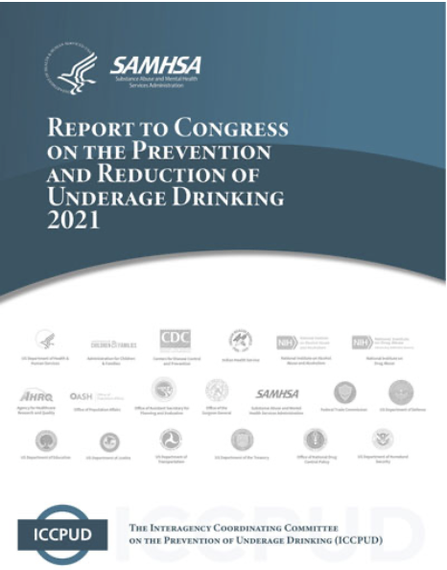
Legislation- STOP Act
Created an interagency coordinating committee in 2004 to report on prevention efforts
Requires annual reports:
  STOP Act Report to Congress
  Reports on state prevention and enforcement activities
Notes:
This Photo by Unknown Author is licensed under CC BY
This Photo by Unknown Author is licensed under CC BY-ND
https://www.stopalcoholabuse.gov/about-iccpud/data/national-reports/report-to-congress/default.aspx
Talk about MLDA as a one sentence intro to the STOP ACT
https://www.cadca.org/stop-act
ICCPUD includes representatives from a number of offices and agencies
NIAAA
NIDA
SAMHSA
HHS
Dept Ed
NHTSA
CDC
OJJDP
ONDCP
National Minimum Drinking Age Act of 1984
Mandated reduced federal highway funds to states that did not raise their minimum legal drinking ages (MLDAs) to 21.

Slide 58

Funding Authorizations
SAMHSA
Department of Justice: OJJDP
National Institutes of Health: NIAAA
Centers for Disease Control and Prevention
Department of Education
Department of Transportation
…and others!
Notes:
This Photo by Unknown Author is licensed under CC BY-NC

Slide 59
Conclusion
Many potential EBPs to address underage alcohol use
Need to use strategic planning to determine which are best fit for your needs
And select EBPs that can fit together into a comprehensive approach
This involves weighing the evidence behind strategies, understanding your own capacity, and analyzing the needs of the community

Slide 60
Josh Esrick & Emily Patton jesrick@danyainstitute.org
Emily@Carnevaleassociates.com

Slide 61


Evaluation
Your feedback is important!
Evaluation Form
To complete the evaluation form, go to https://ttc-gpra.org/P?s=211581
Resources Page and Slides
Upon completion of the evaluation form, your browser will redirect to the Resources Page for today’s webinar, which will include a PDF of the PowerPoint slides.
Certificate of Attendance / Contact Hour
To request a certificate: complete the evaluation form and then click on the red Request Certificate button located at the top of the Resources Page. Certificates must be requested within 1 week of the webinar, and will be processed within 30 days.
Recording
A recording of today's webinar will be
available online in 4-6 weeks.
If you have any issues accessing the evaluation, resources page, or slides,
please send an email to
webinars@danyainstitute.org

Slide 62


Contact Us
a program managed by
Central East PTTC website: | Danya Institute website:
www.pttcnetwork.org/centraleast | www.danyainstitute.org
Deborah Nixon-Hughes, Director: | Danya Institute email and phone:
dhughes@danyainstitute.org | info@danyainstitute.org (240) 645-1145
Funding for this presentation was made possible by SAMHSA grant no. 1H79SP081018. The views expressed by speakers and moderators do not necessarily reflect the official policies of HHS; nor does mention of trade names, commercial practices, or organizations imply endorsement by the U.S. Government.

