Slide 1
Recovery
and
Prevention
A Family Guide
Notes:
•

Slide 2
This product is developed by Pamela Mulready under the 2023 New England Prevention Technology Transfer Center (PTTC) Research and Design (RAD) Fellowship Program. The New England PTTC and this program are supported by SAMHSA of the U.S. Department of Health and Human Services (HHS). The contents are those of the author and do not necessarily represent the official views of, nor an endorsement, by SAMHSA/HHS, or the U.S. Government. SAMHSA Cooperative Agreement #5H79SP081020-05.
Recovery and Prevention
A Family Guide
Notes:
This program was developed in partnership with the New England Prevention Technology Transfer Center with funded support from the Substance Abuse and Mental Health Service Administration.

Slide 3
About The Product Developer
Pamela Mulready, MS, LPC, LADC, RSS has worked in behavioral health direct care as well as in the fields of prevention and recovery support. She specializes in providing trauma-informed therapy for individuals with co-occurring substance use and mental health conditions. She has also worked as a clinical supervisor in multiple settings and has provided support to teams of therapists facilitating Intensive Outpatient Programming. Pam has been employed as an Alcohol and Other Drug Education Specialist in multiple collegiate communities and currently works in a nonprofit setting in both the fields of recovery and prevention. She is passionate about promoting mental health and substance recovery supports/resources, particularly for the young adult population. Pam enjoys witnessing others cultivate joy and meaning in their lives through the process of engaging in peer recovery support communities.
Pam is grateful for this opportunity.
Email: pam153153@gmail.com
Recovery and Prevention
alternative to suspension program

Slide 4
Product Description
A practical resource to be shared by clinicians with individuals in treatment for substance use disorder. This toolkit will provide the person in treatment with resources from the disciplines of prevention and peer recovery support.
It will assist in increasing the family’s awareness of applicable prevention information and strategies and will also educate about various levels of clinical and peer support that are available in the community.
The product is in 2 presentation slide decks and a corresponding
resource guide
One presentation focuses on family recovery
One presentation focuses on substance use prevention for families
Recovery and Prevention
alternative to suspension program
Notes:
https://youtu.be/JL2XMiOO0Fg

Slide 5
Family involvement on any level can:
•Motivate people with substance use disorder to receive or continue treatment/recovery
•Improve overall family functioning
•Foster healing for family members affected by the consequences of substance use
•Reduce risk to children and adolescents of developing substance use disorder and other life challenges
Research shows that families can greatly influence the treatment of any illness, including substance use disorders
Recovery and Prevention
alternative to suspension program

Slide 6
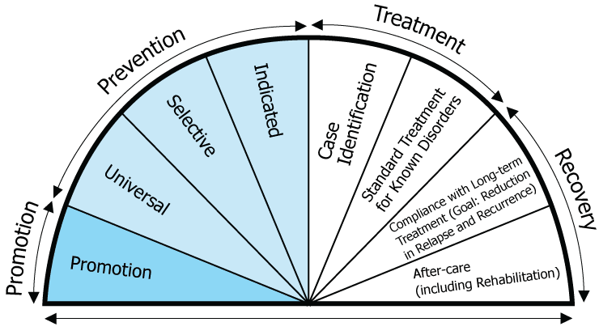
Clinical Treatment Settings Can Benefit From Implementing The Tools And Wisdom From Other Portions Of The Continuum Of Care
Springer, John & Phillips, Joël. (2007). The Institute of Medicine Framework and its implication for the advancement of prevention policy, programs and practice. Retrieved from (PDF) The Institute of Medicine Framework and its implication for the advancement of prevention policy, programs and practice (researchgate.net)
Recovery and Prevention
alternative to suspension program

Slide 7
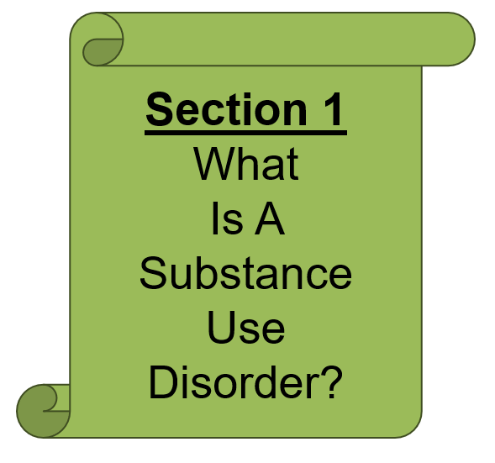
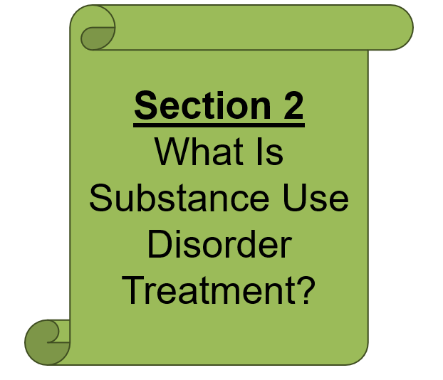
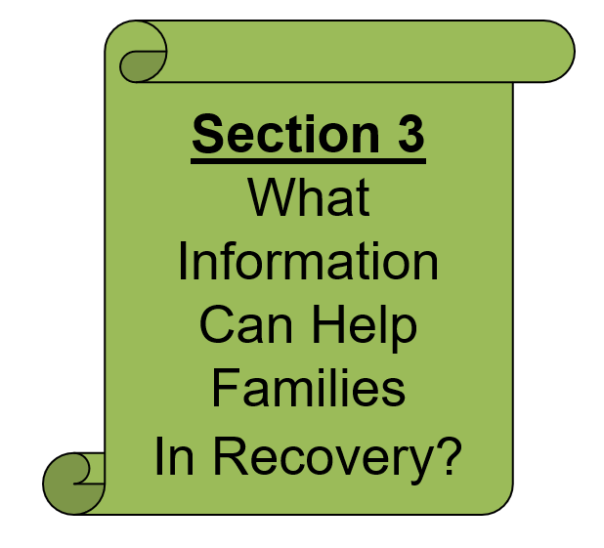
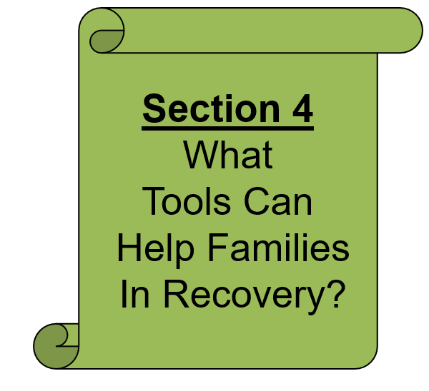
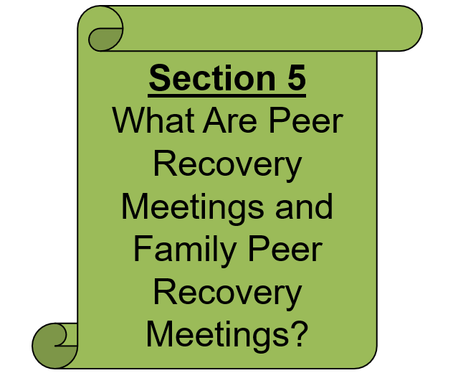
Themed Sections Can Be Used Over The Course Of Treatment
In The Family Recovery Presentation
Recovery and Prevention
alternative to suspension program
Notes:
https://youtu.be/JL2XMiOO0Fg

Slide 8
Interactive Elements To Help Participants Engage Fully
Recovery and Prevention
alternative to suspension program
Notes:
https://youtu.be/JL2XMiOO0Fg

Slide 9
Clickable Links To Go Directly To Resources
Recovery and Prevention
alternative to suspension program
Notes:
https://youtu.be/JL2XMiOO0Fg

Slide 10
How Common Is It To Have A
Practical Strategies For Prevention And Support
Recovery and Prevention
alternative to suspension program
Notes:
https://youtu.be/JL2XMiOO0Fg

Slide 11
Useful Tools Families Can Access After The Presentation
How Common Is It To Have A
Recovery and Prevention
alternative to suspension program
Notes:
https://youtu.be/JL2XMiOO0Fg

Slide 12
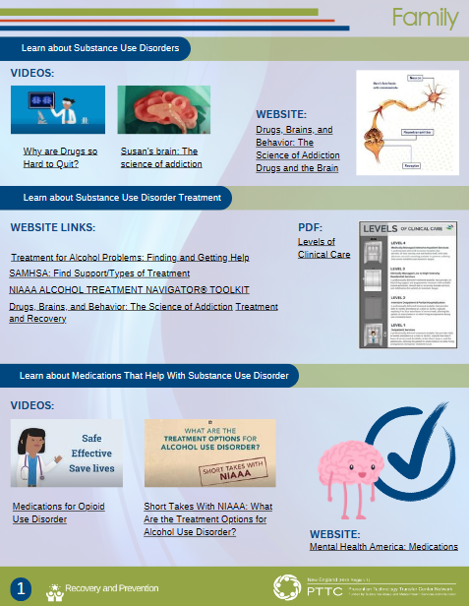
Both Presentations Can Be Used With A Person In SUD Treatment OR Their Adult Family Member
Both Presentations Have Notes On Choice Points
And Suggestions For Implementation In A Clinical Setting,
Written With Multiple Audiences In Mind
Both Presentations Have Corresponding Handouts That Can Be Share Electronically with Attendees
Recovery and Prevention
alternative to suspension program

Slide 13
Thank You For The Work That YOU Do!
I Hope This Product Is Helpful For Your Work And For The People You Serve!
Recovery and Prevention
alternative to suspension program

