Slide 1
Prevention
A Family Guide
Notes:
•

Slide 2
This product is developed by Pamela Mulready under the 2023 New England Prevention Technology Transfer Center (PTTC) Research and Design (RAD) Fellowship Program. The New England PTTC and this program are supported by SAMHSA of the U.S. Department of Health and Human Services (HHS). The contents are those of the author and do not necessarily represent the official views of, nor an endorsement, by SAMHSA/HHS, or the U.S. Government. SAMHSA Cooperative Agreement #5H79SP081020-05.
Please note: Material sourced from .gov domain websites is otherwise available on each specific agency’s website for no charge.
References for this PowerPoint are contained in the associated supplemental material: Substance Use Recovery And Prevention For Families In Treatment: A Guide For Therapist, Clients, And Families
Recovery and Prevention
A Family Guide
Notes:
This program was developed in partnership with the New England Prevention Technology Transfer Center with funded support from the Substance Abuse and Mental Health Service Administration.

Slide 3
A Note For Clinical Teams
This large slide deck is meant to be a wealth of resources for you, clients, and family members. One may show amount of the slide deck that is fitting for the setting and situation on any given day.
This full PTTC Fellowship Project contains:
A PowerPoint slide deck about recovery
A PowerPoint slide deck about prevention
A resource guide that can be shared directly with clients and families which contains clickable links to all the resources in both slide decks
It is recommended that you discuss with your team how to best implement these materials. They are written in such a way that they can be shown to either adult clients in substance use disorder treatment or family members however is it is not recommended that they attend presentations together.
Each slide deck has guidance and suggestions in the notes section of the slides to help you best utilize the information in such a way that attendees are both receptive to the material and have the best learning outcomes.
The resource guide can be emailed, placed on a website to be downloaded, or a QR code can be created for ease of access.
If you find these materials useful and/or would like to discuss ways in which they can be better implemented, please feel free to contact me at pam153153@gmail.com Collaboration is most welcome to help promote quality recovery and prevention information being disseminated to the community.
Recovery and Prevention
A Family Guide
Notes:
Please note: Throughout the presentation the term substance use disorder is used. Although this may not be the language that is most comfortable for all, this was done to ensure continuity between the various resource materials, statistics, videos, and the slides. If attendees prefer to use different language when speaking about their own or a family member’s recovery, it is best to honor that and it can be a great discussion point. There are many resources online discussing “the language of recovery” that can be shared with attendees. One such resource can be found here LanguageofRecovery.pdf
t

Slide 4
What Is Prevention?
“Prevention activities work to educate and support individuals and communities to prevent the use and misuse of drugs and the development of substance use disorders.”
Source: Prevention of Substance Use and Mental Disorders | SAMHSA
Recovery and Prevention
A Family Guide
Notes:
Many people may not be familiar with prevention as a field. We can discuss that many community education events and also the messaging that we encounter on billboards, in public service announcements, on social media, and in print are often created and promoted by a substance use prevention professionals. We can also share that they provide the quality, well-researched information that schools and nonprofits use to help encourage the public to make healthy choices. Prevention professionals also have training on how to share science-based information in a way that has the greatest positive impact.

Slide 5
Sometimes it challenging to think about trying to prevent harm from substance use.
We may :
have a lot of feelings about our own and/or our partner’s use
have difficult thoughts about our own substance use as a young person
feel angry, in retrospect, with our parents not discouraging our use
feel like we have no right to tell children not to do something we’ve done
not want to hear how substance use has impacted children in our home
have no idea what information is helpful or how to begin to share it
think children won’t listen or that talking about it won’t make any difference
Recovery and Prevention
A Family Guide
Notes:
Some of these bullet points may be worth brief discussion if the group is open to it. It may be helpful to ask if anyone would like to volunteer to share one thing on the list that resonated with them. This list also may bring up feelings of guilt and shame for many so there is a choice point, depending on your group dynamics, whether to let this evolve into a discussion or to continue on after touching on these points only briefly.

Slide 6
Prevention Science And Messaging Have Come A Long Way In 30+ Years!
Many of us have seen and laughed at this commercial. Research shows that using scare tactics doesn’t prevent substance use.
Modern-day research now tells us what to say and how to say it so that our messaging has the best chance of influencing young people to lead healthy lives.
We hope this presentation gives you better quality substance use prevention information than what you might have heard as a kid.
We also hope that you will use some of the practical tools included to help the young people in your life.
Video: This is your brain on drugs
Recovery and Prevention
alternative to suspension program
Notes:
Attendees may be of an age where they were exposed to emotionally manipulative messaging as well as exaggerated claims about what substances would do to them. For this reason, having a good laugh at the classic “This is your brain on drugs” commercial may help provide some humorous relief and can simultaneously acknowledge that some of what was done historically wasn’t very impactful.
It is important to contrast this with the field now, which has developed campaigns that emphasize both factual information and empowering youth.

Slide 7
We encourage youth to:
use sunscreen to prevent sunburns
limit junk food to prevent stomachaches and long-term illness
go to bed on time to prevent crankiness and being overtired the next day
manage feelings of anger so they don’t yell at others and hurt relationships
Notice:
We feel comfortable encouraging children to do all these things…
despite potentially not doing them perfectly ourselves
Children may not appreciate hearing any of these suggestions but we
have the life experience to know that we are preventing harm,
even if it creates short-term discomfort for children AND the adults
What Is Prevention?
It’s something you already do as a routine part of your everyday parenting and self-care!
Recovery and Prevention
alternative to suspension program

Slide 8
What is a healthy behavior that you were encouraged to have as a child that you are grateful for now?
Recovery and Prevention
alternative to suspension program
Notes:
People may benefit from the clinician offering some simple examples like brushing their teeth or eating vegetables. It may be useful to only have a few people volunteer information to make this point, many attendees may have had traumatic experiences or been neglected as children and may not easily be able to reflect on health-promoting behaviors that were encouraged. We can also rephrase this question to ask for an example of a healthy behavior or routine they have now and then be curious how they learned to do that or how they learned that it was important.

Slide 9
Let’s Learn About:
Substance Use Rates, Substance Use Prevention,
Youth and Families
Recovery and Prevention
A Family Guide

Slide 10
Approximately What Percentage Of People In The US Drank Any Alcohol In 2021?
15%
88%
33%
62%
Recovery and Prevention
A Family Guide

Slide 11
Why?
Any alcohol use is considered unhealthy for people under the age of 21 because the brain continues to develop and mature into a person’s mid to late 20s.
Note:
ANY alcohol use is considered unhealthy for people under the age of 21.
Source: NSDUH
Recovery and Prevention
alternative to suspension program
Notes:
Source: Samhsa announces National Survey on Drug Use and Health (NSDUH) results detailing mental illness and substance use levels in 2021. SAMHSA. (2023b, January 4).

Slide 12
Who Should Not Drink Any Alcohol, According To The Current Dietary Guidelines For Americans?
Some people who should not drink alcoholic beverages at all include:
people who are pregnant or might become pregnant.*
people who are under the legal age for drinking.
people with certain medical conditions or taking certain medications that can interact with alcohol.
people who are recovering from an alcohol use disorder.
* Note: There are often specialized counseling and medical programs that can help people who are pregnant and using substances.
Recovery and Prevention
alternative to suspension program
Notes:
Many states have laws that ensure that substance use alone is not a sufficient reason to contact child protective services, this helps people feel safer to access substance use treatment when pregnant.
Highlighting use during pregnancy on this slide provides an opportunity to inform attendees that help is available if they or a loved one is ever in this situation in the future. If you are aware of programs that specifically treat this population in your area, that would be helpful to share.

Slide 13
Approximately What Percentage Of Underage Youth In The US Did Not Drink Any Alcohol In 2021
20%
85%
62%
32%
Recovery and Prevention
A Family Guide

Slide 14
Research shows that most people overestimate how many of their peers are engaging in unhealthy behaviors.
Helping youth learn about the healthy behavior of their peers can help them make better choices for themselves.
Source: NSDUH
Recovery and Prevention
alternative to suspension program
Notes:
Attendees may feel any of the statistics presented are inaccurate. We can acknowledge that it is common to believe “everyone is drinking” however we can also emphasize that these statistics are from large-scale studies of diverse cross-sections of people and that over time many of the rates stay in a similar range despite year-to-year differences. We encourage attendees to consider that people often assume what is typical for their close family and friends is typical for all people and often this can skew their perceptions.
Source: Samhsa announces National Survey on Drug Use and Health (NSDUH) results detailing mental illness and substance use levels in 2021. SAMHSA. (2023b, January 4).

Slide 15
Approximately What Percentage Of People In The US Used Any Illicit Drug In 2021?
44%
88%
22%
7%
Recovery and Prevention
A Family Guide
Notes:
In this research illicit drug use included any use of marijuana or hashish, cocaine, crack, heroin, hallucinogens, inhalants, or methamphetamine, as well as use of prescription drugs including pain relievers, tranquilizers, stimulants, and sedatives in any way other than as directed by a health care provider.

Slide 16
2 Facts From Recent Research
The most commonly used illicit drug was cannabis in 2021.
In 2021, 12% of high school students reported that within their lifetime they had taken prescription pain medicine, without a doctor’s prescription or differently than how a doctor told them to use it.
Source: NSDUH
Recovery and Prevention
alternative to suspension program
Notes:
It is notable here that the vast majority of people in 2021, over the age of 12, did not use any illicit substances. In this research illicit drug use included any use of marijuana or hashish, cocaine, crack, heroin, hallucinogens, inhalants, or methamphetamine, as well as use of prescription drugs including pain relievers, tranquilizers, stimulants, and sedatives in any way other than as directed by a health care provider.
While cannabis might be the most common substance used in this category, we also have to consider this data represents misuse of opioids as well. The statistic about lifetime misuse of opioids by high school students is worth noting, particularly due to the commonly mistaken belief that opioids are not a significant concern for the youth age group.
Source: Samhsa announces National Survey on Drug Use and Health (NSDUH) results detailing mental illness and substance use levels in 2021. SAMHSA. (2023b, January 4).

Slide 17
There Has Been An Increase In The Rate Of Youth Overdoses
In 2021, fentanyl and fentanyl-related substances were identified in 77.14% of adolescent overdose deaths.
Other substances which caused adolescent overdose deaths:
13.26% were benzodiazepines [pills like Xanax]
9.77% were methamphetamine
7.33% were cocaine
5.76% were prescription opioids
2.27% were heroin 1
Among persons aged 14–18 years, overdose deaths increased 94% from 2019 to 2020 and 20% from 2020 to 2021 2
Since 2015, fentanyl has been increasingly added to counterfeit pills that resemble prescription medications.
Research shows that youth commonly believe pills are safer to use than other drugs.
DEA lab testing in recent years showed that 6 out of every 10 counterfeit pills with fentanyl contain a potentially lethal dose. 3
It is critical to educate young people that pills purchased via social media, given to them by a friend, or obtained from an unknown source may contain fentanyl.
Recovery and Prevention
alternative to suspension program
Notes:
Social media has changed the amount and variety of substances that a young person may have access to and this combined with the increase in counterfeit pills that contain fentanyl puts young people at increased risk.
Attendees will benefit from knowing that counterfeit pills are often indistinguishable from prescription medications and that any powder can be pressed into the form of a pill, with markings on it to mimic specific types of pills.
Source 1:Friedman J, Godvin M, Shover CL, Gone JP, Hansen H, Schriger DL. Trends in Drug Overdose Deaths Among US Adolescents, January 2010 to June 2021. JAMA. 2022;327(14):1398–1400. doi:10.1001/jama.2022.2847
Source 2:Centers for Disease Control and Prevention. (2023a, March 16). Weekly report. Centers for Disease Control and Prevention. https://www.cdc.gov/mmwr/index2022.html
Source 3: DEA. (n.d.). One Pill Can Kill Initiative. https://www.dea.gov/sites/default/files/2022-03/20220208-DEA_OPCK%20Overview%20and%20Key%20Results.pdf

Slide 18
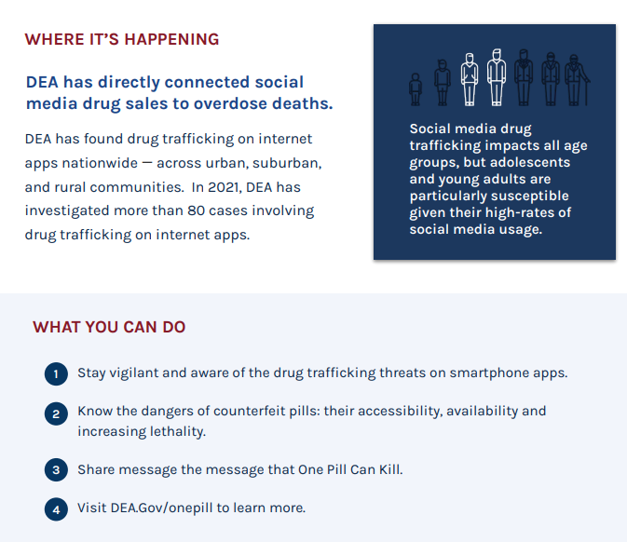
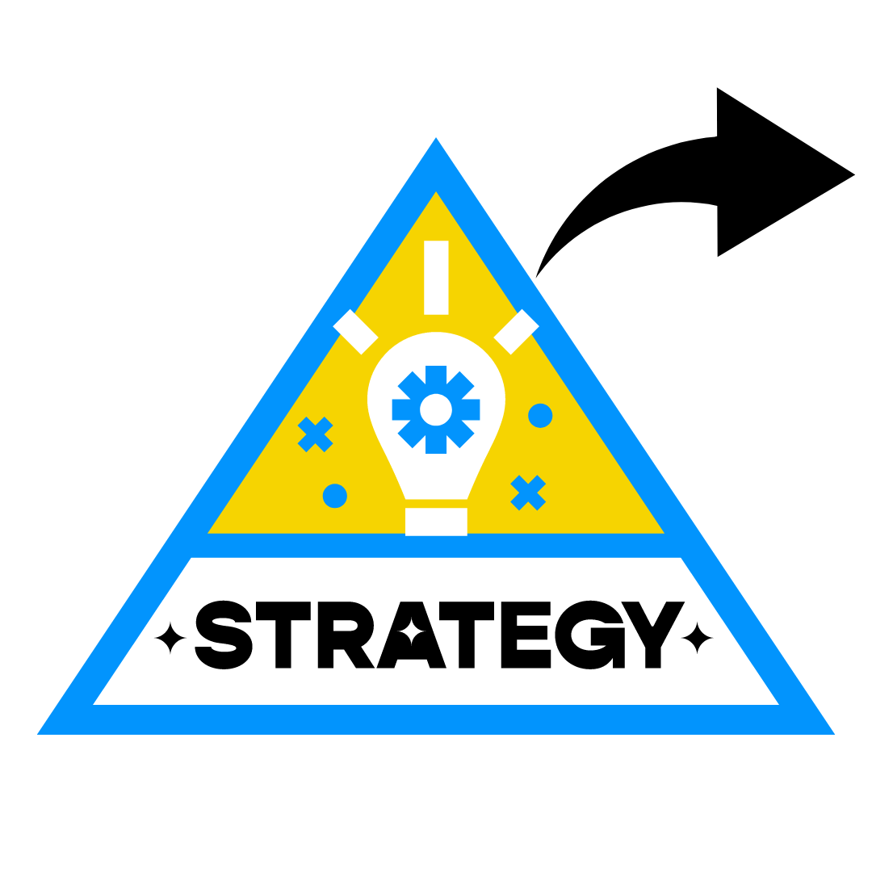
Speak With Your Loved Ones About Counterfeit Pills AND About The Risks Of Taking Any Pills Not Prescribed To Them
Social Media Drug Trafficking
Recovery and Prevention
A Family Guide
Notes:
The link above leads to the full handout (which is partially pictured here). It may be useful for parents to see the emoji codes that are used to purchase substances on social media however these may be well-known to people with SUD and may be a trigger, thus they are not pictured here.

Slide 19
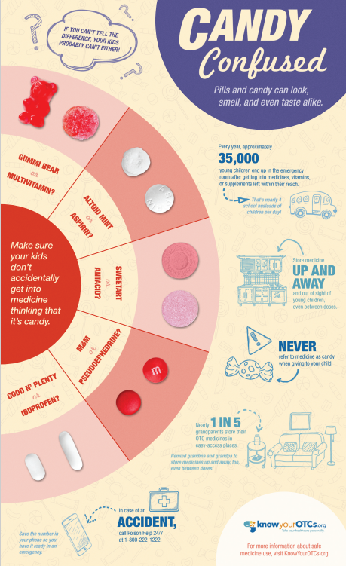
Learn How To Securely Store Medications and Substances
Candy flyer and other materials from Up and Away
Recovery and Prevention
A Family Guide
Notes:
It is helpful for parents to see this visual with the pills and candy side by side so they recognize how similar they may look to children and may be more motivated to place dangerous items out of reach. There are other handouts on that website that may be useful, with tips we may not have thought of about such things as traveling safely with mediations/vitamins and how to childproof a grandparent’s home for when children visit.

Slide 20
Learn How To Securely Store Medications and Substances
Video: Up and Away
Recovery and Prevention
A Family Guide
Notes:
This video is a bit repetitive however we should know that this is based on useful health promotion practices including having a simple message and helping people retain it through repetition. Attendees can be encouraged to keep the poison control hotline number readily available at home or programmed into their phones in case of emergency.

Slide 21
Learn How To Securely Store Substances
Cannabis edibles video
Recovery and Prevention
A Family Guide
Notes:
Attendees can be encouraged to consider lockboxes or lockbags to securely store edibles or any other substance that children should not have access to. As shown in the video, often cannabis edibles packaging mimics other treats which can be confusing to children. This slide provides an opportunity to talk about accidental ingestion in general and to remind anyone that during active use it is imperative that drugs are out of reach of children and that anything that touches a drug, including items used to prepare drugs, be cleaned or hidden. Particularly, coffee tables and other surfaces within reach of children need to be cleaned. We can also remind attendees that pets can be harmed by access to substances including edibles as well.
Cannabis edibles are metabolized by the body differently than other forms of cannabis and can take 30 minutes to an hour or longer to start producing a noticeable effect. Often the amount recommended by the manufacturer to be consumed is a small fraction of what would typically be eaten of a similar candy or baked good (think one to two gummy bears versus the handful or two that someone might otherwise eat). Teens and young adults can have frightening experiences of panic and psychosis if using edibles, particularly if taking an extremely large dose by accident, and should be discouraged from underage use altogether. A parent may choose to provide this harm reduction information if they suspect their child is starting to use or become more interested in cannabis products.

Slide 22
Learn How To Dispose of Unwanted Or Expired Medications
Disposal Video
Drug Disposal: FDA’s Flush List for Certain Medicines | FDA
Recovery and Prevention
A Family Guide
Notes:
On this slide, we can acknowledge that if someone has a substance use disorder, it may sound absurd to flush medications. If it is challenging to afford medications, it can also sound absurd to dispose of them.
However, flushing or otherwise disposing of certain pills and other substances has prevented children from accessing substances and also has prevented many relapses. The flush list is a more recent addition to the disposal recommendations. Attendees may have heard in recent years to never flush medications so it is good to be aware the guidance has been updated, but only for these specific medications on the list.

Slide 23
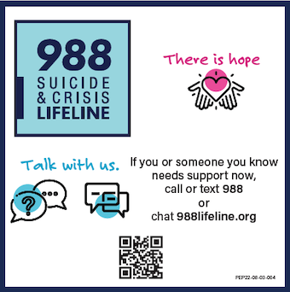
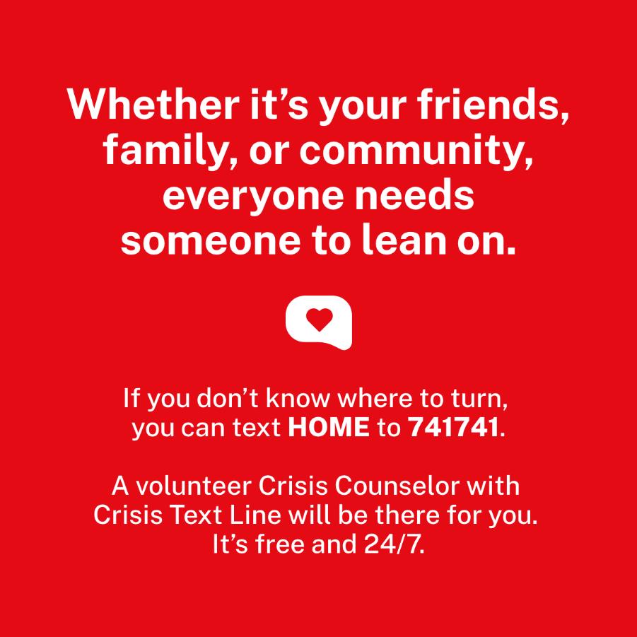
Learn How To Access Help
Flushing or otherwise disposing of certain pills and other substances has prevented many relapses and can be done with a sponsor or other trusted person involved.
Many people have thoughts of suicide that are related to medications. It’s important that you speak with someone you trust if you are having these thoughts. This can help you secure or dispose of pills or other items that could be life-threatening in the future.
A therapist can form a plan with you to help you decrease or cope with these thoughts and stay safe or can help you access emergency care or inpatient treatment if that is the safest option.
If you don’t feel like you can talk to the people in your life at any given moment, you can contact 988 or Crisis Text Line 24/7
You can also ask them how to help someone else in your life who may be having suicidal thoughts.
Substance use disorder and a family history of substance use disorder can be some of the risk factors for suicide.
Recovery and Prevention
A Family Guide
Notes:
Often people assume any mention of suicide will mean they will be taken automatically to a hospital against their will so discussing the actual screening and safety planning process can empower people to be honest about their feelings. People may not have engaged in safety planning before and thus may not be aware that this can be an option, if appropriate, for them to remain safely in the community.

Slide 24
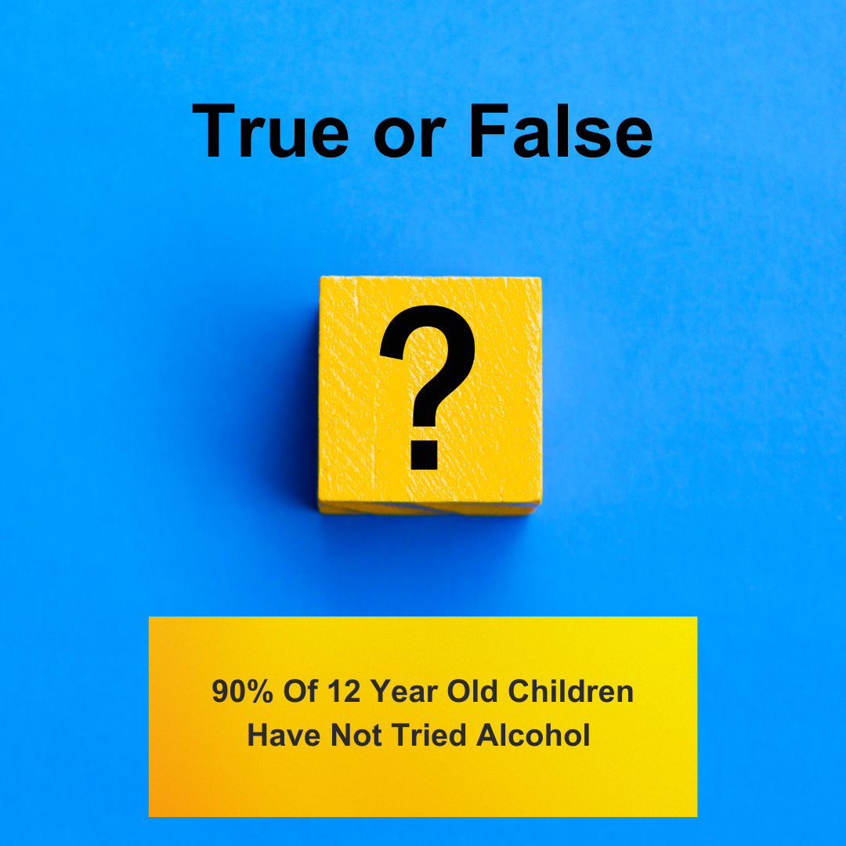
Recovery and Prevention
A Family Guide

Slide 25
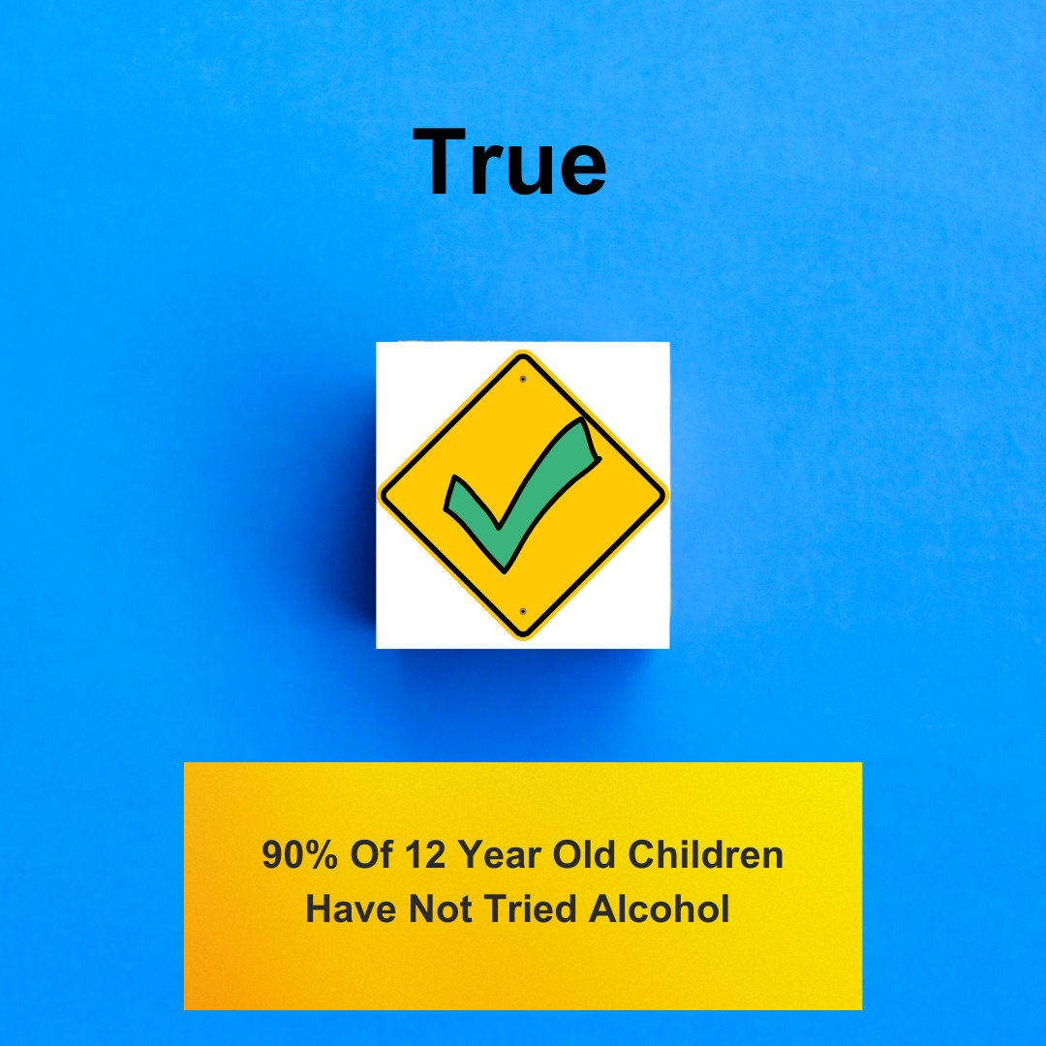
This does mean, however, that 10% of children have tried alcohol at the age of 12.
By age 15, that number jumps to 50 percent.
Research has also shown that people who use alcohol before age 15 are six times more likely to become alcohol dependent than adults who begin drinking at age 21.
Children who are exposed to substance use disorders in their homes are more likely to develop substance use disorders themselves.
Sources: CDC, SAMHSA
Recovery and Prevention
A Family Guide
Notes:
On this slide is important to highlight that “more likely to develop” does not mean that this happens automatically. It can be motivating to view ourselves as able to acknowledge and reduce risks through taking action, such as using some of the prevention skills from this presentation and working on one’s own recovery.
Sources:
SAMHSA. (n.d.). “talk. they hear you.”® campaign. https://www.samhsa.gov/talk-they-hear-you
Children living with parents who have a substance use disorder. (n.d.). https://www.samhsa.gov/data/sites/default/files/report_3223/ShortReport-3223.html
Centers for Disease Control and Prevention. (2022a, April 19). Alcohol questions and answers. Centers for Disease Control and Prevention. https://www.cdc.gov/alcohol/faqs.htm

Slide 26
Encourage Youth To
Delay
Any Decision To Try Drinking Until They Are Older
Do not give alcohol to your children.
Set clear rules, including rules about alcohol use.
Help your children find ways to have fun without alcohol.
Source: SAMHSA
Recovery and Prevention
A Family Guide
Notes:
This slide can be used to reinforce the information that starting substances earlier places young people at overall greater risk for SUD so delaying use can have a very beneficial impact for their overall brain development and lowering their risk of future dependence on a substance. We can also carefully acknowledge that using substances at young ages can be dangerous for reasons other than dependence including risk of accident, injury, alcohol poisoning, or assault. We tread lightly on this topic as it is frightening to think of in relation to young people that we care about and may bring up memories of trauma related to substance use. It may be useful to transition that information into a discussion of how to speak with children about being able to call their parent/guardian, no matter what, if they feel like they need to leave a situation. Providing action steps can be reassuring and help people feel more in control.
SourceL “talk. they hear you.”® campaign. SAMHSA. (n.d.). https://www.samhsa.gov/talk-they-hear-you

Slide 27
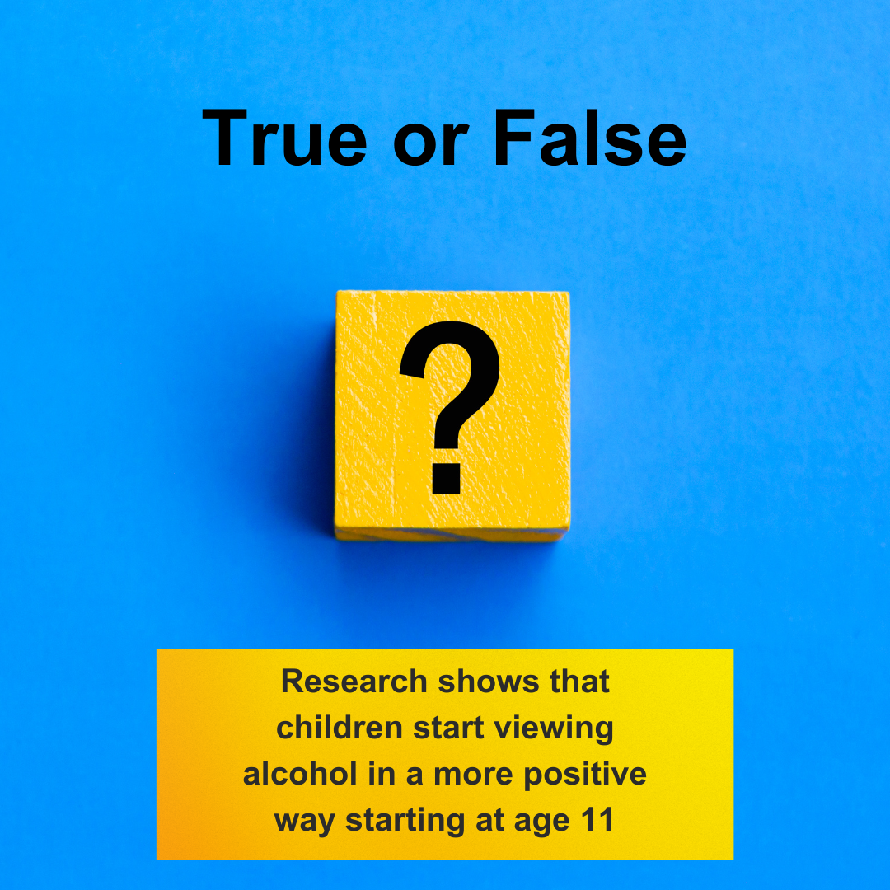
Recovery and Prevention
A Family Guide
Notes:
Source: Why you should talk with your child about alcohol and other drugs. SAMHSA. (n.d.-e). https://www.samhsa.gov/talk-they-hear-you/parent-resources/why-you-should-talk-your-child

Slide 28
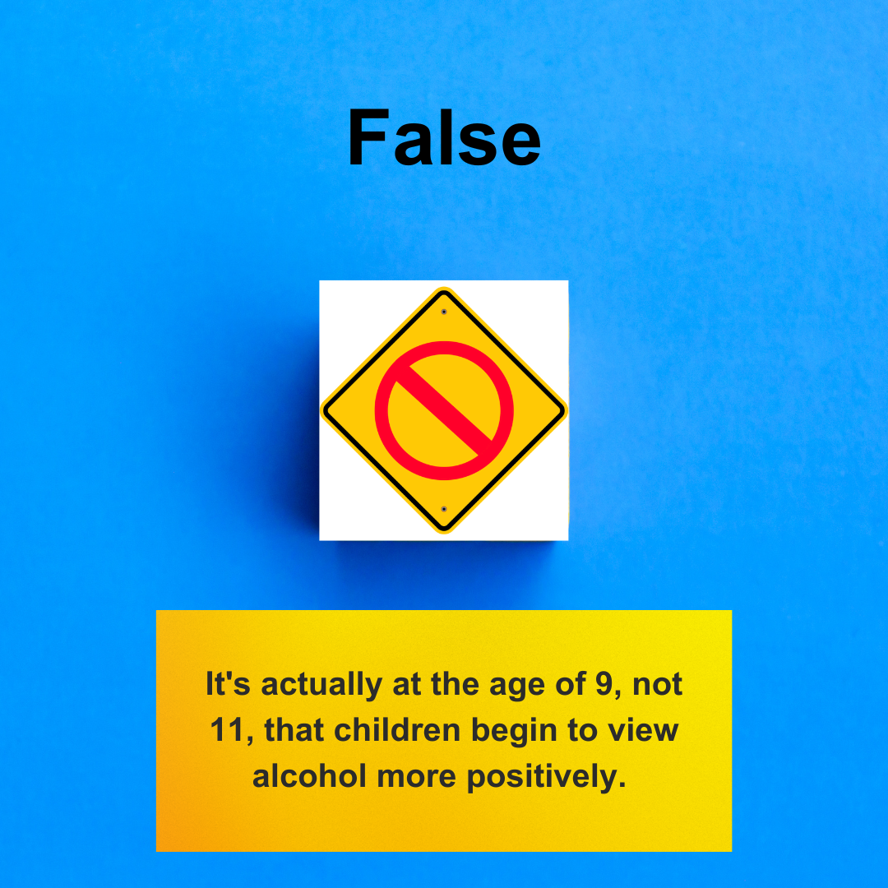
Recovery and Prevention
A Family Guide
Notes:
This slide provides an opportunity to acknowledge how much messaging there is in the media about alcohol and increasingly about cannabis as well. We can encourage families to consider how they speak about other things their children may view that are not in keeping with family values or are dangerous. They have an opportunity to share their own messaging about substance use when it comes up organically due to advertising or movies/television, just as they might when violence, swearing, or dangerous stunts are being shown.

Slide 29
Begin Conversations About Alcohol And Substances
Early
Don’t wait until your child is in high school to start conversations about alcohol.
Think about how you’ll start the conversation – take into account your child’s age and maturity level.
Consider if your children should attend parties where there is likely to be a lot of alcohol use
If anyone in your home drinks, they can positively influence your child by drinking in moderation. However, families should consider if any drinking at home promotes their family recovery and prevention goals.
Source: SAMHSA
Recovery and Prevention
A Family Guide
Notes:
Source “talk. they hear you.”® campaign. SAMHSA. (n.d.). https://www.samhsa.gov/talk-they-hear-you

Slide 30
Recovery and Prevention
A Family Guide

Slide 31
Recovery and Prevention
A Family Guide
Notes:
Often people believe it is pointless to speak with children about substance use or that it is a given that children will eventually experiment with substances. This slide is a chance to highlight for attendees that they do not have to think of themselves as powerless in this equation and that speaking in appropriate ways with children about substances can have a protective influence.

Slide 32
Have Conversations About Alcohol And Other Drugs
Often
It is important to have ongoing conversations throughout their childhood, adolescence, and young adult years.
Short, frequent discussions can have a real impact on your child's decisions about substances.
Get into the habit of chatting with your child every day. It will make it easier to have serious conversations about things like substances and will make your child more comfortable coming to you for advice.
Source: SAMHSA
Recovery and Prevention
A Family Guide
Notes:
Source: “talk. they hear you.”® campaign. SAMHSA. (n.d.). https://www.samhsa.gov/talk-they-hear-you

Slide 33
Have Conversations About Alcohol And Other Drugs
Often
Having lots of little talks takes the pressure off trying to get all of the information out in one lengthy discussion, and your child will be less likely to tune you out.
It's also important to hear their point of view. Give your child the opportunity to ask you questions and listen to what they have to say.
Use everyday opportunities to talk with them: in the car, during dinner, or while watching TV.
Continued
Source: SAMHSA
Recovery and Prevention
A Family Guide
Notes:
Source: “talk. they hear you.”® campaign. SAMHSA. (n.d.). https://www.samhsa.gov/talk-they-hear-you

Slide 34
How Common Is It To Have A
Recovery and Prevention
alternative to suspension program

Slide 35
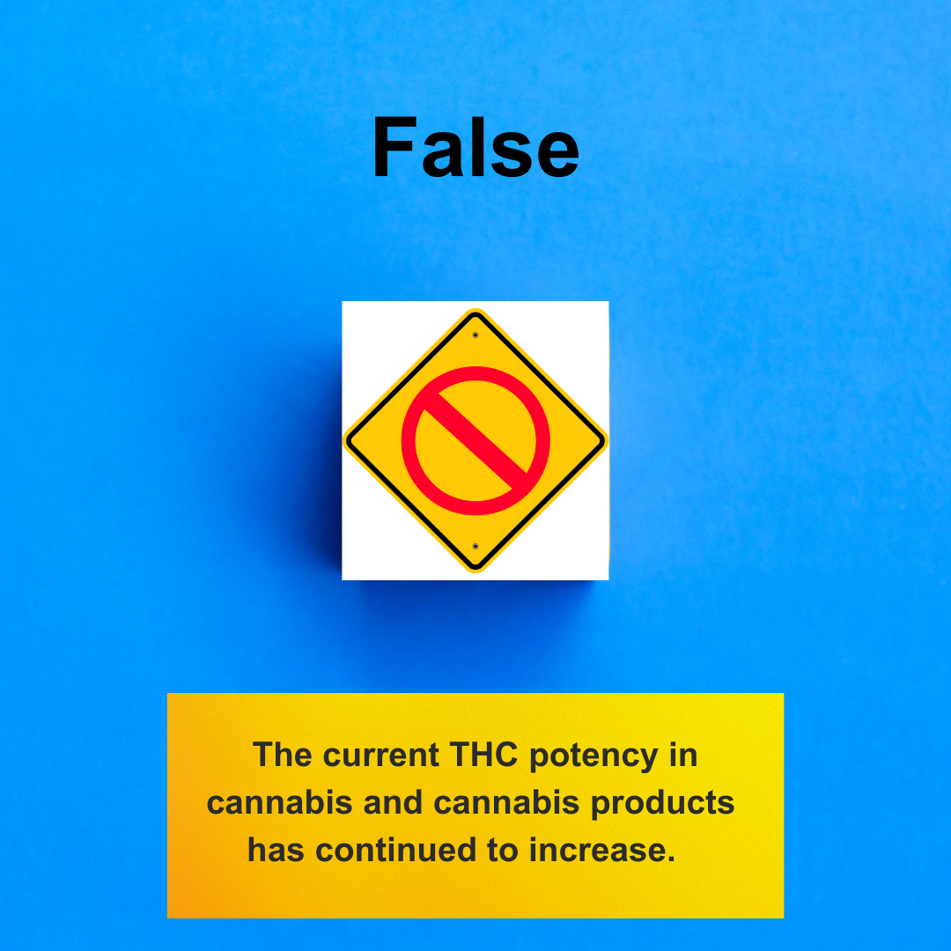
Cannabis Is Different Now
How Common Is It To Have A
Many cannabis products typically have THC concentrations of 40 to 90 percent or greater. The use of high-potency products is associated with a greater risk of both psychosis and cannabis use disorder.
Despite common belief, repeated cannabis use can lead to cannabis use disorder for some people. This simply means that people can have trouble quitting, even though it is having a negative impact on their lives.
Cannabis affects adolescents much differently than adults because their brains are still developing.
Recent studies suggest cannabis use is associated with higher rates of depression and suicide, especially among youth.
Frequent cannabis use between the ages of 14 and 21 is associated with lower rates of high school and college graduation, lower rates of income by the age of 25, and lower levels of relationship and life satisfaction.
Source: SAMHSA
Recovery and Prevention
alternative to suspension program
Notes:
This slide may be challenging for attendees as this information is contrary to what is in the popular discourse and, especially in advertising. People may have a lot of false information from advertising that they fervently believe is factual and we can encourage research on quality health information sites. There is a very comprehensive link is on the slide 37 that all clinicians should read to better understand the research on cannabis. We would be wise to avoid debating whether cannabis is more or less harmful than alcohol, which can be a popular comment when cannabis is mentioned. It is also wise to avoid any debates about a person’s belief that cannabis is beneficial. We are able to share that further research is needed as there are still a lot of unknowns, which can lessen debate. People may equate legal status and the legislation of medical marijuana in some places as an endorsement of it being overall a helpful and/or harmless substance. This page below is a good resource to better understand beneficial medications that are derived from the cannabis plant versus the broad range of products that have been legislatively deemed as medical without FDA testing or approval. It can be helpful to acknowledge that further research may indeed prove there are more benefits however this would not mean that it is without harm or universally helpful for all.
Is marijuana safe and effective as medicine? | National Institute on Drug Abuse (NIDA) (nih.gov)
It will be helpful to keep the focus on how it impacts youth and the developing brain specifically, which is different from adults.
Attendees may need to hear that, similar to how some people develop a dependence on alcohol and others don’t, cannabis can impact some people’s lives very strongly and others may not be as affected. It may not be their personal experience that cannabis was particularly harmful from their point of view however this doesn’t mean everyone experiences it that way. For many clients in SUD treatment, they may have a history of using substances that have a much more noticeable impact on their mind and body than cannabis therefore may not think much of its impact on them. It can be helpful to acknowledge that cannabis is not typically as life-altering as fentanyl, yet this doesn’t mean it’s harmless either (particularly for youth). This can be a good place to educate attendees about the symptoms of cannabis withdrawal as well, a list can be found on this page along with other information about cannabis aimed at parents mj_parents_facts_brochure.pdf (nih.gov)
Source: Substance Abuse and Mental Health Services Administration (SAMHSA). Preventing Marijuana Use Among Youth. SAMHSA Publication No. PEP21-06-01-001. Rockville, MD: National Mental Health and Substance Use Policy Laboratory. Substance Abuse and Mental Health Services Administration, 2021.

Slide 36
Is This A Myth
OR A FACT?
Video about cannabis
Recovery and Prevention
A Family Guide
Notes:
Dr. Huberman is a professor of neurobiology from Stanford. This is a short clip of a much larger episode. If attendees are intrigued by the positive effects he mentions for adults with very occasional use, they should be directed to find the full episode where he presents a comprehensive view of research and acknowledges there are some conflicting research results in this area. Although that may naturally be of interest to attendees, we can discuss that substance use is not something we would promote in our positions however they are free to gather more information from this full episode. The value of this clip is in the strong research that indicates the detrimental impacts of cannabis on developing brains, specifically. It is also a useful clip due to Dr. Huberman being a respected authority in the medical field as well as in public opinion, which may help attendees take this information under consideration rather than dismissing it.

Slide 37
Educate
Yourself and Your Family About Cannabis
Share with your children that cannabis being legal for adults (in certain places) doesn’t mean it’s safe for children.
Discourage underage use and driving while under the influence of anything. It is not true that people drive more carefully while high.
Parental use and beliefs about cannabis use also strongly influence youth behavior. Youth whose parents do not believe cannabis use is risky are 1.5 times more likely to use when compared with youth whose parents hold more negative beliefs.
Adopting no-tolerance rules around youth cannabis use and greater parental monitoring are also associated with decreased cannabis use.
Comprehensive Information About Cannabis
Recovery and Prevention
A Family Guide
Notes:
Source: “talk. they hear you.”® campaign. SAMHSA. (n.d.). https://www.samhsa.gov/talk-they-hear-you

Slide 38
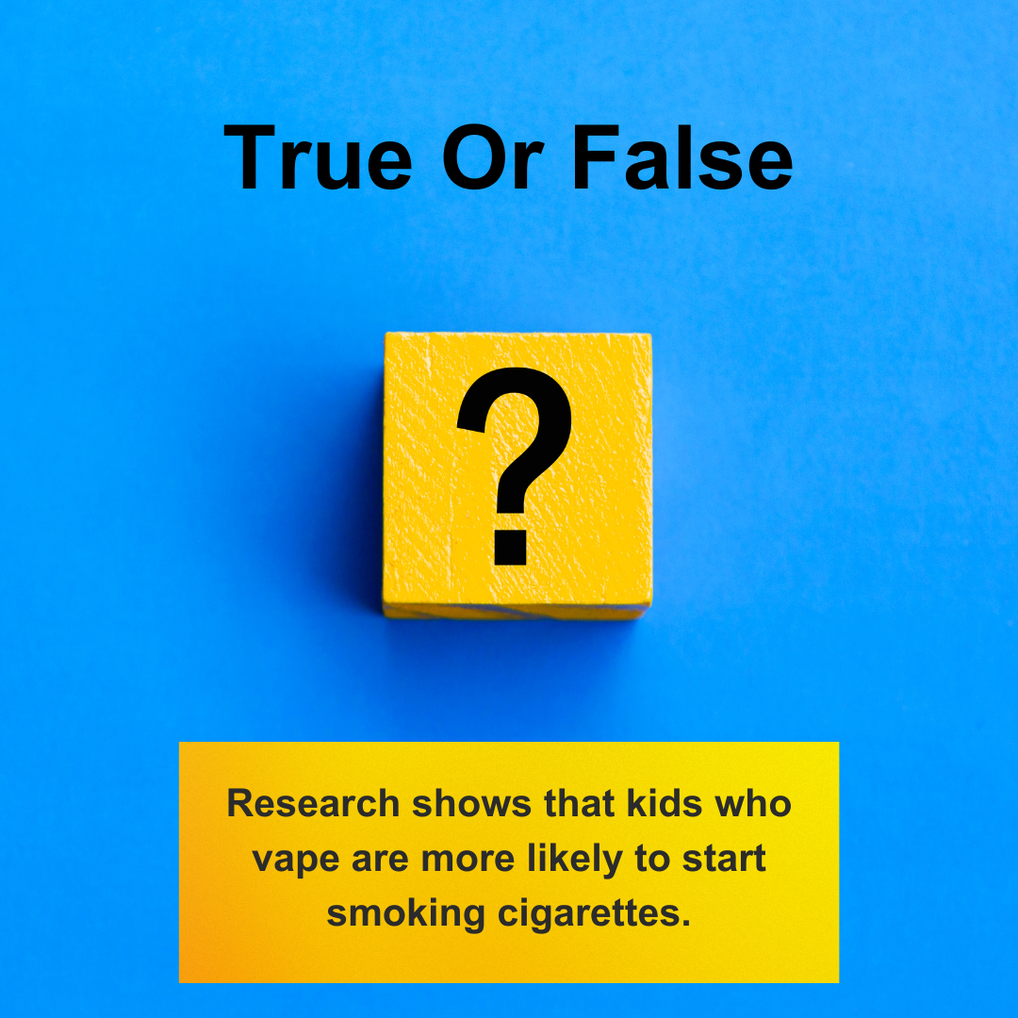
Is This A Myth
OR A FACT?
Recovery and Prevention
A Family Guide

Slide 39
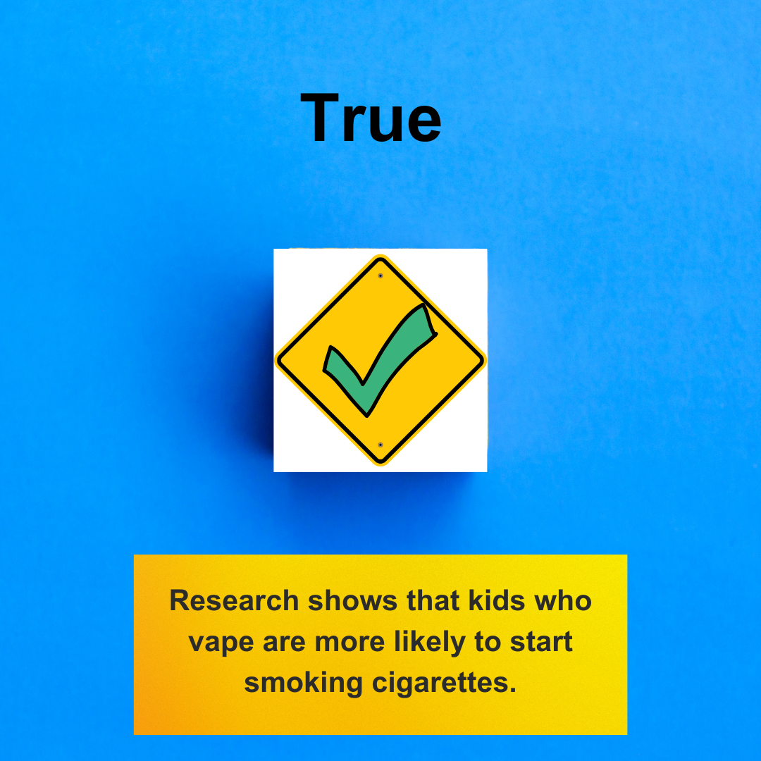
Concerns About E-Cigarettes/Nicotine
When surveyed, many youth don’t even know they are using nicotine in e-cigarettes/vapes.
Nicotine disrupts normal functioning in the young brain which can make it harder for them to concentrate, learn, and control their impulses.
Using nicotine as a youth can also rewire the brain to become more easily addicted to other drugs.
How Common Is It To Have A
Video pediatrician about vaping
Recovery and Prevention

Slide 40
Know
That E-cigs And All Nicotine Products Are Harmful For Youth
Recognize that youth do not see e-cigs as harmful and this puts them at greater risk.
Look for opportunities to share your knowledge and your concerns about nicotine use.
Know most 15 to 17-year-olds borrow vaping devices, get to know their friends and potential influences, and discuss any concerns.
Be aware that behaviors now may not just be temporary, current research shows that 3 out of 4 teen smokers will smoke as adults.
Set a good example by being tobacco-free now or in the future when you can.
Offer free quit resources to a teen who seems to be struggling with addiction.
Some kids are buying e-cigarettes online and having them delivered without their parent's knowledge. FDA has taken action to remove these products from the marketplace, however, the risk still remains.
Know what current e-cigarette products look like and be aware they can hide in plain sight.
Source: SAMHSA
Recovery and Prevention
A Family Guide
Notes:
Source:
Substance Abuse and Mental Health Services Administration (SAMHSA): Reducing Vaping Among Youth and Young Adults. SAMHSA Publication No. PEP20-06-01-003. Rockville, MD: National Mental Health and Substance Use Policy Laboratory, Substance Abuse and Mental Health Services Administration, 2020.

Slide 41
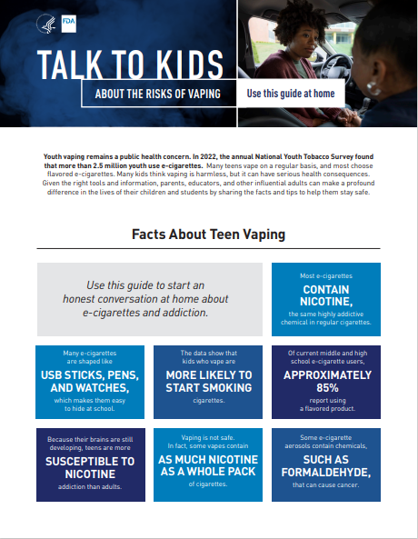
Learn
About Nicotine/Vaping Education
And Resources for Quitting
Talk with Your Teen About E-cigarettes: A Tip Sheet for Parents (surgeongeneral.gov)
There are resources for teens and everyone on smokefree.gov
Video pediatrician speaks about youth nicotine cessation
quitSTART is an app with all the tools for quitting
Quitlines have counselors trained to help you or anyone you love quit, call this number to be connected 1 800 784 8669
quitSTART | Smokefree
Smokefree Teen
Recovery and Prevention
A Family Guide
Notes:
Showing the Smokefree resources may assist attendees in seeing the potential value of the website for themselves, loved ones, or teens.

Slide 42
How Common Is It To Have A
SAMHSA’s “Talk. They Hear You.” campaign mobile app helps parents and caregivers learn how to turn everyday situations into opportunities to talk with their children about alcohol and other drugs.
Video about the Talk They Hear You Campaign
Parent & Caregiver Resources | SAMHSA
Recovery and Prevention
alternative to suspension program
Notes:
This presentation has shared a lot research-based suggestions for families. A significant amount of the resources for speaking with youth are easily accessed by families through the use of this app.

Slide 43
Some Risk Factors For Youth High-Risk Substance Use Can Include:
High-Risk Substance Use Prevention Strategies
How Common Is It To Have A
Research has improved our understanding of factors that help buffer youth from a variety of risky behaviors, including substance use.
These are known as protective factors. Some protective factors for high-risk substance use include:
Parent or family engagement
Family support
Parental disapproval of substance use
Parental monitoring
School connectedness
Family history of substance use
Favorable parental attitudes toward the behavior
Poor parental monitoring
Family rejection of sexual orientation or gender
Association with peers who use substances
Lack of school connectedness
Low academic achievement
Childhood sexual abuse
Mental health issues
Recovery and Prevention
alternative to suspension program
Notes:
Adapted from: Centers for Disease Control and Prevention. (2023a, March 16). Weekly report. Centers for Disease Control and Prevention. https://www.cdc.gov/mmwr/index2022.html

Slide 44
Get Ideas
For Increasing Protective Factors
Ways to Engage in Your Child’s School to Support Student Health and Learning | DASH | CDC
Free Download: 40 Developmental Assets© in English and Spanish (search-institute.org)
Parental monitoring | DASH | CDC
Recovery and Prevention
alternative to suspension program
Notes:
https://www.cdc.gov/healthyyouth/protective/factsheets/parentengagement_parents.htm

Slide 45
Learn
About Tools For Parent’s Concerned About Their Children’s Substance Use
Video about parent coaches
Meetings - Partnership to End Addiction (drugfree.org)
Recovery and Prevention
A Family Guide

Slide 46
Notice When Someone May Need Support
How Common Is It To Have A
Know the Warning Signs | NAMI: National Alliance on Mental Illness
Substance Use: How Worried Should I Be
Treatment & Recovery: Creating A Plan
Resources for Families Coping with Mental and Substance Use Disorders | SAMHSA
SAMHSA’s National Helpline | SAMHSA
Recovery and Prevention
alternative to suspension program

Slide 47
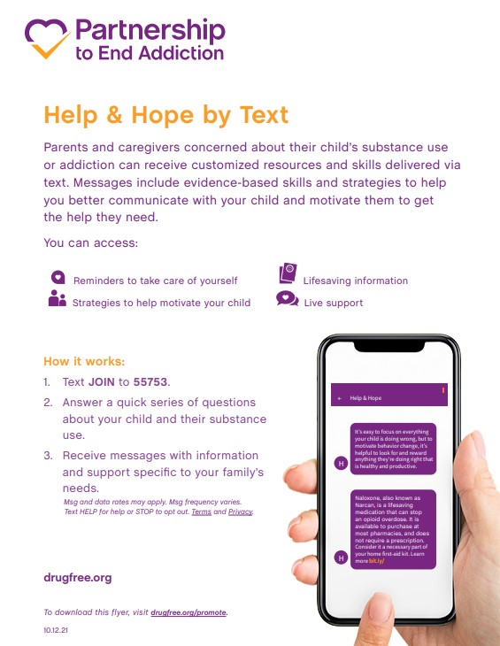
Help-Hope-by-Text
Recovery and Prevention
A Family Guide

Slide 48
Find Support
For People Concerned About A Loved One’s Substance Use
Families Anonymous
SMART Recovery Family & Friends | Addiction Help for Family Members
Parents of Addicted Loved Ones | Support Group for Parents, Spouses, Family of Addicted Loved One
Helpingfamilieshelp
Recovery and Prevention
A Family Guide

Slide 49
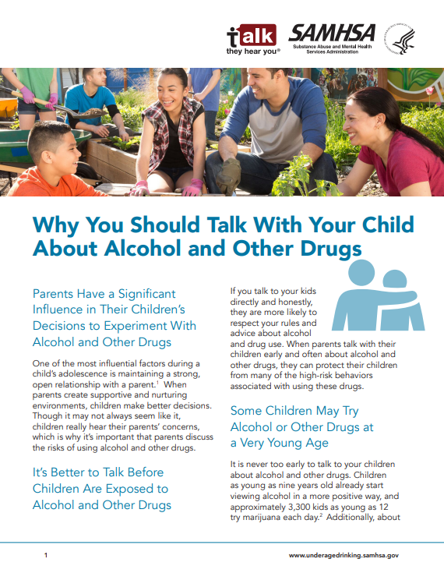
What Is Your Why?
What are your hopes for the children in your life?
How can preventing and/or addressing underage use of substances help support your hopes and their life goals?
Why You Should Talk With Your Child About Alcohol and Other Drugs (samhsa.gov)
Recovery and Prevention
alternative to suspension program

Slide 50
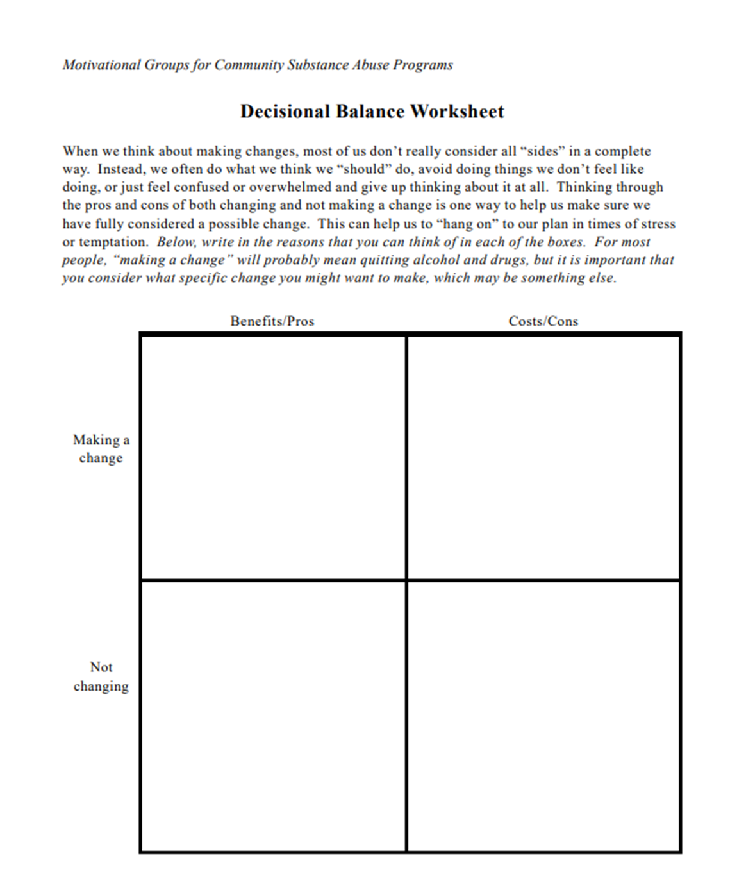
How Common Is It To Have A
It can be uncomfortable to have certain conversations with our children. Yet, many of these conversations are critical for their development and happiness.
Let’s complete a decisional balance sheet as a group using “Having Prevention Conversations With A Young Person In My Life” as a change we are considering.
Decisional Balance Worksheet
Recovery and Prevention
Notes:
The decisional balance sheet or cost-benefit analysis is a great motivational tool. On this slide, we can review/introduce this as a general tool for making decisions as well as use it to see the clear benefits of prevention conversations while acknowledging that they are sometimes awkward to have. One can also label things on the list as likely to be short-term or long-term, which will further reinforce the potential long-term benefit of the child’s well-being versus the short-term discomfort of having these conversations.
It is best to complete this as a group for this topic.

