Slide 1
This product was funded under a cooperative agreement from the Substance Abuse and Mental Health Services Administration (SAMHSA) (Grant Number: H79SP080995 ). All material, except that taken directly from copyrighted sources, is in the public domain and may be used and reprinted for training purposes without special permission. However, any content used should be attributed to the Northwest Prevention Technology Transfer Center.
Notes:
NOTE: need NW PTTC branding for this and next slide
These slides can be used as a stand-alone overview of the Social Development Strategy as a strategy that any adult can use to build protection in the lives of young people.

Slide 2
The Social Development Strategy:
5 Proven Keys to Raising Healthy, Successful Youth
Notes:
These slides can be used as a stand-alone overview of the Social Development Strategy, or incorporated into other presentations or materials. Citing the Northwest PTTC and the Social Development Research Group as the author of these slides is greatly appreciated, noting that all content is derived from federally funded research projects including the landmark prevention science longitudinal study, the Seattle Social Development Project (SSDP), which began in 1981 with an intervention in early elementary school and has followed those students ever since to document the impact of promoting the Social Development Strategy early in their lives. See for example:
Kosterman, Rick, Haggerty, Kevin P., Hawkins, J. David (2010). Long-term effects of social development intervention. Better: Evidence-Based Education, 2(2), 6-7.
Hawkins JD, Kosterman R, Catalano RF, Hill KG, Abbott RD. Effects of social development intervention in childhood 15 years later. Arch Pediatr Adolesc Med. 2008;162(12):1133–1141. doi:10.1001/archpedi.162.12.1133
J. David Hawkins, Brian H. Smith, Karl G. Hill, Rick Kosterman, Richard F. Catalano & Robert D. Abbott (2007) Promoting Social Development and Preventing Health and Behavior Problems during the Elementary Grades: Results from the Seattle Social Development Project, Victims & Offenders, 2:2, 161-181, DOI: 10.1080/15564880701263049
Hawkins JD, Kosterman R, Catalano RF, Hill KG, Abbott RD. Promoting Positive Adult Functioning Through Social Development Intervention in Childhood: Long-term Effects From the Seattle Social Development Project. Arch Pediatr Adolesc Med. 2005;159(1):25–31. doi:10.1001/archpedi.159.1.25

Slide 3
Social Development Strategy
Social Development Strategy
Notes:
To activate protection, to enhance healthy development, and to prevent a problem before it happens, we know in the field of prevention science that we must Address the Predictors – this is what is meant by A Risk And Protection Focused Approach To Prevention
Research has identified two types of predictors for healthy youth development:
Risk Factors (including Adverse Child Experiences) and Protective Factors
The Social Development Strategy (SDS) is a tool for enhancing five factors that are proven to build protection, and organizes these protective factors into a strategy for action that anyone can use in their daily interactions with young people.
The SDS is as simple as 5 fingers on one hand. First, let’s review the overall theory. And then we’ll go a little deeper into each component.
The first component of the SDS is: Opportunities (point to the sign on the graphic)
If you want to increase healthy behaviors among young people the first thing you need to do is provide opportunities. (Developmentally appropriate opportunities for active involvement.)
The second component? Skills! (point to ‘Skills’ sign on the slide):
The second element of the SDS is skills. Young people need the skills to be successful in the opportunities they have.
The 3rd SDS component is recognition (point to ‘recognition’ sign on the slide):
The third element of the SDS is recognition.
Providing recognition for improvement, effort, and achievement.
Recognition is important because it leads to the fourth element of the SDS …
Which is Bonding (point to ‘Bonding’ grouping on the slide):
Bonding is a sense of emotional closeness and attachment who provided those opportunity skills and recognition.
Bonding will happen in any of the domains where a young person experiences the first three components. It can happen in a community, within a family, a school or among friends/peer groups (point to each symbol on the slide while referencing these domains).
Bonding is important because it provides the motivation to live by the fifth element …
Which is clear standards (point to the ‘Clear Standards’ notation on the slide):
It’s essential that we adults communicate clear and consistent standards for our youths’ behaviors – and when those youth feel a sense of attachment and commitment to us, they are more likely to abide by those clearly communicated standards.
When youth follow those clear standards, they will be more likely to have the healthy behaviors we’re advocating for them!
So the KEY to the Social Development Strategy is: that Offering Opportunities, Building Skills, and Giving Recognition is the FOUNDATION of Creating Bonding…which opens a young person to work with Clear Standards & Have Healthy Behaviors!
Finally, Let’s Look at Individual Characteristics (point to the phrase at the bottom of the slide):
As we activate each of these 5 elements of the SDS, we always need to keep individual characteristics in mind.
For example,
Does offering opportunities set up for individual characteristics?
Do you only offer sports when a young person is interested in music?
At each step, we recognize that opportunity skills and recognition need to be provided in ways that take into account individual children differences and cultural differences.

Slide 4
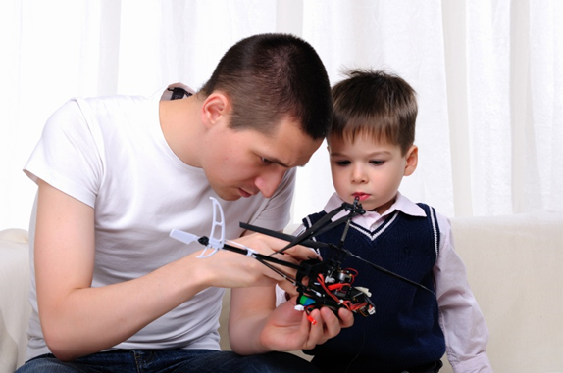
SDS: Five key protective factors Opportunities
Opportunities
When providing opportunities:
Build on individual characteristics
Make them meaningful and age-appropriate
Fit a young person’s interests and abilities
Show young people that they are valued.
Notes:
Ok, now let’s dive a little deeper into each of these 5 components of the SDS
If you want to increase healthy behaviors among young people the first thing you need to do is provide opportunities.
Opportunities must be developmentally appropriate for the age, abilities and interests of the young person.
There are many examples of enhancing opportunity structures at home, school, and in the community. AND, we should consider the developmental age and whether the opportunities are appropriate.
For example, it may not be appropriate to provide cooking classes on a hot stove to 5-year-olds, but opportunities to learn about and choose healthy snacks might be more age appropriate.
Opportunities also need to be meaningful. For example, engaging teens as change agents in a community coalition without providing them with a meaningful voice may not be motivating and may further alienate teens.
It is also important to match opportunities to the young person’s individual characteristics and interests (e.g., providing an opportunity to be on a basketball team may not be meaningful to all 13-year-olds). Finally, opportunities must be challenging enough to be motivating but not so challenging that they become frustrating.
Examples? – you can ask your audience to think of some other examples. Here is a list that parents might do:
Picking up your infant
Reading to your preschooler
Involving your child in decisions about chores
Participating in sport, social, musical, and educational time with your child
Engaging your teen in decisions about curfew
Volunteering with your teen for a cause you agree on
Remember! When providing opportunities:
Build on individual characteristics
Make them meaningful and age-appropriate
Fit a young person’s interests and abilities
Show young people that they are valued.

Slide 5
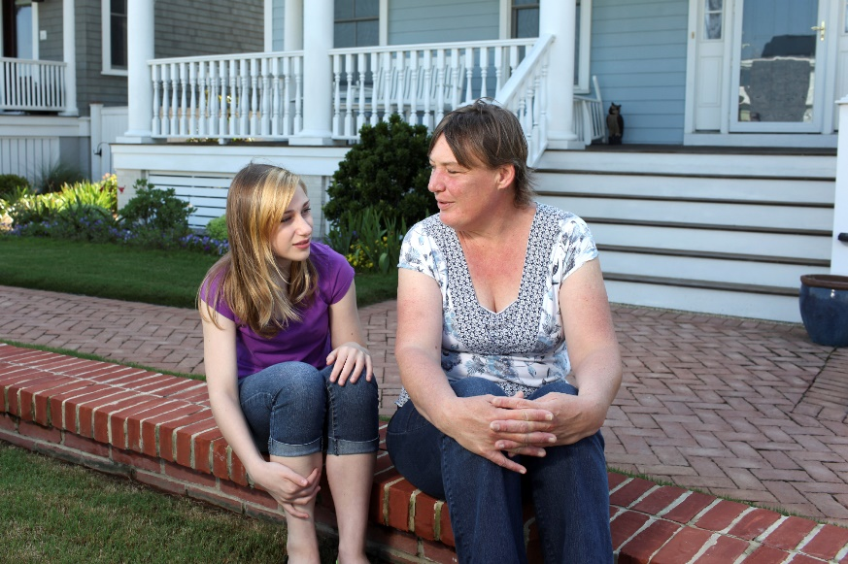
SDS: Five key protective factors Skills
Opportunities
Skills
When teaching skills:
Be intentional and realistic
Motivate the youth to want to learn the skill
Start small: break skills into small steps
Model the steps & practice together
Notes:
The second element of the SDS is skills. Young people need the skills to be successful in the opportunities they have.
Whether providing a comprehensive program within a school or working with youths on an individual basis, there are several important practice considerations we have learned about teaching youth skills.
First, be intentional and realistic. The skill should identified and be appropriate for the youth’s abilities. Children learn best and are willing to keep on trying when they gain success quickly. Just because one child learned a skill at a particular age, that does not mean that another child will necessarily be ready to learn that skill at the same age.
Second, motivate the young person to learn the skill. Help them understand why this skill is great for them to have; reflect and reinforce their own statements about the value of the skill.
Third, start small. If you want a child to learn a complicated skill, break the skill into small steps and teach one part at a time. For example, if you want children to learn how to clean their rooms, start by teaching them how to put away their toys. Once children have mastered this skill, teach them how to fold and put away clothes or make the bed. Children’s inability or lack of readiness to learn a certain skill may be the result of adult failures to break a difficult task up into manageable steps and teach those steps one at a time.
Fourth, make sure to model, then practice. Demonstrate the skill you are teaching. Professional ball players first see the skill, then practice, practice, practice. Creating natural opportunities to practice is important. Finally, build on success. Provide new challenges as success occurs. If children experience 100% success 100% of the time, they may have a tendency to give up the first time they encounter something difficult. On the other hand, if children experience frequent failures, they can become so discouraged they will stop even trying.
Examples?
Practice reading & writing together – can build reading skills, study skills as well as social interaction skills
Asking teen about curfew – communication and negotiation skills
When teaching skills:
Take advantage of chances to teach needed skills
Motivate the youth to want to learn the skill
Break skills into small steps
Model the steps
Practice together.

Slide 6
SDS: Five key protective factors Recognition
Opportunities
Skills
Recognition – for improvement, effort and achievement!
Recognize a skill or talent the young person is developing
Be specific and positive
Encourage children for trying or getting started
Notes:
The third element of the SDS is recognition.
Providing recognition for improvement, effort, and achievement.
There are several practice considerations we have learned about providing recognition,.
It is helpful to consider that some youths are not going to feel comfortable receiving an award at an all-school assembly or in front of a large crowd. Knowing that a youth has a fear of being in front of crowds is important when providing feedback that will be meaningful and rewarding. For some, a quiet word or a note is more meaningful; for others, bring on the assembly and news articles!
For educators and social workers implementing youth-centered approaches, this means that recognizing effort is critical. Recognition is most effective when it is specific to a skill or talent the student is developing. For instance, a teacher might say, “Maria, I can see your hard work to control your anger when you are mad. It has really improved. Your hard work is paying off.”
When recognizing either accomplishments or effort, it is important to be specific and positive. Notice what children are doing well, and recognize it. Encourage children for trying or getting started and course correct where necessary. For example, “It was great you got started on the dishes tonight without my asking.” When youths are recognized for their skillful involvements, it promotes strong bonds, which provide the motivation to contribute to and follow healthy beliefs and clear standards.
Examples?
Thank you for listening without interrupting!
You really worked hard on that last assignment!
Recognition is important because it leads to the fourth element of the SDS

Slide 7
SDS: Five key protective factors Bonding
Opportunities
Skills
Recognition
Bonding – a sense of belonging!
Notes:
The 4th element is bonding. Bonding is a sense of emotional closeness and attachment to those who provided those opportunities, skills and recognition.
This synergy of opportunities, skills, and recognition begins the process of bonding. Every day, when a child consistently experiences such moment-to-moment interactions, bonding is strengthened, and that bond acts as a motivator to follow family, school or community norms and values.
Family and community bonding is a source of strength, especially in communities of color, and it may vary based on the cultural and racial background of the community. Such variations may need to be responsive to the individuals or communities being addressed
Bonding is important because it provides the motivation to live by the fifth element

Slide 8
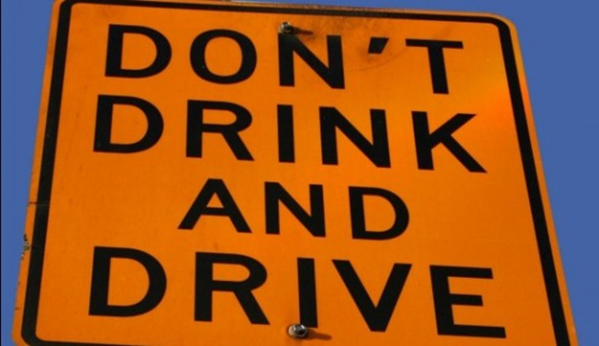
SDS : Five key protective factors Clear standards
Opportunities
Skills
Recognition
Bonding
Clear Standards for Healthy Behavior
Notes:
The fifth element of the SDS is clear standards for healthy behavior. It’s essential that we adults provide clear and consistent standards for our youths’ behaviors – and when those youth feel a sense of attachment and commitment to us, they are more likely to abide by those clearly communicated standards.
Clear standards can be provided in all domains in which children live: at home, in school, and in the community
As communities work to promote youth protection, it is important to understand and address issues of inequality that might constrain young people from feeling connected or bonded to positive adults
Examples? Ask your audience to imagine what the clear standards might be from each picture on this slide – in family, school and community.
Ask them to think of more!

Slide 9
Social Development Strategy
Social Development Strategy
Notes:
When youth follow those clear standards, they will be more likely to have the healthy behaviors we’re advocating for them!
So the KEY to the Social Development Strategy is: that Offering Opportunities, Building Skills, and Giving Recognition is the FOUNDATION of Creating Bonding…which opens a young person to work with Clear Standards & Have Healthy Behaviors!
And we can keep in mind that opportunity skills and recognition need to be provided in ways that take into account individual children differences and cultural differences.
Please know that building these protections has been proven to create more protective environments and to enhance young people’s healthy development in myriad measures – over the long term as they developed into young adults and parents themselves. You can learn more about these studies on the Communities That Care website on the tab discussing the Social Development Strategy -- and see some references in the next slide (https://www.communitiesthatcare.net/how-ctc-works/social-development-strategy/ ) and on the SDRG website section discussing the Seattle Social Development Project (http://www.sdrg.org/projectdetail.asp?frmPSelect=37&Status=1&New+Entry=View+Details )

Slide 10
References
https://www.communitiesthatcare.net/how-ctc-works/social-development-strategy/
SDRG website section discussing the Seattle Social Development Project (http://www.sdrg.org/projectdetail.asp?frmPSelect=37&Status=1&New+Entry=View+Details )
Kevin P. Haggerty and Kristin J. McCowan, Using the Social Development Strategy to Unleash the Power of Prevention Journal of the Society for Social Work and Research 2018 9:4, 741-763
Kim, B. K. Elizabeth, Gloppen, Kari M., Rhew, Isaac C., Oesterle, Sabrina, Hawkins, J. David (2015). Effects of the Communities That Care prevention system on youth reports of protective factors. Prevention Science, 16(5), 652‐662.
Kosterman, Rick, Haggerty, Kevin P., Hawkins, J. David (2010). Long-term effects of social development intervention. Better: Evidence-Based Education, 2(2), 6-7.
Hawkins JD, Kosterman R, Catalano RF, Hill KG, Abbott RD. Effects of social development intervention in childhood 15 years later. Arch Pediatr Adolesc Med. 2008;162(12):1133–1141. doi:10.1001/archpedi.162.12.1133
J. David Hawkins, Brian H. Smith, Karl G. Hill, Rick Kosterman, Richard F. Catalano & Robert D. Abbott (2007) Promoting Social Development and Preventing Health and Behavior Problems during the Elementary Grades: Results from the Seattle Social Development Project, Victims & Offenders, 2:2, 161-181, DOI: 10.1080/15564880701263049
Hawkins JD, Kosterman R, Catalano RF, Hill KG, Abbott RD. Promoting Positive Adult Functioning Through Social Development Intervention in Childhood: Long-term Effects From the Seattle Social Development Project. Arch Pediatr Adolesc Med. 2005;159(1):25–31. doi:10.1001/archpedi.159.1.25

