Slide 1

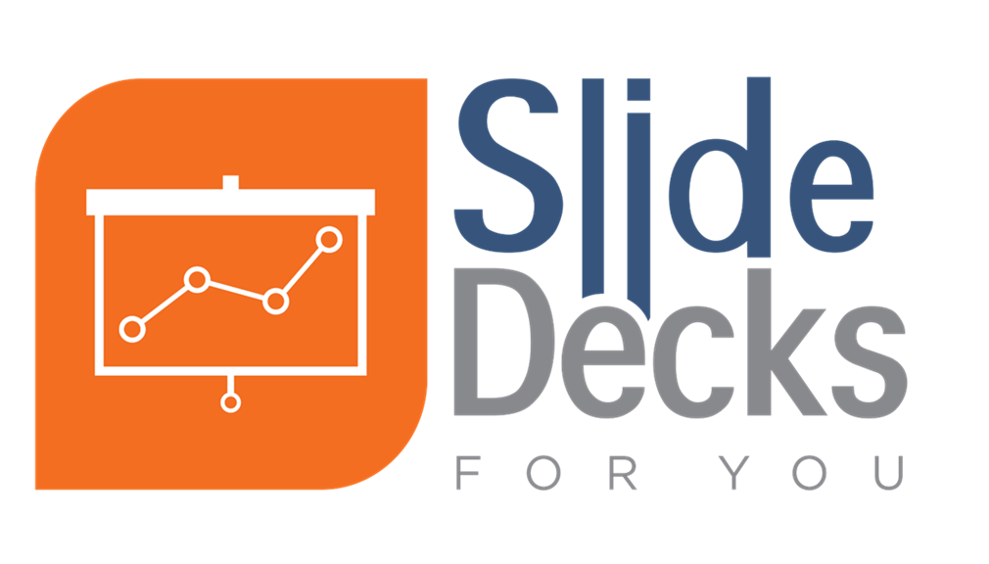

This product was funded under a cooperative agreement from the Substance Abuse and Mental Health Services Administration (SAMHSA) (Grant Number: H79SP081015). All material, except that taken directly from copyrighted sources, is in the public domain and may be used and reprinted for training purposes without special permission. However, any content used should be attributed to the Pacific Southwest Prevention Technology Transfer Center.
Notes:
These slides can be used as a stand-alone overview of the updated “Spectrum of Behavioral Health Services” (formerly, and still often referred to as the “Continuum of Care” or “Continuum of Mental, Emotional, and Behavioral Services”) or incorporated into other presentations or materials. Citing the Pacific Southwest PTTC as the author of these slides is greatly appreciated, noting that all content is derived from the various Institute of Medicine/National Research Council/National Academies of Sciences, Engineering, and Medicine reports on this topic.
One note: The Institute of Medicine changed names and is now referred to as the National Academies of Sciences, Engineering, and Medicine in 2015. The National Academies of Sciences, Engineering, and Medicine are private, nonprofit institutions that provide expert advice on some of the most pressing challenges facing the nation and the world. https://www.nap.edu/content/about-the-national-academies-press

Slide 2
Understanding the Spectrum of Behavioral Health Services
Developed by the Pacific Southwest PTTC, 2019
Notes:
These slides can be used as a stand-alone overview of the updated “Spectrum of Behavioral Health Services” (formerly, and still often referred to as the “Continuum of Care” or “Continuum of Mental, Emotional, and Behavioral Services”) or incorporated into other presentations or materials. Citing the Pacific Southwest PTTC as the author of these slides is greatly appreciated, noting that all content is derived from the various Institute of Medicine/National Research Council/National Academies of Sciences, Engineering, and Medicine reports on this topic.
One note: The Institute of Medicine changed names and is now referred to as the National Academies of Sciences, Engineering, and Medicine in 2015. The National Academies of Sciences, Engineering, and Medicine are private, nonprofit institutions that provide expert advice on some of the most pressing challenges facing the nation and the world. https://www.nap.edu/content/about-the-national-academies-press

Slide 3
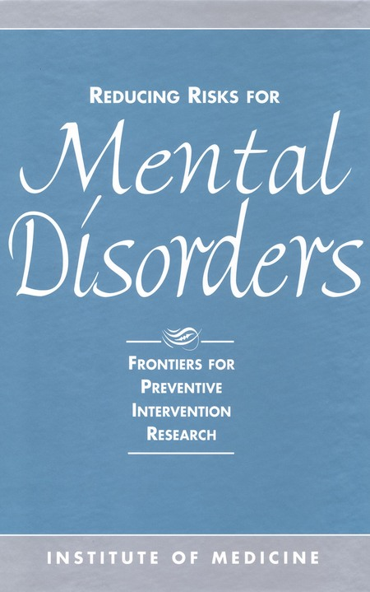
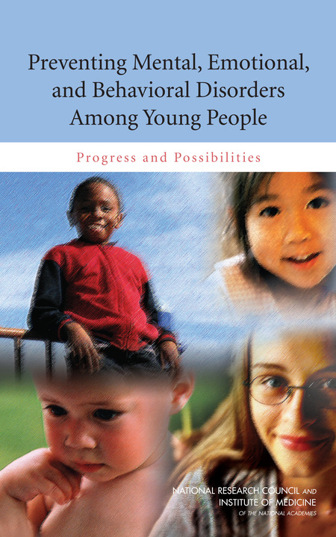

25 Years of Prevention Science
1994¹
2009²
2019³
Notes:
In 1994, the Institute of Medicine (IOM) released its seminal report: “Reducing Risks for Mental Disorders: Frontiers for Preventive and Intervention Research.” This report included substance use disorders/preventing substance use misuse as a component and focused on recent research demonstrating that understanding risk factors was key to reducing mental disorders and aided the field of prevention science in taking a giant leap forward into improving how we select, implement, and evaluate evidence-based interventions.
In 2009, the IOM released a long-awaited report “Preventing Mental, Emotional, and Behavioral Disorders Among Young People: Progress and Possibilities” demonstrating the number of mental, emotional, and behavioral disorders that are, in fact, preventable. “the term ‘mental, emotional, and behavioral
disorders’…encompasses both disorders diagnosable using Diagnostic and Statistical Manual of Mental Disorders, 4th Edition (DSM-IV) criteria and the problem behaviors associated with them, such as violence, aggression, and antisocial behavior. Many mental, emotional, and behavioral disorders of youth exist on a continuum…. The term encompasses mental illness and substance abuse, while including a somewhat broader range of concerns associated with problem behaviors and conditions in youth” (National Research Council and Institute of Medicine, 2009, p. xv). It highlighted the vast amount of research conducted since the initial 1994 report, demonstrated that billions of dollars can be saved with effectively implementing evidence-based interventions, and demonstrated the need to devote significantly more resources to both prevention research and prevention interventions. It describes evidence regarding interventions for improving the MEB outcomes of children and youth, points to the need to make those interventions available on a large scale, and emphasizes several key points:
Prevention requires a paradigm shift.
Mental health and physical health are inseparable.
Successful prevention is inherently interdisciplinary.
MEB disorders are developmental.
Coordinated community-level systems are needed to support young people.
In 2019, the National Academics of Sciences, Engineering, and Medicine (noting that the IOM changed to this name in 2015) released its third report in this series and continued with the same definition of “Mental, emotional, and behavioral health disorders” as in 2009. From the report summary: “Over the last decade, a growing body of research has significantly strengthened understanding of healthy MEB development and the factors that influence it, as well as how it can be fostered. Yet, the United States has not taken full advantage of this growing knowledge base. Ten years later, the nation still is not effectively mitigating risks for poor MEB health outcomes; these risks remain prevalent, and available data show no significant reductions in their prevalence.”

Slide 4
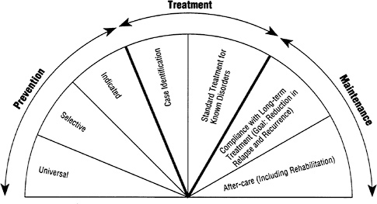
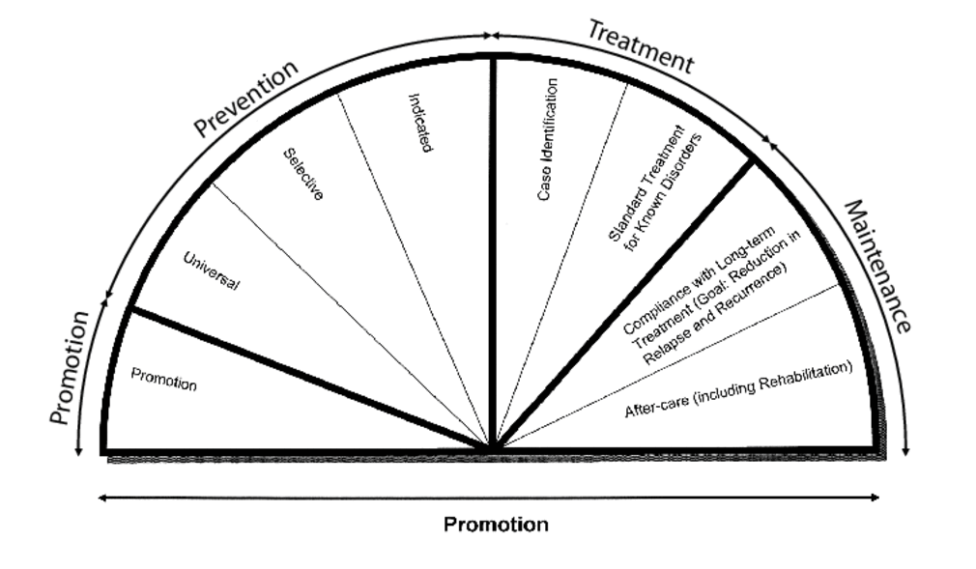
Evolution of the Spectrum/Continuum
1994¹
2009²
Notes:
Note to presenter: This slide is to just highlight the changes from the original spectrum of services in 1994 to 2009, and to then highlight additional changes from 2009 to 2019. For in-depth definitions of terminology and explanations is presented in the following slides.
The original spectrum of behavioral health services was proposed in 1994 to demonstrate that we need a comprehensive set of interventions that span across focus areas to address the increasing problems of mental, emotional, and behavioral health disorders. It subdivided Prevention, Treatment, and Maintenance into several segments. Prevention services included services designed for universal, selective, and indicated populations. Note: These will be defined later in the slide deck.
Based on more research conducted between 1994 and 2009, the report authors added an additional segment, “promotion.” Importantly, “promotion” was also added across the bottom of the continuum to demonstrate that promotion services must not only be offered in general but must be incorporated into all other types of services, from universal prevention services through after-care and rehabilitation services.
So with research conducted since 2009, how did this multi-disciplinary team of prevention science experts update this important figure?

Slide 5
2019: Spectrum of Mental, Emotional, and Behavioral (MEB) Interventions³
Selective
Indicated
Universal
Case Identification
Individual & Family
Treatment of Disorders
Community
Long-term Treatment
Societal
After-care
PROMOTION
Notes:
The title of the image has shifted over time, referred to as a “continuum of care” in 2009, and now a “Spectrum of Mental, Emotional, and Behavioral Interventions” in 2019. Rather than focusing on the name change, it is much more important for prevention practitioners to understand what this change means and how prevention practitioners can apply this tool.
There are 2 very noteworthy changes to the model:
Promotion has been divided from 1 segment into 3 segments: Societal promotion, Community promotion, and Individual and Family promotion. This is based on the understanding that we need an increase in promotion services and they should be focused on different levels of influence on health and well-being.
The authors adjusted the size of the segments, with the larger segments reflecting where more MEB interventions needs to be focused when developing and implementing a comprehensive, community prevention plan to prevent MEBs.
In other words, these authors argue that while we need MEB interventions in every category along the spectrum, and every intervention should incorporate promotion within it, we need a greater proportion of interventions to focus on Promotion and Prevention.
Let’s take a closer look at each section and segment within, and talk through what exactly each of these include.

Slide 6
Promotion^{3,4,5}
Individual & Family
Community
Societal
PROMOTION
Notes:
Promotion involves interventions (programs, practices, and environmental strategies) that enable people “to increase control over, and to improve, their health.”⁴ It includes strategies that develop skills-based positive attributes, such as self-regulation, self-efficacy, goal setting, and positive relationships that promote MEB development. ³
The focus of promotion is on general well-being, with the goal of enhancing people’s ability to:²
“Achieve developmentally appropriate tasks”
Acquire “a positive sense of self-esteem, mastery, well-being, and social inclusion”
“Strengthen their ability to cope with adversity”
The National Prevention Strategy concurs. Emotional well-being “allows people to realize their full potential, cope with the stresses of life, and make meaningful contributions to their community.” Further, since childhood experiences can have a lasting impact on a person’s life, promoting wellness in the early years can help “build a foundation for overall health.” ⁵
A key difference between promotion and prevention is that promotion focuses on building general health and well-being and is not disorder-specific. Prevention interventions focus on impacting risk/protective factors that influences specific disorders, diseases, or problematic behaviors such as preventing cardiovascular disease, binge-drinking, or depression.
The updated Spectrum of MEB Interventions divides promotion into three focus areas:
Societal: Interventions (programs, policies, strategies) that promote health and well-being at the societal level. This includes economic factors, media, discrimination, and other broad factors.
Examples: Policies that address poverty, structural racism, discriminatory lending policies for home loans impacting housing
Community: Interventions (programs, policies, strategies) that promote health and well-being at the community level. This includes the settings within communities, such as schools, workplaces, other places where people gather in a community.
Examples: community-level policies that promote access to early childhood education; policies and practices supporting authoritative, positive school climate; community access to affordable, healthy foods
Individual and Family: Interventions (programs, policies, strategies) that promote health and well-being at the individual, peer, family, and other relationship levels.
Examples: Policies that support paid family leave; implementation or enforcement of anti-bullying policies in schools, Programs that build social-emotional learning
Note that the community segment is slightly larger, suggesting that a good starting point for communities wishing to increase their health promotion should start with this level while being sure to building promotion add societal and individual/family levels for a comprehensive, impact prevention plan.
⁴World Health Organization. (n.d.) Health promotion [Website]. Retrieved from www.who.int/topics/health_promotion/en
³2019 report
⁵National Prevention Council. (2011). National prevention strategy: America’s plan for better health and wellness. Washington, DC: U.S. Department of Health and Human Services, Office of the Surgeon General.

Slide 7
Prevention^{2,5}
Selective
Indicated
Universal
PROMOTION
Notes:
Prevention focuses on interventions that occur prior to the onset of a disorder and which are intended to prevent the occurrence of the disorder or reduce risk for the disorder. Prevention is also about striving to optimize well-being.²
The National Prevention Strategy states that “preventing drug abuse and excessive alcohol use improves quality of life, academic performance, workplace productivity, and military preparedness; reduces crime and criminal justice expenses, and motor vehicle crashes and fatalities; and lowers health care costs for acute and chronic conditions. Excessive alcohol use includes binge drinking, underage drinking, drinking while pregnant, and alcohol impaired driving. Drug abuse includes inappropriate use of pharmaceuticals and any use of illicit drugs.” ⁵
Preventive interventions, according to the Institute of Medicine, can be designed to address three population levels: universal, selective, and indicated. ²
Universal preventive interventions focus on the “general public or a population subgroup that have not been identified on the basis of risk.”
Examples: education for physicians on prescription drug misuse, skill-based educational curriculum for all middle school students
This requires that you have specifically defined your population group and are clear on exactly who you are trying to reach. A Universal strategy should be equally appropriate for anyone within your defined population group.
Selective preventive interventions focus on individuals or subgroups of the defiend population “whose risk of developing behavioral health disorders is significantly higher than average.”
Examples: prevention education for new immigrant families living in poverty with young children, and peer support groups for adults with a history of family mental illness and/or substance abuse, educational curriculum for students with one or more parent incarcerated
Indicated preventive interventions focus on “high-risk individuals who are identified as having minimal but detectable signs or symptoms” that foreshadow behavioral health disorders, “but who do not meet diagnostic levels at the current time.”
Examples: information and referral for young adults who violate campus or community policies on alcohol and drugs; and screening, consultation, and referral for families of older adults admitted to emergency rooms with potential alcohol-related injuries
*Note that the “Universal” segment is larger than selective or indicated. This does not mean that selective or indicated are unimportant. However, research demonstrates that universal programs have a greater impact on changing overall substance misuse rates. This is partly because a universal program naturally includes those within the selective or indicated subgroups. Also, because a large proportion of people who engage in problematic behavior are actually lower risk and come from the universal population but are not within a selective or indicated population necessarily, so ONLY focusing on those at high risk actually leave out a greater percentage of people who will eventually go on to engage in problematic behaviors. For more information, see The Prevention Paradox video on YouTube: https://www.youtube.com/watch?v=qg-Qk4agpyk&t=8s for an alcohol-specific example, and the video “Prevention Paradox: Why We are Failing to Prevent Disease” for a more generic but equally relevant example.
²National Research Council and Institute of Medicine. (2009). Preventing mental, emotional, and behavioral disorders among young people: Progress and possibilities (O’Connell, M. E., Boat, T., & Warner, K. E., Eds.) Washington, DC: National Academies Press.
⁵National Prevention Council. (2011). National prevention strategy: America’s plan for better health and wellness. Washington, DC: U.S. Department of Health and Human Services, Office of the Surgeon General.
National Research Council and Institute of Medicine. (2009). Preventing mental, emotional, and behavioral disorders among young people: Progress and possibilities (O’Connell, M. E., Boat, T., & Warner, K. E., Eds.) Washington, DC: National Academies Press.
Optional: Why might the authors place greater importance on Universal strategies over Selective and Indicated? For information on this, consider the “Prevention Paradox” and learn more about it by sharing this video.

Slide 8
Treatment²
Case Identification
Treatment of Disorders
PROMOTION
Notes:
Treatment interventions include case identification and standard forms of treatment (e.g., detoxification, outpatient treatment, in-patient treatment, medication-assisted treatment). ²
Treatment becomes necessary when someone is diagnosed with a Mental, Emotional, or Behavioral Health Disorder. Unlike most prevention strategies, treatment works mostly at the individual level, and might incorporate family into the treatment program. Successful treatment moves people into “maintenance” of their treatment strategies that are working for them.
Universal prevention strategies, such as strong laws and policies restricting alcohol (such as limiting hours and/or days of sales) do benefit people in treatment, though.
²National Research Council and Institute of Medicine. (2009). Preventing mental, emotional, and behavioral disorders among young people: Progress and possibilities (O’Connell, M. E., Boat, T., & Warner, K. E., Eds.) Washington, DC: National Academies Press.

Slide 9
Maintenance^{2,6,7}
Long-term Treatment
After-care
PROMOTION
Notes:
Maintenance includes interventions that focus on compliance with long-term treatment to reduce relapse and recurrence and after-care, including rehabilitation and recovery support. ^{2,6}
Recovery is a process of change through which individuals improve their health and wellness, live a self-directed life, and strive to reach their full potential.⁷
Again, certain universal policy strategies actually benefit those in long-term recovery, as well.
²National Research Council and Institute of Medicine. (2009). Preventing mental, emotional, and behavioral disorders among young people: Progress and possibilities (O’Connell, M. E., Boat, T., & Warner, K. E., Eds.) Washington, DC: National Academies Press
⁶Compton, M. T. (2009). Clinical manual of prevention in mental health (1st ed.). Arlington, VA: American Psychiatric Publishing, Inc.;
⁷Substance Abuse and Mental Health Services Administration. (2012). SAMHSA's Working Definition of Recovery. Rockville, MD: Substance Abuse and Mental Health Services Administration. Retrieved from http://store.samhsa.gov/product/SAMHSA-s-Working-Definition-of-Recovery/PEP12-RECDEF

Slide 10
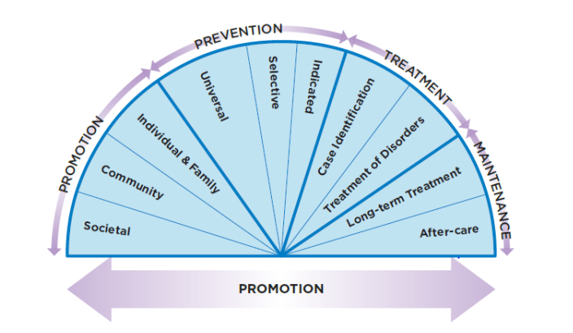
Spectrum of MEB Interventions³
Notes:
Once again, here is the complete and full Spectrum of MEB Interventions. The report authors acknowledge that to truly improve the mental, emotional, and behavioral health of our youth, young people, and all future generations, we need a comprehensive set of services ranging from promotion through prevention, treatment, and maintenance available. These services should be evidence-based, accessible, and without stigma. However, these experts continue to argue for increased promotion and prevention services, community promotion and universal prevention in particular, as demonstrated in the updated Spectrum so that we make a the maximum impact to reduce the prevalence of mental, emotional, and behavioral health disorders and create a society where all are healthy and well.

Slide 11
References
¹Institute of Medicine (1994). Reducing Risks for Mental Disorders: Frontiers for Preventive Intervention Research. Washington, DC: National Academies Press.
²National Research Council and Institute of Medicine. (2009). Preventing Mental, Emotional, and Behavioral Disorders among Young People: Progress and Possibilities. Washington, DC: National Academies Press.
³National Academies of Sciences, Engineering, and Medicine (2019). Fostering Healthy Mental, Emotional, and Behavioral Development in Children and Youth: A National Agenda. Washington, DC: The National Academies Press. https://doi.org/10.17226/25201.
⁴World Health Organization. (n.d.) Health promotion [Website].
⁵National Prevention Council. (2011). National Prevention Strategy: America’s Plan for Better Health and Wellness. Washington, DC: U.S. Department of Health and Human Services, Office of the Surgeon General.
⁶Compton, M. T. (2009). Clinical Manual of Prevention in Mental Health (1st ed.). Arlington, VA: American Psychiatric Publishing, Inc.
⁷Substance Abuse and Mental Health Services Administration. (2012). SAMHSA's Working Definition of Recovery. Rockville, MD: Substance Abuse and Mental Health Services Administration. Retrieved from http://store.samhsa.gov/product/SAMHSA-s-Working-Definition-of-Recovery/PEP12-RECDEF

