Slide 1

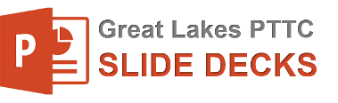
Preventing and Reducing Stigma: Evidence-based Practices
Chuck Klevgaard
Prevention Manager
Notes:
Welcome to this recorded webinar on Preventing and Reducing Stigma
You may be listening today simply to increase your understanding of stigma and how to reduce it, others of you may be listening as trainers or community mobilizers to prepare yourselves to take action that include making presentations of your own
For those of you who are trainers, keep know that the slides you are about to see can be downloaded and customized for your own use.
As you can see on this title, you can add your local organization or town, and who is presenting
In addition, you will find slide sets focused on individual community sectors or types of professionals such as criminal justice or prevention specialists
We are so glad you joined us to learn about this important topic.
This slide serves as a placeholder for you to insert basic information on stigma form the “Stigma basics slide deck”

Slide 2


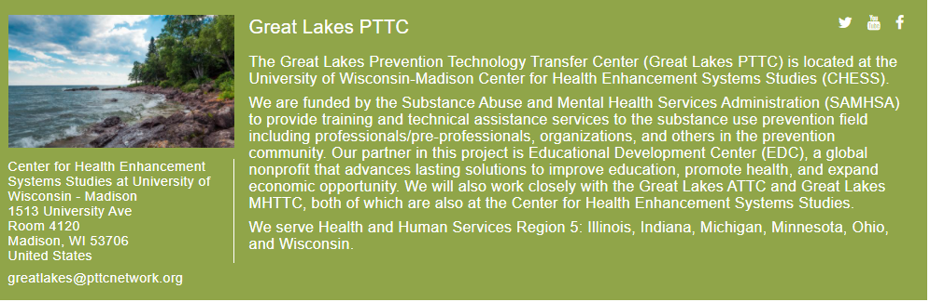
Brought To You By:
Notes:
The Great Lakes Prevention Technology Transfer Center (Great Lakes PTTC) is located at the University of Wisconsin-Madison Center for Health Enhancement Systems Studies (CHESS).
We are funded by the Substance Abuse and Mental Health Services Administration (SAMHSA) to provide training and technical assistance services to the substance use prevention field including professionals/pre-professionals, organizations, and others in the prevention community.

Slide 3

About Us
The Great Lakes ATTC, MHTTC, and PTTC are funded by the Substance Abuse and Mental Health Services Administration (SAMHSA).
Funding Statement
This work is supported by the following cooperative agreements from the Substance Abuse and Mental Health Services Administration:
  Great Lakes ATTC: 1H79TI080207-03
  Great Lakes MHTTC: IH79SM-081733-01
  Great Lakes PTTC: 1H79SP081002-01

Slide 4
Disclaimer
This presentation was prepared for the Great Lakes PTTC under a cooperative agreement from the Substance Abuse and Mental Health Services Administration (SAMHSA). All material appearing in this presentation, except that taken directly from copyrighted sources, is in the public domain and may be reproduced or copied without permission from SAMHSA or the authors. Citation of the source is appreciated. Do not reproduce or distribute this presentation for a fee without specific, written authorization from the Great Lakes PTTC.
At the time of this presentation, Elinore F. McCance-Katz, served as SAMHSA Assistant Secretary. The opinions expressed herein are the views of the speakers and do not reflect the official position of the Department of Health and Human Services (DHHS), SAMHSA. No official support or endorsement of DHHS, SAMHSA, for the opinions described in this document is intended or should be inferred.
November 2020
Notes:
This presentation was prepared for the Great Lakes PTTC under a cooperative agreement from the Substance Abuse and Mental Health Services Administration (SAMHSA).
The opinions expressed in this webinar are the views of the speakers and do not reflect the official position of the Department of Health and Human Services (DHHS), SAMHSA.

Slide 5
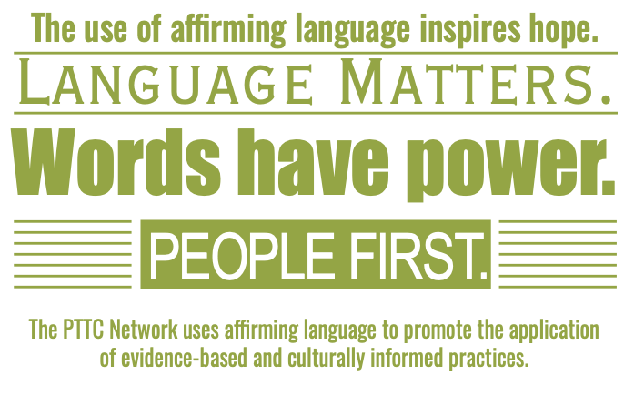
PTTC Network and Langauge
Notes:
The PTTC Network uses affirming language to promote the application of evidence based practice.
You will learn more in this recorded webinar about the importance of language to inspire hope and put people first

Slide 6
Learning Objectives
Participants will be able to:
Describe common components and three levels of stigma
Describe the importance of non-stigmatizing language
List cross-cutting practices for preventing or reducing stigma
List evidence-based strategies for stigma prevention or reduction
Notes:
Okay Lets get started, as a result of listening to this recorded webinar today you will be able to
Describe common components and three levels of stigma
Describe the importance of non-stigmatizing language
List cross-cutting practices for preventing or reducing stigma
List evidence-based strategies for stigma prevention or reduction

Slide 7




A Basic Definition
“Stigma can be understood as an attribute, behavior, or reputation that is socially discrediting, and substance-related problems appear to be particularly susceptible to stigma.”
(John F. Kelly∗, Cassandra M. Westerhoff)
Notes:
Its important to clarify what we are talking about. We encourage everybody to take the time to introduce a basic definition.
This can create stimulate conversation, provide a foundation for common language, and increase community-wide literacy on this topic of stigma.
This definition comes to us from John Kelly and Casandra westerhoff, two important researchers in the field and major contributors to our current understanding of the importance of language. You will hear more about that later in this recoding.
So a basic definition states:
“Stigma can be understood as an attribute, behavior, or reputation that is socially discrediting, and substance-related problems appear to be particularly susceptible to stigma.”
Now take a minute to assess how this definition squares with your own beliefs
Tip: Invite people to react to this definition. In particular, please comment on the language in this definition that squares with what you believe.

Slide 8
A Look at the Components of Stigma
Stereotypes
Ideas
Discrimination Actions
Prejudice
Beliefs
Notes:
Lets now look at stigma as components
Stereotypes: Ideas and attitudes assigned to labeled social entities
Prejudice: Endorsement of negative beliefs and attitudes within those stereotypes
Discrimination Behaviors that act to endorse and reinforce stereotypes, and disadvantage those labeled
Stigma is frequently conferred through labels, which are at times officially sanctioned terms encoded by official agents of (e.g., “mentally ill” by the medical profession, “criminal” by the justice system) intentional or not this perpetuates negative beliefs.
It also happens informally (e.g., anyone referring to an entire race of individua's as “lazy”) sets up the negative belief and leading to prejudice.
To be clear labels produce stereotypes with variable levels of negative social consequences of prejudice often leading to discrimination
The word stigma itself is sometimes debated, some see it as “a victim word, and prefer “discrimination as a better word for framing the issue”
While I would agree that its important that all of us play a role in shaping perceptions, I think its also important to bring people together, meaning don’t get hung up about political correctness. Instead focus on where you and a colleague can agree. Be gentle with folks who use stigmatizing language, its almost always unintentional. A gentle reminder about language in private is always more productive than a public reprimand.

Slide 9
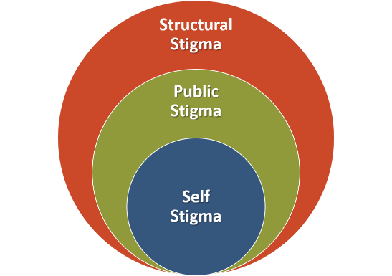
Stigma on Three Levels
Stigma is a dynamic multidimensional, multilevel phenomenon that occurs at three levels of society—structural (laws, regulations, policies), public (attitudes, beliefs, and behaviors of individuals and groups), and self-stigma (internalized negative stereotypes).
(National Academies Press, 2016)
Notes:
Stigma happens on various levels or sometimes described as layers in somewhat of an ecological model
Structural Stigma: Prejudice and discrimination by policies, laws, and constitutional practice; also called institutionalized stigma at the societal level or community level
Public Stigma: Stereotypes, prejudice, and discrimination endorsed by the general population a set of negative attitudes and beliefs that motivate individuals to fear, reject, avoid, and discriminate against people with mental illness. Unchecked public stigma almost always leads to discrimination
Public stigma can lead to: − Differential public and political support for treatment policies − Differential public and political support for criminal justice preferences − Barriers to employment/education/training − Reduced housing and social support − Increased social distance (social isolation)
Personal or Self stigma Internalization of public stigma can lead to Shame/guilt and Lowered self-esteem
For some self stigma can lead to a lack of problem acknowledgment (I am a bad person rather than an individual with a disorder that needs treatment) This can result in Delays in help-seeking, Less treatment engagement, and the creation barriers for recovery
All three levels have an impact on successful we can be with treatment outcomes and support in recovery

Slide 10
Stigma on Three Levels
Examples:
State health agency boards who make decisions, with no representation of individuals with lived experience
Neighborhood perspectives regarding the presence of drug activity
Believing that you’re not worth treatment
(National Academies Press, 2016)
Notes:
Its sometimes helpful to provide colleague with a few examples
Structural stigma exists in public and private institutions, including businesses, the courts, government at all levels, professional groups, school systems, social service agencies, and universities. Stigma at the structural level can appear to endorse discrimination, which contributes to public and self-stigma.
Examples include limits on exercising one’s civil rights, such as serving on a jury or holding a political office, and discriminatory hiring or admissions policies based on stereotypes. People with mental and substance use disorders are overrepresented in the criminal justice system, which is both a consequence and a source of stigma.
Another example is State health agency boards who make decisions about populations and strategies with no representation of individuals with lived experience
Public stigma is operationalized through the behaviors of individuals and groups of all kinds in society. Relevant groups include educators, employers, health care providers, journalists, police, judges, policy makers, and legislators. With their broad reach, the media have a strong influence on stigma at every level. Despite ongoing and successful efforts to educate media professionals about behavioral disorders, stereotypes of violently mentally ill people are perpetuated in media and social media reports of incidents of mass violence and in public discourse about mental illness. Social media can be a source of stigma or a means of promoting affirming attitudes.
Example might be the existence of attitudes in your neighborhood regarding the presence of drug activity
I recently saw a news article showing a GIS map showing neighborhood hots spots for overdose and a heat map to reported crime
Sort of unintentional, but without any context that article could perpetuate fear or even create or strengthen existing stereotypes that individuals with opioid use disorders are dangerous
Self-stigma reduces self-efficacy and can discourage people from disclosing their conditions for fear of being labeled and subjected to discrimination. Take time with your colleagues to talk about the damage that self stigma can do.
For example Label avoidance in turn discourages help and as we mentioned a moment ago reduces treatment-seeking on the part of people with mental and substance use disorders and their families.
This avoidance creates a barrier to early diagnosis and treatment, adding to the heavy social burden of untreated mental and substance use disorders, including chronic disease; costs related to victimization, crime, and incarceration; lost productivity; and premature death.

Slide 11



Stigma Can
Impact Recovery
Reduce willingness to seek professional help
Cause reluctance to attend treatment
Limit access to healthcare, housing, and employment
Notes:
Now lets will move into a discussion about the impact that the three levels of stigma can have on recovery
Stigma can..
Reduce willingness to seek professional help
Cause reluctance to attend treatment, resulting of some in the noncompletion of treatment
Limit access to healthcare, housing, and employment

Slide 12


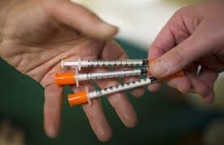
Impacts on Stigmatized Populations …
Increase adverse outcomes
Diminish self-esteem
Affect personal relationships at a time they are needed most
Increase involvement in risky behavior
Notes:
In addition to impacts on recovery
Research indicates that stigma contributes to a host of adverse outcomes for stigmatized populations including people with mental health substance use disorders, The impact of stigma both disadvantages the stigmatized individuals and is a major source of stress in their lives.
In face many argue that stigma is in fact a central driver of morbidity and mortality at a population level.
And Emerging evidence indicates that stigma can be discussed as a fundamental cause of health inequalities.
So here’s how to talk about that
Let people know that because Stigma does this through a few mechanisms …
Stigma influences several physical and mental health outcomes that affect millions of people in the United States
Further It disrupts or inhibits access to multiple resources—structural, interpersonal, and psychological—that could otherwise be used to avoid or minimize poor health
Including:
Diminished self-esteem
Can affect personal relationships at a time they are needed most
Increase involvement in risky behavior
Inequalities between stigmatized and non- stigmatized groups are by no means inevitable, We will talk later in this recording about what can all do about
Stigma as a Fundamental Cause of Population Health Inequalities
https://www.ncbi.nlm.nih.gov/pmc/articles/PMC3682466/

Slide 13



A Statement on Language
How we refer to individuals with substance-related conditions and that use of, and exposure to, the “abuser” label may inadvertently elicit and perpetuate stigmatizing attitudes.
(Substance Abuse and Mental Health Services Administration, 2008)
Notes:
Now lets clarify what we mean by person first language
The language we use to discuss mental health and substance use disorders (SUDs) either formally, as part of our organization or professions messaging, or informally, in conversations with colleagues and stakeholders, can either increase or decrease stigma.
In the context of the growing opioid crisis, the language we use becomes particularly important as many of us now find ourselves working in partnership with people who actively misuse substances.
Remembering that Public stigma is driven by stereotypes about people, in this case with opioid use disorders, such as their perceived dangerousness or perceived moral failings, which translate into negative attitudes toward people with opioid use disorders. Unchecked these stereotypes can become encoded in cultural norms, laws, and lead to discriminatory policies.
Here’s how this can happen
One community I have worked with recently provides an example
In this small town local leaders came up with what I think is a discriminatory policy solution in response to both compassion and real resource fatigue
After years of dedicating resources through first responders administering naloxone as large part of their day realized they were doing overdose reversals with some of the same individuals again and again.
The solution was to set a limit on how many times and under what conditions local first responders would administer naloxone. One aspect of this proposed policy was to require individuals to give back and perform community service if they had a second or third overdose reversal. I don’t think we would treat others this way. This policy seemed grounded in a negative inaccurate belief or stereotype about individuals with OUD. Implies that they have control and that’s its somehow their fault. Two of the most pervasive conditions that we must work against in the perpetuation of stigma.
Before we leave this conversation Now take a moment to consider the significant challenges in rural America in relation to the opioid crisis. Limited resource, access to opioid specific treatment, and the geography the distance people are from one another. Are there other solutions we could offer these local leaders. We will talk about how address public stigma later in this recording.

Slide 14
Affirming Language
Adopted by the ASAM Board of Directors September 15, 2019
Notes:
Back up is that position statement we talked about at the beginning.
This serves as a great example of some simple steps you can take. Consider developing a position of your coalition, your agency, your organization and then disseminate that message through all the channels already in place. That can include your agency brochures and all your training materials.

Slide 15

Commonly Studied Dimensions of Stigma
Blame - individuals are to blame (control and fault).
Social Distance - would I have them marry into my family.
Dangerousness - are they unexpectedly volatile, a threat to my safety.
Notes:
Blame – are they responsible for causing their problem/disorder
Prognostic pessimism/optimism – will they even recover “be normal”, “trustworthy”
Social Distance – would I have them marry into my family, share an apartment with them, have them as a babysitter?
Dangerousness – are they unpredictably volatile, a threat to my/other safety?

Slide 16

What We Are Learning
SUD are more stigmatized
People with SUD are perceived as more to blame for their disorder
Patients themselves who hold more stigmatizing beliefs about SUD are less likely to seek treatment
Describing SUD as treatable helps
Notes:
Compared to other psychiatric disorders, SUD is more stigmatized
Compared to other psychiatric disorders, people with SUD are perceived as more to blame for their disorder
Patients themselves who hold more stigmatizing beliefs about SUD are less likely to seek treatment
Describing SUD as treatable helps
A large body of research indicates that this stigma is persistent, pervasive, and rooted in the belief that addiction is a personal choice reflecting a lack of willpower and a moral failing. Though the severity of the stigma varies with the particular drug being used, evidence shows that stigmatizing beliefs underlie views about addiction in general.

Slide 17


Language Matters
The word ‘abuser' implies volitional acts of willful misconduct, and is associated with things like child abuse,"
‘substance use disorder' conveys something very different — a medical disorder. Substance use is the only thing we talk about this way.
Notes:
JOHN F. KELLY, PH.D., ABPP
Founder and Director of the Recovery Research Institute (RRI) at Massachusetts General Hospital
Kelly has helped us to understand the impact of the word abuse and in particular how it leads the use of term abuser
The word ‘abuser' implies volitional acts of willful misconduct, and is associated with things like child abuse,"
‘substance use disorder' conveys something very different — a medical disorder.
Substance use is the only thing we talk about this way.
He often cites the example that People with eating-related conditions are always referred to as “having an eating disorder”, never as “food abusers”.

Slide 18
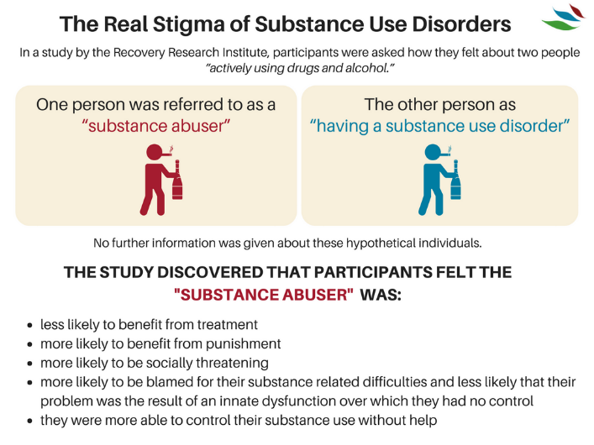

Findings
The use of "substance abuser" increased participants’ believing that the character was personally responsible for his actions and should even be punished for them.
Additional Beliefs about “Substance Abusers”
Notes:
Now lets take a look at what Kelly Found:
In the study, he surveyed more than 500 mental health care providers. Each clinician read one of two vignettes about a character with a substance use problem who was in a court-mandated treatment program but had relapsed and had positive urine tests. The vignettes were identical except that in one, the character was described as a "substance abuser" and in the other as someone with a "substance use disorder." He found that the clinicians who read the vignette about the "substance abuser" were significantly more likely to say that the character was personally responsible for his actions and should be punished for them (International Journal of Drug Policy, 2010).
Participants in the study also felt that substance abuser as compared to the individual with a substance use disorder was
Less likely to benefit from treatment, more likely to benefit from punishment, be socially threatening , and more likely to be blamed and more able to control their use without help. Take a moment and think about all the implications of those beliefs and how they could contribute to all three levels of stigma we talked about earlier
Kelly suggests, in addition to "substance use disorder," using such non-stigmatizing words as "misuse," "hazardous use," "harmful use" and "unhealthy use."
https://www.recoveryanswers.org/research-post/the-real-stigma-of-substance-use-disorders/

Slide 19
Significance of Descriptive Labels
Subscales Comparing the “Substance Abuser” and “Substance Use Disorder” Labels
.90
.80
.70
.60
.50
.40
.30
.20
.10
.00
Substance Abuser
Substance Use Disorder
0.76
0.79
0.69
0.67
0.67
Mean of Subscale Score
0.58
0.41
0.42
0.33
0.23
0.24
0.21
Treatment Punishment Social Threat Blame Exoneration Self-regulation
Source: Kelly, J. F., Dow, S. J., & Westerhoff, C. (2010) Does Our Choice of Substance-Related Terms Influence Perceptions of Treatment Need? An Empirical Investigation with Two Commonly Used Terms. Journal of Drug issues, 40(4), 805-818
Notes:
Here’s a graph showing what we just talked about comparing the use of labels.
Look that significant differences where participants landed on punishment and exoneration.
And self regulation, almost twice as likely to believe that abuser could self regulate as opposed to an individual with a disorder

Slide 20
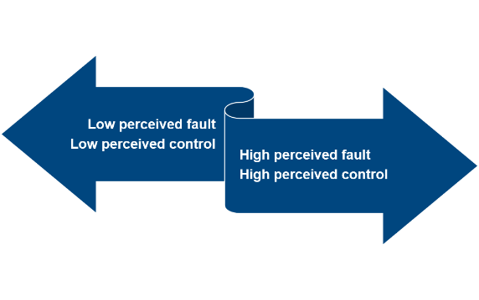
Language and Stigmatized Conditions
Non-Stigmatizing Conditions
Stigmatizing Conditions
Person first language (for example, reference to “a person with substance use disorder”) suggests that the person has a problem that can be addressed. By contrast, calling someone a “drug abuser” implies that the person is the problem.
Words Matter: How Language Choice Can Reduce Stigma PreventionSolutions@EDC
Notes:
This image presents us with a way of thinking about conditions in our community
Starting on the right If people in our community believe that individuals with substance use disorders are at fault and could stop if they wanted to – we are likely to see lots of public stigma, prejudice and discrimination.
If we can increase community members understanding of addiction thereby reducing perceived fault and control, we can expect to see less public stigma and sdiscrimination
Clearly increasing the use of person first language can play a significant role in shifting community conditions in the right direction

Slide 21
Language Matters
Substance Use Disorder
Person with a substance use disorder
Positive drug screen
Recurrence of use
In recovery, abstinent or in remission
Substance Abuse
Addict
Substance abuser Junkie
Dirty drug test
Relapse
Off the wagon
Clean
Ex-addict
Notes:
Present your colleagues with information about language and offer alternatives for non stigmatizing language
Which of the stigmatizing words have you heard used where you live or work.
Remember we talked about earlier that often the use of stigmatizing language is not intentional
IT bears repeating that we don’t want to put ourselves in the position of enforcers of political correctness.
At the same time we all need to take a role in reframing the conversations and language that perpetuates stigma.
As we talked about, pulling someone aside discreetly, privately to remind them about the importance of language is often more productive that embarrassing someone. .

Slide 22
‘ADDICION-ARY’ ADVICE
ABUSER, ADDICT
Use “person first” language: Rather than call someone as addict, say he or she suffers from addiction or a substance use disorder.
DRUG
Use specific terms such as “medication” or a non-medically used psychoactive substance” to avoid ambiguity.
CLEAN, DIRTY
Use proper medical terms for positive or negative test results for substance use.
LAPSE, RELAPSE, SLIP
Use morally neutral terms like “resumed” or experienced a “recurrence” of symptoms.
HMS Professor John Kelly helped to create the Addiction-ary, a glossary of addiction-related terms to help medical professionals and the general public modify their language about addiction. Graphic by Rebecca Coleman/Harvard Staff
Notes:
The Recovery Research Institute's glossary of addiction-related term flags several entries with a “stigma alert” based on research that suggests they induce bias. A sampling:
John Kelly helped to create the Addiction-ary, a glossary of addiction-related terms to help medical professionals and the general public modify their language about addiction. Graphic by Rebecca Coleman/Harvard Staff

Slide 23




Cross-Cutting Practices to Address Stigma
Increase awareness and knowledge about mental and substance use disorders.
Educate about stigmatizing language and its impact on population health.
Notes:
Now we are in the home stretch.
Before we talk about evidence based strategies, we think its important to identify what we call cross cutting practices.
These are based on principles that drive our work on stigma prevention
Things we can all do regardless of what we do where we work include the following
Increase awareness and knowledge about SUD and mental health
Educate about stigmatizing language and its impact on population health

Slide 24


Cross-cutting Practices
Enhance support and resources to entities who are working with SUD and mental health populations
Engage various community partners and stakeholders in conversations about SUD and mental health
Notes:
Further we can
Enhance support and resources to entities who are working with SUD and mental health populations
Engage various community partners and stakeholders in conversations about SUD and mental health

Slide 25

More Cross-Cutting Practices
Provide opportunities for interaction with individuals with substance use or mental health disorders
Promote peer programs in which people who have disclosed their conditions offer their experience and expertise.
Notes:
Finally, we can all work to
Provide opportunities to interact with people with substance use or mental health disorders
Contact-based education uses social contact as a way to improve relations, and dispel stereotypes, among groups that are experiencing stigma and discrimination
Stigma is reduced by providing an opportunity for interpersonal contact between people who have a mental or substance use disorder and audiences who may be stigmatizing towards them or simply who need to work with them in culturally relevant and non stigmatizing ways
Promote peer programs in which people who have disclosed their conditions offer their experience and expertise.
Quick but important caveat. Involvement of those individuals needs to be preceded by opportunities to guide participants who are considering disclosure to make informed decisions considering the risks and benefits of disclosure.

Slide 26



What Works
Structural Stigma
Professional Education
Advocacy
Legal
Policy
National Academies of Sciences, Engineering, and Medicine. (2016). Ending Discrimination Against People With Mental and Substance Use Disorders: The Evidence for Stigma Change.
Notes:
We will take a look at strategies at three levels Structural, Public, and Self Stigma
You recall that talked earlier about structural stigma as Prejudice and discrimination by policies, laws, and constitutional practice; also called institutionalized stigma at the societal level or community level
Targets of structural stigma would include legislators, institutions, and policy makers of systems and organizations that fund and regulate the places and situations where discrimination
The interventions that would be appropriate for this level are legal, policy, advocacy, and professional education strategies.
Strategies would be aimed at changing decision-making processes, policies, and regulations that support discrimination against people with mental and substance use disorders.

Slide 27

What Works
Public Stigma
Mass Media Messaging
Education
Community Programming
Contact Strategies
National Academies of Sciences, Engineering, and Medicine. (2016). Ending Discrimination Against People With Mental and Substance Use Disorders: The Evidence for Stigma Change.
Notes:
Now we will turn to Public stigma
We talked about this as Stereotypes, prejudice, and discrimination endorsed by the general population a set of negative attitudes and beliefs that motivate individuals to fear, reject, avoid, and discriminate against people with mental illness.
Targets for interventions to reduce public stigma include the general public and landlords, employers, health care providers, and groups within the criminal justice system.
The corresponding interventions would be aimed at changing behaviors and interactions from discrimination, fear, neglect, and sometimes abuse to extending support, high-quality treatment, and equal opportunities for housing, employment, and personal success.
Examples of such interventions include use of media for mass messaging to dispel myths regarding behavioral health disorders and treatment, education to counter the lack of knowledge about disorders and treatment, contact with people with behavioral disorders, and protest strategies against discrimination.

Slide 28

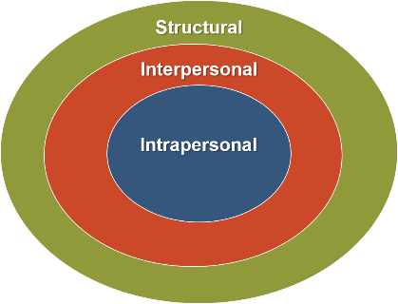

What Works
Self-Stigma
Education
Empowerment
Peer Support
National Academies of Sciences, Engineering, and Medicine. (2016). Ending Discrimination Against People With Mental and Substance Use Disorders: The Evidence for Stigma Change.
Notes:
Finally let’s dive into self stigma
Personal or Self stigma Internalization of public stigma can lead to Shame/guilt and Lowered self-esteem .
For some self stigma can lead to a lack of problem acknowledgment (I am a bad person rather than an individual with a disorder that needs treatment) This can result in Delays in help-seeking, Less treatment engagement, and the creation barriers for recovery
The general effects of self-stigma and the “why try” effect may be diminished by interventions that target individuals with behavioral disorders.
Interventions would focus on promoting self-esteem and self-efficacy; empowerment through peer support, mentoring, and education to dispel myths and increase social and coping skills; and education to encourage treatment engagement
For many individuals, disclosure may be an initial step in the process of reducing self-stigma when it can be done in a safe and strategic manner

Slide 29
Preventing and Reducing Stigma: Evidence-based Practices
My Town, USA
Presenter
Organization
Date
Notes:
Welcome to this recorded webinar on Preventing and Reducing Stigma
You may be listening today simply to increase your understanding of stigma and how to reduce it, others of you may be listening as trainers or community mobilizers to prepare yourselves to take action that include making presentations of your own
For those of you who are trainers, keep know that the slides you are about to see can be downloaded and customized for your own use.
As you can see on this title, you can add your local organization or town, and who is presenting
In addition, you will find slide sets focused on individual community sectors or types of professionals such as criminal justice or prevention specialists
We are so glad you joined us to learn about this important topic.
This slide serves as a placeholder for you to insert basic information on stigma form the “Stigma basics slide deck”

