Slide 1


Preventing and Reducing Stigma: Evidence-based Practices Across Community Sectors Series
Presenter
Organization
Date

Slide 2



Preventing and Reducing Stigma Cross Sector Slide Deck
Education
Impact and Evidence-based Strategies for Preventing and Reducing Stigma
Notes:
Introduce Yourself
Welcome participants to the Webinar, Training, Learning Opportunity
Say something about what addressing stigma means to you or Why you believe its important to have this dialogue

Slide 3


Brought To You By:
The Great Lakes ATTC, MHTTC, and PTTC are funded by the Substance Abuse and Mental Health Services Administration (SAMHSA under the following cooperative agreements:
  Great Lakes ATTC: 1H79TI080207-03
  Great Lakes MHTTC: IH79SM-081733-01
  Great Lakes PTTC: 1H79SP081002-01

Slide 4
Disclaimer
This presentation was prepared for the Great Lakes PTTC under a cooperative agreement from the Substance Abuse and Mental Health Services Administration (SAMHSA). All material appearing in this presentation, except that taken directly from copyrighted sources, is in the public domain and may be reproduced or copied without permission from SAMHSA or the authors. Citation of the source is appreciated. Do not reproduce or distribute this presentation for a fee without specific, written authorization from the Great Lakes PTTC.
At the time of this presentation, Elinore F. McCance-Katz, served as SAMHSA Assistant Secretary. The opinions expressed herein are the views of the speakers and do not reflect the official position of the Department of Health and Human Services (DHHS), SAMHSA. No official support or endorsement of DHHS, SAMHSA, for the opinions described in this document is intended or should be inferred.
November 2020
Notes:
This presentation was prepared for the Great Lakes PTTC under a cooperative agreement from the Substance Abuse and Mental Health Services Administration (SAMHSA).
The opinions expressed in this webinar are the views of the speakers and do not reflect the official position of the Department of Health and Human Services (DHHS), SAMHSA.

Slide 5

Adopted by the ASAM Board of Directors September 15, 2019
Notes:
Read the slide text and ask participants to reflect on and apply this to the dialogue.

Slide 6

Follow Us On Social Media!
Facebook and Twitter:
  @GreatLakesATTC
  @GMhttc
  @GLPTTC
Photo: iStock
Notes:
If you would like to know more about what we are doing or information on upcoming events, please see our social media pages

Slide 7
Learning Objectives
Participants will be able to:
Describe why addressing stigma within educational settings is important
List the potential impact of stigma and the role that educators can providers can play
List strategies for engaging educators in the prevention and reduction of stigma
Notes:
Quickly Review the Objectives for Today
Describe why addressing stigma within educational settings is important
List the potential impact of stigma and the role that educators can providers can play
List strategies for engaging educators in the prevention and reduction of stigma

Slide 8





















A Role for Every Sector
Law Enforcement
Police and other professionals engaged in enforcement
Criminal Justice
Judges, Courts, Probation and Jails
Prevention
Community level prevention practitioners
Education
Professionals in school and higher education settings.
Preventing
& Reducing Stigma
Policy Makers
State and Local Government Officials
First Responders
Professionals such as EMT’s who are among those first to provide assistance
Behavioral Health
Clinicians working in treatment and mental health Settings
Faith Leaders
People within faith institutions guiding or leading others.
Healthcare
Professionals working in healthcare or community health centers
Business
Workplace Settings
EMPOWERMENT and RESILIENCE
Notes:
Make the Point that Behavioral Health workers have not been singled out as the cause or the only solution to addressing stigma.
The purpose of todays discussion is to identify opportunities rather than blame.
Encourage the leaders or faith partners to listen and share what they are thinking, learning and doing including
Invite them to share what segments that have seen addressing stigma in a positive way

Slide 9

A Role for Everyone
Stigma disproportionately influences health outcomes and mental well-being for individuals with mental health or substance use disorder.
Stigma is not limited to one setting or condition; it is cross-cutting in all communities and populations.
Notes:
Present the importance of cross cutting principles as we approach this work and the potential specifically for Educators
Stigma disproportionately influences health outcomes and mental well-being for individuals with mental health or substance use disorder (SUD). Fear of being judged and/or discriminated against can prevent people from getting the help they need. Stigma is complex due to various societal and research definitions, including it comes in many different forms.
2. Stigma is not limited to one setting or condition, rather it is cross-cutting in all communities and populations.
3. The best approach to stop or prevent stigma is through cross-cutting practices such as:
Increase awareness and knowledge about SUD and mental health
Educate about stigmatizing language and its impact on population health
Enhance support and resources to entities who are working with SUD and mental health populations
Engage various community partners and stakeholders in conversations about SUD and mental health
Provide opportunities to interact with people with substance use or mental health disorders (contact-based education programs)
Promote peer programs in which people who have disclosed their conditions offer their experience and expertise to individuals and families, programs that range from informal peer-led programs to peer specialized services in health services systems." (National Academies Press, 2016)

Slide 10


Education
Why it Matters
Approximately ten million secondary education students require professional help due to a mental health condition.
Staff and faculty are on the front lines when it comes to supporting students.
Notes:
Approximately ten million secondary education students require professional help due to a mental health condition.
In this population, depression, anxiety, attention-deficit hyperactivity disorder (ADHD), and bipolar disorder are the most common mental health conditions. Staff and faculty are on the front lines when it comes to supporting students who have mental illnesses. School staff and faculty need significant and ongoing training on the mental health issues affecting students across the age spectrum. With direct and daily interaction with students, educators and other school personnel have an excellent opportunity to carry out systems that will prevent mental health crises in educational settings.

Slide 11

Why it Matters
Few teaching and training programs adequately prepare educators and staff to work with students
Students with mental health or SUDs are more likely to experience in-person and cyber-bullying than other students.
Notes:
Students with mental health or SUDs are more likely to experience in-person and cyber-bullying than other students. Unfortunately, many students with mental health disorders lack access to professional help. Untrained educators and staff may end up reacting to students rather than taking a proactive approach. Due to the scarcity of resources and support, educators and staff are often forced to separate students who need greater attention or cause distractions.
Few teaching and training programs adequately prepare educators and staff to work with students who have a mental health or SUD. Many training programs may perpetuate misconceptions about these students' needs. When they do not perform well, students with behavioral health issues can be labeled as "bad," furthering the disconnection. Early intervention and trajectory set the stage for interactions around mental health. Schools are often the first contact for students with SUD/mental illness. De-stigmatizing mental illness and SUD can allow students to get the educational accommodations and supports they need (e.g., leave of absence, specialized instruction).
Suicide is the leading cause of death for those aged 10-24. 90% of students 10-14 years old who died from suicide had an underlying mental illness

Slide 12



Education
What's the Impact
In some educational settings, as few as one in four college students with mental health or SUD seek campus services.
Potential returning students in recovery from SUD may not return due to a perceived lack of understanding.
Notes:
In some educational settings, as few as one in four college students with mental health or SUD seek campus services. When they do reach out, they are more likely to receive inadequate services or experience delays.
Potential returning students in recovery from SUD may not return due to a perceived lack of understanding of the risks of returning to a high-risk educational setting and lack of recovery specific services that can support them.
Students with mental health problems are often segregated from other students, furthering gaps in knowledge and socialization.
School dropouts and subsequent unemployment are significant consequences of stigma.
Self-stigma and reluctance or failure to disclose mental illness or SUD
Often limited school counselors to address these issues (structural stigma due to lack of funding)

Slide 13


What’s the Impact
School dropouts and subsequent unemployment are significant consequences of stigma.
Often limited school counselors to address these issues.
Notes:
Students with mental health problems are often segregated from other students, furthering gaps in knowledge and socialization.
School dropouts and subsequent unemployment are significant consequences of stigma.
Self-stigma and reluctance or failure to disclose mental illness or SUD
Often limited school counselors to address these issues (structural stigma due to lack of funding)

Slide 14


Education
What Can Be Done
Include instruction about mental health issues, SUDs, and recovery in training programs.
Provide opportunities for educators to hear directly from individuals with substance misuse and mental health challenges.
Notes:
Educate students with mental health and SUDs about coping strategies.
Include instruction about mental health issues, SUDs, and recovery in teacher and staff training programs. Provide opportunities for educators and staff to hear directly from individuals with substance misuse and mental health challenges.
Help educators and staff understand the relationship between early trauma and mental health and substance misuse. Provide training on the impact of trauma on student behavior and work with school administrators and staff to implement trauma-informed educational practices.

Slide 15

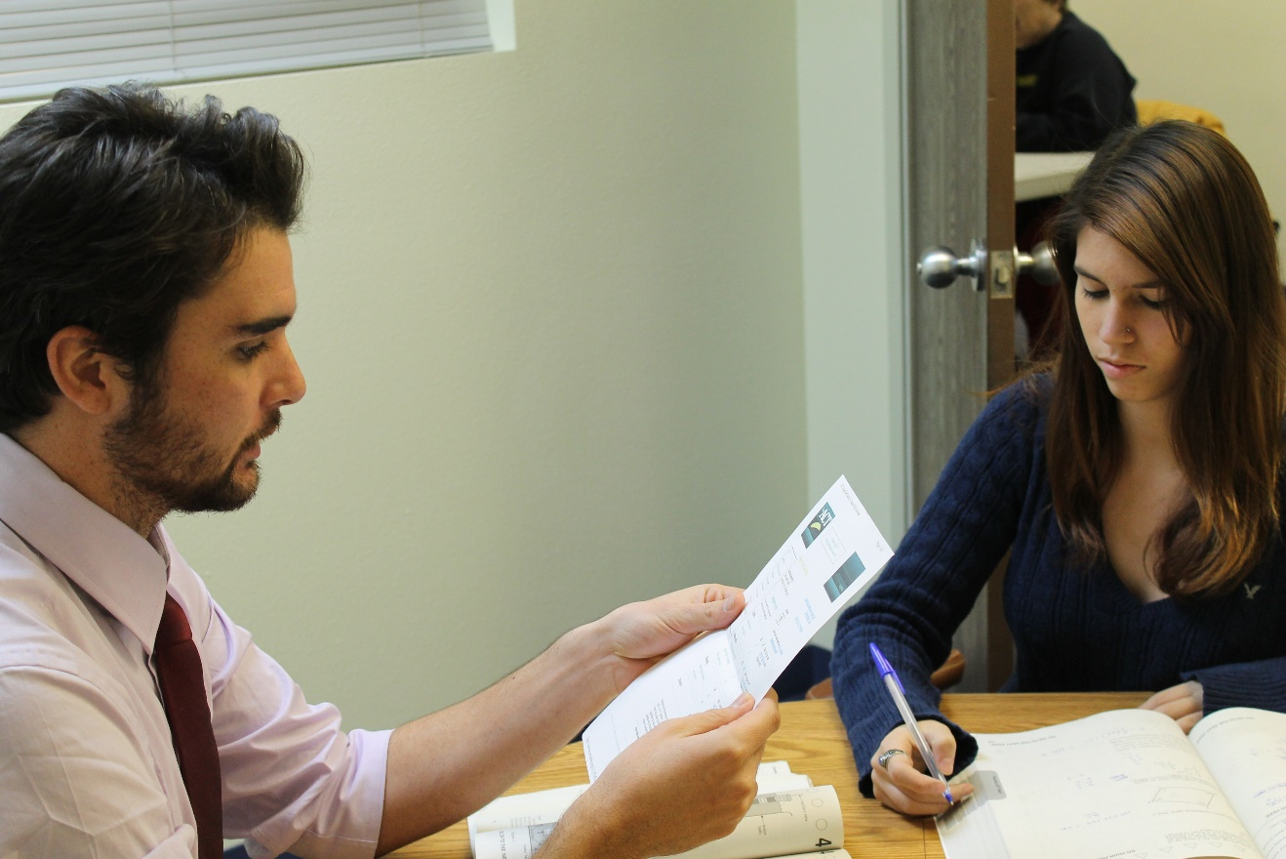
What Can Be Done
Educate students with mental health and SUDs about coping strategies.
Enhance and support academic accommodations for mental illness/SUD due to student disclosure.
Notes:
Educate students with mental health and SUDs about coping strategies.
Promote anti-stigma campaigns in educational settings, including online approaches.
Enhance and support academic accommodations for mental illness/SUD due to student disclosure.

Slide 16


We Can…
Promote anti-stigma campaigns in educational settings, including online approaches.
Notes:
We Can Promote anti-stigma campaigns
For example: https://www.thechildrenscenter.com/stopthestigma/

Slide 17

Questions

Slide 18
Follow Us On Social Media!
Facebook and Twitter:
  @GreatLakesATTC
  @GMhttc
  @GLPTTC
Photo: iStock
Notes:
If you would like to know more about what we are doing or information on upcoming events, please see our social media pages

