Slide 1


Preventing and Reducing Stigma: Evidence-based Practices Across Community Sectors Series
Presenter
Organization
Date

Slide 2


Brought To You By:
The Great Lakes ATTC, MHTTC, and PTTC are funded by the Substance Abuse and Mental Health Services Administration (SAMHSA under the following cooperative agreements:
  Great Lakes ATTC: 1H79TI080207-03
  Great Lakes MHTTC: IH79SM-081733-01
  Great Lakes PTTC: 1H79SP081002-01

Slide 3
Disclaimer
This presentation was prepared for the Great Lakes PTTC under a cooperative agreement from the Substance Abuse and Mental Health Services Administration (SAMHSA). All material appearing in this presentation, except that taken directly from copyrighted sources, is in the public domain and may be reproduced or copied without permission from SAMHSA or the authors. Citation of the source is appreciated. Do not reproduce or distribute this presentation for a fee without specific, written authorization from the Great Lakes PTTC.
At the time of this presentation, Elinore F. McCance-Katz, served as SAMHSA Assistant Secretary. The opinions expressed herein are the views of the speakers and do not reflect the official position of the Department of Health and Human Services (DHHS), SAMHSA. No official support or endorsement of DHHS, SAMHSA, for the opinions described in this document is intended or should be inferred.
November 2020
Notes:
This presentation was prepared for the Great Lakes PTTC under a cooperative agreement from the Substance Abuse and Mental Health Services Administration (SAMHSA).
The opinions expressed in this webinar are the views of the speakers and do not reflect the official position of the Department of Health and Human Services (DHHS), SAMHSA.

Slide 4

Adopted by the ASAM Board of Directors September 15, 2019
Notes:
Read the slide text and ask participants to reflect on and apply this to the dialogue.

Slide 5
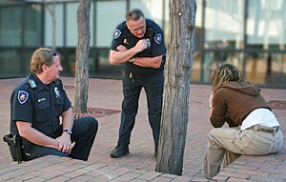


Preventing and Reducing Stigma Cross Sector Slide Deck
Law Enforcement
Impact and Evidence-based Strategies for Preventing and Reducing Stigma
Notes:
Introduce Yourself
Welcome participants to the Webinar, Training, Learning Opportunity
Say something about what addressing stigma means to you or Why you believe its important to have this dialogue

Slide 6
Learning Objectives
Participants will be able to:
Describe why addressing stigma within law enforcement is important
List the potential impact of stigma and the role that law enforcement can providers can play
List strategies for engaging law enforcement in the prevention and reduction of stigma
Notes:
Quickly Review the Objectives for Today
Describe why addressing stigma within prevention is important
List the potential impact of stigma and the role that prevention practitioners can providers can play
List strategies for engaging prevention specialists and coalition leaders in the prevention and reduction of stigma

Slide 7





















A Role for Every Sector
Law Enforcement
Police and other professionals engaged in enforcement
Criminal Justice
Judges, Courts, Probation and Jails
Prevention
Community level prevention practitioners
Education
Professionals in school and higher education settings.
Preventing
& Reducing Stigma
Policy Makers
State and Local Government Officials
First Responders
Professionals such as EMT’s who are among those first to provide assistance
Behavioral Health
Clinicians working in treatment and mental health Settings
Faith Leaders
People within faith institutions guiding or leading others.
Healthcare
Professionals working in healthcare or community health centers
Business
Workplace Settings
EMPOWERMENT and RESILIENCE
Notes:
Make the Point that Behavioral Health workers have not been singled out as the cause or the only solution to addressing stigma.
The purpose of todays discussion is to identify opportunities rather than blame.
Encourage the leaders or faith partners to listen and share what they are thinking, learning and doing including
Invite them to share what segments that have seen addressing stigma in a positive way

Slide 8

A Role for Everyone
Stigma disproportionately influences health outcomes and mental well-being for individuals with mental health or substance use disorder.
Stigma is not limited to one setting or condition; it is cross-cutting in all communities and populations.
Notes:
Present the importance of cross cutting principles as we approach this work and the potential specifically for Law Enforcement
Stigma disproportionately influences health outcomes and mental well-being for individuals with mental health or substance use disorder (SUD). Fear of being judged and/or discriminated against can prevent people from getting the help they need. Stigma is complex due to various societal and research definitions, including it comes in many different forms.
2. Stigma is not limited to one setting or condition, rather it is cross-cutting in all communities and populations.
3. The best approach to stop or prevent stigma is through cross-cutting practices such as:
Increase awareness and knowledge about SUD and mental health
Educate about stigmatizing language and its impact on population health
Enhance support and resources to entities who are working with SUD and mental health populations
Engage various community partners and stakeholders in conversations about SUD and mental health
Provide opportunities to interact with people with substance use or mental health disorders (contact-based education programs)
Promote peer programs in which people who have disclosed their conditions offer their experience and expertise to individuals and families, programs that range from informal peer-led programs to peer specialized services in health services systems." (National Academies Press, 2016)

Slide 9



Law Enforcement
Why it Matters
Law enforcement personnel frequently interact with people with mental illness and SUD.
Law enforcement may perceive people with mental illness and SUD as more dangerous and less credible than others.
Notes:
Law enforcement personnel frequently interact with people with mental illness and SUD because these populations are disproportionately represented in jails and overall within the criminal justice system.
Law enforcement may perceive people with mental illness and SUD as more dangerous and less credible than others. The presence of serious mental illness increased the likelihood of incarceration following a misdemeanor by more than 50%, even when controlling for variables such as race, violence of the offense, and prior arrest history.

Slide 10
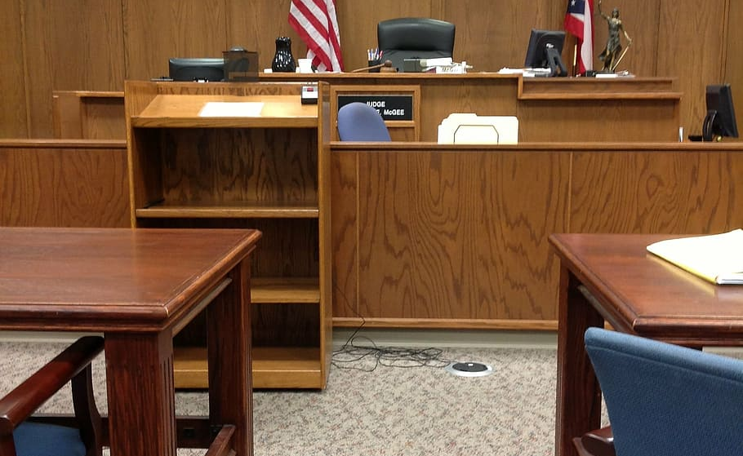
Why it Matters
Law enforcement personnel frequently must exercise substantial judgment about mental illness and SUD.
They frequently serve as a gatekeeper between the criminal justice system and mental health systems.
Notes:
Law enforcement personnel have to exercise substantial judgment about mental illness and SUD since law enforcement frequently serves as a gatekeeper between the criminal justice system and mental health systems.
Law enforcement personnel would benefit from a greater understanding of various psychiatric conditions, mental health issues, SUDs, and their co-occurrence.

Slide 11


Law Enforcement
What’s the Impact
Overrepresentation of people with mental illness and disorders in the criminal justice system.
People may fear that law enforcement will use an aggressive approach, including refusing to listen to them.
Notes:
Overrepresentation of people with mental illness and disorders in the criminal justice system.
People with mental illness and SUDs may fear that law enforcement will use an aggressive approach, including refusing to listen to them.
People with mental illness are perceived as untrustworthy and unable to provide accurate information about their situations; little is done to resolve injustices on their behalf.
People with mental illness are vulnerable to victimization. If they seek help from the police, they may not be taken seriously or receive appropriate assistance.
Unrecognized trauma and blaming
Intersectionality of race/ethnicity/gender/ sexual orientation further complicates stigma and police interactions

Slide 12


What’s the Impact
People with mental illness may be perceived as untrustworthy and unable to provide accurate information.
Unrecognized trauma and blaming.
Intersectionality further complicates stigma.
Notes:
People with mental illness are perceived as untrustworthy and unable to provide accurate information about their situations; little is done to resolve injustices on their behalf.
People with mental illness are vulnerable to victimization. If they seek help from the police, they may not be taken seriously or receive appropriate assistance.
Unrecognized trauma and blaming
Intersectionality of race/ethnicity/gender/ sexual orientation further complicates stigma and police interactions

Slide 13
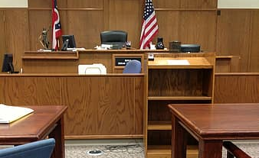

Law Enforcement
What Can Be Done
Provide training and support on crisis intervention, de-escalation, and addition and mental illness.
Offer court-ordered treatment, 24-hour structured care, case management, and family involvement.
Notes:
Provide police with training and support, including mental health consultation, formal training in crisis intervention, how to recognize mental health symptoms, and controlled role-playing that encourages discussion and feedback.
Offer court-ordered treatment, 24-hour structured care, case management, and family involvement.

Slide 14


What Can Be Done
Provide programs that facilitate social contact between people with and without behavioral disorders.
Increase access to community based-treatment services that reduce police contact, jail time, and re-incarceration rates.
Notes:
Provide programs that facilitate social contact between people with and without behavioral disorders (contact-based programs)
Increase access to community based-treatment services that reduce police contact, jail time, and re-incarceration rates.
Develop and implement crisis intervention teams (CIT). Work through local through community mental health agencies to train officers to de-escalate without force, properly restrain individuals, and make initial assessments on handling situations with individuals with mental illness or substance use disorders.

Slide 15
We Can…
Develop and implement crisis intervention teams.
Train officers to de-escalate without force, properly restrain individuals, and make initial assessments on handling situations.
Notes:
Develop and implement crisis intervention teams (CIT). Work through local through community mental health agencies to train officers to de-escalate without force, properly restrain individuals, and make initial assessments on handling situations with individuals with mental illness or substance use disorders.

Slide 16

Questions
Notes:
The language practitioners use to talk about substance misuse shapes how the public views substance use disorders. Unintentionally stigmatizing language can perpetuate negative stereotypes about the types of people who are affected by substance misuse and can decrease public support for prevention and treatment programs.
By contrast, language that supports pro-health activities, even if a person is actively using substances, can help decrease stigmas.
For example, prevention messages that highlight the self-efficacy of people with SUDs to use naloxone to reverse opioid overdose frames them as capable and important community members, and directly tackles existing stigmas of people with SUDs as selfish and lazy.

Slide 17

Follow Us On Social Media!
Facebook and Twitter:
  @GreatLakesATTC
  @GMhttc
  @GLPTTC
Photo: iStock
Notes:
If you would like to know more about what we are doing or information on upcoming events, please see our social media pages

