Slide 1
Live Life Powerfully
Waylon Pahona
Notes:
Welcome to the Essential Substance Abuse Skills webinar series. I am XX, and today we have XX presenting XX

Slide 2
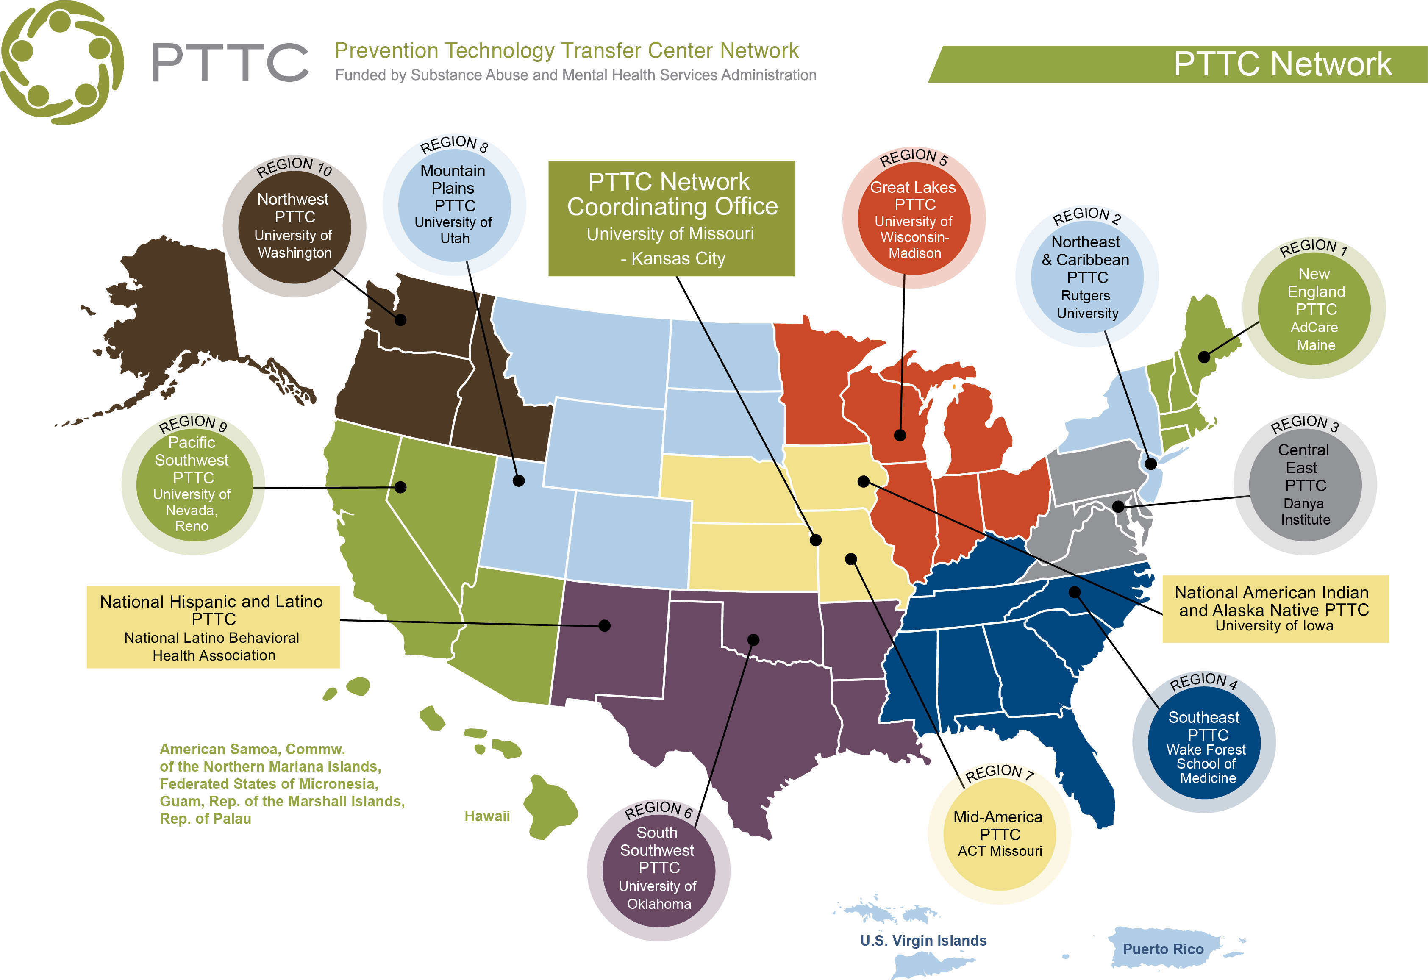
American Indian & Alaska Native Prevention webinar series
This webinar is provided by the National American Indian & Alaska Native PTTC, a program funded by the Substance Abuse and Mental Health Services Administration (SAMHSA).
Notes:
This training series is brought to you by the National American Indian & Alaska Native Prevention Technology Transfer Center. We are part of the PTTC Network, which also includes 10 regional centers, a network coordinating office, and the National Hispanic and Latino PTTC.

Slide 3
Webinar follow-up
We will be getting in touch following today’s event to share our survey link in case you did not get a chance to fill it out, and to share any additional follow-up information. We will be saving the conversation from the chat and sharing that with everyone, so please be aware of that when writing. We will remove sensitive information, and we are not recording this event.
Notes:
We will be getting in touch following today’s event to share our survey link in case you did not get a chance to fill it out, and to share any additional follow-up information. We will be saving the conversation from the chat and sharing that with everyone, so please be aware of that when writing. We will remove sensitive information, and we are not recording this event.

Slide 4
Webinar follow-up
Evaluation: SAMHSA’s GPRA
This webinar is provided by the National American Indian & Alaska Native MHTTC, a program funded by the Substance Abuse and Mental Health Services Administration (SAMHSA).
Participation in our evaluation lets SAMHSA know:
How many people attended our webinar
How satisfied you are with our webinar
How useful our webinars are to you
You will find a link to the GPRA survey in the chat box. If you are not able to complete the GPRA directly following the webinar, we will send an email to you with the survey link. Please take a few minutes to give us your feedback on this webinar. You can skip any questions that you do not want to answer, and your participation in this survey is voluntary. Through the use of a coding system, your responses will be kept confidential and it will not be possible to link your responses to you.
We appreciate your response and look forward to hearing from you.
Notes:
We will be sharing a link to our GPRA survey at the end of our session today. This survey takes just a few minutes to complete, and asks about your satisfaction with the event. This feedback is critical to our future work, and we value your opinion and would greatly appreciate your time in sharing your thoughts with us.

Slide 5
Zoom Overview
Participant overview:
You will need to click on the “Chat” icon to open up the chat on the right side of the screen.
To ask questions or share comments, please type them into the chat pod and hit “Enter.”
Notes:
You will be muted for the duration of this webinar. Please use the chat feature to share your questions and comments, and we will address questions at appropriate points during the presentation.

Slide 6
Today’s Speaker
Waylon Pahona Jr. Hopi & Tewa/ Maricopa grew up on the Hopi Reservation. He spent more than ten years within the Gila River Indian Community employed by WIA (Workforce Investment Act), as a Youth Coordinator for five years, and five years with Gila River Health Care as a Lead Staff Trainer. Waylon is well known for transforming his life and being the founder/creator of Healthy Active Natives (HANs). The HANs social networking group on Facebook currently has over 76,000 HAN members nationally and internationally. Waylon’s journey has motivated and inspired many people across the nation to join the HAN’s movement. When creating Healthy Active Natives in 2012, Waylon’s vision was for HANs to be a space where Natives welcome all fitness levels and uses positive reinforcement to pick each other up against all odds to make positive changes. In 2013 Waylon also received the Healthy Innovation award by IHS Indian Health Services for his social media group. Waylon is also an Ambassador to Tanka Bar Jerky.

