Slide 1
Diversifying Your Network for Equity
Great Lakes Prevention Technology Transfer Center Network
Ericka Burroughs-Girardi, MA, MPH February 10, 2022
countyhealthrankings.org
Ericka.Burroughs-Girardi@chrr.wisc.edu

Slide 2
County Health rankings and roadmap
Notes:
CHR&R is a national program of the University of WI Population Health Institute. Our work is supported by RWJF.

Slide 3
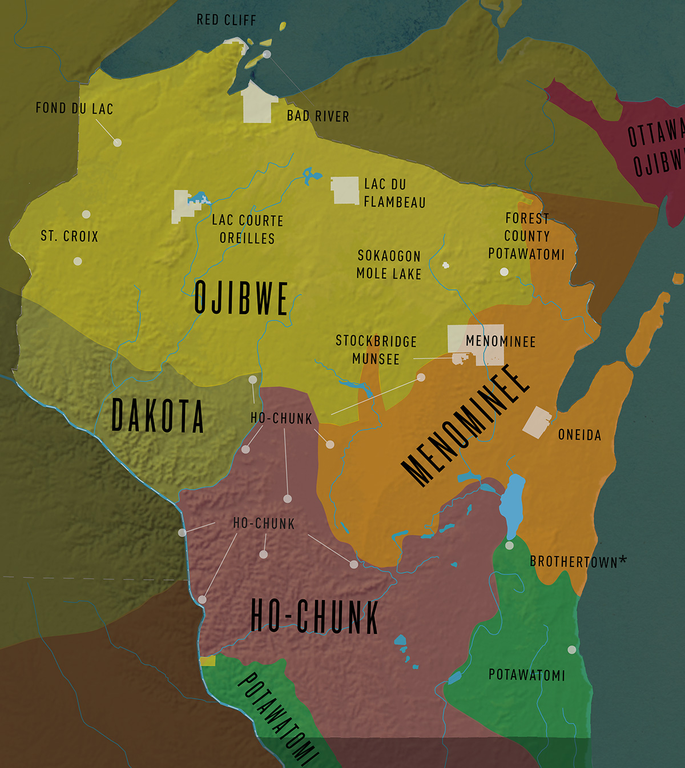
Land acknowledgement
The University of Wisconsin-Madison occupies ancestral Ho-Chunk land, a place their nation has called Teejop (day-JOPE) since time immemorial. In an 1832 treaty, the Ho-Chunk were forced to cede this territory. Decades of ethnic cleansing followed when both the federal and state government repeatedly, but unsuccessfully, sought to forcibly remove the Ho-Chunk from Wisconsin. This history of colonization informs our shared future of collaboration and innovation. Today, the University of Wisconsin-Madison respects the inherent sovereignty of the Ho-Chunk Nation, along with the eleven other First Nations of Wisconsin.
Notes:
I would like to share our land acknowledgment.
If you happen to know the ancestral lands on which you are currently occupying, please feel free to share that in the chat.

Slide 4
Ways to Engage Today
Participate in polls
Use the Q/A Box to ask your questions of ME. Questions breaks will occur following each section
Use the chat to respond to a question I may ask YOU
Use the notes section in your workbook
The pencil icon on a slide indicates a workbook activity
Poll
Workbook
Workbook Activity
Video
Notes:
I encourage you to really dig into today’s session to help you grow. There are a number of ways to engage today.
I will be launching polls. Note that ALL polls are anonymous. So, please answer honestly.
We have the Q/A and chat box. Here is the difference between the two. The Q/A box is used to place questions you have for ME.
The Chat is used to respond to questions I ask you, the audience.
Finally, there is your workbook that you received. Respond to questions in your workbook.
When you see the data icon, that means a poll will be launched so be prepared. When you see the workbook icon, it means the information is today’s workbook or a previous workbook that you have already received. When you see the pencil icon, it means there is a question in your workbook to respond to, but I will remind you each time, so don’t feel you need to memorize all of this.

Slide 5
Review of Key Definitions
Health Equity: A conceptual term describing a world where everyone has a fair and just opportunity to be as healthy as possible
Inequity: Unequal access to quality education, healthcare, housing, transportation, or other resources
Social Determinants of Health: Life-enhancing resources whose distribution across populations effectively determines length and quality of life
Education access and quality
Health care and quality
Neighborhood and built environment
Social and community context
Economic stability
Notes:
Before we dig in, let’s make sure you are grounded in the definition of health equity. Health equity describes a world where everyone has a fair and just opportunity to be as healthy as possible. An inequity occurs when there is unequal access to the conditions that impact our health like education, healthcare, housing, and so forth.
It is important to note that inequities or unequal access occurs because policies and/or practices have led to them. I have included in your workbook a sample of policies that led to some of the inequities that certain residents encounter today.
Lastly, know that there are several determinants that impact our health: Health behaviors is one determinant of health. Health behaviors would include our diet, our physical activity habits and, yes, our use of substances like tobacco, alcohol or other substances. However, Social determinants of health or critical. Why? Well, these are the determinants that govern our decisions to make healthy choices. We may have the best intentions to eat healthy or be physically active , but if we do not have the income to support a healthy diet, or if we work three jobs and do not have the energy to exercise, the decision to be healthy has been made for us.

Slide 6
New Definition: Equity
Conditions where everyone has a fair and just opportunity to thrive
Factors that can determine equitable opportunities
Ageism
Racism
Sexualism (discrimination against a sexual orientation)
Ableism (discrimination against people with disabilities)
Notes:
Today, you will hear me use the term equity, perhaps without health at the handle. Equity is a conceptual term meaning conditions where everyone has a fair and just opportunity to thrive.
Who is included with everyone? Everyone! That means no matter what a person’s background, color, sexual orientation or any other factor that makes us unique should not interfere with their ability to thrive in this world.
So today, we are discussing how to diversify your network so that equity is the outcome.

Slide 7
Difference between equality and equity
Notes:
RWJF Equity Video: https://www.youtube.com/watch?v=MlXZyNtaoDM
What do you think the difference between equality and equity is

Slide 8
Today’s Learning Objectives
Understanding the connection between a diverse network and equitable solutions
Learning and exchanging strategies to diversify your networks
Practicing authenticity for connection
Notes:
With that, here are today’s leaning objectives

Slide 9
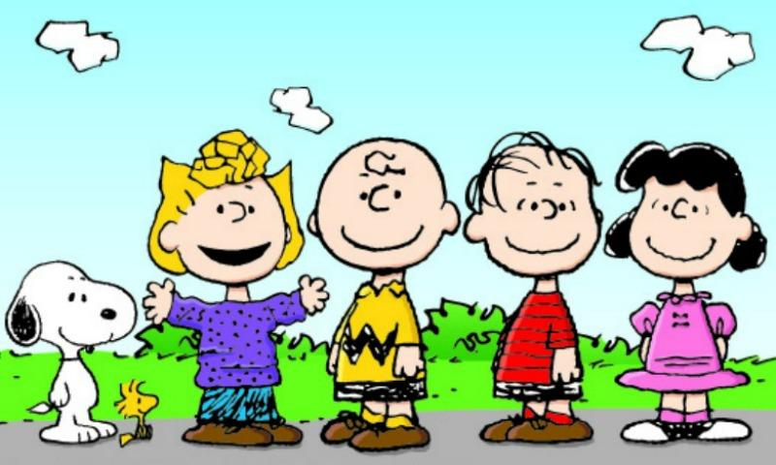
POLL: Which Peanuts Character Are you Today?
Sally | I just want to move on from this equity stuff.
Charlie | I am unsure what all this equity stuff means.
Linus | I know some things, but I need to learn more about equity.
Lucy | I can teach this equity stuff.
Peanuts Characters
( United Feature Syndicate, Inc. )
Notes:
We can all be Snoopy and Woodstock who are always looking to have a good time. My goal is for this training to be a fun learning event.
Sally: It’s all about me and gets frustrated when things stand in the way of getting what she wants
Charlie Brown: Unsure of himself
Linus: Always recognizes his limitations and is not ashamed of that
Lucy: Some may call her bossy; I call her self-confident
Please build in this Poll:
Which Peanuts character are you today? (choose one)
Sally
Charlie
Linus
Lucy

Slide 10
Understanding the connection between a diverse network and equitable solutions

Slide 11
What is A Network?
Partners +
Notes:
A network includes your core partners PLUS the partners of your partners. An abbreviated way
Your core partners are trusted individuals or organizations who give you access to a new group of additional partners. These trusted core partners become your ambassador to their world. Within our private lives we all operate in networks. Here are a few examples.

Slide 12
Common Individual Networks
Shopping parties (Mary Kay, Pampered Chef)
Faith-based institutions
Book clubs
Gym memberships
Social media
Notes:
Individual networks include friends or people you typically engage with and their friends.

Slide 13
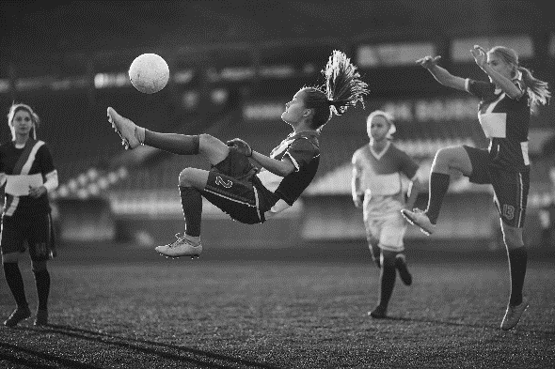
Who is in OUR Professional NetworkS?
Schools
Law Enforcement
Youth Groups
Are these the usual playmates?
Notes:
Now your professional network for your prevention work may look different. Remember your network consists of partners plus the partners of your partners.
Your professional network that supports the work you so may consist of schools, law enforcement or justice-oriented organizations, or youth groups like sports teams, boys and girls clubs, or other groups traditionally core to prevention work. There are probably other core partners as well that you are thinking about.
Right now, make a list of the core partners you work with.
Do you know the partners that work with your partners?
Are you connected to these folks?

Slide 14
Why Expand Beyond traditional Partners
May have blind spots (We don’t know what we don’t know)
May have limited exposure to those experiencing inequities
May possess a limited equity growth mindset
Notes:
Why is important to expand beyond our traditional partners? Well, some of our partners may have blind spots. They may not really notice inequities among those they serve because they are dedicated to just serving everyone. And that’s ok. I am not saying you should shun these partners. I am just saying that you need to think about expanding your network.
Some of your traditional partners may simply have limited exposure to those experiencing inequities. For example, if one of your partners is the local polo club, it is unlikely that the polo club members interact with people who struggle to get their daily needs met.
Then, there are those partners who are not ready to learn about inequities, and believe me, they exist too. Give the example of Joe.

Slide 15
Creating a basic Professional Network Analysis
Interview your partners
Ask each partner to list their partners
Make note of how many times an organization is being listed as a partner
Notes:
It best to schedule time with each of your partners for an interview like this one. Your partners should also know what’s in it for them..

Slide 16
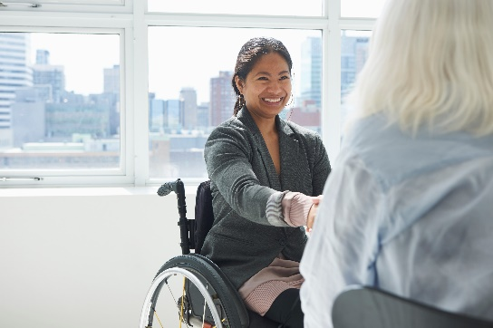
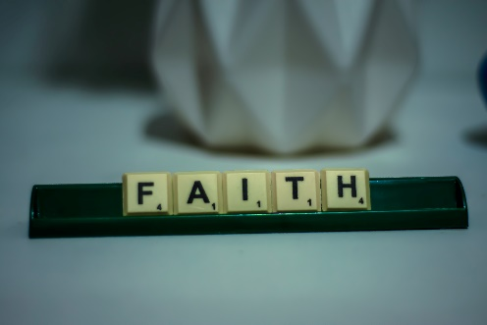
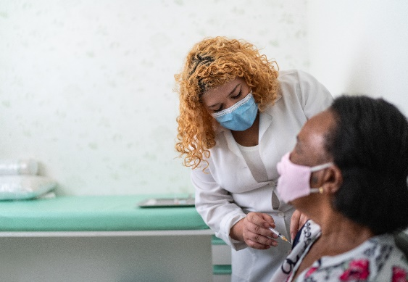
Who Could be in Your professional network?
Faith photo credit: Alex Shute on Unsplash
Notes:
Now, let’s imagine how you can expand your network so that it includes non-traditional partners, or the unusual suspects. Your network should reflect those in your community who are experiencing inequities, not just those with influence in your community.
Youth serving organizations that you have not connected with such as those serving first generation college students like Upward Bound
Organizations that serve people with disabilities
Managed care companies
Organizations that serve gay/lesbian/transgender/ and questioning individuals
Faith based institutions
What organizations in your network have been created specifically to focus on the needs of people experiencing inequities. Not organizations serving everyone, but organizations serving specifically those who bare the burden of inequities.
Share your ideas in the chat.

Slide 17
Benefits of AN analysis
This analysis helps all partners who are seeking to create equity
It helps to know which partner seems to be connected to everyone. This is likely the partner with the most influence
It’s helpful to know which partner is not on everyone’s radar. This may be the partner that can use more support and therefore eager to engage with you to grow their influence
It’s helpful to know which partner has access to those who are experiencing inequities
It will prompt you to think about what populations to whom you want to build a deeper connection.

Slide 18
KeY TakeAways
Equity means conditions where everyone has a fair and just opportunity to thrive
Networks in includes partner + their partners
Expanding our network can increase our proximity to those who experience inequities
Your network should reflect those experiencing the most inequities in your community
Questions?

Slide 19
Strategies to Diversify your network

Slide 20
What’s Next?
Notes:
Let’s say you have identified some partners not in your network with whom you want to connect. What now? How do you connect? How do you explain why you want to connect and what you do? How do you explain the need for them to be involved in prevention work?
We all feel tension when we need to engage with someone who is different than us. When they have a different life experience than we have had, when they are a different race. When they live in a different neighborhood. What is that tension?

Slide 21
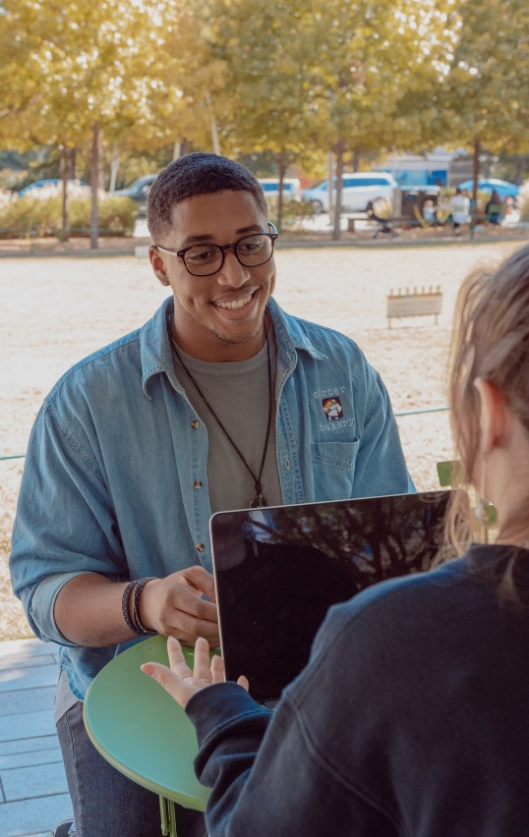
Learning & Growth Require The 3 H’s
Honesty
Humility
Hearing
Photo by Eliott Reyna on Unsplash
Notes:
Let’s identify it. A minute I am going to write out these tensions. But before I do that, I need you to consider the 3’s H’s of growth. If we are to learn and grow, we must be
Honest with what we feel and what we don’t know.
We must approach learning with humility. Do you know that you will always learn something when you open yourself up to learning more.
Lastly, we have be willing to hear a perspective that is different from our own.
Again, this is a requirement if we are expected to grow. Now, take 3 minutes to write down what tension you feel when you need to engage with a new partner that is different than you.
If you are comfortable listing some of those tensions you experience in the chat, please share.

Slide 22
The One on One Meeting
Be honest, be humble, be willing to hear
Notes:
I had a co-worker who always said never underestimate the power of a good cup of coffee. Treating someone to a good cup of coffee will cost you less than $20 bucks. But the return on your investment can be limitless.
This is where the partner you are closet to serves as your ambassador. They can connect the dots so you can learn more. Come to this meeting planning to pay and planning to listen. Be honest. Be Humble Be A Listener

Slide 23
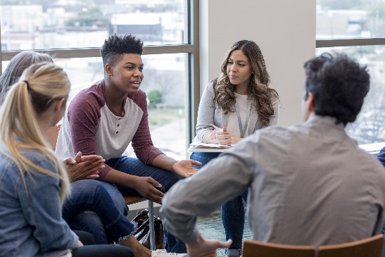
Strategy: Listening Circles
Community Meeting
Listening Circles
Be honest,
Be humble,
Be willing to hear
Notes:
You should always seek to hear directly from the community, not just the partner that serves that community. I recommend working with your new partner or partners to organize a community engagement event.
All of us have been part of community meetings. Listening circles are a newer strategy for engaging community. Now some people mistake a community meeting for engaging the community. Let me be clear! A community meeting is not the same as community engagement. I once attended a meeting being facilitated by the of Orange County government. The goal of this meeting was to hear from residents about where to place new parks in come of the towns that are economically distressed. One residents kept raising her hand. The facilitator continued to ignore her unto the crowd started grumbling because she was obviously ignoring the woman. The facilitator then ran out of patience and sad “Excuse me, I am trying to engage the community here!”
Let me tell you about listening circles. Listening circles can occur with a group, but the group should never be large enough where people feel uncomfortable talking. So, you break people up into smaller groups of 6 or 8. You ask someone to facilitate and prepare discussion questions. Each group has a recorder and then you gather that information. Each listening circle should have a staff member participating to listen and ensure that everyone in the group.
Click
Even in this role, the staff member should be listening. Not trying to persuade people.
Click
I always advocate for the listening circle strategy. Community meetings are designed to share information. Not gather information.

Slide 24
What Can Happen when People Are Heard?
Orlando’s Creative Village
Notes:
Authentic Community engagement story

Slide 25
Spend Time AND Money in Inequitable Communities
Notes:
Explain Creative Village
The chief engineer spent Monday-Friday the neighborhood where Creative Village was eventually built.

Slide 26
Be honest,
Be humble,
Be willing to hear
Notes:
He ate lunch multiple times a week at Nikki’s Place.
He took the bus to travel around the city.

Slide 27
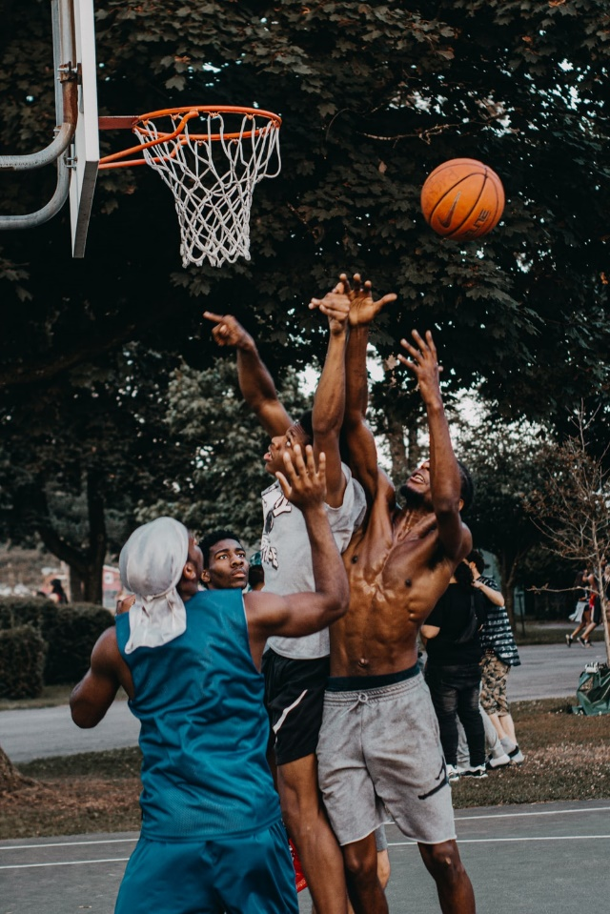
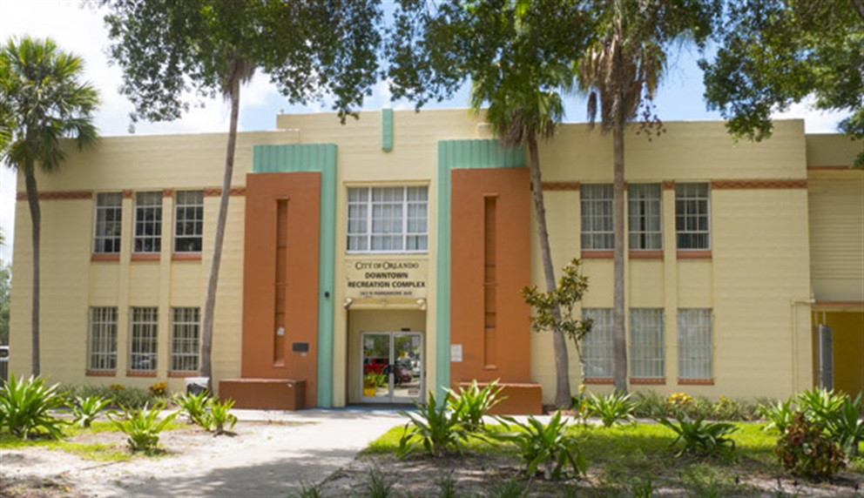
Photo by Joshua Rodriguez on Unsplash
Be honest,
Be humble,
Be willing to hear
Notes:
He played pick up games with the youth after school and he used the neighborhood gym to work out in.

Slide 28
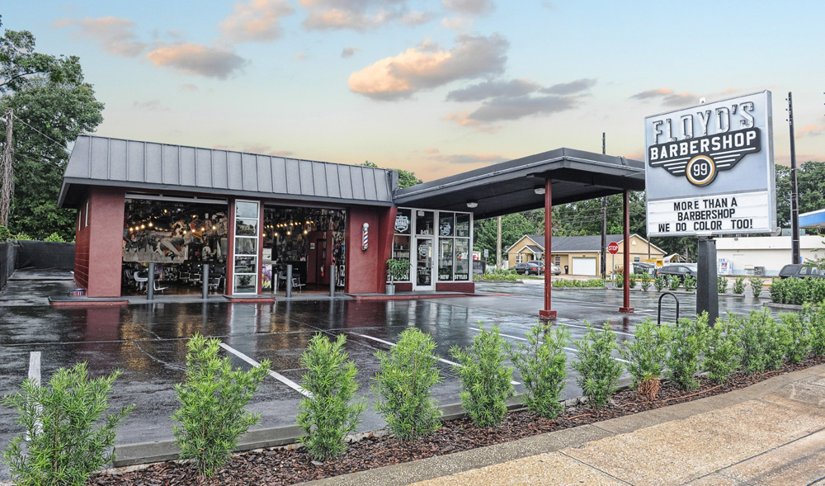
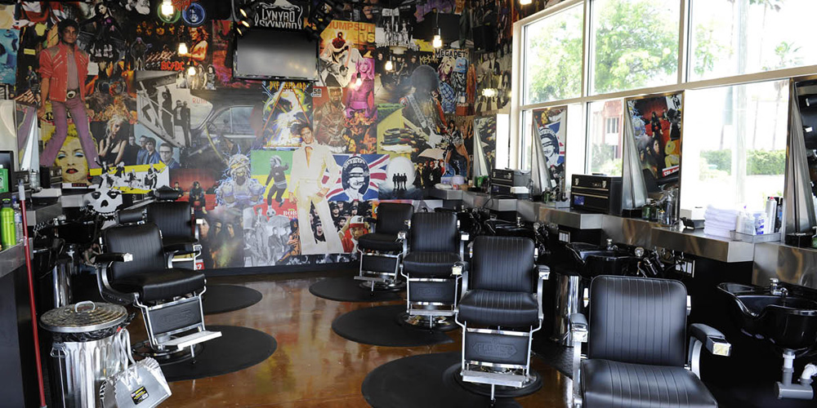
Be honest,
Be humble,
Be willing to hear
Notes:
He got his hair cut at Floyd’s barbershop every Thursday.
Oh, and did I mention he is white?

Slide 29
Poll: Which One of these strategies Would be the most challenging for you?
Notes:
Consider these strategies now respond to this poll
Please build this poll:
Which one of these strategies would be the most challenging for you?
The One-on-One Meeting
Listening Circles
Spending Time & Money In a Community

Slide 30
Key Takeaways
Be honest, be humble, be willing to listen to learn and grow about others
There is a difference between a community meeting and engaging the community
Your partners are your ambassadors to others: spend time and money in the community
Equitable changes can happen when people are heard
Questions?

Slide 31
What’s Gone Awry Here?
CBS TV
Notes:
Amy and Sheldon: https://www.youtube.com/watch?v=3_dAkDsBQyk
Take one minute to complete the questions in your workbook.
Unmute for responses
This was a humorous example to break the ice, but let’s dig deeper

Slide 32
Greater Good Science Center
Bridging Differences
Notes:
Whe
Video: https://greatergood.berkeley.edu/video/item/what_happens_when_political_opponents_get_to_know_each_other

Slide 33
Bridging Differences Quiz
Notes:
Take 5 minutes to complete this quiz: https://greatergood.berkeley.edu/quizzes/take_quiz/bridging_differences

Slide 34
Key TakeAways
Diversifying your partnership for equity positions you to engage with people that your network should reflect
To engage with people in an authentic way, we need to be honest, be humble, and willing to hear
Engaging authentically takes courage and practice
Questions?

Slide 35
Why I Fight for equity?
Meet Brexton!

Slide 36
…& much more on the chr&r website
Facebook.com/CountyHealthRankings
Follow @CHRankings
Sign up for our newsletter CountyHealthRankings.org/subscribe
Notes:
Ericka
Make sure you follow us on social media. We are now on LinkedIn, which is exciting.
Also, be sure to sign up for our newsletter. This is the best way to find out about our exciting webinars and our latest tools and resources.

Slide 37
Thank you

