Slide 1
Poll #1
I am comfortable reading, interpreting, analyzing, and sharing data.
A. Absolutely!
B. Somewhat…
C. Not really
D. That’s someone else’s job

Slide 2
Examining Data for Disparities
Nicole M. Augustine
February 24, 2022
Notes:
Part 4 of the Health Equity in Prevention Series
Are you interested in learning how to harness data in your work to address health disparities? If so, this workshop is for you! With interactive exercises, we'll help you explore the power of data -- the power for good, and the power to amplify bias. Data is the foundation of everything we do, so it's important that we learn to read and understand it correctly. With this skill set, you'll be able to identify structural inequities in your community and garner support for innovative strategies. Register now to reserve your spot!

Slide 3
A Note About Land Acknowledgement:
“It is important to understand the longstanding history that has brought you to reside on the land, and to seek to understand your place within that history.
Land acknowledgements do not exist in a past tense, or historical context: colonialism is a current ongoing process, and we need to build our mindfulness of our present participation.”
– Northwestern University
Notes:
Handover to Nicole
2min
https://native-land.ca/
Sugaree
Catawba

Slide 4
Creating Our Intention
Notes:
5min
Spiral activity
Take a sheet of paper and divide into 4 squares
At the the cross section of the paper, draw the tightest spiral you can draw. I will set a timer for 1min. The purpose of those activity is to ground you into this training experience. Use those moment to clear you mind.
Set timer
Now, I’ll give you a one-minute timer to respond to four questions. You won’t share your answers with anything, so be honest as you answer the questions.
In the top let corner write your answer the the following question:
When you think about data, what comes to mind?
Set timer
In the top right corner write your answer the the following question:
What is your biggest challenge in using data to inform your work?
Set timer
In the bottom left corner write your answer the the following question:
How do you think data can be used to improve health equity?
Same question from first session, did your response change
Set timer
In the bottom right corner write your answer the the following question:
What do you hope to get out of this training experience?
Set timer

Slide 5
Learning Objectives
Understand the power of data for good vs amplifying bias
Define data literacy and understand how to be a critical consumer of data
Describe how to conduct an equity-focused needs assessment

Slide 6
Poll #2
I’ve attended multiple sessions in this series:
A. Yes, I’ve been here for all 4!
B. Yes, I’ve been on most of them.
C. Life’s a blur…I don’t remember!
D. No, this is my first session.
Notes:
Who attended
Who watched the recording
Not done either

Slide 7
The Power of Data
“Data are just summaries of thousands of stories – tell a few of those stories to help make the data meaningful.”
- Chip & Dan Heath

Slide 8
Why Equity Matters in Our Work
Notes:
This graphic truly sums up why equity matters in our work. So often our prevention strategies focus on the individual level with minimal consideration for the environment in which that individual lives, works, and plays. Take a moment to reflect on a thriving community environment. Think of the neighborhood, the schools, parks, grocery stores, and the physical built environment. Think of all the ways a person’s health and well-being is nurtured by living in an environment with high protective factors. Now imagine the environment of those community members who are suffering from disparities and social inequalities. Can you see how different the environment looks for these two communities? If this is a foreign concept to you, just take a drive to the “other” side of town and you will immediately see the difference. Much like the figure, you will see barren trees struggling to survive in unhealthy soil. Understanding this concept is paramount to understanding the role of policy change and environmental strategies in creating sustainable change. When our efforts only focus on the leaves of the tree, we miss the opportunity to enrich the soil. Think about the prevention initiatives you’re currently implementing. Are they focused on just the leaves of the tree? Consider what you could be doing to change the soil and roots of the community health problems.
Equality means each individual or group of people is given the same resources or opportunities. ... Equity recognizes that each person has different circumstances and allocates the exact resources and opportunities needed to reach an equal outcome.
None of us are responsible for the advantages or disadvantages we are born with but we ARE responsible for understanding how advantages and disadvantages affect long term outcomes for individuals
Before we move to talking about building an equity action plan, I want to review a view key terms to make sure we are all speaking the same language.

Slide 9
Mentimeter: Reflection 1
Go to:
Enter Code:
Question:
www.menti.com
1111 1111
What level of data are you collecting?
Leaves
Trunk
Roots
All the above

Slide 10
Through Data We Can…
Quantify and qualify disparities
Quantify and qualify opportunities
Fuel policy action and advocacy
Notes:
The power of data can be articulate in three ways:
Quantify (count) and qualify (describe) disparities – with the right data, you can make statements about the magnitude of the problem. Additionally, you will be able to describe the impacts of these disparities on health outcomes
Quantify (count) and qualify (describe) opportunities – disparities and opportunities are two sides of the same coin. As you discover the disparity issues, you will also begin to uncover the opportunities for establishing equity and improving health outcome.
Fuel policy action and advocacy – by the nature of how disparities come into existence, many communities must focus on environmental strategies as the best means of improving health outcomes. This takes requires us to use data to inform policy change and to support advocacy for health equity.

Slide 11
Leveraging the Power of Data
Notes:
In this video, a community coalition leader named Donna explores the City Health Dashboard’s data and demographic breakdowns in order to better understand equitable access to healthy foods across the town’s neighborhoods.
https://www.youtube.com/watch?v=n9Nc2-_G7lM&t=56s
https://www.cityhealthdashboard.com/
Caveat – this is a great example of how data can be used, however many of the measure we use are not included in this dashboard. This is were we collaborate with data enginers to construct dashboards that help us specifically in the field of substance misues prevention. This dashboard has:
Opioid death
Smoking
Binge drinking

Slide 12
The Burden of Power
Survey tools – inequity potential
Respondents – true representation
Data Narratives – amplifying bias
Notes:
I think it’s important to also acknowledge that all the data can be a wonderful powerful tool of good it can also amplify bias and this is something that we should really be aware of.
Although data can be a powerful tool of good it can also amplify bias and perpetuate inequality when used improperly. Here are the things to consider when prioritizing equity while working with data:
Survey tools - What social determinants may influence someone’s ability to find time and energy to respond to a survey? For whom might these questions feel loaded or stigmatizing due to the structure of our society? Are you choosing a survey tool(s) with the right literacy level?
Respondents – How to the demographics of the survey respondents compare to the demographics of the overall community? What percentage of the overall community did you survey? Is it enough to draw any
conclusion?
Data Narratives – What narrative are with promulgating when share data, especially when we share data that is misleading. Remember disparity simple describes a particular experience, it does not characterize that group of people. When you discover a disparity, you should be asking WHY is this happening. There is some social inequality at the root of the disparity data. That is our place of opportunity!

Slide 13
What is Data Literacy?

Slide 14
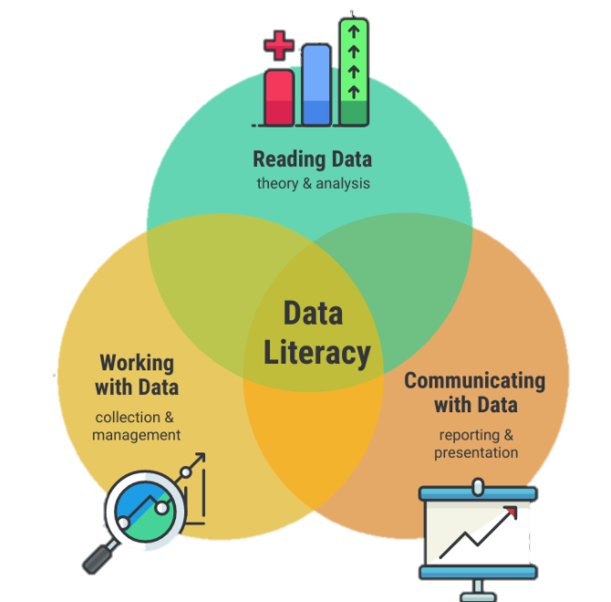
Data Literacy
Reading, theory, and analysis
Collection and management
Reporting and presenting

Slide 15
Reading Data
Uncertainty is inevitable
Data can tell many stories
Notes:
Let’s first think about some tips when reading data:
Uncertainty is inevitable – When you’re reading data remember this! You should look for the author to explain the limitations of the data and the questions that are still unanswered.
When you analyze data, you are generally looking for patterns. These patterns may tell a story about what has happened, or what’s most common, or something else. Most patterns will come down to the relationships between two or more variables, which are the “things” that are being counted, measured, or described. It’s only through analysis that you can begin to uncover insights. And there may be many to uncover, so it’s worth it to keep digging and not merely settle for the first “aha” you stumble upon.
Check out the 5 whys: https://youtu.be/N7cR2gArCFE

Slide 16
Working with Data
Primary vs secondary data
Qualitative vs quantitative data
Data sources
16
Notes:
Primary data is the data you collect. It’s original data. Unless you have expertise in survey development, it is recommended that you hire an evaluator to assist with development your data tools. Be sure to remember the social and cultural context of your community when developing survey tools. Consider the need for language, literacy and even the delivery (verbal, electronic, pen and paper, etc). Secondary data is the data someone else collects, which the most utilized category of data in our work. When using secondar data, you will lean on the skills from “reading data”.
There are 2 main types of data:
Qualitative – which focuses on telling a rich story by describing a problem
Quantitative – which focuses on counting a problem.
You need both to tell a comprehensive story.
Lastly you want to think about the type of data sources which can include: survey, interviews, observations and experiments. The skills developed for understanding how to work with data, will also help you in reading secondary data. This help you take a critical eye to reviewing your secondary to be sure it’s the right data to use in building the logic for your intervention strategy.

Slide 17
Communicating with Data
Uncertainty is inevitable
Responsible sharing
Notes:
Let’s review a few tips when communicating with data:
Just like with reading data, uncertainty is inevitable! - this is important to keep in mind especially if we are communicating data. If we are using visuals, such as infographics, to do so, they will likely mask the messiness of reality and make our statements seem more factual. We must be responsible communicators by understanding the data well and, when possible, explaining what we still don’t know.
First consider, what are you hoping to share with others?
Descriptions of the data, such as frequencies or percentages
Distributions of the data, such as ranges or averages
Comparisons in the data, such as changes over time or correlations between variables

Slide 18
Equity-Focused Needs Assessment

Slide 19
Why Assess?
Create consensus
Identify underlying factors
Establish a baseline
19
Notes:
When you start the assessment process, it is likely folks will have different opinions on what is the major substance abuse problem.
The data you collect will help you:
Create community consensus about ATOD problems in the community.
To find a solutions, you must know why the problem exist. When talking about substance abuse prevention this usually means understanding the problem in terms of consequences and consumption patterns.
The data you collect will help you:
Create community consensus about ATOD problems in the community.
To find a solutions, you must know why the problem exist. When talking about substance abuse prevention this usually means understanding the problem in terms of consequences and consumption patterns.
Consequences describe what happens when people use substances. Any social, economic, or health problem can be defined as a substance- related consequence if the use of alcohol, tobacco, or illicit drugs increases the likelihood that the consequence will occur.
Consumption describes the way people drink, smoke and use illicit drugs. Examples of consumption patterns include binge drinking among underage youth, women of child-bearing years who drink 5 or more drinks per day, and senior citizens who mix alcohol with their medications.
You want to know the risk factors that can make certain problems more likely to occur, and the protective factors that reduce the chance of certain problems occurring. Identifying which risk factors exist in your community could reveal possible areas of need.
It’s important to remember the intention and outcome of our work is a positive change in community health outcomes.
Additionally, it’s important to be able to determine if the solution developed worked. So the initially assessment gives you baseline data for you compare during the evaluation.

Slide 20
Key Questions to Enhance Equity
?
Are specific communities experiencing different consequences?
Are specific communities experiencing difference consumption patterns?
What is the magnitude – vs impact – of the problems in a particular community?
20

Slide 21
Mentimeter: Reflection 2
Go to:
Enter Code:
Question: Closing reflection
www.menti.com
1111 1111

Slide 22
Discussion
Notes:
Need 45min for this section

Slide 23
Nicole Augustine
Notes:
https://www.linkedin.com/in/nicolemaugustine/

