Slide 1






Substance Misuse Prevention’s Role in Harm Reduction
[Presenter’s name]
[Presenter’s Organization]
[Date]
Notes:
Introduce yourself and, as time allows, ask participants to introduce themselves.

Slide 2
Disclaimer
This slide deck was created by the Great Lakes PTTC under a cooperative agreement #1H79SP081002-04 from the Substance Abuse and Mental Health Services Administration (SAMHSA). All material appearing in this presentation, except that taken directly from copyrighted sources, is in the public domain and may be reproduced or copied without permission from SAMHSA or the authors. Citation of the source is appreciated. Do not reproduce or distribute this presentation for a fee without specific, written authorization from the Great Lakes PTTC. For more information on obtaining copies of this presentation, email events@chess.wisc.edu.
At the time of creation of this document, Dr. Miriam Delphin-Rittmon serves as Assistant Secretary for Mental Health and Substance Use. The opinions expressed herein are the views of the speakers and do not reflect the official position of the Department of Health and Human Services (DHHS), SAMHSA. No official support or endorsement of DHHS, SAMHSA, for the opinions described in this document is intended or should be inferred.
February 2022
Notes:
Share that this slide deck was created by the Great Lakes Prevention Technology Transfer Center (PTTC) which is funded by the Substance Abuse and Mental Health Services Administration (SAMHSA). The opinions expressed in this presentation do not reflect the official position of SAMHSA.

Slide 3
Language Matters.
Adopted by the ASAM Board of Directors September 15, 2019
Notes:
Read the slide text and encourage participants to focus on using affirming language with one another during this training and beyond.

Slide 4

Learning Objectives
By the end of this training, participants will be able to:
Define harm reduction
Identify the role that harm reduction plays in a comprehensive approach
Name strategies prevention can implement to enhance harm reduction efforts
4
Notes:
Review the objectives on the slide and ask if participants have any questions about the purpose of the training.

Slide 5


Harm Reduction Exists in All Facets of Our Lives
Listen in the video for examples of harm reduction you have experienced.
5
Notes:
Share with participants that you will be playing a video. Encourage participants to listen in the video for examples of harm reduction that they have experienced themselves.

Slide 6
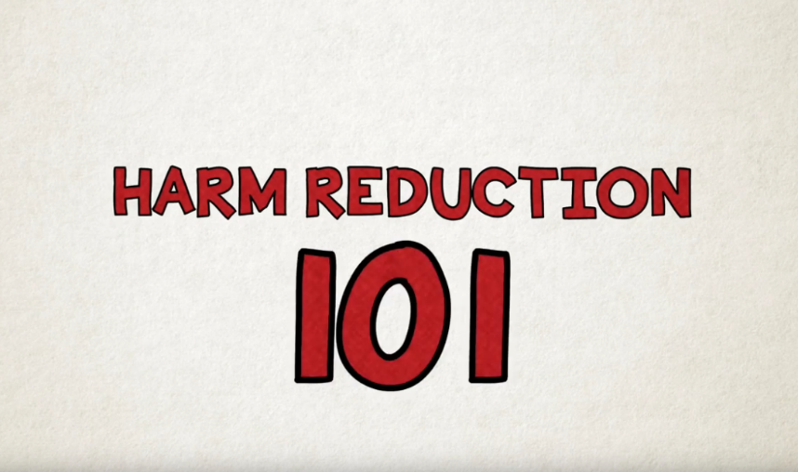
Video: Harm Reduction 101
6
Notes:
https://www.youtube.com/watch?v=fXJJj_jgFmE (2’34”)
We strongly recommend that you STOP the video at 1’35”. The conclusion of the video makes it sounds as though safe injection sites are the most important harm reduction strategy.

Slide 7

Video Debrief - 1
Share the harm reduction strategies mentioned in the video that you have experienced.
7
Notes:
Ask participants to share what harm reduction strategies they heard in the video that they have experienced themselves.
Options:
If you are presenting in a virtual setting, you can ask participants to share this in the chat box.
If you are presenting to a large group, you can ask participants to turn to a person near them and share their thoughts.

Slide 8
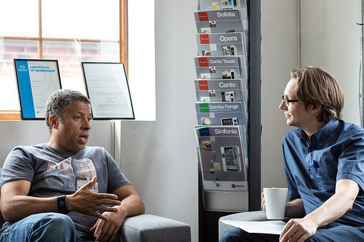

Harm Reduction Defined
All life activities carry some risk to engage in them and a society or community we have created lots of ways to provide guard rails, safety nets, and services to rescue people.
Harm reduction is a set of practical strategies and ideas aimed at reducing negative consequences associated with drug use.
Harm reduction is also a movement for social justice built on a belief in, and respect for, the rights of people who use drugs.
- harmreduction.org
The complete elimination of risky behavior
is rarely attainable or desirable for everyone.
8
Notes:
Photo: https://unsplash.com/photos/ywqa9IZB-dU
Review the definition on the slide. CLICK to see the quote at the top right. Read this quote. CLICK to see the quote on the bottom right.

Slide 9


Understanding Harm Reduction
Focus Population
People actively using substances, including alcohol
9
Notes:
Share that the focus of harm reduction efforts is on people who are actively using substances, including alcohol.
At this point, depending on your audience and setting, you can lead a discussion regarding how huge of a shift this focus population is from the populations that substance misuse prevention typically works with.

Slide 10


Understanding Harm Reduction
Grounded in 8 Guiding Principles
A non-judgmental approach
Evidence-based, feasible, and cost-effective practices
Acceptance of behavior change as an incremental process
Meaningful participation of drug users, former drug users, and stakeholders in shaping drug use policies and practices
10
Notes:
From: https://www.hrw.org/sites/default/files/related_material/us0911brochurewebwcover_0.pdf
From https://www.hrw.org/sites/default/files/related_material/us0911brochurewebwcover_0.pdf
Share with participants that these principles guide the work done in the harm reduction field. Review each principle.

Slide 11
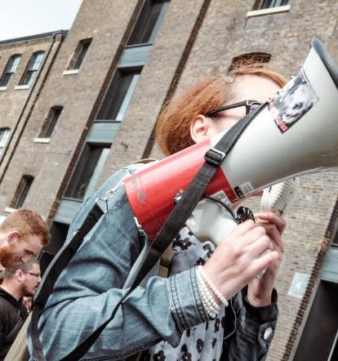
Understanding Harm Reduction
Grounded in 8 Guiding Principles, continued
5. Focus on enhancing quality of life not
abstinence
6. Recognition of complex social factors
7. Empowerment of drug users in reducing the
harms of their drug use
8. Commitment to defending universal human
rights
11
Notes:
From https://www.hrw.org/sites/default/files/related_material/us0911brochurewebwcover_0.pdf
From https://www.hrw.org/sites/default/files/related_material/us0911brochurewebwcover_0.pdf
Continuing reviewing these additional four principles.
Depending on the audience and amount of time you have for the presentation, you can open a discussion regarding these principles by asking: “Which of these principles are consistent with principles of prevention? Which differ? How do these principles complement the work we are doing in prevention?”

Slide 12
Understanding Harm Reduction
Examples of Strategies
Sterile syringes
Safe smoking supplies
Masks/vaccines
Counseling
Motivational interviewing
Low threshold medication
Naloxone
Overdose education kits
Peer support specialists
Case managers
Fentanyl test strips
Access to condoms
Sex education
Notes:
Source: SAMHSA, Harm Reduction, https://www.samhsa.gov/find-help/harm-reduction
BEFORE THE PRESENTATION: Research which of these strategies are being implemented in your community and/or state.
Share with participants that these are examples of harm reduction strategies being implement with people who are actively using drugs, including alcohol. Provide information to participants regarding which of these harm reduction strategies are being implemented in your community.

Slide 13


Harm Reduction Strategies and Principles
We defined 8 principles of harm reduction and a range of strategies
Listen for examples of strategies linked to one or more of these principles
13
Notes:
Share with participants that you will be showing another video. Ask them to listen for examples of harm reduction strategies linked to one or more of harm reduction’s guiding principles.

Slide 14

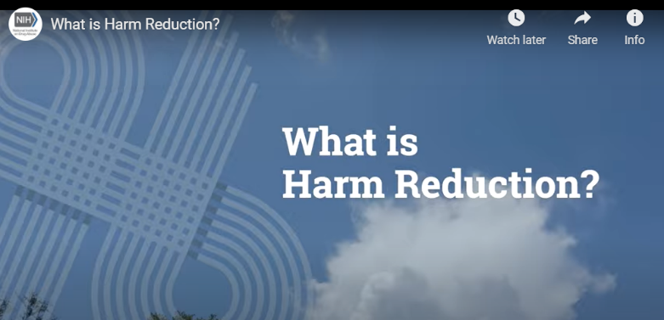
What is Harm Reduction Video
14
Notes:
Play video: https://www.drugabuse.gov/videos/what-harm-reduction
Video length: 3:51
Depending on the audience of this presentation, an option is to play this video instead: https://www.youtube.com/watch?v=fXJJj_jgFmE&t=154s If you use this video, be sure to point out that the annual overdose deaths have increased significantly since this video was made, then share the next slide.

Slide 15
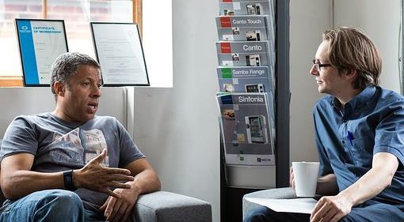
Video Debrief - 2
Share a harm reduction strategy you heard linked to a harm reduction principle.
15
Notes:
Ask participants to share a harm reduction strategy that they heard during the video and to which harm reduction principle they would link it.
Options:
If you are presenting in a virtual setting, you can ask participants to share this in the chat box.
If you are presenting to a large group, you can ask participants to turn to a person near them and share their thoughts.

Slide 16

Prevention Focus
Prevention
People who are not misusing substances
Notes:
Share with participants that, as they likely already know, prevention focuses its efforts on those who are not misusing substances with the goal of preventing them from misusing substances in the future.

Slide 17


Prevention Defined
Substance misuse prevention efforts work to… prevent the use and misuse of drugs and the development of substance use disorders.
Substance Abuse and Mental Health Services Administration
17
Notes:
Photo: https://unsplash.com/photos/ywqa9IZB-dU
Review this definition of prevention from SAMHSA.

Slide 18
In Short...
Prevention
Prevent the behavior
Harm reduction
Prevent the consequences
Notes:
Share with participants that broadly speaking prevention focuses on preventing the behavior (specifically substance misuse), while harm reduction focuses on preventing the consequence of the behavior (specifically the consequences of substance misuse).

Slide 19

Prevention's Role
In Enhancing Harm Reduction Efforts
Promote community readiness for harm reduction
Address stigma of substance misuse and substance use disorders
Provide education and resources
Coordinate strategy implementation
Link harm reduction to “upstream” strategies
19
19
Notes:
Share with participants that there are several areas where prevention can provide assistance to those working in harm reduction. Quickly review the 5 areas listed on the slide, letting participants know that the next slides will have information on each area.

Slide 20

Prevention's Role
1. Promote Community Readiness
1
Build readiness to support harm reduction approaches
Correct misperceptions about harm reduction
Help build necessary support among stakeholders for harm reduction approaches
20
20
Notes:
Share with participants that harm reduction operates on the premise that there are many positive changes a person can make to reduce the negative consequences of their misuse—including, but not limited to, complete abstinence. Some stakeholders may have difficulty embracing any other perspective but abstinence, convinced that any level of misuse is unacceptable. Others may believe that harm reduction approaches, such as naloxone distribution, might encourage continued and/or more dangerous use. As prevention practitioners, we recognize the importance of building readiness and support for prevention approaches and have experience crafting messages designed to correct misperceptions and build this necessary support. We can assist those working on harm reduction efforts with building necessary support among stakeholders for harm reduction approaches.

Slide 21

Prevention's Role
2. Address Stigma
2
Educate stakeholders and others about the nature of addiction and the recovery process
Educate community about substance use disorder (SUD)-related stigma:
Promote use of non-stigmatizing language
Raise awareness of SUDs as treatable diseases
Encourage treating those who suffer from SUDs with dignity and respect
21
21
Notes:
Share with participants that prevention practitioners can help people examine their prejudices and stigma. Stakeholder reluctance to embrace harm reduction approaches is often fueled by negative attitudes about people who use drugs. Prevention practitioners can work to reduce the stigma and prejudice that prevent some stakeholders from supporting harm reduction approaches, by, for example, educating them about the nature of addiction and the recovery process, what substance use disorder (SUD)-related stigma is, and how to address it. Stigma-reducing strategies include:
Promoting the use of non-stigmatizing language;
Raising awareness of SUDs as treatable-diseases; and
Encouraging treating those who suffer from SUDs with dignity and respect.

Slide 22
PTTC Position on Affirming Language
22
Adopted by the ASAM Board of Directors September 15, 2019
Notes:
Share with participants that this slide should look familiar, as you showed it at the beginning.
This serves as an example of a some simple step you can take to address stigma. Consider developing a position of your coalition, your agency, your organization and then disseminate that message through all the channels already in place. That can include your agency brochures and all your training materials.

Slide 23

Prevention's Role
3. Provide Education and Resources
3
Develop messaging designed to build awareness and support for harm reduction efforts
Create pamphlets, tip card, instruction sheets, tips sheets, etc.
Educate on topics including:
  How to identify an overdose
  How to use naloxone
  How to reduce post-overdose risk
  How to access recovery supports
23
23
Notes:
Share with participants that prevention practitioners can take the lead in developing and/or tailoring pamphlets, tip cards, instruction sheets, and other informational resources to support harm reduction strategies on topics such as how to identify an overdose, use naloxone, reduce post-overdose risk, and access recovery supports. Practitioners also bring to the table experience developing and delivering trainings tailored to the needs of both lay and professional audiences, as well as expertise developing messaging designed to build awareness and support for selected interventions.

Slide 24

Prevention's Role
4. Coordinate Strategy Implementation
4
Identify existing harm reduction efforts (e.g., first responder teams, task force on overdose prevention)
Assist harm reduction efforts in creating collaborative opportunities
Help bring various sectors together to coordinate and merge efforts, when possible
Help partners work through potential barriers
24
Notes:
Share with participants that because prevention practitioners are well-versed in coalition-building and collaboration, they can help to ensure that the various sectors responsible for implementing harm reduction strategies know what one another is doing and merge their efforts into a coordinated response. For example, to increase access to naloxone for people at risk for overdose, prevention practitioners can bring together important community stakeholders (like emergency medical services providers and community health workers), facilitate a naloxone program planning process, help partners work through potential barriers to participation, and contribute financial resources (if allowed).

Slide 25

Prevention's Role
5. Link Harm Reduction to “Upstream” Efforts
5
Create links with harm reduction approaches such as:
  Provide prevention services for the children of people who use drugs
  Work on policies that will address both harm reduction and prevention issues
25
Notes:
Share with participants that prevention practitioners can help link harm reduction work to more “upstream” prevention efforts. Prevention practitioners understand that a comprehensive approach requires a combination of “downstream” harm reduction strategies (designed to prevent overdose and related consequences) and “upstream” prevention strategies (designed to reduce substance misuse in the first place). Prevention practitioners can play an important role in linking these two approaches, for example, by referring family members of people who use drugs to prevention programs like Strengthening Families and the Life Skills Training which promote factors that protect against future substance misuse by building strong family ties, strengthening social skills, and establishing drug-resistance strategies.

Slide 26



Keep in Mind…Moving Forward
Coordinating efforts across prevention, treatment, recovery, and harm reduction will enhance ALL our efforts
Prevention practitioners have skills, experience, and access to strategies that can assist and augment harm reduction efforts
Together we can have a greater impact!
26
Notes:
Point out to participants that harm reduction offers stakeholders working across disciplines tangible and respectful ways to help people stay alive and healthy, and to feel like they are making a difference in the midst of a crisis that can often feel insurmountable. Prevention practitioners can play an important role in helping stakeholders understand and implement these strategies, and in finding ways to integrate these approaches into a coordinated prevention response.

Slide 27
Taking Action
What additional learning do we need to do regarding harm reduction?
Identify “low hanging fruit”… What is an easy lift for us?
What will be the action steps, timeline, and persons responsible?
27
Notes:
Take the time to discuss the questions on this slide and develop a plan on how to move forward.

Slide 28

Thank You!
Thank you!
Thank you!
Notes:
Thank participants for taking the time to participate in this training.

