Slide 1
What Does NOT Work in Prevention
Erin Ficker and Kris Gabrielsen
March 2, 2022

Slide 2
Objectives
Identify at least 5 interventions that have been shown through research to NOT be effective in preventing substance misuse
List evidence-based approaches that can be used as effective alternatives to the ineffective/counterproductive strategies
Describe strategies to address resistance to discontinuing ineffective and/or counterproductive prevention strategies

Slide 3
Agenda
Welcome and introduction
History of the evidence base
Ineffective and effective prevention strategies
Strategies for promoting effective, evidence-based strategies

Slide 4
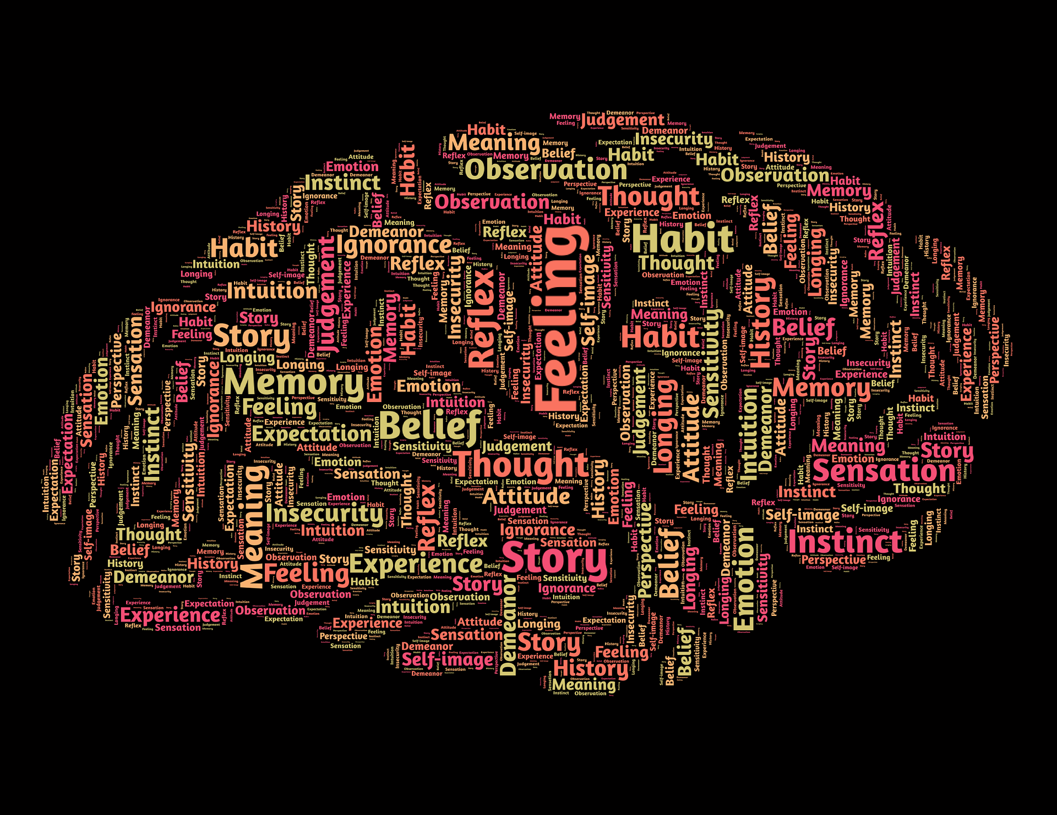
Mindset
Open to learning
Ask questions
Share your experiences
No shaming
No guilt
No judgment
Notes:
Photo: https://pixabay.com/illustrations/mind-brain-mindset-perception-544404/

Slide 5
What is your greatest fear or hope when you hear, “What does NOT work in prevention?”

Slide 6
A History of Evidence
The importance and role of evidence-based strategies in substance misuse prevention

Slide 7
A Timeline of Prevention
TIME | STRATEGY | ACTIVITIES
1950s and 1960s | Scare tactics | Films and speakers
Early 1970s | Drug education | Curricula based on factual information
Mid-/Late-1970s | Affective education and alternatives to drug use | Curricula based on communication, decision-making, values clarification, and self-esteem
Late-1970s to early 1980s | Affective education, alternatives to drug use and training | Social skills curricula, refusal skills training, parenting education

Slide 8
A Timeline of Prevention, continued
TIME | STRATEGY | ACTIVITIES
Late-1980s to mid-1990s | Parent, school, and community partnerships | Research-based curricula, peer programs
Mid-1990s to 2010 | Replication of research-based models and application of research-based approaches | Environmental approaches, comprehensive programs targeting many domains and strategies, evaluation of prevention programs, media campaigns
2010s to today | Expansion of research base-models with a focus on more diverse audiences through continued evaluation and research | Cross sector prevention efforts, public health focus, community-based strategies for greater impact, focus across the lifespan and on diverse population groups

Slide 9
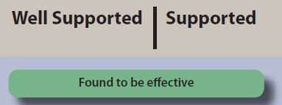
Continuum of Evidence of Effectiveness
Notes:
From: https://www.cdc.gov/violenceprevention/pdf/continuum-chart-a.pdf

Slide 10
Keep in Mind
Implementing effective, evidence-based programs ensures that prevention programs and policies do no harm
Ineffective/counterproductive prevention strategies can increase the risks of drug misuse

Slide 11
Strategic Prevention Framework

Slide 12
Why Use the SPF?
Good planning is key to success
Notes:
Photo: https://pixabay.com/illustrations/key-tag-security-label-symbol-2114334/

Slide 13
Where is Program Selection in the SPF?
Notes:
Before going through slide, ask people to put in the chat where they think program selection is within the SPF.
Trick question! Program selection is impacted by every step of the SPF.

Slide 14
Step 3: Planning
Prioritize risk/protective factors
Select effective, evidence-based program
Develop comprehensive, data-driven plan

Slide 15
Reflection #1
How does your community/organization typically make decisions about strategies to implement?
Does the loudest voice in the room “win”?
Is it hard to break “traditions” in terms of what is implemented year to year?
Does data drive your decisions?
Notes:
Photo: https://unsplash.com/photos/P8PlK2nGwqA

Slide 16
Any Questions So Far?

Slide 17
Comparing Effective and Ineffective Prevention Strategies
A review of strategies with a focus on what research and evidence shows about effectiveness

Slide 18
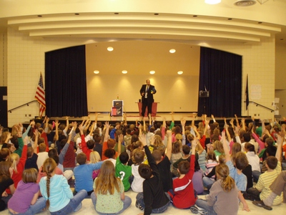
Ineffective Education Strategies
One-time events
Assemblies
Personal testimony from people in recovery
Mock car crashes
Drunk googles
Notes:
Image: http://www.michiganschoolassembly.com/
These type of one-time events often make adults, policy makers, and community members feel good about addressing the issue. However, the impacts are short-term at best.
Research shows that one-time events offer a sensational depiction of the consequences of substance use that can lead to distrust of the messages and the messenger. The erosion of credibility of the prevention community among both youth and adults has lasting ramification for the success of prevention efforts.
Assemblies: often focus on scare tactics, role playing, and information that has been shown ineffective in other settings.
Personal Testimony from People in Recovery: does not impact youth and young adults because of their likelihood to feel as though this “couldn’t happen to me” The understandings of consequences is still developing making it unlikely that youth will take these messages and testimonies to heart.
Mock Car Crashes: while exciting and sensational the impact is short lived, if received at all. Again, the sense of “indestructability” and the “it can’t happen to me” attitudes override the long-term impact of these strategies.
Drunk googles: Similarly fun and a favorite of adults and community members, there is no evidence to show the lasting impact on behavior change.

Slide 19
Ineffective: Assemblies
Often involves scare tactics and other ineffective appeals
One-time presentation of information
Impact is not lasting
Notes:
These type of one-time events often make adults, policy makers, and community members feel good about addressing the issue. However, the impacts are short-term at best.
Research shows that one-time events offer a sensational depiction of the consequences of substance use that can lead to distrust of the messages and the messenger. The erosion of credibility of the prevention community among both youth and adults has lasting ramification for the success of prevention efforts.
Assemblies: often focus on scare tactics, role playing, and information that has been shown ineffective in other settings.
Personal Testimony from People in Recovery: does not impact youth and young adults because of their likelihood to feel as though this “couldn’t happen to me” The understandings of consequences is still developing making it unlikely that youth will take these messages and testimonies to heart.
Mock Car Crashes: while exciting and sensational the impact is short lived, if received at all. Again, the sense of “indestructability” and the “it can’t happen to me” attitudes override the long-term impact of these strategies.
Drunk googles: Similarly fun and a favorite of adults and community members, there is no evidence to show the lasting impact on behavior change.

Slide 20
Ineffective: Personal Testimonies
Youth and young adults perceive themselves as “indestructible”
Understanding of connection between behavior and consequences is still developing in youth
Often feature extreme stories that can undermine the prevention message and messengers if the message does not match the experience
Notes:
Image: Microsoft stock
These type of one-time events often make adults, policy makers, and community members feel good about addressing the issue. However, the impacts are short-term at best.
Research shows that one-time events offer a sensational depiction of the consequences of substance use that can lead to distrust of the messages and the messenger. The erosion of credibility of the prevention community among both youth and adults has lasting ramification for the success of prevention efforts.
Assemblies: often focus on scare tactics, role playing, and information that has been shown ineffective in other settings.
Personal Testimony from People in Recovery: does not impact youth and young adults because of their likelihood to feel as though this “couldn’t happen to me” The understandings of consequences is still developing making it unlikely that youth will take these messages and testimonies to heart.
Mock Car Crashes: while exciting and sensational the impact is short lived, if received at all. Again, the sense of “indestructability” and the “it can’t happen to me” attitudes override the long-term impact of these strategies.
Drunk googles: Similarly fun and a favorite of adults and community members, there is no evidence to show the lasting impact on behavior change.

Slide 21
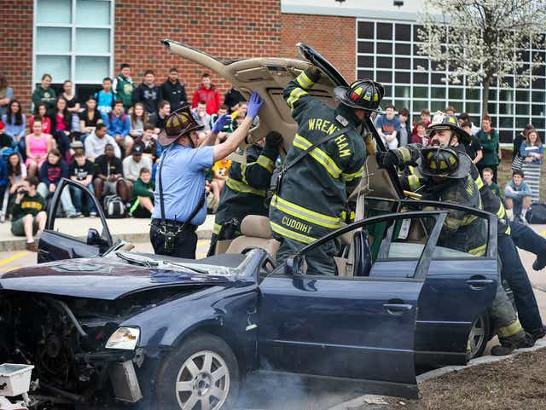
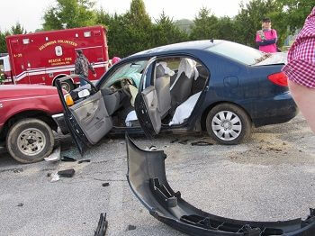
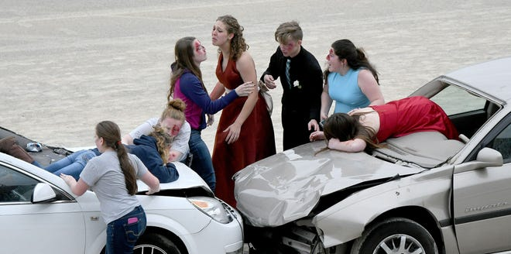
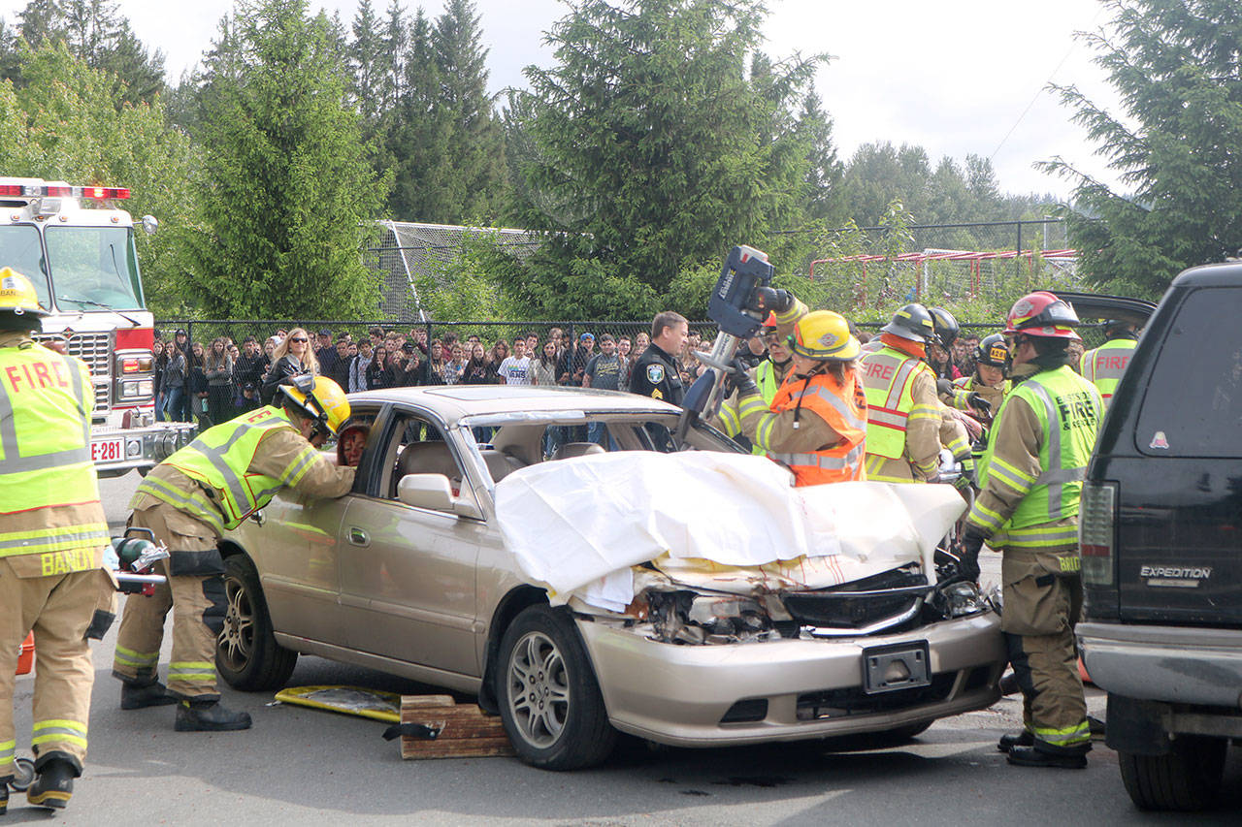
Ineffective: Mock Car Crashes
Sensationalizes
Little to no lasting impact
Can be traumatizing
Notes:
Image: https://www.mansfieldnewsjournal.com/story/news/local/2017/04/25/mock-crash-reminder-driving-safety/100881386/
These type of one-time events often make adults, policy makers, and community members feel good about addressing the issue. However, the impacts are short-term at best.
Research shows that one-time events offer a sensational depiction of the consequences of substance use that can lead to distrust of the messages and the messenger. The erosion of credibility of the prevention community among both youth and adults has lasting ramification for the success of prevention efforts.
Assemblies: often focus on scare tactics, role playing, and information that has been shown ineffective in other settings.
Personal Testimony from People in Recovery: does not impact youth and young adults because of their likelihood to feel as though this “couldn’t happen to me” The understandings of consequences is still developing making it unlikely that youth will take these messages and testimonies to heart.
Mock Car Crashes: while exciting and sensational the impact is short lived, if received at all. Again, the sense of “indestructability” and the “it can’t happen to me” attitudes override the long-term impact of these strategies.
Drunk googles: Similarly fun and a favorite of adults and community members, there is no evidence to show the lasting impact on behavior change.

Slide 22
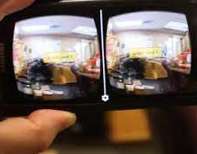
Ineffective: “Drunk” Goggles
Little to no long-term impact
Research has shown no evidence of effectiveness
Often part of one-time events
Notes:
Image: https://www.arabamericannews.com/tag/drunk-goggles/
These type of one-time events often make adults, policy makers, and community members feel good about addressing the issue. However, the impacts are short-term at best.
Research shows that one-time events offer a sensational depiction of the consequences of substance use that can lead to distrust of the messages and the messenger. The erosion of credibility of the prevention community among both youth and adults has lasting ramification for the success of prevention efforts.
Assemblies: often focus on scare tactics, role playing, and information that has been shown ineffective in other settings.
Personal Testimony from People in Recovery: does not impact youth and young adults because of their likelihood to feel as though this “couldn’t happen to me” The understandings of consequences is still developing making it unlikely that youth will take these messages and testimonies to heart.
Mock Car Crashes: while exciting and sensational the impact is short lived, if received at all. Again, the sense of “indestructability” and the “it can’t happen to me” attitudes override the long-term impact of these strategies.
Drunk googles: Similarly fun and a favorite of adults and community members, there is no evidence to show the lasting impact on behavior change.

Slide 23
Effective Education
Social emotional learning curricula in school
Parenting programs focused on talking to and supporting youth
Curricula proven to address risk and protective factors
Age-appropriate information delivered over time
Long-term education campaigns with a focused goal and audience
Notes:
Image: Microsoft stock
When information is delivered over time individuals have time to process, consider, practice, and apply this information. The learning is carried from session to session and builds on learning in a developmental way.
Addressing risk factors as opposed to presenting information allows prevention professionals the best chance of changing behavior. For example, if and identified risk factor in your community is the lack of school connectedness, social emotional learning curriculums and efforts in school settings can work to address and build a sense of belonging. If there is a sense among youth that the community and adults are accepting of youth drinking, educating parents and caretakers on the importance of discussing expectations and consequences is more likely to change perceptions and ultimately change behavior.
While these approaches may not be as “fun” or “exciting” because they have evidence of effectiveness the strategies set your prevention work up for the greatest likelihood of success.
Often we hear adults and youth say they like the one time events, but liking an event doesn’t make it effective. We all like cookies, but that doesn’t make them good for us.

Slide 24
Ineffective Appeals
Fear-based campaigns
Grotesque images
Long-term consequences
Exaggerated dangers
Moralistic appeals
Notes:
Image: https://www.therecoveryvillage.com/mental-health/phobias/related/fear-vs-phobia/
MORALISTIC APPEALS
As teens individuate, a normal process of human development, they
begin to develop their own set of core values that may be different than
the families and institutions they are bonded to. Appealing to morality
as young people are finding their own path to adulthood may produce
the opposite effect of what we intend and compromise their healthy
choices.27
FEAR BASED CAMPAIGNS
These messages are not developmentally appropriate and researchers point out that fear arousal often backfires when youth have access to contrary information and experience
For example, one study found that call volume to a national tobacco “quitline” in the United Kingdom was lower during a fear-based social marketing campaign than during a positive, emotion-based social marketing campaign.xv This demonstrated that instilling fear decreased the likelihood that individuals would contact the quitline for help.

Slide 25
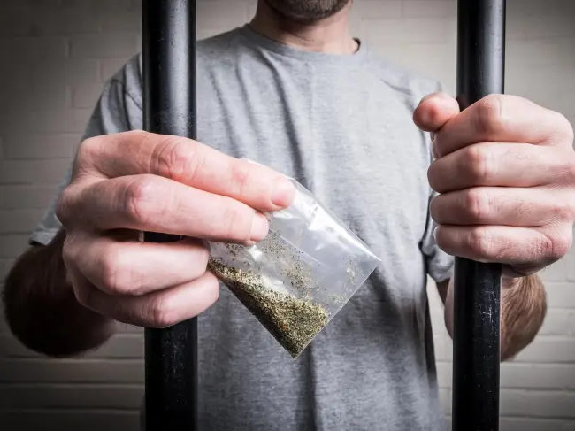
Ineffective: Fear-based Campaigns
Shown to be ineffective with most audiences
Messages not developmentally appropriate
Can backfire if experiences are contrary
Notes:
Image: https://www.thesun.co.uk/news/7158016/spice-is-now-being-smuggled-into-britains-jails-stitched-inside-dead-birds/
FEAR BASED CAMPAIGNS
These messages are not developmentally appropriate and researchers point out that fear arousal often backfires when youth have access to contrary information and experience
For example, one study found that call volume to a national tobacco “quitline” in the United Kingdom was lower during a fear-based social marketing campaign than during a positive, emotion-based social marketing campaign.xv This demonstrated that instilling fear decreased the likelihood that individuals would contact the quitline for help.

Slide 26
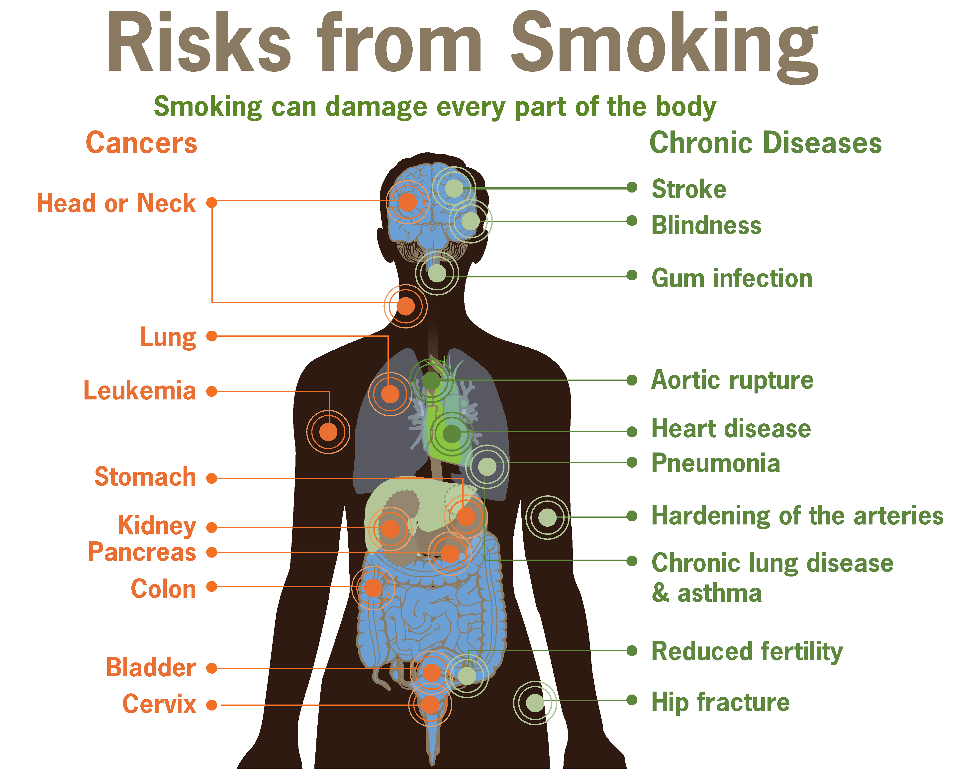
Ineffective: Long-term Consequences
Shown to be ineffective
Outcome too far in the future to influence
“It won’t happen to me”
Notes:
Image: https://en.wikipedia.org/wiki/Health_effects_of_tobacco
Causes distrust of messenger. My grandma smokes and she is fine. I won’t smoke that long. Short term consequences can be impactful, such as bad breath and yellow teeth or loss of friends, etc.

Slide 27
Ineffective: Exaggerated Dangers
Loss of trust in prevention messages
Can be counter to personal experiences
Attitude of “indestructability” among youth and young adults
Notes:
Image: montana meth project

Slide 28
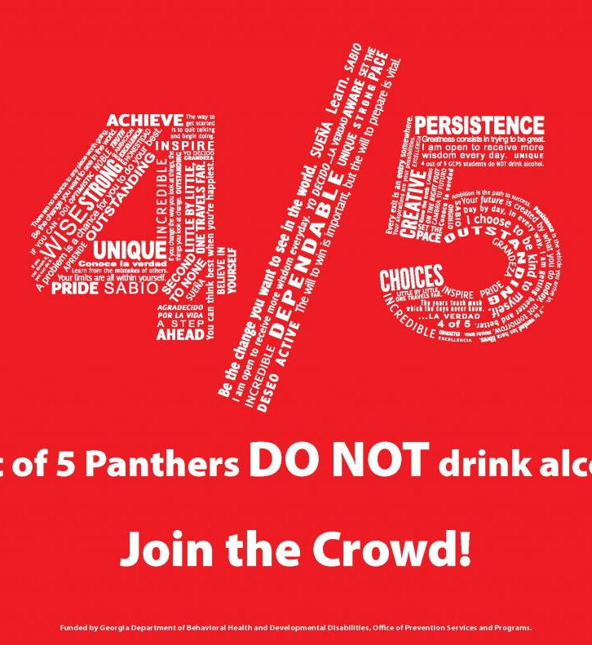
Effective Appeals
Normative messages regarding peer use and actions
Short-term impacts of use
Positive effects of no use
Notes:
Images: https://guideinc.org/wp-content/uploads/2020/01/Youth-Positive-Social-Norms-Campaign-Packet.pdf
https://www.luriechildrens.org/en/serving-the-community/magoon-institute-for-healthy-communities/youth-substance-use/

Slide 29
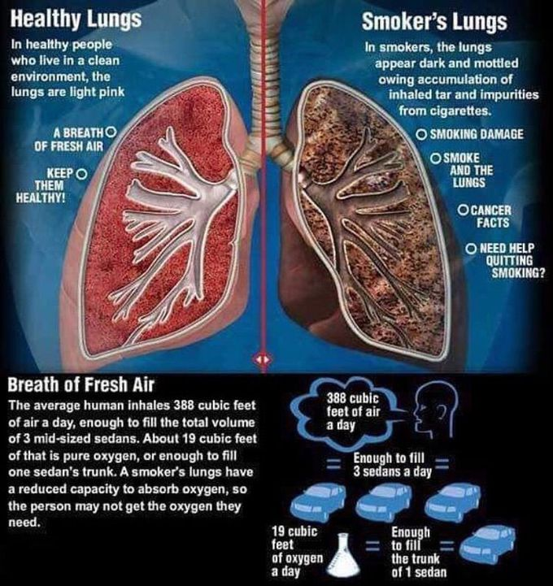
Ineffective Information Sharing
Knowledge-based interventions
Drug fact sheets
Effects of drugs
Myth busting
Notes:
INEFFECTIVE
It is normal for young people to have questions about alcohol and other drugs, but providing too much information too early can negatively influence their healthy decisions and behavior. For example, drug fact sheets and posters that describe reasons for use, methods of use, the street names of drugs, and potential benefits of use are ineffective at best and may increase experimentation in vulnerable children and youth.
Curricula that only provide information about the consequences of substance use do not produce measurable and long-lasting changes in behavior or attitudes. This approach is considered by prevention scientists among the least effective educational strategies.
MYTH BUSTING
Myth busting may be among the most commonly used means for correcting false norms across all types of health communication; however, research shows that people exposed to a myth/fact presentation style are more likely to recall myths as facts! Scientists have termed the reason for this as the Illusion of Truth Effect, which demonstrates that commonly held beliefs and repeated statements are easier for the brain to process and are therefore perceived to be more truthful than new information. Put simply, myth busting is actually myth reinforcing. It is much more effective to simply state the facts and then repeat them over time.
DRUG FACT SHEETS
In fact, there is significant data to demonstrate that fact sheets in the hands of middle school students show them how to defy adults and enhance peer reputation by engaging in risky behaviors. Showing the benefits of drug use, even when paired with consequences, promotes drug use among youth. The idea that there is an easy way to forget pain, lose weight, cope with anxiety and fit-in may entice teens to experiment.
EFFECTIVE
As we have mentioned before, focusing on addressing identified risk and protective factors, even in your education materials is essential and effective. Use your information sharing as an opportunity to draw a line from risk factors to strategies and actions that the community and/or individuals can take. You can use your information sharing strategies to make the case for why your work will impact the problem in your community. Take every opportunity to tie your education back to your strategic plan.
Providing action focused information to youth, adults, and parents is more impactful. For example, if your community has an issue with perceived parental approval of alcohol use providing information on the impact of this perception on behavior and actions parents can take to provide clear boundaries and communicate disapproval. Providing action items directs individuals to make an impact. Education with out application does not impact behavior. Another example is to provide information to adults about ways to avoid driving under the influcene. Provide educational materials that include numbers of car services and taxis, provide talking points for how to talk to peers about designating a driver and making safe choices – even providing a script for indivduals to use if they find themselves or their friends in dangerous situations.

Slide 30
Effective Information Sharing
Education related to risk and protective factors
Action-focused information
Notes:
Image: Microsoft stock

Slide 31
Reflection #2
Write one strategy that has been or is being done in your community that is known to be ineffective
List the reasons why the community (or an individual) is invested in this strategy

Slide 32
What Drives Continued Implementation of Ineffective Strategies
Perception that the interventions are “liked” by the audience
Partners not open to change
Partners insist on implementing despite evidence
Individuals feel the strategy “worked for me”
Concern regarding capacity and/or cost

Slide 33
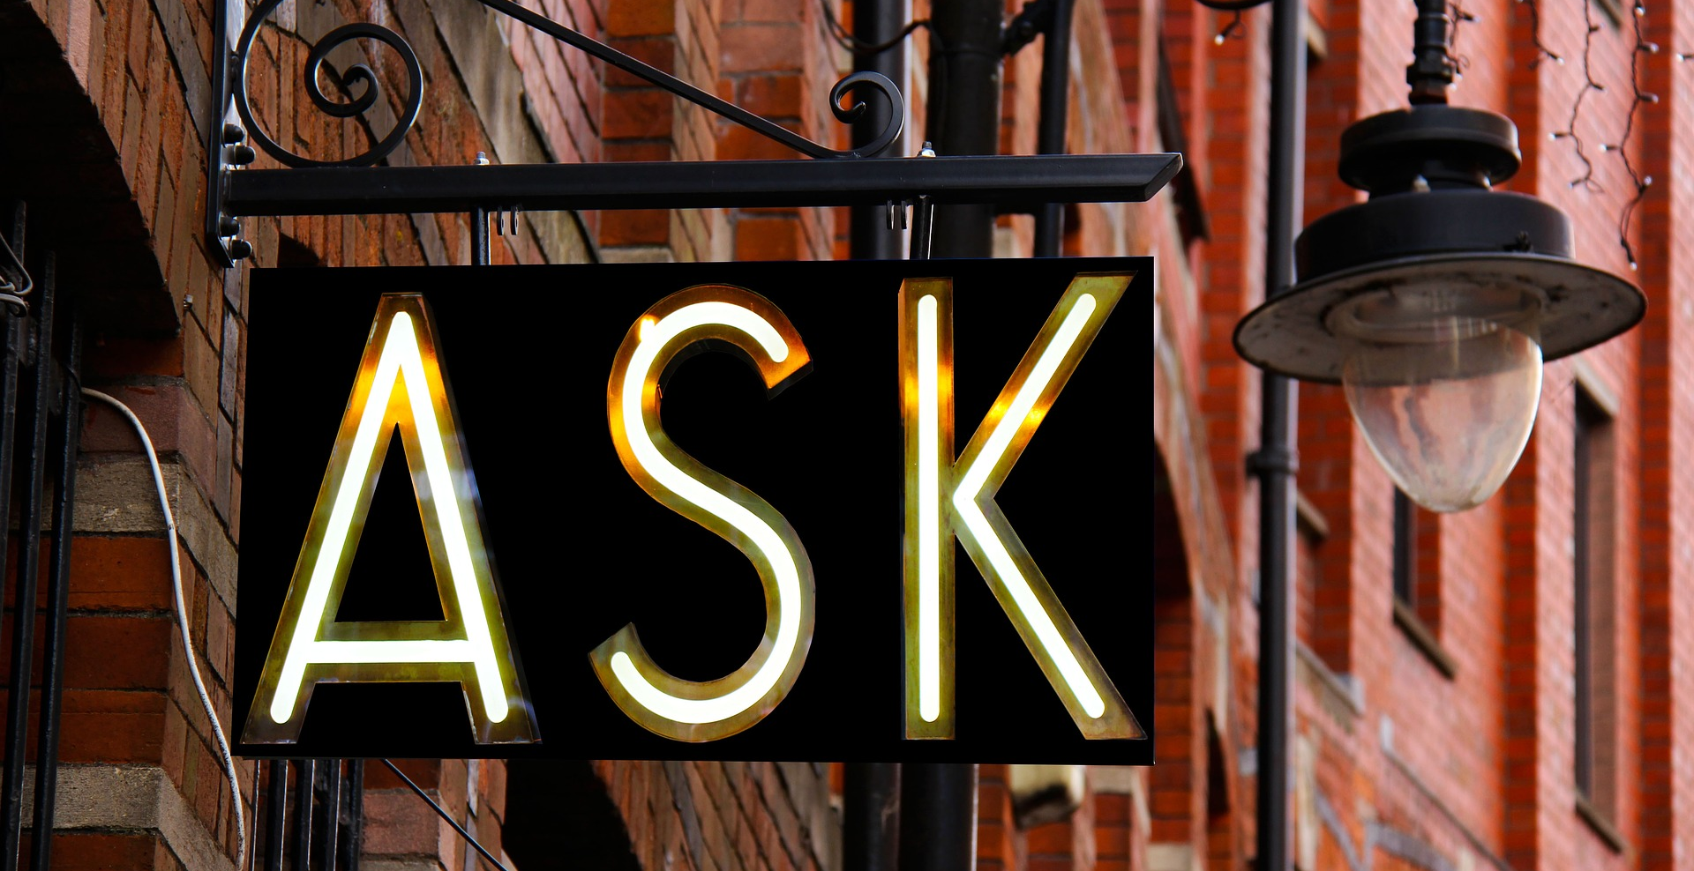
Questions? Clarifications?
Notes:
Photo: https://pixabay.com/photos/ask-sign-design-creative-2341784/

Slide 34
Moving Forward…

Slide 35
Simon Sinek Video: Consider…
Incremental change vs sudden change
How can you move your community incrementally toward more effective strategies?
Law of Diffusion of Innovation
How can you apply this law to moving your community toward more effective strategies?
Who might your early adopters be? How can you build demand?

Slide 36
Video: Navigate and Embrace Change
https://www.youtube.com/watch?v=pUmTQ-86-YI
Notes:
https://www.youtube.com/watch?v=pUmTQ-86-YI

Slide 37
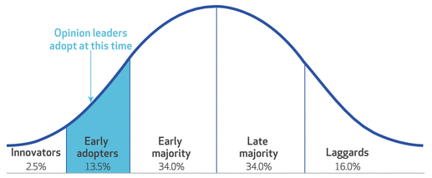
Video Debrief
Incremental change vs sudden change
How can you move your community incrementally toward more effective strategies?
Law of Diffusion of Innovations
How can you apply this law to moving your community toward more effective strategies?
Who might your early adopters be? How can you build demand?
Notes:
Image from: https://www.healthaffairs.org/doi/10.1377/hlthaff.2017.1104

Slide 38
Prime the Pump!
Review your strategic plan, including the priority problems, risk/ protective factors
Provide training on logic models
Identify evidence-based strategies that are a good fit for your community
Notes:
Photo: https://unsplash.com/photos/JQwzKcHLHoc

Slide 39
Steps to Moving Toward More Effective Strategies
Identify
Identify WHY your community (or a certain individual) is invested in the ineffective strategy
Find
Find evidence-based, effective strategies that can be implemented instead
Brainstorm
Brainstorm how the change in strategy could benefit those invested in the ineffective strategy
Create
Create a message to persuade people to embrace replacing the ineffective strategy
Meet
Meet with those invested in the ineffective strategy

Slide 40
Reflection #3
Review your notes from Reflection #2
Brainstorm how a shift to an effective, evidence-based strategy could benefit those invested in the ineffective strategy

Slide 41
Perspective from the Field
Notes:
Introduce our “guest.” Ask them to share what they were up against, in terms of a favorite strategy being implemented in their community that they knew research had shown wasn’t effective. What did they do? How were they able to help their community shift directions to more effective strategies?

Slide 42
Reminders
Understand what is appealing about the ineffective strategies
Anticipate and prepare for resistance
Use strategic plan to ensure strategies selected are a good fit
Notes:
Photo: https://pixabay.com/photos/magnet-blank-reminder-message-4872634/
Understand what is appealing about the ineffective strategies to those invested in the strategy
Anticipate and prepare for resistance
Refer to your strategic plan to ensure strategies selected are a good fit for your goals and your community

Slide 43
Reminders, continued
Craft messages that provide:
Compelling reason to quit using the ineffective strategy
How the new strategy will be advantageous
A clear call to action
Practice, practice, practice!
Notes:
Craft messages that provide:
A compelling reason to stop implementing the ineffective strategy
An explanation of how the new strategy can continue the positive aspects of the old strategy and also have positive outcomes re substance misuse prevention
A clear call to action to stop using the ineffective strategy and begin using an effective one
Practice, practice, practice!

Slide 44
Questions?

Slide 45
Circling Back
Post in the chat any shifts you experienced during the webinar regarding the phrase “what does NOT work in prevention.”

Slide 46
Office Hours
March 3, 1-2 CT with Erin
March 7, 10-11 CT with Kris
Open to webinar participants only
Zoom links will be sent via email to webinar participants
No registration required
No certificates of participation

Slide 47
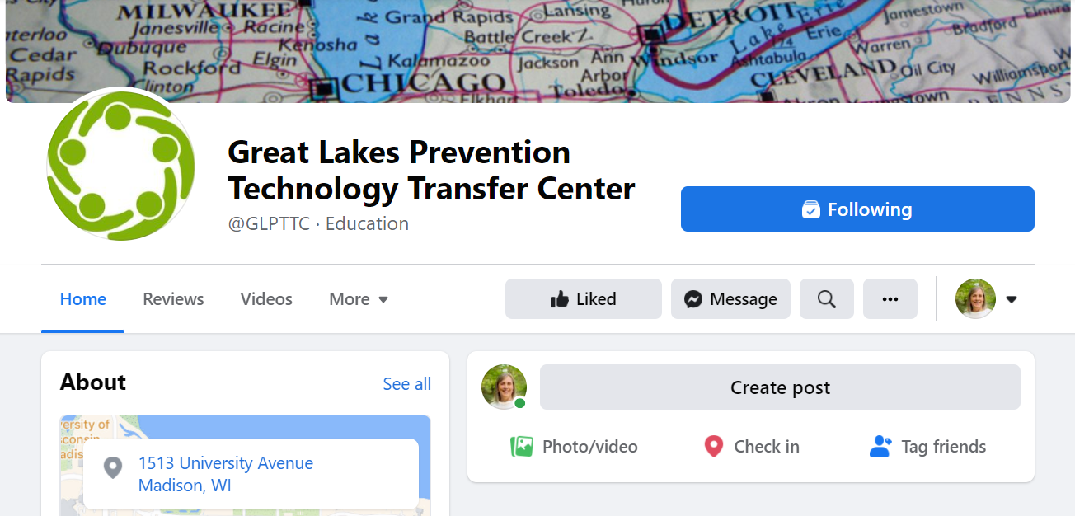
Great Lakes PTTC Facebook Page

Slide 48
Upcoming Trainings
Five C’s (Not D’s) of Data March 9, 10-11:30 CT
Foundations in Prevention Intensive Training Course March 21, 24, 28, 31, April 4, 7, 11, & 14, 10:00-11:30 CT
Taking Action on Stigma training series March 30 and April 6, 9-11 CT
To register: https://tinyurl.com/GLPTTCevents

Slide 49
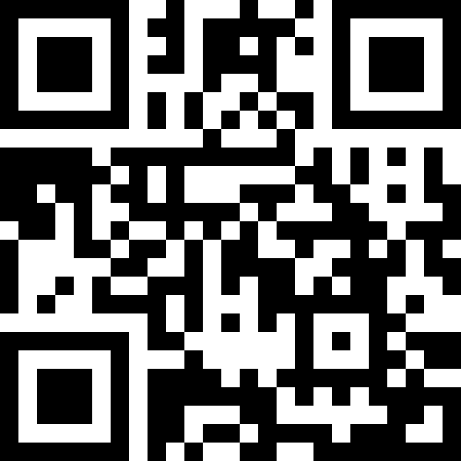
Post-Training Feedback
https://ttc-gpra.org/P?s=847427

Slide 50
Thank You!
Notes:
From: https://www.pexels.com/photo/thank-you-heart-text-791024/

