Slide 1
Selecting Prevention Strategies that Work
[Presenter’s name] [Presenter’s Organization]
[Date]
Notes:
Inform your community partners/coalition members that this guidance document, and companion workbook, will guide them through the strategy selection process. Let them know that the process will take place over multiple sessions, with homework in between sessions.

Slide 2
Disclaimer
This slide deck was created by the Great Lakes PTTC under a cooperative agreement #1H79SP081002-04 from the Substance Abuse and Mental Health Services Administration (SAMHSA). All material appearing in this presentation, except that taken directly from copyrighted sources, is in the public domain and may be reproduced or copied without permission from SAMHSA or the authors. Citation of the source is appreciated. Do not reproduce or distribute this presentation for a fee without specific, written authorization from the Great Lakes PTTC. For more information on obtaining copies of this presentation, email events@chess.wisc.edu.
At the time of creation of this document, Dr. Miriam Delphin-Rittmon serves as Assistant Secretary for Mental Health and Substance Use. The opinions expressed herein are the views of the speakers and do not reflect the official position of the Department of Health and Human Services (DHHS), SAMHSA. No official support or endorsement of DHHS, SAMHSA, for the opinions described in this document is intended or should be inferred.
July 2022
Notes:
Share that this slide deck was created by the Great Lakes Prevention Technology Transfer Center (PTTC) which is funded by the Substance Abuse and Mental Health Services Administration (SAMHSA). The opinions expressed in this presentation do not reflect the official position of SAMHSA.

Slide 3
Objectives
By the end of this process, community partners will:
Define evidence-based
Identify prevention strategies that work
Select strategies that will fit with community needs, resources, and readiness
3
Notes:
Review the objectives on the slide and ask if participants have any questions about the purpose of the strategy selection process.

Slide 4
Session 1: How to look for strategies

Slide 5
Planning Timeline and Next Steps
Prioritization
Strategy Selection
Action Planning
HANDOUT 1
Notes:
BEFORE THE PRESENTATION: Develop a handout that summarizes the risk and protective factors prioritized by your community to address with prevention strategies. For each factor, note which substance and/or substances the factor is associated with. Also for each factor, provide the most recent local data. If you have prioritized any populations of focus based on disparities identified for any of the factors, name the population of focus and share relevant data.
Ask community partners/coalition members to review the risk and protective factors prioritized at the beginning of the planning phase. For any new members, briefly describe the process used to prioritize those factors and who was involved.

Slide 6
Strategy Selection Definitions
What is a prevention strategy, and what makes a strategy evidence based?
6
Notes:
Ask community partners/coalition members to share their understanding of evidence-based practices. If you’re working with a large group, consider having them break into pairs and then come back to report out to the larger group.

Slide 7
Strategy Selection What is a prevention strategy?
A policy, program, or protocol used to prevent and/or reduce a risk factor, or to enhance a protective factor
Some “prevention strategies” found in registries are actually comprehensive processes or frameworks comprising multiple strategies
Providing information, enhancing skills, and changing consequences can all be “types” of strategies or “components” of strategies
7
Notes:
List a couple of examples of “strategies” that are really processes or frameworks. Communities that Care is a “prevention strategies” that involves identifying risk and protective factors similar to the SPF.
FOR DFC: DFC grantees are asked to report on their efforts by seven strategies. In many cases, a prevention strategy may cut across several of these. For example, implementing a combination of Responsible Beverage Server Training and compliance checks would entail:
Providing information to retailers about the consequences of sales to minors and/or over-service
Enhance skills of retailers to spot fake IDs and watch for signs of over-service
Provide support by recognizing retailers that pass compliance checks
Change consequences by increasing fines for non-compliant retailers
Change physical design by giving RBST participants signs to post stating that they card
Change policy by requiring all retailers to receive annual RBST training

Slide 8
Strategy Selection What makes a strategy evidence-based?
Conceptual Fit
Best Practices Fit
Practical Fit
Evidence of Effectiveness
8

Slide 9
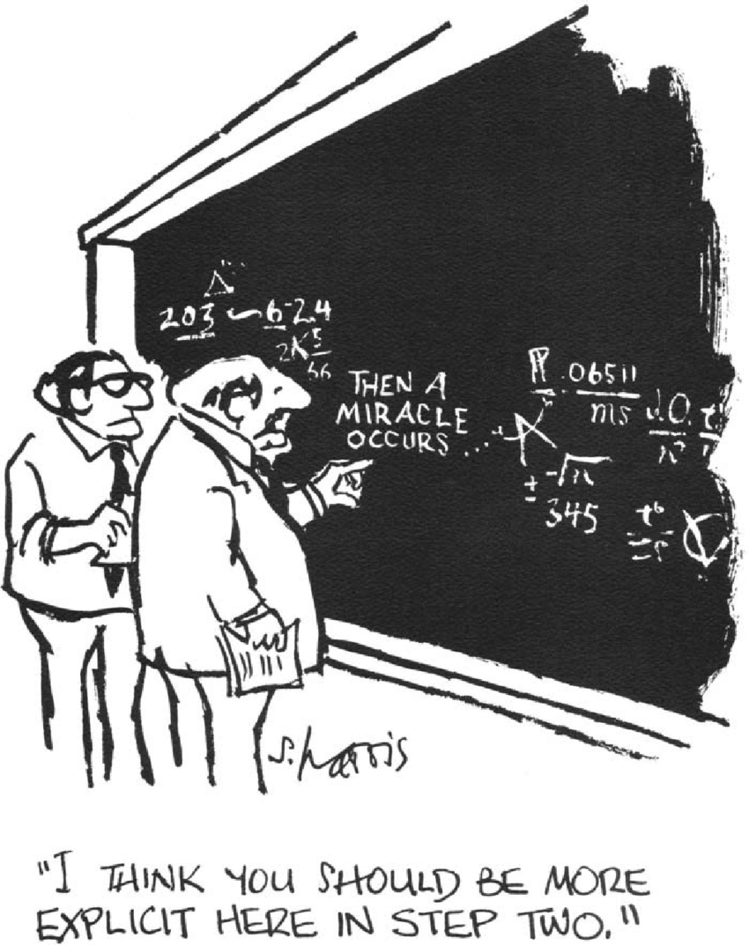
Strategy Selection Conceptual Fit
Relevant for the specific risk/protective factor or local condition prioritized
Specific to the community’s characteristics and culture (e.g., youth, rural, mostly White and Hispanic)
9
Notes:
Add notes from Iowa document about if/then statements!!!

Slide 10
Strategy Selection Practical Fit
Community’s technical ability to implement a strategy:
Readiness and buy-in
Having necessary resources (e.g., human, financial)
Feasibility given the timeline of the grant
10

Slide 11
Strategy Selection Evidence of Effectiveness
Included in a federal registry of evidence-based practices
Evidence of effectiveness demonstrated in multiple peer-reviewed journal articles
Effectiveness documented through unpublished evaluations and supported by the consensus judgement of informed experts
11

Slide 12
Evidence of Effectiveness Federal Registries
Online registries assess research on behavioral health programs and rate their effectiveness
Registries provide prevention practitioners inform to help select strategies that would be the best fit
12
Notes:
https://pttcnetwork.org/centers/pacific-southwest-pttc/product/guide-online-registries-substance-misuse-prevention-evidence
Alert community partners/coalition members that not all strategies listed in registries are evidence based.
Many registries review a broad array of strategies, and rate them as evidence-based, promising, or as having weak or no evidence.
Just because a strategy has been shown to be effective, it may not be effective for your context/community. That’s why conceptual and practical fit are so important.
Evidence-based strategies will only be effective if your community can implement them as intended/with fidelity.

Slide 13
Evidence of Effectiveness Peer-Reviewed Journal Articles
Avoid “flash” studies or pre-peer reviewed articles
Does the article clearly describe the community/setting and population of focus?
Does the article clearly spell out its outcomes? Limitations?
What was the overall quality of the study?
How many articles found evidence of effectiveness? How many articles did not?
13
Notes:
Carefully review each article. In the results and discussion section, did they find significant change to the risk or protective factor you are trying to address in your community?

Slide 14
Evidence of Effectiveness Evaluation Findings and Expert Opinion
The practice is based on a theory of change that is documented in a logic model
The practice is similar in content and structure to one in a registry or peer review journal
The practice has been successfully implemented multiple times, and evaluation results show evidence of effectiveness
The practice has been reviewed and deemed appropriate by a panel of informed prevention experts
14

Slide 15
Evidence of Effectiveness Why not just pick from a list of EBPs?
The reason to prioritize local data first is:
It’s important to base decisions on local data and local conditions
Compliance checks won’t lead to successful outcomes if students aren’t getting alcohol from retail sources
An evidence-based curriculum won’t lead to successful outcomes if schools don’t have the buy-in and time to implement with fidelity
EBPs come from tried and tested promising practices in cases where no strategies were available to address priority factors
15

Slide 16
Evidence of Effectiveness What works and what doesn’t?
Some strategy selection guides also make note of strategies that don’t work
What if a community partner is excited about implementing a strategy that is not effective?
16
Notes:
Https://theathenaforum.org/best-practices-toolkit-prevention-tools-what-works-what-doesn’t
Red light! Avoide a strategy has been shown to be potential harmful, or to have the opposite of the impact intended
Yellow light! As long as the strategy is not potentially harmful, consider implementing it if it will support active coalition members or key community partners. However, weigh carefully the amount of time and resources your community invests in ineffective strategies.

Slide 17
Next Steps
Process:
Research and assess strategies as a large group
Research and assess strategies as homework between sessions
If 2:
Work individually
Work on all risk/protective factors and compare notes with others later
Sign up for one or two priority risk/protective factors
Work in small groups of two or three
Work on all risk/protective factors and compare notes with others later
Sign up for one or two priority risk/protective factors
Choose your own adventure!
Vote on which process would you prefer.
17
Notes:
Now is the time to move to action! As a group, discuss the process you would like to use to research and assess potential strategies.
Considerations include:
How much time people can commit to each session
How many people are willing and able to research and score strategies
The extent to which people want to work alone or in groups

Slide 18
Next Steps (cont’d)
Steps:
Break the work into multiple steps between each session:
Identify strategies
Describe strategies in detail
Assess strategies for fit
Describe and assess strategies as you find them
Choose your own adventure!
Vote on which process would you prefer.
18

Slide 19
Session 2: Identifying and assessing strategies for fit

Slide 20
Identifying Strategies Doing the Research
Use registries, peer-reviewed articles, and other resources to search for strategies
List potential strategies by risk/protective factor
Make note of the source of information
HANDOUT 2
20

Slide 21
Assessing Strategies for Fit Describe Each Strategy
HANDOUT 3
Briefly describe the strategy.
Which risk and/or protective factor(s) does it address?
What evidence of effectiveness is available?
Which community partners would need to be involved in implementation?
What additional resources would be needed to implement the strategy?
What potential barriers or challenges do you foresee?
What is the cost of the strategy?
21

Slide 22
Strategy Assessment Tools
Handout 4
Conceptual Fit | 1 | 2 | 3 | 4 | 5
1a. How likely is it that the strategy will change the priority substance misuse problem (1 = not at all likely; 5 = very)
1b. Does the strategy align with your risk/protective factor? (1 = doesn’t align at all; 5 = aligns exactly)
1c. Will the strategy reach enough members of the population of focus? (1 = not sufficient; 5 = sufficient)
1d. How relevant is the evidence given your community’s characteristics? (1 = not at all relevant; 5 = very)
1e. How similar is your community’s culture to those in the communities studied? (1 = very different; 5 = very similar)
TOTAL: Add 1a-1e
AVERAGE: Divide total by 5
Notes:
Complete Handout 4 for each strategy selected.

Slide 23
Strategy Assessment Tools - 2
Practical Fit | 1 | 2 | 3 | 4 | 5
2a. How feasible is implementation of the strategy given the community’s capacity (e.g., skills, partners, funds)
2b. To what extent does the coalition have the necessary buy-in from partners needed for implementation?
2c. How feasible is it for you to implement this strategy before the end of the grant?
2d. How sustainable is this strategy? Can it continue to be effective beyond the funding period?
2e. To what extent does the strategy build on prevention work already in place?
TOTAL: Add 2a-2e
AVERAGE: Divide total by 5

Slide 24
Strategy Assessment Tools - 3
Evidence of Effectiveness | 1 | 2 | 3 | 4 | 5
3a. Which definition of evidence-based does the strategy meet (1 = registry; 2 = peer reviewed journals; 3 = expert opinion; 4 = promising; 5 = none)

Slide 25
Session 3: Prioritizing strategies

Slide 26
Final Strategy Selection Prioritization
What did you find? Where you able to find potential strategies for each risk and protective factor?
26
Notes:
In preparation of the session, if meeting in person have a dry erase board, large flip charts. Prepare spaced to capture notes for each priority risk/protective factor. If meeting virtually, set up a virtual platform such as Google Jamboard or a Miro board.
Walk through each risk and protective factor one at a time. Ask community partners/coalition members to share a brief description of the potential prevention strategies they found. For each strategy, how familiar are participants with the strategy. Does anyone have any immediate concerns or red flags about any of the strategies? Were there any factors for which nobody was able to find a potential strategy.

Slide 27
Strategy Assessment Tools - Blank
Handout 5
Risk/Protective Factor | Strategy | Conceptual Fit Score | Practical Fit Score | Evidence of Effectiveness | Final Rating
Notes:
Complete handout 5 entering each strategy in its own row. Enter in the scores for conceptual fit, practical fit, and evidence of effectiveness from Handout 4. As a group, reflect on the scores and rate each strategy as high priority, moderate priority, or low priority.

Slide 28
Final Strategy Selection Prioritization - 2
Do you have the right mix of strategies to fully engage interested stakeholders?
Do you have the right mix of strategies to adequately reach the population of focus?
28

Slide 29
Final Strategy Selection Funder Requirements
Which strategies will they approve, and which will they not approve
Does a certain proportion of your strategies need to be evidence based?
Does a certain proportion of your strategies need to be environmental vs. individual?
Are there certain activities or items you can’t spend grant funds on?
29

