Slide 1
Introduction to Prevention Science
Curriculum Infusion Package
Notes:
This curriculum infusion package, Introduction to Prevention Science, was developed in 2021 by the Northwest Prevention Technology Transfer Center (PTTC). The slide deck was created to help educators infuse core components of prevention science into their curriculum.
The slide deck has 2 parts. The first part provides a high-level overview of prevention science. The second part delves deeper into three broad prevention practice content areas: 1) epidemiology, 2) evidence-based programs and practices, and 3) implementation science. This slide deck was created so that you can use it as a whole, or by individual sections. Each slide contains notes for the instructor. References are included within the presenter notes as well.
Supplemental resources are also available. The Prevention Science Curriculum Infusion Resource Table (https://pttcnetwork.org/centers/northwest-pttc/product/prevention-science-curriculum-infusion-resources) was developed to provide educators across disciplines with a variety of materials related to the same three prevention practice content areas. These resources can help supplement the slide deck and can also be infused into existing courses to enhance training in prevention science.

Slide 2

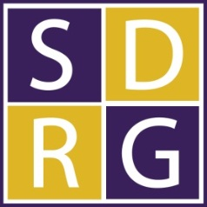



The Northwest PTTC is a partnership led by the Social Development Research Group (SDRG) at University of Washington (UW) School of Social Work in collaboration with the Prevention Science Graduate Program at Washington State University (WSU), and the Center for the Application of Substance Abuse Technologies (CASAT) at the University of Nevada, Reno (UNR).
Northwest partnering institutes share a vision to expand the impact of community-activated prevention by equipping the prevention workforce with the power of prevention science.
Notes:
You are free to use these slides and pictures, but please give credit to the Northwest PTTC when using them by referencing the Northwest PTTC at the beginning of your presentation.
The Northwest PTTC (HHS Region 10) is a partnership led by the Social Development Research Group (SDRG) at University of Washington (UW) School of Social Work in collaboration with the Prevention Science Graduate Program at Washington State University (WSU), and the Center for the Application of Substance Abuse Technologies (CASAT) at the University of Nevada, Reno (UNR). HHS Region 10 is comprised of Alaska, Idaho, Oregon, and Washington. For additional information, please access its website at https://pttcnetwork.org/centers/northwest-pttc/home. If you require further information on this topic, please contact the Northwest PTTC.

Slide 3
Disclaimer
This training is supported by SAMHSA of the U.S. Department of Health and Human Services (HHS) through SAMHSA Cooperative Agreement # H79SP080995. The contents are those of the author(s) and do not necessarily represent the official views of, nor an endorsement, by SAMHSA/HHS, or the U.S. Government.
Notes:
This training is supported by SAMHSA of the U.S. Department of Health and Human Services (HHS) through SAMHSA Cooperative Agreement # H79SP080995. The contents are those of the author(s) and do not necessarily represent the official views of, nor an endorsement, by SAMHSA/HHS, or the U.S. Government.

Slide 4





This slide deck is meant to be flexible
The slide deck can be used as a whole, by individual subsection, diving into an area of prevention science, or you may pick and choose slides you wish to embed in your own materials or create your own slide deck.
Feel free to swap out examples for ones that are more relevant to your field
You may make changes to the slides themselves
Citations and credit are provided within the notes section of the slide.
Examples of Use
Both synchronous and asynchronous
Assign a portion as extra credit along with a lesson package activity
Uploaded a recorded lecture using the slides and assigned as asynchronous content and had students post on a discussion board following the assignment prompt.
Connect the lesson package activities to another class assignment

Slide 5
Learning Objectives
Students will be able to:
  Define and describe prevention science
  Give examples of risk and protective factors
  Explain how evidence-based programs can be selected and how they are implemented
  Understand broadly how epidemiology, risk and protective factors, and implementation weave together
Notes:
This slide states the desired learning objectives for this slide deck. Review these with the class.
To reinforce these objectives, Lesson Packages have also been created for each of the three content areas: 1) epidemiology, 2) evidence-based programs and practices, and 3) implementation science. These packages include supplemental materials (e.g., handouts, articles) and application activities to go along with the section.
At the end of each section of the PowerPoint, instructors are provided a “lesson package debriefing slide” that describes the activity (please see appropriate lesson package for details).
Image Credit: Getty Images (purchased image).

Slide 6
What is Prevention Science?
Notes:
The first section of this slide deck focuses on answering the question: “What is Prevention Science?”
This section will provide students with a broad overview of prevention science.

Slide 7

What is Prevention Science?
Interdisciplinary field that applies basic research about individuals, families, and communities to the development, evaluation, and dissemination of scientifically-based programs and policies to promote physical, social, and psychological well-being.
An ounce of prevention is worth a pound of cure.
Benjamin Franklin
Notes:
So, what exactly is prevention science?
You’ve probably all heard this famous quote by Benjamin Franklin, “An ounce of prevention is worth a pound of cure.” This means that preventing something bad from happening in the first place is better than waiting until something bad happens and then having to try and fix it or cure it.
In order to identify that “ounce of prevention” – this interdisciplinary field applies basic research about individuals, families, and communities to the development, evaluation, and dissemination of scientifically-based programs, practices, and policies to promote physical, social, and psychological well-being.
When you hear “prevention”, many of you might think of things like…diabetes prevention or skin cancer prevention – this is a good frame of reference.
Prevention Science can include the prevention of physiological diseases like these, but it typically focuses on behavioral-related health problems like delinquency prevention, school drop-out prevention, or crime prevention --- and the promotion of positive behaviors.
What ties it all together is an ultimate goal of improving public health or promoting positive population-level change.

Slide 8
Prevention scientists use research and data to guide and inform our understanding of public health problems and their solutions.
Requires input and involvement from communities.
Evidence-based Programs and Practices
Epidemiology
Implementation
What is the health problem in my community?
What causes this health problem? (risk and protective factors)
What program/ policy works to prevent it?
How do we implement these programs and policies at scale?
Improved public health
Notes:
Prevention science uses research to guide and inform our understanding of public health problems and their solutions. However, they are not the only individuals involved in this process. It requires input and involvement from communities as well.
As a starting point, prevention scientists work with communities to identify what the health problem is in their community that needs to be addressed – for example, middle school substance use. Often epidemiological data is examined to determine which problems are most prevalent in the community.
--
They then dig deeper to identify what causes this health problem – this includes determining what risk and protective factors are associated with the health problem.
--
Next, they identify evidence-based program and practice registries to decide which program or policy would work best for this population and for the specific health problem, as well as the other causes they identified previously. For example, an evidence-based program for middle school substance misuse may also address social relationships or teach positive coping skills which are important risk and protective factors associated with substance use.
--
After a program or policy is selected, prevention scientists and their community partners must decide how it will be implemented into the community, or in this case perhaps a school. This step also takes into consideration what people and other resources would be needed to implement the program at a large scale, since again we are preventing substance misuse for a whole population rather than just one individual.
--
As the program is implemented to address the health problem, we begin to see positive changes for this problem within the community.

Slide 9
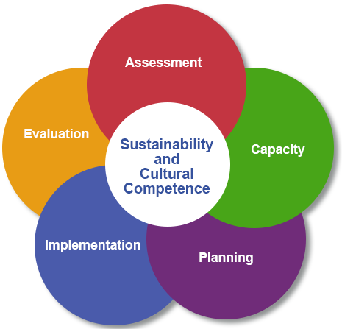
SAMHSA’s Strategic Prevention Framework
SAMHSA, 2019
Notes:
The process just described is also outlined in SAMHSA’s Strategic Prevention Framework (SPF) – a community-focused strategic planning model comprising five steps:
SAMHSA’s Strategic Prevention Framework (SPF) is a proven strategic planning model comprising five steps:
Step 1. Assessment involves gathering and using data to identify a priority problem, factors influencing this problem, and resources and readiness to address it.
Step 2. Capacity involves building resources and readiness to address the priority problem and its associated factors.
Step 3. Planning involves developing a comprehensive plan that details prevention priorities, programs and practices selected to address them, and anticipated outcomes.
Step 4. Implementation involves moving the prevention plan into action by fine-tuning selected programs and practices and delivering them as intended.
Step 5. Evaluation involves examining how programs and practices are working and using lessons learned to improve them and the plan overall.
These five steps are guided by two principles - cultural competence and suitability.
Download the Strategic Prevention Framework guide here - https://www.samhsa.gov/resource/ebp/strategic-prevention-framework
Image Credit: http://bit.ly/samhsaSPF
Citation: Substance Abuse and Mental Health Services Administration. (2019). A Guide to SAMHSA's Strategic Prevention Framework. Rockville, MD: Center for Substance Abuse Prevention.

Slide 10

Adolescent Substance Use Example
Notes:
This slide includes a three-minute video from the Addiction Policy Forum illustrating what prevention is within the context of adolescent substance misuse prevention. See their website for additional details: https://www.addictionpolicy.org/prevention
Video Credit: Addiction Policy Forum, August 13, 2019

Slide 11
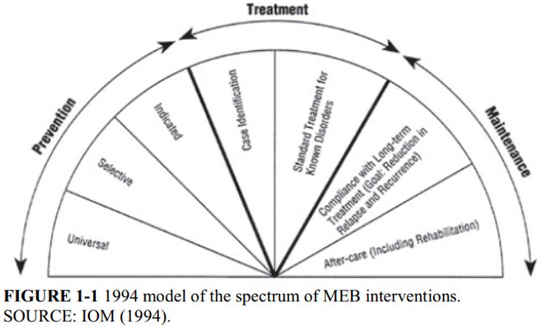
Where does prevention fit in the spectrum of mental, emotional, and behavioral interventions?
1994 model of the spectrum of mental, emotional, and behavioral (MEB) interventions depicts interventions beyond treatment to include prevention, and maintenance (sustain treatment effects).
Image from National Academies of Sciences, Engineering, and Medicine et al., 2019
Notes:
You might be asking yourself, where does prevention fit in the spectrum of interventions aimed at improving behavioral health?
This figure shows the 1994 model of the spectrum of mental, emotional, and behavioral (MEB) interventions from the National Academies of Sciences, Engineering and Medicine. This version depicts the extension of interventions beyond treatment to include, prevention, and maintenance, thus expanding to the importance of sustaining the effects of treatment.
Image Credit: National Academies of Sciences, Engineering, and Medicine, 2019
Citation: National Academies of Sciences, Engineering, and Medicine. (2019). Fostering Healthy Mental, Emotional, and Behavioral Development in Children and Youth: A National Agenda. Washington, DC: The National Academies Press. https://doi.org/10.17226/25201.

Slide 12
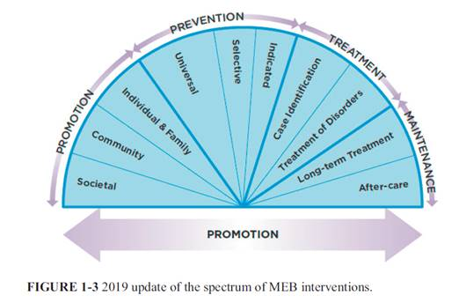
Where does prevention fit in the spectrum of mental, emotional, and behavioral interventions?
The spectrum of mental, emotional, and behavioral (MEB) interventions depicts the extension of interventions beyond treatment to include promotion (interventions that promote improvement MEB health outcomes), prevention, and maintenance.
Promotion of health outcomes is done actively across the spectrum.
Image from National Academies of Sciences, Engineering, and Medicine et al., 2019
Notes:
This model was then expanded again in 2009 . Here you’ll see that the spectrum of mental, emotional, and behavioral (MEB) interventions now also includes promotion, in addition to prevention, treatment and maintenance.
Promotion includes interventions that promote improvement of MEB health outcomes at societal, community, individual, and family levels. The model now also shows how promotion of health outcomes should be done actively across the spectrum.
It is also important to note that the universal slice is bigger in this model as universal preventions are meant to reach everyone and there is a larger potential impact and scale than selective or indicated prevention interventions.
For a full version of the Fostering Healthy Mental, Emotional, and Behavioral Development in Children and Youth (2019) visit, https://www.nap.edu/catalog/25201/fostering-healthy-mental-emotional-and-behavioral-development-in-children-and-youth
Image Credit: National Academies of Sciences, Engineering, and Medicine, 2019
Citation: National Academies of Sciences, Engineering, and Medicine. (2019). Fostering Healthy Mental, Emotional, and Behavioral Development in Children and Youth: A National Agenda. Washington, DC: The National Academies Press. https://doi.org/10.17226/25201.

Slide 13
Levels of Prevention
Indicated
Selected
Universal
Preventing significant problems for a group of people who are already showing some indication that they have early stages of the problem.
Preventing a problem among a group of people that have been identified as particularly at risk for the problem.
Preventing a problem before it has happened.
The aim is to prevent the problem for everyone.
National Academies of Sciences, Engineering, and Medicine et al., 2019
Notes:
As was depicted in the previous model, there are three levels of prevention…
Universal prevention is preventing a problem before it has happened. The aim is to prevent the problem for everyone (although we are rarely successful in reaching every young person).
Selected prevention is preventing a problem among a group of people that have been identified as particularly at risk for the problem.
Indicated prevention is preventing significant problems for a group of people who are already showing some indication that they have early stages of the problem.
Citation: National Academies of Sciences, Engineering, and Medicine. (2019). Fostering Healthy Mental, Emotional, and Behavioral Development in Children and Youth: A National Agenda. Washington, DC: The National Academies Press. https://doi.org/10.17226/25201.

Slide 14
Levels of Disease Prevention
Primary Prevention
Secondary Prevention
Tertiary Prevention
Prevention from getting a disease or intervening before health risks occur
Detecting or identifying the disease early to prevent worsening
Managing the disease post diagnosis to reduce symptoms
Ex. Chemotherapy
Ex. Vaccines
Ex. Routine physical exams
CDC, 2017
Notes:
The terminology used when describing “levels of prevention” varies depending on the field you are in. For example, in medical professions levels of prevention may be described as primary, secondary, and tertiary prevention.
For an applied example of the levels of disease prevention please see the CDC’s Prevention Picture of America:
https://www.cdc.gov/pictureofamerica/pdfs/picture_of_america_prevention.pdf
Citation: Centers for Disease Control and Prevention. (2017). Prevention: Picture of America. https://www.cdc.gov/pictureofamerica/pdfs/picture_of_america_prevention.pdf

Slide 15
Three broad content areas of prevention science can inform prevention practice.
Epidemiology
Evidence-Based Programs and Practices
Implementation
Notes:
There are three broad content areas where prevention science can inform prevention practice.
Epidemiology: Understanding the development of behavioral health problems and the associated risk and protective factors at the individual, family, school, and community levels;
Evidence-Based Programs: Developing and/or selecting evidence-based prevention programs, practices, and policies; and
Implementation: Implementing evidence-based prevention programs, practices, and policies to meet community needs and reduce behavioral health problems.
We will now take a deeper dive into these three areas starting with Epidemiology.
Image Credit: Getty Images (purchased image)

Slide 16
References
Centers for Disease Control and Prevention. (2017). Prevention: Picture of America. https://www.cdc.gov/pictureofamerica/pdfs/picture_of_america_prevention.pdf
National Academies of Sciences, Engineering, and Medicine. (2019). Fostering Healthy Mental, Emotional, and Behavioral Development in Children and Youth: A National Agenda. Washington, DC: The National Academies Press. https://doi.org/10.17226/25201.
Substance Abuse and Mental Health Services Administration. (2019). A Guide to SAMHSA's Strategic Prevention Framework. Rockville, MD: Center for Substance Abuse Prevention.

Slide 17
Epidemiology
Notes:
The first content area is epidemiology.

Slide 18

What is Epidemiology?
Epidemiology is the method used to find the causes of health outcomes and diseases in populations (CDC, 2016).
Prevention science uses a developmental epidemiological perspective to understand the major risk and protective factors (individual, peer, school, community) that are empirically linked to future healthy development or the development of various behavioral health problems.
Notes:
Epidemiology is the method used to find the causes of health outcomes and diseases in populations (CDC, 2016).
Prevention science uses a developmental epidemiological perspective to understand the major risk and protective factors (individual, peer, school, community) that are empirically linked to future healthy development or the development of various behavioral health problems.
Image Credit: Getty Images (purchased image)
Citation: Centers for Disease Control and Prevention. (2016). What is epidemiology? https://www.cdc.gov/careerpaths/k12teacherroadmap/epidemiology.html

Slide 19
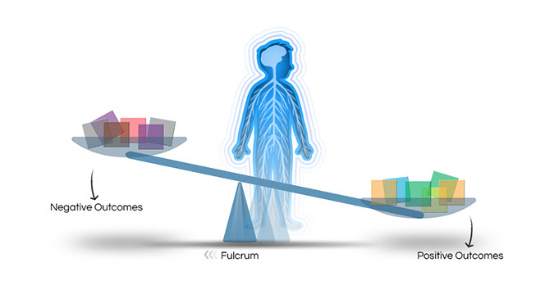
Risk and Resilience Framework
Risk Factors: individual, school, peer, family, and community influences that increase the likelihood that a child will experience a social or health problem
Protective Factors: influences, characteristics or conditions that buffer youth from the negative effects of risk and decrease the likelihood of experiencing a social or health problem
Resilience: successful adaption in the presence of risk or adversity
Image from Center on the Developing Child at Harvard University, nd
Notes:
This slide shows a figure developed by the Center on the Developing Child at Harvard University to depict the association between risk factors, protective factors, and resilience – and how they interact with one another to influence children’s development.
The red and purple blocks on the left side of the scale depict risk factors, which include conditions that decrease the likelihood of a positive outcome. The presence of a risk factor does not ensure or guarantee that a specific outcome is inevitable – it merely increases the chance or probability that a problem will develop.
The orange, yellow, green, and blue blocks on the right side of the scale depict protective factors, which include conditions that buffer youth from the negative effects of risk and increase the likelihood of positive, healthy development (e.g., decreased problem behaviors).
In this figure, resilience, is depicted as a fulcrum that can move to the left or right – increasing or decreasing the likelihood that risk or protective factors with have a stronger influence on children’s development. It is important to note that resilience is NOT a single factor, but instead the outcome of a process that considers both the level of risk exposure and the presence of protective factors.
These concepts are described further in this two-minute video called InBrief: The Science of Resilience from the Center on the Developing Child at Harvard University. https://www.youtube.com/watch?v=1r8hj72bfGo&feature=emb_rel_pause
Image Credit: Center on the Developing Child at Harvard University
Citation: Center on the Developing Child at Harvard University. (nd). Resilience. https://developingchild.harvard.edu/science/key-concepts/resilience/
Ellis, B. J., Bianchi, J., Griskevicius, V., & Frankenhuis, W. E. (2017). Beyond risk and protective factors: An adaptation-based approach to resilience. Perspectives on Psychological Science, 12(4), 561–587. https://doi.org/10.1177/1745691617693054

Slide 20
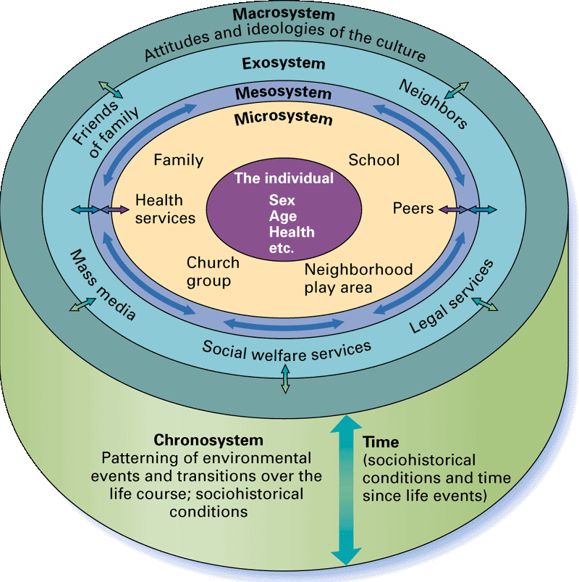
Ecological Theory
An individual’s development is affected by interactions between characteristics of the self and conditions in their environment.
Image from Santrock, J.W. (2007). Child development: An introduction (11th ed.). Princeton, NJ: McGraw Hill.
Notes:
Ecological theory explains how individual’s development is affected by interactions between characteristics of the self and conditions in his/her environment. Environmental conditions are the contexts in which the individual develops – layers of the family, peer, school, community.
For example, a child who is referred to the juvenile justice system is also a child who lives within some type of family unit, attends a local school, and has a network of peers.
Image Credit: Santrock, J.W. (2007). Child development: An introduction (11th ed.). Princeton, NJ: McGraw Hill.
Citation: Bronfenbrenner, U., & Ceci, S. J. (1994). Nature-nuture reconceptualized in developmental perspective: A bioecological model. Psychological Review, 101(4), 568–586. https://doi.org/10.1037/0033-295X.101.4.568
Radua, J., Ramella-Cravaro, V., Ioannidis, J., Reichenberg, A., Phiphopthatsanee, N., Amir, T., Yenn Thoo, H., Oliver, D., Davies, C., Morgan, C., McGuire, P., Murray, R. M., & Fusar- Poli, P. (2018). What causes psychosis? An umbrella review of risk and protective factors. World Psychiatry, 17(1), 49-66. https://doi.org/10.1002/wps.20490

Slide 21
Policies at all levels – institutional, local, state, and federal – can impact other levels of the ecological model
Ecological Theory
Identify prevalence of problem & key risk and protective factors across development
Policy Responses
Design policies to reduce risk, increase protection, and foster resilience
Interventions
Implement research- based programs and services for youth and families
Social policies are most likely to be effective when they address the multiple influences that lead to and may sustain problem behavior for young people.
Williford, 2019
Notes:
Policies at all levels – community, state, and national – can impact the other levels of the ecological model
Regardless of the policy domain - child welfare, mental health, juvenile justice, etc. – a risk and resilience framework helps to:
Identify prevalence of problem
Identify risk and protective factors related to that problem; and specifies their influence across development
Informs how to design policies to reduce risk, increase protection, and foster resilience
Identify specific research-based programs that target these risk/protective processes
Social policies are most likely to be effective when they address the myriad of influences that lead to and may sustain problem behavior for young people.
Citation: Williford, A. (2019). Prevention training module 3: Policy prevention practice. The Coalition for the Promotion of Behavioral Health. https://static1.squarespace.com/static/5ad22921372b96bedc6b7d88/t/5fe3cd4b6174a079dac8c78c/1608764748433/Prevention+Training+Module+4+Policy+FINAL.pdf

Slide 22
To be maximally effective, policies and programs should…
Support
Support responsive relationships for children and adults.
Strengthen
Strengthen core life skills in children and adults.
Reduce
Reduce sources of stress in the lives of children and families.
Center on the Developing Child at Harvard University (2021)
Notes:
To be maximally effective, policies & programs should:
1) Support responsive relationships for children & adults: For children, responsive relationships with adults have a double benefit, both promoting healthy brain development and providing the buffering protection needed to prevent very challenging experiences from producing a toxic stress response. https://developingchild.harvard.edu/resources/three-early-childhood-development-principles-improve-child-family-outcomes/
2) Strengthen core life skills: We all need a set of essential skills to manage life, work, and relationships successfully. These core capabilities (executive function and self regulation) support our ability to focus, plan for and achieve goals, adapt to changing situations, and resist impulsive behaviors. No one is born with these skills; they are developed over time through coaching and practice
3) Reduce sources of stress in the lives of children and families: Reducing the pile-up of potential sources of stress will protect children directly (i.e., their stress response is triggered less frequently and powerfully) and indirectly (i.e., the adults they depend upon are better able to protect and support them, thereby preventing lasting harm).
These three principles can guide decisionmakers as they choose among policy alternatives, design new approaches, and shift existing practice in ways that will best support building healthy brains and bodies. They point to a set of key questions: What are current policies, systems, or practices doing to address each principle? What could be done to address them better? What barriers prevent addressing them more effectively?
Citation: Center on the Developing Child at Harvard University (2021). Three Principles to Improve Outcomes for Children and Families, 2021 Update. http://www.developingchild.harvard.edu

Slide 23
Risk and Protective Factors: Example 1
What are some risk and protective factors for early engagement in adolescent substance use?
 | Risk Factors | Protective Factors
Individual-level | Adverse childhood experiences (ACEs) | Positive social skills
Family-level | Lack of supervision Family conflict | Strong attachment
School-level | Bullying Perceived physical safety | Pro-social peer group Achievement recognition
Community-level | Perceived availability of substances Economic disadvantage | Opportunities to get involved in positive ways in the community
Adapted from National Research Council and Institute of Medicine, 2009
Notes:
Here are some examples of risk and protective factors specifically for early engagement in adolescent substance use. These factors can be present at the individual, family, school and/or community levels.
Examples of individual-level risk factors include adverse childhood experiences (ACEs), while a protective factor may be having good social skills.
Family-level risk factors include lack of supervision or family conflict, and a family-level protective factors is strong attachment to your family.
School-level risk and protective factors include being bullied at school as well as perceived physical safety, and protective factors include pro-social peer groups, and achievement recognition.
Lastly, an example of a community-level risk factor is availability of substances or economic disadvantage, and a protective factor may be opportunities to get involved in positive ways in the community.
What are some other risk and protective factors you can think of for early engagement in adolescent substance use?
Citation: Adapted from National Research Council and Institute of Medicine. (2009). Preventing Mental, Emotional, and Behavioral Disorders Among Young People: Progress and Possibilities. Committee on Prevention of Mental Disorders and Substance Abuse Among Children, Youth and Young Adults: Research Advances and Promising Interventions. M. E. O’Connell, T. Boat, and K. E. Warner (Eds.). Board on Children, Youth, and Families, Division of Behavioral and Social Sciences and Education. The National Academies Press.
Stone, A. L., Becker, L. G., Huber, A. M., & Catalano, R. F. (2012). Review of risk and protective factors of substance use and problem use in emerging adulthood. Addictive Behaviors, 37(7), 747-775. https://doi.org/10.1016/j.addbeh.2012.02.014

Slide 24
Risk and Protective Factors: Example 2
What are some risk and protective factors for intimate partner violence (IPV) among older adults?
 | Risk Factors | Protective Factors
Individual-level | Unemployment Gender (females) | Self-esteem Help-seeking behavior
Family/Peer-level | Intergenerational conflicts or violence | Social support
Community-level | Isolation from community (rural areas) | Access to IPV services and resources
Adapted from Gerino et al. 2018
Notes:
Here is another case of some examples of risk and protective factors specifically for intimate partner violence among older adults. These factors can be present at the individual, family, and community levels.
Examples of individual-level risk factors include unemployment and gender (i.e., females at higher risk), while a protective factor may be having high self-esteem and using help-seeking behaviors.
Family-level or peer-level risk factors include a history of intergenerational conflicts or violence, and a family-level protective factor is having a lot of social support from friends and family.
Lastly, an example of a community-level risk factor is isolation from the community (i.e., living in a rural area), and a protective factor may be access to services and resources that support IPV survivors.
What are some other risk and protective factors you can think of for intimate partner violence among older adults or a different demographic?
Citation: Gerino, E., Caldarera, A. M., Curti, L., Brustia, P., & Rollè, L. (2018). Intimate partner violence in the golden age: Systematic review of risk and protective factors. Frontiers in psychology, 9, 1595.

Slide 25
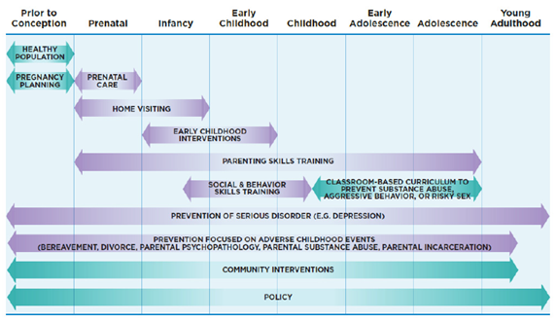
Different outcomes span different life stages.
Image from National Academies of Sciences, Engineering, and Medicine et al., 2019
Notes:
As was described earlier, prevention science uses a developmental epidemiological perspective – and therefore thinking developmentally is key.
This figure helps show how different types of preventive interventions are more relevant at different developmental stages – depending on the settings and individuals that are most relevant at these different stages. For example, home visiting programs are most relevant during the prenatal and infancy stages – when most children are not yet in childcare settings.
This figure also helps show that preventive interventions targeting some outcomes are more relevant during specific developmental stages, whereas others are relevant across the lifespan.
In general, it’s important to acknowledge that different outcome areas span different parts of the life course.
Image Credit: National Academies of Sciences, Engineering, and Medicine et al., 2019
Citation: National Academies of Sciences, Engineering, and Medicine. (2019). Fostering Healthy Mental, Emotional, and Behavioral Development in Children and Youth: A National Agenda. Washington, DC: The National Academies Press. https://doi.org/10.17226/25201.

Slide 26
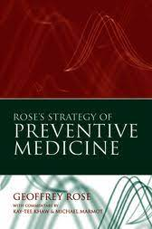
The Prevention Paradox
Rose’s Theorem: A large number of people exposed to a small risk may generate many more cases than a small number exposed to a high risk (Rose, 1992, pg. 24).
Prevention Paradox in the context of high school binge drinking.
Cover art from Rose, 2008
Notes:
Another important concept related to risk and protective factors is referred to as the prevention paradox. This paradox is based on the concept proposed by Dr. Geoffrey Rose, a pioneering epidemiologist that primarily studied chronic disease prevention. Based on his work, he proposed that a large number of people exposed to a small risk may generate many more cases than a small number exposed to a high risk.
In this video, you’ll hear Dr. David Hawkins, a prevention scientist from the Center for Communities that Care, explain the paradox in the context of high school binge drinking.
https://www.youtube.com/watch?v=qg-Qk4agpyk (4:17)
Citation: Rose, G. (1992). The strategy of preventive medicine. Oxford University Press.

Slide 27
Knowledge Check!
1. Protective factors ________ the likelihood of experiencing a social or health problem.
2. Which of the following may be a risk factor for homelessness?
3. According to the CDC, the method used to find the causes of health outcomes and diseases in populations is known as…
4. Prevention Science uses a developmental epidemiological perspective and therefore acknowledges that different outcome areas span different parts of the life course.
  Increase
  Decrease
  Loss of employment
  Strong ties to the community
  Social support
  Biology
  Public Health
  Epidemiology
  None of the above
  True
  False
Notes:
Here’s a knowledge check on epidemiology. Correct responses are on the next slide.
One option would be to create a copy of this slide and place it at the beginning of the section to prompt students to look or listen for these answers.

Slide 28
Knowledge Check! Responses
1. Protective factors ________ the likelihood of experiencing a social or health problem.
2. Which of the following may be a risk factor for homelessness?
3. According to the CDC, the method used to find the causes of health outcomes and diseases in populations is known as…
4. Prevention Science uses a developmental epidemiological perspective and therefore acknowledges that different outcome areas span different parts of the life course.
  Increase
  Decrease
  Loss of employment
  Strong ties to the community
  Social support
  Biology
  Public Health
  Epidemiology
  None of the above
  True
  False

Slide 29

Prevention Lesson Package:
Understanding and Assessing Risk and Protective Factors
Notes:
This lesson package contains readings, resources, and activities that will help students remember and understand… What is epidemiology? What are risk and protective factors? What are some examples? And apply and synthesize this information.

Slide 30
Activity 1: Youth Risk Behavior Surveillance System (YRBSS)
Access the Youth Risk Behavior Surveillance System (YRBSS) and read the Overview. Access the full report and report supplements here.
Choose a state and answer the following questions:
  How do the state estimates compare to the country as a whole?
  How would you use this information to inform your prevention efforts?
Notes:
*remove if not using the associated lesson package activity 1
This activity helps students identify trends in risk and protective factor data, as well as identify which areas are most prominent in a state. This can be done independently or in small groups and may be tailored in many ways. For example, looking at a specific health risk behavior across a region, or examining differences in trends between sex or race. You may also conduct this activity with another data source such as Monitoring the Future or School Health Profiles.
For this activity students will use the Youth Risk Behavior Surveillance System reports.
Explain the YRBS.
Please note that some states such as Washington, do not participate in the YRBS. Instead, states may have their own version of a youth survey.
Have students read through the Overview page. (this may be done prior to class)
Direct students to the full report and report supplements here.
Have students/groups choose a state. Ask students to look at different risk and protective factors examined by the YRBS.
Using the report students will answer - How do the state estimates compare to the country as a whole? How would you use this information to inform your prevention efforts?
At the end of the activity, have students think about how this relates back to their own area of research or their population of interest.
Access the Lesson Package here.

Slide 31
Activity 2: Identifying Community Risk & Protective Factors
Explore Chapter 3 on Assessing Community Needs and Resources, as well as the corresponding Toolkit.
In your small groups, review the scenario. Using your assigned method, discuss with your group:
  How would you employ this method in the community?
  What would you ask?
  What answers would you expect to get from asking such questions?
  What information would you use to support that your method of assessing community risk factors is better than others?
Notes:
*remove if not using the associated lesson package activity 2
This activity explores different applications and assessment of community risk and protective factors. Students will use information from the University of Kansas Community Tool Box to demonstrate how they would assess community risk and protective factors. Students will also gain an understanding of why there is no-one-size-fits-all method in assessing risk and protective factor data.
Explain the University of Kansas Community Tool Box.
Explore Chapter 3 on Assessing Community Needs and Resources, as well as the corresponding Toolkit.
Have students get into small groups and assign each group a method discussed in the chapter (e.g., surveys, interviews, focus groups).
Give each group a community-based scenario. For example… your groups are being brought in as experts in their assigned methodology to determine what risk factors are of most importance to community members.
Have groups discuss how they would employ this method in a community to address the scenario. What would you ask? What answers would you expect to get from asking such questions? What information would you use to support that your method of assessing community risk factors is better than others?
Have each group share with the class what they discussed.
At the end of the activity, have students think about how this relates back to their own area of research or their population of interest.
Access the Lesson Package here.

Slide 32
References
Bronfenbrenner, U., & Ceci, S. J. (1994). Nature-nuture reconceptualized in developmental perspective: A bioecological model. Psychological Review, 101(4), 568 –586. https://doi.org/10.1037/0033-295X.101.4.568
Center on the Developing Child at Harvard University (2021). Three Principles to Improve Outcomes for Children and Families, 2021 Update. http://www.developingchild.harvard.edu
Center on the Developing Child at Harvard University. (nd). Resilience. https://developingchild.harvard.edu/science/key-concepts/resilience/
Centers for Disease Control and Prevention. (2016). What is epidemiology? https://www.cdc.gov/careerpaths/k12teacherroadmap/epidemiology.html
Ellis, B. J., Bianchi, J., Griskevicius, V., & Frankenhuis, W. E. (2017). Beyond risk and protective factors: An adaptation-based approach to resilience. Perspectives on Psychological Science, 12(4), 561–587. https://doi.org/10.1177/1745691617693054
Gerino, E., Caldarera, A. M., Curti, L., Brustia, P., & Rollè, L. (2018). Intimate partner violence in the golden age: Systematic review of risk and protective factors. Frontiers in psychology, 9, 1595.
National Academies of Sciences, Engineering, and Medicine. (2019). Fostering Healthy Mental, Emotional, and Behavioral Development in Children and Youth: A National Agenda. Washington, DC: The National Academies Press. https://doi.org/10.17226/25201.
National Research Council and Institute of Medicine. (2009). Preventing Mental, Emotional, and Behavioral Disorders Among Young People: Progress and Possibilities. Committee on Prevention of Mental Disorders and Substance Abuse Among Children, Youth and Young Adults: Research Advances and Promising Interventions. M. E. O’Connell, T. Boat, and K. E. Warner (Eds.). Board on Children, Youth, and Families, Division of Behavioral and Social Sciences and Education. The National Academies Press.
Radua, J., Ramella-Cravaro, V., Ioannidis, J., Reichenberg, A., Phiphopthatsanee, N., Amir, T., Yenn Thoo, H., Oliver, D., Davies, C., Morgan, C., McGuire, P., Murray, R. M., & Fusar- Poli, P. (2018). What causes psychosis? An umbrella review of risk and protective factors. World Psychiatry, 17(1), 49-66. https://doi.org/10.1002/wps.20490
Rose, G. (1992). The strategy of preventive medicine. Oxford University Press.
Stone, A. L., Becker, L. G., Huber, A. M., & Catalano, R. F. (2012). Review of risk and protective factors of substance use and problem use in emerging adulthood. Addictive Behaviors, 37(7), 747-775. https://doi.org/10.1016/j.addbeh.2012.02.014
Williford, A. (2019). Prevention training module 3: Policy prevention practice. The Coalition for the Promotion of Behavioral Health. https://static1.squarespace.com/static/5ad22921372b96bedc6b7d88/t/5fe3cd4b6174a079dac8c78c/1608764748433/Prevention+Training+Module+4+Policy+FI NAL.pdf

Slide 33
Evidence-Based Programs and Practices
Notes:
This section provides an overview of evidence-based programs and practices.

Slide 34
What are Evidence-based Programs and Practices?
Evidence-based programs are programs/interventions that have been rigorously tested in research (such as controlled trials), proven effective in achieving meaningful improvements in health and wellness or reductions in disease or related problems, and translated into practical models that are widely available to community-based organizations (Evidence-Based Leadership Collaborative, n.d.; Gottfredson et al., 2015).
Evidence-based practices “are skills, techniques, and strategies that can be used when a practitioner is interacting directly with a customer (Fixsen et al., 2005, p 26).”
Notes:
What are evidence-based programs and practices?
There is no universal definition for evidence-based programs and practices. However, this slide presents commonly used definitions.
First it is important to distinguish between a program and a practice. A program is a set of predetermined, structured, and coordinated activities. A practice is a type of approach, technique, or strategy (SAMHSA, 2018).
Evidence-based programs are programs/interventions that have been rigorously tested in research (such as controlled trials), proven effective in achieving meaningful improvements in health and wellness or reductions in disease or related problems, and translated into practical models that are widely available to community-based organizations (EBLC, n.d.; Gottfredson et al., 2015).
Evidence-based practices “are skills, techniques, and strategies that can be used when a practitioner is interacting directly with a customer (Fixsen et al., 2005, p 26).”
It is important to note that research-based does not mean evidence-based. Research-based programs and practices have not necessarily been tested for efficacy, for example, have been research in controlled settings.
Citation: Substance Abuse and Mental Health Services Administration. (2018). Selecting best-fit programs and practices: Guidance for substance misuse prevention practitioners. Rockville, MD.
Evidence-Based Leadership Collaborative. (n.d.). Evidence-based programs 101. http://www.eblcprograms.org/docs/pdfs/EBPs_101.pdf
Gottfredson, D. C., Cook, T. D., Gardner, F. E., Gorman-Smith, D., Howe, G. W., Sandler, I. N., & Zafft, K. M. (2015). Standards of evidence for efficacy, effectiveness, and scale-up research in prevention science: Next generation. Prevention science, 16(7), 893-926.
Fixsen, D. L., Naoom, S. F., Blase, K. A., Friedman, R. M. & Wallace, F. (2005). Implementation Research: A Synthesis of the Literature. Tampa, FL: University of South Florida, Louis de la Parte Florida Mental Health Institute, The National Implementation Research Network (FMHI Publication #231).

Slide 35
Identifying the Program That Fits Just Right
#1: Understand Your Community’s Health Needs & Priorities
#3: Assessing Strength of Evidence and Degree of Fit
Choose the evidence-based program or practice that’s right for your community
#2: Find Your Options
Notes:
So how do we identify a program that fits just right? Here is a three-step process that can help you identify a program.

Slide 36
#1: Understand Your Community’s Health Needs & Priorities
Image from SAMHSA 2018
Notes:
To find the best options, the first step is understanding your community’s health needs and priorities.
--
Using data as well as input from community members and key stakeholders, researchers identify priority problems and risk and protective factors (where the community is at), and what the desired outcomes are, to identify a prevention evidence-based program/practice to achieve desired outcomes (where the community wants to go).
This is mapped out by building a logic model which depicts the “explicit rationale for selecting programs and practices” by presenting the relationship between problems, associated risk and protective factors, selected programs and practices, and anticipated short- and long-term outcomes.
A completed logic model should show the path of how a community plans to address a priority problem, for example bullying.
Image Credit: http://bit.ly/samhsaEBPguide
Citation: Substance Abuse and Mental Health Services Administration. (2018). Selecting best-fit programs and practices: Guidance for substance misuse prevention practitioners. Rockville, MD.

Slide 37
#2: Find Your Options
Registry Name | Sponsor/Funder | Focus | Categories
Blueprints for Healthy Youth Development | University of Colorado Boulder/Arnold Ventures (previously funded by Annie E. Casey & OJJDP) | Evidence-based interventions that are effective in reducing antisocial behavior and promoting a health course of youth development and adult maturity | Model Plus, Model, Promising, Non-Certified
Crime Solutions | National Institute of Justice | Justice-related programs and practices (e.g., delinquency prevention) | Effective, Promising, No Effects, Inclusive Evidence
California Evidence-based Clearinghouse | California Department of Social Services’ Office of Child Abuse Prevention | Child welfare practices and programs aiming to improve child safety, increase permanency, increase family and community stability, and promote child and family well-being | Well-supported, Supported, Promising, Fails to Demonstrate Effect, Concerning Practice, Not able to be rated
U.S. Department of Education What Works Clearinghouse | Institute of Education Sciences | Helps education professionals make evidence-based decisions by providing evidence of effectiveness on programs, policies and practices. | Meets WWC standards without reservations, Meets WWC standards with reservations, Does not meet WWC standards
Notes:
Options for evidence-based programs and practices can be found using registries. There are now numerous evidence-based program registries or lists supported and sponsored by federal, state, and private organizations.
These online resources can be a useful place to start, but they can also contain incomplete, out-of-date, contradictory, or missing information about the level of evidence supporting the program and the human and financial resources needed to implement the program.
For additional examples of federal registries visit https://youth.gov/evidence-innovation/evidence-based-program-directories
Citation: Blueprints for Healthy Youth Development. (nd). FAQ. https://www.blueprintsprograms.org/faq/
Buckley, P. R., Fagan, A. A., Pampel, F. C., & Hill, K. G. (2020). Making evidence-based interventions relevant for users: A comparison of requirements for dissemination readiness across program registries. Evaluation Review, 44(1), 51–83. https://doi.org/10.1177/0193841X20933776

Slide 38
#3: Assessing Strength of Evidence and Degree of Fit
Image from SAMHSA 2018
Notes:
After you have explored your options, your next step is to consider fit the strength of the evidence supporting each program you are exploring.
Strength of fit can be established by examining the conceptual fit (degree to which the program/practice is a match for the job that needs to be done), the practical fit (degree to which the program/practice matches the target population), and evidence of the effectiveness (evidence that the program/practice does what it is intended to do)
Repeat these steps until you find the evidence-based program or practice that fits just right for your community.
Image Credit: http://bit.ly/samhsaEBPguide
Citation: Substance Abuse and Mental Health Services Administration. (2018). Selecting best-fit programs and practices: Guidance for substance misuse prevention practitioners. Rockville, MD.
Puddy, R. W. & Wilkins, N. (2011). Understanding Evidence Part 1: Best Available Research Evidence. A Guide to the Continuum of Evidence of Effectiveness. Atlanta, GA: Centers for Disease Control and Prevention. https://www.cdc.gov/violenceprevention/pdf/understanding_evidence-a.pdf

Slide 39
Knowledge Check!
1. During the process of identifying an evidence-based program that fits your community which of the following should you do?
2. Evidence-based programs are skills, techniques, or strategies that can be used when a practitioner is interacting directly with a customer.
3. Online registries are the best starting place for identifying an evidence-based program, however they may also be…
4. Assessing community needs involves examining local data and gathering input from key community stakeholders about priority problems and risk/protective factors.
  Understand your community’s health needs and priorities
  Assess the strength of evidence
  Consider the degree of fit
  All the above
  True
  False
  Incomplete
  Out-of-date
  Contradictory to other evidence of the same program
  All the above
  True
  False
Notes:
Here’s a knowledge check on evidence-based programs and practices. Correct responses are on the next slide.
One option would be to create a copy of this slide and place it at the beginning of the section to prompt students to look or listen for these answers.

Slide 40
Knowledge Check!
1. During the process of identifying an evidence-based program that fits your community which of the following should you do?
2. Evidence-based programs are skills, techniques, or strategies that can be used when a practitioner is interacting directly with a customer.
3. Online registries are the best starting place for identifying an evidence-based program, however they may also be…
4. Assessing community needs involves examining local data and gathering input from key community stakeholders about priority problems and risk/protective factors.
  Understand your community’s health needs and priorities
  Assess the strength of evidence
  Consider the degree of fit
  All the above
  True
  False
  Incomplete
  Out-of-date
  Contradictory to other evidence of the same program
  All the above
  True
  False

Slide 41
Prevention Lesson Package:
Selecting Evidence-based Programs and Practices
Notes:
This lesson package contains readings, resources, and activities that will help students remember and understand… What is an evidence-based program? What are some examples of evidence-based programs? And apply this information.

Slide 42
Activity 1: Selecting Evidence-Based Programs Based
Choose an outcome of interest to you and using the “Find Programs” tab on the Blueprints for Healthy Youth Development website, look at some of the programs that are identified for addressing your outcome.
Select a program and summarize and be prepared to share with the class:
  risk and protective factors the program is addresses;
  main outcomes of the program;
  program background;
  evidence for the program;
  components of the program; and
  who you would recommend this program to and why.
Notes:
*remove if not using the associated lesson package activity 1
This activity helps students select evidence-based programs and practices using Blueprints for Healthy Youth Development. This can be done independently or in small groups and may be tailored in many ways. For example, looking at various combinations of risk and protective factors or comparing programs. You may also conduct this activity with another evidence-based program registry such as U.S. Department of Education What Works Clearinghouse. If students are interested in social policy programs please consider having them use the Results First Clearinghouse Database.
Explain Blueprints for Healthy Youth Development. Have students read through the FAQ page to understand the meaning and utilization of an evidence-based programs registry.
Individually or in a small group, ask students to choose an outcome of interest.
Using the “Find Programs” tab on the website, look at some of the programs that are identified for addressing your factors. Choose one program and read the information provided by the site.
Summarize and be prepared to share with the class 1) risk and protective factors your program is addressing; 2) main outcomes of the program; 3) program background; 4) evidence for the program; 5) components of the program and 6) who you would recommend this program to and why.
At the end of the activity, have students think about how this relates back to their own area of research or their population of interest.
Access the Lesson Package here.

Slide 43
References
Blueprints for Healthy Youth Development. (nd). FAQ. https://www.blueprintsprograms.org/faq/
Buckley, P. R., Fagan, A. A., Pampel, F. C., & Hill, K. G. (2020). Making evidence-based interventions relevant for users: A comparison of requirements for dissemination readiness across program registries. Evaluation Review, 44(1), 51–83. https://doi.org/10.1177/0193841X20933776
Evidence-Based Leadership Collaborative. (n.d.). Evidence-based programs 101. http://www.eblcprograms.org/docs/pdfs/EBPs_101.pdf
Gottfredson, D. C., Cook, T. D., Gardner, F. E., Gorman-Smith, D., Howe, G. W., Sandler, I. N., & Zafft, K. M. (2015). Standards of evidence for efficacy, effectiveness, and scale-up research in prevention science: Next generation. Prevention science, 16(7), 893-926.
Fixsen, D. L., Naoom, S. F., Blase, K. A., Friedman, R. M. & Wallace, F. (2005). Implementation Research: A Synthesis of the Literature. Tampa, FL: University of South Florida, Louis de la Parte Florida Mental Health Institute, The National Implementation Research Network (FMHI Publication #231).
Puddy, R. W. & Wilkins, N. (2011). Understanding Evidence Part 1: Best Available Research Evidence. A Guide to the Continuum of Evidence of Effectiveness. Atlanta, GA: Centers for Disease Control and Prevention. https://www.cdc.gov/violenceprevention/pdf/understanding_evidence-a.pdf
Substance Abuse and Mental Health Services Administration. (2018). Selecting best-fit programs and practices: Guidance for substance misuse prevention practitioners. Rockville, MD.

Slide 44
Implementation
Notes:
This section will talk about how evidence-based programs and practices are implemented and discuss other aspects of implementation.

Slide 45
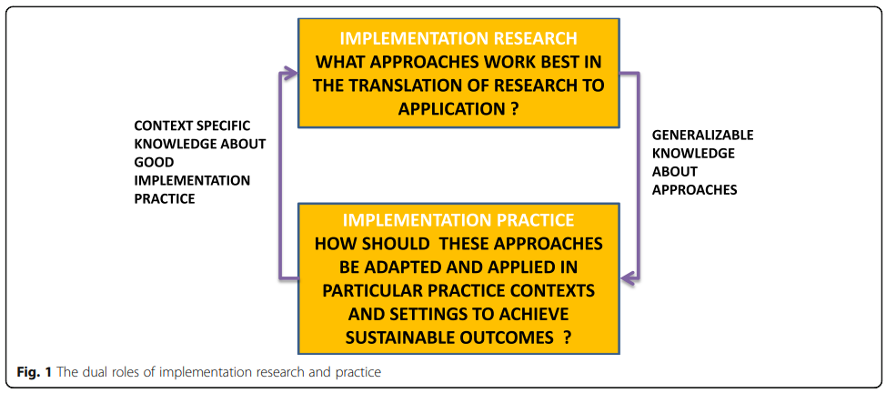
What is Implementation?
Implementation science connects research and practice (Ramaswamy et al., 2019).
Notes:
Implementation science connects research and practice.
Implementation research seeks to understand the processes and strategies that work best to translate research and promote the uptake of evidence-based programs/practices in real world settings.
Implementation practice seeks to promote the uptake of and adapt these approaches in different settings to achieve desired outcomes associated with an evidence-based program/practice.
Research and practice inform one another’s work.
Image Credit: Ramaswamy et al., 2019
Citation: Bauer, M. S., & Kirchner, J. (2020). Implementation science: what is it and why should I care?. Psychiatry Research, 283, 112376. https://doi.org/10.1016/j.psychres.2019.04.025
Bauer, M.S., Damschroder, L., Hagedorn, H., Smith, J., & Kilbourne, A.M. (2015). An introduction to implementation science for the non-specialist. BMC Psychol 3(32). https://doi.org/10.1186/s40359-015-0089-9
Ramaswamy, R., Mosnier, J., Reed, K., Powell, B. J., & Schenck, A. P. (2019). Building capacity for Public Health 3.0: introducing implementation science into an MPH curriculum. Implementation Sci, 14, 18. https://doi.org/10.1186/s13012-019-0866-6

Slide 46
Dimensions of Implementation (Berkel et al., 2011)
Dimension | Definition | Other Labels
Differentiation | Distinctiveness of a program’s theory and practices from other available programs | Program uniqueness
Dosage | Number of program sessions delivered | Quantity Intervention strength
Reach | Extent to which participants being served by the program are representative of the target population | Participation rates Program scope
Monitoring | Documenting what services members of intervention and control groups receive beyond the program being evaluated | Treatment contamination Usual care Alternative services
Fidelity | Whether prescribed program components were delivered as instructed in program protocol | Adherence Compliance Integrity Faithful replication Completeness
Quality | Teaching and clinical skill with which the program is implemented | Competence
Adaptation | Additions made to the program during implementation | Modification Reinvention
Responsiveness | Involvement and interest in the program | Engagement Attendance Retention Satisfaction Home practice completion Dosage
Notes:
Implementation consists of many components or dimensions.
A review of articles discussing program implementation identified eight core dimensions of implementation. This table also identifies other terms that may be used to label each dimension, as terminology may differ across settings.
--
Berkel and colleagues identified four of these dimensions that are most likely to impact outcomes as they occur “within the delivery of program sessions, and as a result, constitute potential sources of disconnect between the program as designed and that which is implemented” (Berkel et al., 2011, p 23). They include: fidelity, quality, adaptation, and responsiveness.
Image Credit: Berkel et al., 2011
Citation: Berkel, C., Mauricio, A. M., Schoenfelder, E., & Sandler, I. N. (2011). Putting the pieces together: An integrated model of program implementation. Prevention Science, 12(1), 23-33.

Slide 47
Model of Program Implementation
High Fidelity
Positive Participant Outcomes
High Quality of Delivery
Positive Participant Engagement & Responsiveness
Adaptation Best Practices
Modified from Berkel et al., (2011)
Integrated Model of Program Implementation
Notes:
These four implementation dimensions make up the integrated model of program implementation.
So, when a community chooses an evidence-based program…
--
There needs to be high fidelity. Fidelity is the degree to which a program is delivered as designed and adheres to the program’s model of behavioral change (delivery of all core components, prescribed dosage).
--
Plus, high quality of delivery which is how well the program’s material and activities are conveyed to the participants (e.g., facilitator enthusiasm).
--
Plus, necessary adaptations or any changes to the dimensions that are required to meet the needs of the specific implementation context. It is important that these adaptations, which can include additions, deletions, or modifications to program content and delivery approaches do not alter the core components of the program.
--
If these are achieved, it should increase positive participant responsiveness or the extent to which participants are engaged with the program’s activities and materials (attendance).
--
And then, altogether this should lead to positive participant outcomes.
Citation: Berkel, C., Mauricio, A. M., Schoenfelder, E., & Sandler, I. N. (2011). Putting the pieces together: An integrated model of program implementation. Prevention Science, 12(1), 23-33.

Slide 48
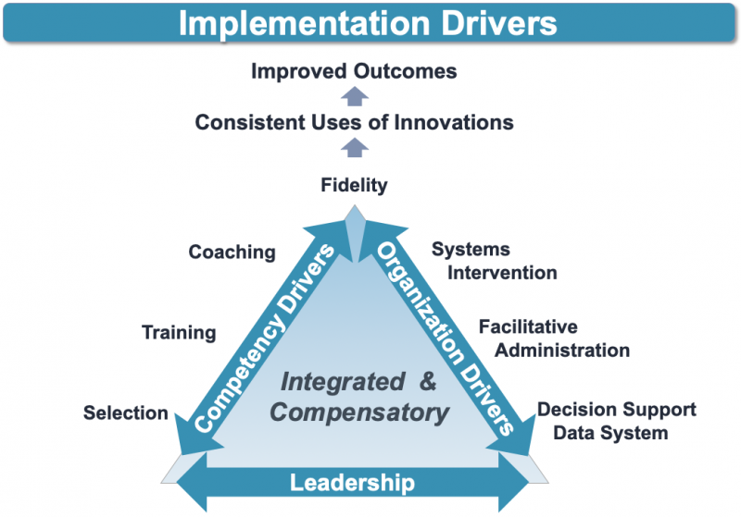
Implementation Drivers
Notes:
Another perspective on implementation is presented by the National Implementation Research Network (NIRN), which has identified implementation drivers that help ensure high fidelity and facilitate the success of program implementation.
There are three types of implementation drivers – 1) competency drivers (which include selection, training, and coaching), 2) organization drivers (which include decision support data system, facilitative administration, and systems intervention), and 3) at the base of this is leadership drivers which include both technical (e.g., resolving procedural problems) and adaptive (e.g., addressing uncertain problems and solutions) strategies.
Implementation drivers should be integrated and compensatory – and represent core aspects of the capacity needed to facilitate sustained use of an intervention and thus, improved participant outcomes.
For more information on the implementation drivers, see the NIRN Handout 12: Implementation Drivers - https://nirn.fpg.unc.edu/resources/handout-12-implementation-drivers
Image Credit: Betram et al., 2015
Citation: Bertram, R. M., Blase, K. A., & Fixsen, D. L. (2015). Improving programs and outcomes: Implementation frameworks and organization change. Research on Social Work Practice, 25(4), 477-487.
Bopp, M., Saunders, R.P., & Lattimore, D. (2013). The tug-of-war: Fidelity versus adaptation throughout the health promotion program life cycle. Journal of Primary Prevention, 34, 193–207. https://doi.org/10.1007/s10935-013-0299-y
National Implementation Research Network. (n.d.). Framework 3: Implementation drivers. Active Implementation Hub. https://nirn.fpg.unc.edu/module-1/implementation-drivers

Slide 49
Implementation Stages (Bertram et al., 2015)
Exploration
Installation
Initial Implementation
Full Implementation
Monitor, manage implementation drivers
Assess needs
Examine intervention components
Consider implementation drivers
Assess fit
Acquire resources
Prepare organization
Prepare implementation drivers
Prepare staff
Adjust implementation drivers
Manage change
Deploy data systems
Initiate improvement cycles
Achieve fidelity and outcome benchmarks
Further improve fidelity and outcomes
2-4 Years
Notes:
Implementation takes place across four stages which can span 2 to 4 years.
--
Stage one is exploration. The tasks of this stage are centered around determining if a program is needed based on an evaluation of community needs. Focus is placed on assessing the needs of the community (i.e., resources, population characteristics) to make sure these needs match the components of the selected evidence-based program while also considering possible challenges to implementation. During this stage implementation drivers are also considered. Program fit is also assessed.
--
Stage two is installation. This stage helps prepare the facilitating organization for participants. During this stage resources that are needed to implement are acquired and the facilitators (e.g., organization, staff) are prepared, for example they receive training on the program, as well as the implementation drivers.
--
Stage three is initial implementation. During this stage the organization begins to deliver the program to participants. Facilitators begin to try out the skills and practices, and data-informed adjustments are made to improve processes. It’s important that challenges are normalized during this stage.
--
Stage four is full implementation. Full implementation is when the program is well-integrated with high fidelity.
For more information on the implementation stages, see the NIRN resources for Module 4: Stages - https://nirn.fpg.unc.edu/ai-hub/resources?f[0]=field_module%3A78
Citation: Bertram, R. M., Blase, K. A., & Fixsen, D. L. (2015). Improving programs and outcomes: Implementation frameworks and organization change. Research on Social Work Practice, 25(4), 477-487.
National Implementation Research Network. (n.d.). What are implementation stages. Active Implementation Hub. https://nirn.fpg.unc.edu/module-4/topic-1-implementation-stages-overview/what-are-stages

Slide 50
Knowledge Check!
1. What is the science of connecting research to practice?
2. Which of the following is not a dimension of implementation?
3. Fidelity is the degree to which a program is delivered as designed and adheres to the program’s model of behavioral change.
3. During which implementation stage are tasks centered around determining if a program is needed based on an evaluation of community needs?
  Epidemiology
  Program Development
  Prevention Science
  Implementation Science
  Fidelity
  Effectiveness
  Dosage
  Responsiveness
  True
  False
  Exploration
  Installation
  Initial Implementation
  Full Implementation
Notes:
Here’s a knowledge check on implementation science. Correct responses are on the next slide.
One option would be to create a copy of this slide and place it at the beginning of the section to prompt students to look or listen for these answers.

Slide 51
Knowledge Check! Responses
1. What is the science of connecting research to practice?
2. Which of the following is not a dimension of implementation?
3. Fidelity is the degree to which a program is delivered as designed and adheres to the program’s model of behavioral change.
3. During which implementation stage are tasks centered around determining if a program is needed based on an evaluation of community needs?
  Epidemiology
  Program Development
  Prevention Science
  Implementation Science
  Fidelity
  Effectiveness
  Dosage
  Responsiveness
  True
  False
  Exploration
  Installation
  Initial Implementation
  Full Implementation

Slide 52
Prevention Lesson Package:
Implementation of Evidence-Based Programs
Notes:
This lesson package contains readings, resources, and activities that will help students remember and understand… What is implementation science? What is fidelity and quality of delivery and why are they important to program implementation? And apply and analyze this information.

Slide 53
Activity 1: Reviewing Evidence-based Program Implementation
Using the Crime Solutions registry, either individually or in small groups, have students choose an evidence-based program and investigate how the program is implemented. Encourage students to use outside resources such as program websites or peer-reviewed articles.
Have students think of answers to the following questions and share them with the class:
  What are the barriers to implementation of this evidence-based program or practice? How can this be overcome?
  What (or do any) supports exist in the program to achieve implementation? Sustainability?
  How would you cope with these barriers as the organization trying to implement this program?
Notes:
*remove if not using the associated lesson package activity 1
This activity teaches students how to apply their knowledge of implementation. Implementation is multidimensional and therefore there are many possible barriers and facilitators to implementing evidence-based programs.
1. Have students select an evidence-based program using the Crime Solutions registry. Students will investigate how the program is implemented. Encourage students to use outside resources such as program websites or peer-reviewed articles.
2. Using knowledge learned in the slide deck and through supplemental materials, students will answer the following questions and share them with the class:
What are the barriers to implementation of this evidence-based program or practice? How can this be overcome?
What (or do any) supports exist in the program to achieve implementation? Sustainability?
How would you cope with these barriers as the organization trying to implement this program?
At the end of the activity, have students think about how this relates back to their own area of research or their population of interest.
Access the Lesson Package here.

Slide 54
Activity 2: CDC Select, Adapt, Evaluate
Independently, have students read and work through the activities on the CDC’s VetoViolence website – Select, Adapt, Evaluate.
As a class work through the two case examples at the end of the module.
  Separate the class into two points of view – one representing “red light” and one representing “green light.”
  Read the example scenario. Have each group discuss why it would be a red light or green light adaptation, from the group’s assigned point of view.
  Reveal the answer and facilitate a discussion based on the groups’ responses and the given answer.
Notes:
*remove if not using the associated lesson package activity 2
This activity teaches students how to apply their knowledge of implementation. Implementation is multidimensional and therefore there are many possible barriers and facilitators to implementing evidence-based programs.
1. Independently, have students read and work through the activities on the CDC’s VetoViolence website – Select, Adapt, Evaluate.
2. As a class work through the two case examples at the end of the module.
Separate the class into two points of view – one representing “red light” and one representing “green light.”
Read the example scenario. Have each group discuss why it would be a red light or green light adaptation, from the group’s assigned point of view.
Reveal the answer and facilitate a discussion based on the groups’ responses and the given answer.
At the end of the activity, have students think about how this relates back to their own area of research or their population of interest.
Access the Lesson Package here.

Slide 55
References
Bauer, M. S., & Kirchner, J. (2020). Implementation science: What is it and why should I care?. Psychiatry Research, 283, 112376. https://doi.org/10.1016/j.psychres.2019.04.025
Bauer, M.S., Damschroder, L., Hagedorn, H., Smith, J., & Kilbourne, A.M. (2015). An introduction to implementation science for the non-specialist. BMC Psychol 3(32). https://doi.org/10.1186/s40359-015-0089-9
Berkel, C., Mauricio, A. M., Schoenfelder, E., & Sandler, I. N. (2011). Putting the pieces together: An integrated model of program implementation. Prevention Science, 12(1), 23-33.
Bertram, R. M., Blase, K. A., & Fixsen, D. L. (2015). Improving programs and outcomes: Implementation frameworks and organization change. Research on Social Work Practice, 25(4), 477-487.
Bopp, M., Saunders, R.P., & Lattimore, D. (2013). The tug-of-war: Fidelity versus adaptation throughout the health promotion program life cycle. Journal of Primary Prevention, 34, 193–207. https://doi.org/10.1007/s10935-013-0299-y
National Implementation Research Network. (n.d.). Framework 3: Implementation drivers. Active Implementation Hub. https://nirn.fpg.unc.edu/module-1/implementation-drivers
National Implementation Research Network. (n.d.). What are implementation stages. Active Implementation Hub. https://nirn.fpg.unc.edu/module-4/topic-1-implementation-stages-overview/what-are-stages

Slide 56

Interested in learning more about prevention science?
Society for Prevention Research
  Prevention Science Journal
Prevention Science Technology Transfer Center Network
Applied Prevention Science International
Society for Prevention Research Standards of Knowledge
Notes:
Society for Prevention Research - https://www.preventionresearch.org/
Prevention Science journal - https://www.springer.com/journal/11121?gclid=Cj0KCQjwktKFBhCkARIsAJeDT0jaF-_LGNBoR0usKFaayTWbztQ8d2kb1XUZHWobXQmeyD7p7QFqbmMaAlI5EALw_wcB
Prevention Science Technology Transfer Center Network - https://pttcnetwork.org/
Applied Prevention Science International - https://www.apsintl.org/
Society for Prevention Research Standards of Knowledge - https://www.preventionresearch.org/advocacy/standards-of-knowledge/

Slide 57



References
= Open source
= PDF download available
= website or online PDF

Slide 58
References
= Open source
= PDF download available
= website or online PDF

Slide 59
References
= Open source
= PDF download available
= website or online PDF

Slide 60
References
= Open source
= PDF download available
= website or online PDF

