Slide 1

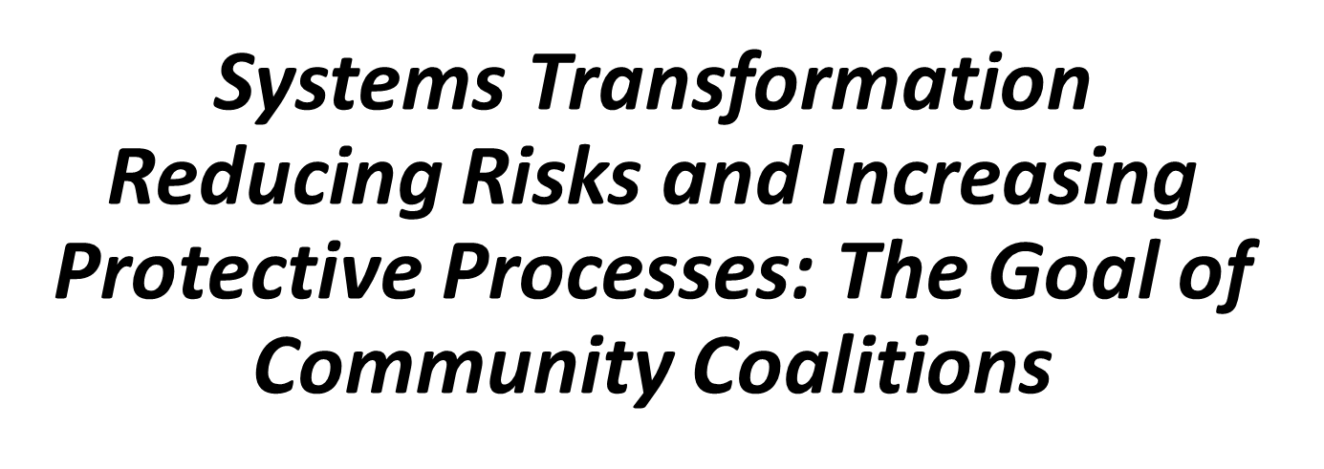
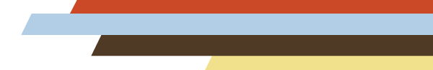
PTTC Coffee Chat
May 23, 2023
Zili Sloboda
Applied Prevention Science International

Slide 2

This Webinar is Now Live
This webinar is being recorded and will be available for future viewing along with a copy of today’s slides.
Notes:
Carissa (reads from slide)

Slide 3

Technical Information
This webinar is being recorded and archived and will be available to all webinar participants.
This training was developed under the Substance Abuse and Mental Health Services Administration’s Prevention Technology Transfer Center task order.
Reference # 1H79SP081018.
For training use only.
Notes:
Carissa
This webinar is being recorded and archived and will be available to all webinar participants.
This training was developed under SAMHSA’s PTTC task order and is for training use only.

Slide 4

Chat and Q&A
Please use the chat feature for comments or questions. We welcome your thoughts and hope for a rich conversation in the chat.
You may also type questions for our presenters at any time during the presentation in the Q & A feature
Notes:
Carissa (reads slide)

Slide 5
Developmental Nature of Substance Use

Slide 6
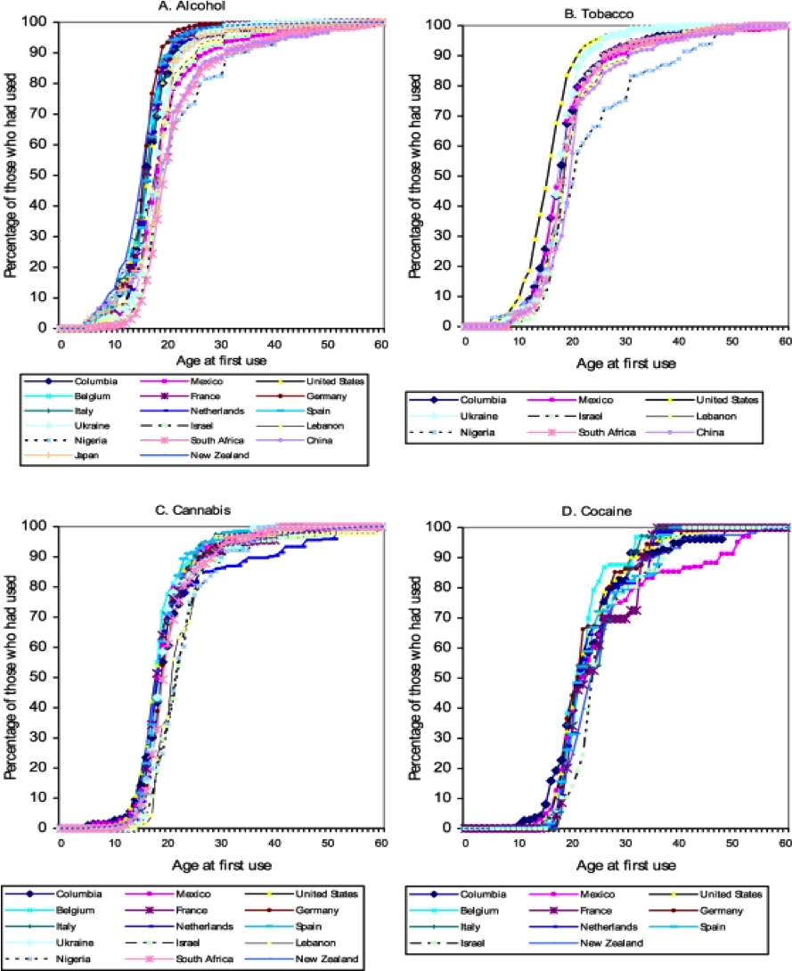
Substance Use Starts with the Young
Source: Degenhardt et al., 2008

Slide 7
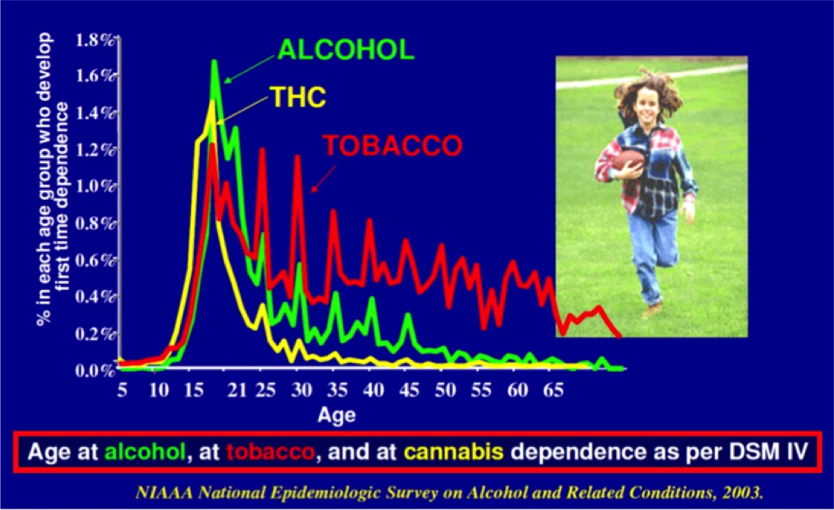
Developmental Nature of
Substance Use

Slide 8
Developmental Phases
(1/2)
Each stage of development, from infancy to early adulthood, is associated with the growth of the following as a person matures:
  Intellectual ability
  Language development
  Cognitive, emotional, and psychological functioning
  Social competency skills
UNODC, International Standards, 2015.

Slide 9
Developmental Phases
(2/2)
Any major disruption of this growth will make a person more vulnerable to problem behaviors such as substance use

Slide 10
Vulnerability to Substance Use and Progression to Addiction

Slide 11
Etiology of Substance Use
The term “etiology" has been defined as “… the science that deals with the causes or origin of disease, the factors which produce or predispose toward a certain disease or disorder”
(Source: Merriam-Webster Dictionary)

Slide 12
Etiologic Studies
Determinants of or factors involved in substance use initiation
  Longitudinal studies of children and adolescents
    General populations
    Children of substance users
Applied Prevention Science International Education Center - 2023

Slide 13
Risk and Protective Factors: Background
(1/3)
Relatively little research was conducted until the 1970s regarding what factors or processes were associated with the onset of substance use
In the mid-1970s, primarily in the United States, several longitudinal studies were conducted that followed cohorts of early adolescents into adulthood that examined factors that were related to substance use initiation

Slide 14
Risk and Protective Factors: Background
(2/3)
In 1992 two significant works summarized this research on factors related not only to the initiation of substance use but also to the progression from use to abuse
Risk factors are defined as measures of behavior or psychosocial functioning (including attitudes, beliefs, and personality) that were found to be associated with increased risk to use psychoactive substances
  Contextual factors
  Individual and interpersonal
Hawkins, J. D., Catalano, R. F., & Miller, J. Y. (1992); Glantz, M. D. & Pickens, R. W. (1992).

Slide 15
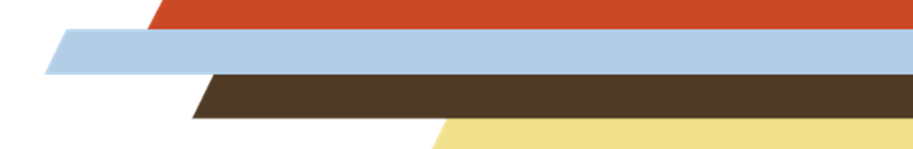
Risk and Protective Factors: Background
(3/3)
Protective factors involve measures that appear to prevent the use of psychoactive substances or reduce the untoward negative effects of risk. Protective factors identified through research include strong bonding to family, school, community and peers that hold prosocial attitudes and support prosocial behaviors.
http://www.sdrg.org/ctcresource/risk_and_protective_factor_scale.pdf

Slide 16
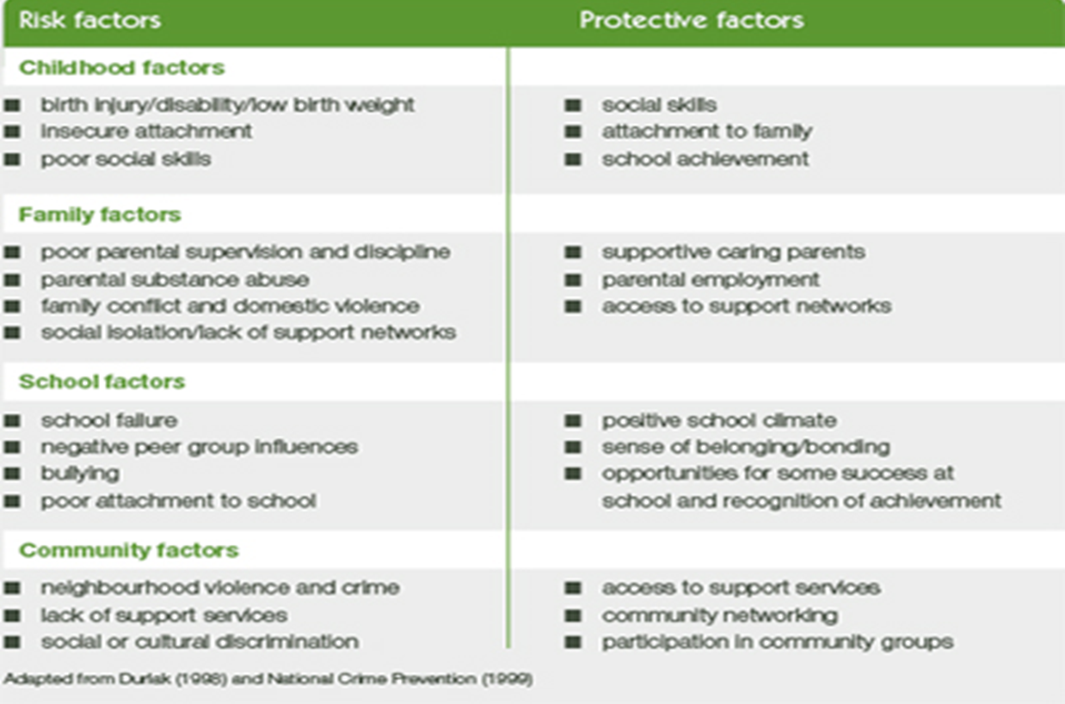
Examples of Risk and Protective Factors
Source: www.community.nsw.gov.au/about
_us/news_and_publications/inside...

Slide 17
Exploding New Research:
Intriguing Directions
(1/2)
Genetics
  Up to 70% of variance associated with diagnosis of substance abuse disorder or dependence is estimated to be inheritable (e.g., Kendler et al, 2003, Kendler et al., 2007; Ducci and Goldman, 2012)
  100% of genetic variance and 80% of phenotypic variance are shared across different substances and other substance use disorders (e.g., Tsuang et al., 2001)
  Other neurological process associated with onset of substance use disorders and other problem behaviors

Slide 18
Exploding New Research:
Intriguing Directions
(2/2)
Neurobiology, Adolescent Brain Development
  Cortex changes and functional reorganization of neural circuitry
    Cognitive functioning (decision making, self-monitoring, abstract thinking, forming goal strategies),
    Behavioral and affective regulation
Psychopathology
Notes:
Of particular importance to prevention work is having a better understanding of brain development that provides more information and further understanding of vulnerability and liability to substance use initiation and progression.

Slide 19
Nature-Environment
Proximal environments
  Parenting
  Positive school climate
Distal environments
  Physical neighborhood of residence,
  Social/normative community
Brody et al., 2018

Slide 20
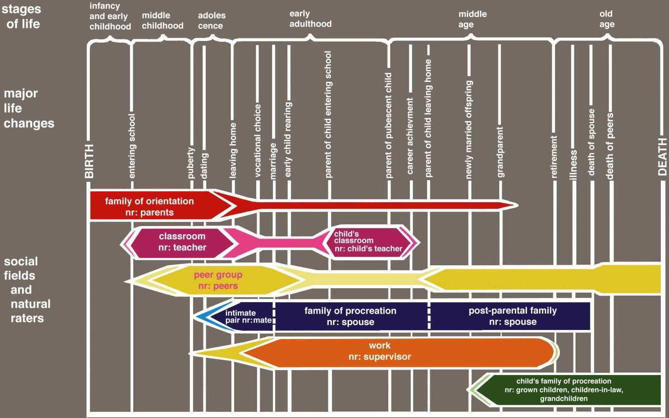
Life Course Social Field Concept
Kellam et al., 1975
Notes:
Let’s look at this issue differently digging deeper into these processes.
This slide depicts the age groups across the top: infancy and early childhood through old age. The vertical white lines represent stages of life, major life events such as birth, entering school, entering puberty, vocational choice, marriage etc.. The micro-level environments or social fields, as Kellam and his group term them, influence the direction of an individual’s life and are shown as horizontal bars across these major events. Those are the bars in different colors.
The width of the colored bars represent the strength of influence. So, we see that the red bar, family or parents have the most influence from birth through puberty and although family or parental influence diminishes over time it remains strong into middle and old age. The other bars depicted here are the school in magenta, peers in yellow, spouse and immediate family in dark blue, workplace in orange, and grandchildren, etc., in green. These fields represent the micro-level influences on how children develop into adults at different periods in their lives.
These influences or influencers are also called socialization agents. It is through these people and settings that surround us that we as human beings learn what is expected of us in our society. These socialization agents guide us by teaching us the spoken and body language of our culture, how to behave in a variety of situations, and how to make important life decisions. This process is called “socialization”.
What does this term mean?

Slide 21
Socialization
Human infants are born without any culture.
Socialization is a process of transferring culturally acceptable attitudes, norms, beliefs and behaviors and to respond to such cues in the appropriate manner.
Since socialization is a lifelong process, the individual will be socialized by a large array of different socializing agents (e.g., parents, teachers, peer groups, religious, economic and political organization and virtual agents, such as mass media).

Slide 22

Family Structure
Parenting Style
Perceived Parental Tolerance of
Negative Behaviors
Socio-Economic Status
Perceived School/Workplace Climate
School Bonding/Stress
Perceived Tolerance of Negative Behaviors
Peer Relationships
Perceived Tolerance of Negative Behaviors
Social Disorganization
Perceived Neighborhood Tolerance of Negative Behaviors
Poverty/Unemployment
Perceptions of Neighborhood (e.g. safety, crime, cleanliness)
Environment
Neighborhood
Family
School
Peers
Workplace
Climate change
Attitudes/Beliefs
Prosocial Attitudes and behaviors
Normative Beliefs
Perceptions of risks/consequences
Vulnerability
Skills
Decision-making skills
Refusal/Avoidance skills
Interpretation of environmental cues
Interpretation of intrapersonal cues
Liability Measure
Interpersonal/Environmental
Family Structure
Isolation
Intrapersonal (e.g.)
Novelty Seeking
Concentration problems
Aggression
Self-Regulation
Prosociality
Temperament
Developmental Markers
Cognitive Skills
Executive Functioning
Language
Learning and Memory
Visuospatial
Social-emotional
Outcomes Behaviors
Academic Attainment
Peer Involvement
Employment Status
Legal Status
Substance Use
Sexual Health Status
TIME
APSI 2020

Slide 23
What Does This Mean For Prevention?
  Prevention needs to intervene early in each developmental phase to prevent the onset of substance use and dependence

Slide 24
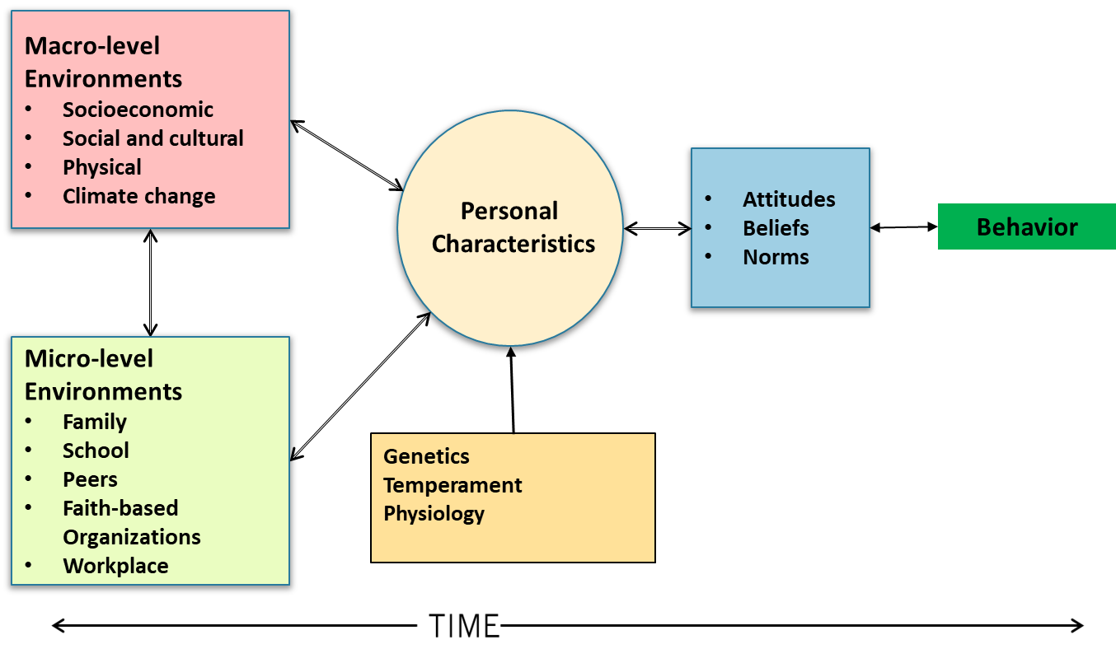
Etiology Model
Sloboda, 2009

Slide 25
Risk is the Interface between Individual Characteristics and the Micro- and Macro-Level Environments
RISK
Micro-Level Environment
Macro-Level Environment
Personal
Characteristics
Copyright APSI
Applied Prevention Science International Education Center - 2020

Slide 26
Protection is the Interface between Individual Characteristics and the Micro- and Macro-Level Environments
PROTECTION
Micro-Level Environment
Macro-Level Environment
Personal
Characteristics
Copyright APSI
Applied Prevention Science International Education Center - 2020

Slide 27
Alcohol Related Outcomes Related to Family Management Style with Children with Behavioral Disinhibition
Hill et al., 2010

Slide 28
Reducing Risk Processes for Positive Developmental Outcomes
(1/2)
Risk processes increase the likelihood of negative outcomes
Effective prevention programs address risk processes before the onset of risky behavior

Slide 29
Reducing Risk Processes for Positive Developmental Outcomes
(2/2)
Risk processes, like substance use itself:
    Vary across age groups
    Have cumulative effects
    Arise from individuals and from family-, school-, and community-level environments

Slide 30
Increasing Protective Processes for Positive Developmental Outcomes
Protective processes those that offset or buffer the impact of existing risks
Protective processes occur at all levels:
  Individual level
  Micro level (family, school, peer)
  Macro (poverty, social and physical environment)
Notes:
In parallel to the last slides, this one better defines protective processes that reduce the vulnerability of individuals. They “protect” the individual from engaging in behaviors that may have negative health outcomes
Protective processes are characteristics that offset or buffer the impact of existing risk processes. In other words, protective processes reduce the vulnerability of youth.
Protective processes occur at
The individual level
The micro level (family, school, peer)
The macro level (poverty, social and physical environment)
Examples of protective processes originating at each level are as follows.
For individuals: Good temperament, self-regulation
For families: Bonding with caregivers
For schools: Prosocial skills, development (e.g., decision-making and problem-solving)
For communities: Quality of education, positive community norms

Slide 31
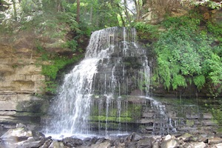
Positive, Cascading Effects Across Developmental Stages
Preventive intervention at one developmental stage can influence later developmental stages in ways that lead to even longer-term effects.
This “cascade effect” helps bring positive outcomes in later adulthood.
Sources: Masten et al., 2005; Spoth et al., 2015.

Slide 32
An Interaction of Personal Characteristics and the Micro- and Macro-Level Environments, Socialization and Points of Intervention
Macro-Level
Environments
Beliefs
Attitudes
Biological/
Personal
Characteristics
Behavior
Intent
Social and Cognitive Competence
Skills
Micro-Level
Environments
= Points of Intervention
Socialization
©Sloboda, 2014

Slide 33
Need for a Multi-Level Multi-Component Developmental Prevention System
(1/4)
There is a complex interplay of individual and environmental factors that make children, youth, and adults vulnerable to substance use and other risky behaviors.
Self
Family
Community
Nation
World

Slide 34
Need for a Multi-Level Multi-Component Developmental Prevention System
(1/3)
Helps ensure that interventions have the broadest and most significant impact.
Organizes risk and protective processes, their interrelationships, and potential consequences and benefits according to defined developmental periods.
Source: Substance Abuse Mental Health Services Administration (See www.samsha.gov)

Slide 35
Need for a Multi-Level Multi-Component Developmental Prevention System
(2/3)
Helps planners match community-based prevention efforts to the developmental needs and competencies of their targeted audience.
Helps planners align prevention efforts with key periods in young peoples’ development.

Slide 36
Need for a Multi-Level Multi-Component Developmental Prevention System
(3/3)
Effective prevention intervention must “have an integrated range of interventions and policies based on scientific evidence, in multiple settings, targeting relevant ages and levels of risk.”
“A good understanding of the target population and its realities is a prerequisite for effective, cost-effective and ethical drug prevention.”
Source: UNODC, 2013; European Drug Prevention Quality Standards, 2011.
Notes:
The development-related patterns of substance use and the multiple types of settings and contexts in which people live, warrant community-based preventive intervention efforts carefully considering both development and setting or context factors.
In this vein, the UNODC Standards state that effective prevention intervention must “have an integrated range of interventions and policies based on scientific evidence, multiple settings, and targeting relevant ages and levels of risk.”
Similarly, the European Drug Prevention Quality Standards also state, “A good understanding of the target population and its realities is a prerequisite for effective, cost-effective and ethical drug prevention.”

Slide 37

Key Concept to Community-Based Prevention Implementation Systems
A single prevention intervention is not enough.
Prevention interventions must address:
  Different developmental stages
    WITHIN
  Different settings
  TO ADDRESS
  Different vulnerabilities and risks
  AND ENHANCE
  Different assets and protections.

Slide 38
Systems Transformation

Slide 39
Systems Transformation
Families
Parenting Skills
Support
Treatment
Treatment, Health and Social Services
Equality
Comprehensive
Community
Norms
Attitudes
Behaviors
Workplace
Policies
Climate
Norms/Attitudes/Behaviors
Schools
Policies
Climate
Norms/
Attitudes/
Behaviors

Slide 40

In Sync
This Photo by Unknown Author is licensed under CC BY-SA-NC

Slide 41
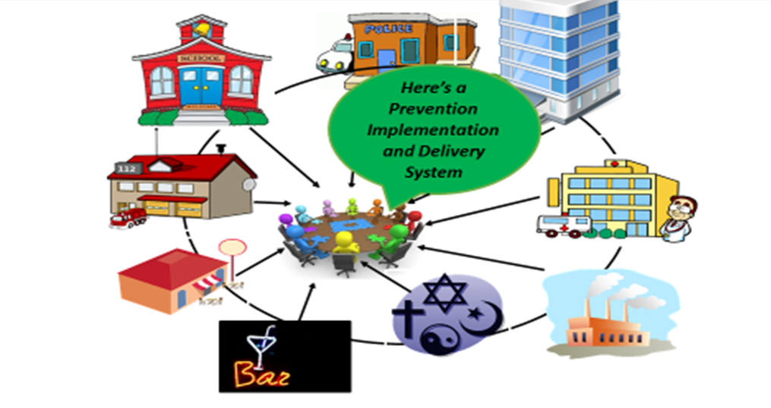
Community-Based Prevention Implementation and Delivery System

Slide 42
Community-Based Prevention Implementation and Delivery System
Such a system requires both
Behavioral interventions such as:
  Parenting programs (e.g., Strengthening the Family (10-14); Incredible Years)
  Workplace-based programs (e.g., TEAM)
  School-based programs (e.g., Good Behavior Games; LifeSkills Training)
  Responsible Beverage Server Training
Environmental interventions such as:
  Workplace policies
  School policies
  Community policies

Slide 43
Community-Based Prevention Implementation and Delivery System
AND THEY MUST BE EVIDENCE-BASED!

Slide 44
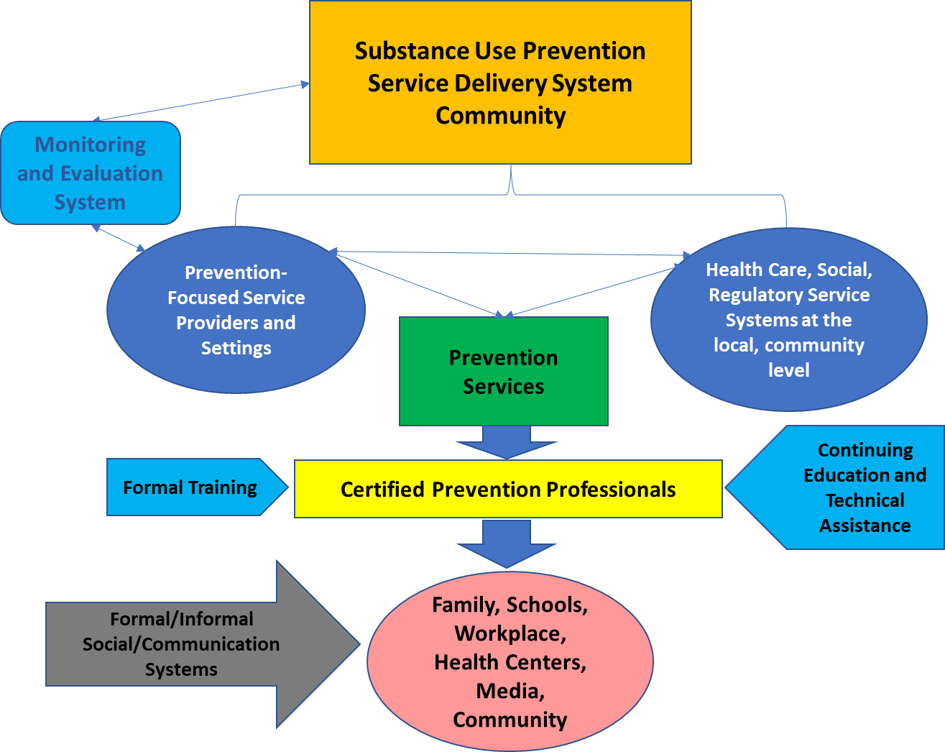

Slide 45
Substance Abuse Service Delivery System
National o State o Community
Prevention and Treatment Service System at the local, community level
Other Health Care, Social & Regulatory Service Systems at the local community level
Monitoring and Evaluation System
PREVENTION AUTHORITY
Service Delivery System
Continuing Education and Technical Assistance
Formal Training
Certified Prevention and Treatment Professionals
Formal/Informal Public Communication Systems
Family, Schools, Workplace, Health Centers, Media
Notes:
.

Slide 46
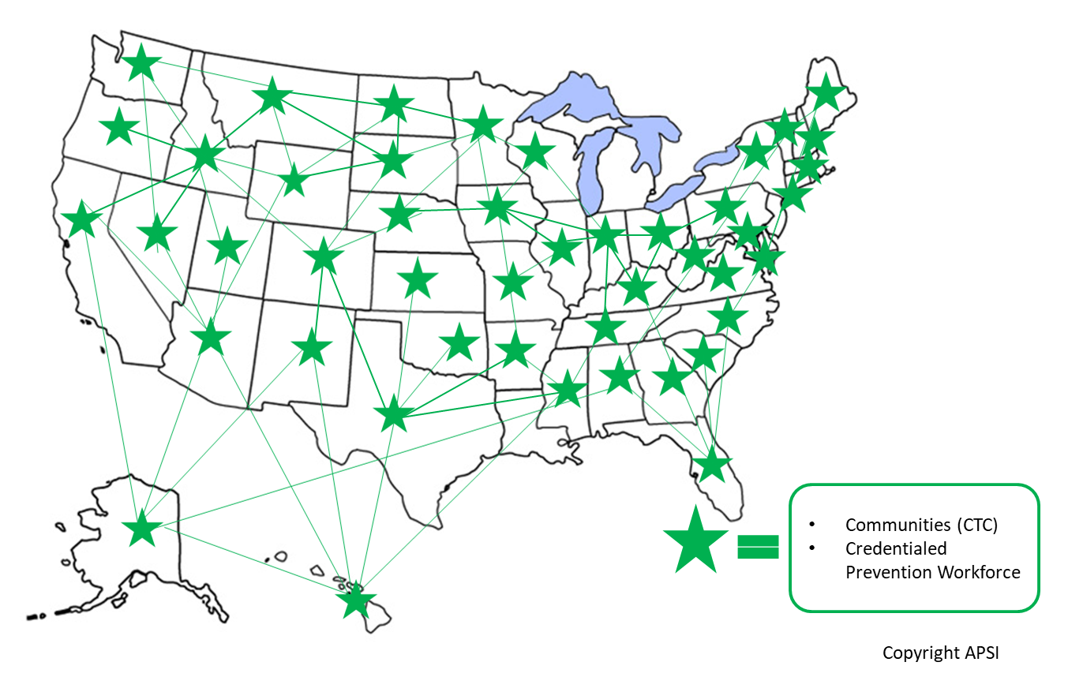

Slide 47

Reflection:
Application to Your Community
What I need to remember….

Slide 48
Zili Sloboda zili.sloboda@apsintl.org
Applied Prevention Science International www.apsintl.org

