Slide 1
Getting to System Transformation: Practical Tools for Coalitions
PTTC Coffee Chat
May 25, 2023
Sarah Davis, MNM
Rocky Mountain Public Health Training Center
Notes:
Place your title on this first slide and include any subtitle.
DO NOT CHANGE THE FORMAT OF THIS TEMPLATE. If you are creating PTTC-branded slides, you must use this template. If you move around boxes, make sure to check the reading order. If you widen any boxes they must not overlap any other box.
IF YOU ADD ANY GRAPHICS, you will need to add ALT TEXT and check READING ORDER.
If the notes on ALT TEXT and READING ORDER do not make sense to you or you require help with remediation (making a product 508 compliant after using this template), please go to the Help Desk website https://ttcrequest.zendesk.com.

Slide 2
This Webinar is Now Live
This webinar is being recorded and will be available for future viewing along with a copy of today’s slides.
Notes:
Carissa (reads from slide)

Slide 3
Technical Information
This webinar is being recorded and archived and will be available to all webinar participants.
This training was developed under the Substance Abuse and Mental Health Services Administration’s Prevention Technology Transfer Center task order.
Reference # 1H79SP081018.
For training use only.
Notes:
Carissa This webinar is being recorded and archived and will be available to all webinar participants. This training was developed under SAMHSA’s PTTC task order and is for training use only.

Slide 4
Chat and Q&A
Please use the chat feature for comments or questions. We welcome your thoughts and hope for a rich conversation in the chat.
You may also type questions for our presenters at any time during the presentation in the Q & A feature
Notes:
Carissa (reads slide)

Slide 5
Icebreaker
What would you do if you had an entire day to yourself?
Notes:
My link: https://www.mentimeter.com/app/presentation/alrzc1m9sjrm9quzeonzj5e4kcbmhxyu/pqz3c7w5b3g3/edit

Slide 6
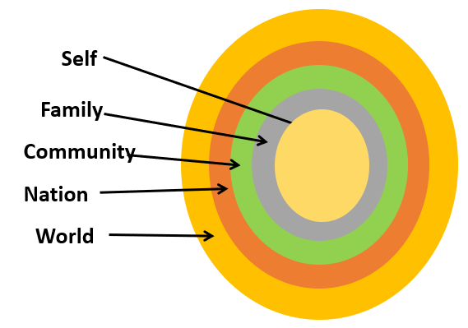
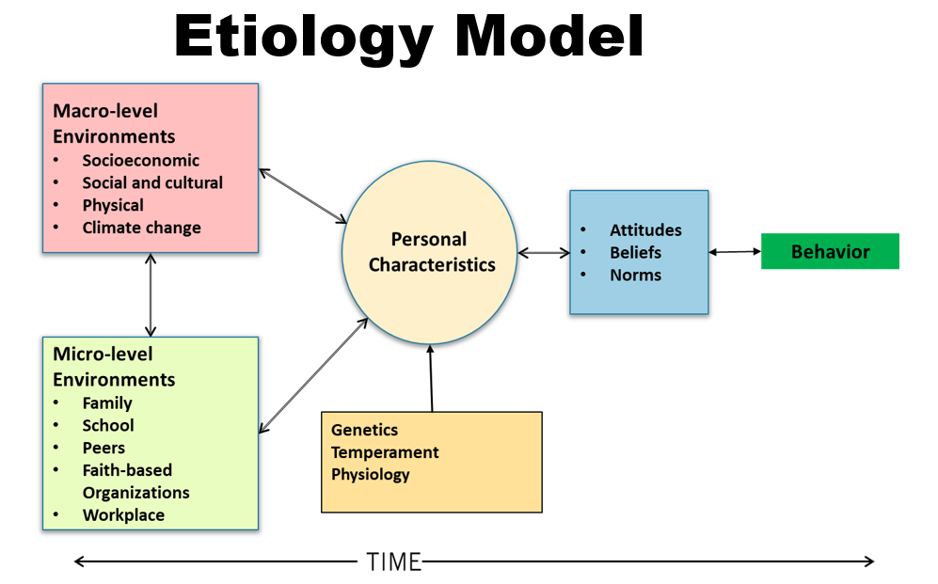
Refresher
Notes:
A quick review of some of the key points Zili shared with us Monday – the recording will be available for those who weren’t able to make it.
System Transfortation Reducing Risks and Increasing Protective Processes: The Goal of Community Coalitions
Zili shared the Etiology Model [click to animate]
“When we are born, we have our own biological and physiological characteristics. These shape how we behave and interact with our environments. In positive environments we are enabled to achieve our developmental goals; in negative environments we are not always successful in these achievements.
We are born into both micro- and macro-level environments. The micro-level environments consist of those that are immediate or most proximal to us such as our parents and families and as we get older the school, our peers, and the workplace. Beyond the micro-level environment is the larger neighborhood, community, and society. Although ever present, our micro-level environments buffer or temper and explain the macro-level environment until we are able to engage with the macro-level environment as independent individuals.
The interactions between and across these environments can be positive and result in our development and growth into productive adults but also can be negative and result in stresses and possibly our engagement in potentially harmful behaviors or lifestyles.”
She also shared about Risk and Protective Factors that come into play at the individual, family, community, and society level. These are factors that either increase or decrease the likelihood of negative outcomes.
[click] And the importance of approaching prevention with a multi-level multi-component approach that looks at mitigating risk factors and increasing protective factors at each of these levels
[click] Finally, Zili had us think about the systems within a community – including the health care system, the school system, legal system, businesses, organizations, workplaces, and so much more. She emphasized the important role that coalitions can play in connecting those systems.

Slide 7
Objectives
Describe community-level risk and protective factors
List systems within a community that can support reducing risk factors and increasing protective factors
Identify tools that coalitions can use to support systems thinking
Identify tools that coalitions can use to support systems change
Notes:
Today we’ll build on those ideas.
We’ll …

Slide 8
Six Elements of Effective Coalitions
Notes:
And we’ll center our conversation today around these 6 elements of effective coalitions.
There are great resources available to learn more about each of these elements if you’re not already familiar. Derek is going to drop those into the chat.
We’ll look at how some of these specific elements support a coalition in working toward systems change

Slide 9
Working at the Community Level
Society
Community
Family
Individual
Notes:
Let’s go back to this model that Zili showed us.
We have the individual at the center, surrounded by these multiple contexts.
Today we’re going to talk about the influence coalitions can have specifically at the community level. [click] The reason we’re going to do that is because this is a place where your coalition can have a lot of impact.
It doesn’t mean that working with individuals or families isn’t important – or that working to change cultural norms that support substance misuse or addressing wide-spread issues such as gender or racial or class inequality aren’t important. We know from Zili’s presentation that working at multiple levels is essential for effective prevention!
When we focus on making changes to systems at the community level, though, we have the opportunity to dramatically change the contexts in which families and individuals live. And we are broadening our impact by affecting hundreds and thousands of people. Also, the changes we make to systems within our community, make it easier to make changes at the bigger societal level.

Slide 10
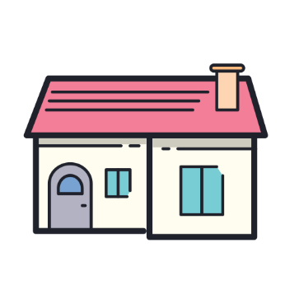
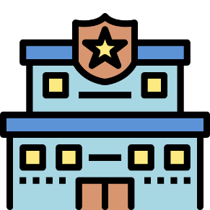
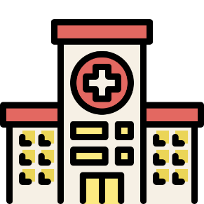
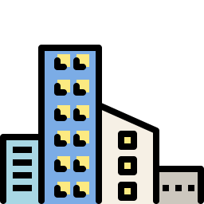
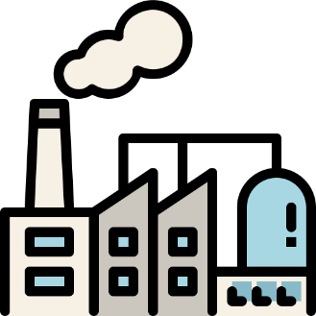
Systems within a Community
Notes:
Okay, so what kinds of systems do we have within our community?
[click] We’ve got the school system
[click] The healthcare system
[click] Law enforcement and the court system
[click] We have parks and recreation
[click] Businesses, nonprofits,… And other employers
[click] Faith groups
[click] Social services
[click] And then there’s economic development
[click] And housing
[click] And transportation
And all of these components create the context in which individuals live, work, learn…

Slide 11
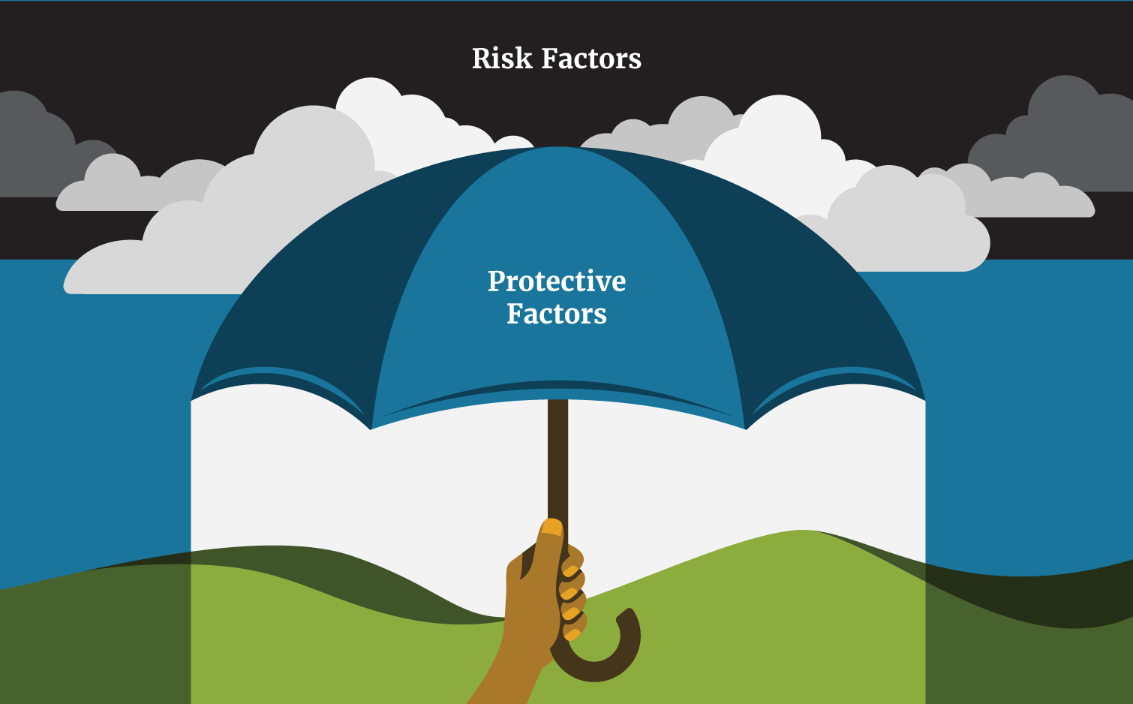
Risk & Protective Factors for Substance Misuse
Community
Low cost/taxation of alcohol, cannabis
High density of alcohol, cannabis retailers
Neighborhood poverty
Violence
High mobility, low stability
Faith-based resources
Afterschool activities
Sources: https://www.ncbi.nlm.nih.gov/books/NBK424850/table/ch3.t2/; https://www.ncbi.nlm.nih.gov/books/NBK424850/table/ch3.t3/;
https://www.samhsa.gov/sites/default/files/20190718-samhsa-risk-protective-factors.pdf ; https://www.dhs.wisconsin.gov/resilient/risk-protective-factors.htm
Notes:
If we look at Risk Factors for Substance Misuse at the Community Level, we see things like:
[click]
Low cost of substances –through promotional deals, happy hours, or low tax rates
High availability of substances – because there is a high density of retailers, or high availability through community events
As well as things like high rates of Poverty and violence
And within the community there is a lot of transition – which can be due to a lack of stable housing
We also see that things like: [click]
Faith based resources or
Opportunities for positive activities outside of school hours within the community
Serve as protective factors and reduce substance misuse

Slide 12
Systems within a Community
Notes:
Now let’s add our coalition into this picture
Based on our previous slide, we can see where there might be opportunities to work with community systems to either REDUCE risk factors, or INCREASE protective factors related to substance misuse.
For example, we could look at the retail landscape [click] to assess:
What is our retail density like? Do we have lots of alcohol or cannabis retailers in certain neighborhoods?
What’s our current tax rate for legal substances? How does that compare to other communities or states?
Is alcohol widely available and heavily promoted at lots of community events?

Slide 13
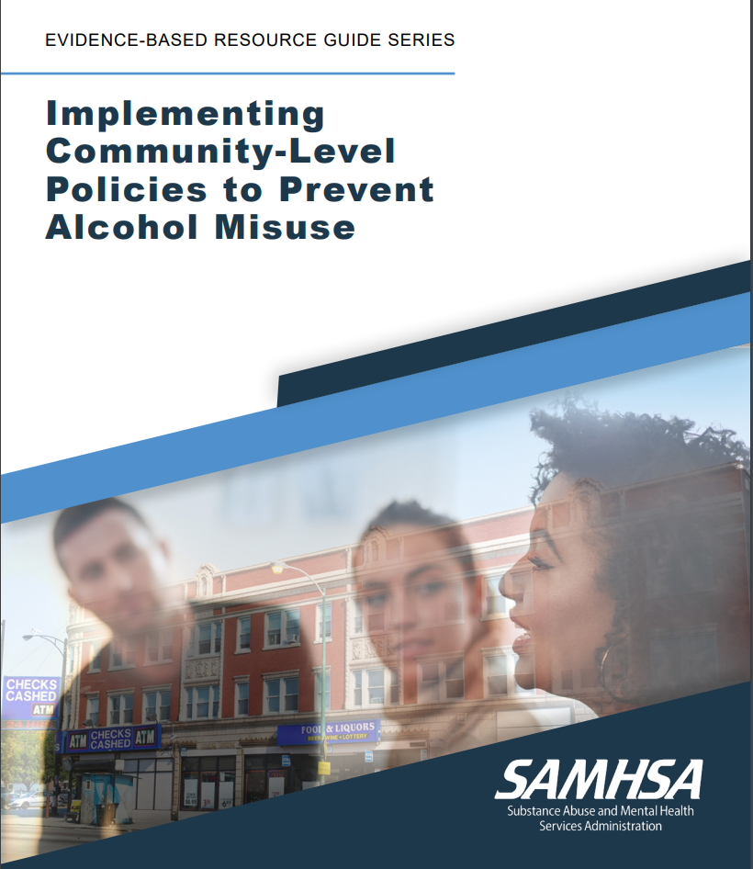
Systems within a Community
Regulate Density:
Licensing
Zoning
Increase Price:
Taxes
Limiting price promotions
Decrease Social Marketing:
Alcohol-free events
Sober spaces
Restricting marketing
Notes:
After our coalition assessed what was going on around density, or pricing, or availability of substances in our community,
We could then look for evidence-based strategies to address some of these. There are several Evidence-Based Resource Guides and Directories out there. Here’s one from SAMHSA: https://store.samhsa.gov/sites/default/files/SAMHSA_Digital_Download/pep22-06-01-006.pdf
We might look at addressing the risk factor of density through
a policy that limits the number of licenses for establishments that sell alcohol or cannabis, based on the population of the area. Or
A zoning law that determines where alcohol or cannabis establishments can be located
Or maybe our coalition found that the low price of legal substances was an important factor in our community. We might look at increasing price through:
An excise or sales tax on alcohol or cannabis
Or a policy that limits retailers’ ability to offer price promotions like “2 for 1” or restricts bars and restaurants’ in the “happy hour” or “bottomless drink” specials they can offer
Or maybe the coalition decides to focus on reducing the social accessibility or restricting marketing through
Organizational or event policies that agree to hold alcohol-free events, designate sober spaces; or
Policies that eliminate or restrict the marketing of substance at a music event, art festival, cultural celebration, or the like

Slide 14
Systems within a Community
Notes:
Your coalition could take a similar approach to INCREASING a protective factor like positive social activities for young people and work with afterschool programs, boys and girls clubs, parks and rec.

Slide 15
Poll
Who is a part of your coalition?
Notes:
So we’ve just talked about lots of different sectors within the community – I’m curious about which of these you already have involved in your coalition.
You can scan the QR code again, or if you still have the last poll pulled up on your phone or computer, it should take you to the next question.
Go ahead and pick all that apply
Comment on results – tie to diverse stakeholders + ideas for further diversifying
My link: https://www.mentimeter.com/app/presentation/alrzc1m9sjrm9quzeonzj5e4kcbmhxyu/pqz3c7w5b3g3/edit

Slide 16
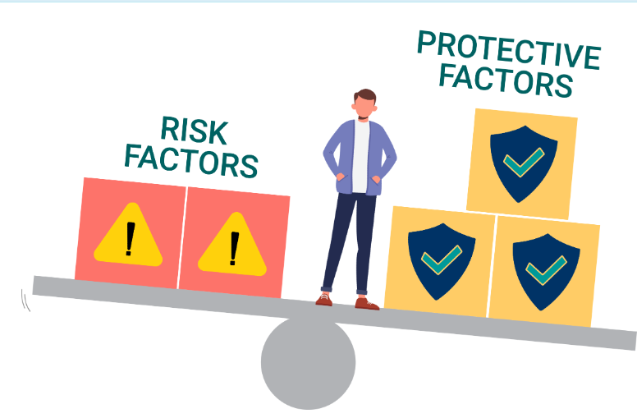
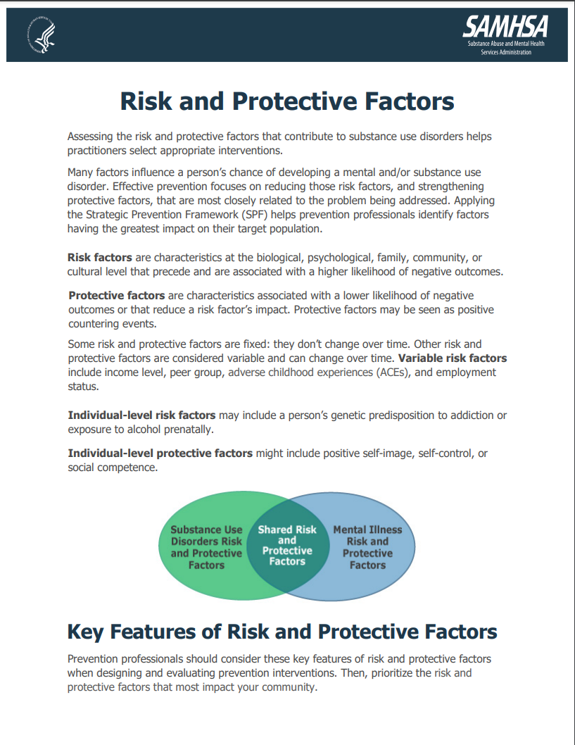
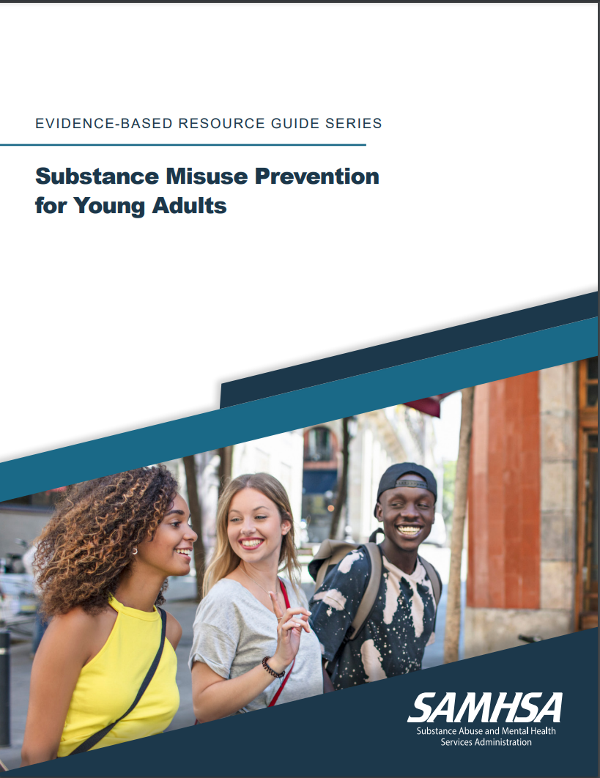
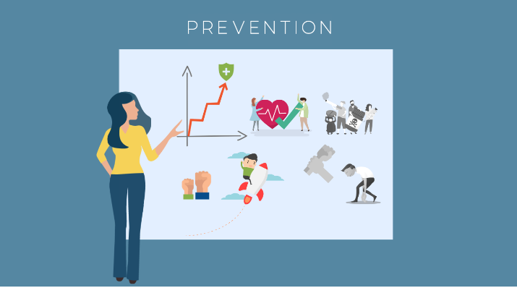
Resources
https://registrations.publichealthpractice.org/Training/Detail/898
https://registrations.publichealthpractice.org/Training/Detail/341
https://www.samhsa.gov/sites/default/files/20190718-samhsa-risk-protective-factors.pdf
https://store.samhsa.gov/sites/default/files/d7/priv/pep19-pl-guide-1.pdf
Notes:
Maybe some of this is newer to you – or your coalition members
Here are a few resources to support skill-building around risk and protective factors and taking a community-wide approach to prevention.
[click] SAMHSA has several fact sheets and resource guides – a couple of which are linked here.
[click] The Rocky Mountain Public Health Training Center also has a couple of free, self-paced modules that are great for those leading substance misuse prevention work – as well as community members or coalition partners

Slide 17
Where to Focus?
What’s the problem?
Why is it occurring?
Prescription drug
misuse
Why?
Why?
Why?
Why?
5 Whys
Notes:
So, we have a picture of the different sectors that make up our community
And we have an understanding of risk and protective factors and how we might impact some of them at the community level
But there are so many options, how do we know where to focus?
In order to know where our coalition can have the most impact, we need to really understand substance misuse in our communities
Let’s start with a problem – [click] Prescription drug misuse.
Why does this problem exist? [click] (ideas: https://www.samhsa.gov/data/sites/default/files/report_3210/ShortReport-3210.html)
Drop your answers in the chat
Physicians are Overprescribing
Many prescribed medications are highly addictive – leading to misuse
Deal with Mental health issues
Stress relief
Relieve pain
Stay alert
Pick 1 from the chat:
[click] why does this happen?
- Why does overprescribing happen?
- Why are there mental health issues? Why are people stressed? Why are people in pain?
Drop your answers in the chat
economic, family, job loss stressors
Working 2 jobs
Don’t have insurance or consistent healthcare access to deal with health issues
Stigma against mental health issues
pick one from chat:
{click} Why is it that ________?
pick one from chat:
[click] And why is that? What’s causing that problem?
The process that we just went through is called [click] “The 5 Whys”
We could do a similar process to try and better understand why young people in your community are using cannabis… or why cannabis use rates among pregnant women are on the rise… or why alcohol misuse rates in certain neighborhoods is higher.
This is a great activity for a diverse coalition to undertake because people will come with different perspectives and knowledge in different areas.
Whereas I might say “I have no idea why misuse rates in this county are so much higher than in the next county over” – individuals from that county will likely have lots of insight.
So when you’re doing this exercise, consider who you have around the table.
Let’s use an example of a coalition that is focusing on Reducing Prescription Drug Misuse
We start with what we see:
Now we want to dig deeper – what are the patterns that we see?
Okay, let’s go deeper still – what is contributing to higher rates among _____?
Systems in place leading to
The misuse rates are highest among ______
Hospitalizations, Deaths

Slide 18
Where to Focus
Notes:
Depending on where your responses to an exercise like the 5 Whys takes you – can help you figure out which sectors to focus on
[click] Are the issues contributing to prescription drug misuse in your community healthcare related?
Overprescribing by physicians
Inconsistent health care
Lack of access to mental health resources
Stigma around mental health issues
[click] Are there violence or safety issues contributing to drug misuse?
[click] Or are the issues contributing to misuse in your community more about economics?
Unemployment or underemployment
Being unhoused or lacking stable housing
Living paycheck to paycheck or struggling with debt

Slide 19
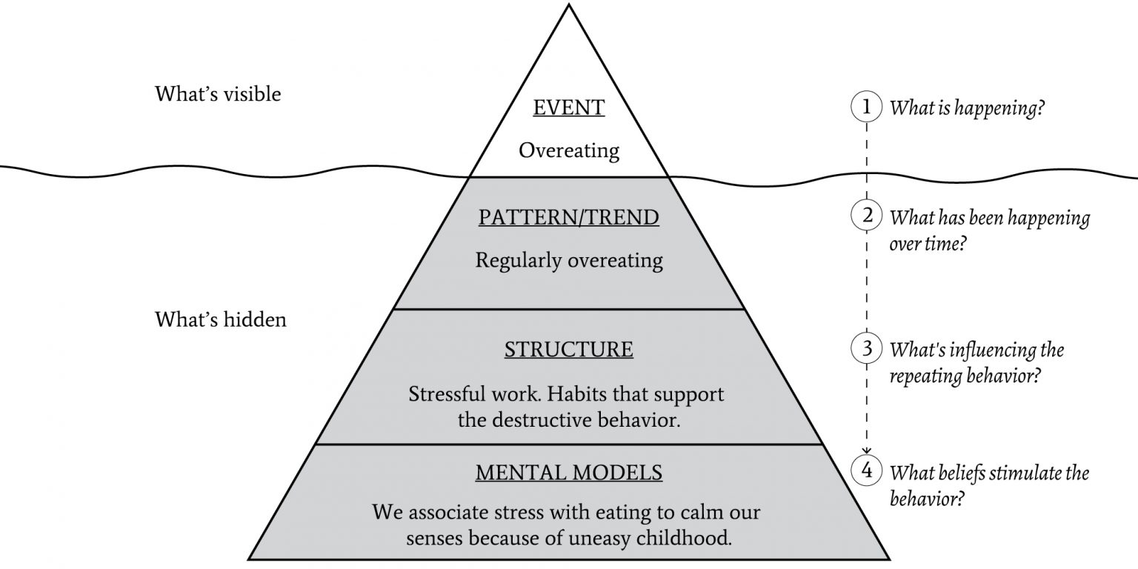
Getting to the Root Cause
Someone drives home intoxicated
Someone is regularly intoxicated
Stress of no job
Inadequacy, Identity, Pride
Notes:
Give me a thumbs up emoji if you’ve seen or are familiar with the “iceberg” model
This is how it works. [click]
You see something visible above the water. This is what’s happening right in front of you.
In this example, “overeating” is the event that is happening.
[click] We could also use the example of “someone drives home intoxicated”
We could just look at this event and plan for how to deal with the event
If we look a little underneath the surface, though, we would look for the patterns
[click] it’s not a single instance of overeating, but rather a pattern of regularly overeating
Or regularly drinking to intoxication
Going deeper beneath the surface we start to look at the structures and systems that are causing the regular overeating
[click] the overeating is a way to handle the stress at work
The regular intoxication is a way to escape and deal with the anger of being laid off
Going deeper still [click] we examine the patterns of thinking – or the narratives or mental models that have been in place a long time
The stress of not having a job is compounded by feelings of inadequacy of not being able to provide for my family – a lack of identity and pride
This is an example from an individual perspective.

Slide 20
Getting to the Root Cause
Binge drinking
Higher & rising rates among LGBTQ+ youth
Discriminatory policies that limit expression, access to facilities, health care → poor mental health
Binary thinking. Some things are right – others are wrong. Long-standing, sometimes unconscious, beliefs and values.
Source: https://durmonski.com/self-improvement/iceberg-model-systems-thinking/#:~:text=The%20iceberg%20model%20of%20systems%20thinking%20is%20a%20way%20of,exist%20in%20the%20first%20place
Notes:
That was an example from an individual perspective – from a community perspective
Our youth risk and behavior factor survey shows that binge drinking is a problem in our community
When we dig in to learn more about the problem – we find that binge drinking is especially prevalent amongst our Lesbian, Gay, Bisexual, Transgender, Queer, and Gender-expansive young people and that rates have recently risen.
When we get curious about why, we start to see that More than 1 in 3 LGBTQ Americans faced discrimination of some kind in the past year (source: https://www.americanprogress.org/article/state-lgbtq-community-2020/). The discrimination either from individuals – or through policies and practices that don’t provide gender neutral bathrooms or restrict which bathroom individuals can use – or laws that criminalize expression through banning drag shows - is contributing to high rates of mental health issues like anxiety and depression – with 45% of LGBTQ youth who seriously considered suicide in the past year (source: https://www.thetrevorproject.org/survey-2022/#mental-health-suicide-risk).
And way down deep are the mental models – the ways of thinking – that have led to the policies that are in place or keep them in place.
It’s important to remember, some of what’s in this level are beliefs and values we are aware of – because they are values we are taught from our parents or religious institutions – which much of what’s on this level is unconscious. We do things a certain way because that’s how we always have and we haven’t stopped to think about the why or the impact.

Slide 21
Where to Focus
Notes:
So how is this a useful tool for our coalition? An activity like the iceberg can help you figure out which sectors to focus on
Rather than only addressing what is at the “tip of the iceberg” – the act of binge drinking – we now have the opportunity through our deeper understanding of the problem – to work with youth-serving organizations, schools, faith groups, and mental health providers to support young people who are facing discrimination in order to reduce their use of binge drinking as a coping skill.
And maybe we’re able to lend our support to organizations who are working on addressing discriminatory policies – because we recognize the negative health impacts.

Slide 22
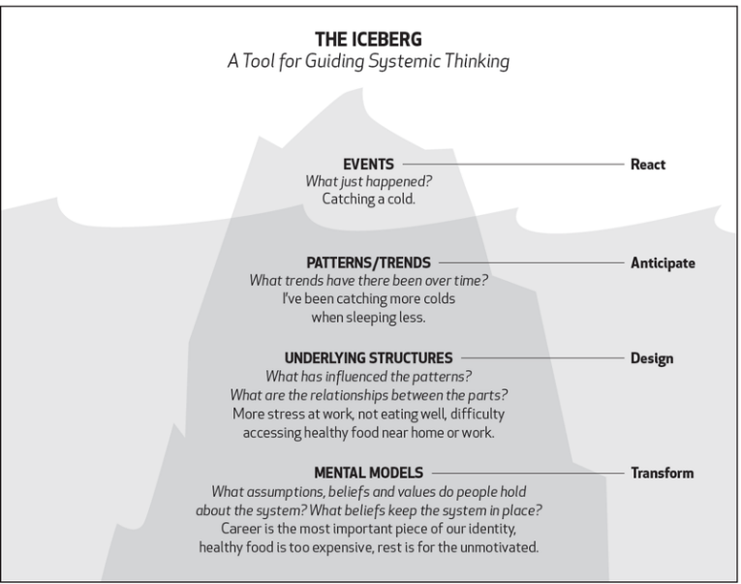
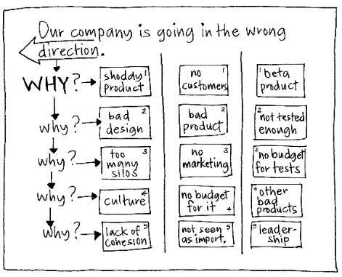
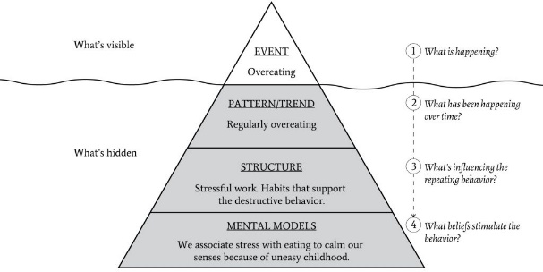
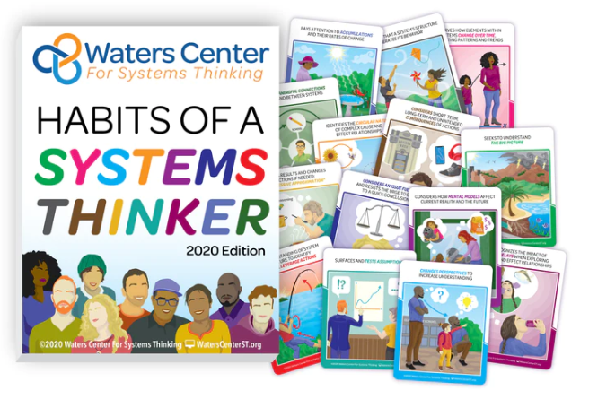
Resources
https://ecochallenge.org/iceberg-model/
https://gamestorming.com/the-5-whys/
https://durmonski.com/self-improvement/iceberg-model-systems-thinking/
https://waterscenterst.org/
Notes:
Links to a few resources if you’re interested in facilitating either the 5 Whys or the Iceberg process with your coalition to explore root causes.
Game Storming is not a public health related site, but they have a great description of how to lead a group through a 5 Whys activity.
[click] I’ve included links to 2 versions of the iceberg and sites that explain how to apply the model – again, most of these are not public health or substance misuse specific – but are absolutely applicable!
[click] Finally – the Waters Center is a new discovery for me – they have several learning opportunities about “systems thinking” – which include these ideas of getting to root causes and seeing the big picture of an issue

Slide 23
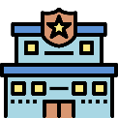
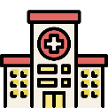
Transformation
Community
Why?
Why?
Why?
Why?
Why?
Notes:
The theme of this 2-part coffee chat is “transformation”
What we’ve talked about today is really focusing on the community level [click]
Looking at the risk and protective factors [click] at play at the community level
[click] Taking a systems-view of your community – recognizing the many different sectors and how they intersect with the work of substance misuse prevention
And some thinking exercises that help us consider [click “why” a problem is occurring and encourage us to look beyond the [click] “tip of the iceberg” to help determine where our coalition might focus in order to best impact the problem we’re trying to solve.
Now I want to explore the mechanism for bringing about some of this transformation at the community level through Policy, Systems, and Environmental Change work
Quick Zoom poll – How familiar are you with P, S, E change?
Very familiar – my coalition is working on P, S, E efforts
Familiar – but my coalition isn’t working on any PSE efforts
Somewhat familiar – I’ve heard of it
Not familiar

Slide 24
Policy, Systems, Environmental Change
Changes to:
Laws
Ordinances
Policies
Practices
Procedures
Rules
Which:
Affect a community
Institutionalize change
Notes:
PSE change includes making changes to laws, ordinances, policies, practices, procedures, or rules
That affect a community rather than an individual or individual family unit. In this case “community” can mean a geographic community (like a city) or a school or workplace community
The other important element of PSE changes are they institutionalize change – what we mean by that is that the change is written down – it’s integrated – it’s not voluntary – it’s not dependent on an individual

Slide 25
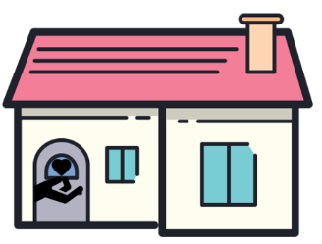
Policy, Systems, Environmental Change
Changes to:
Laws: Taxing recreational cannabis
Ordinances: Zoning limiting density of alcohol retailers
Policies: Employers expand mental health benefit
Practices: School counselors are trained in SBIRT
Procedures: FQHC implements a Pain Management Plan when prescribing opioids
Rules: Festival organizers allow attendees to bring Narcan kits
Notes:
PSE change can happen at the [click] school level, within a workplace, a hospital or health center, an organization, a city, state, or country.
Some examples might include:
[click] Setting or raising a tax on alcohol or cannabis
[click] Passing an ordinance that limits the number of alcohol or cannabis retailers can be in the community
[click] Employers could expand their coverage of mental health services – to reduce the likelihood of substances as a coping strategy
[click] It could become standard practice that all School counselors are trained in Screening, brief intervention, and referral to treatment (SBIRT) for substances and have integrated the brief intervention as a standard practice into their meetings with students
[click] A Federally Qualified Health Center might integrate a Pain Management Plan into their electronic medical record system so that it becomes a standard operating procedure for providers to fill it out with a patient when they are being prescribed opioids.
[click] Given the increase of fentanyl-laced substances, organizers of many of the world’s largest festivals have announced that attendees will now be permitted to bring unopened Narcan kits with them
With all of these examples – an entire population or community are impacted – not single individuals… and these are institutionalized – part of the employee handbook, the festival rules, the standard operating procedures, the law

Slide 26
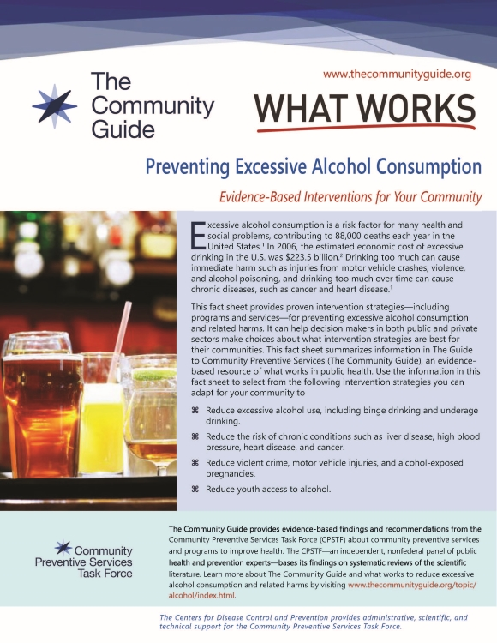
Resources
https://store.samhsa.gov/sites/default/files/SAMHSA_Digital_Download/pep22-06-01-006.pdf
https://www.thecommunityguide.org/
https://www.countyhealthrankings.org/take-action-to-improve-health/what-works-for-health
Evidence-Based Policies
Notes:
Whether we’re talking about implementing programs or policies, we know we want to look to the evidence to see what has been proven to be effective.
There are numerous evidence-based registries and directories out there – [click] here are 3 from SAMHSA, The Community Preventive Services Taskforce, and Robert Wood Johnson.
Each of these identify what policies have been shown to be effective at reducing substance misuse – AND they will tell you the policies that have been shown not to be effective.

Slide 27
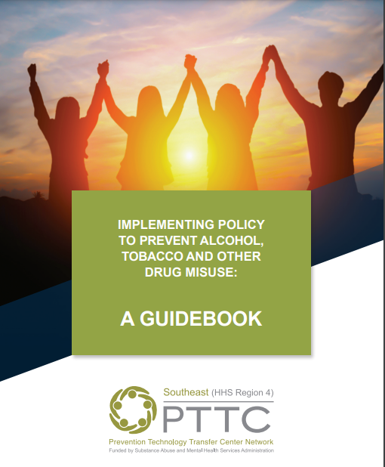
Resources
https://registrations.publichealthpractice.org/Training/Detail/365
https://pttcnetwork.org/sites/pttc/files/2022-11/Digital-PTTC%20Preventing%20Substance%20Abuse%20Guidebook.pdf
PSE Implementation
Notes:
And Two more free resources to support you and your coalition and you learn more about and embark on PSE change.
[click] A guidebook from the Southeast PTTC + [click] a self-paced module from the RM-PHTC

Slide 28
Six Elements of Effective Coalitions
Notes:
As we conclude, I’d like to tie back to and reflect on our elements of an effective coalition.
We touched on having diverse stakeholders [click] as part of your coalition – connections to these various different sectors within your community allows you the opportunity to better affect some of these community-level changes.
We looked at increasing skills [click] within your community to:
Understand risk and protective factors for substance misuse
To understand the multiple systems at play within your community
And the Skills of assessment and looking at root causes
Looking at community-level change – assessing systems-level issues – working toward policy change within those systems offers valuable opportunities for:
The coalition to focus on a solid goal [click] – which provides focus, increasing the coalition’s efficiency [click]
Community-level change wouldn’t be possible without
[click] broad participation from coalition partners – which helps
And working together toward a common goal builds group cohesion [click]

Slide 29
Questions? Additional Resources to Share?
Sarah Davis, MNM
Sarah.e2.Davis@cuanshutz.edu
SdavisConsulting@gmail.com
https://www.linkedin.com/in/sarah-davis-mnm-151096b/
Notes:
I would welcome any questions from the group – and also encourage you to unmute or drop a link into the chat if you know of a helpful resource or tool related to what we discussed today.

