Slide 1
An Application of the AUDIT Model to Assess Alcohol Use Among Military Veterans Participating in Outdoor Activities
By Steve Otero, PTTC Fellow, HHS Region 8
Notes:
Place your title on this first slide and include any subtitle.
DO NOT CHANGE THE FORMAT OF THIS TEMPLATE. If you are creating PTTC-branded slides, you must use this template. If you move around boxes, make sure to check the reading order. If you widen any boxes they must not overlap any other box.
IF YOU ADD ANY GRAPHICS, you will need to add ALT TEXT and check READING ORDER.
If the notes on ALT TEXT and READING ORDER do not make sense to you or you require help with remediation (making a product 508 compliant after using this template), please go to the Help Desk website https://ttcrequest.zendesk.com.

Slide 2
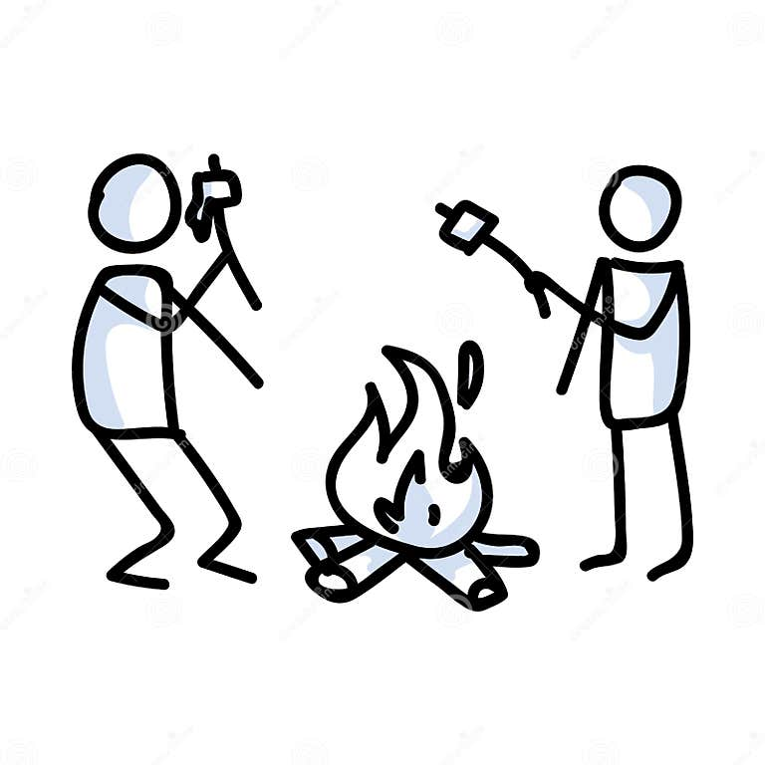
Definitions
Outdoor activities refers to leisure pursuits that occur outdoors in natural or semi-natural settings. The primary aim is to experience enjoyment, pleasure, and personal growth through activities that are physically engaging, intellectually stimulating, or spiritually uplifting.
Military Veteran enlisted after September 8, 1980
A minimum service requirement exists. Service members must have served a minimum of 24 months of active duty to be considered a veteran. If the service member becomes disabled because of their time in the service, there is no minimum length of service to qualify for VA benefits.
38 U.S.C. § 101(2) provides:
The term "veteran" means a person who served in the active military, naval, or air service, and who was discharged or released therefrom under conditions other than dishonorable.
Notes:
Here is an example of content layout. You can put text, images, videos, graphs, etc. in either box. Do not use SmartArt (it is not and cannot be made to be 508 compliant).
Check out the other slide layouts available by selecting “Layout” from the “Home” tab. (If “Layout” is grayed out, you will need to place your cursor in an open area outside the slide to activate it.)
If you require help with remediation (making a product 508 compliant after using this template), please go to the Help Desk website https://ttcrequest.zendesk.com.

Slide 3
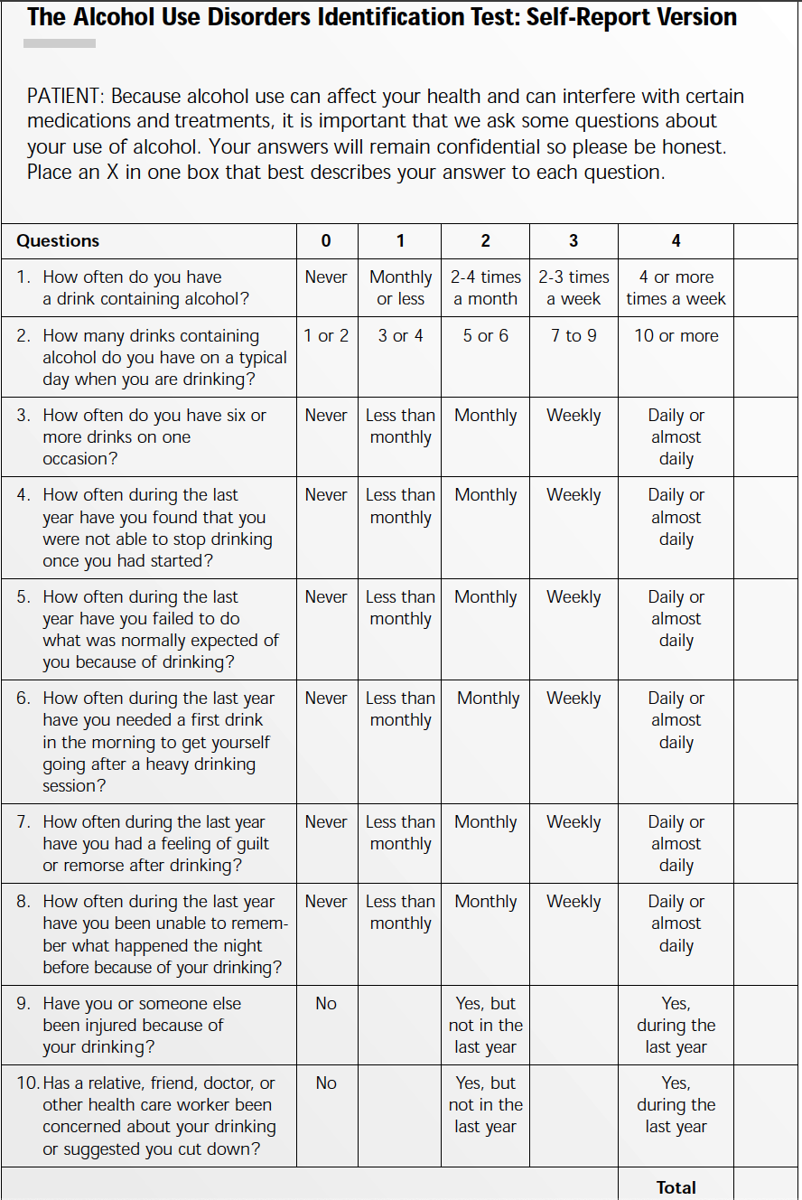
Definitions
AUDIT
The Alcohol Use Disorders Identification Test (AUDIT) is a 10-item screening tool developed by the World Health Organization (WHO) to assess alcohol consumption, drinking behaviors, and alcohol-related problems.
Notes:
Here is an example of content layout. You can put text, images, videos, graphs, etc. in either box. Do not use SmartArt (it is not and cannot be made to be 508 compliant).
Check out the other slide layouts available by selecting “Layout” from the “Home” tab. (If “Layout” is grayed out, you will need to place your cursor in an open area outside the slide to activate it.)
If you require help with remediation (making a product 508 compliant after using this template), please go to the Help Desk website https://ttcrequest.zendesk.com.

Slide 4
Background
Veteran Population
Did You Know?
18.2 million
The number of military veterans in the United States from 2015-2019.
1.6 million
The number of female veterans in the United States from 2015-2019.
1.7%
The percentage of veterans from 2015-2019 who were Asian Americans. Additionally, 77.2% were non-Hispanic White; 6.9% Hispanic or Latino (of any race); 11.9% African American; 0.8% American Indian or Alaska Native; 0.2% Native Hawaiian or Other Pacific Islander; and 1.3% were Some Other Race. (The numbers include only those reporting a single race.)
23.5%
The percentage of veterans ages 75 and older from 2015-2019. At the other end of the age spectrum, 8.8% were younger than age 35.
Notes:
Alcohol use is associated with American concepts of “freedom” as a new/young military member

Slide 5
Background
Recent literature has highlighted the therapeutic benefits of outdoor activities for veterans, including improved physical health, psychological wellbeing, and social connections
The interplay between these outdoor activities and alcohol use patterns among veterans, however, remains underexplored
Alcohol misuse is consistently identified as a significant public health concern among military veterans
Research has shown rates of alcohol misuse are higher in the veteran population compared to civilian peers
More than 40% of US military veterans have a life-time history of alcohol use disorder. Veterans with a life-time history of alcohol use disorder have substantial comorbid psychiatric burden, including elevated rates of suicidal ideation and attempts. Certain socio-demographic (e.g. younger age, male sex, lower education) and clinical (e.g. trauma burden, history of depression) characteristics are associated with increased risk of AUD.
Notes:
Alcohol use is associated with American concepts of “freedom” as a new/young military member

Slide 6
Background
The Alcohol Use Disorders Identification Test (AUDIT) is a 10-item screening tool developed by the World Health Organization (WHO) to assess alcohol consumption, drinking behaviors, and alcohol-related problems
Given the potential for outdoor activities to serve as a healthy coping mechanism, and thus potentially influencing alcohol use among veterans, there is a need for systematic investigation into this relationship
The AUDIT model has been widely used in both clinical and research settings to identify individuals with hazardous and harmful patterns of alcohol consumption
AUDIT provides a comprehensive understanding of alcohol consumption, alcohol dependence symptoms, and alcohol-related problems, making it an ideal instrument for the proposed research
Notes:
Here is an example of content layout. You can put text, images, videos, graphs, etc. in either box. Do not use SmartArt (it is not and cannot be made to be 508 compliant).
Check out the other slide layouts available by selecting “Layout” from the “Home” tab. (If “Layout” is grayed out, you will need to place your cursor in an open area outside the slide to activate it.)
If you require help with remediation (making a product 508 compliant after using this template), please go to the Help Desk website https://ttcrequest.zendesk.com.

Slide 7
Is there a relationship between alcohol use among military veterans and engagement in outdoor activities?
Research Question
Notes:
Place your title on this first slide and include any subtitle.
DO NOT CHANGE THE FORMAT OF THIS TEMPLATE. If you are creating PTTC-branded slides, you must use this template. If you move around boxes, make sure to check the reading order. If you widen any boxes they must not overlap any other box.
IF YOU ADD ANY GRAPHICS, you will need to add ALT TEXT and check READING ORDER.
If the notes on ALT TEXT and READING ORDER do not make sense to you or you require help with remediation (making a product 508 compliant after using this template), please go to the Help Desk website https://ttcrequest.zendesk.com.

Slide 8
Methods
Cross-sectional
Recruitment of military veteran participants from 11 outdoor education/experience providers nationwide
Educate participants on study and apply AUDIT questionnaire prior to participation in activities – delivered by program staff, not researcher
Adults over 18 years old
US Military Veterans
Participants must be involved in outdoor activities at least once a week
Alcohol use within last year
Notes:
Inclusion Criteria:
Veteran Status: Participants must be military veterans, having served in any branch of the military (Army, Navy, Marine Corps, Air Force, Coast Guard).
Age: All adults over 18
Outdoor Activity Engagement: Participants should be involved in regular outdoor recreational activities at least once a week.
Alcohol Use: Using the AUDIT, participants must have consumed alcohol in the past year.
Exclusion Criteria:
Non-veterans: Anyone who has not served in the military should be excluded.
Health Status: Veterans with physical or mental health conditions that may prevent them from participating in outdoor activities could be excluded, as these conditions could introduce bias into results. This might include severe physical disabilities or mental health conditions such as severe PTSD.
Current Substance Use Disorders: If your focus is on alcohol, you might choose to exclude veterans with diagnosed substance use disorders (other than alcohol) as this could confound your results.
Lack of consent: Any veteran who does not give informed consent to participate in the research should be excluded.

Slide 9
Analytics
Descriptive Statistics: To provide a basic understanding of the distribution of AUDIT scores, means, medians, modes, ranges, and standard deviations will be calculated.
ANOVA (Analysis of Variance): There will be different types of outdoor activities, an ANOVA could be used to detect differences in mean AUDIT scores among the groups.
Regression Analysis: To identify predictors of alcohol use (e.g., frequency of outdoor activity, type of outdoor activity, age, or PTSD symptoms), linear or logistic regression models will be applied.
Correlation Analysis: Pearson's or Spearman's correlation coefficients could be used to explore relationships between AUDIT scores and other continuous variables like age, duration of outdoor activities, or mental health measures.
Chi-Squared Tests: If dealing with categorical variables, Chi-squared tests could be used to explore associations between AUDIT categories (e.g., low-risk, high-risk) and other categorical factors such as engagement in specific types of outdoor activities.
Notes:
Inclusion Criteria:
Veteran Status: Participants must be military veterans, having served in any branch of the military (Army, Navy, Marine Corps, Air Force, Coast Guard).
Age: All adults over 18
Outdoor Activity Engagement: Participants should be involved in regular outdoor recreational activities at least once a week.
Alcohol Use: Using the AUDIT, participants must have consumed alcohol in the past year.
Exclusion Criteria:
Non-veterans: Anyone who has not served in the military should be excluded.
Health Status: Veterans with physical or mental health conditions that may prevent them from participating in outdoor activities could be excluded, as these conditions could introduce bias into results. This might include severe physical disabilities or mental health conditions such as severe PTSD.
Current Substance Use Disorders: If your focus is on alcohol, you might choose to exclude veterans with diagnosed substance use disorders (other than alcohol) as this could confound your results.
Lack of consent: Any veteran who does not give informed consent to participate in the research should be excluded.

Slide 10
Timeline
Notes:
Here is an example of content layout. You can put text, images, videos, graphs, etc. in either box. Do not use SmartArt (it is not and cannot be made to be 508 compliant).
Check out the other slide layouts available by selecting “Layout” from the “Home” tab. (If “Layout” is grayed out, you will need to place your cursor in an open area outside the slide to activate it.)
If you require help with remediation (making a product 508 compliant after using this template), please go to the Help Desk website https://ttcrequest.zendesk.com.

Slide 11
Outcomes
A better understanding of the relationships between alcohol use, outdoor engagement, mental health, and overall well-being.
This understanding could subsequently inform and enhance prevention, intervention, policy-making, and support strategies, leading to improved care for veterans.
Notes:
Here is an example of content layout. You can put text, images, videos, graphs, etc. in either box. Do not use SmartArt (it is not and cannot be made to be 508 compliant).
Check out the other slide layouts available by selecting “Layout” from the “Home” tab. (If “Layout” is grayed out, you will need to place your cursor in an open area outside the slide to activate it.)
If you require help with remediation (making a product 508 compliant after using this template), please go to the Help Desk website https://ttcrequest.zendesk.com.

Slide 12
Thank you for the training and inspiration!
Notes:
Here is an example of content layout. You can put text, images, videos, graphs, etc. in either box. Do not use SmartArt (it is not and cannot be made to be 508 compliant).
Check out the other slide layouts available by selecting “Layout” from the “Home” tab. (If “Layout” is grayed out, you will need to place your cursor in an open area outside the slide to activate it.)
If you require help with remediation (making a product 508 compliant after using this template), please go to the Help Desk website https://ttcrequest.zendesk.com.

Slide 13
References
Fuehrlein, B. S., Mota, N., Arias, A. J., Trevisan, L. A., Kachadourian, L. K., Krystal, J. H., Southwick, S. M., & Pietrzak, R. H. (2016). The burden of alcohol use disorders in US military veterans: results from the National Health and Resilience in Veterans Study. Addiction (Abingdon, England), 111(10), 1786–1794. https://doi.org/10.1111/add.13423
How will outdoor recreation be defined?. How will Outdoor Recreation be defined? | U.S. Bureau of Economic Analysis (BEA). (2017, November). https://www.bea.gov/help/faq/1194
Santiago, P. N., Wilk, J. E., Milliken, C. S., Castro, C. A., Engel, C. C., & Hoge, C. W. (2010). Screening for alcohol misuse and alcohol-related behaviors among combat veterans. Psychiatric services (Washington, D.C.), 61(6), 575–581. https://doi.org/10.1176/ps.2010.61.6.575
Seal, K. H., Cohen, G., Waldrop, A., Cohen, B. E., Maguen, S., & Ren, L. (2011). Substance use disorders in Iraq and Afghanistan veterans in VA healthcare, 2001-2010: Implications for screening, diagnosis and treatment. Drug and alcohol dependence, 116(1-3), 93–101. https://doi.org/10.1016/j.drugalcdep.2010.11.027Spera, C., Thomas, R. K., Barlas, F., Szoc, R., & Cambridge, M. H. (2011). Relationship of military deployment recency, frequency, duration, and combat exposure to alcohol use in the Air Force. Journal of studies on alcohol and drugs, 72(1), 5–14. https://doi.org/10.15288/jsad.2011.72.5
Substance Abuse and Mental Health Services Administration (SAMHSA) Treatment Episode Data Set (TEDS), 2013. (2013, January 23). Veterans’ primary substance of abuse is alcohol in treatment admissions. https://www.samhsa.gov/data/sites/default/files/report_2111/Spotlight-2111.html
U.S. Census Bureau Releases Key Stats on Nation’s veteran population. U.S. Department of Commerce. (2021, November 10). https://www.commerce.gov/news/blog/2021/11/us-census-bureau-releases-key-stats-nations-veteran-population
U.S. Department of Veterans Affairs. (2019, October). Verification assistance brief - veterans affairs. VA.gov. https://www.va.gov/OSDBU/docs/Determining-Veteran-Status.pdf
Notes:
Here is an example of content layout. You can put text, images, videos, graphs, etc. in either box. Do not use SmartArt (it is not and cannot be made to be 508 compliant).
Check out the other slide layouts available by selecting “Layout” from the “Home” tab. (If “Layout” is grayed out, you will need to place your cursor in an open area outside the slide to activate it.)
If you require help with remediation (making a product 508 compliant after using this template), please go to the Help Desk website https://ttcrequest.zendesk.com.

Slide 14
Additional Info
Restrepo – https://vimeo.com/517671942
Our Lonely Society, Sebastian Junger - https://youtu.be/o9DNWK6WfQw
Outward Bound Veterans - https://youtu.be/WWJnxTjSszQ
FreeThink, Warrior Expeditions - https://youtu.be/fFEtvSjn0I4
The Hornet’s Nest - https://youtu.be/N0N0Kpa4HTY
Treks For Vets, ASU - https://youtu.be/0dU2aoTwPes
Task Force on Outdoor Recreation for Veterans - https://www.federalregister.gov/documents/2022/02/23/2022-03734/notice-of-request-for-information-regarding-veterans-outdoor-recreation
Notes:
Here is an example of content layout. You can put text, images, videos, graphs, etc. in either box. Do not use SmartArt (it is not and cannot be made to be 508 compliant).
Check out the other slide layouts available by selecting “Layout” from the “Home” tab. (If “Layout” is grayed out, you will need to place your cursor in an open area outside the slide to activate it.)
If you require help with remediation (making a product 508 compliant after using this template), please go to the Help Desk website https://ttcrequest.zendesk.com.

