Slide 1
What is Prevention?
[Presenter’s Name]
[Presenter’s Organization]
[Date]
Notes:
[Insert your name, organization and date on the slide before your presentation.]
Introduce yourself and, as time allows, ask participants to introduce themselves.

Slide 2
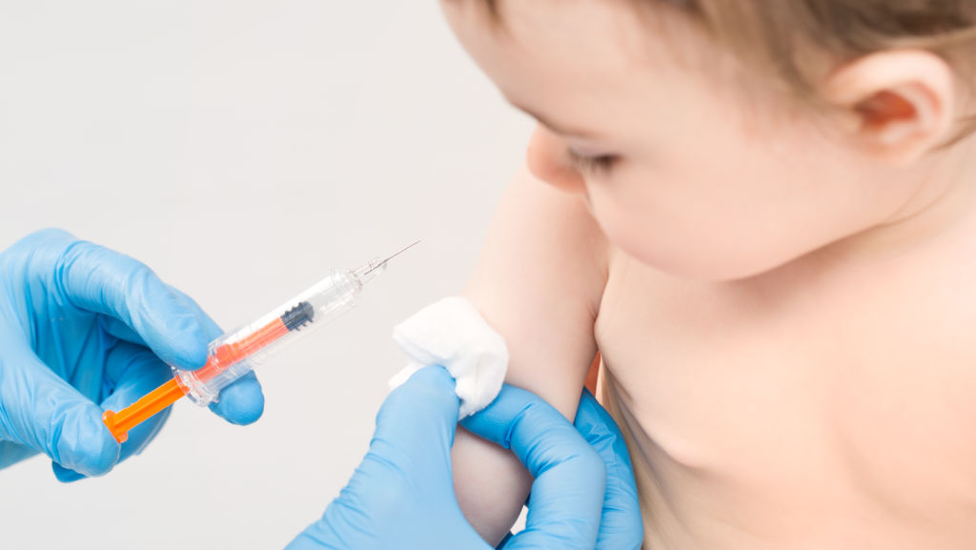
Prevention efforts aim “Upstream”
Notes:
Point out the examples of prevention in other fields:
Anti-virus software PREVENTS viruses from attacking your computer
Lighthouses PREVENT ships from crashing into rocks
Vaccinations PREVENT illnesses
Sunscreen PREVENTS sunburns
Harm reduction PREVENTS overdose and death. Both to bring it within our realm of work and also to set primary prevention apart from harm reduction

Slide 3
Focus of Substance Misuse Prevention
People who are not misusing substances (primary)
People who may be at a higher risk of misusing substances (selective)
People who may have misused substances, but who don't yet have a substance use disorder (indicated)
Notes:
Share with participants that, as they likely already know, prevention focuses its efforts on those who are not misusing substances with the goal of preventing them from misusing substances in the future. However, there are other types of prevention programming (that often take more resources and serve a smaller population) that serve people who may be at higher risk to use, or who may have already misused substances but don't yet meet the criteria for having a substance use disorder.

Slide 4
Prevention is...
A proactive process that empowers individuals
and systems to meet the challenges of life events
and transitions by creating and reinforcing conditions that promote healthy behaviors and lifestyles.
Notes:
Share that this is one version of a definition for prevention and that you will “unpack” this definition. Then click to the next slide.

Slide 5
Prevention is...
A proactive process that empowers individuals
and systems to meet the challenges of life events
and transitions by creating and reinforcing conditions that promote healthy behaviors and lifestyles.
Notes:
Prevention is PROACTIVE, not reactive. We take action BEFORE a problem occurs.

Slide 6
Prevention is...
A proactive process that empowers individuals
and systems to meet the challenges of life events
and transitions by creating and reinforcing conditions that promote healthy behaviors and lifestyles.
Notes:
We are looking to impact both individuals as well as systems. Yes, we want to support people as individuals, but no one person is alone in the world, people don't make decisions alone, and there are many factors that influence a person's choice to use and misuse substances. By impacting systems and improving environments, we can give individuals the best chance to make healthier choices.

Slide 7
Prevention is...
A proactive process that empowers individuals
and systems to meet the challenges of life events and transitions by creating and reinforcing conditions that promote healthy behaviors and lifestyles.
Notes:
We all experience challenging life events and transitions. So the work we do to empower individuals and systems, helps buffer the impacts of these challenges and transitions.

Slide 8
Prevention is...
A proactive process that empowers individuals
and systems to meet the challenges of life events
and transitions by creating and reinforcing conditions that promote healthy behaviors and lifestyles.
Notes:
Sometimes good, healthy conditions already exist, and the work of the prevention specialist is to support these, call them out and continue to work toward making sure those conditions continue. When those conditions aren't in place, the work of prevention is to create those healthy and positive environments that… (click to the next slide)

Slide 9
Prevention is...
A proactive process that empowers individuals
and systems to meet the challenges of life events
and transitions by creating and reinforcing conditions
that promote healthy behaviors and lifestyles.
Notes:
Ensure people have what they need at the most basic level, and beyond that people have spaces and places where they can truly thrive. Communities where people can just survive is the minimum level to achieve, we really want to work toward communities where people can be their best selves, and then even support other's to be their best selves as well.

Slide 10
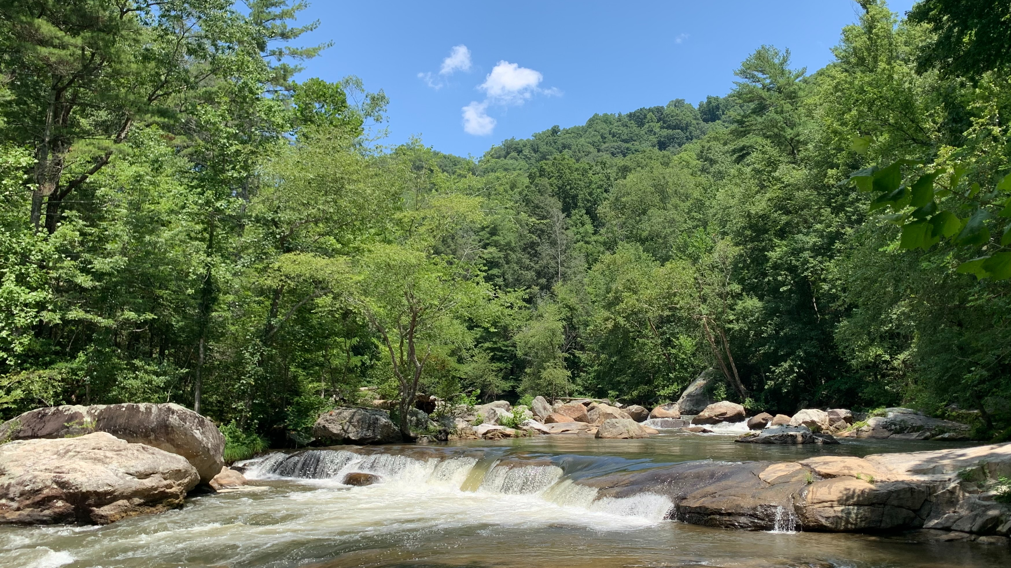
Goal of Substance Misuse Prevention:
Put measures in place before there is a problem so those “downstream” are carrying less of the public health burden.
Notes:
https://unsplash.com/photos/cyxtMIhirDw
Share the information from this slide and ask if people have any questions about what is meant by prevention. Note that by putting resources "upstream" we save time, money, energy, and lives downstream. Be sure the audience understands this metaphor, as it is used a lot.

Slide 11
How Do We Prevent Substance Misuse?
Increase protective factors that buffer the impact of risk factors.
Reduce risk factors that increase the likelihood of substance misuse.
Notes:
What happens, "upstream" then? Share that we are able to move “upstream” by reducing risk factors that we know through research increases the likelihood of substance misuse. At the same time, we need to focus on increasing protective factors that buffer the impact of risk factors and increase health and wellness. By making risk factors lower, and protective factors higher, we are creating and reinforcing conditions that promote health behaviors and lifestyles, which was part of the definition of prevention we discussed earlier.

Slide 12
A Comprehensive Approach to Prevention
Individual
Family
School
Community/ Society
Notes:
Point out to participants that we need a comprehensive approach to prevention with prevention interventions in all four of these contexts: Individual, family, school, and community/society. This is the part of the definition of prevention where we talked about, "empowering individuals and systems"
Share with participants:
Since multiple contexts influence people’s lives, multiple interventions are necessary to reduce substance misuse and to promote emotional well-being.
Since multiple contexts influence health and well-being, it’s important to collaborate with professionals in different sectors of the community, such as education, justice, and law enforcement.
If you have time, provide examples of substance misuse prevention efforts that your community is implementing in these different contexts in order to reduce risk factors and increase protective factors.

Slide 13
Planning for Prevention
Which substance misuse problem needs to be addressed?
Which risk factors to address and where to enhance protective factors?
Which prevention strategies to implement and how to evaluate them?
Notes:
Share with participants that before prevention interventions are selected to be implemented in your community, it is essential that these three questions are answered using data collected for your community. Ask the questions, then let participants know that we have an evidence based, scientifically grounded planning process to help us answer these questions using that data. It's called the Strategic Prevention Framework, then show the next slide.

Slide 14
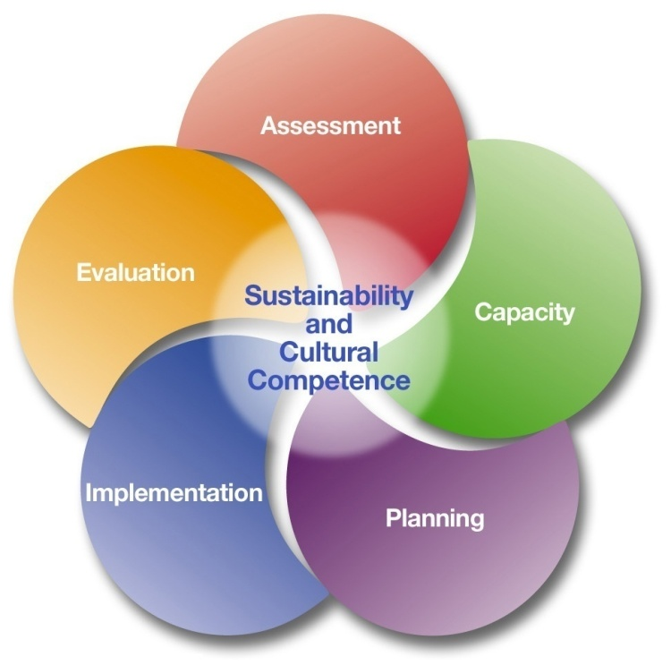
Strategic Prevention Framework
Notes:
Share with participants that the SPF is the “How” of prevention. It is a strategic planning process that SAMSHA (Substance Abuse and Mental Health Services Administration) has identified and evidence supports as being effective at identifying and implementing prevention practices.
“Strategic Prevention Framework (SPF), a 5-step planning process that guides the selection, implementation, and evaluation of evidence-based, culturally appropriate, sustainable prevention activities. The SPF's effectiveness begins with a clear understanding of community needs and depends on the involvement of community members in all stages of the planning process. Each step contains key milestones and products that are essential to the validity of the process. Focused on systems development, the SPF reflects a public health, or community-based, approach to delivering effective prevention.
The SPF includes these steps, guided by the principles of cultural competence and sustainability:
Step 1. Assess Needs
Step 2. Build Capacity
Step 3. Plan
Step 4. Implement
Step 5. Evaluate
And, once you have gone through the process, you begin again to continue to monitor and evaluate your programing to be sure you continue to meet the needs of the community as the needs, and the community, change.

Slide 15
Funding Statements
ORN Funding Statement
Funding for this initiative was made possible (in part) by grant no. 1H79TI085588 from SAMHSA. The views expressed in written conference materials or publications and by speakers and moderators do not necessarily reflect the official policies of the Department of Health and Human Services; nor does mention of trade names, commercial practices, or organizations imply endorsement by the U.S. Government.
PTTC Funding Statement
This slide deck was created by the PTTC network through cooperative agreements from the Substance Abuse and Mental Health Services Administration (SAMHSA). All material appearing in this presentation, except that taken directly from copyrighted sources, is in the public domain and may be reproduced or copied without permission from SAMHSA or the authors. Citation of the source is appreciated. Do not reproduce or distribute this presentation for a fee without specific, written authorization from the Great Lakes PTTC. For more information on obtaining copies of this presentation, email events@chess.wisc.edu.
At the time of creation of this document, Dr. Miriam Delphin-Rittmon serves as Assistant Secretary for Mental Health and Substance Use. The opinions expressed herein are the views of the speakers and do not reflect the official position of the Department of Health and Human Services (DHHS), SAMHSA. No official support or endorsement of DHHS, SAMHSA, for the opinions described in this document is intended or should be inferred.
May 2023

