Slide 1



Semi-Synthetic Cannabis Products: Public Health Concerns and Policy Solutions
Delivered by:
Prevention Technology Transfer Center Cannabis Risk Workgroup
May 23, 2024
Notes:
Welcome everyone, thank you for joining us today for the Semi-Synthetic Cannabis Products: Public Health Concerns and Policy Solutions hosted by the PTTC Network Cannabis Risk Workgroup.

Slide 2

Acknowledgement:
The event in which you are about to participate is provided through the Prevention Technology Transfer Center National Coordinating Office, a program funded through the Substance Abuse and Mental Health Services Administration’s (SAMHSA). Reference # # 1H79SP081018.
The views expressed do not necessarily reflect the official policies of the Department of Health and Human Services; nor does mention of trade names, commercial practices, or organizations imply endorsement by the U.S. Government.
Notes:
As a quick disclaimer, this event is made possible in part by funding from the Substance Abuse and Mental Health Services Administration’s (SAMHSA), The views expressed do not necessarily reflect the official policies of the Department of Health and Human Services; nor does mention of trade names, commercial practices, or organizations imply endorsement by the U.S. Government.

Slide 3

This Webinar is Now Live
This webinar is being recorded and will be available for future viewing along with a copy of today’s slides.
The recording and slides will be posted on the PTTC Network’s Products and Resources Catalog at pttcnetwork.org in approximately 5 business days.

Slide 4

Certificates of Attendance
Certificates of attendance will be provided via email in approximately 48 hours.
They will be sent with the post event survey.

Slide 5

Chat and Q&A Features
Please use the chat feature for comments and discussions. We welcome your thoughts and hope for a rich conversation in the chat.
Type any questions for the presenters in the Zoom Q&A function. These questions will be addressed by the presenters at the end of the webinar.

Slide 6




About the PTTC Network
Implementation
Improve implementation and delivery of effective substance use prevention interventions.
Technical Assistance
To meet the needs of recipients and the prevention field.
Evidence Based
Based in prevention science and use evidence-based and promising practices.
Network
Leverage the expertise and resources available through the alliances formed within and across the HHS regions and the PTTC Network.

Slide 7
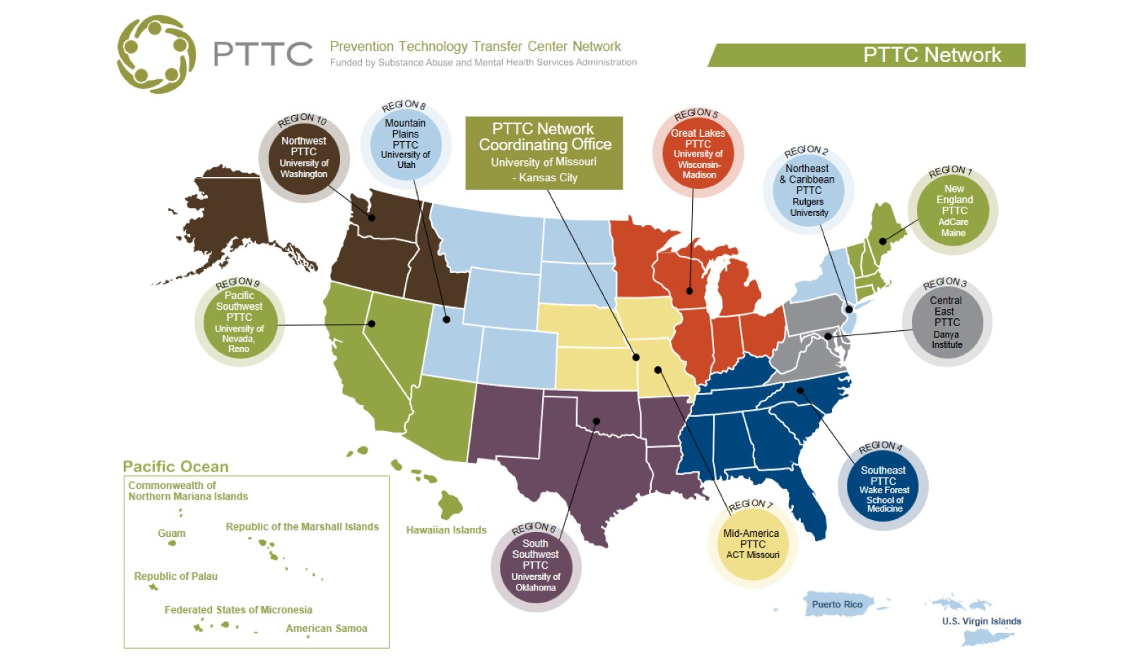
Notes:
the PTTC Network is comprised of 10 Domestic Regional Centers and a Network Coordinating Office. Together the Network serves the 50 U.S. states, the District of Columbia, Puerto Rico, the U.S. Virgin Islands, and the Pacific Islands of Guam, American Samoa, Palau, the Marshall Islands, Micronesia, and the Mariana Islands.

Slide 8


Slide 9
Objectives
By the end of this webinar, participants will be able to:
Describe recent shifts in the US cannabis market and their implications for public health and safety
Describe various cannabinoid analogs and their chemical similarities and differences
Identify the health risks associated with cannabinoid analogs
Critique marketing tactics that promote semi-synthetic cannabis products, especially those targeting youth
Summarize laws and policies that are effective in addressing the related public health issues

Slide 10
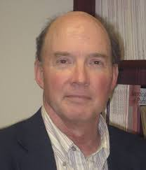

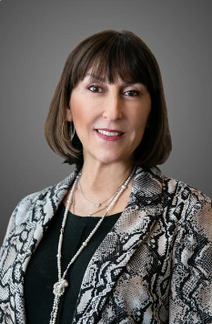

Meet the Presenters
Dr. Ken Winters
Dr. Matthew Rossheim
Sue Thau
Notes:
Dr. Ken Winters is a Senior Scientist at the Oregon Research Institute (MN location) and a Consultant for the Native Center for Behavioral Health at the University of Iowa. He previously was a Professor at the University of Minnesota’s Department of Psychiatry, where he founded and directed for 25 years the Center for Adolescent Substance Abuse Research. He is a board member and co-founder of Smart Approaches to Marijuana Minnesota, an affiliate to the national organization. Dr. Winters has received numerous research grants to address behavioral health from NIH and various foundations, and is a frequent publisher in scientific journals. Of note, he co-edited with Kevin Sabet, Contemporary Health Issues on Marijuana, published in 2018 by Oxford University Press.
Dr. Matthew Rossheim is an Associate Professor at the University of North Texas Health Science Center. His work, including more than 80 peer-reviewed research manuscripts and 100 scientific presentations, has helped influence the development of laws from the local- to federal-levels. He is a leading public health expert on derived intoxicating cannabis products and their marketing.
Sue Thau is a Public Policy Consultant representing Community Anti-Drug Coalitions of America (CADCA). She is nationally recognized for her advocacy and legislative accomplishments on behalf of the substance abuse prevention field. She has an extensive background in public policy and has held high positions at the federal, state, and local levels. She was a Budget Examiner and Legislative Analyst at the Office of Management and Budget, in the Executive Office of the President for over ten years. Sue was a driving force behind the passage, reauthorization and full funding of the Drug-Free Communities Act. In addition, Sue has worked to save and enhance funding for all federal substance abuse prevention and treatment programs over the last three decades. She is highly respected as an expert on demand reduction issues by members of Congress and staff on both sides of the aisle on Capitol Hill. Sue has an undergraduate degree from Cornell University in Human Development and Family Studies and a Master's Degree from Rutgers University in City and Regional Planning.

Slide 11
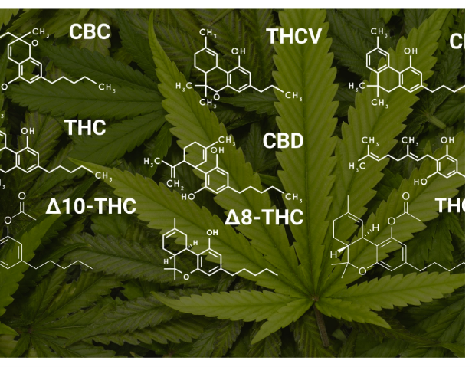
1. Background
4. Summary
2. Semi-Synthetics
(Analogs)
3. Potency

Slide 12

What expertise do I have about chemistry?

Slide 13

What expertise do I have about chemistry?

Slide 14
1. Background
4. Summary
2. Semi-Synthetics
(Analogs)
3. Potency

Slide 15
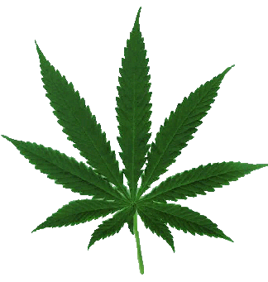











Background #1:
The Six “Majors” Analogs to Delta-9 (THC)
Type | Strength | Legality | Detectable in User | Primary Source
Delta-8
Delta-10
Delta-11
HHC
THC-A
THC-P
?
½ Delta-9
CBD→solvents
?
$Δ$9?
CBD→solvents
?
CBD→solvents
?
CBD→solvents
$Δ$9?
CBD→solvents
30
?
$Δ$9?
CBD→solvents
Notes:
They referred to “analogs” because similar to the chemical structure to Delta 9 or THC. And they are a group for which there is some research-based information.
Those on list after Delta-9 are found naturally in cannabis plant but only in very small quantities.
To produce commercial delta 8 or delta 10 products, legal hemp-derived CBD is treated with heat or chemical catalysts to convert it into the other cannabinoids.
The same is true of the newly commercialized delta 11 THC and other popular cannabinoids closely related to THC, like HHC and THCP. Cannabinoids not found naturally in the hemp plant (like THC-O) cannot be legally produced from hemp-derived CBD, even though it is possible to do so.
THCP binds 33 times more readily with the body’s CB1 receptors, possibly making it the strongest commercially available cannabinoid. However, that’s a big “possibly.” There’s no actual proof that enhanced receptor binding translates to ultra-high potency.

Slide 16
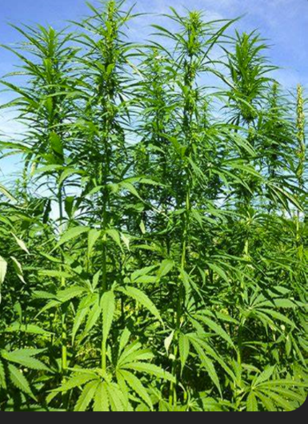
Background #1:
Eight “Other” Analogs
CBG
CBN
Delta-6
THC-B
THC-JD
THC-O
THCV
THC-X
Notes:
Other group: because virtually no research on their effects; only anecdotal reports; consumer beware about claims of their effects

Slide 17
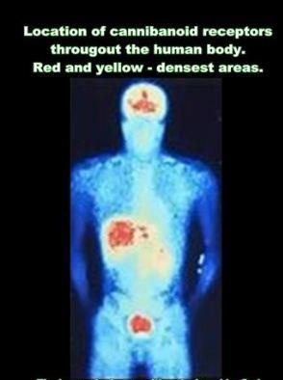
Background #2: Why We Get High From the Cannabinoids?
All intoxicating cannabinoids have a trait in common: they bind to the endogenous cannabinoid receptors located throughout the body
  two primary ones have been identified – CB1 and CB2
  these receptors are prominent in the brain, but also located throughout the body
Expected potency effects of a cannabinoid based on its binding affinity to CB1/CB2 (some exceptions)

Slide 18

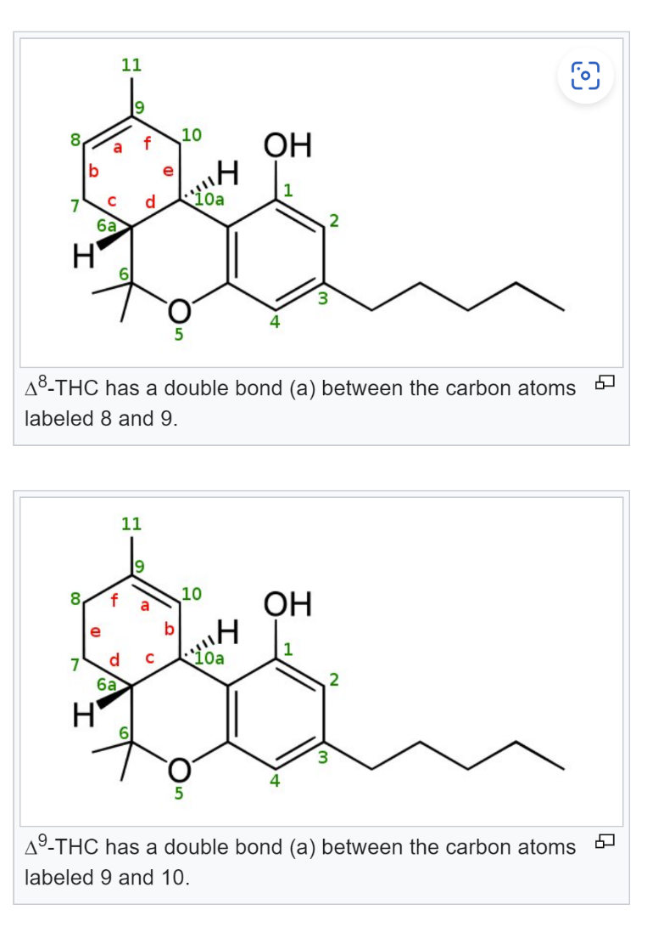
Chemical Structure & Binding Affinity
  One chemical structural factor related to binding affinity: location of the “double bond”
      Example:
        Delta-8 and Delta-9 have different locations of a “double bond” between carbon atoms
        Delta-9’s double bond location causes more binding affinity to CB1 receptors compared to Delta-8
8
9
Notes:
A double bond occurs when two atoms share two sets of electrons, or 4 electrons (electrons are always shared in pairs).
Delta term: Used in chemistry to reflect change in concentration.

Slide 19
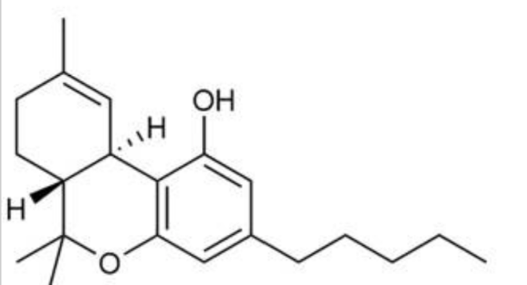
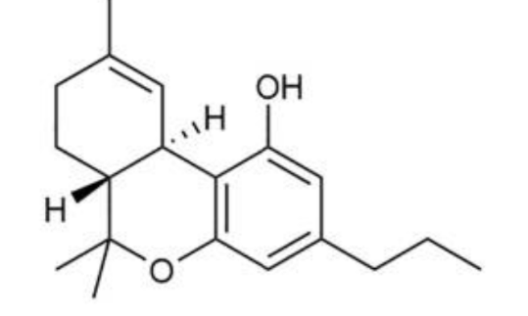
Chemical Structure & Binding Affinity
  Another chemical structural factor related to binding affinity: length of the carbon tail
  length of the carbon tail is a marker of potency differences
  longer tails tend to bind better to CB1
Delta-9
THCV
Notes:
CBD exception: has very long tails but does not bind to CB brain receptors

Slide 20
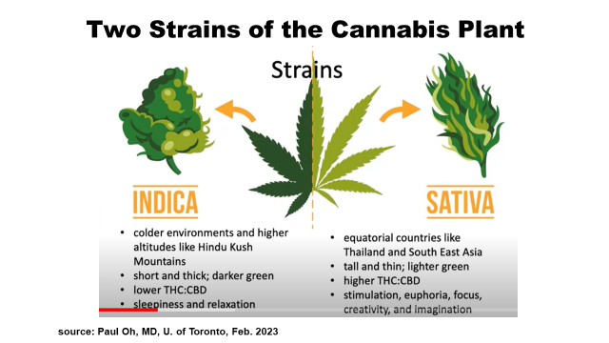
Background #3: The Analogs Need CBD
cannabis plants: ~ 0.10% is CBD
hemp plant: ~ 5-15% is CBD

Slide 21
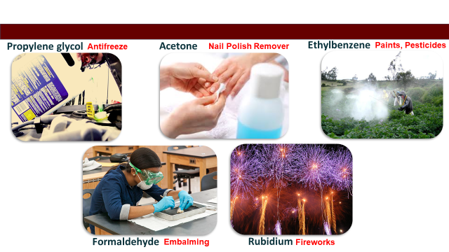
Background #4: The Analogs Need Chemicals
  Hemp ----------------------→CBD-----------------------→product
  Harmful solvents, acid, and other “chemical constituents” are needed to convert the CBD into the target analog
    these chemicals and by-products during manufacturing may be consumed or inhaled
Notes:
Common chemicals: Heptane, Hexane, Cyclohexane, Toluene, Sulfuric acid, Hydrochloric acid, sulfonic acid
Some are used in engine fluid, glue, and various cleaners.
If consumed or inhaled, these chemicals and the by-products created during manufacturing can be harmful.

Slide 22
Background #5: Research on the Analogs
Scientists have known about these rare analogs; but little, if any, lab research
Why?
  some occur in negligible amounts naturally
  with some exceptions, not on the radar for most cannabis researchers
Anecdotal reports of effects dominate

Slide 23

Background #5: Research on the Analogs
Not clear how different analogs overload the endocannabinoid receptors
Example: Some of the analogs bind to CB1/CB2 with greater binding affinity than Delta-9, but the experienced “high” may not be proportionally as strong

Slide 24
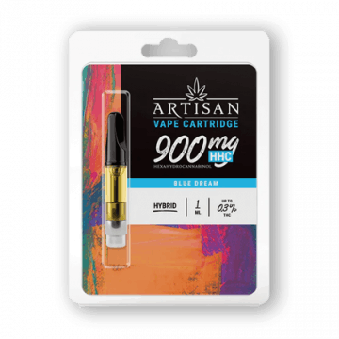
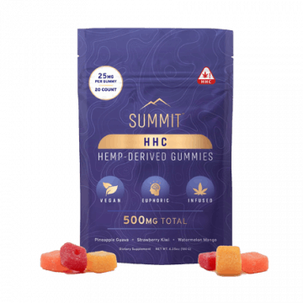
Background #6: Analogs as Vapes and Edibles

Slide 25
1. Background
4. Summary
2. Semi-Synthetics
(Analogs)
3. Potency

Slide 26
The Six “Majors”
Type | Strength | Legality | Detectable in User | Primary Source
Delta-8
Delta-10
Delta-11
HHC
THC-A
THC-P
?
½ Delta-9
CBD→solvents
?
$Δ$9?
CBD→solvents
?
CBD→solvents
?
CBD→solvents
$Δ$9?
CBD→solvents
30
?
$Δ$9?
CBD→solvents
Notes:
Those on list after Delta-9 are found naturally in cannabis plant but only in very small quantities.
To produce commercial delta 8 or delta 10 products, legal hemp-derived CBD is treated with heat or chemical catalysts to convert it into the other cannabinoids.
The same is true of the newly commercialized delta 11 THC and other popular cannabinoids closely related to THC, like HHC and THCP. Cannabinoids not found naturally in the hemp plant (like THC-O) cannot be legally produced from hemp-derived CBD, even though it is possible to do so.
THCP binds 33 times more readily with the body’s CB1 receptors, possibly making it the strongest commercially available cannabinoid. However, that’s a big “possibly.” There’s no actual proof that enhanced receptor binding translates to ultra-high potency.

Slide 27
Delta-8
“Delta-9 Light” or “Diet Weed”
  yields less pronounced euphoria and fewer side effects
Sales are gaining in popularity due to…
  some prefer the “diet” effect
  lack of clear regulations

Slide 28
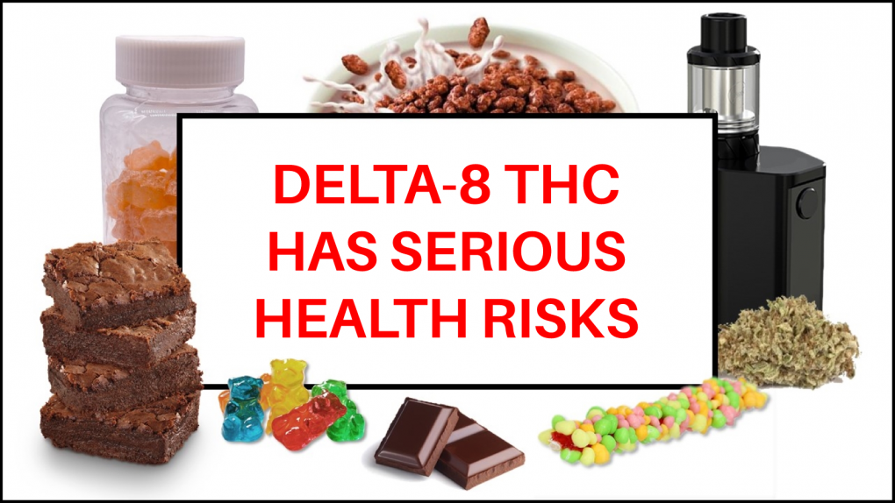
FDA: 5 Things to Know about Delta-8
Not safe
Received >100 adverse event reports
Is intoxicating
Can be adulterated
Danger to children and pets
Notes:
Google: FDA and Delta-8 risks

Slide 29
Delta-10 & Delta-11
Delta-10: milder than Delta-8 (?)
Delta-11: more potent than Delta-9 (?)

Slide 30
HHC
Strength in-between Delta-8 and Delta-9 (?)
Tricky to manufacture; hydrogen is added to the THC molecule (hydrogenation)

Slide 31
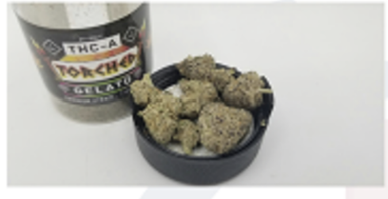
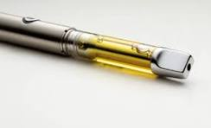
THC-A
Effects similar to Delta-8 (?)
Heating it (e.g., vape pen) required to create an effect
Notes:
Consuming raw THCA, without heating and decarbing it, definitely won’t get you high. However, many THCA products, like vape carts or disposables, convert the contained THCA into delta 9 THC (by heating it) before the vapor even reaches your lungs.
Most THCA hemp products contain only small to moderate amounts of the cannabinoid—probably not enough to get the user high—or are misleadingly labeled and contain none at all. Always check the product’s certificate of analysis (COA) to verify its contents.

Slide 32
THC-P
Among all cannabinoids studied, THC-P appears to have the greatest binding affinity to CB1 receptors
Chemical structure suggests up to 30x greater binding to CB1 compared to Delta-9
Not clear how pronounced an effect on the user

Slide 33
The “Other” Analogs
CBG/CBN
  both similar to CBD; CBN: neuroprotective ?
Delta-6
  similar to Delta-8 ?
THC-B
  analgesic effects ?
THC-JD
  as potent as THC-P ?
THCV
  may decrease appetite (“diet weed”) ?
THC-O
  stronger than Delta-9 ? Hallucinating?
THC-X
  marketing buzzword ?
Notes:
Reminder: virtually no research; may be marketed as an added ingredient in a cannabis product
CBN: getting on the radar screen of researchers as having neuroprotective properties

Slide 34
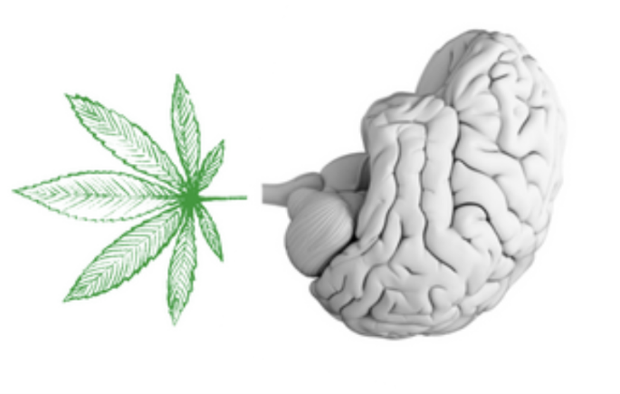
1. Background
4. Summary
2. Semi-Synthetics
(Analogs)
source: Recovery Research Institute
3. Potency

Slide 35
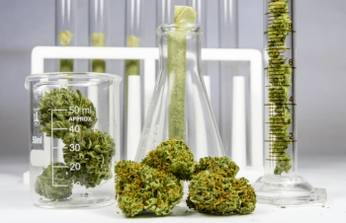
A Speculative Potency Strength Continuum of Select Cannabinoids
Final Point: Potency Likely Impacts Acute and Chronic Effects, Regardless of Which Cannabinoid is Consumed
STRONGER
LIGHTER
THCV?
CBD
THC-JD?
Delta-11?
Delta-9
HHC?
Delta-8
Delta-10?
CBG
THC-P?
THC-O?
THC-B?
THC-A?
CBN

Slide 36
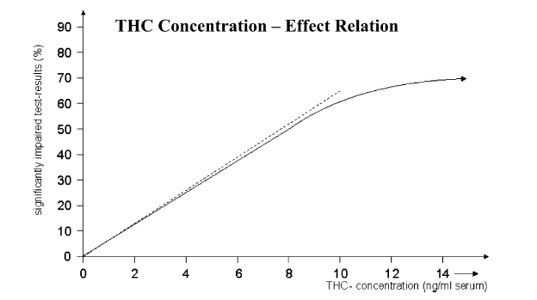
Cannabis Potency: Cognitive Functioning
Review of Cognitive Performance and THC (adapted from Berghaus et al., 1998; cited in Ramaekers et al., 1994)
Synthesis from 87 experimental studies that examined acute effects of cannabis
All studies compared pre-post results on one or more cognitive tests as a function of THC concentration in plasma after eating (---) and smoking (—) cannabis
    tracking, reaction time performance, eye-hand coordination, distractibility
Data in the chart are the frequency (%) of observed significantly impaired cognitive test results associated with varying levels of THC
eating THC
smoking THC

Slide 37

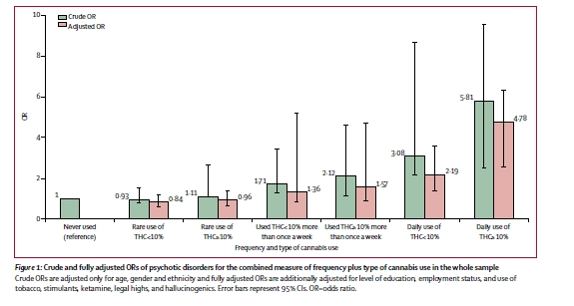
Cannabis Potency:
Risk of First Episode Psychosis (Di Forti et al., 2019)
Daily use, high potency
Source: Lancet Psychiatry, 2019
Daily use of low potency cannabis = adjusted odds ratio, 3.2
  Daily use of high potency cannabis = adjusted odds ratio, 4.8
Control group: non users
Notes:
901 patients with first episode psychosis across 11 clinic sites in Europe compared to 1237 population controls

Slide 38
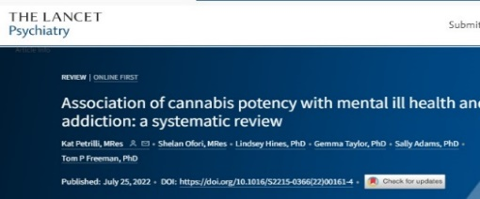
Cannabis Potency:
Risk of Mental Illness (Petrilli et al., 2022)
Systematic literature review of published research on the association of cannabis potency with mental health and addiction
20 met the eligibility criteria: eight studies focused on psychosis, eight on anxiety, seven on depression, and six on Cannabis Use Disorder (CUD)
“Overall, use of higher potency cannabis, relative to lower potency cannabis, was associated with an increased risk of psychosis and CUD. Evidence varied for depression and anxiety.”

Slide 39
1. Background
4. Summary
2. Semi-Synthetics
(Analogs)
3. Potency

Slide 40

The non-Delta-9 cannabinoid analogs represent the wild west in the marketplace and mostly unchartered territory in terms of research.
The manufacturing process can lead to toxic products being consumed.
Regardless of the type of cannabinoid consumed, “heavy” consumption of any cannabinoid likely contributes to more short- and long-term harms compared to “light” consumption.

Slide 41

Suggested Resources
  1. Research publication:
  Shahbazi, F., Grandi, V., Banerjee, A., & Trant, J. F. (2020). Cannabinoids and cannabinoid receptors: The story so far. IScience, 23 (7).
2. Web site (caution – it’s a vaping site):
https://vaping360.com/learn/strongest-cannabinoid-thc-delta-variants/

Slide 42

Marketing and Retail Availability of Semisynthetic Cannabinoids
Matthew Rossheim, PhD, MPH, CPH
University of North Texas Health Science Center
School of Public Health

Slide 43
2018 Farm Bill
“Cannabis”
“Hemp”
> 0.3% Δ9
≤ 0.3% Δ9

Slide 44
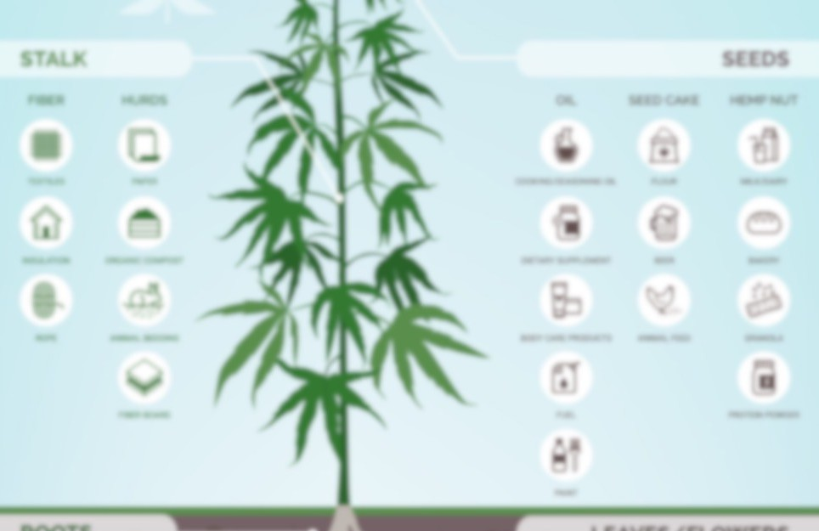
2018 Farm Bill
Δ6
THC-O
THC-JD
THC-P
“Cannabis”
“Hemp”
THC-B
Δ11
THC-A
THC-M
Δ9 edibles
HHC-O
Δ8
Δ10
HHC-P
>.3% Δ9
THC-A
PHC
Δ9
o
HHC
THCV
HXC-P
HXC

Slide 45
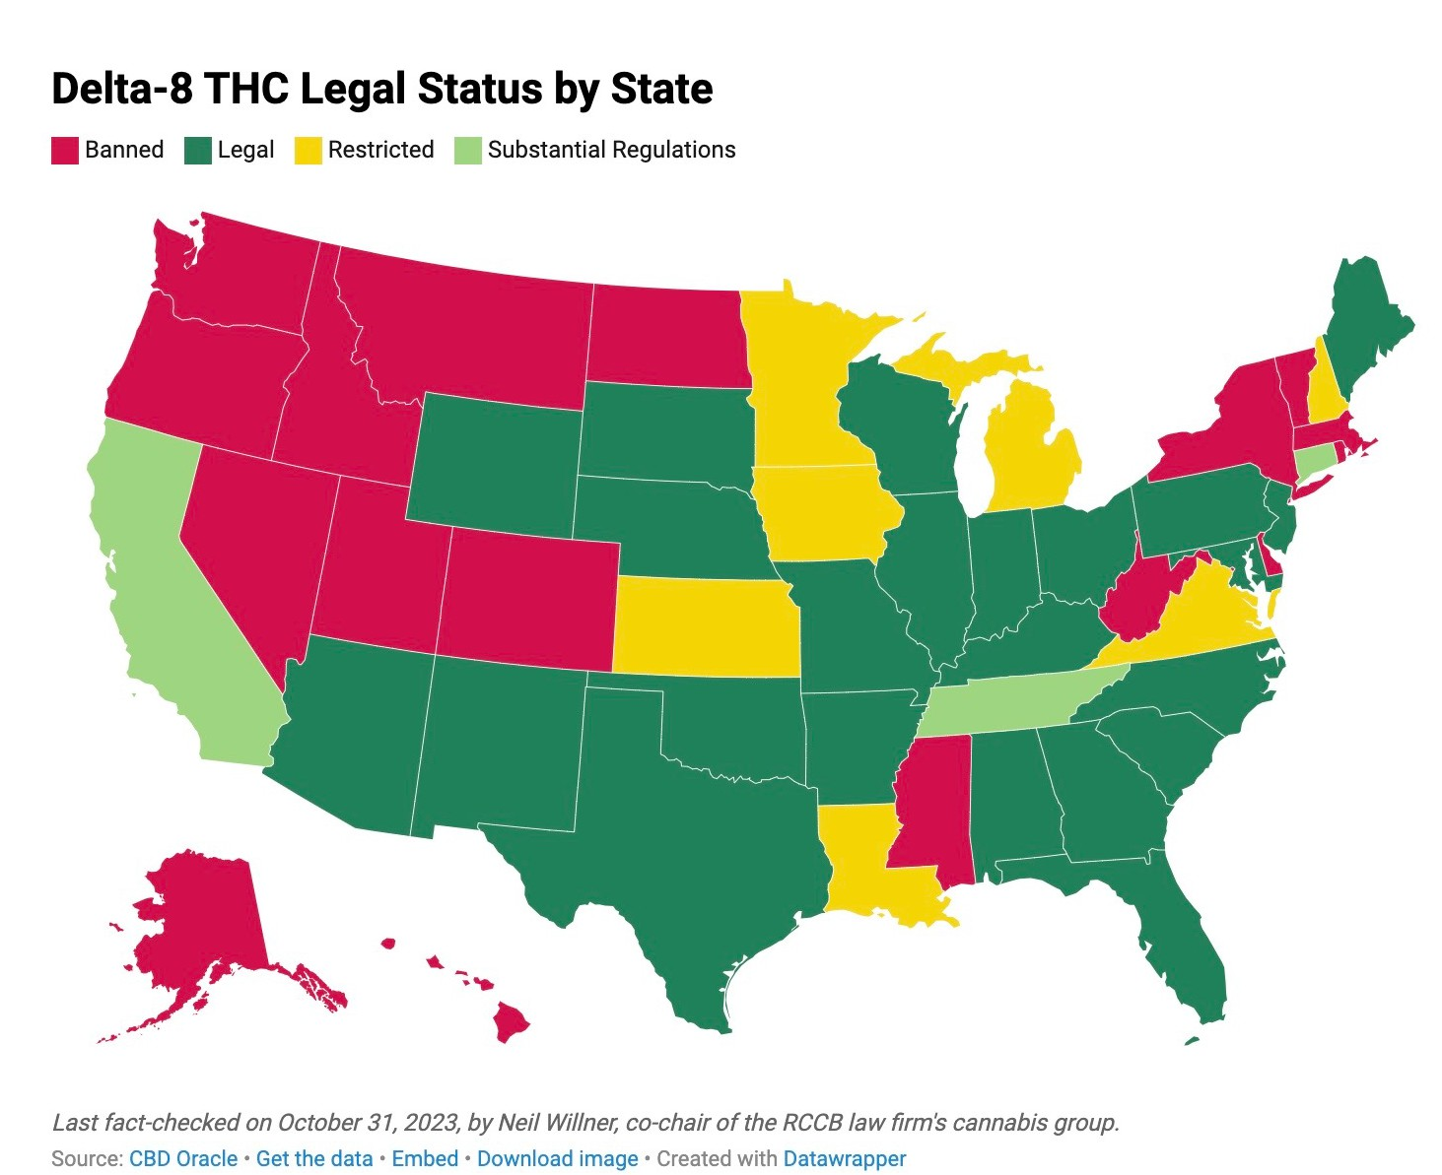
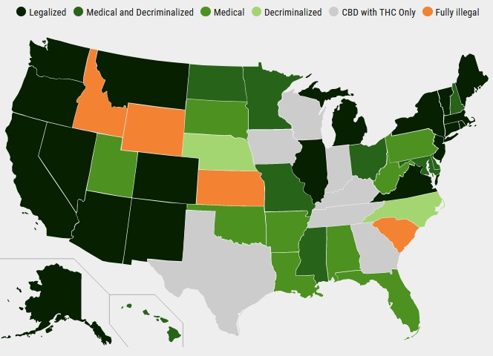
State Laws
Delta-9 THC

Slide 46
In which states can you buy intoxicating cannabis products?
Without a medical cannabis card
Where in the U.S. can you walk into a store and purchase
A cannabis product that can get you “high”

Slide 47
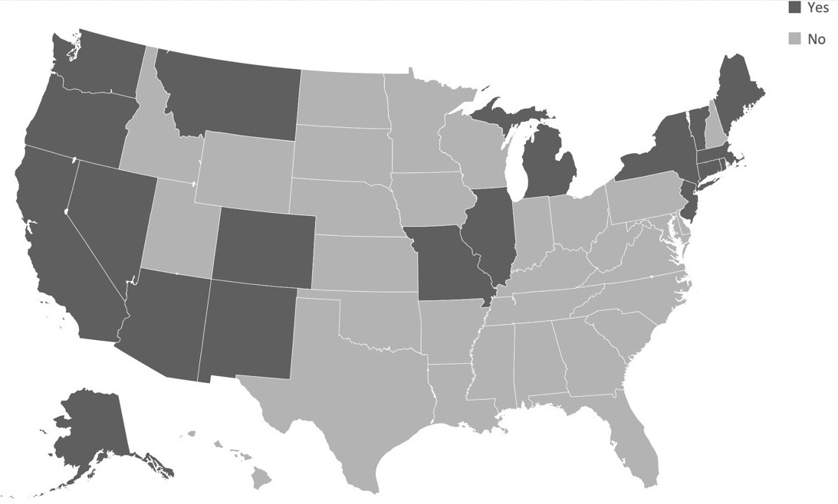
Retail Cannabis Legal + Dispensaries

Slide 48
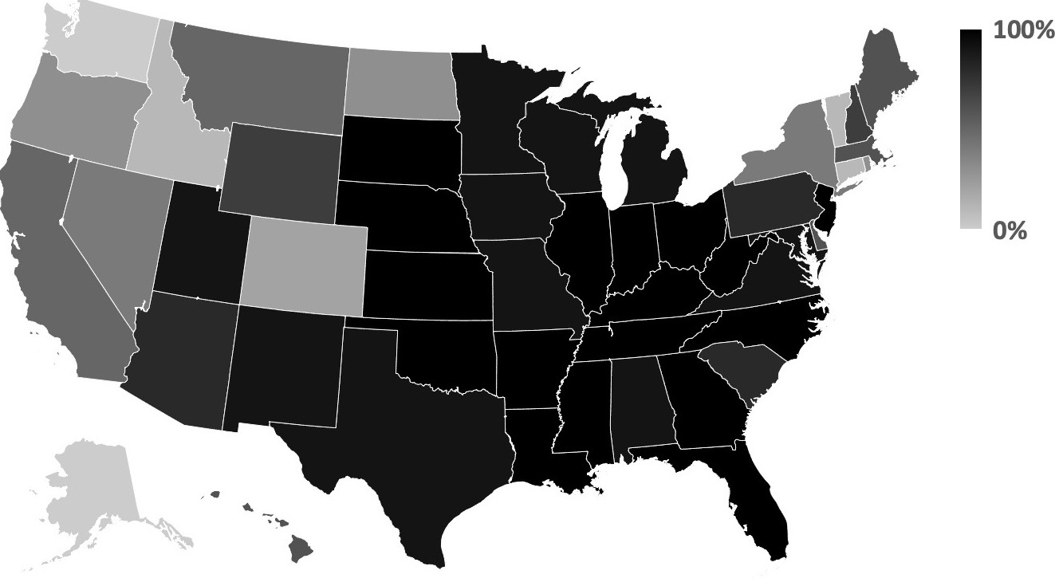
Vape Shops, November – December 2023:
Sell Intoxicating
Cannabis Products

Slide 49
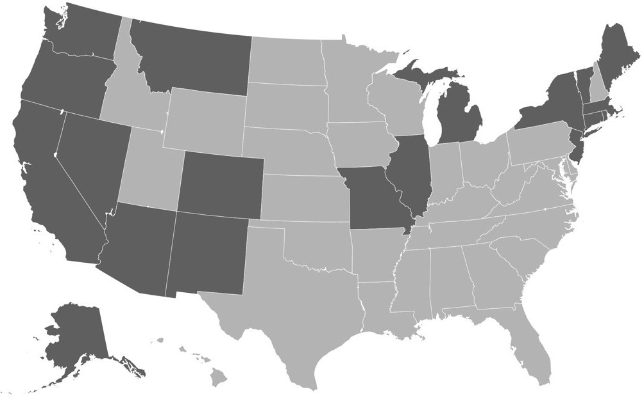
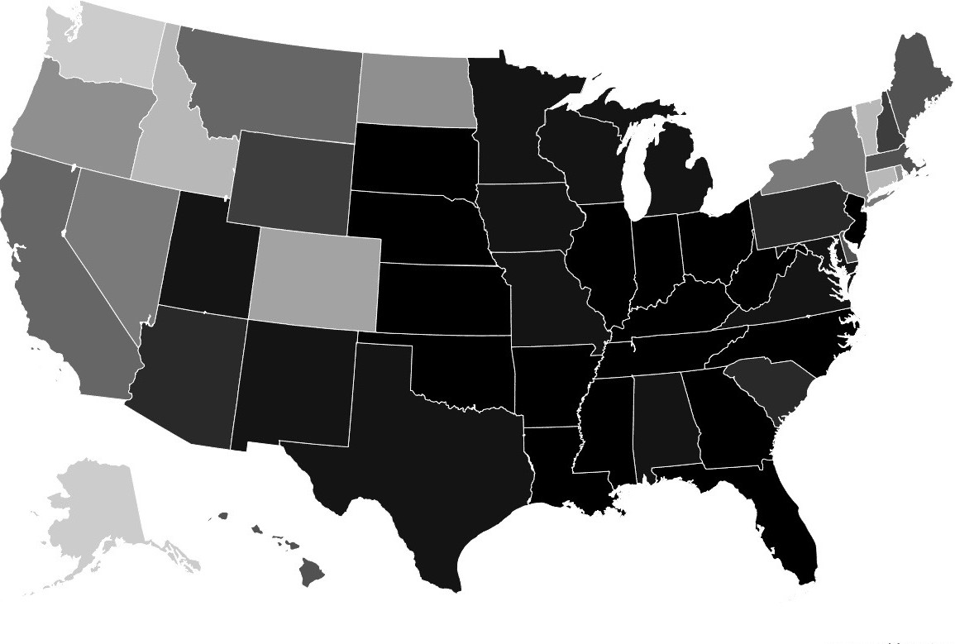
Retail Availability of Intoxicating Cannabis Products

Slide 50
Common Types Sold in Vape Shops Differs
Michigan & Massachusetts: HHC
Virginia: THCA
New York: Delta-9 THC edibles
Most states: All of them

Slide 51
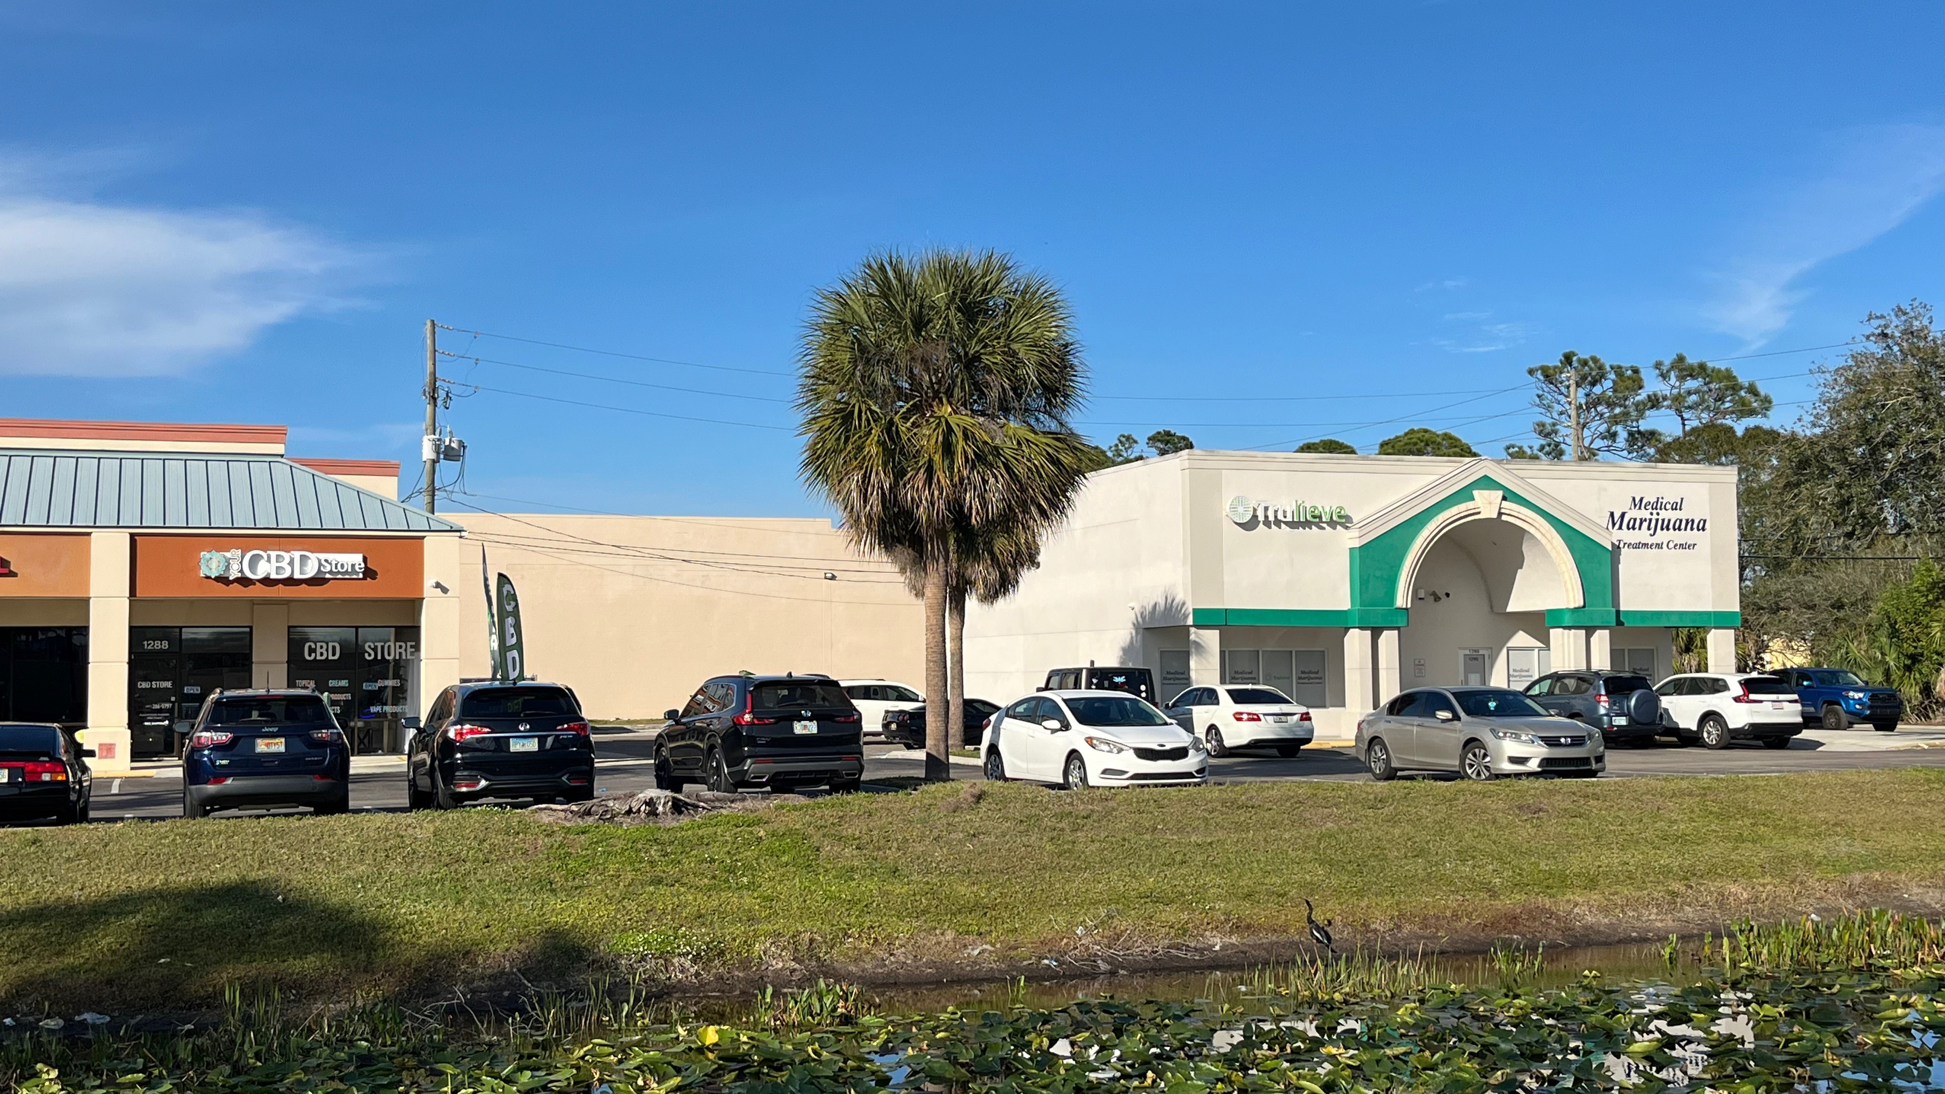

Slide 52
Purported Legality: New Hampshire
Some said all THC products illegal
Others reported only Delta-9 THC illegal
One did not understand what they were selling, explaining they did not sell any THC products, while simultaneously reporting that they sold Δ-8
  verified by providing related brand names
Others appeared to know they were potentially violating laws
  one reported “yes” to carrying each (Delta-8 THC, Delta-9 THC, Delta-10 THC, HHC, THCA, and THCO) with the caveat that the person calling was not a law enforcement officer ("If you're not a cop, yeah")

Slide 53
Purported Legality: Delaware
One retailer selling only Delta-9 products said that it was the only legal THC product
A different retailer stated the opposite: Delta-9 THC products were the only illegal to sell (they sold everything else: D8, D10, HHC, THCA, THCO)
A third Delaware retailer reported selling only Delta-9 THC vapes and HHC vapes, because they were purportedly the only legal products to sell
  Met the 0.3% THC by weight threshold, whereas claimed edibles were mislabeled in this regard

Slide 54
Why Marketing Matters
Shapes social norms and perceptions
  Make substances more desirable, acceptable, accessible
Availability and price are major determinants of use
  Particularly among young people
Important policy levers for prevention
  Retail availability
  Pricing strategies
  Restricting advertising to youth
Best Practices and Best Buys

Slide 55
Delta-8 THC: Retail Assessment, Fort Worth, 2021
Contacted 1,223 stores with alcohol, cannabidiol, and/or tobacco licenses
131 stores selling Δ-8 THC: low retail prices
  96% sold vapes and/or ‘‘flower’’ (hemp leaves coated with Δ -8 THC distillate)
  76% sold edibles
Edibles were available less expensive than flower/vapes
  least expensive product was $8.58 less on average
Δ-8 outlets were in areas with greater socioeconomic deprivation
Most reported a minimum purchase age of 21
  however, 4% reported 18 years or no minimum age
Rossheim, M.E. LoParco, C.R., Walker, A., Livingston, M.D., Trangenstein, P.J., Olsson, S., McDonald, K.K., Yockey, R.A., Luningham, J.M., Kong, A.Y., Henry, D., Walters, S.T., Thombs, D.L., & Jernigan, D.H. (2022). Delta-8 THC Retail Availability, Price, and Minimum Purchase Age. Cannabis and Cannabinoid Research. doi: 10.1089/can.2022.0079

Slide 56
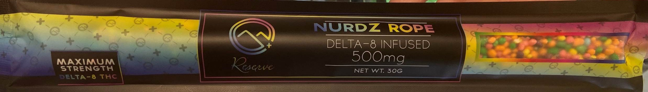
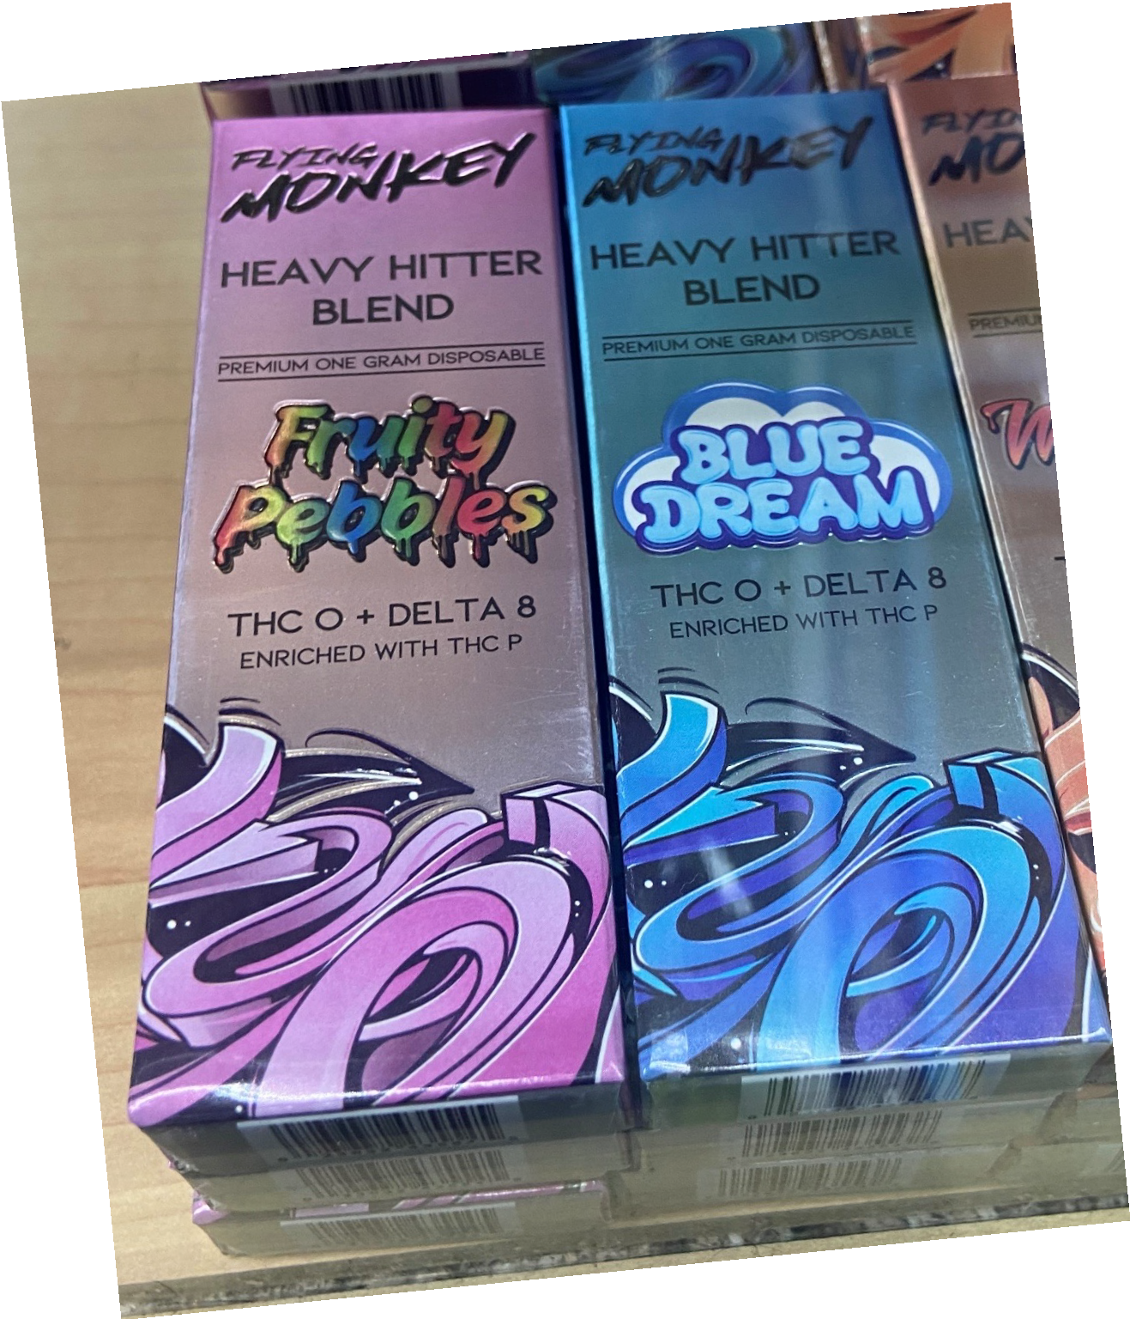
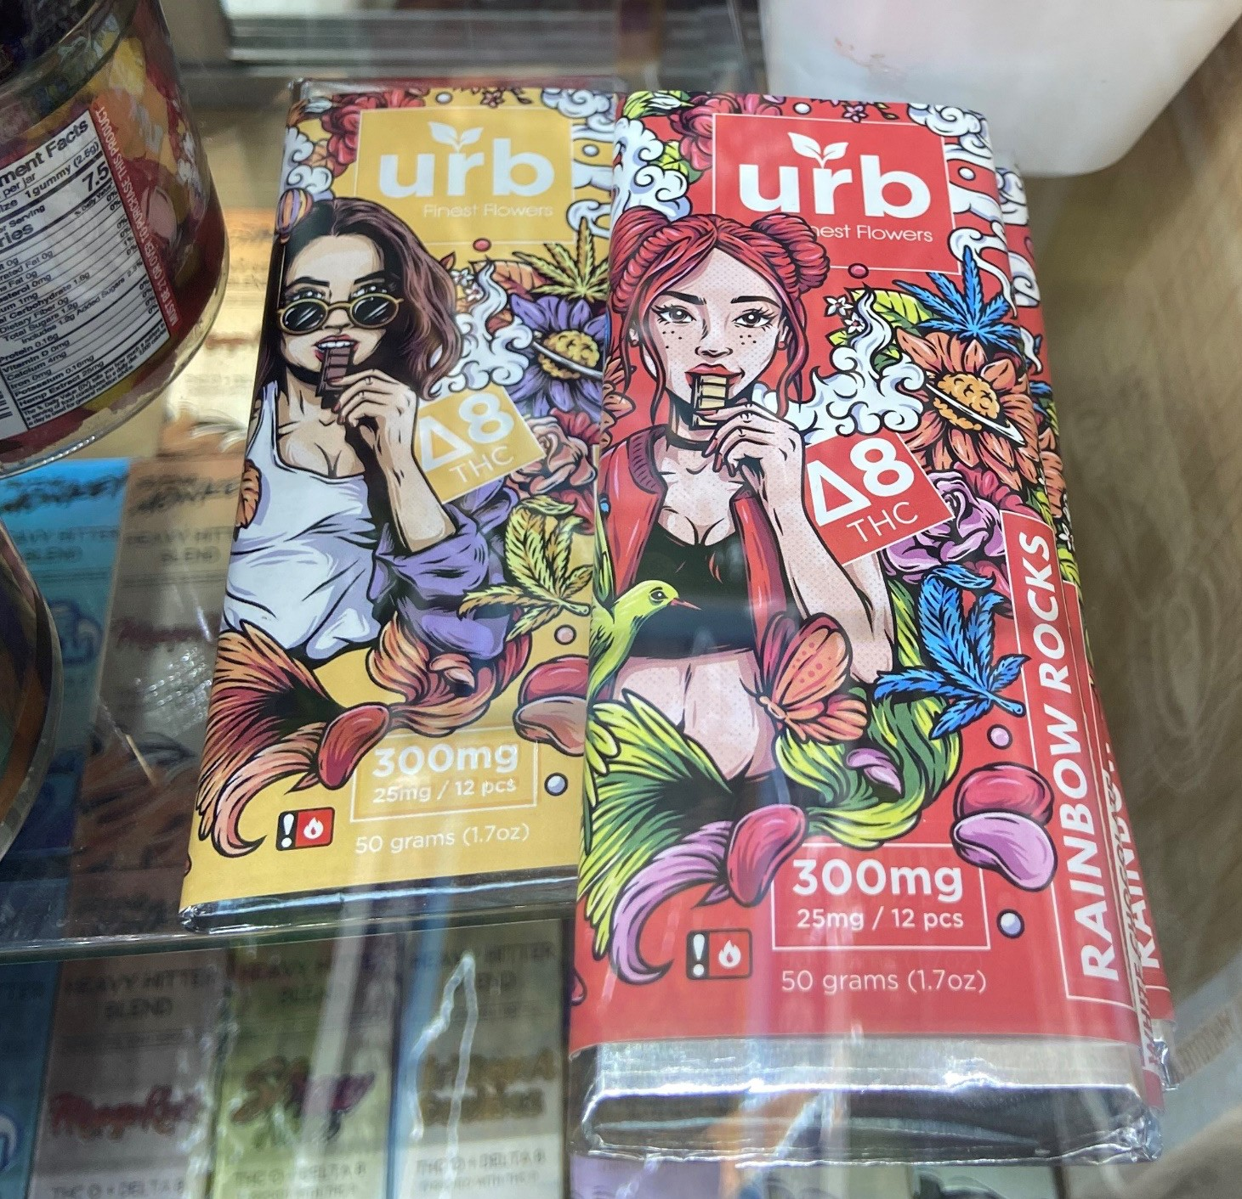
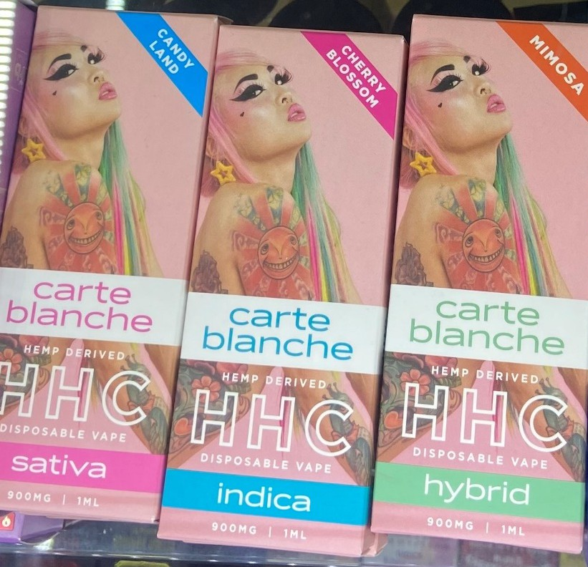
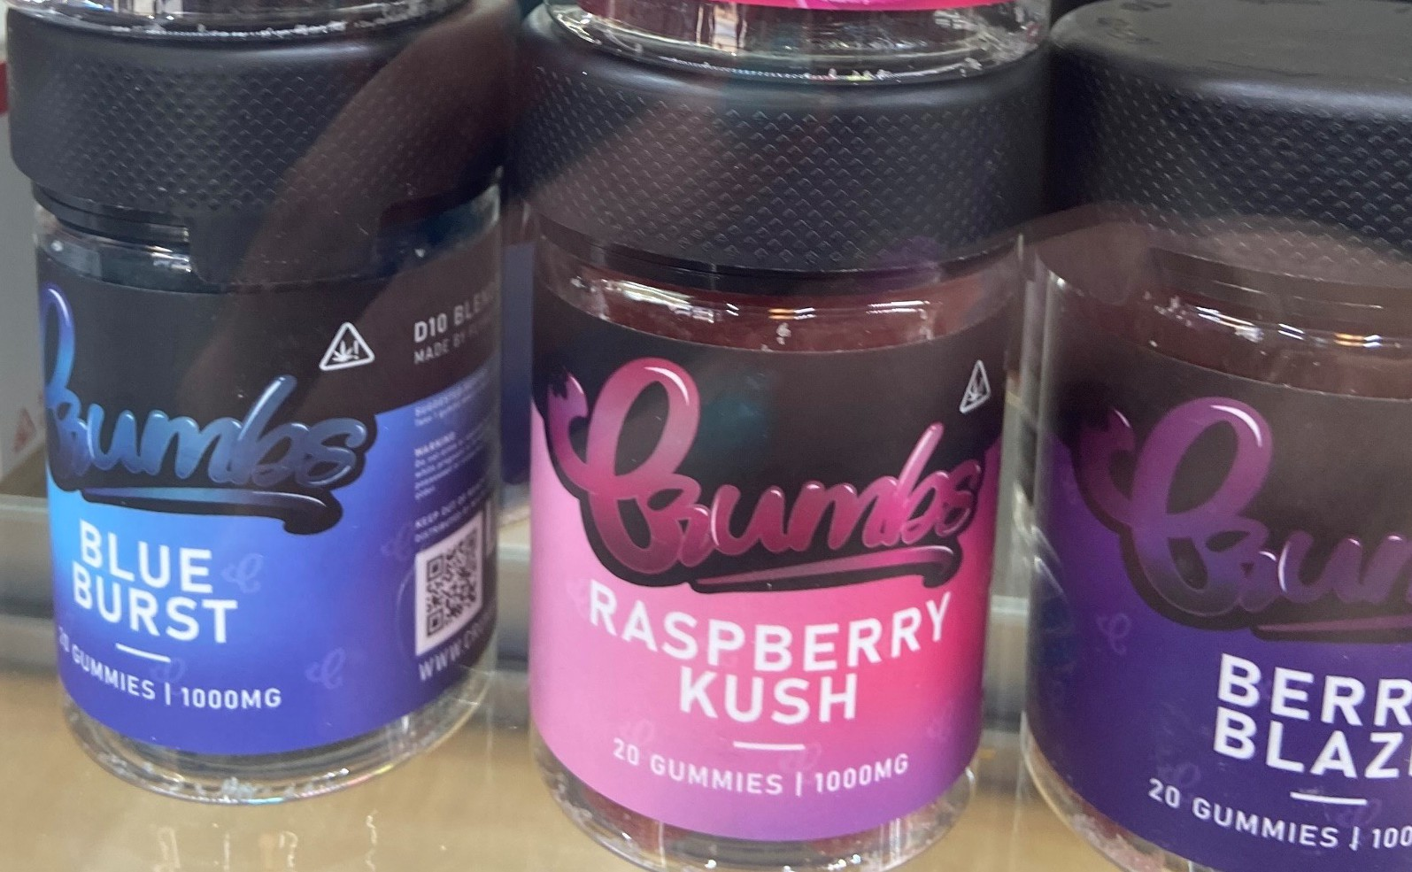
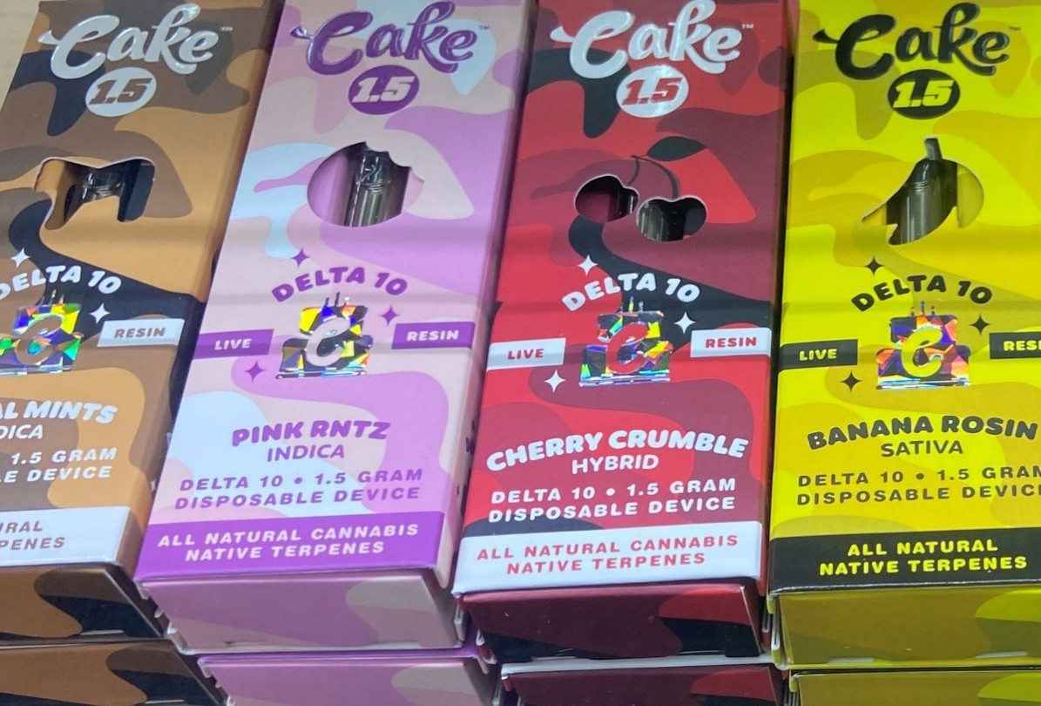

Slide 57
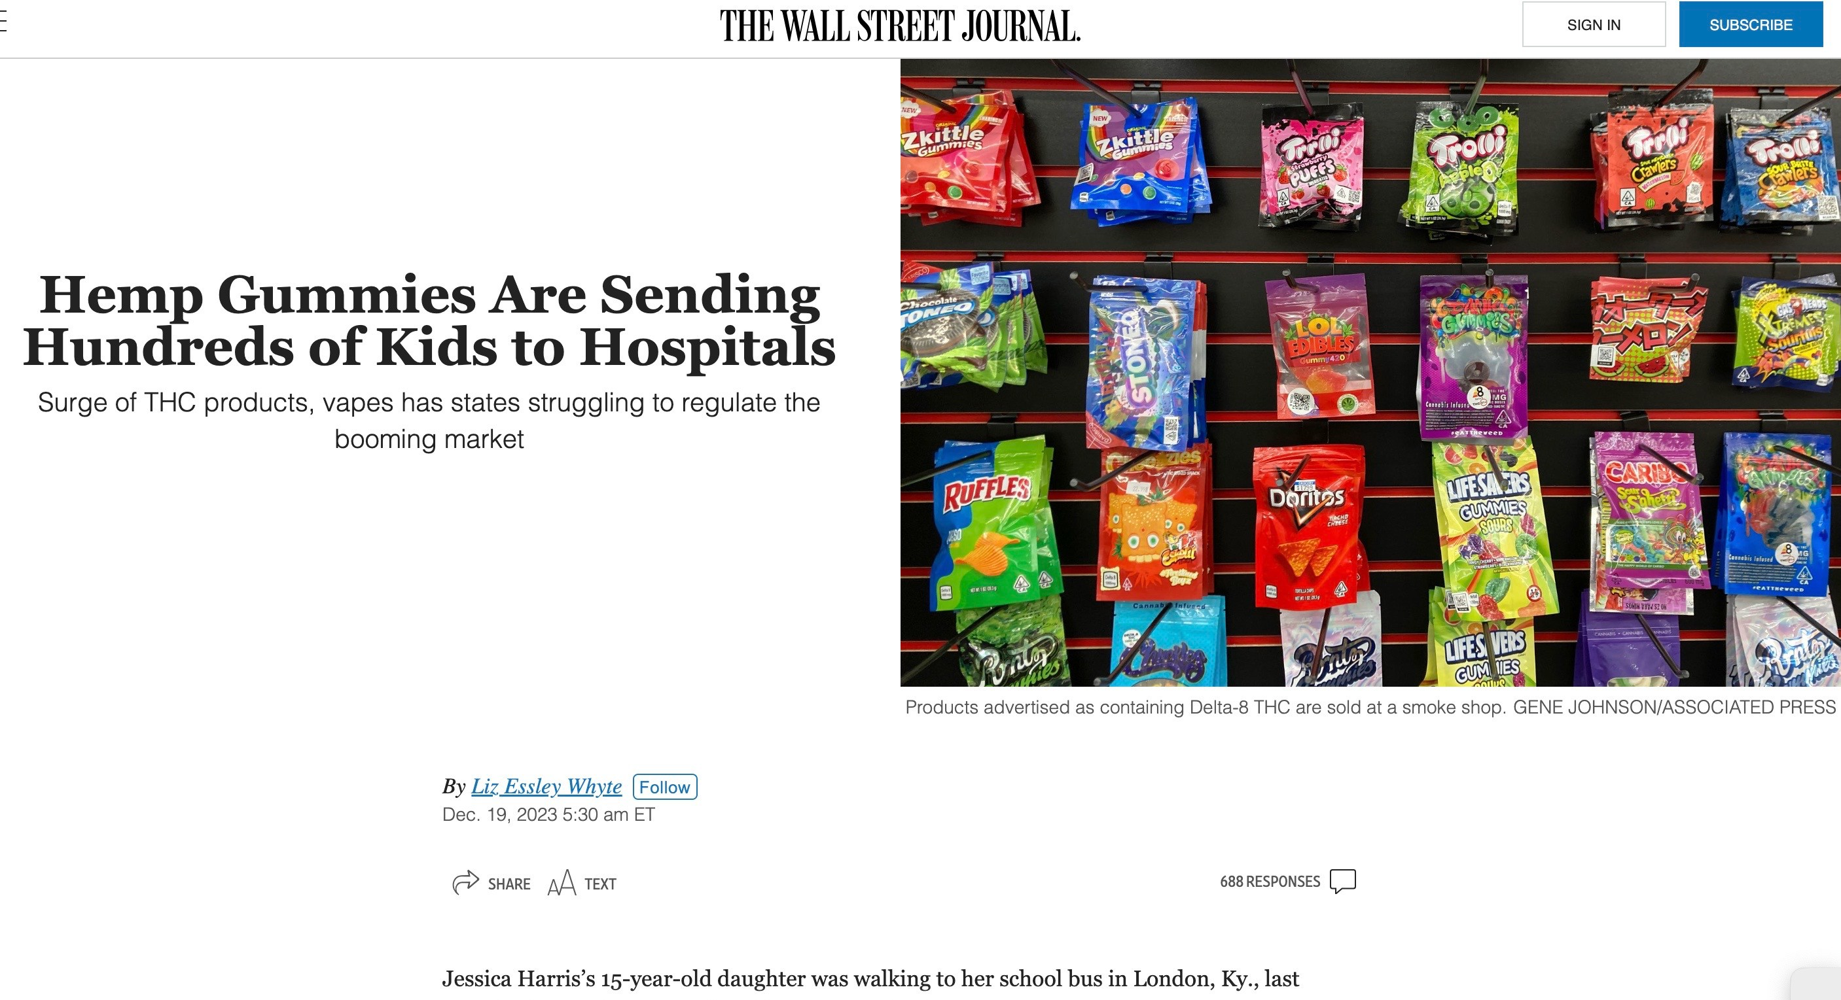
Where can kids buy THC?

Slide 58
Monitoring the Future Data, 2023
12th graders
  29% reported past year cannabis use
  11.4% reported Delta-8-THC use in the past year
2024
  8th and 10th graders will also be asked about Delta-8 THC use

Slide 59
Delta-8 THC: Online/Youth Access
8 Online Purchases of Delta-8 THC
  Easily accessible online
  Age verification methods are self-reported and easily circumvented
  Contact with the customer was never requested at the point of home delivery
  Policies and their enforcement are needed to prevent youth access from online sources
65 students in one Texas ISD caught with THC vapes 2022-2023 school year:
  Some used Snapchat & cash apps
Egan KL, Villani S, Soule EK. Absence of Age Verification for Online Purchases of Cannabidiol and Delta-8: Implications for Youth Access. J Adolesc Health. 2023 Mar 2:S1054-139X(23)00067-8. doi: 10.1016/j.jadohealth.2023.01.020.
https://www.cbs19.tv/article/news/local/65-students-charged-with-felony-for-bringing-thc-vape-tyler-isd-campuses/501-9bfbc945-6150-4f49-ad62-41114cef6db6

Slide 60
Online Retail Assessment
Methods
Google “buy delta thc” in incognito mode
Downloaded top 100 results using resultstoexcel.com
Used SimilarWeb to compare web traffic: top 3 sites

Slide 61
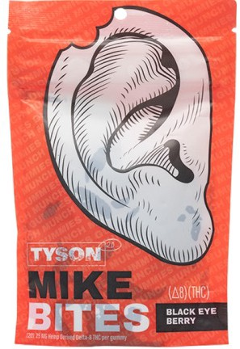
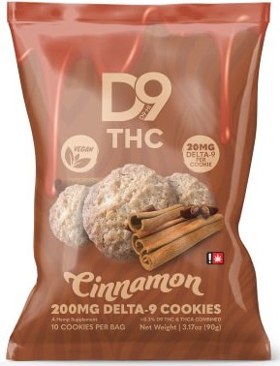
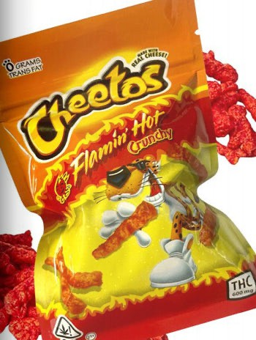
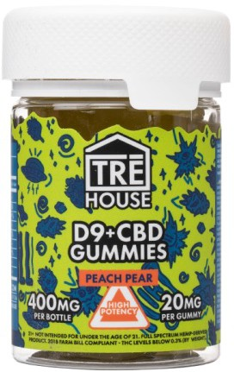
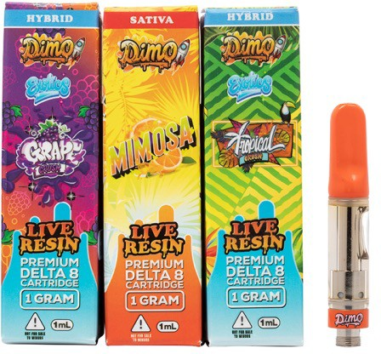
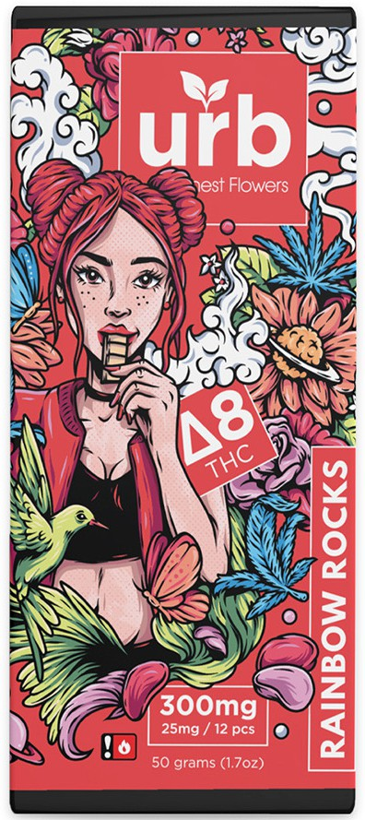
Delta-8 THC
Delta-9 THC

Slide 62
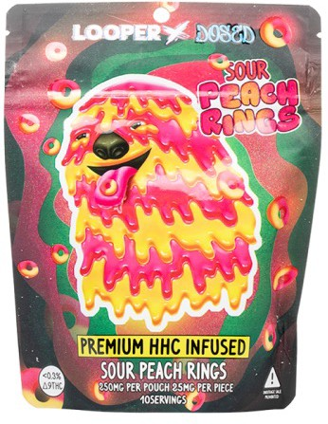
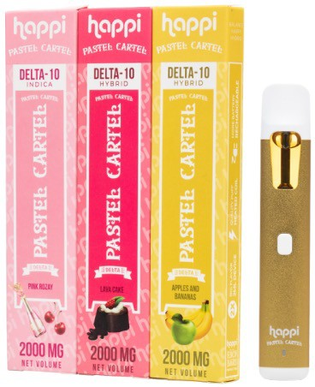
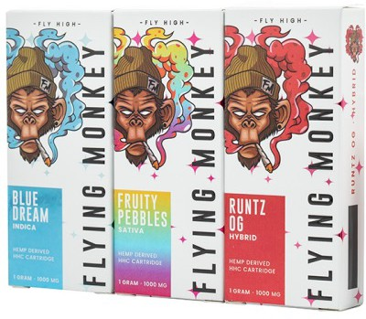
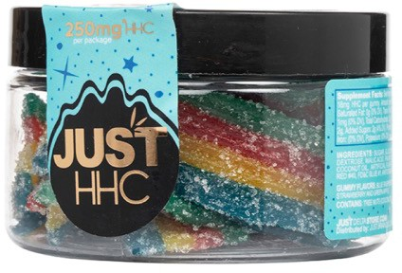
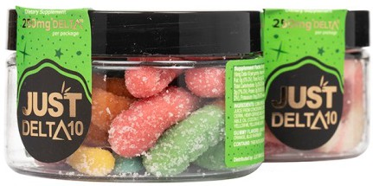
Delta-10 THC
HHC

Slide 63
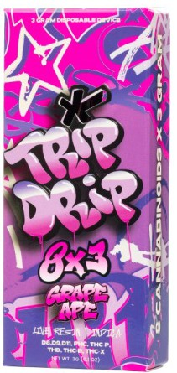
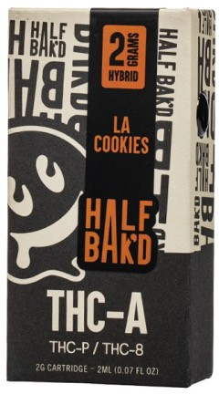




Blends

Slide 64
Online Retail Assessment
Results
26 intoxicating compounds marketed including:
  Delta-8 THC
  THC-P
Delta-9 THC
HHC
THC-A
Delta-10 THC
THC-H
THC-B
THC-JD
THC-X
HHC-P
Delta-11 THC
Overall, most products (54%) were blends, containing 2 to 8 different intoxicating compounds in a single product
THC-P usually in blends
Unclear whether some are the same chemical compound…

Slide 65
Online Retail Assessment
Results
26 distinct intoxicating compounds being marketed
There were 185 different combinations of intoxicating compounds contained within these 804 products
  there is little understanding of the health effects from using these compounds individually, let alone in these various combinations

Slide 66
Smoke Shop Retailers:
“We basically sell the whole darn alphabet”
“We have more blends than stuff on its own”

Slide 67

4/20 Specials & Promotional Events

Slide 68






Slide 69







Slide 70
Online Retail Assessment
Results
Modalities included
  disposable vapes (43%)
  edibles (29%)
  vape carts (18%)
  pre-rolls (7%)
  flower (2%)
  dabs (1%)
  vape pods (<1%)

Slide 71
Online Retail Assessment
Results
Among the 118 brands, the most common were:
  Exhale
  Delta Extrax
  Cake
  URB
  Looper
  TRE House

Slide 72







Slide 73





Slide 74





Slide 75

Research Publications
Rossheim, M.E., LoParco, C.R., Berg, C.J., Tillett, K.K., Trangenstein, P.J., Henry, D., Yockey, R.A., Livingston, M.D., Jernigan, D.H., & Sussman, S.Y. (in press). Derived psychoactive cannabis products and 4/20 specials: An assessment of popular brands and retail price discounts in Fort Worth, Texas, 2023. Drug and Alcohol Dependence. doi: 10.1016/j.drugalcdep.2024.111119
Rossheim, M.E., Tillett, K.K., Vasilev, V., LoParco, C.R., Berg, C.J., Trangenstein, P.J., Yockey, R.A., Sussman, S.Y., Siegel, M., & Jernigan, D.H. (in press). Types and Brands of Derived Psychoactive Cannabis Products: An Online Retail Assessment, 2023. Cannabis and Cannabinoid Research.
Rossheim, M.E., LoParco, C., Henry, D., Trangenstein, P.J., & Walters, S.T. (2023). Delta-8, Delta-10, HHC, THC-O, THCP, and THCV: What should we call these products? Journal of Studies on Alcohol and Drugs. doi: 10.15288/jsad.23-00008
Rossheim, M.E. LoParco, C.R., Walker, A., Livingston, M.D., Trangenstein, P.J., Olsson, S., McDonald, K.K., Yockey, R.A., Luningham, J.M., Kong, A.Y., Henry, D., Walters, S.T., Thombs, D.L., & Jernigan, D.H. (2022). Delta-8 THC Retail Availability, Price, and Minimum Purchase Age. Cannabis and Cannabinoid Research. doi: 10.1089/can.2022.0079
LoParco, C.R., Rossheim, M.E., Walters, S. T., Zhou, Z., Olsson, S., & Sussman, S. (2023). Delta-8 tetrahydrocannabinol: a scoping review and commentary. Addiction, 118(6):1011–28. doi: 10.1111/add.16142
Walker, A.L., LoParco, C.R., Rossheim, M.E., & Livingston, M.D. (2023). #Delta8: A retailer-driven increase in Delta-8 THC discussions on Twitter from 2020 to 2021. American Journal of Drug and Alcohol Abuse, 49(4):491-9, doi:10.1080/00952990.2023.2222433
Henry, D., Partin, K., LoParco, C., & Rossheim, M. (2023). The Hemp-Derived Cannabinoid Industry and the Potential of Self-Regulation: Using Social Media to Assess an Evolving Health Risk.
Social Science & Medicine.
Livingston, M.D., Walker, A., Cannell, M.B., & Rossheim, M.E. (2022). Popularity of Delta-8 THC on the Internet Across US States, 2021. American Journal of Public Health, 112(2), 296–299. doi: 10.2105/AJPH.2021.306586.
LoParco, C.R., Walters, S.T., Zhou, Z., & Rossheim, M.E. (in press). Associations between cannabis risk perceptions and Delta-8 THC use among young adults. Journal of Substance Use. https://doi.org/10.1080/14659891.2023.2293798.
LoParco, C.R., Kong, A.Y., Yockey, R.A., Sekhon, V., Olsson, S., & Rossheim, M.E. (in press). Factors associated with Delta-8 THC retail availability in Fort Worth, Texas, 2021-2022. Substance Use & Misuse. doi: 10.1080/10826084.2024.2305793
LoParco, C.R., Olsson, S.E., Greene, K.M., Livingston, M.D., Henry, D., Trangenstein, P.J., Walker, A., & Rossheim, M.E. (2022). How are retailers describing Delta-8 THC? A mixed-methods study in Fort Worth, Texas. Journal of Studies on Alcohol and Drugs, 84(2):298-302. doi: 10.15288/jsad.22-00287
LoParco, C.R., Olsson, S., Sekhon, V., McDonald, K.K., Yockey, R.A., Livingston, M.D., Trangenstein, P.J., & Rossheim, M.E. (2023). Associations between Delta-8 THC and Four Loko retail availability in Fort Worth, Texas. Health Behavior Research.
LoParco, C.R., Olsson, S.E., Greene, K.M., Berg, C.J., Walters, S.T., Zhou, Z., & Rossheim, M.E. (in press). Driving under the influence of alcohol, cannabis, and Delta-8 THC: Perceived likelihood, risk perceptions, and behaviors. Journal of Psychoactive Drugs.

Slide 76


Slide 77
Effective Regulation Generally
System of licensing/zoning
Taxes, minimum pricing policies
Restrictions on youth-oriented marketing
Health and safety claims
Ingredient labeling
Potency and product safety standards
Regulate retail environment (rather than PUP)

Slide 78
Questions
How prevalent is the use of each semi-synthetic cannabinoid?
  How valid are our measures?
    Survey questions, biological tests, field sobriety tests…
How do the effects of various DPCPs (and their combinations) compare to Delta-9 THC in terms of potency, and mental and physical health effects?
  Short- and long-term health effect?
Are there specific populations that should be particularly cautious about using DPCPs?
  Young people
  Taken with other substances, prescription medications
  Any others?
How can we effectively regulate if we don’t know the answers?

Slide 79
2024 Farm Bill Reauthorization
Major opportunity to address the negative consequences of the 2018 Farm bill
State laws are still needed

Slide 80
Policy Implications and Solutions for Semisynthetic Cannabinoids
Sue Thau, Public Policy Consultant, CADCA

Slide 81

The U.S. Farm Bill Legalized Hemp
The 2018 Agriculture Improvement Act (“Farm Bill”) legalized the sale and production of hemp.
The Farm Bill defines hemp as “the plant Cannabis sativa L. and any part of that plant, including the seeds thereof and all derivatives, extracts, cannabinoids, isomers, acids, salts, and salts of isomers, whether growing or not, with a delta-9 THC concentration of not more than 0.3 percent on a dry weight basis”.
7 U.S.C. § 1639o (2018)
Erickson, B.E. (2021 August 30). Delta-8-THC craze concerns chemists. C&EN: Chemical and Engineering News. https://cen.acs.org/biological-chemistry/natural-products/Delta-8-THC-craze-concerns/99/i31
Kary, T. (2021 June 2). Pot producers are pushing to clamp down on delta-8 THC. Bloomberg. https://www.bloomberg.com/news/articles/2021-06-02/a-pot-knockoff-sometimes-made-with-household-acid-draws-scrutiny
Partnership to End Addiction. (n.d.). Delta-8 THC: What you need to know about ‘cannabis light’. Partnership to End Addiction. https://drugfree.org/article/delta-8-thc/

Slide 82
Consequences of Hemp Legalization
When Congress legalized hemp production in 2018, farmland devoted to hemp production rose 445%.
The massive amount of hemp produced caused prices to fall by 50%.
CBD producers became the main purchasers of hemp, but an oversupply of CBD also caused its price to plummet.
Producers promptly looked for new hemp-based products, including Derived Psychoactive Cannabis Products (DPCPs) made by simple, and low-cost, chemical transformations of hemp extracts to substances not controlled under drug laws.
Hemp producers also began converting hemp into Delta-8 THC, Delta-10 THC, THC-O, and other DPCPs.
Hemp producers also started manufacturing high potency THC products derived from the 0.3% THC in dry weight in the hemp plants.
All of these products derived from hemp are basically unregulated across the U.S.
Sabet, K. (2021 September 13). The unintended consequences of legalizing hemp. Newsweek. https://www.newsweek.com/unintended-consequences-legalizing-hemp-opinion-1627595
Smart Approaches to Marijuana (2021).The failures of the hemp boom and the rise of potentially dangerous hemp-derived compounds. Smart Approaches to Marijuana. https://learnaboutsam.org/wp-content/uploads/2021/09/8-23-21-FarmBill-HempDerivatives.pdf

Slide 83
Issues with the 0.3% THC in Hemp
Hemp is defined in the U.S. as cannabis sativa with a THC concentration of less than 0.3% BY WEIGHT.
Because the definition applies to a less than 0.3% concentration in the entire plant by dry weight there has been a proliferation of delta-9 THC edibles with very high concentrations of delta-9 THC that are being marketed and sold as “legal” even in states in the U.S. that have not legalized marijuana.
Concentration limitations in the plant do not control the dose or quantity of THC manufactured, sold or consumed.
For example, a muffin weighing 85 grams (3 ounces) containing a concentration of 0.3% THC actually contains 255 mg of THC, many times the dose that may cause impairment.
Hilderbrand, R. (2018 July/August). Hemp & cannabidiol: What is a medicine? Missouri Medicine, 115(4). pp. 306-309.

Slide 84
Availability and Access of DPCPs in the U.S.
DPCPs are available in every state, including those that have banned certain DPCPs, such as Δ-8 THC. This is because the loophole allows for the continuous engineering of new types of DPCPs, including Δ-6 THC, Δ-10 THC, Δ-11 THC, THC-A, THC-O, THC-P, THC-V, THC-JD, PHC, HHC, HHC-P and HXC
Some of these new DPCPs are marketed as being far more potent than cannabis. DPCPs are easy to buy online: age verification measures are rarely used and easily circumvented. In many states, there are no age laws, so it is up to the retailers whether to sell DPCPs to children.
DPCPs are marketed in ways that are extremely likely to attract children, such as candy, chips and chocolates. DPCPs are inexpensive (sometimes < $5), and stores are disproportionately located in low-income areas.
LoParco, C.R., Rossheim, M.E., Walters, S. T., Zhou, Z., Olsson, S., & Sussman, S. (2023). Delta-8 tetrahydrocannabinol: a scoping review and commentary. Addiction, 118(6):1011–28. doi: 10.1111/add.16142 | 2 Rossheim, M.E., LoParco, C., Henry, D., Trangenstein, P.J., &
Walters, S.T. (2023). Delta-8, Delta-10, HHC, THC-O, THCP, and THCV: What should we call these products? Journal of Studies on Alcohol and Drugs. doi: 10.15288/jsad.23-00008
8 Egan, K.L., Villani, S., & Soule, E.K. (2023). Absence of Age Verification for Online Purchases of Cannabidiol and Delta-8: Implications for Youth Access. Journal of Adolescent Health. doi: 10.1016/j.jadohealth.2023.01.020. | 9 Rossheim, M.E.,
LoParco, C.R., Walker, A., Livingston, M.D., Trangenstein, P.J., Olsson, S., McDonald, K.K., Yockey, R.A., Luningham, J.M., Kong, A.Y., Henry, D., Walters, S.T., Thombs, D.L., & Jernigan, D.H. (2022). Delta-8 THC Retail Availability, Price, and Minimum Purchase Age. Cannabis and
Cannabinoid Research. doi: 10.1089/can.2022.0079

Slide 85
DPCPs are unregulated and have limited laboratory testing.
No states require testing for chemical contaminants, even though DPCPs are commonly synthesized using harsh solvents known to be hazardous to human health.
Poison control centers have found the rat poison brodifacoum in these products.
Symptoms of poisonings from these products include back and side pain as well as unexplained bleedings (blood in urine, bleeding from previous wounds, bleeding from the gums, etc.).
Potency limits are rare, despite conclusive evidence that more potent products carry higher risk of harm.
  National Poison Data System, America’s Poison Centers. https://www.aapcc.org/track/synthetic-cannabinoids
  LoParco, C.R., Rossheim, M.E., Walters, S. T., Zhou, Z., Olsson, S., & Sussman, S. (2023). Delta-8 tetrahydrocannabinol: a scoping review and commentary. Addiction, 118(6):1011–28. doi: 10.1111/add.16142 https://pubmed.ncbi.nlm.nih.gov/36710464/

Slide 86


Slide 87

This beverage is being sold in the state of Iowa even though marijuana has not been legalized there.

Slide 88



Marketing of Delta-9 Drinks Made from the 0.3% THC in Hemp As Legal
https://drinkdelta.com/shop/

Slide 89

https://happihourdrink.com/buy-happi/

Slide 90


THC Infused Gummy Bears
Regular Gummy Bears

Slide 91

The First and Best Known DPCP Was Delta-8 THC

Slide 92


Delta8Resellers.com
https://delta8resellers.com/shop/

Slide 93
DPCPs are marketed in packaging that appeals to children. These products can also look like highly recognizable trademarked products, such as Doritos, Cheetos and Nerds.
https://www.ftc.gov/news-events/news/press-releases/2023/07/ftc-sends-cease-desist-letters-fda-companies-selling-edible-products-containing-delta-8-thc

Slide 94



Delta 8 Candies- No Regulation

Slide 95
Continuous Engineering of DPCPs Results in an Ever-Increasing Number of New Products
As written, the definition of hemp in the Farm Bill allows for the continuous engineering of new synthetic and semi-synthetic cannabinoids, including, but not limited to:
  Delta-6 THC
  Delta-11 THC
  THC-A
  THC-P
  THC-V
  THC-JD
  PHC
  HHC
  HHC-P
  HXC
Few to none of these substances, beyond delta-8 THC, have been analyzed at all in a peer-reviewed or evidence-supported way for either short-term safety effects or long-term use.
  https://delta8resellers.com/shop/
  LoParco, C.R., Rossheim, M.E., Walters, S. T., Zhou, Z., Olsson, S., & Sussman, S. (2023). Delta-8 tetrahydrocannabinol: a scoping review and commentary. Addiction, 118(6):1011–28. doi: 10.1111/add.16142 https://pubmed.ncbi.nlm.nih.gov/36710464/
  Rossheim, M.E., LoParco, C., Henry, D., Trangenstein, P.J., & Walters, S.T. (2023). Delta-8, Delta-10, HHC, THC-O, THCP, and THCV: What should we call these products? Journal of Studies on Alcohol and Drugs. doi: 10.15288/jsad.23-00008 https://pubmed.ncbi.nlm.nih.gov/36971760/

Slide 96

https://happihourdrink.com/buy-happi/

Slide 97



Westchester County, NY

Slide 98


Slide 99
U.S. Federal Policy Opportunity
The farm bill that legalized hemp in 2018 is being renegotiated in the U.S. Congress.
CADCA is working to close the loophole.
Kary, T. (2023). Synthetic Pot Sales Reach $2 Billion Despite Safety Fears. : Bloomberg.

Slide 100


Delta 8 Vapes and Edibles

Slide 101
We propose that the following language be included in the Farm Bill reauthorization to change the definition of hemp to explicitly to exclude any synthetic and semi synthetic cannabinoids derived from hemp as follows:
(1) HEMP.—
(A) IN GENERAL.—The term “hemp” means the plant Cannabis sativa L. and any
part of that plant, including the seeds thereof and all derivatives, extracts, cannabinoids,
isomers, acids, salts, and salts of isomers, whether growing or not, with a total
tetrahydrocannabinol concentration (including tetrahydrocannabinolic acid) of not more
than 0.3 percent in the plant on a dry weight basis.
(B) EXCLUSIONS.— The term “hemp” does not include:
(1) HEMP.—
(A) IN GENERAL.—The term “hemp” means the plant Cannabis sativa L. and any
part of that plant, including the seeds thereof and all derivatives, extracts, cannabinoids,
isomers, acids, salts, and salts of isomers, whether growing or not, with a total
tetrahydrocannabinol concentration (including tetrahydrocannabinolic acid) of not more
than 0.3 percent in the plant on a dry weight basis.

Slide 102


THC Infused Sourbelts
Regular Sourbelts

Slide 103


THC Infused Doritos
Regular Doritos

Slide 104

https://hiseltzers.com/about-us/

Slide 105
DPCPs Carry Risk of Harm, Especially to Young People
Most states do not require testing for chemical contaminants, even though DPCPs are commonly synthesized using harsh solvents known to be hazardous to human health. Potency limits are rare, despite conclusive evidence that more potent products carry higher risk of harms. Research supports that DPCP use is associated with acute psychiatric, lung, chest, and heart disorders, as well as injuries and poisonings.
DPCPs are also very new so, the short- and long-term risks from use are unknown. DPCPs are consumed accidentally by children, as evidenced by the large number of calls to Poison Control Centers involving minors because of poor labeling and a lack of child-proof containers.
LoParco, C.R., Rossheim, M.E., Walters, S. T., Zhou, Z., Olsson, S., & Sussman, S. (2023). Delta-8 tetrahydrocannabinol: a scoping review and commentary. Addiction, 118(6):1011–28. doi: 10.1111/add.16142
5 Leas, E.C., Harati, R.M., Satybaldiyeva, N., Morales, N.E., Huaker, S.L., Mejorado, T., & Grant, I. (2023). Self-reported adverse events associated with
Delta-8-Tetrahydrocannabinol (Delta-8-THC) Use. Journal of Cannabis Research, 5(15). doi: 10.1186/s42238-023-00191-y | 6 United States Food and Drug Administration (FDA). (2022). 5 Things to Know about Delta-8 Tetrahydrocannabinol – Delta-8 THC. https://www.fda.gov/consumers/
consumer-updates/5-things-know-about-delta-8-tetrahydrocannabinol-delta-8-thc | 7 Bozman, M.E., Manoharan, S.V.R.R., Vasavada, T. (2022). Marijuana variant of concern: Delta 8-tetrahydrocannabinol (Delta-8-THC, Delta-8-THC). Psychiatry Research Case Reports,
1(2). doi: 10.1016/j.psycr.2022.100028.
10 https://www.fda.gov/food/alerts-advisories-safety-information/fda-warns-consumers-about-accidental-ingestion-children-food-products-containing-thc

Slide 106
Delta-8 Drinks
Texas retailer Spec’s Wine & Spirits announced that it is entering the cannabis beverage business by striking a partnership with THC seltzer brand, hi Seltzer. The beverage brand features zero calories, zero sugar, no alcohol and each 12oz can contains 5 mg of delta-8 THC. hi Seltzer comes in Watermelon, Pineapple, Wild Berry, Real Cherry and Lemon Lime Flavors.
P. Pisano, Senior Vice President of Industry Affairs & General Counsel, NBWA. Personal communication, February 5, 2024.

Slide 107
Delta-8 THC
Demand for Delta-8 THC products was up 144% in one year from 2020-2021.
It is sold in gas stations and marketed to children.
Industry leaders are introducing Delta-8 THC products despite a lack of regulation.
Companies are also introducing other unregulated products like Delta-10 THC.
Delta-8 THC sells for about $1,400/kg and is the “fastest growing segment” of the marijuana market.
Kary, T. (2021 June 2). Pot producers are pushing to clamp down on delta-8 THC. Bloomberg. https://www.bloomberg.com/news/articles/2021-06-02/a-pot-knockoff-sometimes-made-with-household-acid-draws-scrutiny
Zhang, M. (2021 March 27). High anxiety over federal weed loophole. Politico. https://www.politico.com/news/2021/03/27/rise-of-delta-8-thc-478215

Slide 108

https://hiseltzers.com/about-us/

Slide 109


Slide 110
Concerns about Delta-8 THC
The U.S. Cannabis Council tested 16 Delta-8 THC products and found that, on average 15 of the 16 products had more than 10 times the legal limit for THC.
  7 samples also exceeded limits for copper, chromium and nickel.
Delta-8 THC is the “bathtub gin” of the marijuana world and can also contain lead.
Kary, T. (2021 June 2). Pot producers are pushing to clamp down on delta-8 THC. Bloomberg. https://www.bloomberg.com/news/articles/2021-06-02/a-pot-knockoff-sometimes-made-with-household-acid-draws-scrutiny

Slide 111


Delta O THC Dummy Gummies
1 Gummy =
25 mg THC-O
10 per pack

Slide 112


Slide 113
DPCPs are available in all states in the U.S., even those states such as New York, that have banned these products.
  LoParco, C.R., Rossheim, M.E., Walters, S. T., Zhou, Z., Olsson, S., & Sussman, S. (2023). Delta-8 tetrahydrocannabinol: a scoping review and commentary. Addiction, 118(6):1011–28. doi: 10.1111/add.16142 https://pubmed.ncbi.nlm.nih.gov/36710464/
  Rossheim, M.E., LoParco, C., Henry, D., Trangenstein, P.J., & Walters, S.T. (2023). Delta-8, Delta-10, HHC, THC-O, THCP, and THCV: What should we call these products? Journal of Studies on Alcohol and Drugs. doi: 10.15288/jsad.23-00008 https://pubmed.ncbi.nlm.nih.gov/36971760/

Slide 114
DPCPs are available in every region of New York State, despite their being illegal there.

Slide 115




Nassau County, NY

Slide 116



Putnam County, NY
LearnAboutSAM.org

Slide 117






Dutchess County, NY

Slide 118
Synthetic pot sales from hemp reached $2 billion over the past 2 years in the U.S.
Kary, T. (2023). Synthetic Pot Sales Reach $2 Billion Despite Safety Fears. : Bloomberg.

Slide 119
The products below are available online to purchase or in gas stations, convenience stores, bodegas vape shops, hemp or CBD stores and online in the U.S.

Slide 120


Slide 121


Slide 122
Pediatric Edible Cannabis Exposures Among Children aged 5 of Younger Increased 1,375.0% between 2017 and 2021
According to data from the National Poison Data System (NPDS), in the U.S. there were 7,043 cases of pediatric edible cannabis exposures among children aged 5 or younger between 2017 and 2021.
97.1% of exposures occurred in a residential setting

Slide 123
Farm Bill Reauthorization
The explosion in the availability of intoxicating, psychoactive synthetic and semi synthetic substances and products derived from using the CBD in hemp is a huge problem across the entire nation that needs to be addressed at the national level
The creation of these synthetic and semi-synthetic cannabinoids was not the intent of the Farm Bill and runs counter to existing drug policies related to designer drugs and novel psychoactive chemical compounds.
The immense variety and potency of these products – from delta-8 and delta-10 to the scores of synthetic and semi-synthetic cannabinoids that are available now makes regulation impossible because there is potential for an unlimited number of derivations of these products to be created.
We strongly urge the Agriculture Committees to include the following language in the Farm Bill reauthorization to exclude synthetic and semi synthetic cannabinoids from the definition of hemp as these products would never have existed but for the 2018 Farm Bill.

Slide 124
Cont’d
(B) EXCLUSIONS.— The term “hemp” does not include:
(ii) Any synthetic or semisynthetic cannabinoid derivatives of hemp, including
[but not limited to]—
(I) delta-8 tetrahydrocannabinol;
(II) delta-10 tetrahydrocannabinol;
(III) delta-11 tetrahydrocannabinol;
(IV) THC-O-acetate;
(V) tetrahydrocannabiphorol;
(VI) tetrahydrocannabivarin;
(VII) tetrahydrocannabihexol;
(VIII) tetrahydrocannabioctyl;
(IX) hexahydrocannabinol; or
(X) any other isomers or analogues of tetrahydrocannabinol, other than delta-9 tetrahydrocannabinol.
(C ) TESTING CONTROL AND ENFORCEMENT FOR EXCLUSIONS - Testing, control and enforcement for all of the exclusions enumerated above, except for the testing, control and enforcement of the 0.3% THC allowable in hemp, shall take place after the hemp has left the farm where it was produced and has entered into processing channels.

Slide 125
Thank You!
Sue Thau
suerthau@gmail.com

