Slide 1
Iniciativas de Seguridad Vial
Francisco Gomez
Grants Management Team, NHTSA Región 2
Notes:
administración nacional de seguridad del tráfico en las carreteras

Slide 2
Visión del Departamento de Transporte
Cero es el único número aceptable de muertes en nuestras carreteras.
El Departamento está comprometido a tomar medidas sustanciales e integrales para reducir significativamente las lesiones graves y fatales.
Notes:
Together, we must strive for zero roadway fatalities.
The Department, NHTSA and ROPD is committed to taking substantial and comprehensive action to significantly reduce serious and fatal injuries on our nation's roads. It also is important to note that we have not made meaningful progress in decades, long racial disparities and fatal car crashes and things got worse during the pandemic.
Zero is the only acceptable number of deaths and at USDOT, we support all efforts that will get us there.
However, while DOT supports efforts to achieve zero, as NHTSA employees working directly with State Highway Safety Offices, we recognize that zero targets for required performance measures in a States’ 3HSP or Annual Report may not be reasonable.
Roadway travel is inherently risky, but the risk is not born equally among all members of US society.

Slide 3
Nuestra Realidad Actual
Las fatalidades causadas son una crisis de salud pública que afectan a todos.
1.25M
42,939
7,388
Vidas que se pierden cada año en todo el mundo por choques de tránsito
Source: World Resources Institute
Vidas perdidas en las carreteras de EE.UU. en 2021
Source: NHTSA
Peatones muertos en EE. UU. en 2021
Source: NHTSA
3
Notes:
Traffic fatalities are a public health crisis affecting all road users, and it demands a concerted response.
Each year, over a million lives are lost globally from traffic crashes.
For the whole of 2021, a statistical projection of traffic fatalities shows an increase of about 10.5 percent as compared to reported fatalities in 2020.
The traffic fatalities (fatality counts) in multiple categories showed
relatively large increases in 2021 as compared to 2020.
Insert your Regions stats here:
Total Fatals:
Total Un-Restrained:
Total Alcohol Impaired:
Total Speed:
Total Motorcycle:
Total Pedestrians:
Total bicyclists:
(Can include in longer presentations)Some of those categories include:
1. Rural interstate roads (up 15%), rural collectors/local roads (***), urban arterial
(up 15%), and urban collector/local (up 20%); ASK SAM ABOUT Tribal Nation Roadways
2. Multi-vehicle crashes (up 16%);
3. Speeding-related crashes (up 5%) – still higher as
compared to the pre-pandemic levels of 2019;
4. Unrestrained occupants of passenger vehicles (up 3%) –
still higher as compared to the pre-pandemic levels of
2019;
5. Police-reported alcohol involvement crashes (up 5%) –
still higher as compared to the pre-pandemic levels
of 2019
6. Pedestrian fatalities (up 13%); and
7. In crashes involving at least one large truck (up 13%),
reversing the trend seen in 2020.

Slide 4
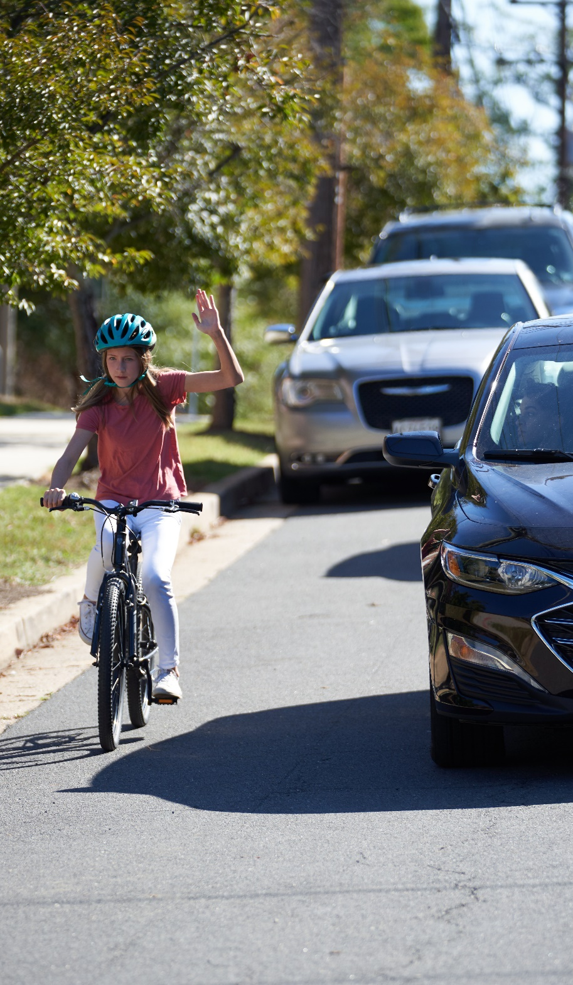
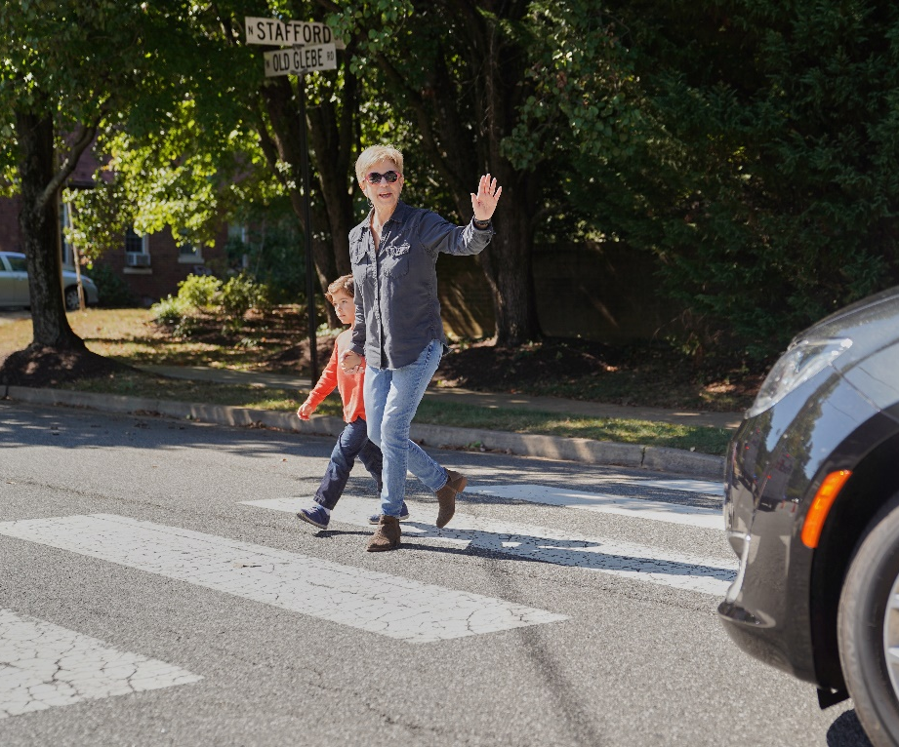
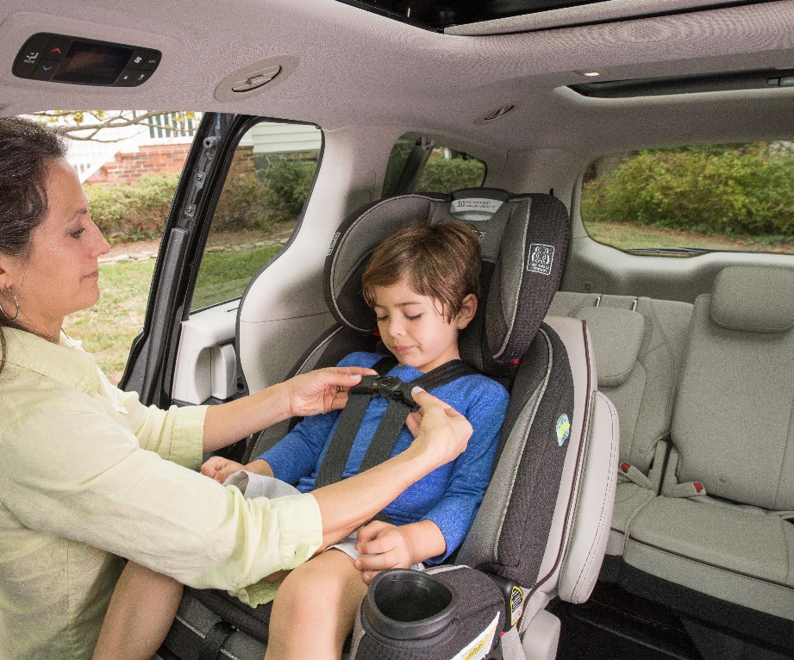

Slide 5
Los Efectos del Alcohol al Manejar
En el 2022, 13,524 vidas fueron perdidas por conducir bajo los efectos de alcohol.
Significa que cada 39 minutos, una persona muere en un choque causado por un conductor bajo los efectos del alcohol,
En Puerto Rico es ilegal manejar con un BAC de .08
Pérdida de la concentración y de la memoria a corto plazo, problemas con el control de la velocidad, capacidad reducida de procesamiento de información

Slide 6
Los Efectos del Manejar Bajo la Influencia de drogas
56% de los conductores involucrados en y choques mortales y con lesiones graves dieron resultados positivos en al menos una droga
Existen muchas ideas equivocadas sobre el consumo de marihuana, como que la marihuana no te perjudica
La cocaína y la metanfetamina pueden hacer que los conductores sean más agresivos e imprudentes.
Medicinas —con prescripción— pueden causar sueño extremo, mareos y otros efectos secundarios
NHTSA esta comprometido con la eliminación del manejo borracho y bajo la influencia de drogas

Slide 7
Un Sistema Seguro (“Safe System Approach”)
SSA Principios
La muerte/lesiones graves son inaceptables.
Los humanos cometemos errores
Los humanos son vulnerables
La responsabilidad es compartida
La seguridad es proactiva
La redundancia es crítica
SSA Elementos
Usuarios de la vía más seguros
Vehículos más seguros
Limitaciones a la velocidad
Carreteras más seguras
Atención medica después
Notes:
By now I’m sure you have some basic knowledge of the Safe System Approach.
We’ve learned that the Safe System Approach has for years been implemented in other countries and other federal agencies have been working to implement it as well.
This graphic is new and hot off the presses, made specifically for NHTSA.
It reinforces three key components 1) the overall “approach,” 2) the “principles,” and 3) “elements.”
If you leave with nothing else from today’s session, I hope you can remember the following precepts:
Everyone shares the Responsibility,
We all must accept and prioritizes safety, and
Our roadway system must be equitable for all road users.
The Principles are found on the outer most part of the wheel (no need to read them, participants can read themselves)
Death/serious injury is unacceptable
Humans make mistakes
Humans are vulnerable
Responsibility is shared
Safety is proactive
Redundancy is critical
And the Elements are within the spokes of the wheel (again don’t read, participants can read them)
Safer road users
Safer vehicles
Safer speeds
Safer roads
Post-crash care
I want to note there is a difference in some language between the NRSS and the SSA from FHWA. NHTSA is opting to use the same language as the NRSS of safer versus safe. You may find that other DOT modes are doing something different.
We aren’t focusing on those word differences, but I wanted to be sure you were aware, just in case someone might ask.

Slide 8
Gracias!

