Slide 1

Advancing Substance Use Prevention to Meet the Moment
Christopher M. Jones, PharmD, DrPH, MPH
CAPT, US Public Health Service
Director, Center for Substance Abuse Prevention
Substance Abuse and Mental Health Services Administration
U.S. Department of Health and Human Services
Notes:
1

Slide 2
Learning Objectives
Characterize the current landscape of substance use in the nation.
Describe the importance of prevention in the context of today's drug threats and its role within the continuum of care.
Examine how established and emerging prevention strategies can be utilized to address the ever-changing drug landscape.
Present a rationale for a comprehensive prevention strategy.

Slide 3
Epidemiology Update

Slide 4
Historically High Overdose Deaths in the U.S.
Source: CDC

Slide 5
Changing Epidemiology of Substance Use & Overdose
Source: CDC NCHS. NVSS/WONDER, 2024.

Slide 6
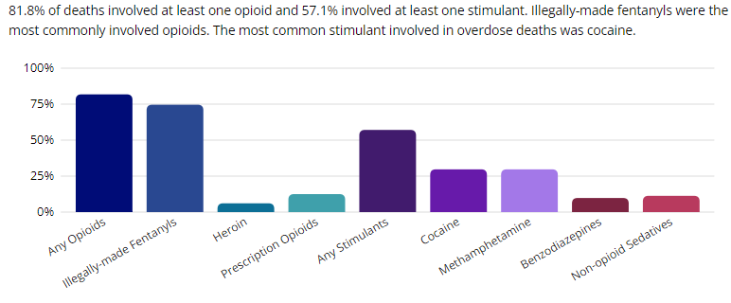
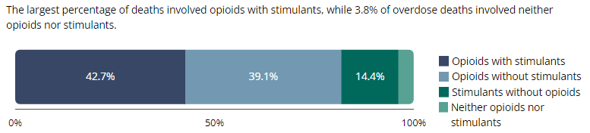
Deaths Driven by Illicit Synthetic Opioids and Stimulants
SUDORS Dashboard: Fatal Overdose Data | Drug Overdose | CDC Injury Center

Slide 7
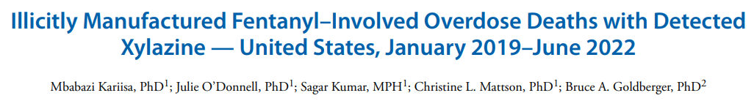
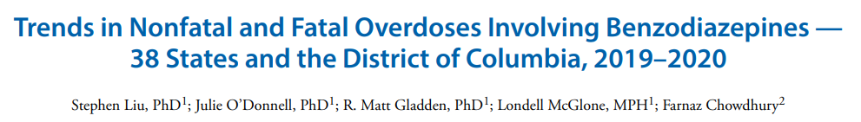
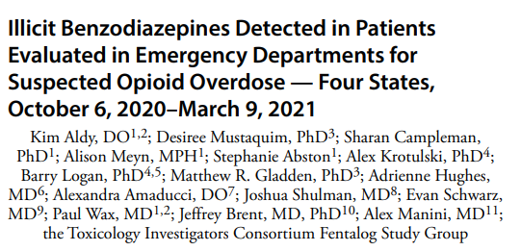
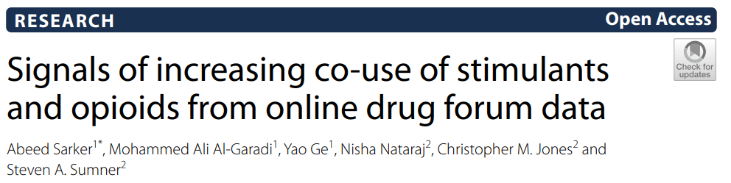
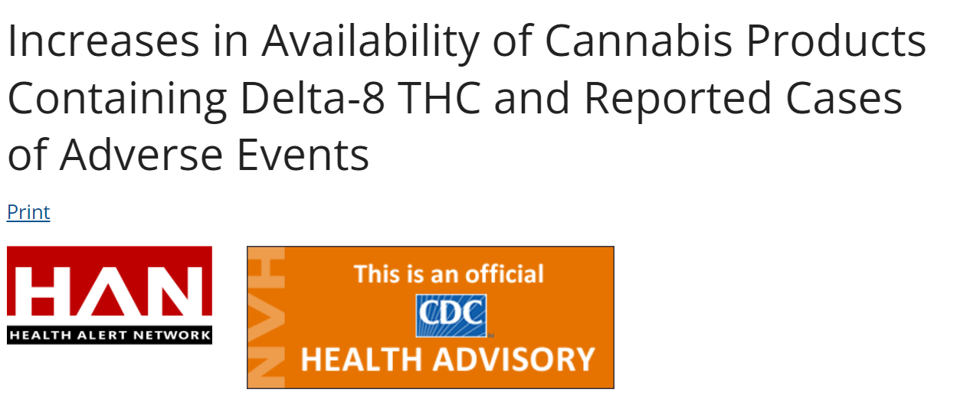
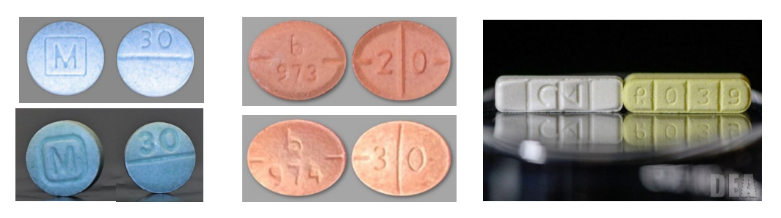
The Substance Use Landscape Is Changing and Has Never Been Riskier

Slide 8
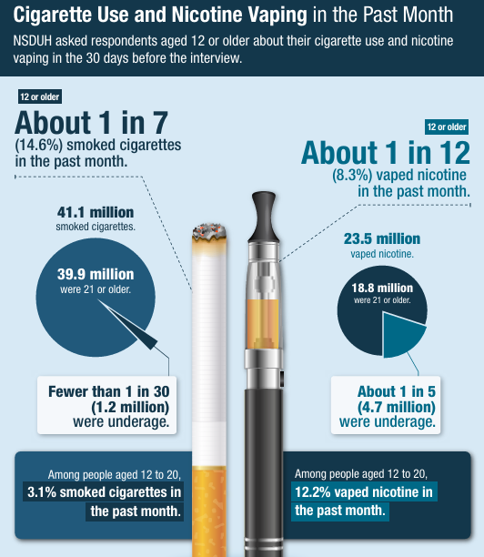
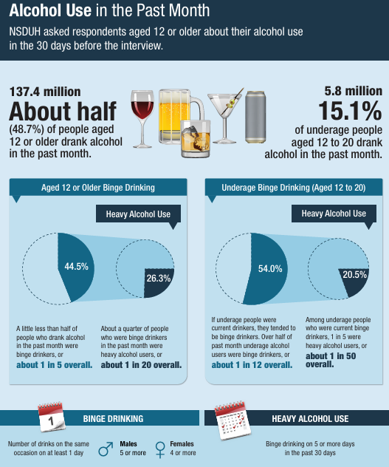
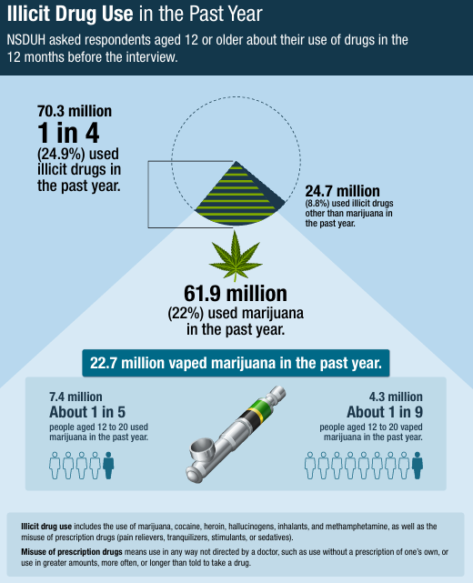
Usual Suspects are Ever-Present and Evolving

Slide 9
Most Commonly Used Substances Among Youth & Young Adults
Data Source: Substance Abuse and Mental Health Services Administration. (2023). Key substance use and mental health indicators in the United States: Results from the 2022 National Survey on Drug Use and Health (HHS Publication No. PEP23-07-01-006, NSDUH Series H-58). Center for Behavioral Health Statistics and Quality, Substance Abuse and Mental Health Services Administration. https://www.samhsa.gov/data/report/2022-nsduh-annual-national-report

Slide 10
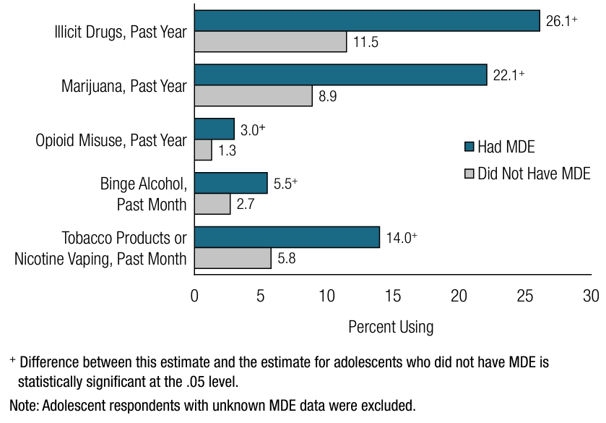
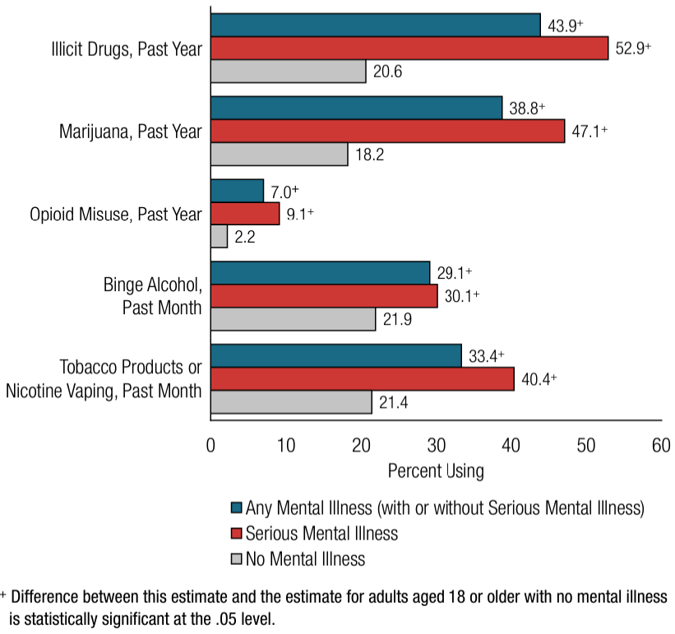
Substance Use and Mental Health are Intimately Linked
Past Year or Past Month Substance Use: Among Adolescents Aged 12 to 17; by Past Year Major Depressive Episode (MDE) Status, 2022
Past Year or Past Month Substance Use: Among Adults Aged 18 or Older; by Past Year Mental Illness Status, 2022
Data Source: Substance Abuse and Mental Health Services Administration. (2023). Key substance use and mental health indicators in the United States: Results from the 2022 National Survey on Drug Use and Health (HHS Publication No. PEP23-07-01-006, NSDUH Series H-58). Center for Behavioral Health Statistics and Quality, Substance Abuse and Mental Health Services Administration. https://www.samhsa.gov/data/report/2022-nsduh-annual-national-report

Slide 11
Holistic Approach to Substance Use & Overdose

Slide 12
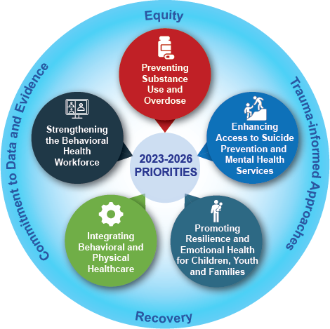
Guiding Frameworks for SAMHSA's Whole Person Approach

Slide 13
Putting Prevention
Front & Center

Slide 14
Substance Use Among Youth – Setting the Stage
Youth substance use rates heading in right direction
Yet, overdose deaths among youth continue to go up – driven by proliferation of fake pills and toxic, unpredictable illicit drug market
  1 in 12 deaths among 12-17 year-olds
  1 in 5 deaths among 18-24 year-olds
Substance use and overdose challenges are intimately linked to ongoing mental health and other social challenges
Disparities in patterns of use and harms depending on sociodemographics
Need a holistic approach to address range of risk and protective factors long-term while also addressing acute issues of increasing overdose risk
Alcohol – down 44% since 2004; down 16% since 2019
Any illicit drug – down 26% since 2004; down 27% since 2019
Cannabis – down 24% since 2004; down 29% since 2019
Any illicit drug other than cannabis – down 59% since 2004; down 38% since 2019

Slide 15
Prevention Opportunities Across the Spectrum
Foundational Prevention Programming
Acute Overdose Prevention
SOURCES: 2022 NSDUH ; SUDORS Dashboard: Fatal Overdose Data | Drug Overdose | CDC Injury Center

Slide 16
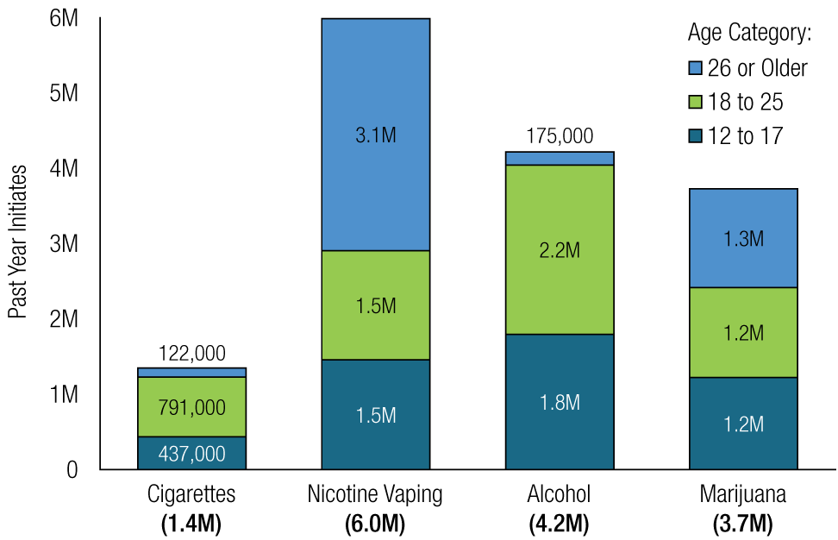
Prevention Isn’t Just for Youth
Initiation Age

Slide 17

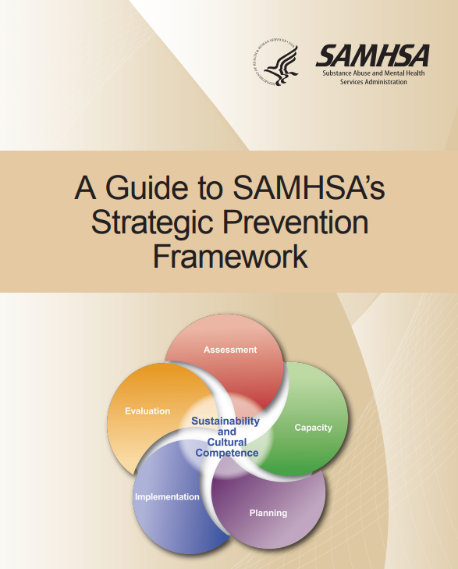
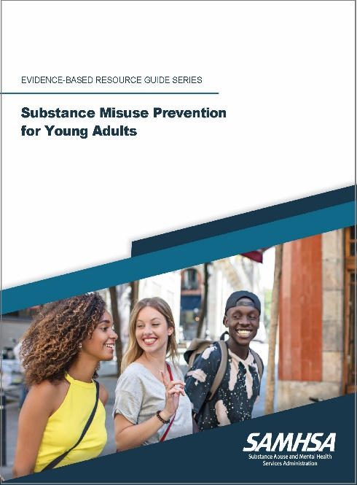
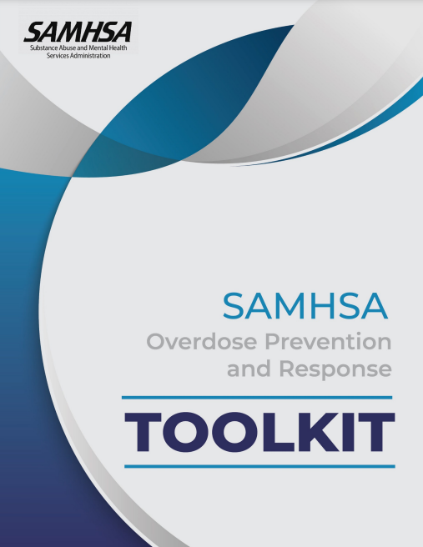


The Future We Envision
CSAP’s Vision
  A future where individuals, families, and communities are healthy and thriving.
CSAP’s Mission
  Provides leadership and collaborates across sectors to advance prevention across the lifespan.
  We aim to:
    Prevent substance use initiation
    Prevention progression of substance use
    Prevent and reduce the harms associated with substance use
How We Do It
  Through use of data, prevention science, communication, collaboration and strategic program investments

Slide 18
CSAP Strategic Priorities and Guiding Principles
Guiding Principles
Data-Driven
Innovative
Community Informed
Grounded in Cultural Humility
Focused on Health Equity
Inclusive of Social Determinants of Health
Analyzing and Disseminating Information on the Latest Data, Trends, and What Works in Prevention
Building Prevention Capacity at the National State, Tribal, Territorial and Local Levels
Raising Awareness and Catalyzing Prevention Action
Advancing Prevention through Strategic Collaborations and Partnerships

Slide 19
Substance Use Risk Factors – Socioecological Model
Individual
Relationship
Community
Societal
Genetic factors
Initiating substance use early
Low risk perception of use
Peers who use substances
Perception that use of substances among peers is high
Emotional distress or aggressiveness that starts early and is persistent
Mental health challenges
Substance use in the family and home
Parental mental health challenges
Family conflict, abuse, or neglect
Parents who favorably view or approve of substance use
Lack of family connectedness
Lack of community connectedness and supports
Community norms favorable toward alcohol and drugs
Violence in schools or community
Availability and costs of drugs and alcohol
Poverty
Lack of economic and educational opportunities
Inadequate housing
Disinvestment
Discrimination
Social norms
Laws and policy environment

Slide 20
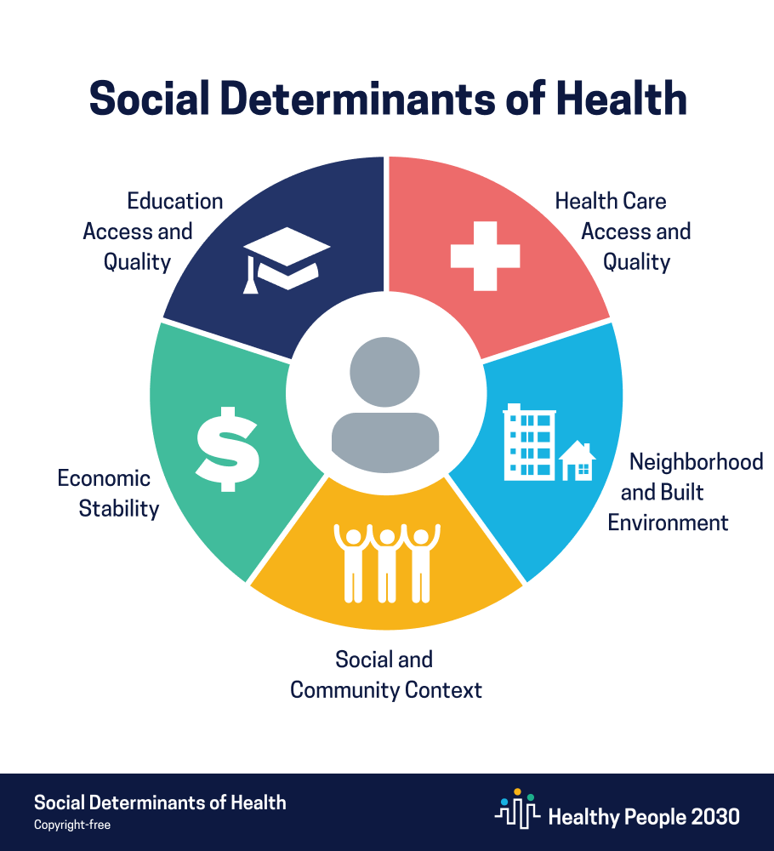
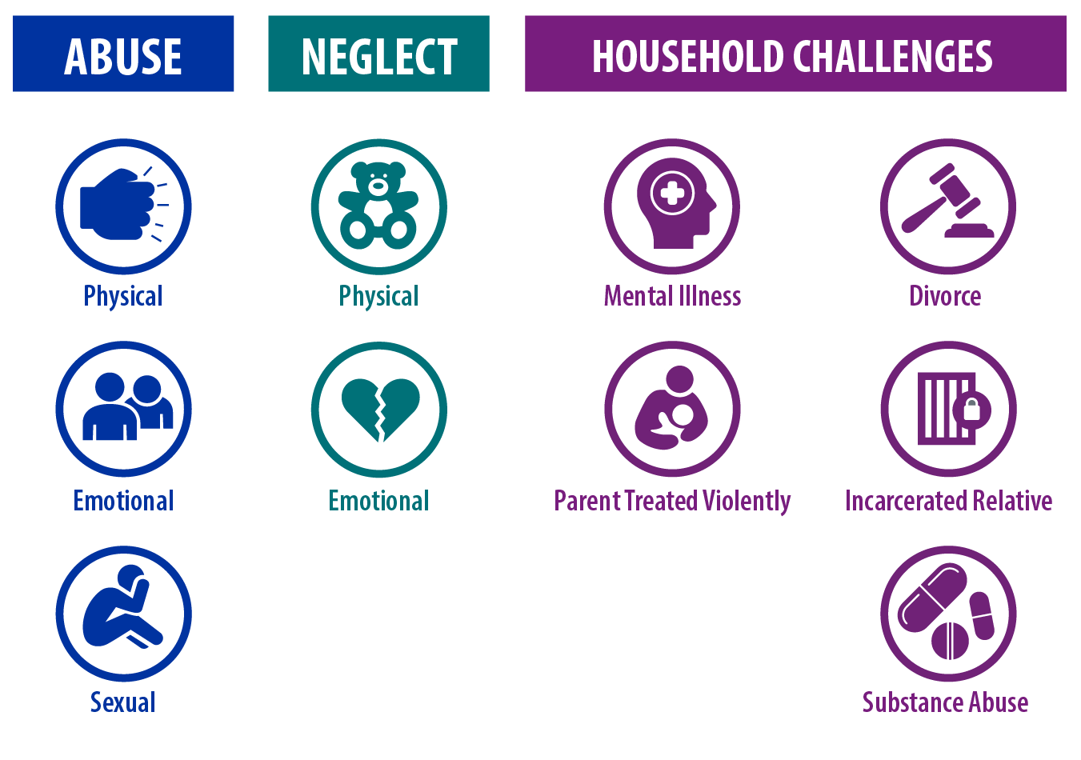
Moving Upstream to Get Ahead of Substance Use Challenges
Adverse Childhood Experiences
Social-Ecological Model
Individual
Relationship
School/Community
Society
Notes:
Chris

Slide 21
ACEs and Risk for Substance Use
Number of Categories of ACEs
Research shows ACEs increase risk for:
        Rx opioid misuse, illicit opioid use, opioid use disorder, opioid injection
        Cocaine and amphetamine use and use disorder
        Earlier age of initiation of substances
Source: Felitti, Vincent J., et al. American journal of preventive medicine 14.4 (1998): 245-258.
Notes:
Chris

Slide 22
ACEs and Poor Mental Health
Source: Anderson et al., MMWR, 2022
Notes:
Chris

Slide 23
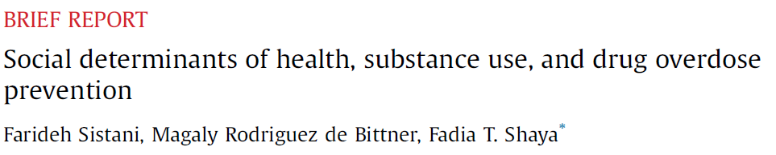
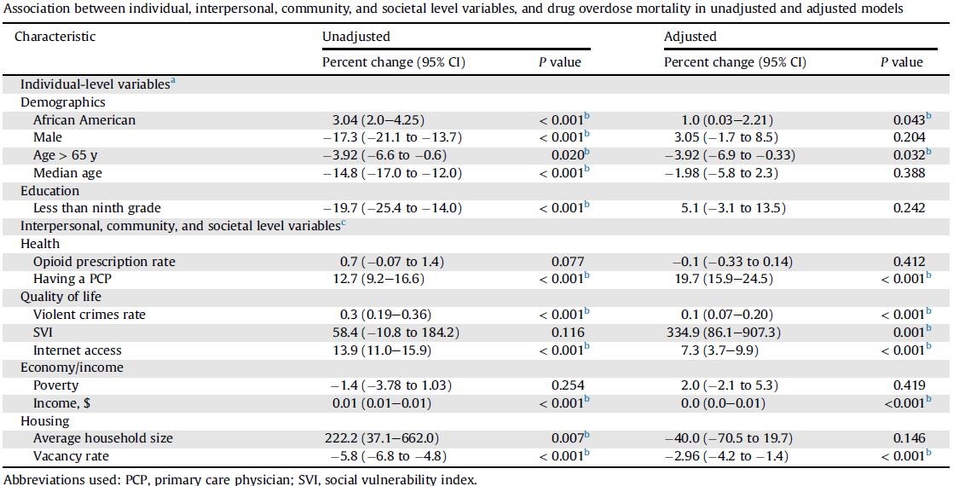
Social Determinants of Health and Substance Use
SDOHs have been directly associated with an increased risk of substance use and others are associated with increased rates of stress and anxiety, which can increase the likelihood of substance use
Greater community-level social vulnerability, violent crime, per capita income, access to health care, and access to the Internet were all associated with increased risk for drug overdose
Having a lower housing vacancy rate was associated with lower risk for drug overdose

Slide 24
Prevention Policies, Programs, & Practices

Slide 25
Individual-Level Strategies
Risk Factors
Genetic factors
Initiating substance use early
Low risk perception of use
Peers who use substances
Perception that use of substances among peers is high
Early and persistent problem behavior
Mental health challenges
Prevention Strategies
Life-skills development
Problem solving skills
Conflict resolution
Strengthening resiliency and self-efficacy
Treatment for health and behavioral health conditions
Empowerment opportunities
Exposing youth to positive adult role models
Raising awareness about risks associated with substance use

Slide 26
Relationship-Level Strategies
Risk Factors
Substance use in family or home
Parental mental health challenges
Family conflict, abuse, or neglect
Parents who favorably view or approve of substance use
Lack of family connectedness
Prevention Strategies
Healthy relationship skills programs
Creating opportunities for positive social involvement with family
Positive parenting skills programs
Strengthening parent-child relationship and communication programs
Addressing household challenges that contribute to stress
Treatment for parental/caregiver substance use, mental health challenges

Slide 27
School and Community-Level Strategies
Risk Factors
Lack of school, community connectedness and supports
Community norms favorable towards alcohol and drugs
Violence in schools or community
Availability and costs of drugs and alcohol
Lack of commitment to school
Poverty
Prevention Strategies
Creating opportunities for positive social involvement with school and community
Supporting community norms about substance use risk, help-seeking behavior
Promoting help-seeking
Environmental design and built environment
Clinical practice and access to healthcare

Slide 28
Society-level Strategies
Risk Factors
Lack of economic and educational opportunities
Inadequate housing
Disinvestment
Discrimination
High rates of transition or instability
Prevention Strategies
Economic, education, and housing policies
Improving access to education, including early childcare and pre-K
Policy environment
Environmental strategies

Slide 29
CSAP Prevention Programs & Resources

Slide 30
CSAP's Grant Programs
State formula funding for prevention
Substance Use Prevention, Treatment, and Recovery Services (SUPTRS) Block Grant.
Synar Program (youth tobacco use prevention)
Opioid-focused discretionary programs
Strategic Prevention Framework for Prescription Drugs (SPF-Rx)
Grants to Prevent Prescription Drug Opioid Overdose Related Deaths (PDO)
First Responders (FR-CARA)
Improving Access to Overdose Treatment (ODTA)
State & community discretionary primary prevention programs
Strategic Prevention Framework – Partnerships for Success (PFS)
  States and Communities programs
STOP Act Program (Sober Truth on Preventing Underage Drinking)
Harm Reduction Grant Program
HIV discretionary program
HIV Prevention Navigator Program for Racial and Ethnic Minorities (MAI)
Tribal discretionary funding
Tribal Behavioral Health (Native Connections)

Slide 31
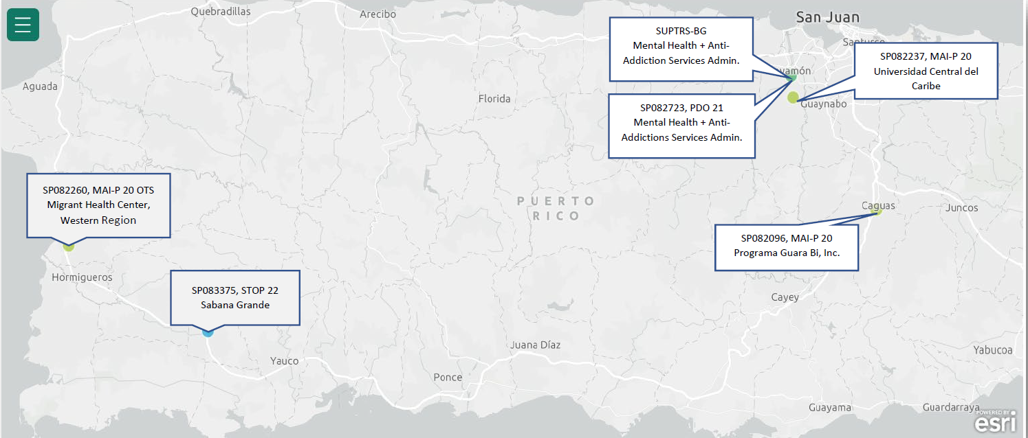
Active CSAP Grantees In Puerto Rico

Slide 32
SAMHSA’s Prevention Technical Assistance Capacity
Prevention Technology Transfer Centers: Provides accessible technical assistance to the prevention field; coordinates with the ATTCs
Strategic Prevention Technical Assistance Center: Provides direct technical assistance to CSAP grantees (SUPTRS BG, PFS, STOP Act, SPF Rx, FR CARA, PDO, ODTA)
Tribal Technical Assistance Center: Provides TA to tribal entities
Native Connections Technical Assistance Center: Provides TA to Native Connections Grantees

Slide 33
$750 planning stipends to support community-held events
Request invitation from Info@StopAlcoholAbuse.net.
Check the activity planning FAQs at www.StopAlcoholAbuse.gov/communitiestalk/
Community activities featured on the Find an Activity map.
Shared Communities Talk Success Stories are featured on the Communities Talk website!

Slide 34

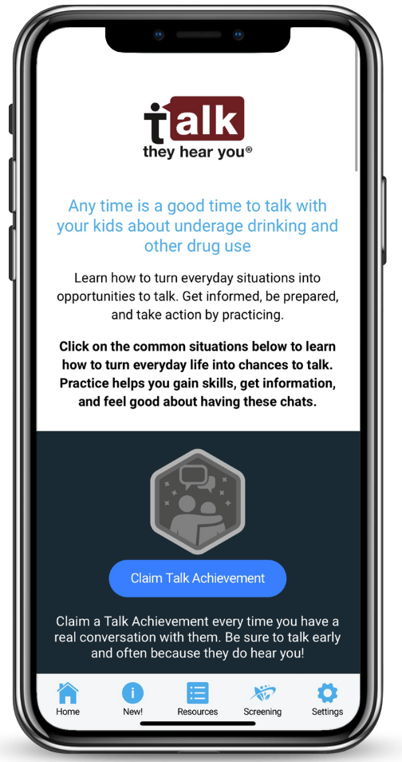
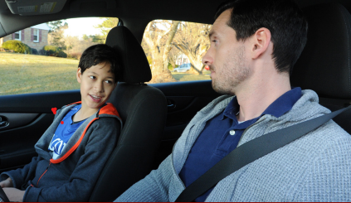






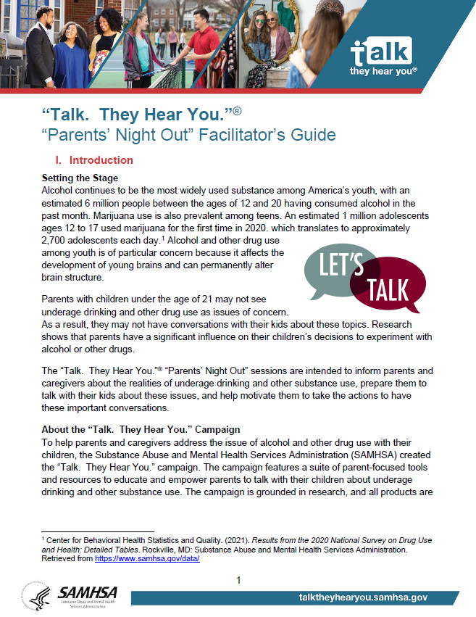
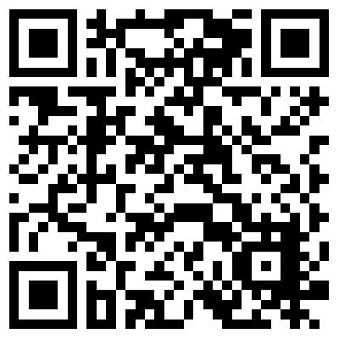
TALK. THEY HEAR YOU. CAMPAIGN UPDATES
National Adult Oriented Campaign
GET INFORMED. BE PREPARED. TAKE ACTION.
TTHY 10TH ANNIVERSARY
DISCUSSION STARTER VIDEOS
"This Life for Us" Product Suite
“COMMUNITIES THAT CARE”
MOBILE APP
STRENGTHEN PARENT AWARENESS, RAPPORT, COMMUNICATIONS (SPARC)
PARENTS’ NIGHT OUT

Slide 35
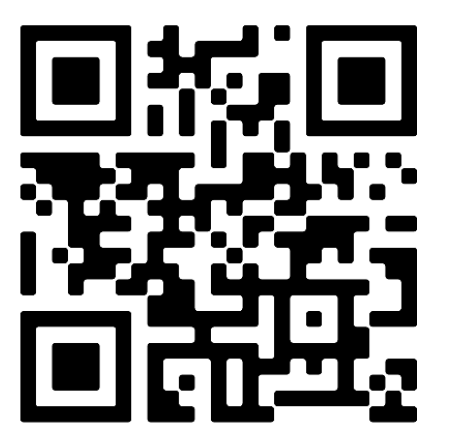
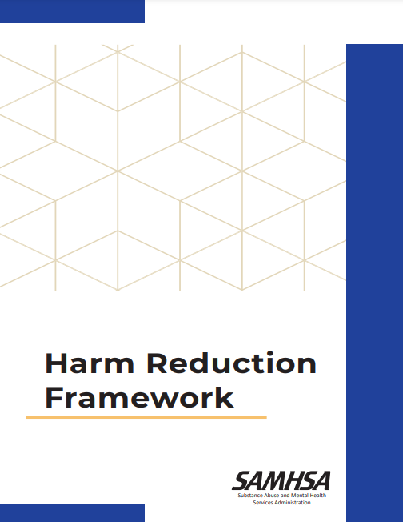
Harm Reduction Framework
First document to comprehensively outline harm reduction and its role within HHS
Provides a roadmap of core practices, 12 principles, and 6 pillars that anyone can apply to their work.
Will inform SAMHSA’s harm reduction activities moving forward, as well as related policies, programs, and practices
Notes:
Chris

Slide 36

SAMHSA Overdose Prevention and Response Toolkit
Updated to reflect latest overdose trends.
Practical tips for preventing, recognizing, and responding to an overdose.
Information on available opioid overdose reversal medications (OORM).
Information for specific audiences
  People who use drugs
  People who take prescription opioids
  Practitioners and health systems
  First Responders
  Policy and systems considerations
https://store.samhsa.gov/product/overdose-prevention-and-response-toolkit-spanish-version/pep24-03-001

Slide 37

Youth Empowerment and Engagement
Voices of Youth: FY2024 Strategic Partnerships
  Communities Talk to Prevent Alcohol and Other Drug Use
  CADCA Partnership
  HOSA – Future Health Professionals
  4-H – Positive Youth Development, Mentorship, and Education
  SAMHSA’s Youth Summit, Fall 2024

Slide 38

SAMHSA’s programs and grants provide for prevention, intervention, treatment, and recovery at all points along the continuum of care and lifespan.
Evidence-based interventions and data-driven decision-making inform our work.
Respect for the individual is augmented through promoting equity and person-centered strategies.
www.samhsa.gov/prevention-week

Slide 39
A Comprehensive Path Forward to Meet the Moment
Data-driven and nimble incorporating the changing substance landscape
Centered in the voices and experiences of community(ies) being served
Holistic and Comprehensive – Addressing Spectrum of Risk & Protective Factors
  Individual
  Relationship
  Community
  Societal
Evidence-based policies, programs and practices as well as integrating practice-based evidence and community-defined evidence
Evaluating, innovating, and continuing to build the knowledge of what works in communities
Opportunity to broaden tent of partners
PREVENTION…
  Supports parents, caregivers, & strengthens families
  Increases exposure to positive role models & youth empowerment opportunities
  Supports healthy social & emotional development
  Strengthens problem solving, conflict, & relationship skills
  Expands evidence-based programs & policies across settings
  Prevents & addresses ACES & trauma
  Addresses structural & social determinants of health
  Improves the safety, stability, & livability of community environments

Slide 40
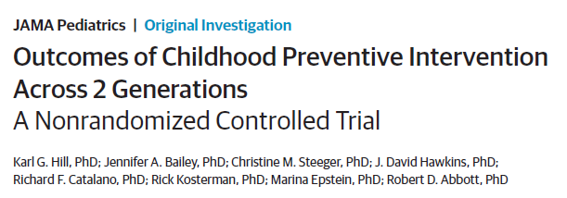
Multigenerational Impacts
Among exposed kids – Better outcomes on:
  School misbehavior and achievement
  Lifetime violence
  Heavy alcohol use
  Mental health
  Employment and socioeconomic outcomes
Among offspring of exposed kids – Better outcomes on:
  Child developmental functioning
  Behavior problems
  Academic skills and performance
  Risk behaviors, including substance use
Multicomponent intervention – Raising Healthy Children
  1 – Teacher training in classroom instruction and management
  2 – Child social and emotional skill development
  3 – Parent training
Source: Hill et al., JAMA Pediatrics 2020

Slide 41



Thank You!
SAMHSA’s mission is to lead public health and service delivery efforts that promote mental health, prevent substance misuse, and provide treatments and supports to foster recovery while ensuring equitable access and better outcomes.
Grant Opportunities
www.samhsa.gov/grants
www.grants.gov/web/grants
988 Suicide and Crisis Lifeline Toolkit
www.samhsa.gov/find-help/988/partner-toolkit
@samhsagov @samhsa_leader
/samhsa
/samhsa

