Slide 1
Effective Coalitions: Process, Data, and Positive Impacts
May 8, 2024
Kristen Gilmore Powell, PhD, MSW
Cory Morton, PhD
Northeast and Caribbean Prevention Technology Transfer Center

Slide 2
Technical Information
This presentation was prepared for the Northeast & Caribbean Prevention Technology Transfer Center under a cooperative agreement from the Substance Abuse and Mental Health Services Administration (SAMHSA). All material appearing in this publication, except that taken directly from copyrighted sources, is in the public domain and may be reproduced or copied without permission from SAMHSA or the authors. Citation of the source is appreciated. Do not reproduce or distribute this publication for a fee without specific, written authorization from Northeast & Caribbean Prevention Technology Transfer Center. For more information on obtaining copies of this publication, call 848-932-8665.
At the time of this publication, Miriam E. Delphin-Rittmon, Ph.D., served as Assistant Secretary for Mental Health and Substance Use in the U.S. Department of Health and Human Services and the Administrator of the Substance Abuse and Mental Health Services Administration. The opinions expressed herein are the view of the presenters from the Northeast & Caribbean PTTC and do not reflect the official position of the Department of Health and Human Services (DHHS), SAMHSA. No official support or endorsement of DHHS, SAMHSA, for the opinions described in this document is intended or should be inferred.
This work is supported by grant 5H79SP081033-05 from the Department of Health and Human Services, Substance Abuse and Mental Health Services Administration.
Presented in 2024.

Slide 3
Agenda
Effective Prevention Coalitions
Identify key coalition processes and functions
The Power of Data in Coalition Efforts
Using GIS and Photovoice

Slide 4
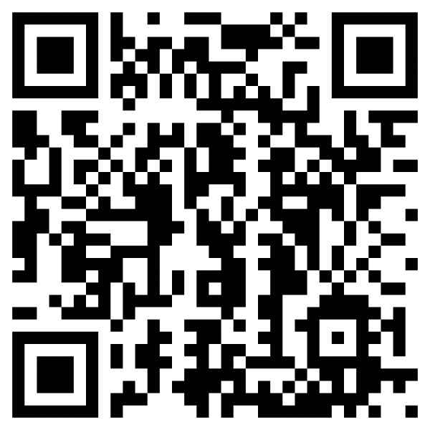
National PTTC Community Coalitions and Collaborators Workgroup (3C’s)
Develop training and technical assistance tools, products, and services on effective community coalitions and collaborations
Disseminate these across the PTTC network
Increase the capacity of prevention coalitions and collaborators to prevent substance misuse

Slide 5
Source Acknowledgements
Some content from this presentation was developed within the national 3C’s PTTC Workgroup, representing multiple regional PTTCs’ and the National Coordinating Office
Some content was based on a study conducted on Program Sustainability in 2002 by Knowlton Johnson, Ph.D., Carol Hays, Ph.D., Hayden Center, Ph.D., and Charlotte Carlton, MA
Some content was based on an updated version of the 2002 study applied to the issue of Coalition Sustainability conducted in 2023 by Hayden Center, Ph.D. and Charlotte Carlton, MA. (in collaboration with the Wyoming community prevention coalitions)

Slide 6
Before we start: Who is in the room?
Prevention Coalitions
Prevention agencies
Harm Reduction
Local or Territory Government/offices
Federal Representatives
Military, National Guard
Policy Makers
Who else?

Slide 7
Effective Coalitions: Why is this an Important Topic?
We know coalitions work!
Coalitions often experience challenges.
A prevention coalition:
Engages the community served by the coalition.
Focuses on effectiveness and community outcomes.
Builds adequate capacities among partners.
Plans for sustainability.

Slide 8
Common Challenges for Coalitions
Time
Capacity
Being understaffed
Maintaining focus in an ever-changing environment
Sustaining outcomes and keeping momentum
Member to member communication
Identifying collective work
Coalition fatigue
Virtual engagement
Notes:
Charlotte
Time: Everyone is so busy.
Capacity: How to balance knowledge of existing members with new members; How to keep both novice and experienced members engaged; How to provide prevention science education when there’s not enough time at meetings for a Substance Abuse Prevention Skills Training (SAPST).
Being understaffed: Both within the coalition membership and the potential agencies for new member recruitment.
Maintaining focus in an ever-changing environment: Often feels like Wack-a-mole, the need to address what's current while also addressing strategic goals and objectives.
Sustaining outcomes and keeping momentum.
Rebuilding after the pandemic, re-connection with stakeholders.
Member to member communication, as opposed to top-down communications.
Identifying collective work.
Coalition fatigue: Re-engaging member enthusiasm.
Virtual engagement: to continue or not.
I see slides 14 and 15 as foundational/introductory slides. They lay the groundwork for why coalitions need to focus on their own structure in addition to the actual prevention work they do. Go through these slides pretty quickly as a way of "getting on the same page."

Slide 9
The Conceptual Model of Effective Coalitions
System Supports
Notes:
Research suggests six elements work together to support a coalition’s capacity to achieve desired outcomes in a community, including changes in community members’ attitudes, knowledge, and skills; community policies and practices; allocation of resources; inter-organizational relationships; community norms and values. Collectively, these outcomes may be characterized as systems transformation.
List is not meant to be exhaustive, but instead serve as a starting place for prevention practitioners and community coalition members who are in the building and maintenance phase of a healthy coalition. Based on a large and growing body of rigorous research, there are six elements that are characteristic of effective coalitions. Future installments in this series will provide tools to help practitioners assess, monitor, and implement these elements to enhance their coalition work.

Slide 10
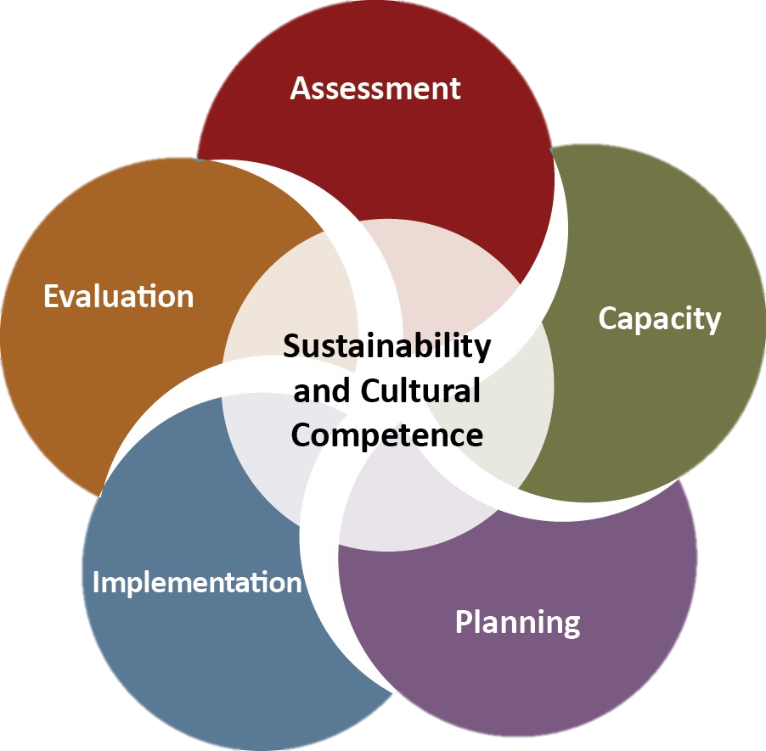
Using the Strategic Prevention Framework (SPF) Model
Facilitates the identification of a community’s problems associated with or the result of substance use.
Supports coalitions work through data informed, objective processes to determine:
Effective strategies and allocation of resources to achieve identified outcomes.
Notes:
Charlotte
The SPF Model encourages us to slow down and make decisions methodically and proactively, rather than reactively.

Slide 11
Diverse Partners
What?
Coalitions that engage a diverse set of sectors in a prevention effort represent a broader group of partners in the community
Why?
More impactful planning and implementation of prevention strategies
Promotes collaboration, builds stronger bridges to the focus populations, pools resources and builds strategic influence
Notes:
What it is:
Coalitions that engage a diverse set of sectors in a prevention effort represent a broader group of stakeholders in the community.
Why it’s important:
• Involving stakeholders who represent targeted sectors is associated with more impactful planning and implementation of prevention strategies. • Inclusion of diverse sectors promotes collaboration, builds stronger bridges to the target populations, pools resources and builds strategic influence
Resources to learn more about Diverse Sectors
Brown LD, Wells R, Jones EC, Chilenski SM. Effects Processes and Outcomes. Prev Sci. 2017;18(5): 600-609. doi:10.1007/s11121-017-0796-y of Sectoral Diversity on Community Coalition
Shapiro VB, Oesterle S, Hawkins JD. Relating Coalition Capacity to the Adoption of Science-Based Prevention in Communities: Evidence from a Randomized Trial of Communities That Care. Am J Community Psychol. 2014;55(1-2). doi:10.1007/ s10464-014-9684-9
Wandersman A, Goodman R. Understanding Coalitions and How They Operate: An “Open Systems” Organizational Perspective.; 1993.
Kegler MC, Swan DW. Advancing coalition theory: the effect of coalition factors on community capacity mediated by member engagement. Health Educ Res. 2012;27(4):572-584. doi:10.1093/her/cyr083

Slide 12
Assess Relationships Among Key Partners
Consider the key community partners critical to achieving, demonstrating, and sustaining the strategy’s positive outcomes.
Are key community partners supportive of the goals and efforts of the coalition?
Are any key partners missing?
Notes:
Charlotte

Slide 13
Tips for Recruiting Coalition Members
Find common/shared interests and goals.
Identify needed members and ask for assistance from current members.
Attend other organizations' events and meetings and promote two-way relationships.
Encourage current coalition members to participate in Community events and promote the coalition.
Invite missing partners to coalition events.
Host regular coalition meetings with actionable projects.
Provide informative communications.
Advertise, when appropriate.
Notes:
Charlotte
Find common/shared interests and goals. Volunteer for other causes and meet like-minded, goal-oriented people. Schedule one-on-one meetings to discuss shared interests and scope of problem(s). Help align dollars or find dollars for collaborative initiatives.
Identify needed members. Ask for assistance from current members. Ask who has an existing relationship with the people/organizations being recruited. Issue a personal invitation, either in person or by email. Consider one-on-one coffees.
Attend other organizations' events and meetings and promote two-way relationships. Show up somewhere unexpected to watch, listen, and learn. There may be someone there you need.
Encourage current coalition members to participate in Community events and promote the coalition. Provide a Sign-up sheet at community events/trainings.
Invite missing stakeholders to coalition events.
Host regular coalition meetings with actionable projects.
Provide informative communications.
Advertise, when appropriate.

Slide 14
How do we encourage ownership?
Identify influential community members (individuals and groups) whose ownership of the prevention system is critical to its sustainability.
Communicate regularly with community members through a variety of means (meetings, newsletters, presentations, newspaper articles, etc.) that celebrate key success stories and connect positive outcomes of the prevention system to identified needs of the community.
Involve key decision-makers in the implementation process.
Notes:
Charlotte
Prevention efforts and infrastructure need ownership among key decision and policy makers, community leaders, and the broader community.

Slide 15
Cultivating System Leaders and Champions
The coalition must cultivate champions for prevention strategies, such as policy change and enforcement, which can influence population level changes in substance use behaviors and consequences.
Build awareness of the importance of prevention in meeting short-term outcomes and its contribution to an overall comprehensive strategy.
Notes:
Charlotte
Champions come from all parts of the community and depend on the message that needs to be conveyed. The champion may be the Police Chief or a middle school student or an elected official, etc. Local champions represent local priorities.

Slide 16
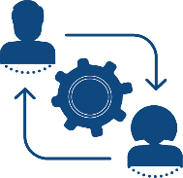
Opportunities for Participation
What?
Encouraging members and providing opportunities to take on a variety of formal roles or positions within a coalition
Roles would utilize members’ expertise and interests
Why?
Retention! Engage your members in meaningful ways!
Provides members an important vehicle to utilize their expertise and make an impact on the coalition functioning
Notes:
Opportunities for participation include encouraging members to take on a variety of formal positions or roles within the coalition that are tied to their expertise, abilities and interests.
Why it’s important:
A coalition may be very successful at attracting membership, but if opportunities are not provided for members to contribute meaningfully, retention could become an issue.
Opportunities for members to take on significant roles has been shown to create an empowering environment as well as increase the program’s success.^{5–8}
Providing members with a variety of roles, not only supports the coalitions goal but also helps to build the skills and competencies of individual members.⁵
The Science behind Opportunities for Participation
Maton KI, Salem DA. Organizational characteristics of empowering community settings: a multiple case study approach. Am J Community Psychol. 1995;23(5):631-656.
Peterson NA, Zimmerman MA. Beyond the individual: Toward a nomological network of organizational empowerment. Am J Community Psychol. 2004;34(1-2):129-145.
Powell KG, Gold SL, Peterson NA, Borys S, Hallcom D. Empowerment in Coalitions Targeting Underage Drinking: Differential Effects of Organizational Characteristics for Volunteers and Staff. J Soc Work Pract Addict. 2017;17(1-2):75-94. doi:10.1080/1533256X.2017.1304947
Butterfoss FD, Goodman RM, Wandersman A. Community Coalitions for Prevention and Health Promotion: Factors Predicting Satisfaction, Participation, and Planning. Heal Educ Behav. 1996;23(1):65-79.
Center for Community Health and Development. Chapter 5. Choosing Strategies to Promote Community Health and Development | Section 5. Coalition Building I: Starting a Coalition | Main Section | Community Tool Box.

Slide 17
Opportunities for Participation: Tips for Empowering Coalition Members to “do the work” Collectively
Delegate.
Utilize a Project Tracker w/assigned people and due dates.
Tie tasks to members’ everyday work.
Consolidate work so it doesn't add too much to any member’s plate.
Don't duplicate meetings/groups.
Encourage ownership and support their efforts.
Be truly interested in members’ opinions, knowledge, skills, and interests.
Leadership can set limits and let members know them.
Notes:
Charlotte
Delegate.
Utilize a Project Tracker w/assigned people and due dates. Try to empower by creating timelines, asking what they can do and by when, etc.
Tie tasks to members’ everyday work.
Consolidate work so it doesn't add too much to any member’s plate.
Don't duplicate meetings/groups - combine efforts.
Encourage ownership and support their efforts. People contribute to what they helped to create. Encourage members to engage in all parts of planning and decision-making.
Be truly interested in members’ opinions, knowledge, skills, and interests.
Leadership can set limits and let members know them.

Slide 18
New Skills
What?
Having a variety of opportunities for trainings and technical assistance can help build upon and refresh staff and coalition members’ skills
Why?
Increase the effectiveness of the coalition in achieving outcomes
Promotes member retention and self-efficacy
Greater coalition accountability
Solid implementation of prevention strategies
Notes:
What it is:
Having a variety of opportunities for trainings and technical assistance can help build upon and refresh staff and coalition members’ skills. Why it’s important:
• As a coalition builds and enhances its functioning, acquisition and fostering of new knowledge and skills among its members can increase the effectiveness of the coalition in achieving outcomes.14 • Opportunities for skills building and technical assistance not only improves the coalition’s impact but can also promote member retention and self-efficacey .15 • Greater coalition accountability can come from providing appropriate trainings and lead to solid implementation of prevention strategies.16
Resources to learn more about New Skills
Feinberg ME, Jones D, Greenberg MT, Osgood DW, and problem behaviors. Prev Sci. 2010;11(2):163-171. doi:10.1007/s11121-009-0161-x Bontempo D. Effects of the communities that care model in Pennsylvania on change in adolescent risk
Hunter SB, Chinman M, Ebener P, Imm P, Wandersman A, Ryan GW. Technical assistance as a prevention capacity-building tool: a demonstration using the getting to outcomes framework. Health Educ Behav. 2009;36(5):810-828. doi:10.1177/1090198108329999
Brown LD, Feinberg ME, Shapiro VB, Greenberg MT. Reciprocal Relations between Coalition Functioning and the Provision of Implementation Support. Prev Sci. 2013;16(1):101-109. doi:10.1007/ s11121-013-0447-x

Slide 19
Tips for Educating and Keeping Members Informed
Schedule routine meetings, with virtual option if appropriate.
Introduce prevention science at every other meeting and/or 15 minutes of "education" at every meeting.
Communicate regularly and through varied communication channels
Provide regular and varied communication.
Maintain positive rapport with community entities.
Offer trainings.
Notes:
Charlotte
Provide routine meetings, with virtual option if appropriate.
Provide prevention science at every other meeting and/or 15 minutes of "education" at every meeting.
Provide regular and varied communication: monthly newsletters, email, personal texts, social media, shared folders, data/factsheets, personal “coffees,” etc.
Keep positive rapport with community entities.
Provide trainings. Notify members and community of educational opportunities via email, on agendas, personal invitations. Include those opportunities in prevention budget if possible.

Slide 20
Efficiency
What?
The work ethic and task focus of the coalition
The coalition’ s ability to utilize its resources to deliver services in a well-organized and effective manner
Why?
Coalitions need to use limited resources in the most impactful way
Helps to respond to changing needs or timelines
Notes:
Coalition efficiency refers to the work ethic and task focus of the coalition, and the coalition’s ability to utilize its resources to deliver services in an well-organized and effective manner.^{1,4}
Why it’s important: People and organizations join or form coalitions to accomplish together what they cannot alone. Often coalitions are working with limited resources and require nimbleness to respond to a quick and changing timeline.
The Science behind Efficiency
Center for Community Health and Development. Chapter 5. Choosing Strategies to Promote Community Health and Development | Section 5. Coalition Building I: Starting a Coalition | Main Section | Community Tool Box. https://ctb.ku.edu/en/table-of-contents/assessment/promotion-strategies/start-a-coaltion/main.

Slide 21
Cohesion
What?
Feelings of unity, group spirit, trust,
Strong interpersonal relationships, effective collaboration strategies, and increased commitment
Can be seen at both the member-level and the organizational-level.
Why?
Member satisfaction, commitment, and retention; implementation effectiveness, long-term project viability
Positive work environment, trust, effective conflict resolution
Notes:
What it is: Coalition cohesion can be seen at both the member-level and the organizational-level. Feelings of unity, group spirit, trust, and belonging are a few common features of a cohesive coalition.1,9 Some also refer to cohesion as synergistic collaboration.1,4 Cohesion among coalition members can be seen as strong interpersonal relationships, effective collaboration strategies, and increased commitment.1
Why it’s important:
• Organizational cohesion leads to member satisfaction, commitment, and retention; implementation effectiveness; and the long term viability of the project.2 • A cohesive coalition has a positive work environment, where members have developed trust with each other and the ability to resolve conflicts. 2
Resources to learn more about Cohesion
Brown LD, Feinberg ME, Greenberg MT. Constructs Through Factor Analysis. Heal Educ Behav. 2012;39(4):486-497. Measuring Coalition Functioning: Refining
Foster-Fishman PG, Berkowitz SL, Lounsbury DW, Jacobson S, Allen NA. Building Collaborative Capacity in Community Coalitions: A Review and Integrative Framework. Am J Community Psychol. 2001;29(2):241-261.
Brown EC, Hawkins JD, Rhew IC, et al. Prevention System Mediation of Communities That Care Effects on Youth Outcomes. Prev Sci. 2014;15(5):623-632.
Kegler MC, Steckler A, Mcleroy K, Malek SH. Factors That Contribute to Effective Community Health Promotion Coalitions: A Study of 10 Project ASSIST Coalitions in North Carolina. Heal Educ B ehav. 1998;25(3):338-353.

Slide 22
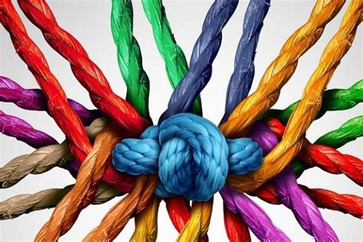
Cohesion
How
Facilitate in a way that is inclusive
Reminders about the ‘why’/big
Take time for fun
Remind folks of all the great things we’re already doing
Relationship building/1-on-1’s with your members
Annual retreat to take stock

Slide 23
Cohesion: Tips for Keeping Members Engaged
Highlight members in the newsletter.
Engage members according to their passion.
Convene subcommittees regularly, big group less often.
Include lived experience and youth involvement among the coalition membership.
Go to their turf for coalition nights and their events.
Maintain focus on forward momentum.
Provide food when appropriate.
Give every member an opportunity to contribute collaboratively.
Keep talking about the mission.
Notes:
Charlotte
Highlight members in the newsletter.
Engage members according to their passion.
Convene subcommittees regularly, big group less often.
Include lived experience and youth involvement among the coalition membership.
Go to their turf for coalition nights and their events, etc.
Maintain focus on forward momentum, progress
Provide food when appropriate – “breaking bread” together fosters relationships
Give every member an opportunity to contribute collaboratively - assign tasks
Keep talking about the mission

Slide 24
Goal-Directedness
What?
Coalitions are formed to achieve a common goal or shared vison
Realistic and action-oriented goals to direct coalition efforts
Why?
Helps to keep a coalition from getting side-tracked and helps to stay focused on central goals
Helps coalitions deliver high-quality program implementation to meet the intended need
Notes:
Coalitions are not formed just for the sake of bringing people together. They are intended as vehicles for members and stakeholders to achieve a common goal or shared vision. Remaining focused on achieving this goal, or maintaining goal-directedness, will help the coalition deliver high-quality program implementation.¹ To work towards the coalition’s overall goal there may be short-term goals that need to be met along the way.² Coalition members should have their goals realistic and action-oriented.^{2,3}
Why it’s important:
Goal-directedness is important because it is easy to be side-tracked by smaller issues or pet projects that surround the coalition’s central goals, thus making task-focus a critical element in achieving goals.^{1,2}
Develop action-oriented goals
Ensure goals are realistic, action- oriented
Short term and long term goal setting
Use logic models to organize goals and objectives
The Science behind Goal Directedness
Brown LD, Feinberg ME, Greenberg MT. Measuring Coalition Functioning: Refining Constructs Through Factor Analysis. Heal Educ Behav. 2012;39(4):486-497. doi:10.1177/1090198111419655
Foster-Fisherman PG, Berkowitz SL, Lounsbury DW, Jacobson S, Allen NA. Building Collaborative Capacity in Community Coalitions: A Review and Integrative Framework. Am J Community Psychol. 2001;29(2):241-261.
Spoth RL, Greenberg MT. Toward a Comprehensive Strategy for Effective Practitioner-Scientist Partnerships and Larger-Scale Community Health and Well-Being. Am J Community Psychol. 2005;35(3-4):107-126.

Slide 25
Prevention Coalitions: Data Driven Processes
Needs Assessment
Assessment of Community Resources and Gaps
Determine focus populations for increased health equity
Direction for prevention strategies that are best fit for the community’s needs

Slide 26
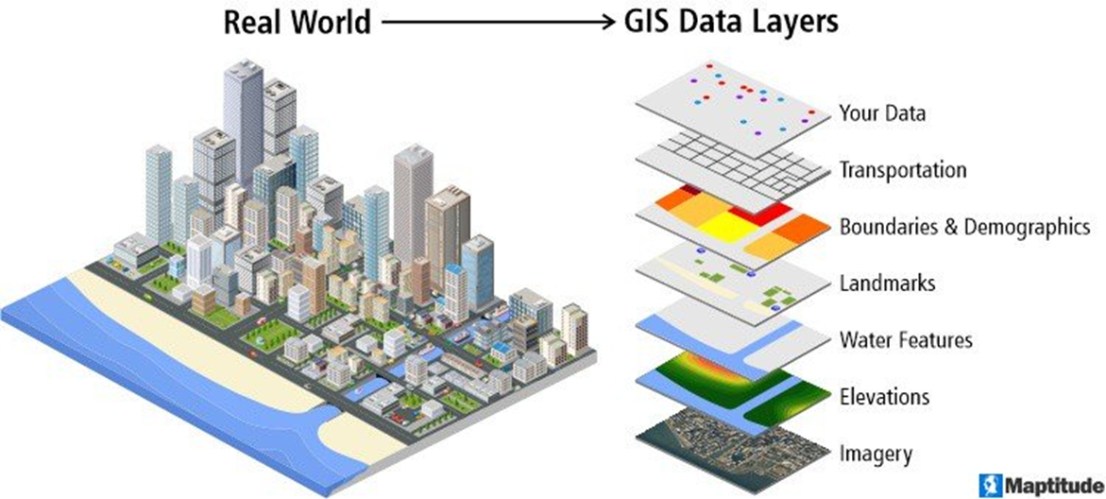
Geographic Information Systems and Strategic Prevention
Geographic Information Systems (GIS) are a helpful tool to support community coalitions as they plan, visualize, and track their work.
The key feature of GIS is the ability to layer data in a way that reveal spatial patterns.

Slide 27
Geographic Information Systems and Strategic Prevention
The products of a GIS (map, geospatial web applications, animations, etc.) support community coalitions in their:
Strategic identification of community need
Evaluation of community impact
Community-friendly dissemination efforts
Celebration of success

Slide 28
Visualizing Community Data with GIS
The following examples provide applied demonstrations of GIS approaches in the context of coalition work.
The demonstrations were designed to show the range of possibilities when using GIS in different data environments
Nicotine initiation prevention among school age children
Data rich environment: Census demographics, tobacco licensing, school locations, photographs
Patterned after a NJ PFS coalition’s use of GIS to support municipal policy change
Youth-focused qualitative GIS approach on the cannabis industry and environmental impact
Low-data environment: photographs and street map

Slide 29
The Conceptual Model of Effective Coalitions
System Supports

Slide 30
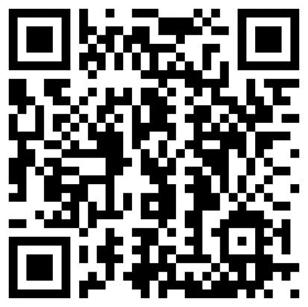
Effective Coalitions Resources
PTTC Network 3 C’s Workgroup Webpage
Self-paced, virtual course to learn basic GIS
https://pttcnetwork.org/the-six-elements-of-effective-coalitions/

Slide 31
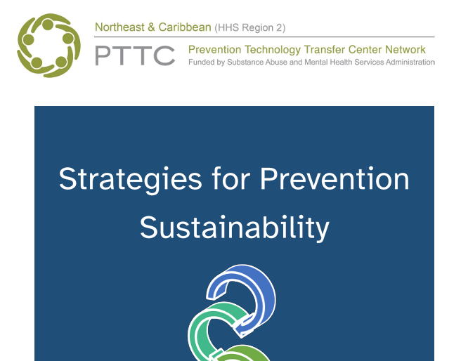
Effective Coalitions Resources
Sustainability Toolkit being translated into Spanish with cultural adaptations
September Virtual Training on Coalition Member Retention

Slide 32
Reflections
Which element stands out most in terms of your coalition success?
Which do you want to work on next?
Diverse Partners
Opportunities to Participate
New Skills (Data Skills!)
Goal Directedness
Efficiency
Cohesion

Slide 33
Questions?

Slide 34
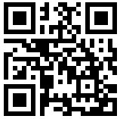
Evaluation
Please take the time to complete a brief evaluation:
Your feedback is appreciated!
Notes:
Clare N

Slide 35
References
Brown LD, Feinberg ME, Greenberg MT. Measur-ing Coalition Functioning: Refining Constructs Through Factor Analysis. Heal Educ Behav. 2012;39(4):486-497. doi:10.1177/1090198111419655
Foster-Fisherman PG, Berkowitz SL, Lounsbury DW, Jacobson S, Allen NA. Building Collaborative Capacity in Community Coalitions: A Review and Integrative Framework. Am J Community Psychol. 2001;29(2):241-261.
Spoth RL, Greenberg MT. Toward a Comprehensive Strategy for Effective Practitioner-Scientist Partnerships and Larger-Scale Community Health and Well-Being. Am J Community Psychol. 2005;35(3-4):107-126.
Brown EC, Hawkins JD, Rhew IC, et al. Prevention System Mediation of Communities That Care Effects on Youth Outcomes. Prev Sci. 2014;15(5):623-632. doi:10.1007/s11121-013-0413-7
Maton KI, Salem DA. Organizational character-istics of empowering community settings: a multiple case study approach. Am J Community Psychol.1995;23(5):631-656. http://www.ncbi.nlm.nih.gov/pubmed/8851343. Accessed September 13, 2019.
Peterson NA, Zimmerman MA. Beyond the individ-ual: Toward a nomological network of organizational empowerment. Am J Community Psychol. 2004;34(1-2):129-145. doi:10.1023/B:AJCP.0000040151.77047.58
Butterfoss FD, Goodman RM, Wandersman A. Community Coalitions for Prevention and Health Promo-tion: Factors Predicting Satisfaction, Participation, and Planning. Heal Educ Behav. 1996;23(1):65-79.
Powell KG, Gold SL, Peterson NA, Borys S, Hall-com D. Empowerment in Coalitions Targeting Under-age Drinking: Differential Effects of Organizational Characteristics for Volunteers and Staff. J Soc Work Pract Addict. 2017;17(1-2):75-94. doi:10.1080/153325 6X.2017.1304947

Slide 36
References (continued)
Kegler MC, Steckler A, Mcleroy K, Malek SH. Fac-tors That Contribute to Effective Community Health Promotion Coalitions: A Study of 10 Project AS-SIST Coalitions in North Carolina. Heal Educ Behav. 1998;25(3):338-353.
Brown LD, Wells R, Jones EC, Chilenski SM. Effects of Sectoral Diversity on Community Coalition Pro-cesses and Outcomes. Prev Sci. 2017;18(5):600-609. doi:10.1007/s11121-017-0796-y
Shapiro VB, Oesterle S, Hawkins JD. Relating Coalition Capacity to the Adoption of Science-Based Prevention in Communities: Evidence from a Ran-domized Trial of Communities That Care. Am J Com-munity Psychol. 2014;55(1-2). doi:10.1007/s10464-014-9684-9
Wandersman A, Goodman R. Understanding Co-alitions and How They Operate: An “Open Systems” Organizational Perspective.; 1993.
Kegler MC, Swan DW. Advancing coalition theory: the effect of coalition factors on community capacity mediated by member engagement. Health Educ Res. 2012;27(4):572-584. doi:10.1093/her/cyr083
Feinberg ME, Jones D, Greenberg MT, Osgood DW, Bontempo D. Effects of the communities that care model in Pennsylvania on change in adolescent risk and problem behaviors. Prev Sci. 2010;11(2):163-71. doi:10.1007/s11121-009-0161-x
Hunter SB, Chinman M, Ebener P, Imm P, Wandersman A, Ryan GW. Technical assistanceas a prevention capacity-building tool: a demon-stration using the getting to outcomes frame-work. Health Educ Behav. 2009;36(5):810-828.doi:10.1177/1090198108329999
Brown LD, Feinberg ME, Shapiro VB, Greenberg MT. Reciprocal Relations between Coalition Function-ing and the Provision of Implementation Support. Prev Sci. 2013;16(1):101-109. doi:10.1007/s11121-013-0447-x

Slide 37
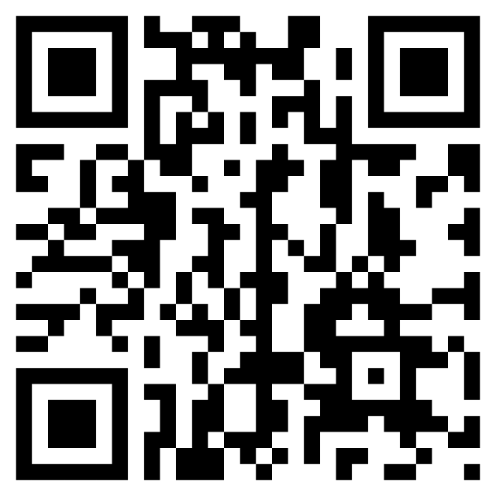
Thank you!
If you have questions or comments, don’t hesitate to contact:
Josue Hidalgo, MSW
jdh194@ssw.rutgers.edu
Kristen Gilmore Powell, PhD, LSW
krisgil@ssw.rutgers.edu
Cory Morton, PhD
cmorton@ssw.rutgers.edu
Check out our website
https://pttcnetwork.org/centers/northeast-caribbean-pttc/home
Sign up for our weekly newsletter

