Slide 1
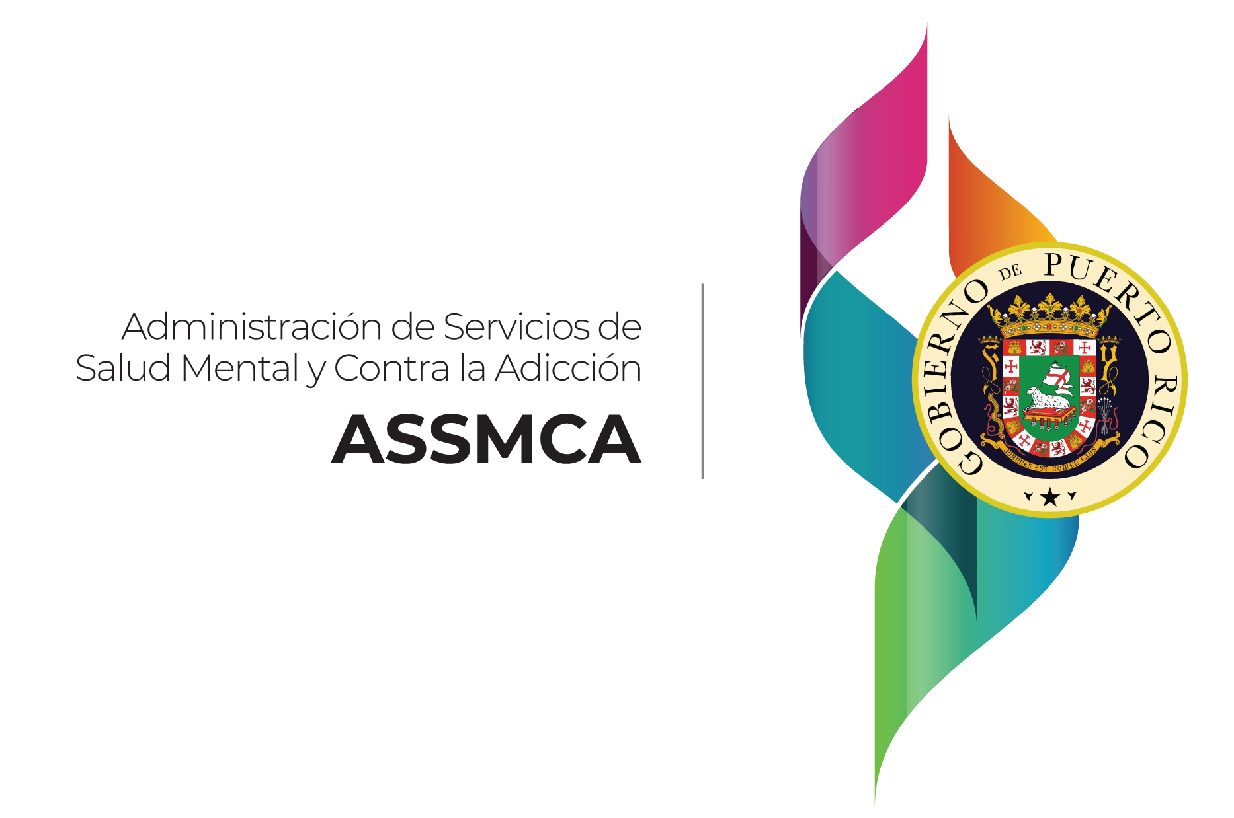

Overview of Opioid Overdose Data
Puerto Rico
Prevent Prescription Drug/Opioid Overdose-Related Deaths (PR-PDO)
State Opioid Response (PR-SOR)
Víctor M. Serrano-Román, M.Ed., LCP
Project Director
Notes:
We are part of a government agency in Puerto Rico known as Mental Health and Addiction Services (or Administración de Servicios de Salud Mental y Adicciones).
Since 2017, after de opioid crisis declaration, the agency has led efforts to mitigate and prevent deaths from opioid overdoses in Puerto Rico.
By then, we did not have data that would allow us to understand the crisis on the island, so in addition to the approaches in prevention, treatment, recovery-oriented services, among others and from the best practices based on evidence, we have developed, implemented and strengthened an Overdose Event Monitoring System, overdose death prevention programs at the community level, and public health policy.
SAMHSA funding have been crucial to implement this approaches on Opioid Overdose Prevention in Puerto Rico.
Furthermore, these efforts have had multi-sector collaboration as a key element for the results that we have been observing to date.
This includes the public safety sector, community organizations, community leaders, health care providers, other government agencies, and the general public.
Establishing informed policies is key to improving health in Puerto Rico and in any other country.

Slide 2
Objectives
Describe ASSMCA's public policy efforts and results for the prevention of opioid overdose deaths in Puerto Rico.
Present Puerto Rico’s opioid overdose data related to the Overdose Event Monitoring System (OEMS).
Disclaimer: The views, opinions, and content expressed in this presentation do not necessarily reflect the views, opinions, or policies of the Center for Substance Abuse Prevention (CSAP), the Substance Abuse and Mental Health Services Administration (SAMHSA), or the U.S. Department of Health and Human Services (HHS).
Notes:
DISCLAIMERS*

Slide 3
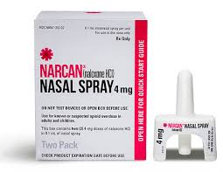

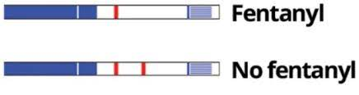
Opioid crisis: Public health
ASSMCA
Opioid prescriptions
Restrictions & education
Carta de Derechos del Paciente
Take-Back Programs
Illicit opioids
Naloxone (Saturation)
Education & prevention
Law 35
Harm Reduction
Monitoring - PDMP
Diversion
Monitoring – OMES/IFS
Illicit access
Fentanyl
MAT access
100,000+ Narcan® Kits
25,000+ Trained audience
10,000+ FTS
Notes:
As part of the introduction:
Since the overdose deaths began to increase above their historical averages in a first wave during the 1990s. These deaths occurred primarily among patients who had been prescribed opioids for pain management. Subsequently – over the past 15 years – illegally manufactured fentanyl has emerged as the cause of a third/forth wave of increases in fatal opioid-overdoses.
The different sources of these waves – pharmacy-dispensed opioids prescribed by professional providers versus illegally manufactured opioids purchased in illegal markets – mean that each indicates that the overdose crisis must be addressed as two separate epidemics with little overlap between the two.
The first wave overdose epidemic has been managed primarily by limiting access to opioids (Public Health: PDMP, Patient Rights Letter of Puerto Rico; Public Safety/Diversion: Police Department, DEA, FBI, HIDTA) (e.g., educating providers, legislating limits on prescribing, monitoring pharmacy dispensing).
The primary strategy for preventing the FENTANYL-wave overdose deaths has been to increase access and availability of naloxone. Harm Reduction efforts; SAMHSA Grants; Monitoring data = Law 35
So let’s begin with data gathering efforts and Puerto Rico Overdose Events Monitoring System.
And how it helps us to understand PR opioid crisis so we can established Opioid Overdose public policy.

Slide 4
Prácticas desde Modelo Salubrista al uso de opioides
Ley Núm. 35, 2021
Tratamiento
Recuperación
Reducción de daños
Observatorio de Salud Mental y Adicciones
Ley Núm. 36, 2021
PDMP
LPAS
SEPS
Sistema de Vigilancia de Sobredosis de Opioides
Herramienta epidemiológica de apoyo para decisiones programáticas y de política pública.
Prevención
Reducción de estigma
FR-CARA
2018 - 2022
PR-SOR
2020 - 2024
PDO
2021 - 2026
STR
2017 - 2020
PDMP
2018 >

Slide 5
Strategies for data collection
OEMS - ASSMCA, Puerto Rico
Identify first responder agencies, community-based organizations, community leaders, and substance treatment providers.
Identify services, scope and needs of these groups and communities served to explore agreements and coordinate trainings.
Training and naloxone distribution.
Opioid Overdose and Naloxone Use Event Form (data collection instrument).
Establish collaboration agreements.
Monthly community outreach and other collaborations with partner organizations.
Notes:
We developed a strategic plan to identify agencies that provide direct or indirect services to people affected by overdose.
We identified with them the needs and gaps experienced by the communities.
We began to establish collaborative agreements with the organizations and began to educate the community about the prevention of overdose deaths and naloxone use. Strategies were created to impact all municipalities in Puerto Rico. As part of this training, we provided them with the overdose form so that when they attended an overdose they could inform us and thus be able to replace the narcan used. At the beginning we started using a paper form and the organizations would send us by e-mail the overdoses intervened. At the moment this form is digital and is uploaded automatically. Finally, monthly outreach activities are promoted to continue connecting with the community and follow-up calls are made to see how many overdoses have been treated.

Slide 6
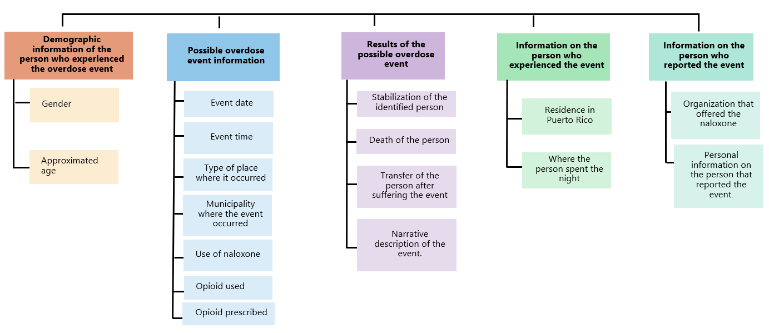
Opioid Overdose and
Naloxone Use Event Form
OEMS - ASSMCA, Puerto Rico

Slide 7
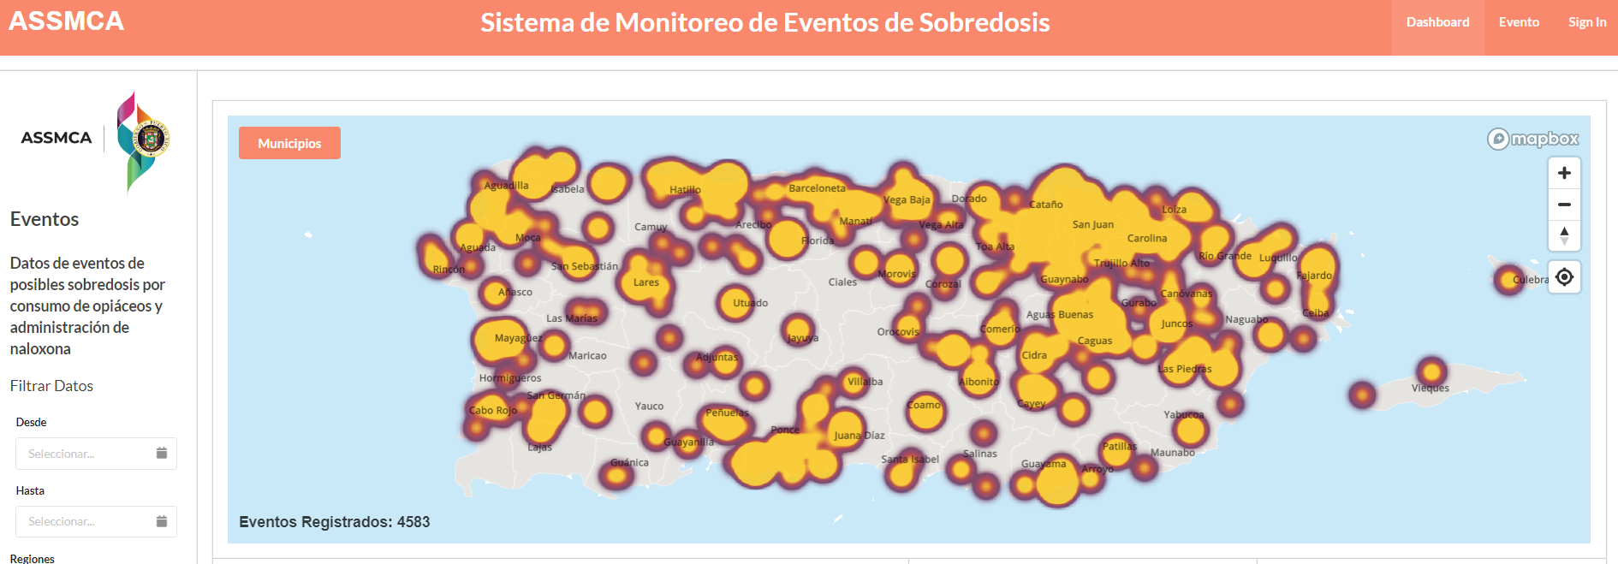
Overdose Event Monitoring System
ASSMCA, Puerto Rico

Slide 8
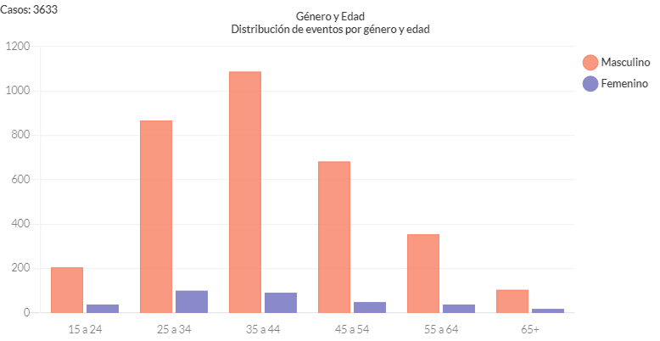
Overdose Event Monitoring System
ASSMCA, Puerto Rico

Slide 9
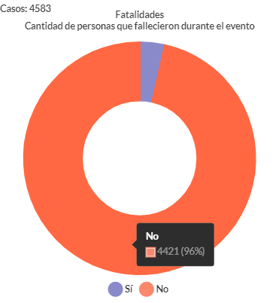
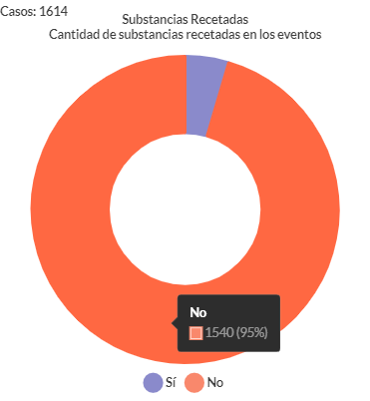
Overdose Event Monitoring System
ASSMCA, Puerto Rico

Slide 10
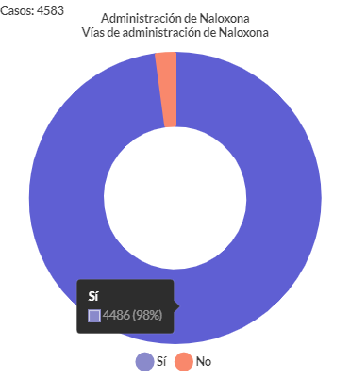
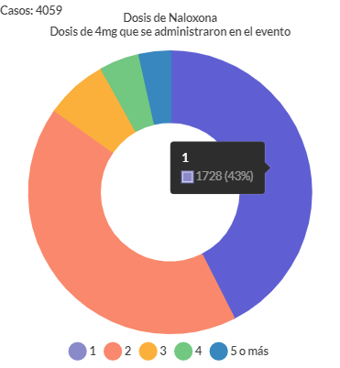
Overdose Event Monitoring System
ASSMCA, Puerto Rico

Slide 11
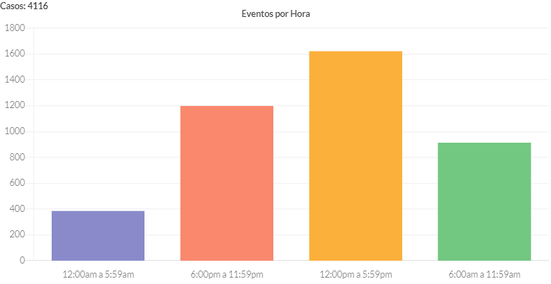
Overdose Event Monitoring System
ASSMCA, Puerto Rico

Slide 12
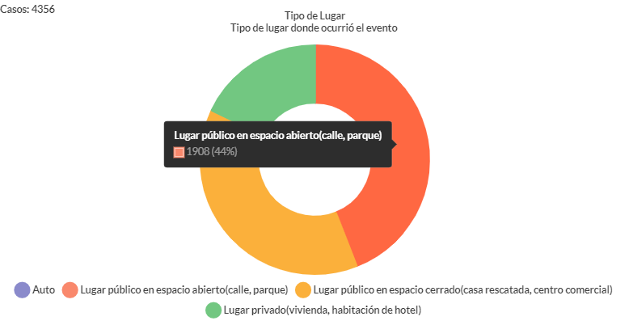
Overdose Event Monitoring System
ASSMCA, Puerto Rico

Slide 13
Overdose Event Monitoring System
ASSMCA, Puerto Rico
Reversed overdoses & fatal overdoses in Puerto Rico (Yr. 2022)
This study was carried out with the purposes of:
  estimating the impact of reversed overdoses on overdose mortality in Puerto Rico (OEMS and IFS data) and,
  identifying underserved geographic areas and population segments (to improve Puerto Rico’s Naloxone Saturation Plan).
Notes:
The data for this study were obtained from two sources:
Institute of forensic science
Our organization data base

Slide 14
Overdose Event Monitoring System
ASSMCA, Puerto Rico
Yr. 2022 = 2,140 overdoses were recorded in Puerto Rico’s OEMS
One [1] overdose every 4 hours
67 overdoses per 100,000 inhabitants
1,385 or 64.7% were reversed by
prevention programs operating in community settings
The study identified Municipalities in which the proportion of overdoses reversed was below the average for the entire island. These Municipalities should be considered for expanding the scope of preventive programs for overdose deaths.

Slide 15
Overdose Event Monitoring System
ASSMCA, Puerto Rico
Yr. 2022
Reversed 1,385
Fatal 755
Notes:
Graph 1 shows the time trend in the number of reversed and fatal overdoses during 2022. The Graph shows a significant increase in overdose events during the second half of the year - overdose events increased by approximately 60% during the second half of the year. The Graph also shows a steady and gradual increase in the proportion of reversed overdoses. During the first quarter, a total of 377 overdoses were recorded of which 215 or 57.0% of these could be reversed. By the fourth quarter overdoses had increased from 377 in the first quarter to 632, an increase of 67.6%.This means that the proportion of overdoses reversed increased from 57.0% during the first quarter to 65.7% during the fourth quarter.

Slide 16
Overdose Event Monitoring System
ASSMCA, Puerto Rico
Opioid overdose prevalence and overdose reversals
Yr. 2022
High overdose rates (> 67 events), high proportion reversed (> 65%)
Low overdose rates (< 67 events), high proportion reversed (> 65%)
Low overdose rates (< 67 events), low proportion reversed (< 65%)
High overdose rates (> 67 events), low proportion reversed (< 65%)
Notes:
This map represents the prevalence of overdoses and reversed overdoses by municipality in Puerto Rico. The green color represents high proportion of reversed overdoses and the violet color represents low proportion of reversed overdoses. Dark green represents municipalities with high overdose rates with a high proportion of reversed overdoses. Light green represents low overdose rates and a high proportion of reversed overdoses. Light purple represents low overdose rates and a low proportion of reversed overdoses and dark purple represents high overdose rates and a low proportion of reversed overdoses.
This map represents the prevalence of overdoses and reversed overdoses by municipality in Puerto Rico. The map shows the municipalities of Puerto Rico classified into four groups. The municipalities with high overdose reversal ratio estimates are represented on the map with the colors green (high overdose rate and high reversal ratio) and light green (low overdose rate but high reversal ratio). Municipalities with low overdose reversal ratio estimates are represented on the map with the colors purple or light purple (low rate and low reversal ratio) and dark purple (high rate but low reversal ratio).

Slide 17
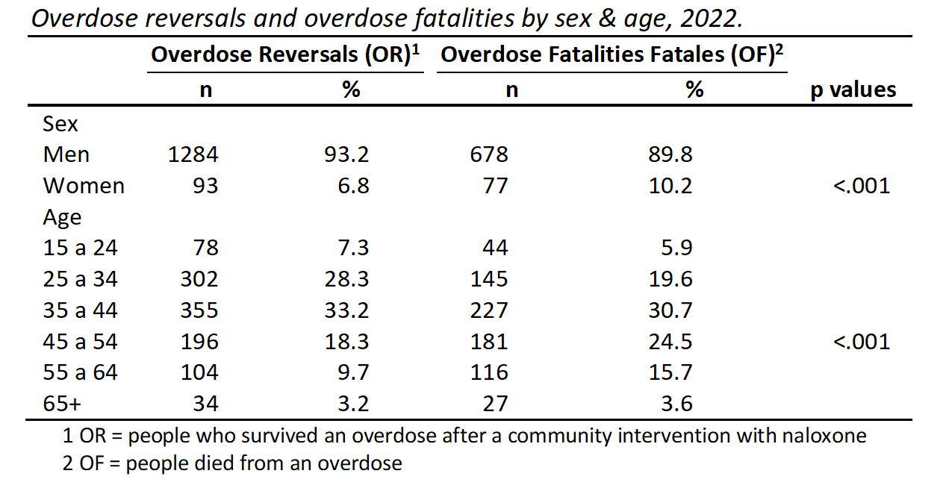
Overdose Event Monitoring System
ASSMCA, Puerto Rico
Notes:
This finding implies that overdoses in women and in users over 44 years of age are more likely to result in fatalities.

Slide 18
Overdose Event Monitoring System
ASSMCA, Puerto Rico
This is one of the first studies to estimate the impact of overdose prevention programs on fatal overdoses in Puerto Rico.
2,140 overdose were recorded in 2022, where 1,385 (64.7%) were reversed by prevention programs operating in community settings.
An encouraging proportion and means that Puerto Rico is managing to reduce the impact of overdose mortality. Still, the number of fatal overdoses during 2022 is well above the average.
There was a greater representation of women and people over 44 years of age among the fatalities.
This finding implies that overdoses in women and in users over 44 years of age are more likely to result in fatalities.
The geographic distribution analysis identified Municipalities that should be given greater attention, either because their overdose rate is high or because the proportion of overdoses reversed is low.

Slide 19
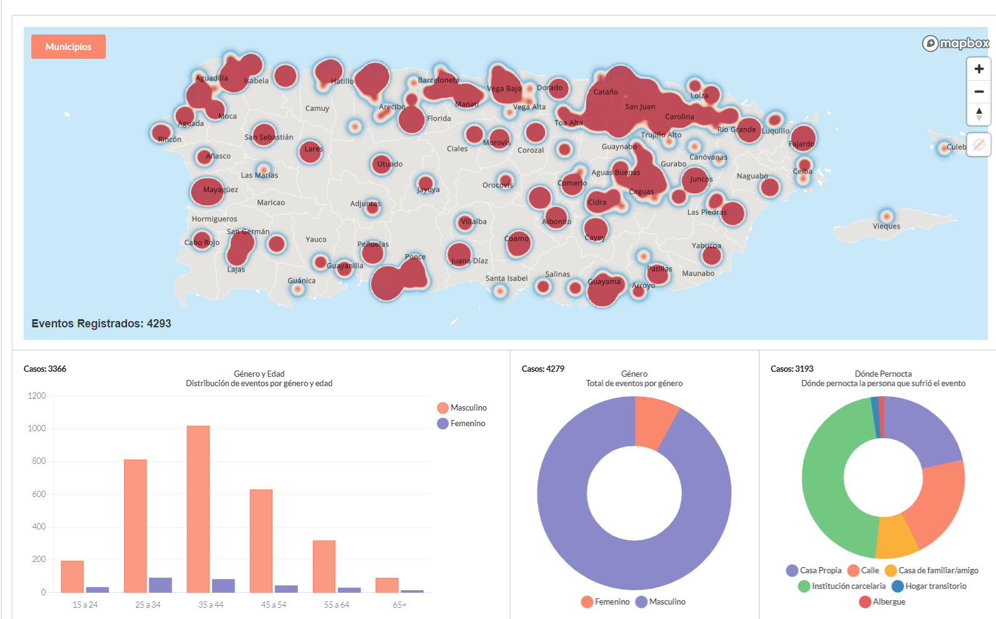



Prevention strategies at all levels
ASSMCA
Trainings
Prevention
Harm Reduction
Recovery-oriented services
Referral and expansion for access to MAT
Surveillance systems
Supported by
Puerto Rico’s
Law No. 35 of 2021
Notes:
Trainings and Community Prevention Programs = to increased knowledge about overdoses, improved attitudes toward naloxone (Law 35), provided successful overdose management training (including ToT), and reduced mortality from opioid abuse.
Prevention strategies at all levels: Public Health and Public Safety (HIDTA, DEA, FBI, PDMP, Department of Health)
Data collection, Surveillance System
EBP’s, Saturation Plan
Empower people with knowledge, skills, resources and PARTICIPATION!!! Accountable or the both resposability
Protections of the Law 35 – Puerto Rico’s Opioid Overdose Prevention signed August 2021

Slide 20
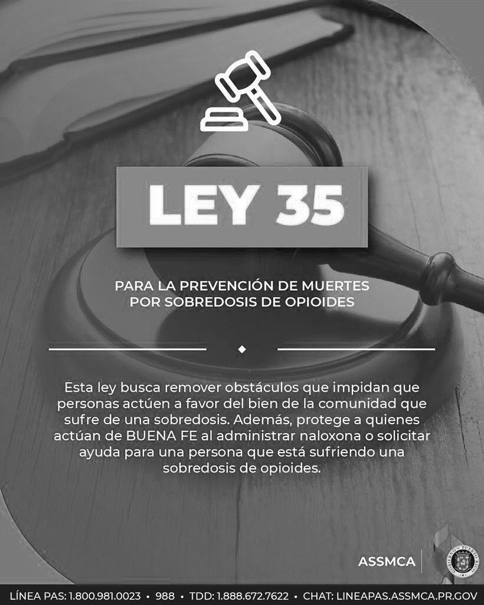
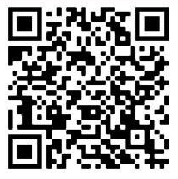
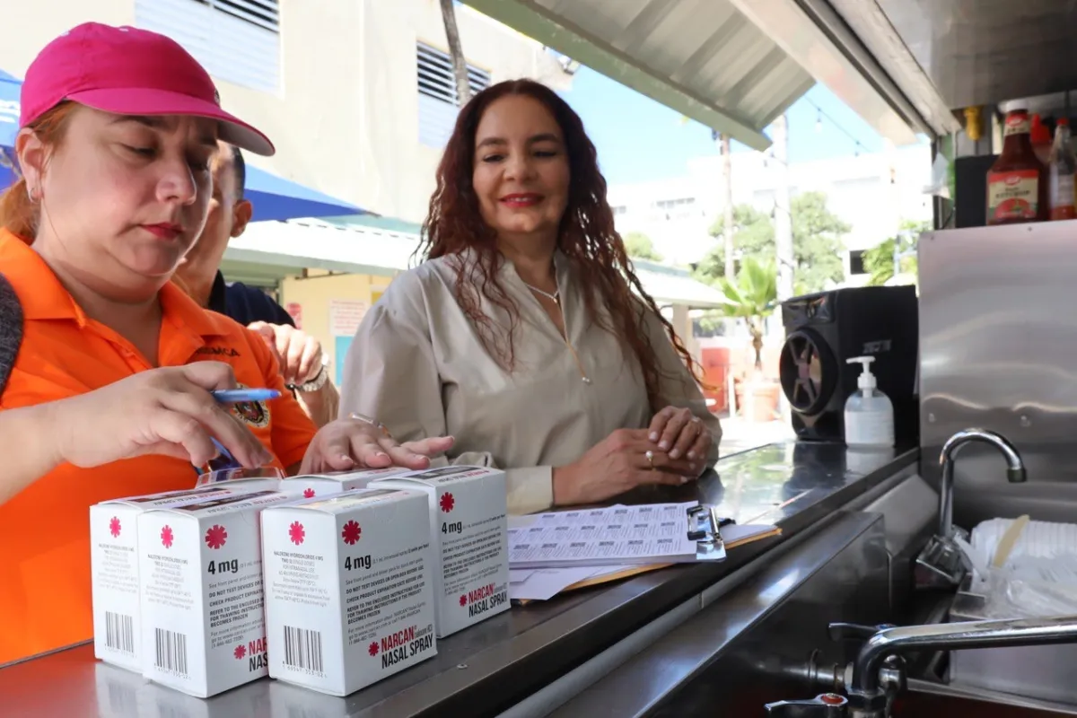
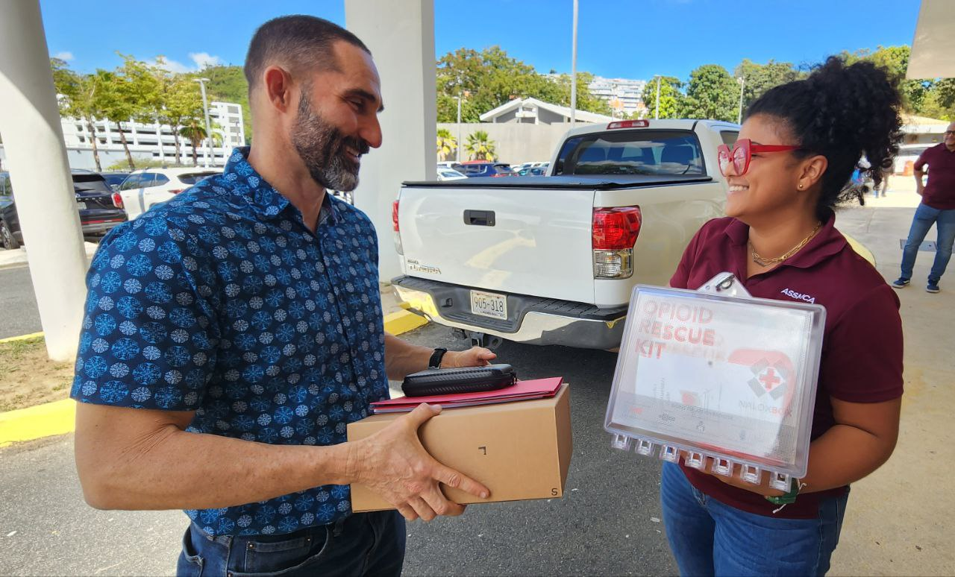
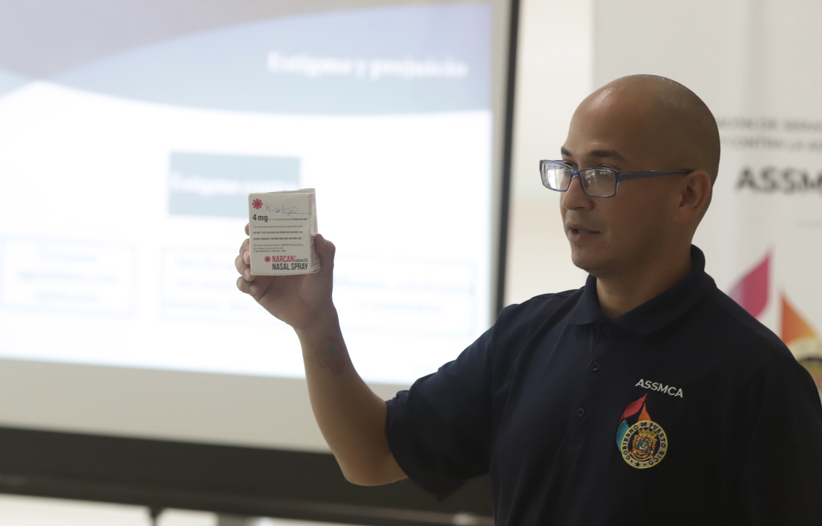
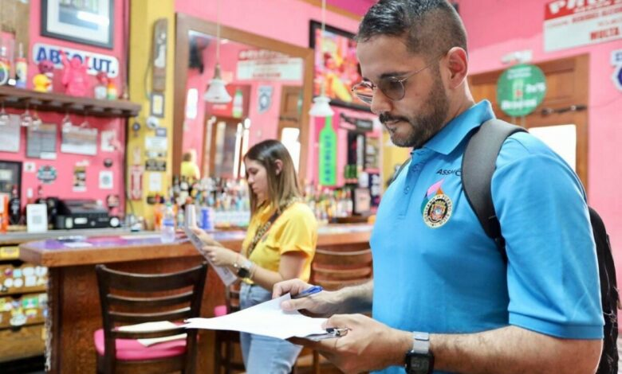
Prevention strategies at all levels
ASSMCA
Notes:
Protections (3)
Program at State Level
Narcan distribution (accessible)
Opportunities*

Slide 21
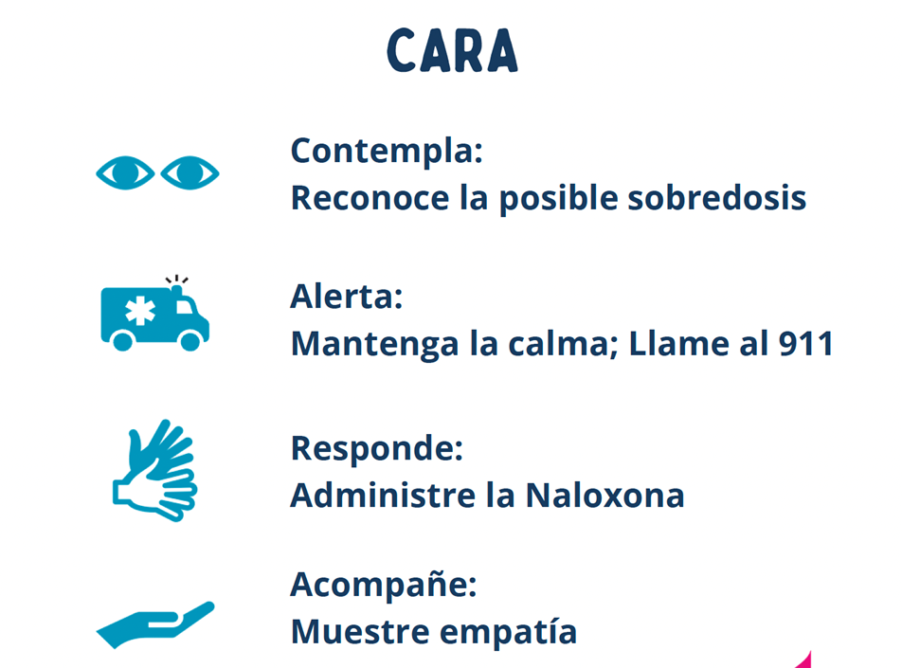
Prevention strategies at all levels
ASSMCA

Slide 22
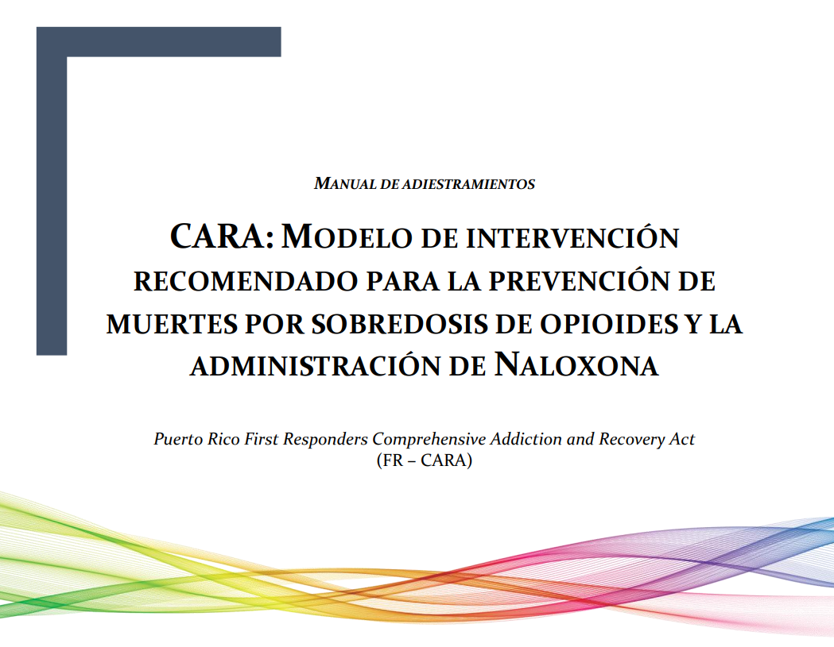

Slide 23
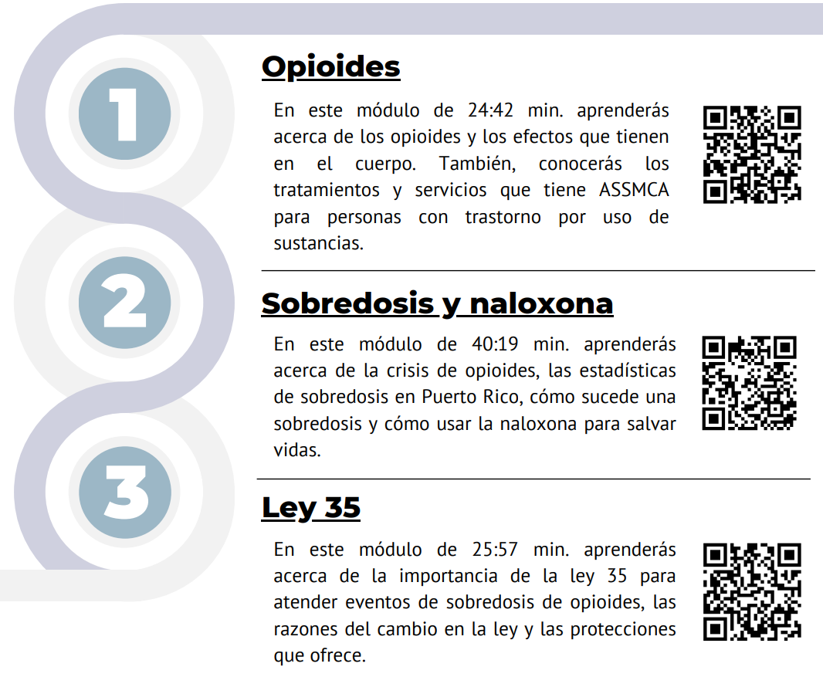

Slide 24
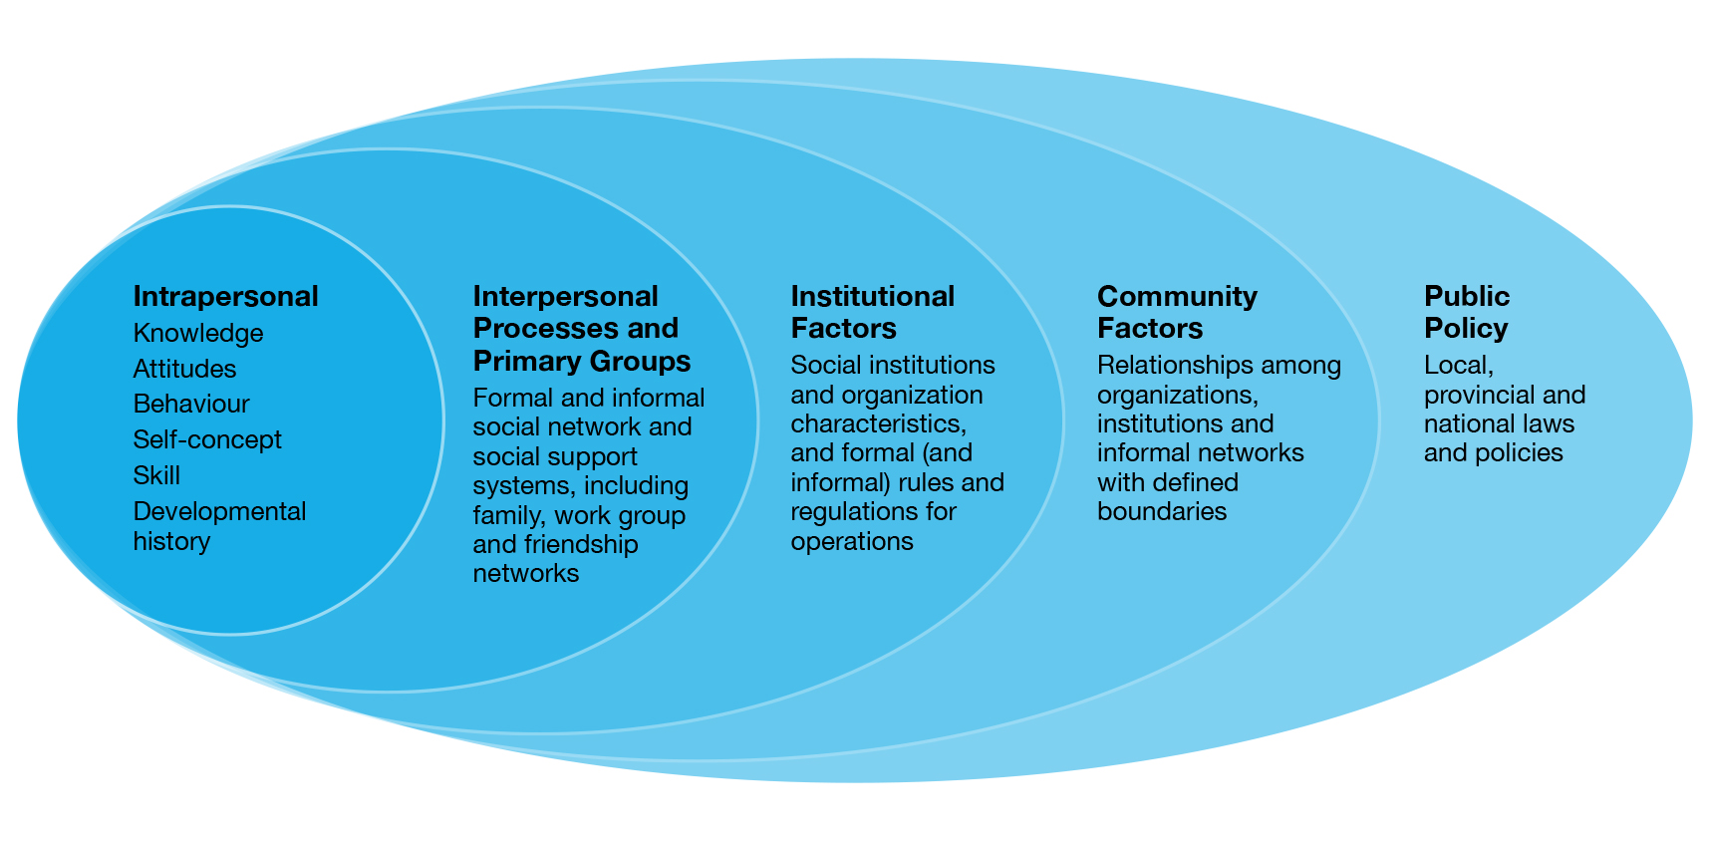
Multisector approach from
a social-ecological framework
ASSMCA - PR-PDO; PR-SOR

Slide 25
Challenges and Achievements
ASSMCA - PR-PDO; PR-SOR
Challenges
Perceived stigma among first responders and the trained community about people who use substances.
Ongoing follow-up with organizations to report overdoses.
The integration of all support services to respond to the needs of the participants, which delays the process of linkage and admission to treatment.
Achievements
Community-based Prevention Programs; greater capacity in communities to intervene in an overdose using naloxone.
Greater collaboration between partner organizations to coordinate and seek treatment services for people with substance use.
Better collaboration of partner organizations in reporting an overdose using the QR Code and OEMS link.
Implementation and dissemination of Law 35.
Naloxone Saturation Plan; distributed in high-risk communities, community organizations, treatment centers, and first responder agencies, among others.

Slide 26
Enfoque salubrista
Identificar y analizar los determinantes sociales, las tendencias en uso y los datos de mortalidad relacionadas a la substancia, para la atención estratégica desde las mejores prácticas de salud pública.

Slide 27
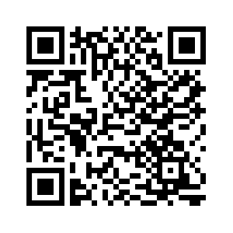
Enfoque salubrista
Empoderar en conocimientos, destrezas y recursos para la toma de desiciones y acciones informadas.

Slide 28

victor.serrano@assmca.pr.gov
1(787)763-7575 x. 1075

